Slide 1


Slide 2

Leadership Development for Technicians – prepare, support and develop technical leaders for now and the future.
Sandy Sparks / 25 September 2023

Slide 3

Outline
Context
MI TALENT Leadership Programmes
Next Steps
IRCC INTERNATIONAL RESEARCH CULTURE CONFERENCE I 25th Sept 2023

Slide 4
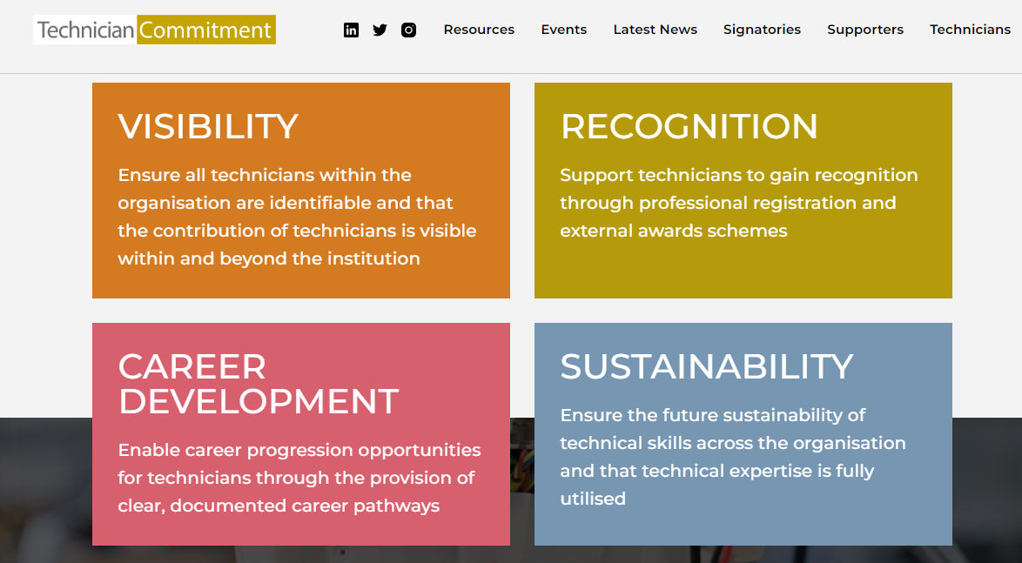
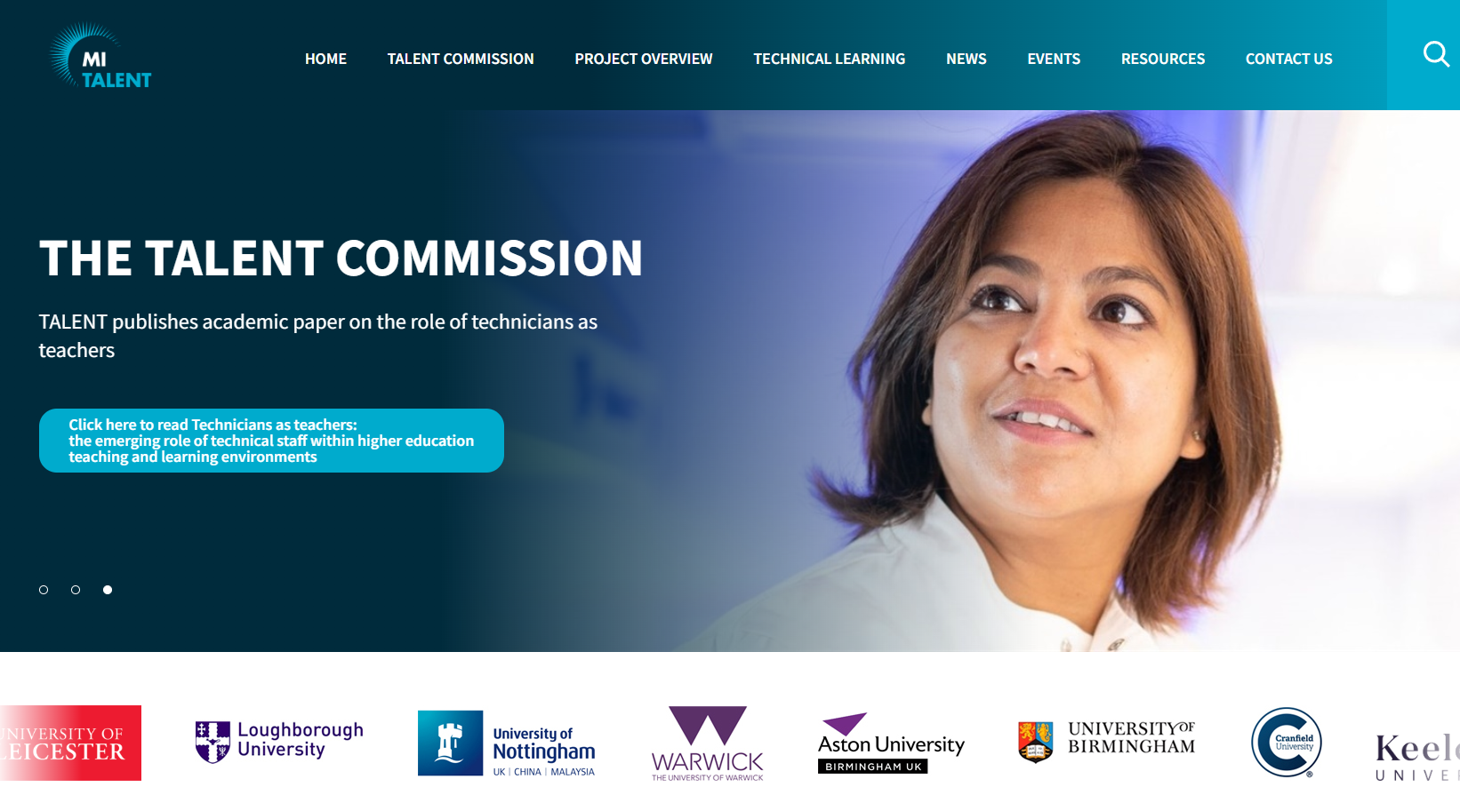
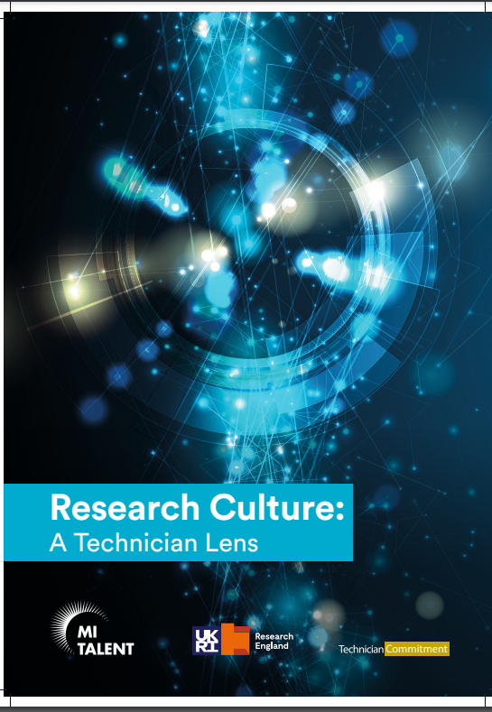
Context
Technician Commitment
MI TALENT
Talent Commission
Research Culture – A Technician Lens
IRCC INTERNATIONAL RESEARCH CULTURE CONFERENCE I 25th Sept 2023

Slide 5
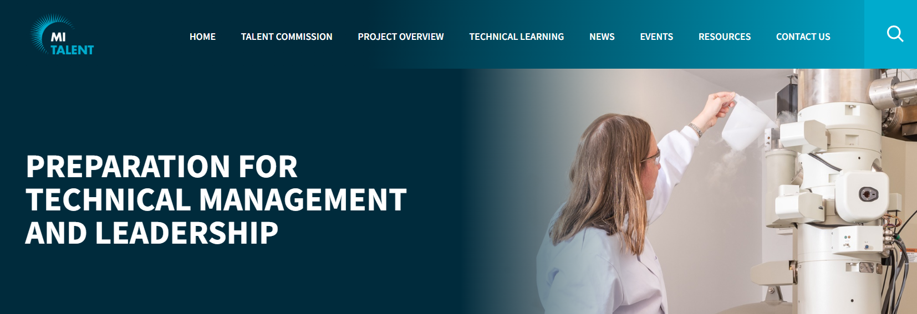
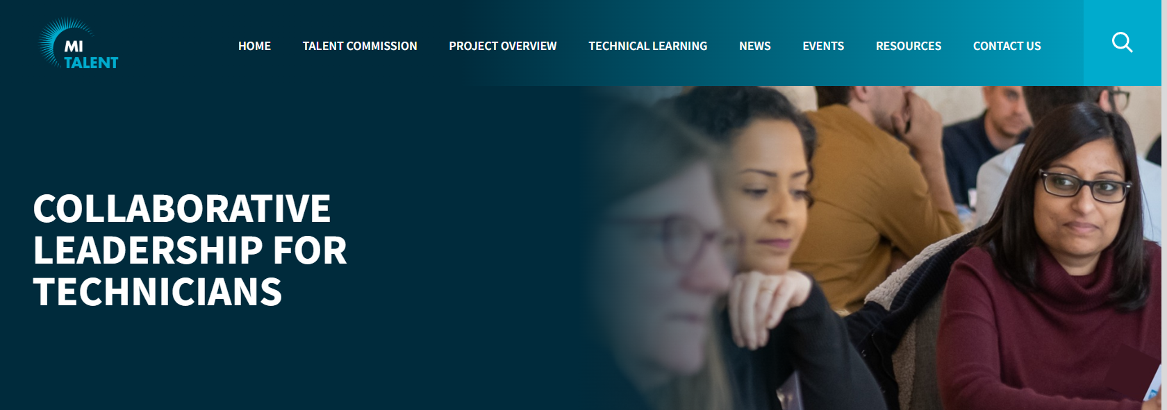
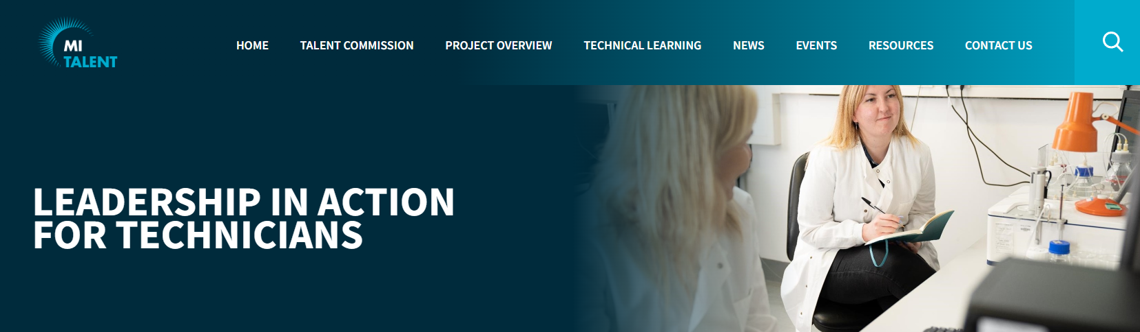
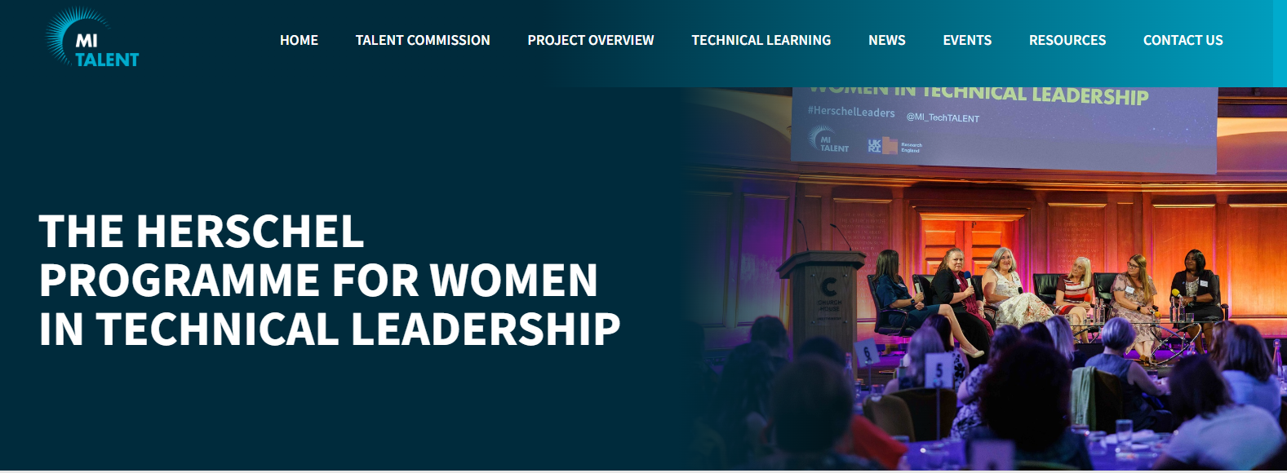
MI TALENT Leadership Programmes
MI TALENT – 8 partner institutions
Preparing for Technical Leadership in Management
Collaborative Leadership for Technicians
Leadership in Action for Technicians
MI TALENT - National
Herschel Programme for Women in Technical Leadership
IRCC INTERNATIONAL RESEARCH CULTURE CONFERENCE I 25th Sept 2023

Slide 6
MI TALENT Leadership Programmes
Cohort based
Each leadership programme facilitated twice
Delivery ranging from fully online to hybrid workshop session delivery
Exposed to a range a tools and resources used in research and leadership
Evaluation & Impact
Resources
IRCC INTERNATIONAL RESEARCH CULTURE CONFERENCE I 25th Sept 2023

Slide 7
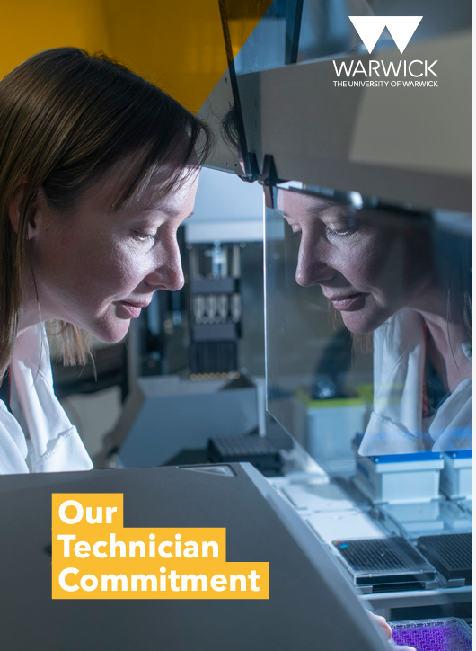
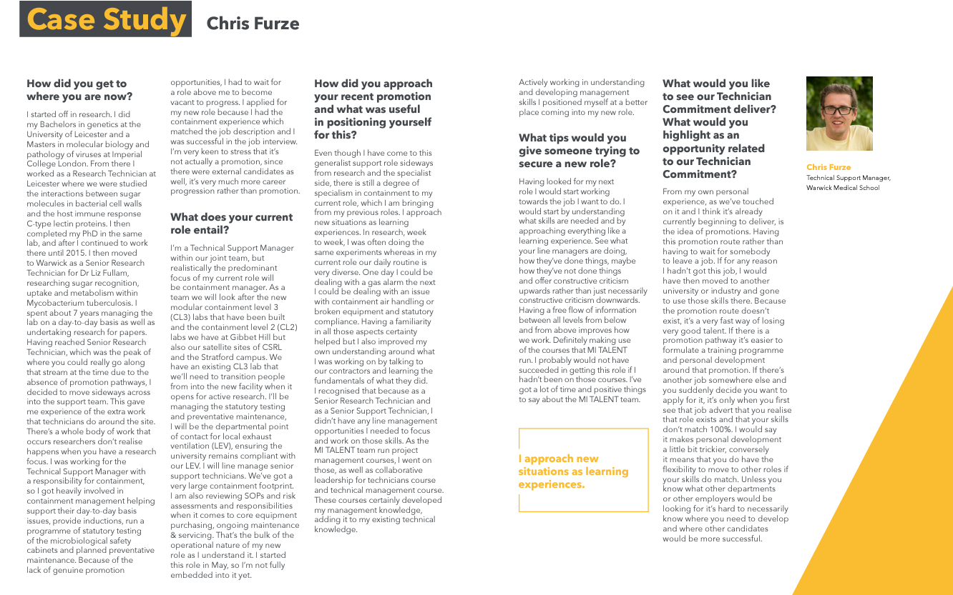
MI TALENT Leadership Programmes
Learning
Support essential
Resources
Timing
Co-creation
Sharing learning & benefits
IRCC INTERNATIONAL RESEARCH CULTURE CONFERENCE I 25th Sept 2023

Slide 8


Next Steps
Continued delivery of the leadership programme through MI TALENT.
National roll out of the three leadership programmes, funded by Research England to 2025. Research England funded Institute of Technical Skills & Strategy (ITSS). Vivien Thomas Technical Leadership Programmes. (Launch October 2023)
Ongoing delivery of the Herschel Programme for Women in Technical Leadership via the Research England funded Institute of Technical Skills & Strategy (ITSS).
New Research Development Theme for Technicians developed for 2023-4.
New Technicians led Cross-Institution Mentoring Scheme.
IRCC INTERNATIONAL RESEARCH CULTURE CONFERENCE I 25th Sept 2023

Slide 9
Resources
MI TALENT
Leadership & Management Programme
Herschel Programme for Women in Technical Leadership
Technician Commitment
Research Culture – A Technician Lens
IRCC INTERNATIONAL RESEARCH CULTURE CONFERENCE I 25th Sept 2023

Slide 10
THANK YOU
Sandy Sparks / 25 September 2023

