Slide 1
Navigating the choppy waters of academia: the experiences of disabled and neurodivergent academics.
Professor Kate Sang
Professor of Gender and Employment Studies
Heriot Watt University, Edinburgh
Twitter @katesang email k.sang@hw.ac.uk

Slide 2
Outline of talk
Disability inclusion in universities
Theoretical underpinning – social relational model of disability
Empirical studies
Key themes
Challenges to the audience
Q&A
EDICa
Notes:
Cat prefers

Slide 3
The wider research team
Dr Jennifer Remnant ​
Dr Thomas Calvard ​
Dr Katriona Myhill​
Dr James Richards​
Abraham Babajide
Mrs Chiara Cocco
Dr Frederick Bosche
Professor Garry Pender
Dr Sara Shinton
Dr Cat Morgan
Dr Lena Wanggren
Dr Clayton Magill
Dr David Woolf
Professor Teresa Fernandes
Mrs Fenella Watson

Slide 4
Disability inclusion in universities
Student focus (Equality Act, 2010) - staff 'cliff edge'
Gender (in)equality well-established (and stubborn)
Very low disclosure rate (neoliberal university, marketisation and managerialism)
Low representation in senior positions
Othered in universities

Slide 5
Theoretical underpinning
The social relational model of disability – Carol Thomas.
Medical model (disability resides in the individual, and needs to be resolved or removed)
Social model (impairment is distinct from disability, which is social oppression that occurs as a result of interacting with an ableist world)
Social relational model (disability and impairment are distinct, disability is social oppression rooted in unequal social relationships. Impairment effects)
Disability does not reside within an individual.
We are disabled by working in ableist and neurotypical workplaces. Identify and remove disabling barriers
Disabled person not person with a disability.

Slide 6
Studies
EPSRC & Heriot Watt funded career acceleration grant in 2017 – experiences of disabled academics
Survey – menstruation, gynaecological health and menopause in university careers
Heriot Watt funded research 2019 – lived experiences of gynaecological health in UK academia
EPSRC funded Inclusion Matters project 2019-2021
NERC Enabling Neurodiverse Inclusive Science Careers 2022
Equality, Diversity and Inclusion Caucus 2023 onwards

Slide 7
Key themes - academics
Performance management
Career progression
Internalised ableism
Distrust of HR
Ill-informed line management
Stigma/shame
Incompatibility of the body with an academic career
Disciplinary differences
Intersectionality

Slide 8
Alex - PGR
Alex is gender non-binary. They experience endometriosis, heavy periods, a respiratory condition and have been diagnosed with mental health issues. They have also been diagnosed with autism but do not consider that diagnosis a disability. They often use a wheelchair. They are completing a PhD in Geosciences. Alex’s colleagues know that they are disabled, and they have disclosed their mental health issues to their line manager.
During their PhD they took a substantial leave of absence and have formal agreement in place to complete their PhD part time. They have informal arrangements with their line manager regarding their use of the lab and flexible hours. To enter the workplace, Alex passes through an area where people congregate to smoke causing them discomfort. The lift in their workplace is regularly out of service. They work in an open plan office, which makes them uncomfortable as they like to be able to see who is coming and going. They also work in a lab that requires specific cleanliness conditions. Conferences are often inaccessible to Alex, as are their institution’s teaching rooms, meaning they can’t teach.

Slide 9
Management of problematic menstruation - blood
'IT WAS LITERALLY SIT ON A PLASTIC BAG ON THE SEAT OF THE CAR. TWO LONG PADS, A SUPER PLUS TAMPON AND A CHANGE OF CLOTHES IN THE BOOT.'
WHEN I FIRST STARTED GOING [HERE] I DIDN’T KNOW THE UNIVERSITY ONE OF THE FIRST THOUGHT WAS “OKAY, I’VE GOT A MEETING IN THIS BUILDING BUT WHERE’S THE NEAREST TOILET?” BECAUSE YOU HAVE TO BE… AND MEN DON’T HAVE TO THINK LIKE THAT, IN THE SAME WAY. AND IT’S JUST, IT JUST MADE ME KIND OF A BIT, DO YOU KNOW, YOU’RE ALWAYS AWARE OF IT WHEN YOU’VE GOT HEAVY PERIODS AND IT’S AN ISSUE.
ESPECIALLY WHEN YOU’RE SHARING A TOILET WITH PEOPLE OF AN OPPOSITE [sex]. AT THAT TIME WE WORKED IN KIND OF LIKE A TENEMENT BUILDING. SO ONE OF THE TOILETS, THERE WAS ONE MAN ON THE FLOOR AND HE USED THE SAME TOILET SO WE WERE ALWAYS KIND OF CONSCIOUS THAT, YOU KNOW, THERE WAS MAN COMING IN. THEY MIGHT HEAR YOU CLICK THE PEDAL BIN AS YOU’RE DISPOSING OF THINGS.

Slide 10
Gynaecological health – wider findings
Miscarriage at work
Male dominated workplaces
Activism
Fear of students knowing(odour)

Slide 11
Key themes – university management and processes
Managers/HR/UCU reps
Policy
Disabled people – sick/underperforming
Policies unhelpful
Distrust (is this a 'real' disability)
Poor understanding of disability
Medical validation
Medical model of disability
Disabled people a problem
Positioned as under-performing
Individualised adjustments requiring medical certification
HR universally distrusted by disabled academics, line managers and union reps

Slide 12
Hazel – HR director
Elizabeth is a senior HR advisor who has worked in HE for over ten years. She explained how across universities, less academics disclose being disabled or having a long term condition than professional services staff.
She explained that university policies relating to disability are due to be reviewed, but said it wasn’t a priority because other policies were more out of date. The relevant policies included absence management, capability and performance management. For Elizabeth it is important to treat everyone the same, and not identify anyone as ‘special’. To explain her point, she pointed out that people in the Deaf community do not consider themselves disabled.

Slide 13
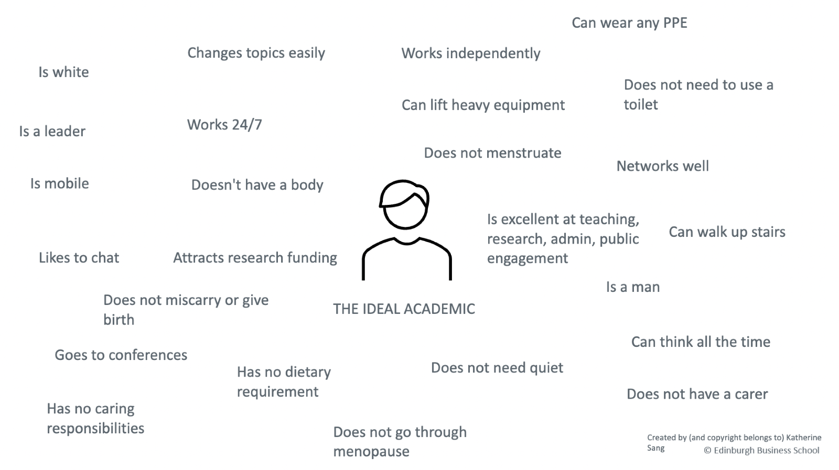

Slide 14
Disability in UK universities – the social relational approach
Across the 4 studies the data shows that
  Academics with 'impairments' are positioned as a problem/not the ideal academic – disabled by attitudes, policy, ableism, built environment, performance expectations
  Internalised ableism amongst academics
  Neoliberal discourses of performance management other academics with impairments
  Impairment effects (neglected)
  'I'm not disabled until I leave my home'

Slide 15
Challenges to the audience
Move away from person first language & no euphemisms!
Move focus to changing oppressive and disabling workplaces
Do not stigmatise disability (or neurodiversity) nor position as a superpower
Centre the social model of disability and the voices of disabled people

Slide 16
Key publications
Sang, K., Calvard, T. and Remnant, J., 2022. Disability and academic careers: Using the social relational model to reveal the role of human resource management practices in creating disability. Work, Employment and Society, 36(4), pp.722-740.
Sang, K., Remnant, J., Calvard, T. and Myhill, K., 2021. Blood work: Managing menstruation, menopause and gynaecological health conditions in the workplace. International Journal of Environmental Research and Public Health, 18(4), p.1951.
Remnant, J., Sang, K., Myhill, K., Calvard, T., Chowdhry, S. and Richards, J., 2022. Working it out: Will the improved management of leaky bodies in the workplace create a dialogue between medical sociology and disability studies?. Sociology of Health & Illness.
Remnant, J., Sang, K., Calvard, T., Richards, J. and Babajide, O., 2023. Exclusionary logics: constructing disability and disadvantaging disabled academics in the neoliberal university. Sociology, p.00380385231162570.
Sang, K.J., Richards, J. and Marks, A., 2016. Gender and disability in male‐dominated occupations: A social relational model. Gender, Work & Organization, 23(6), pp.566-581.
Richards, J. and Sang, K., 2016. Trade unions as employment facilitators for disabled employees. The International Journal of Human Resource Management, 27(14), pp.1642-1661.
Richards, J. and Sang, K., 2021. Socially ir responsible human resource management? Conceptualising HRM practice and philosophy in relation to in-work poverty in the UK. The International Journal of Human Resource Management, 32(10), pp.2185-2212.
Richards, J. and Sang, K., 2019. The intersection of disability and in-work poverty in an advanced industrial nation: The lived experience of multiple disadvantage in a post-financial crisis UK. Economic and Industrial Democracy, 40(3), pp.636-659.

Slide 17
Any questions?

