Slide 1

Enhancing Research Culture at Warwick
Enhancing WMS’s Research Culture through Co-Production and Active Community Engagement
Kirstie Haywood, WMS (HS)
Adele Kenny, WMS (HS)

Slide 2
Aims
To inform the ideal ‘future’ research culture for WMS
  What does the ‘WMS Research Culture of 2028’ look like and how do we get there?
Key components:
Recruitment of RC Officer
Series of Research Culture Cafes
Development of RC website

Slide 3
Activities
Objectives of Research Café 1:
  To explore what research culture means for the WMS community
Objectives of Research Café 2:
  To start to explore the challenges and opportunities that underpin research culture at WMS

Slide 4

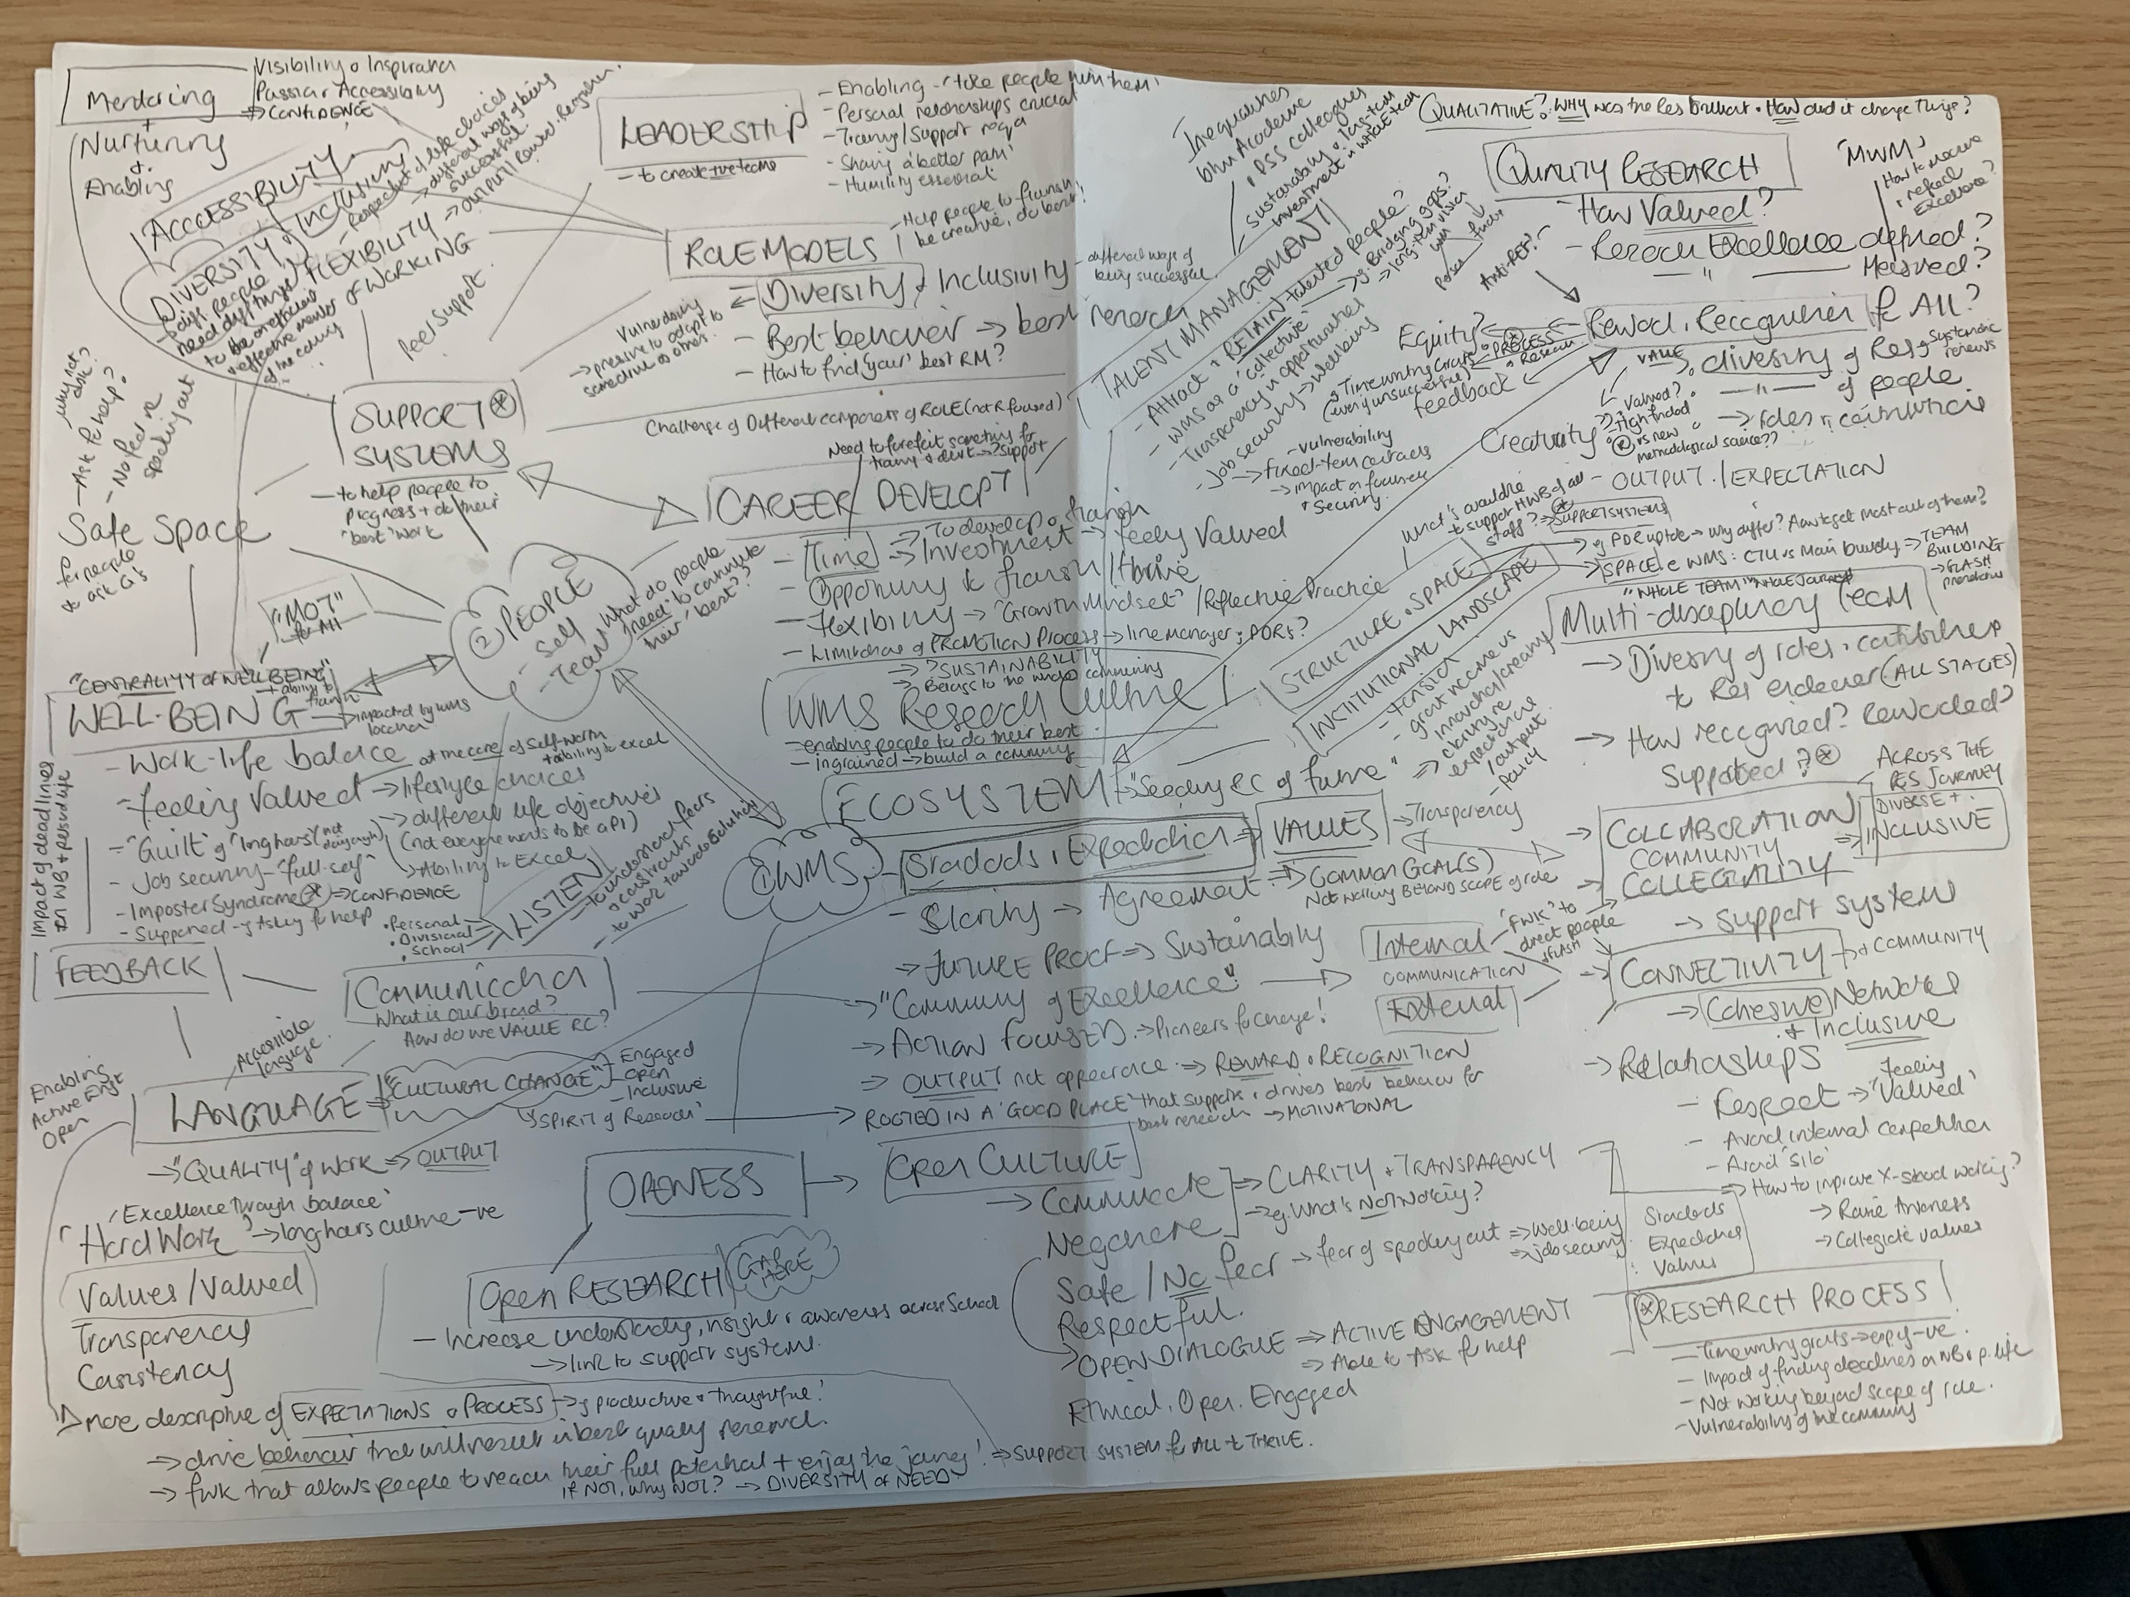
Recommendations:
WMS Values-driven Research Culture
Valuing Our Research
Valuing Our People
Valuing Our Community
Sow, Nurture, Flourish
WMS Values-driven
Research Culture

Slide 5
Next Steps
Launch of Research Culture webpages
https://warwick.ac.uk/fac/sci/med/research/culture/
Research Culture café 3 – 14th June 10am-1pm
Generation of WMS Research Culture Roadmap
Roadmap launch event 19th July 2023
Future funding to support identified initiatives

