Slide 1

Enhancing Research Culture at Warwick
Addressing social mobility issues in STEM through the development of WMG’s Research Culture and contribution to the wider University of Warwick Community
Craig Carnegie, Jane Coleman, Margaret Low
WMG

Slide 2
Aims
Improving Research Culture
Address social mobility issues in STEM
Develop a WMG Research Culture to support this
Contribute to the wider University of Warwick Community
Diversity and Inclusion – Creating and training a team that can work with a very underrepresented group coming from poor socioeconomic standing.
Career Paths – Providing a wide range of training to a core team for leadership, teaching, safeguarding and inclusivity practices.
Open Science – Producing a template / open access resource for hosting and facilitating work experiences on a university campus that can be made available online.
Collaboration – Working with several groups within WMG to generate a diverse team of hosts across multi-disciplinary topics and areas.
Employee Development
Warwick Community
Social Mobility and Inclusion
Team Creation
Work Experience Hosting
Developing a WMG team interacting with young people
Researching and addressing social mobility issues in STEM
Hosting work experience and disseminating to the UoW Community

Slide 3
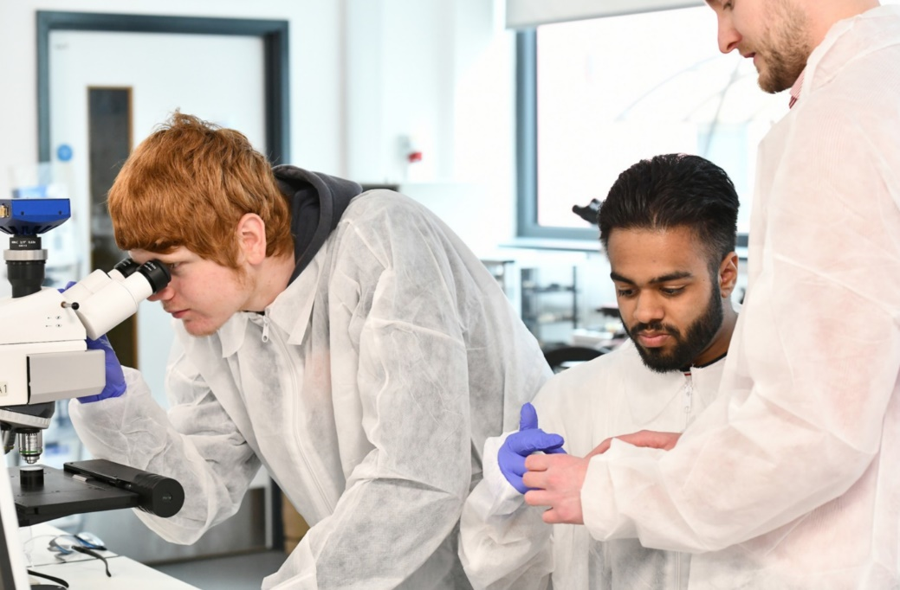
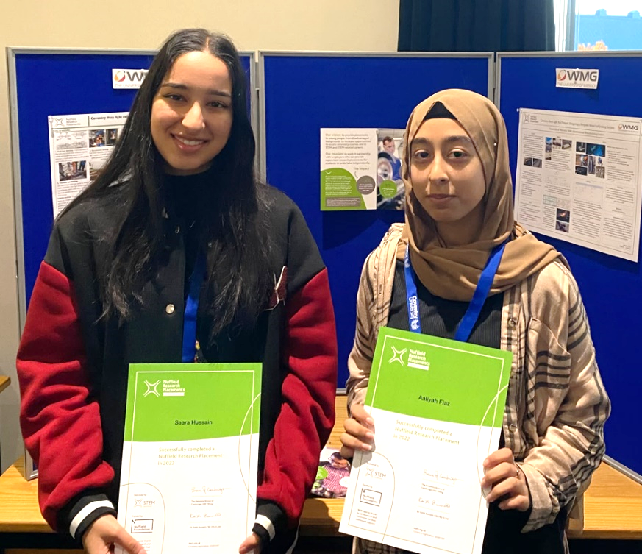
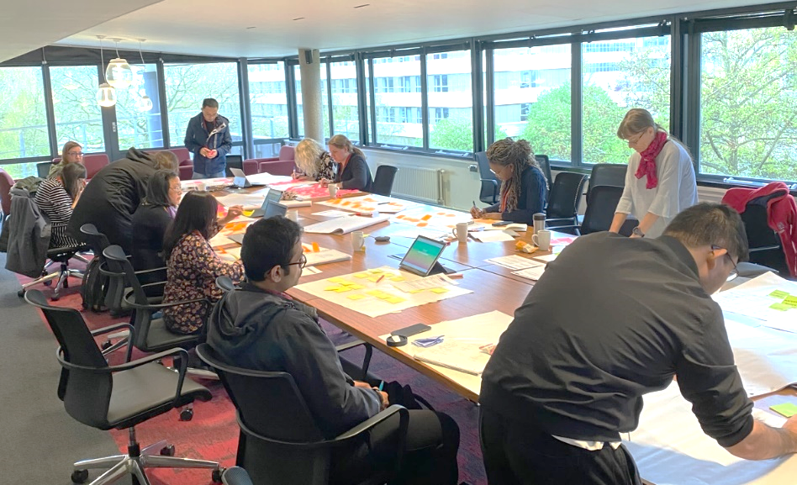
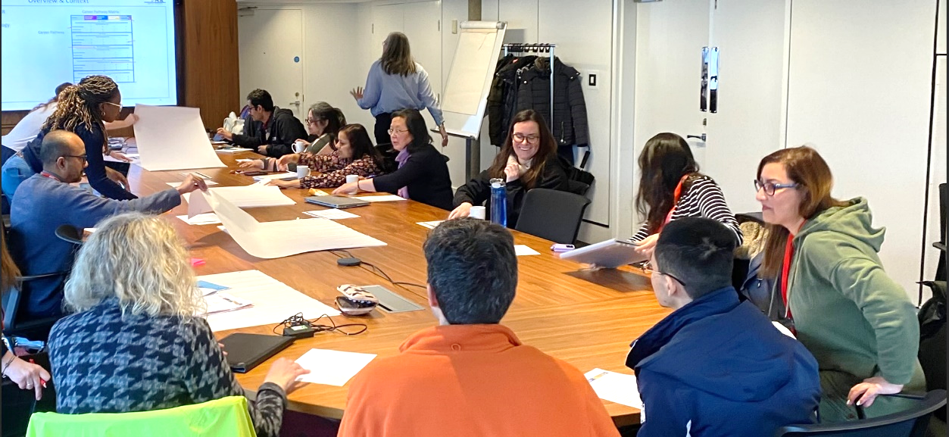
Activities
Created our Employability Team
Hosted a cohort of young people as part of the EY Foundations Smart Futures programme
EY Foundations Beyond Your Limits (May)
Nuffield Research Placements (July)
Worked with a Professional Development Consultant to:
Provide one-on-one training and mentoring in career development
Deliver departmental workshops.
Mapping your Achievements to UoW's Promotions Criteria (April)
Influence & Politics: Being Strategic (June)
Valuing Diversity & Increasing Inclusivity: What more can you be doing? (July)

Slide 4
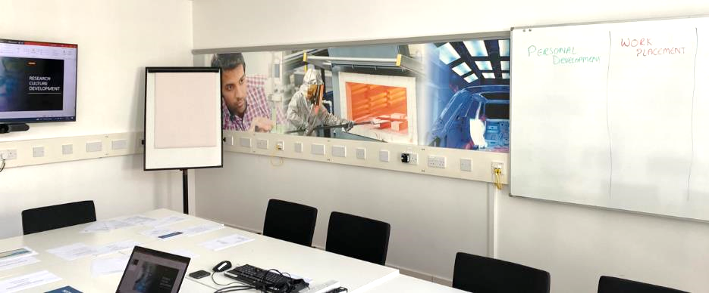
Recommendations
Considerations when delivering your Project:
Recruitment: Start recruitment early
Events: Account for cancelations
Contracts: Involve HR as soon as possible
Co-Worker Commitments: Set realistic expectations
Work Experience Host:
Religious events (Ramadan)
Young People not on time / cancel
Dependence on organisers (Project Partners)

Slide 5
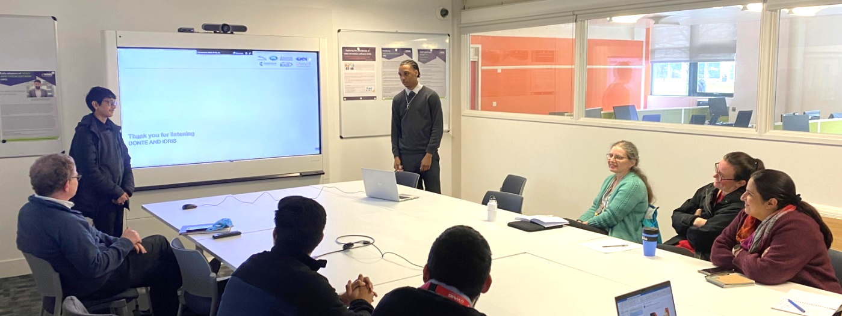
Next Steps
Continue to grow the development of the Work Experience team
Evaluate our delivered work experience in April and extract learning, ready for May and July cohorts
Speak with local employability groups and schools to garner which programme delivery provides the best employability experience for their students
Plan and deliver department Workshops 2 and 3 with a Professional Development Consultant
Collect all learning outcomes into an online source for the wider University community to access

