Slide 1

Enhancing Research Culture at Warwick
Faculty of Arts
School Impact Network
Kathryn van de Wiel &
Emma Roberts
Research & Impact Services

Slide 2

Activities
A working group - comprising Faculty of Arts researchers, research support staff, schoolteachers and school support staff - exploring how Warwick researchers in the Arts and Humanities might tailor their work to address the needs, challenges and aspirations of school students and their teachers.
Series of collaborative, thematic workshops
Facilitate networking and the exchange of ideas
Co-design of any outputs
Mutually beneficial outcomes and long-term dialogue
Focus on ambitious and long-term impact – e.g., curriculum change

Slide 3

Aims
Build a basis for confident engagement with the school sector – able to recognise and leverage opportunities more proactively
Foundation for trust, dialogue and collaboration
Diversify impact portfolio
Outward-looking research culture
Meaningful, user-driven engagement with schools
Improve perception of working with schools

Slide 4
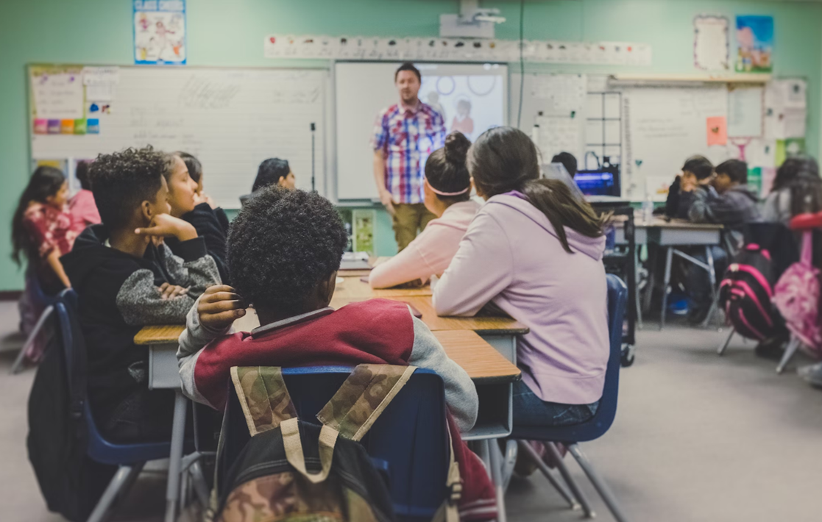
Recommendations
Review of existing resources
Identification of new resources and provision
Programme of events
Clusters of activity and ‘matchmaking’
Better understanding of each other’s challenges, priorities, and opportunities – influence how future work is devised

Slide 5

Next Steps
Putting recommendations into action
New resources
Events
Thematic programme
Longevity?
https://warwick.ac.uk/fac/arts/staffintranet/rss/impact/schoolimpactnetwork/
@SchoolImpactNet

