Slide 1

Enhancing Research Culture at Warwick
Showcasing Physics research
Susan Burrows, Reza Kashtiban Physics

Slide 2
Aims
To show the wide range of physics research being undertaken at Warwick
To encourage under-represented groups to consider a career in physics
To foster a sense of community in researchers within the physics department
To boost confidence in media skills

Slide 3
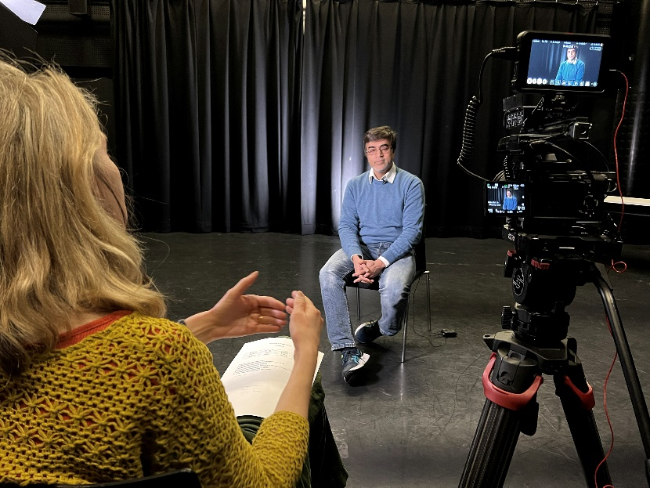
Activities
A professionally made set of ~2 minute videos will be made featuring 12 different researchers of different backgrounds
These will feature interviews plus b-footage showing the researchers at work in their laboratories

Slide 4
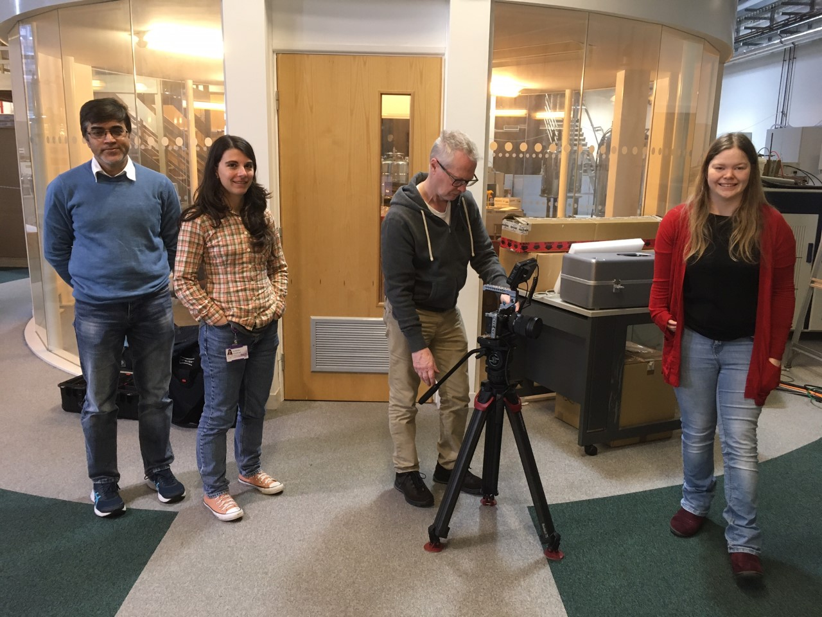
Recommendations
Keep on schedule
Keep momentum going – it has been a great opportunity for researchers to meet each other

Slide 5
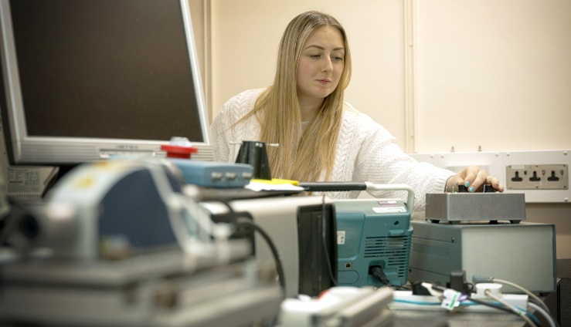
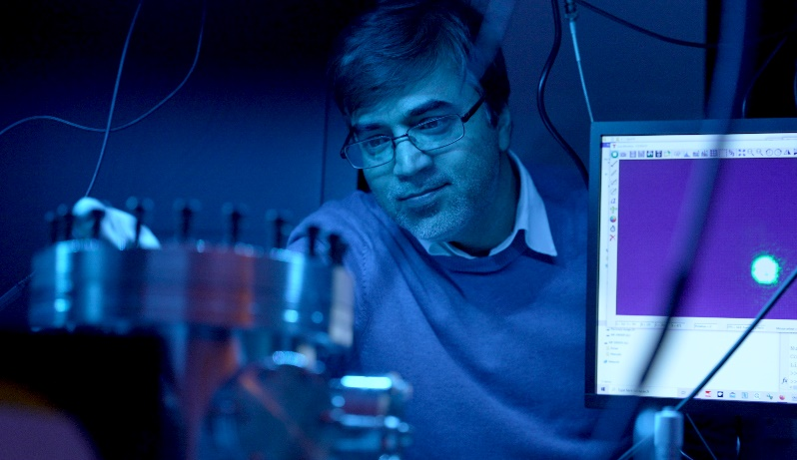
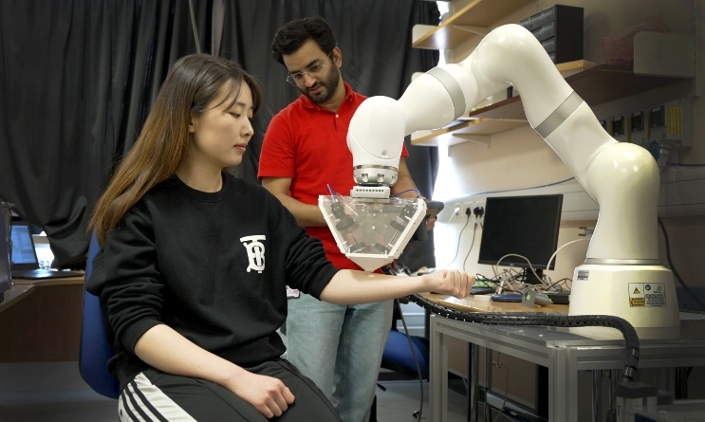
Next Steps
Filming and editing on-going
The videos will be shown as part of a research staff network forum event
Create a webpage to show the videos
Disseminate to the wider community
Gain feedback from participants

