Slide 1

Enhancing Research Culture at Warwick
The Social Mobility Student Research Hub
Dr Tammy Thiele and Vicki Hill, Widening Participation

Slide 2
Aims
The principal aim of the project was to create a ‘Social Mobility Student Research Hub’ to improve access to, and participation in, research, for students from currently underrepresented groups, including those of low socioeconomic backgrounds.

Slide 3
Activities
Funding from the ‘Enhancing Research Culture Fund 2022-2023’ was allocated to student researchers and PGR student mentors.
Student researchers given a stipend (£1,600 – spread over three instalments), PGR mentors are paid an hourly rate.
External collaborators engaged with an invested interest in social mobility supporting on a voluntary basis.
Student researchers are being supported by PGR mentors and the project team to carry out research projects in themes related to Widening Participation, social mobilities, inequalities …
Events include workshops, seminars and conferences where students have opportunities to meet each other, learn new skills and share findings.

Slide 4
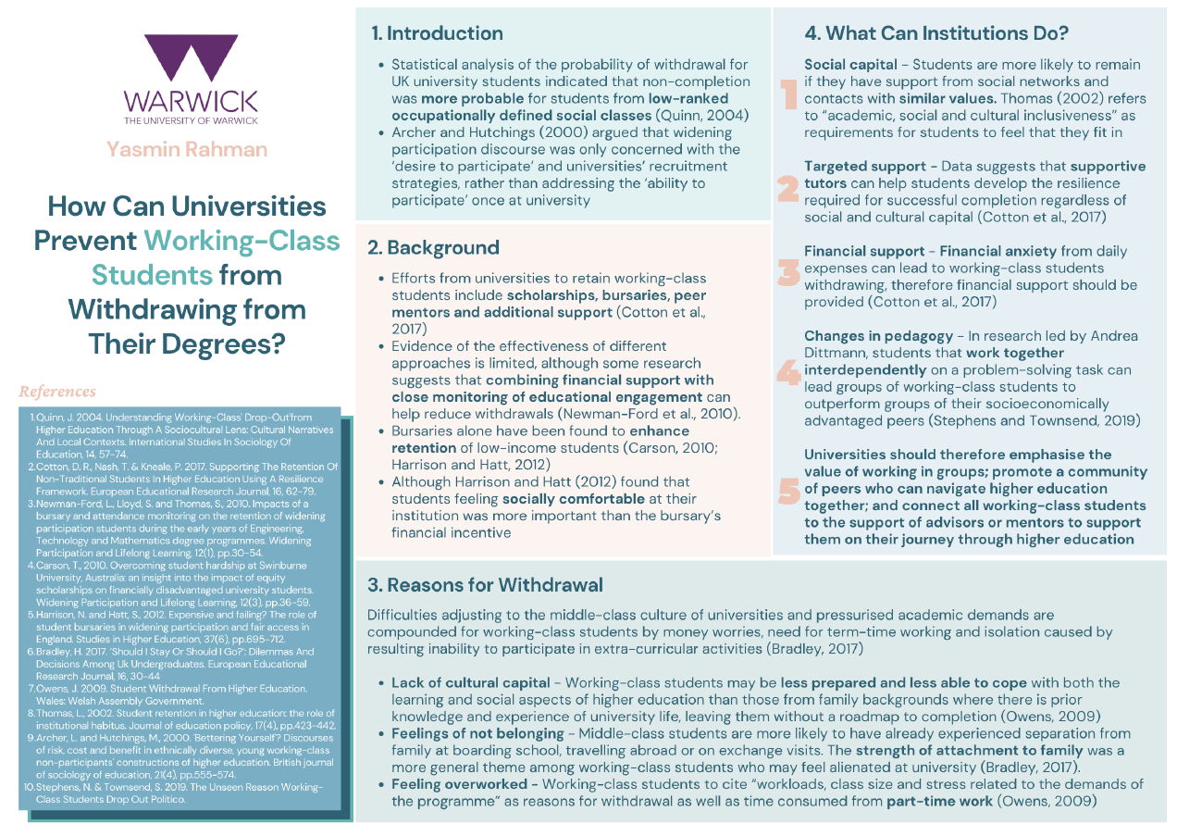
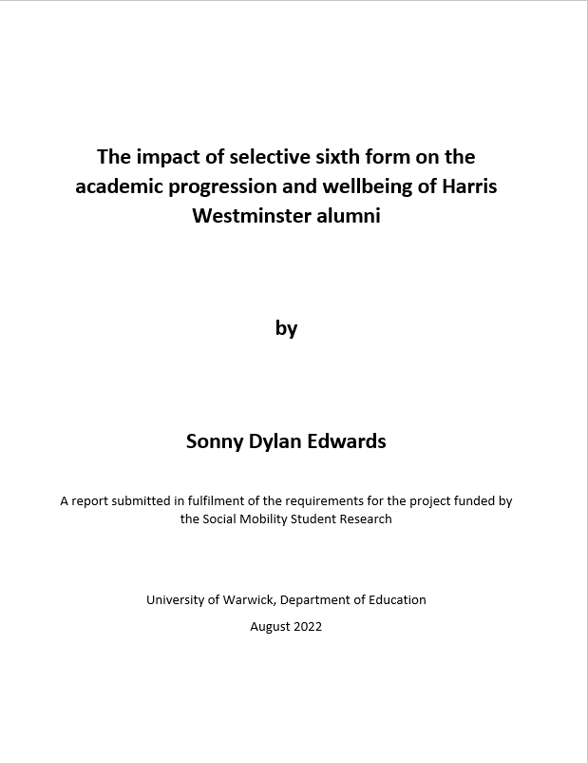
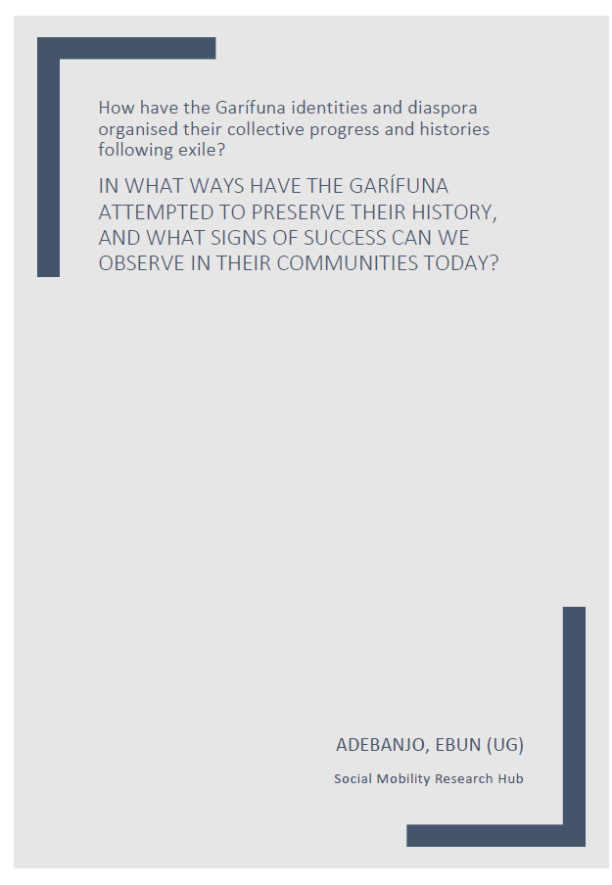
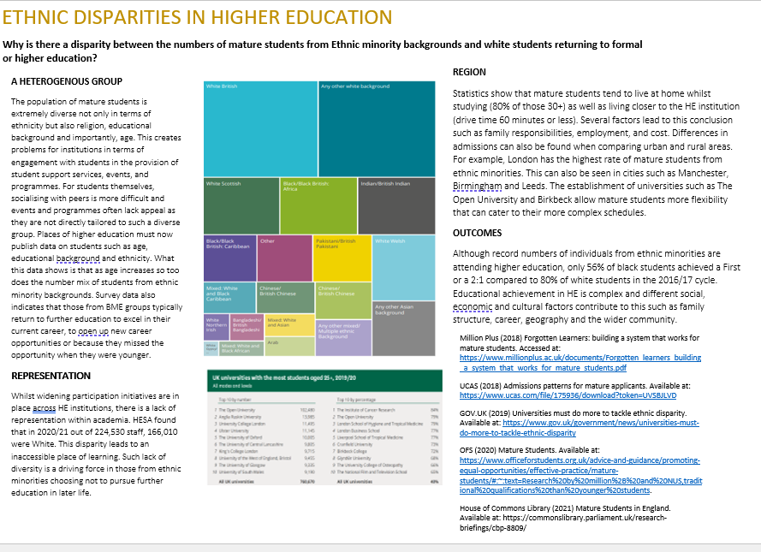
Types of outputs?
Written reports
Literature reviews
Podcasts
Documentary videos
Posters

Slide 5
Recommendations
Enable UG and PGT students from underrepresented groups to take part in research in areas related to their lived experiences, whilst gaining research skills, meeting others, and sharing their views!
Give them opportunities to meet staff from interdisciplinary fields to shape practices and research related to Widening Participation.

Slide 6
Next Steps
Student researchers are completing their ethics applications.
Formalising collaboration opportunities, with external partnerships as additional mentors.
Students will be encouraged to put abstracts in for consideration at conferences and to share their projects/findings both internally and externally.
Evaluation of the SMSRH 2.0 includes surveys, and interviews.

