Slide 1
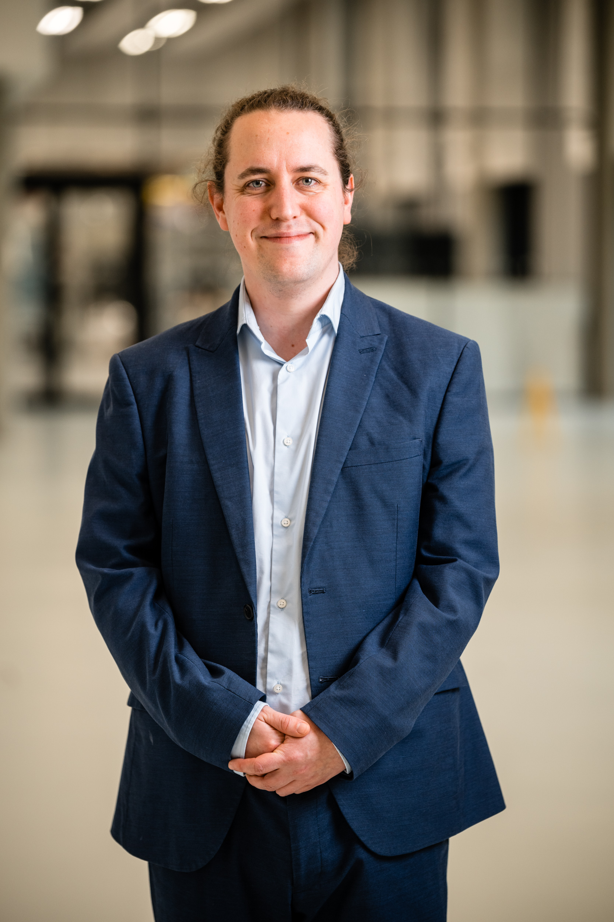
Warwick Resilience Network Profile
Name | Dr Luke Bellamy
Dept. and Faculty | WMG, SEM
Role | Professional Researcher (Lead Engineer)
Core Focus | Industrial & Supply Chain Resilience
Relevant Publications, Projects & Resources:
Supply Chain Resilience Hub | https://supplychainresiliencehub.com/
Resilience Navigator | https://scrn.digitalsupplychainhub.uk/
Research & activities:
Dr Luke Bellamy is the Lead Engineer for Industrial Resilience within the Chief Technology Officer (CTO) team at WMG. He operates at the intersection of academic research and industry to support manufacturing supply chains. Luke co-founded the Warwick Resilience Network to foster interdisciplinary synergy across the institution. His high-impact technical work, delivered in partnership with the High Value Manufacturing Catapult, focuses on circular economy design, resource security and supply chains. By developing digital capabilities such as the Supply Chain Resilience Navigator and practical decision-support tools, Luke translates complex academic theory into robust, systemic solutions that deliver long-lasting industrial and societal impact.
Contact
LinkedIn | https://www.linkedin.com/in/lgpbellamy/
Email | Luke.Bellamy@Warwick.ac.uk

Slide 2
Warwick Resilience Network Profile
Name | Dr Luke Bellamy
Dept. and Faculty | WMG, SEM
Role | Professional Researcher (Lead Engineer)
Core Focus | Industrial & Supply Chain Resilience
Relevant Publications, Projects & Resources:
Supply Chain Resilience Hub | https://supplychainresiliencehub.com/
Resilience Navigator | https://scrn.digitalsupplychainhub.uk/
Research & activities:
Dr Luke Bellamy is the Lead Engineer for Industrial Resilience within the Chief Technology Officer (CTO) team at WMG. He operates at the intersection of academic research and industry to support manufacturing supply chains. Luke co-founded the Warwick Resilience Network to foster interdisciplinary synergy across the institution. His high-impact technical work, delivered in partnership with the High Value Manufacturing Catapult, focuses on circular economy design, resource security and supply chains. By developing digital capabilities such as the Supply Chain Resilience Navigator and practical decision-support tools, Luke translates complex academic theory into robust, systemic solutions that deliver long-lasting industrial and societal impact.
Contact
LinkedIn | https://www.linkedin.com/in/lgpbellamy/
Email | Luke.Bellamy@Warwick.ac.uk

Slide 3
Warwick Resilience Network Profile
Name | Dr Luke Bellamy
Dept. and Faculty | WMG, SEM
Role | Professional Researcher (Lead Engineer)
Core Focus | Industrial & Supply Chain Resilience
Relevant Publications, Projects & Resources:
Supply Chain Resilience Hub | https://supplychainresiliencehub.com/
Supply Chain Resilience Navigator | https://scrn.digitalsupplychainhub.uk/
Strategic Resources HVMC project | Steel circularity and economic assessment
Design for circularity and sustainability HVMC project | Led framework development for social and economic sustainability
Co-lead | Warwick Resilience Network
Case study lead | Supply Chain Access to Finance
Research & activities:
Luke operates at the intersection of academic research and industry to support manufacturing supply chains. Luke co-founded the Warwick Resilience Network to foster interdisciplinary synergy across the institution. His high-impact technical work, delivered in partnership with the High Value Manufacturing Catapult, focuses on circular economy design, resource security and supply chains. By developing digital capabilities such as the Supply Chain Resilience Navigator and practical decision-support tools, Luke translates complex academic theory into robust, systemic solutions that deliver long-lasting industrial and societal impact.
Contact
LinkedIn | https://www.linkedin.com/in/lgpbellamy/
Email | Luke.Bellamy@Warwick.ac.uk

Slide 4
Warwick Resilience Network Profile
Name | Dr Luke Bellamy
Dept. and Faculty | WMG, SEM
Role | Professional Researcher (Lead Engineer)
Core Focus | Industrial & Supply Chain Resilience
Relevant Publications, Projects & Resources:
Supply Chain Resilience Hub | https://supplychainresiliencehub.com/
Supply Chain Resilience Navigator | https://scrn.digitalsupplychainhub.uk/
Strategic Resources HVMC project | Steel circularity and economic assessment
Design for circularity and sustainability HVMC project | Led framework development for social and economic sustainability
Co-lead | Warwick Resilience Network
Case study lead | Supply Chain Access to Finance
Research & activities:
Luke operates at the intersection of academic research and industry to support manufacturing supply chains. Luke co-founded the Warwick Resilience Network to foster interdisciplinary synergy across the institution. His high-impact technical work, delivered in partnership with the High Value Manufacturing Catapult, focuses on circular economy design, resource security and supply chains. By developing digital capabilities such as the Supply Chain Resilience Navigator and practical decision-support tools, Luke translates complex academic theory into robust, systemic solutions that deliver long-lasting industrial and societal impact.
Contact
LinkedIn | https://www.linkedin.com/in/lgpbellamy/
Email | Luke.Bellamy@Warwick.ac.uk

Slide 5
Warwick Resilience Network Profile
Name | Dr Luke Bellamy
Dept. and Faculty | WMG, SEM
Role | Professional Researcher (Lead Engineer)
Core Focus | Industrial & Supply Chain Resilience
Relevant Publications, Projects & Resources:
Supply Chain Resilience Hub | https://supplychainresiliencehub.com/
Supply Chain Resilience Navigator | https://scrn.digitalsupplychainhub.uk/
Strategic Resources HVMC project | Steel circularity and economic assessment
Design for circularity and sustainability HVMC project | Led framework development for social and economic sustainability
Co-lead | Warwick Resilience Network
Case study lead | Supply Chain Access to Finance
Research & activities:
Luke operates at the intersection of academic research and industry to support manufacturing supply chains. Luke co-founded the Warwick Resilience Network to foster interdisciplinary synergy across the institution. His high-impact technical work, delivered in partnership with the High Value Manufacturing Catapult, focuses on circular economy design, resource security and supply chains. By developing digital capabilities such as the Supply Chain Resilience Navigator and practical decision-support tools, Luke translates complex academic theory into robust, systemic solutions that deliver long-lasting industrial and societal impact.
Contact
LinkedIn | https://www.linkedin.com/in/lgpbellamy/
Email | Luke.Bellamy@Warwick.ac.uk

Slide 6
Warwick Resilience Network Profile
Name | Dr Luke Bellamy
Dept. and Faculty | WMG, SEM
Role | Professional Researcher (Lead Engineer)
Core Focus | Industrial & Supply Chain Resilience
Relevant Publications, Projects & Resources:
Supply Chain Resilience Hub | https://supplychainresiliencehub.com/
Supply Chain Resilience Navigator | https://scrn.digitalsupplychainhub.uk/
Strategic Resources HVMC project | Steel circularity and economic assessment
Design for circularity and sustainability HVMC project | Led framework development for social and economic sustainability
Co-lead | Warwick Resilience Network
Case study lead | Supply Chain Access to Finance
Research & activities:
Luke operates at the intersection of academic research and industry to support manufacturing supply chains. Luke co-founded the Warwick Resilience Network to foster interdisciplinary synergy across the institution. His high-impact technical work, delivered in partnership with the High Value Manufacturing Catapult, focuses on circular economy design, resource security and supply chains. By developing digital capabilities such as the Supply Chain Resilience Navigator and practical decision-support tools, Luke translates complex academic theory into robust, systemic solutions that deliver long-lasting industrial and societal impact.
Contact
LinkedIn | https://www.linkedin.com/in/lgpbellamy/
Email | Luke.Bellamy@Warwick.ac.uk

Slide 7
Warwick Resilience Network Profile
Name | Dr Luke Bellamy
Dept. and Faculty | WMG, SEM
Role | Professional Researcher (Lead Engineer)
Core Focus | Industrial & Supply Chain Resilience
Relevant Publications, Projects & Resources:
Supply Chain Resilience Hub | https://supplychainresiliencehub.com/
Supply Chain Resilience Navigator | https://scrn.digitalsupplychainhub.uk/
Strategic Resources HVMC project | Steel circularity and economic assessment
Design for circularity and sustainability HVMC project | Led framework development for social and economic sustainability
Co-lead | Warwick Resilience Network
Case study lead | Supply Chain Access to Finance
Research & activities:
Luke operates at the intersection of academic research and industry to support manufacturing supply chains. Luke co-founded the Warwick Resilience Network to foster interdisciplinary synergy across the institution. His high-impact technical work, delivered in partnership with the High Value Manufacturing Catapult, focuses on circular economy design, resource security and supply chains. By developing digital capabilities such as the Supply Chain Resilience Navigator and practical decision-support tools, Luke translates complex academic theory into robust, systemic solutions that deliver long-lasting industrial and societal impact.
Contact
LinkedIn | https://www.linkedin.com/in/lgpbellamy/
Email | Luke.Bellamy@Warwick.ac.uk

Slide 8
Warwick Resilience Network Profile
Name | Dr Luke Bellamy
Dept. and Faculty | WMG, SEM
Role | Professional Researcher (Lead Engineer)
Core Focus | Industrial & Supply Chain Resilience
Relevant Publications, Projects & Resources:
Supply Chain Resilience Hub | https://supplychainresiliencehub.com/
Supply Chain Resilience Navigator | https://scrn.digitalsupplychainhub.uk/
Strategic Resources HVMC project | Steel circularity and economic assessment
Design for circularity and sustainability HVMC project | Led framework development for social and economic sustainability
Co-lead | Warwick Resilience Network
Case study lead | Supply Chain Access to Finance
Research & activities:
Luke operates at the intersection of academic research and industry to support manufacturing supply chains. Luke co-founded the Warwick Resilience Network to foster interdisciplinary synergy across the institution. His high-impact technical work, delivered in partnership with the High Value Manufacturing Catapult, focuses on circular economy design, resource security and supply chains. By developing digital capabilities such as the Supply Chain Resilience Navigator and practical decision-support tools, Luke translates complex academic theory into robust, systemic solutions that deliver long-lasting industrial and societal impact.
Contact
LinkedIn | https://www.linkedin.com/in/lgpbellamy/
Email | Luke.Bellamy@Warwick.ac.uk

