Slide 1

In situ TEM for understanding materials problems
Alex Robertson
Associate Professor of Physics

Slide 2






University of Warwick
WMG
Warwick Castle
Kenilworth Castle
2
Main campus
New £700M STEM building

Slide 3
Introduction – rechargeable aqueous batteries
Zinc metal anode
Separator
Metal oxide cathode
Aqueous electrolyte (not organic)
Safe and non-toxic
Environmentally friendly
Metal anode
High capacity and cycling rate
► Good candidate for grid storage
Mildly acidic electrolyte (typically ZnSO₄ salt in water)
3

Slide 4
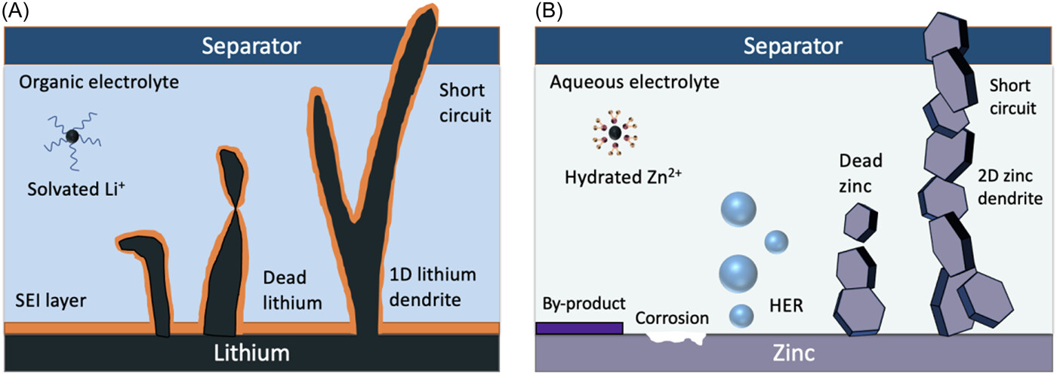

The metal anode – comparison of Li and Zn
Zixuan Li
Z. Li and A. W. Robertson. Electrolyte engineering strategies for regulation of the Zn metal anode in aqueous Zn-ion batteries Battery Energy. 2: 20220029 (2023).
4

Slide 5
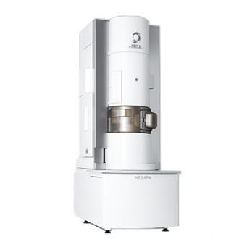
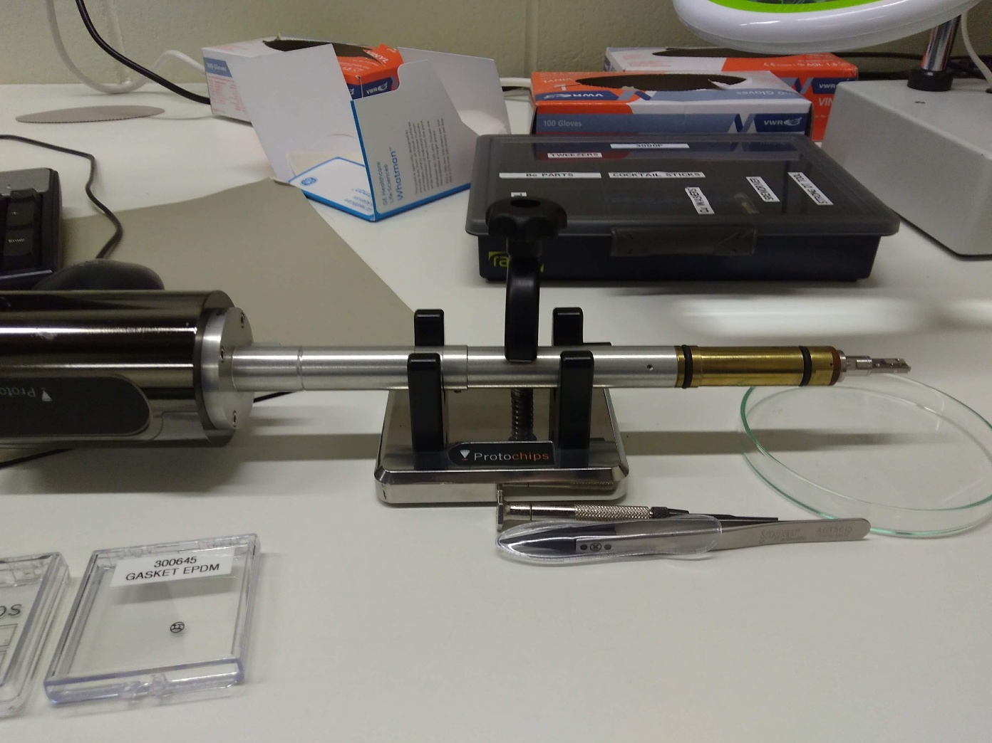
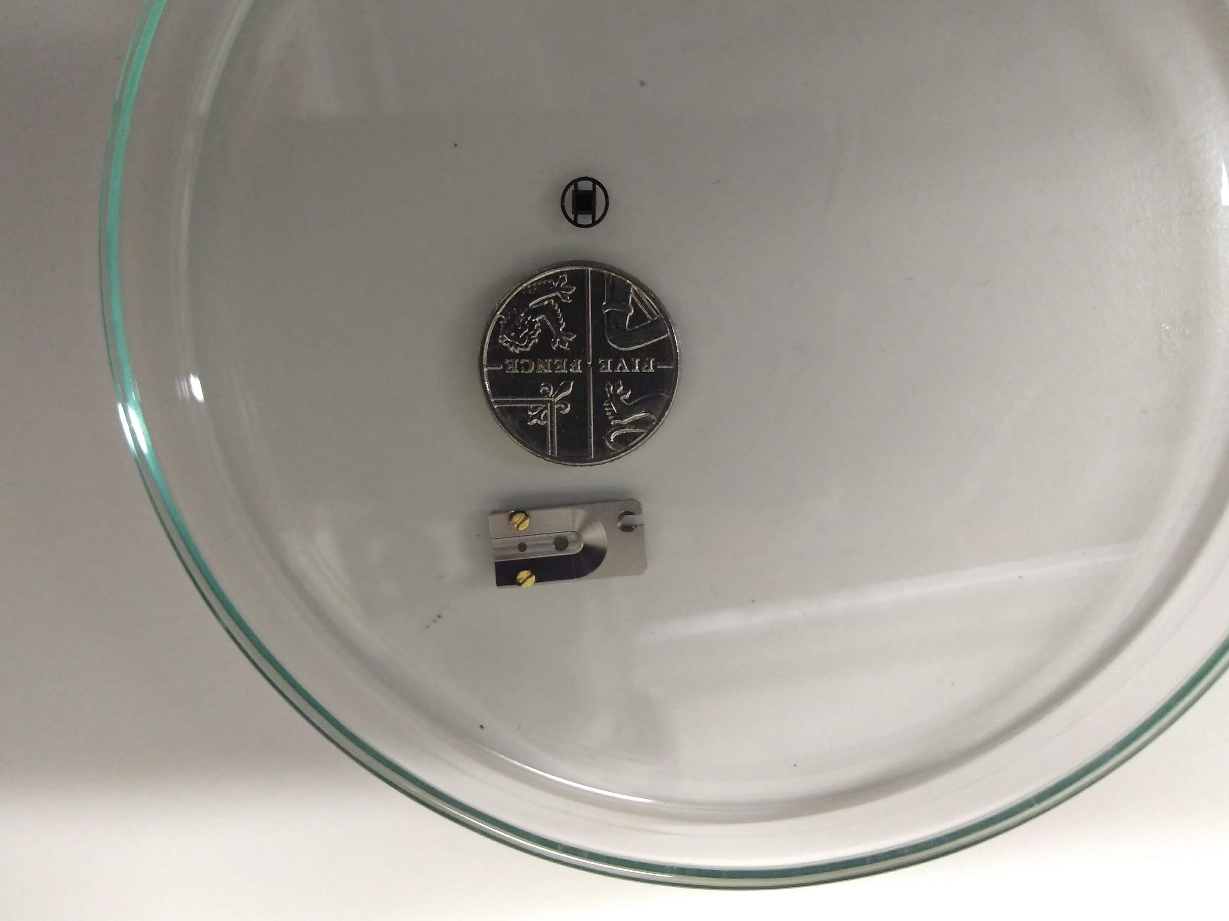
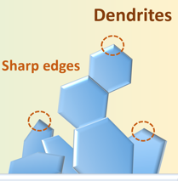
Operando electrochemical TEM
Transfer
Sample preservation
Contaminate
Damage
Revert
E.g. Interface dendrites
TEM imaging
Capture dynamics
Initial state
Material evolution
Final state
State 1
State 2
State 3
Missed!
5

Slide 6
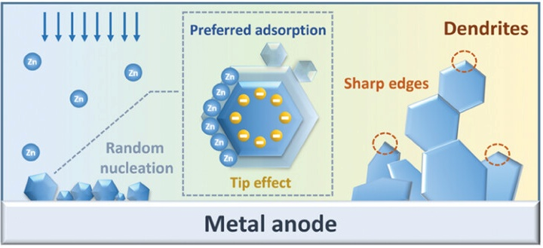
Zn dendrite growth
Electrolyte additives
Electrostatic shielding mechanism
Well studied in Li systems
Similar or different in Zn?
► LiCl additive as prototype candidate
X. Guo, G. He, I. Parkin et al. Alleviation of Dendrite Formation on Zinc Anodes via Electrolyte Additives. ACS Energy Lett. 6, 395-403 (2021).
6

Slide 7
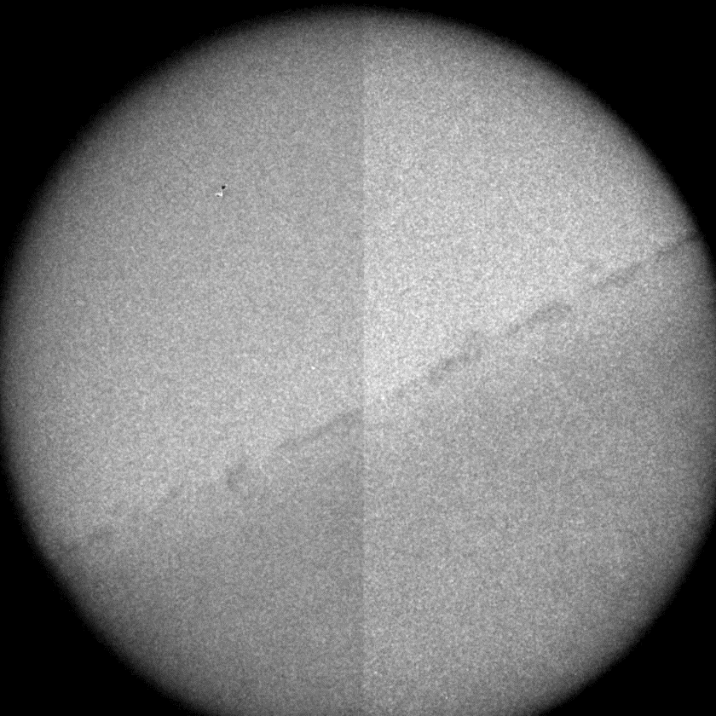

Standard 2 M ZnSO₄ electrolyte (no additive)
Yi Yuan
7
Yuan Y., et al. Diagnosing the Electrostatic Shielding Mechanism for Dendrite Suppression in Aqueous Zinc Batteries. Advanced Materials. 36: 2307708 (2024).

Slide 8
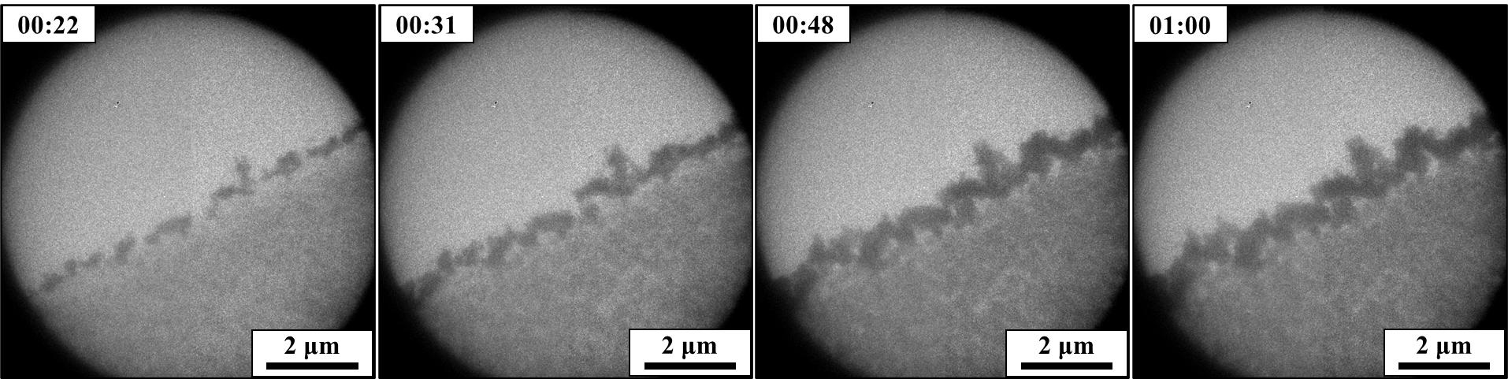
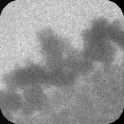
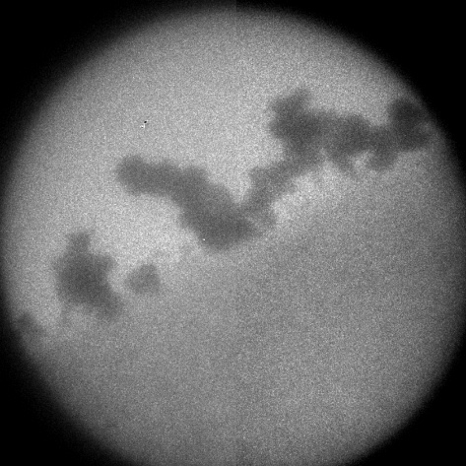
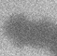

Standard 2 M ZnSO₄ electrolyte (no additive)
100 mA/cm²
Electrolyte
Electrode (Pt)
Θ = 120°
8

Slide 9
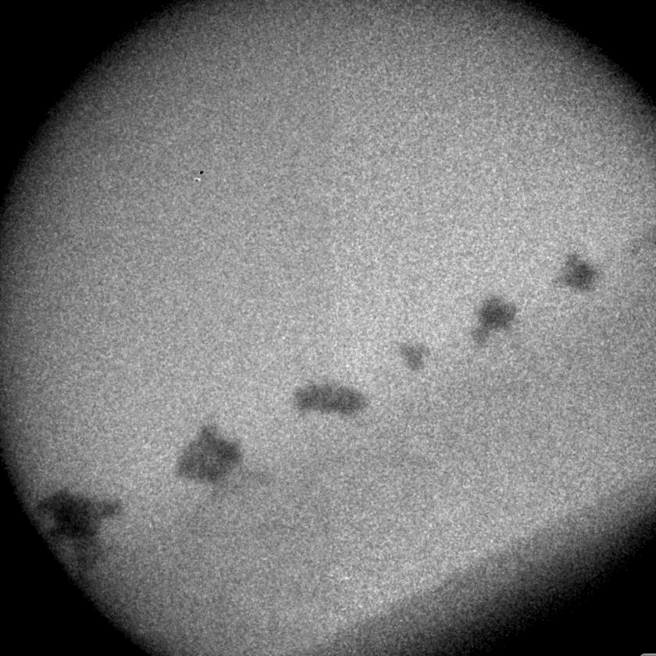
2 M ZnSO₄ electrolyte with LiCl additive
9
Yuan Y., et al. Diagnosing the Electrostatic Shielding Mechanism for Dendrite Suppression in Aqueous Zinc Batteries. Advanced Materials. 36: 2307708 (2024).

Slide 10
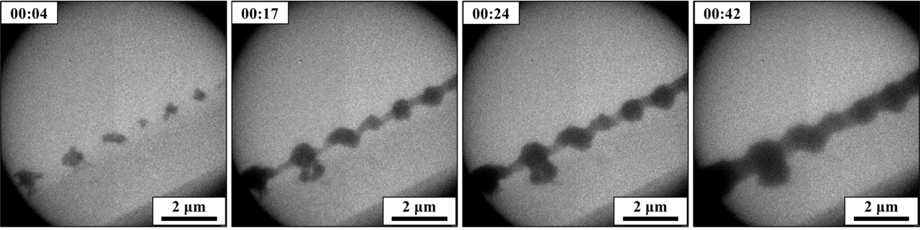
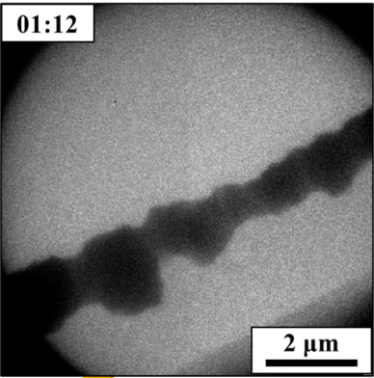
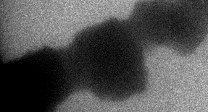
2 M ZnSO₄ electrolyte with LiCl additive
100 mA/cm²
θ = 120°
10

Slide 11
Mechanism?
Nucleation
Primary nuclei growth
Secondary nucleation and growth
Electrode (Pt)
Electrode (Pt)
Electrode (Pt)
No additive – Dendritic
Additive – Block shape
Preferred nucleation sites
Restricted adsorption
Sharp edges
Blunt edges
11

Slide 12
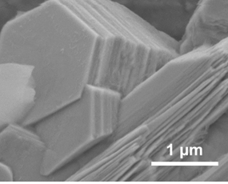
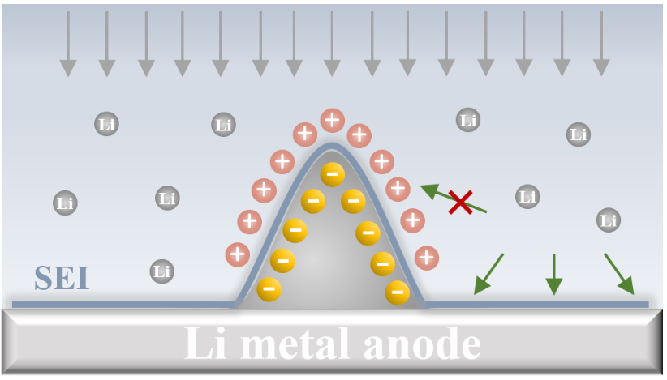
Mechanism – Electrostatic shielding of sharp facets
Cl
Cl
Cl
Cl
Li
Zn
Zn
Li
Li
Cl
Cl
Li
Zn
Li
Zn
Zn
Zn
(100)
Zn
Zn
Zn
Cl
Cl
Li
Zn
Zn
Li
Zn
Zn
Zn
Zn
Side view
Cl
Zn
Zn
(002)
Li
Zn
Zn
Zn
Metal anode
12
Y. Yuan, et al. Diagnosing the electrostatic shielding mechanism for dendrite suppression in aqueous zinc batteries Adv. Mat. 36: 2307708 (2024).

Slide 13
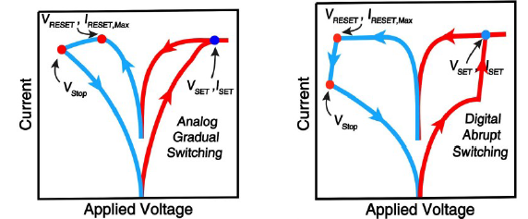
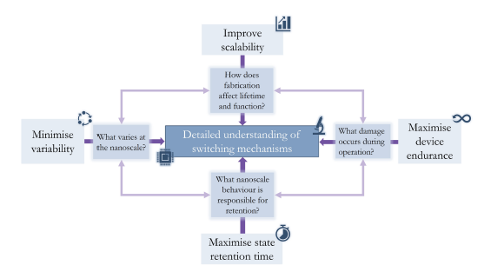

2D materials – MoS₂ Memristors
Rob Wells
13
Wells, R and Robertson, A. W. Molybdenum Disulfide Memristors for Next Generation Memory and Neuromorphic Computing: Progress and Prospects. Advanced Electronic Materials. 10: 2400121 (2024).

Slide 14
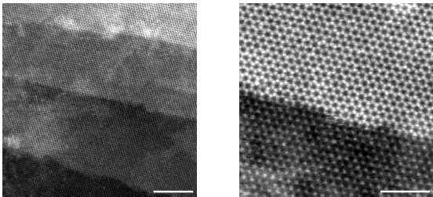
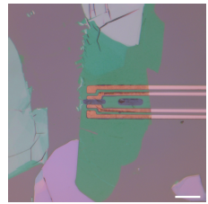
2D materials – MoS₂ Memristors
14

Slide 15
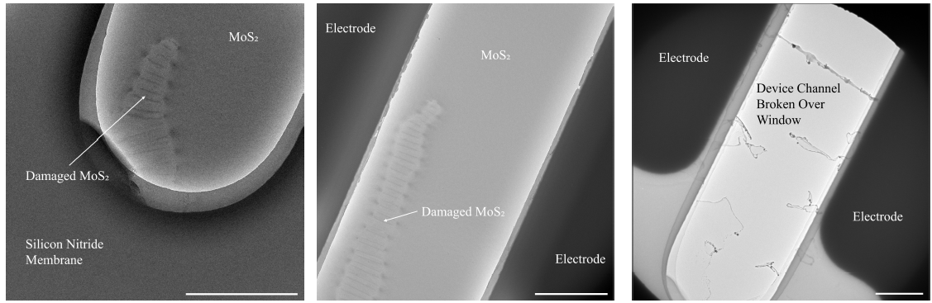
2D materials – MoS₂ Memristors
15

Slide 16
2D materials – MoS₂ Memristors
16

Slide 17









Acknowledgements
The group
The funders
The EM RTP
17

