Slide 1
Mapping electric fields of operando devices in the electron microscope

Slide 2
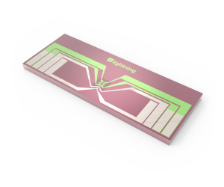
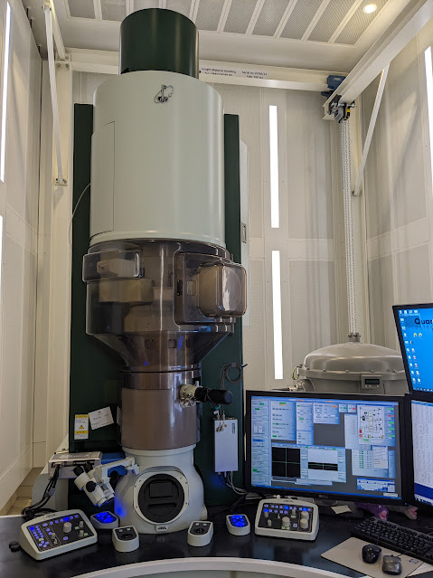
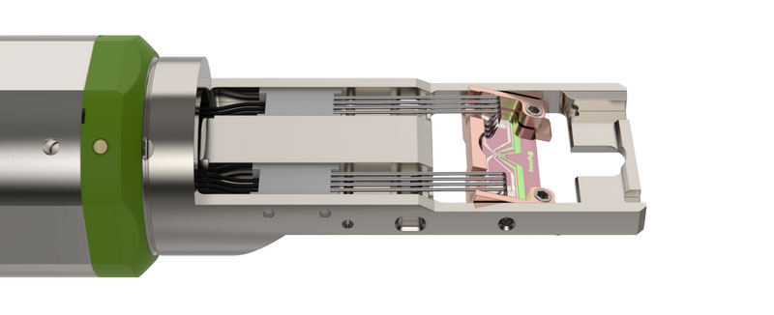
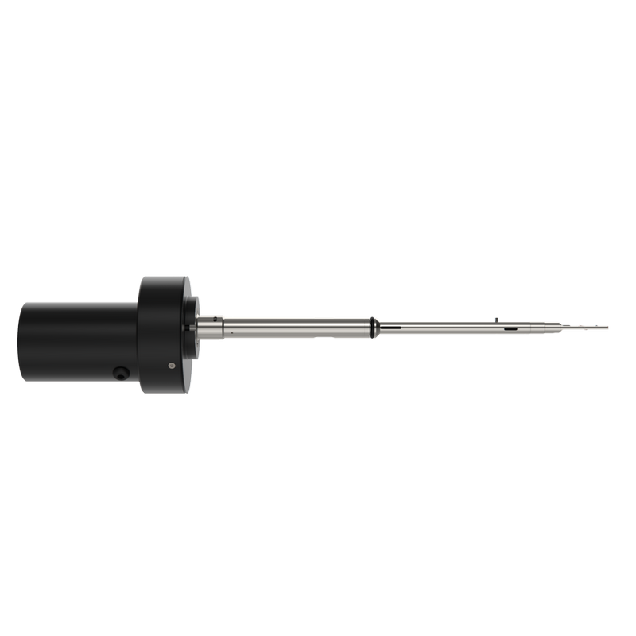
In-situ TEM biasing
micro-electromechanical systems (MEMS) chip
Metal Contacts on a Si_{x}N_{y} membrane
DENS Solutions Lightning Biasing and Heating Holder
Notes:
In the EMRTP we have the aberration corrected JEOL ARM, samples are placed inside through the side entry port. Using specialised holders from DENS Solutions we are able to apply an electrical bias and/or heat the sample. All of the electronics need to feed through the metal pole of the holder to the metal pin contacts at the end. The biasing and heating at the sample is done by the SixNy MEMS chip you can see there, patterned metal electrodes on a Silicon nitride membrane.

Slide 3
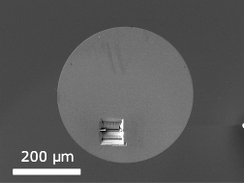
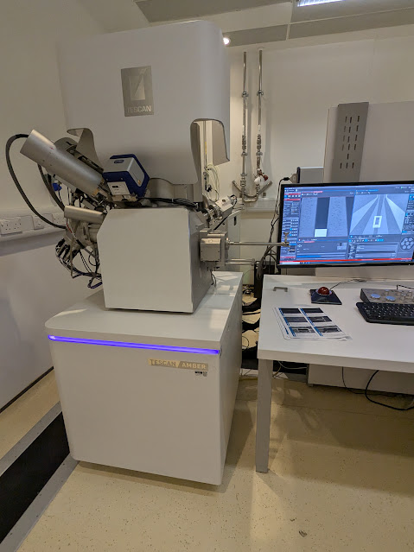
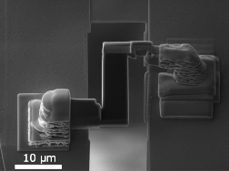
FIB Preparation
Lift out cross-section of Semiconductor device
Attach between 2 metal contacts of MEMS chip

Slide 4
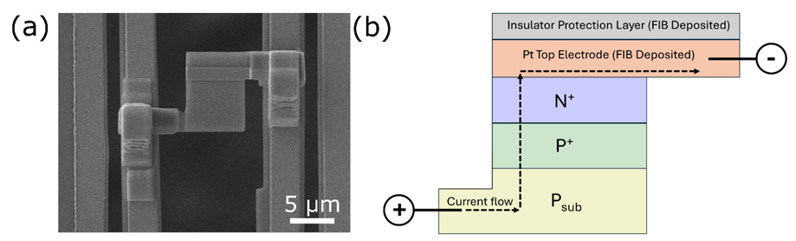
Keeping it simple with a Silicon diode

Slide 5
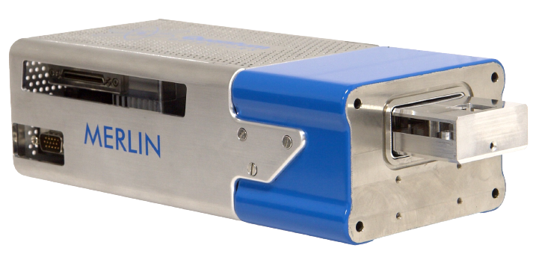
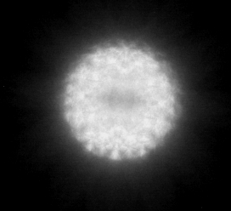
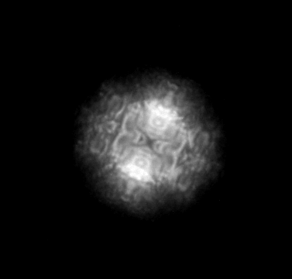
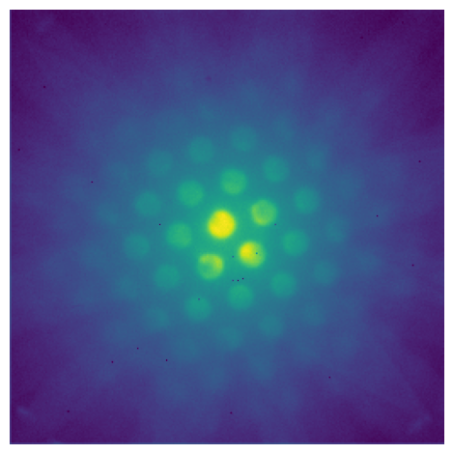
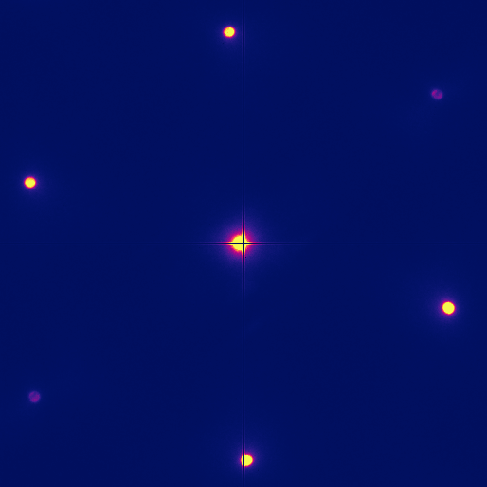




Mapping Electric Fields – 4D-STEM
Increasing Signal-to-Noise Ratio + Detection Limit
$\sim$23 mrad
$\sim 8$ mrad
$\sim$2 mrad
$\sim$0.2 mrad
Increasing Spatial Resolution
Notes:
The whole story is a little more complex and the convergence semi-angle plays a massive part.

Slide 6
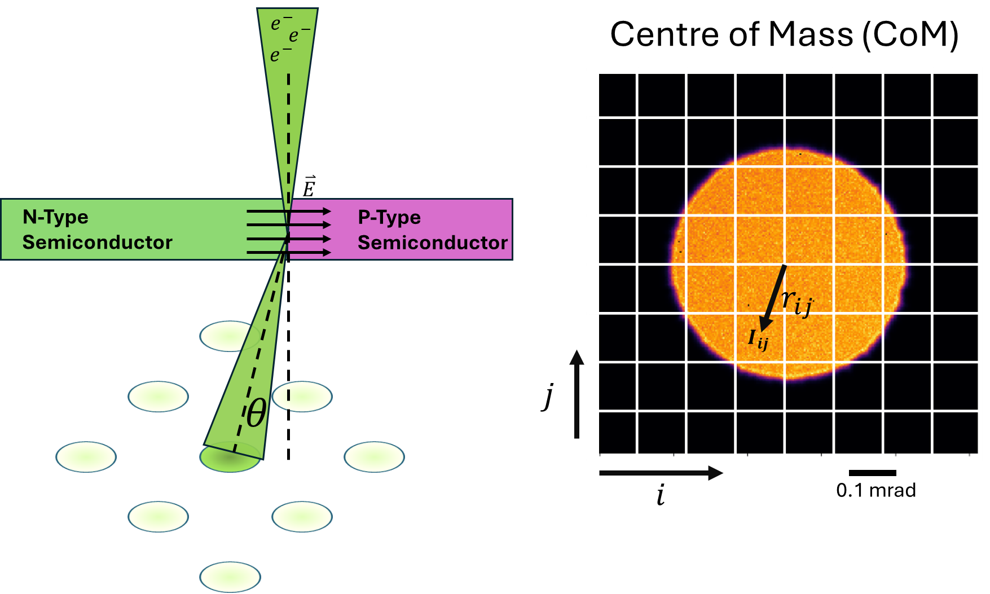
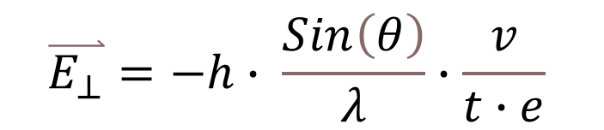
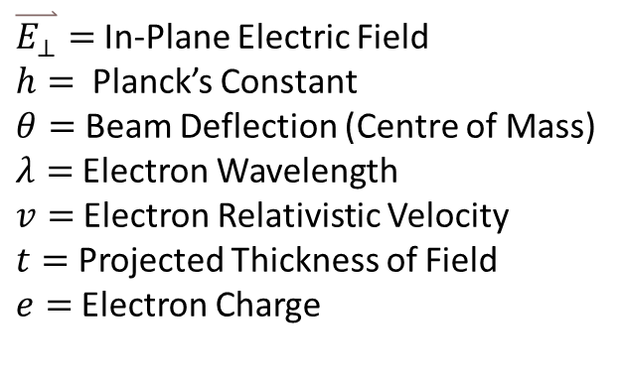
Mapping Electric Fields – 4D-STEM
$$\overset{⃑}{E_{⊥}}=−h∙ \frac{Sin\left(θ\right)}{λ}∙\frac{v}{t∙e}$$
$\overset{⃑}{E_{⊥}}=$In-Plane Electric Field
$h=$ Planck’s Constant
$θ=$ Beam Deflection (Centre of Mass)
$λ=$Electron Wavelength
$v=$Electron Relativistic Velocity
$t=$ Projected Thickness of Field
$e=$Electron Charge
Notes:
The way 4D-STEM works is that we transmit a converged electron beam through a sample and record the resulting diffraction pattern on a direct electron detector. If the electron beam transmits through an electric field then the beam is tilted in real space, which corresponds to a shift in diffraction space. So if we place the central disc of the diffraction pattern on our detector and look at the weighted average of the intensities in each pixel position we can find the centre of the diffraction pattern or the centre of mass. So with the equation on the right here we can calculate the in plane electric field from the tilt angle of the beam measured by CoM

Slide 7
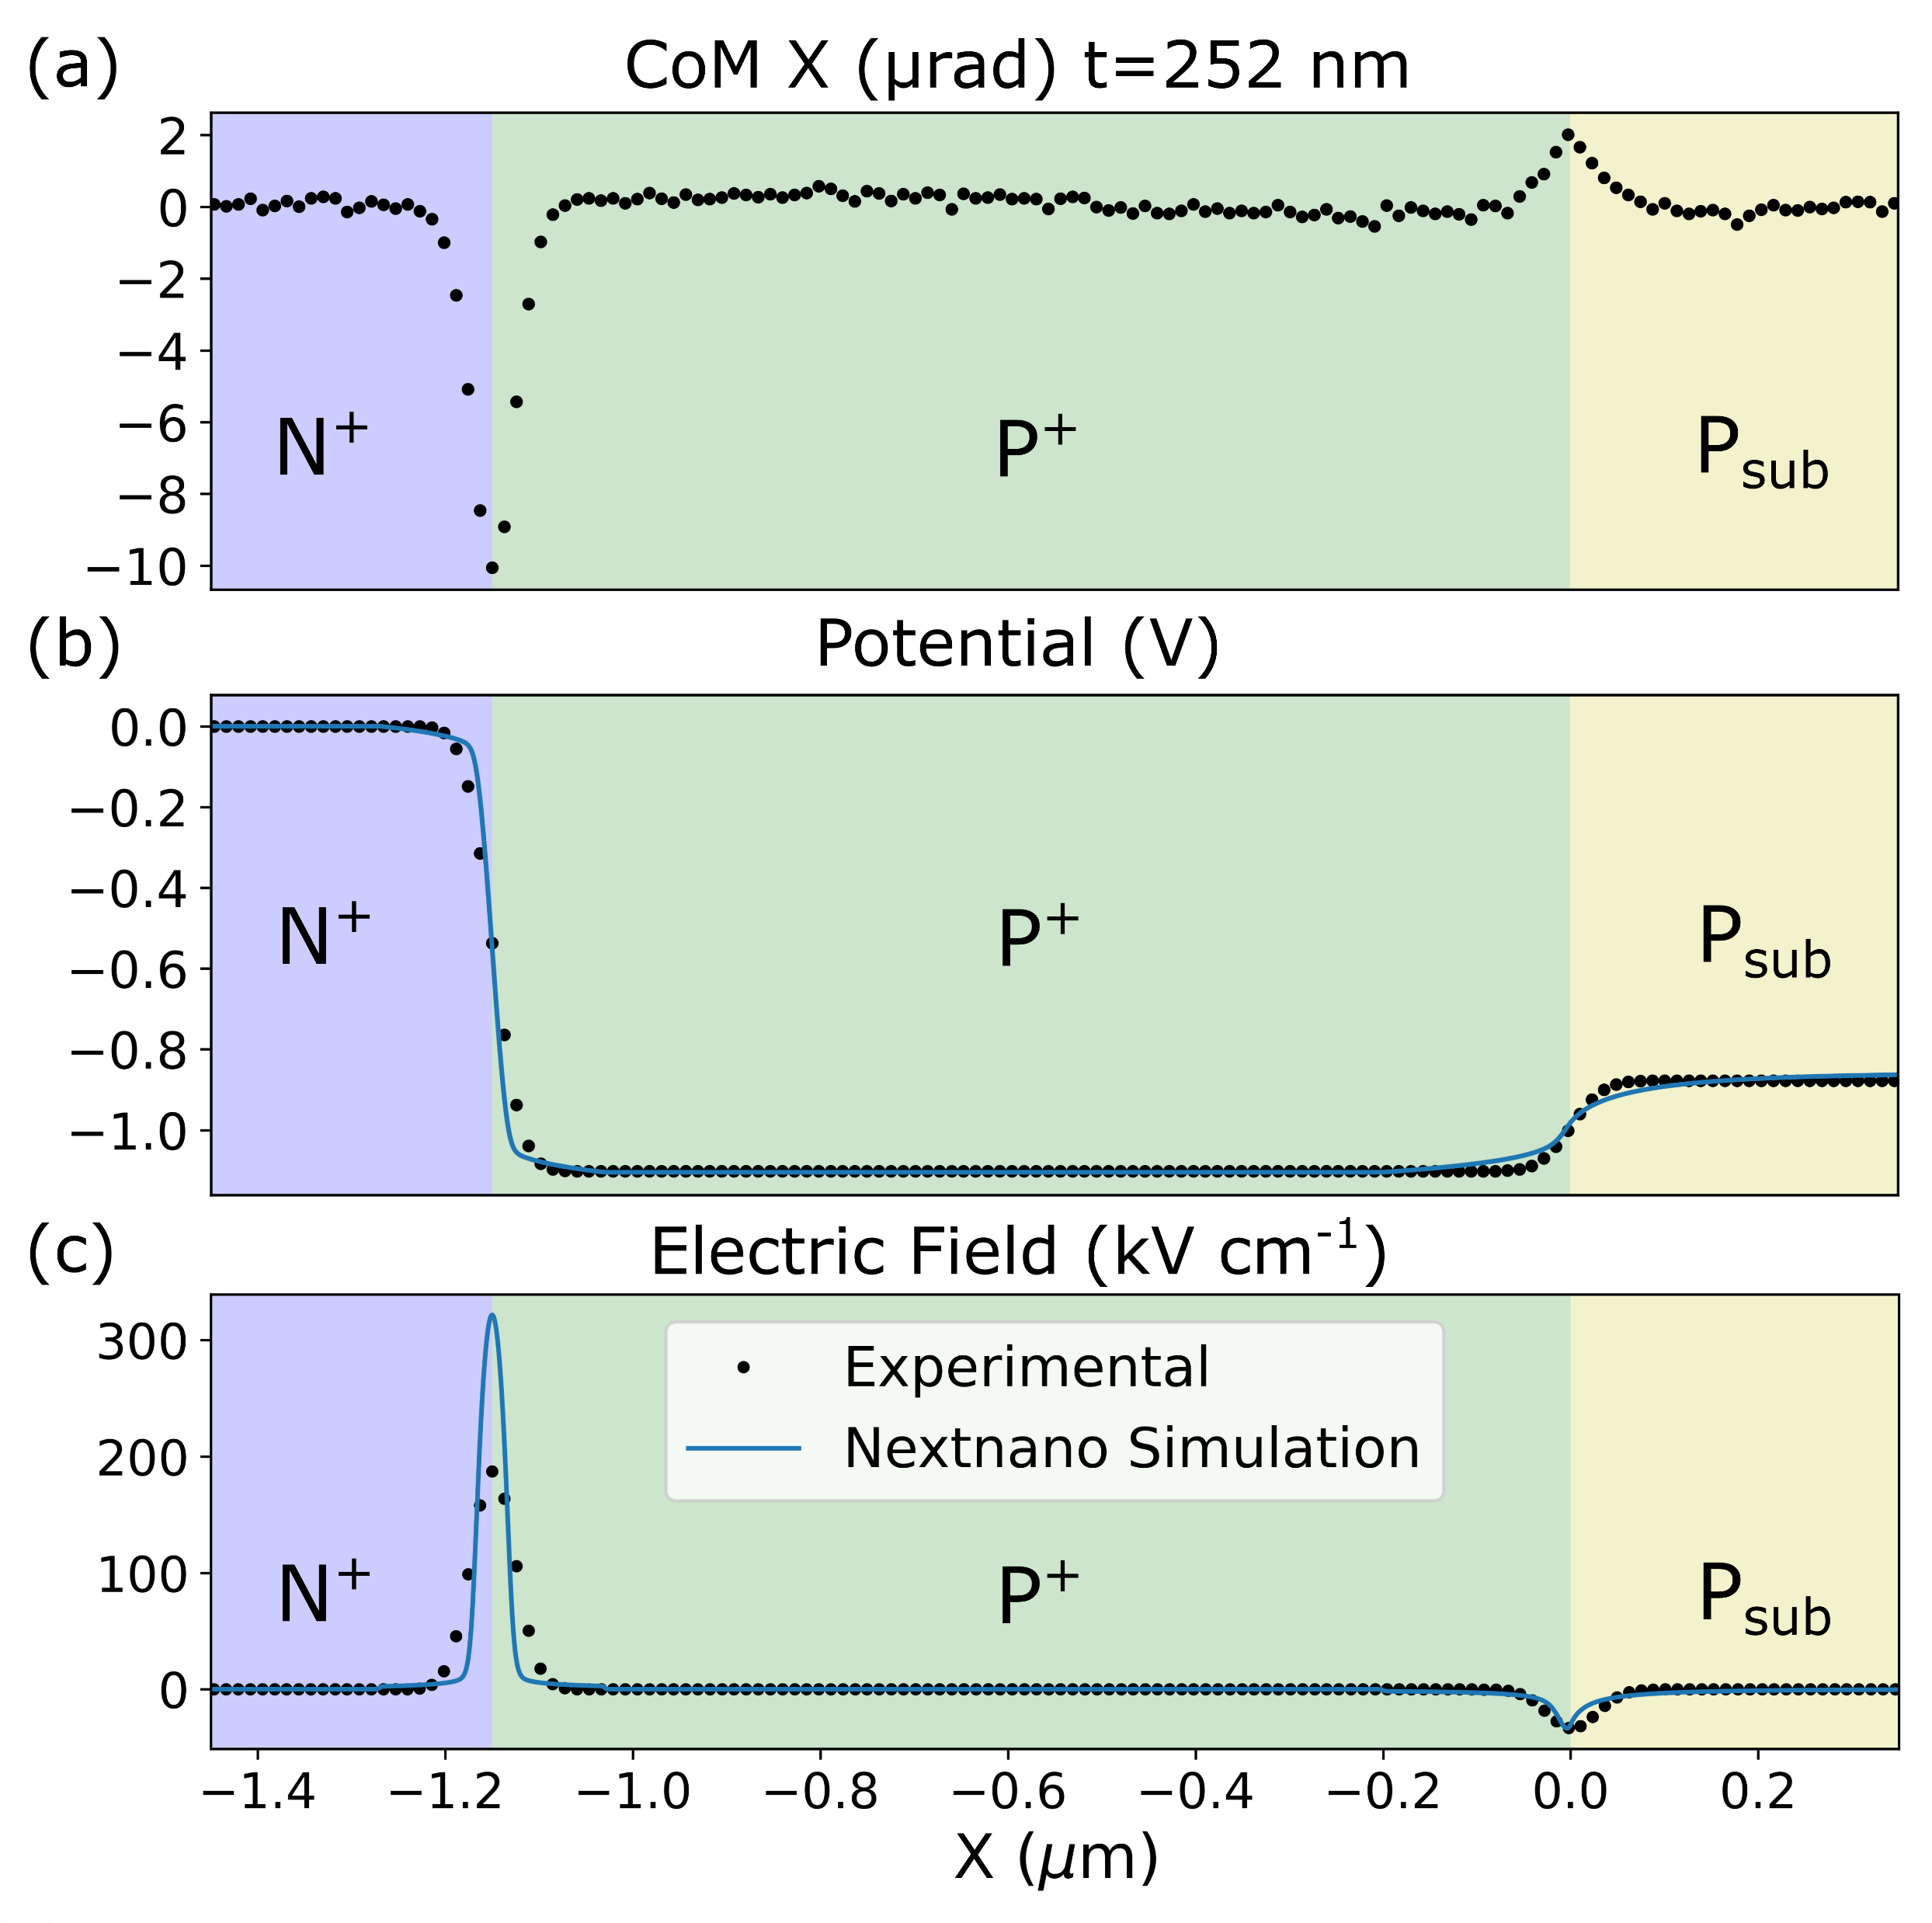
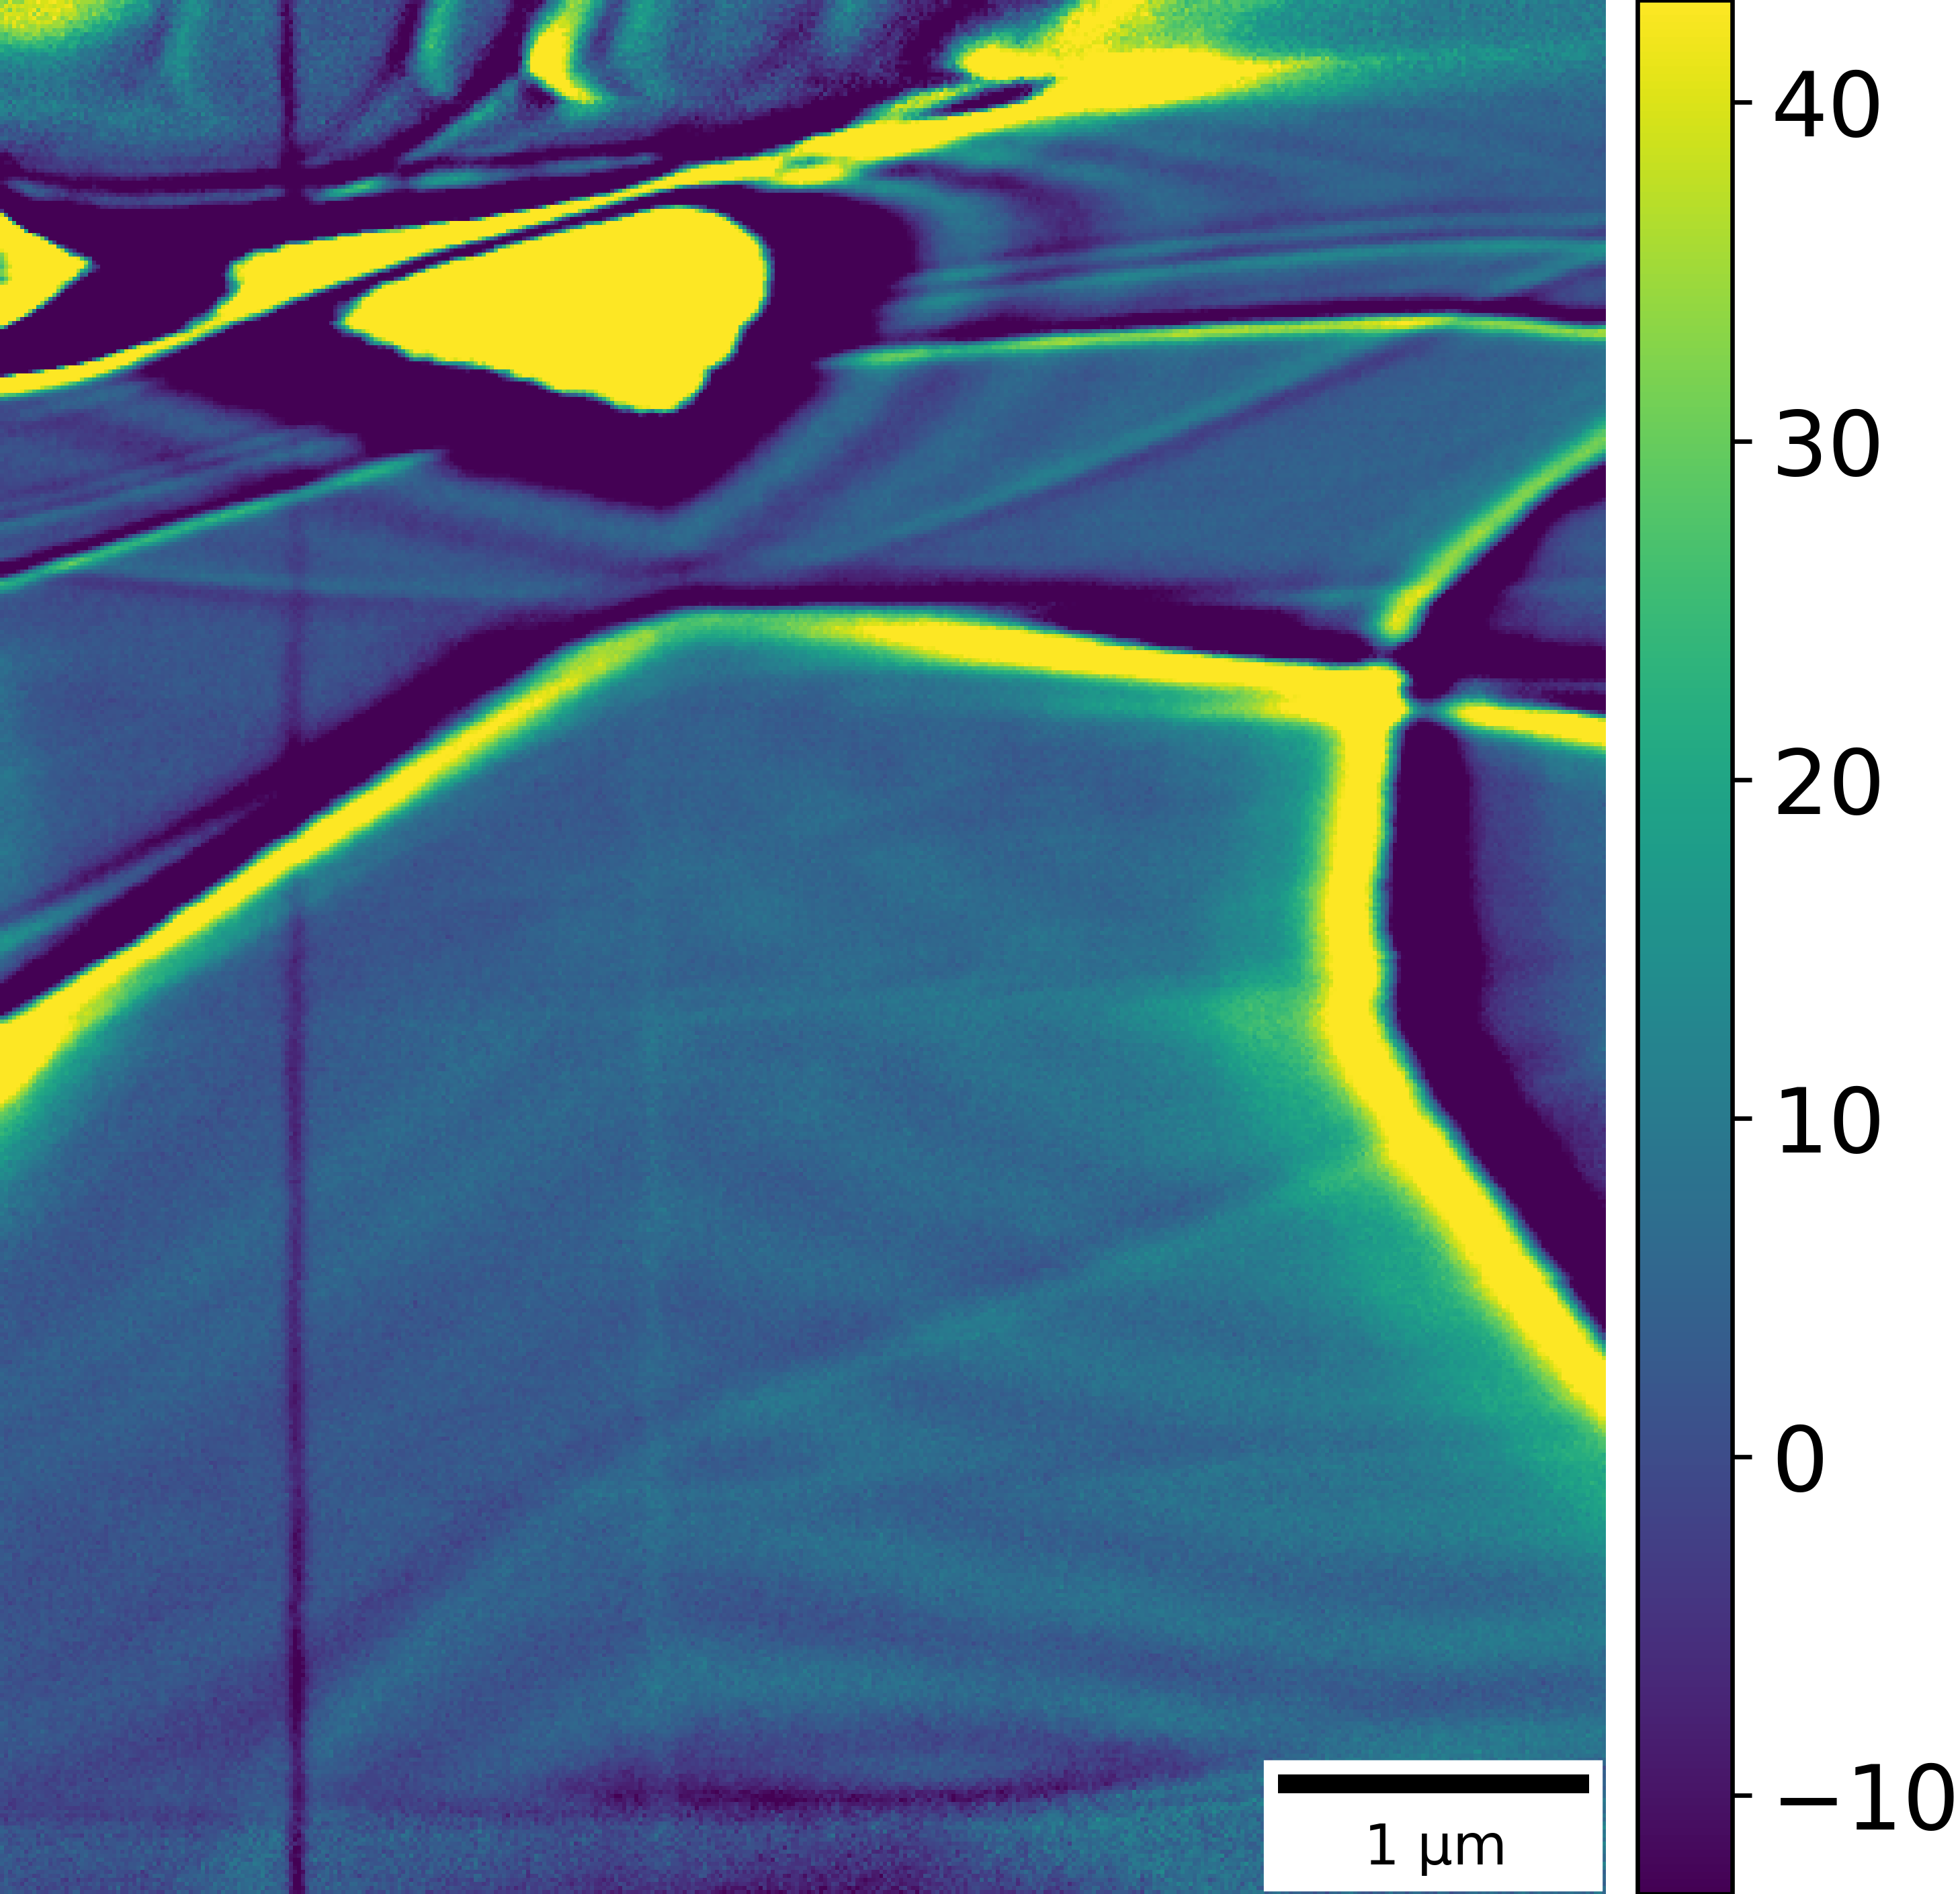
Centre of Mass
CoM X (μrad)

Slide 8




Mapping Electric Fields - Electron Beam Induced Current (EBIC)
1. Electron beam transmits through sample
2. Electron-hole pairs are generated in the sample
3. Electron-hole pairs are separated in the presence of an electric field
4. Collect the generated current
e⁻
e⁻
e⁻
A
$$I_{EBIC}=G\left(r\right) −R(r)$$
e⁻
N-Type
Semiconductor
$$\overset{⃑}{E}$$
P-Type
Semiconductor
$$e^{−}$$
$$h^{+}$$
e⁻
e⁻
e⁻
Notes:
And by closing the circuit at both ends we can collect the generated signal, so one end we connect to our collection apparatus (amplifier + ammeter) and the other end to ground.

Slide 9
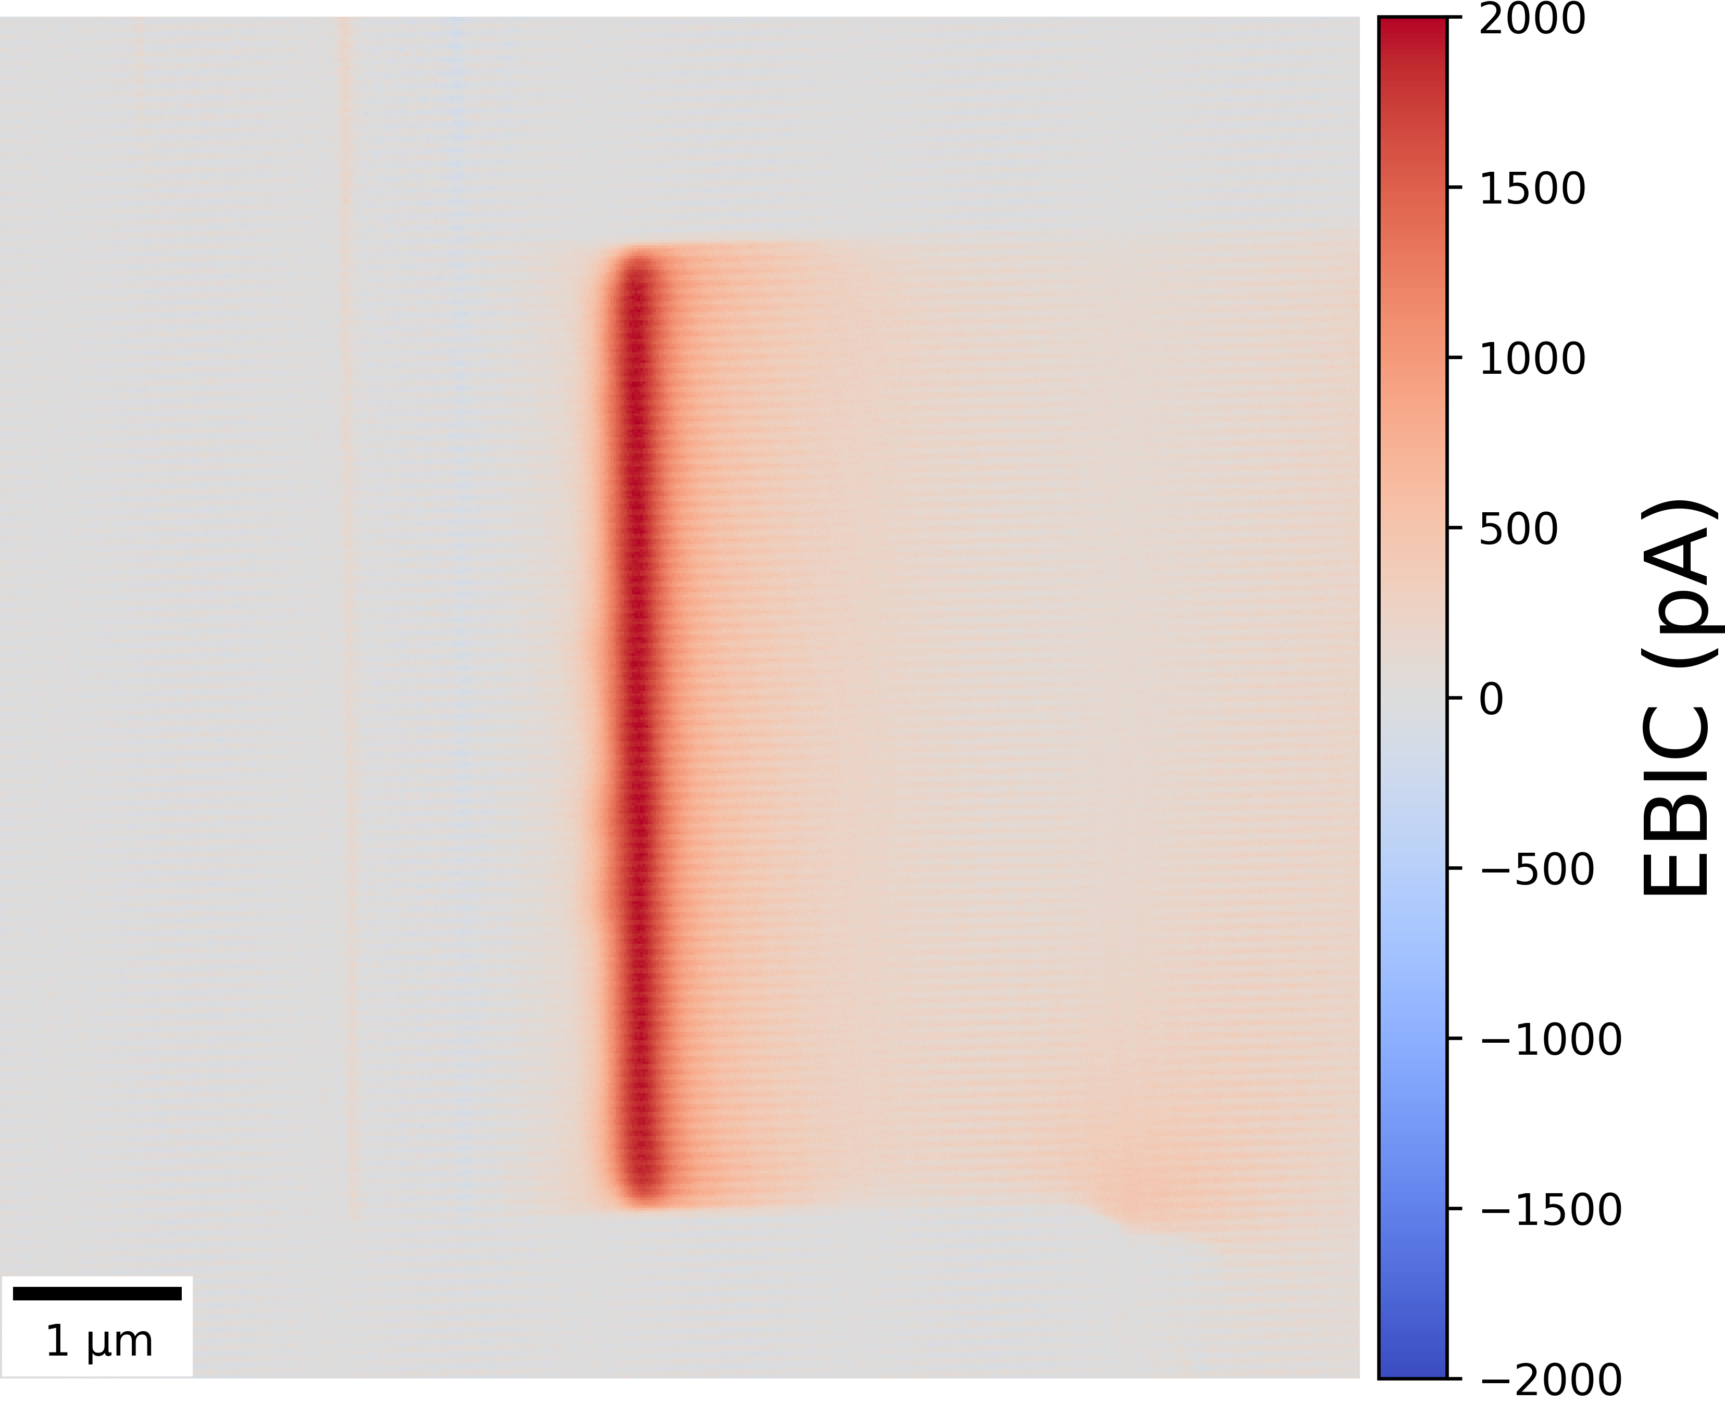
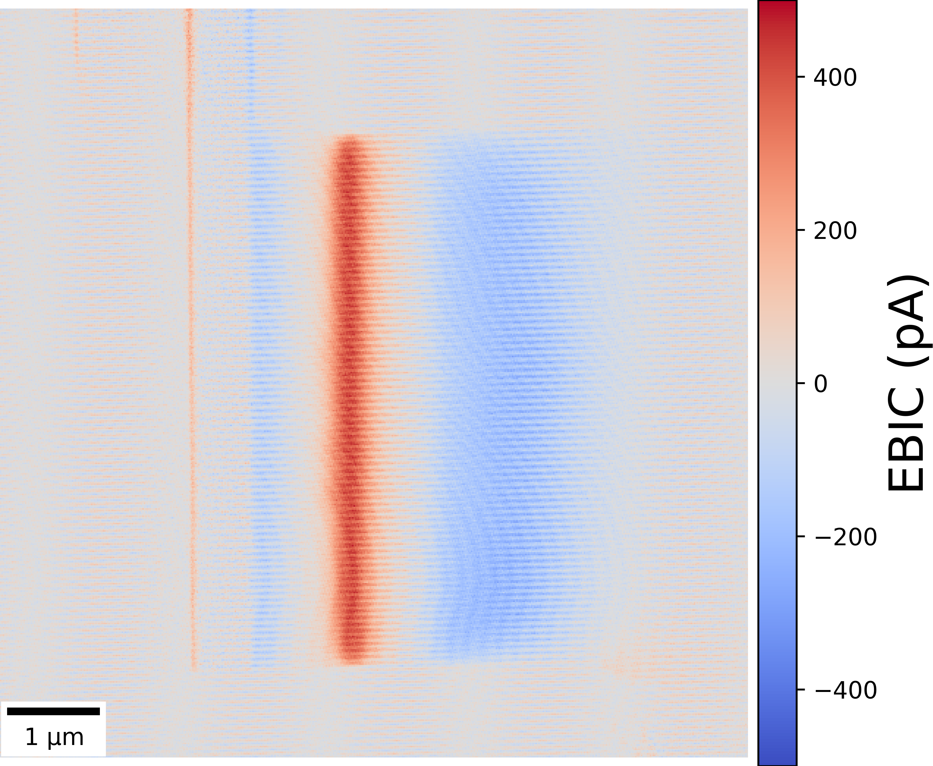
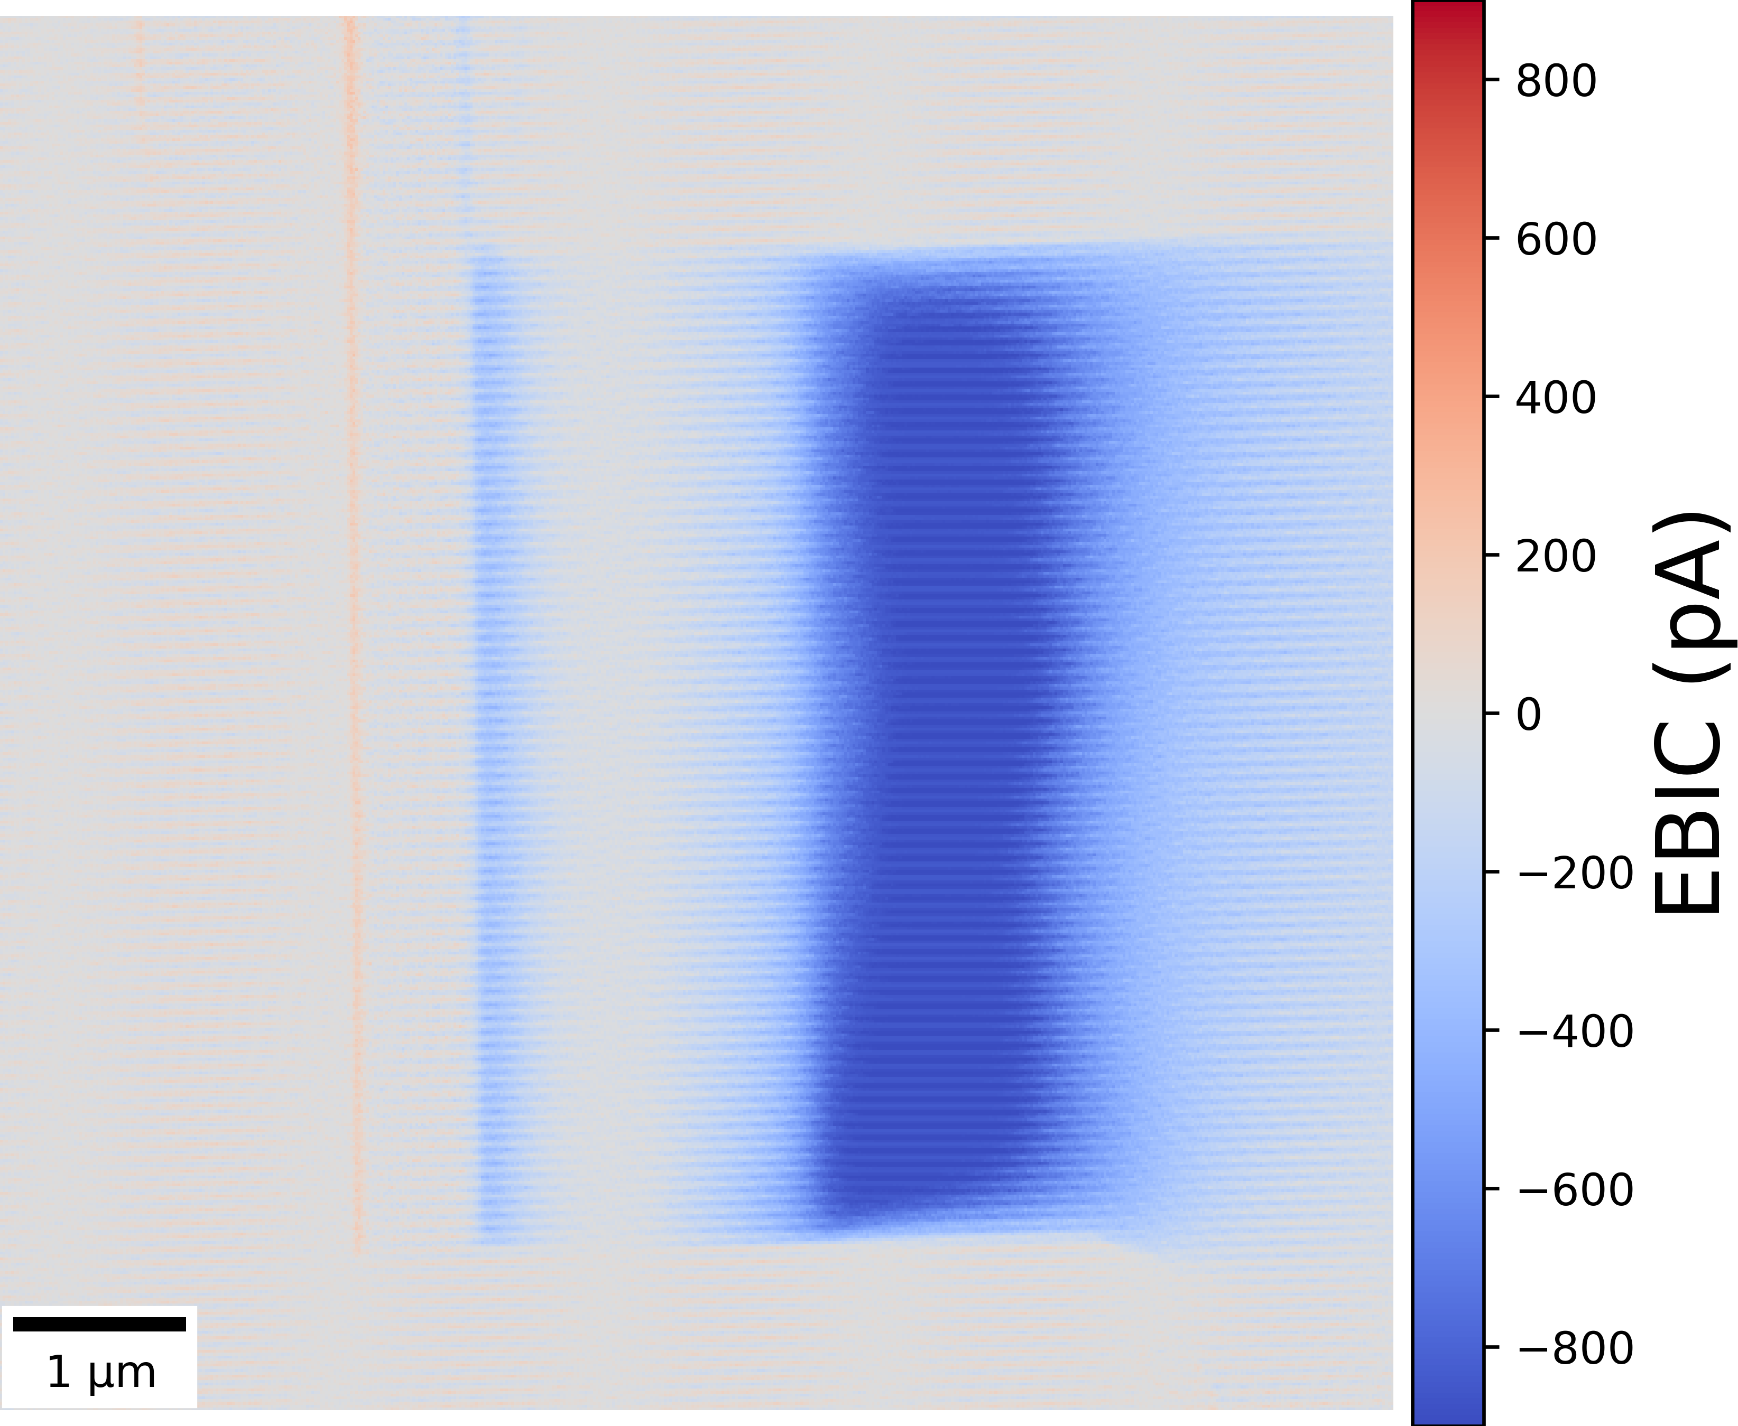
Biasing a Silicon Diode
Reverse Bias -2 V
0 V
Forward Bias +2 V
p-n junction
p⁺/p_{substrate} interface

Slide 10
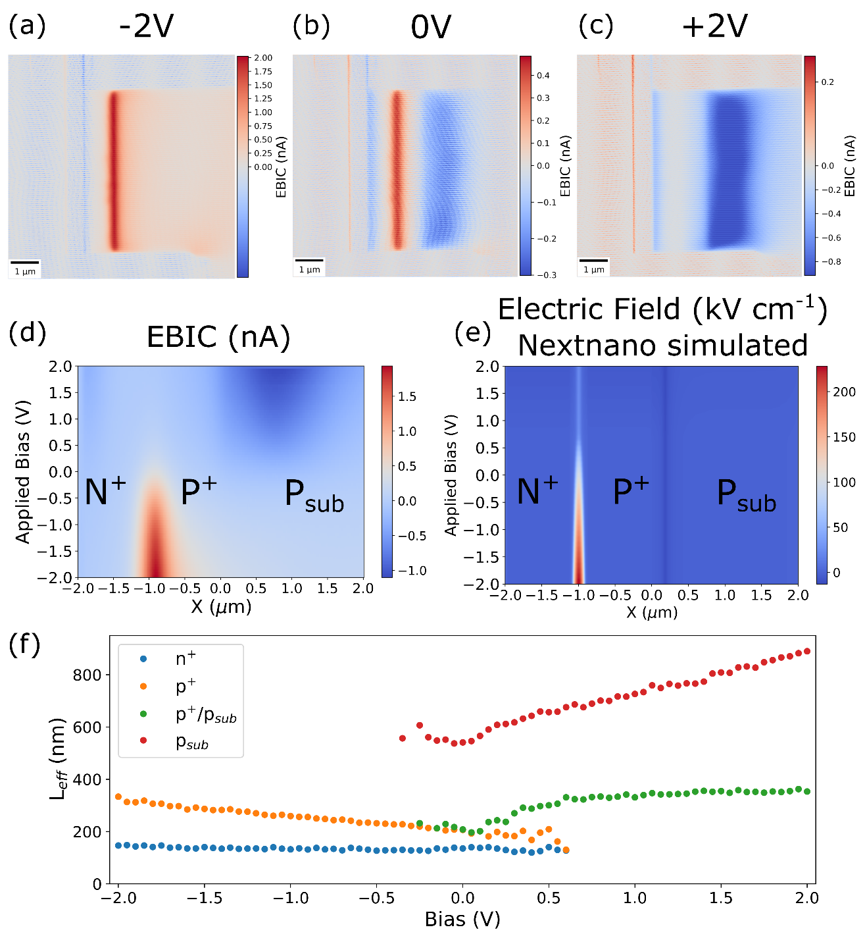
Biasing a Silicon Diode

Slide 11
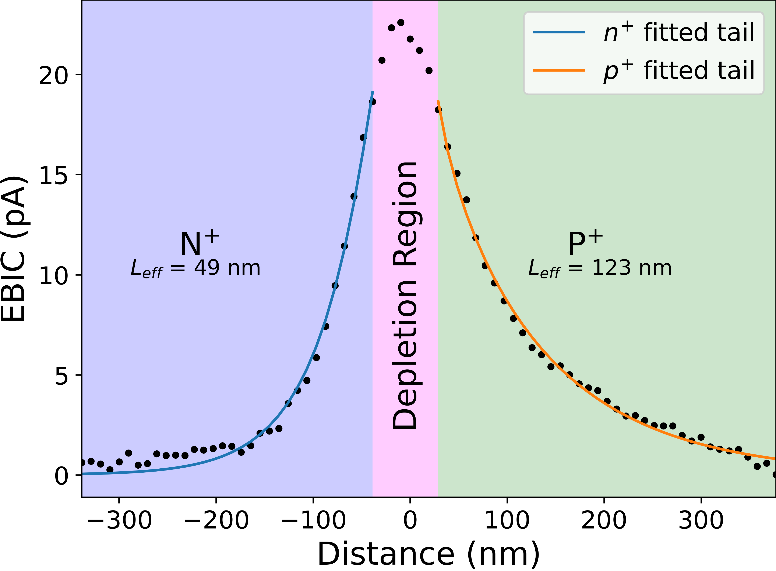
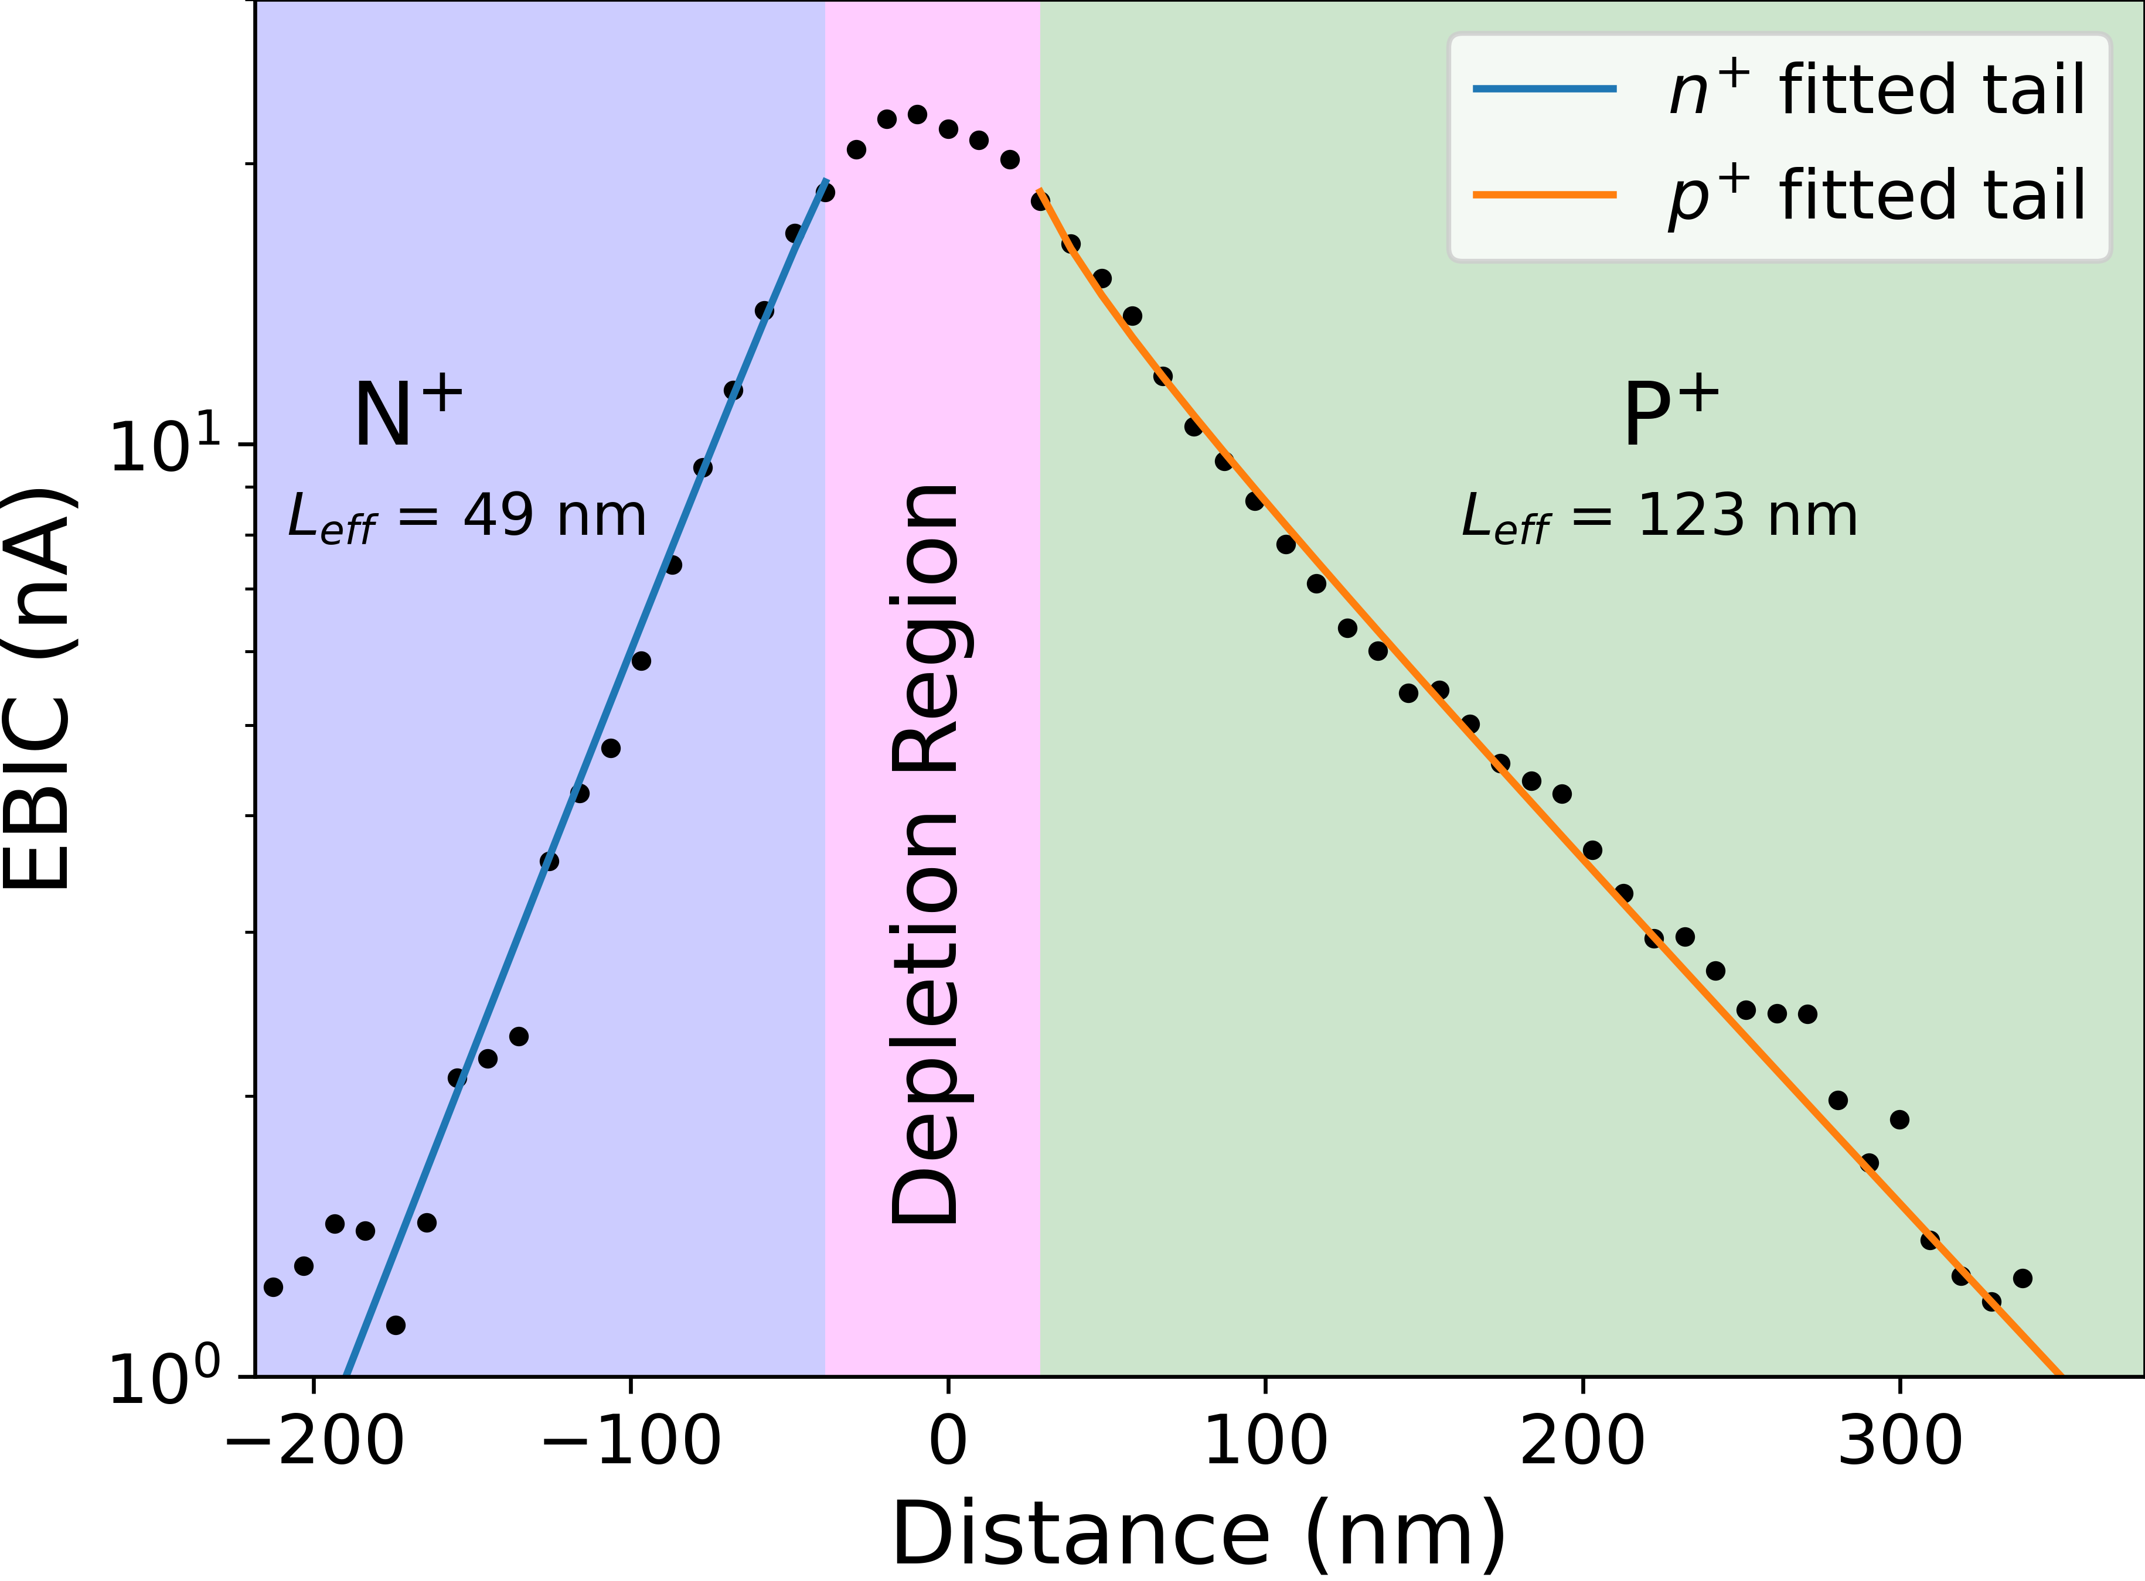
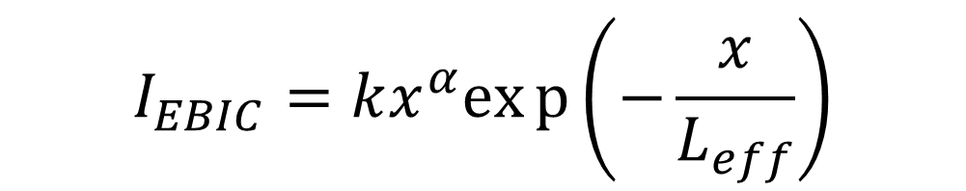
EBIC Measuring Diffusion Length
$$I_{EBIC}=kx^{α}exp\left(−\frac{x}{L_{eff}}\right)$$

Slide 12
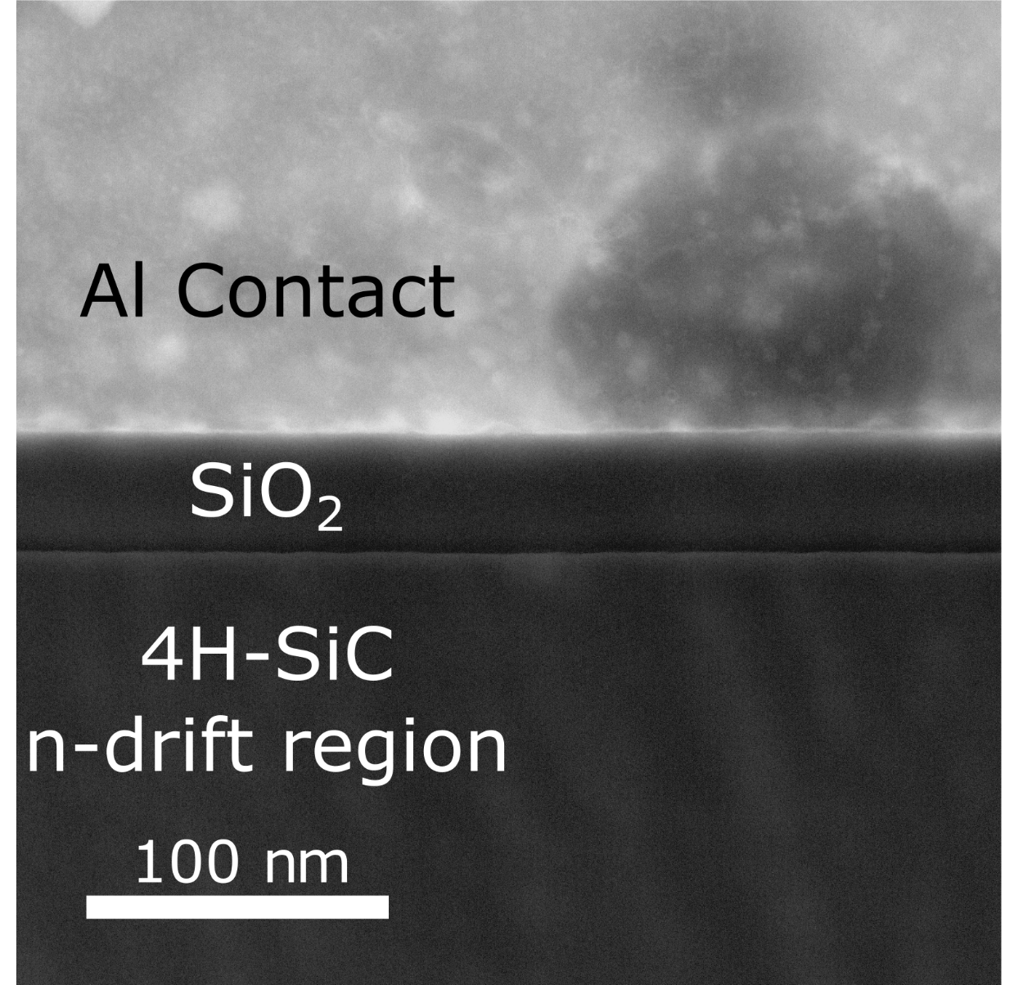
4H-SiC Metal-Oxide-Semiconductor Capacitor (MOSCAP)

Slide 13
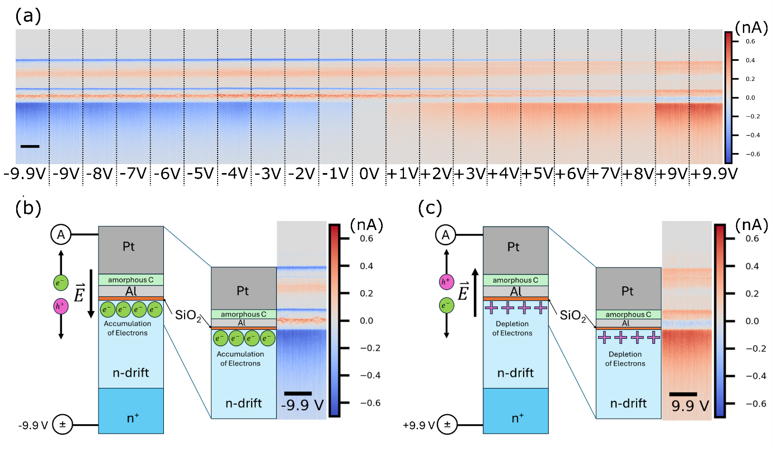

Slide 14





Thank You
Supervisors:
Ana M. Sanchez
Richard Beanland
Merlin Direct Detector, Point Electronic EBIC System, and Dr. Moynihan’s Postdoctoral Research are all funded by EPSRC grant EP/V028596/1
Si diode sample provided by
David Cooper CEA LETI
PhD Student:
Yining Xie
4H-SiC MOSCAP sample provided by
Peter Gammon & Arne (Ben) Renz
Special Thanks to the University of Warwick Electron Microscopy Research Technology Platform (EM-RTP)

Slide 15
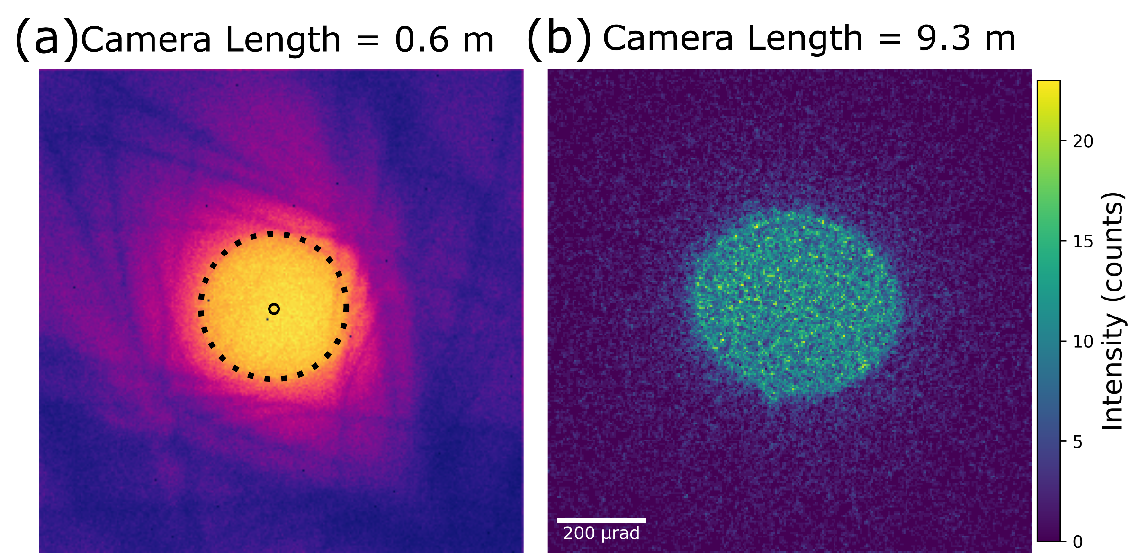

Mapping the Electric Field – 4D-STEM

Slide 17
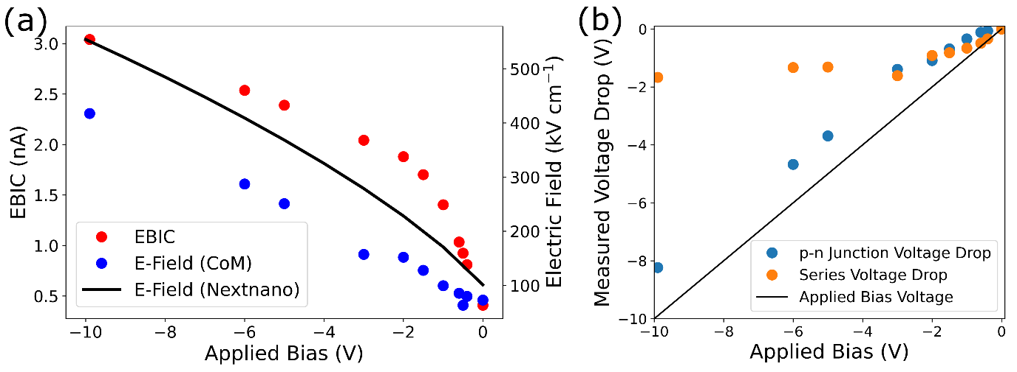
Biased 4D-STEM & EBIC in Reverse Bias

