Slide 1
Accessing conventional synthetic polymers at the atomic level
Dr Evelina Liarou
Department of Chemistry
University of Warwick

Slide 2
Accessing conventional synthetic polymers at the atomic level
Polymer Chemists and Atomic Resolution
Dr Evelina Liarou
Department of Chemistry
University of Warwick

Slide 3
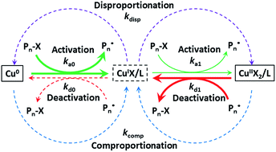
Synthetic Macromolecular Chemistry – Overview
The Mechanism

Slide 4
Synthetic Macromolecular Chemistry – Overview
The Mechanism
The Synthesis

Slide 5
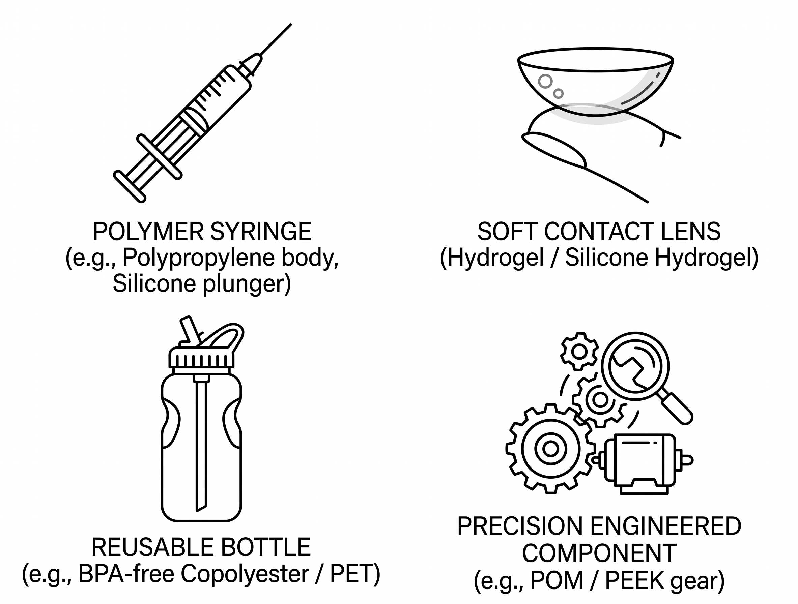
Synthetic Macromolecular Chemistry – Overview
The Mechanism
The Synthesis
The Application

Slide 6
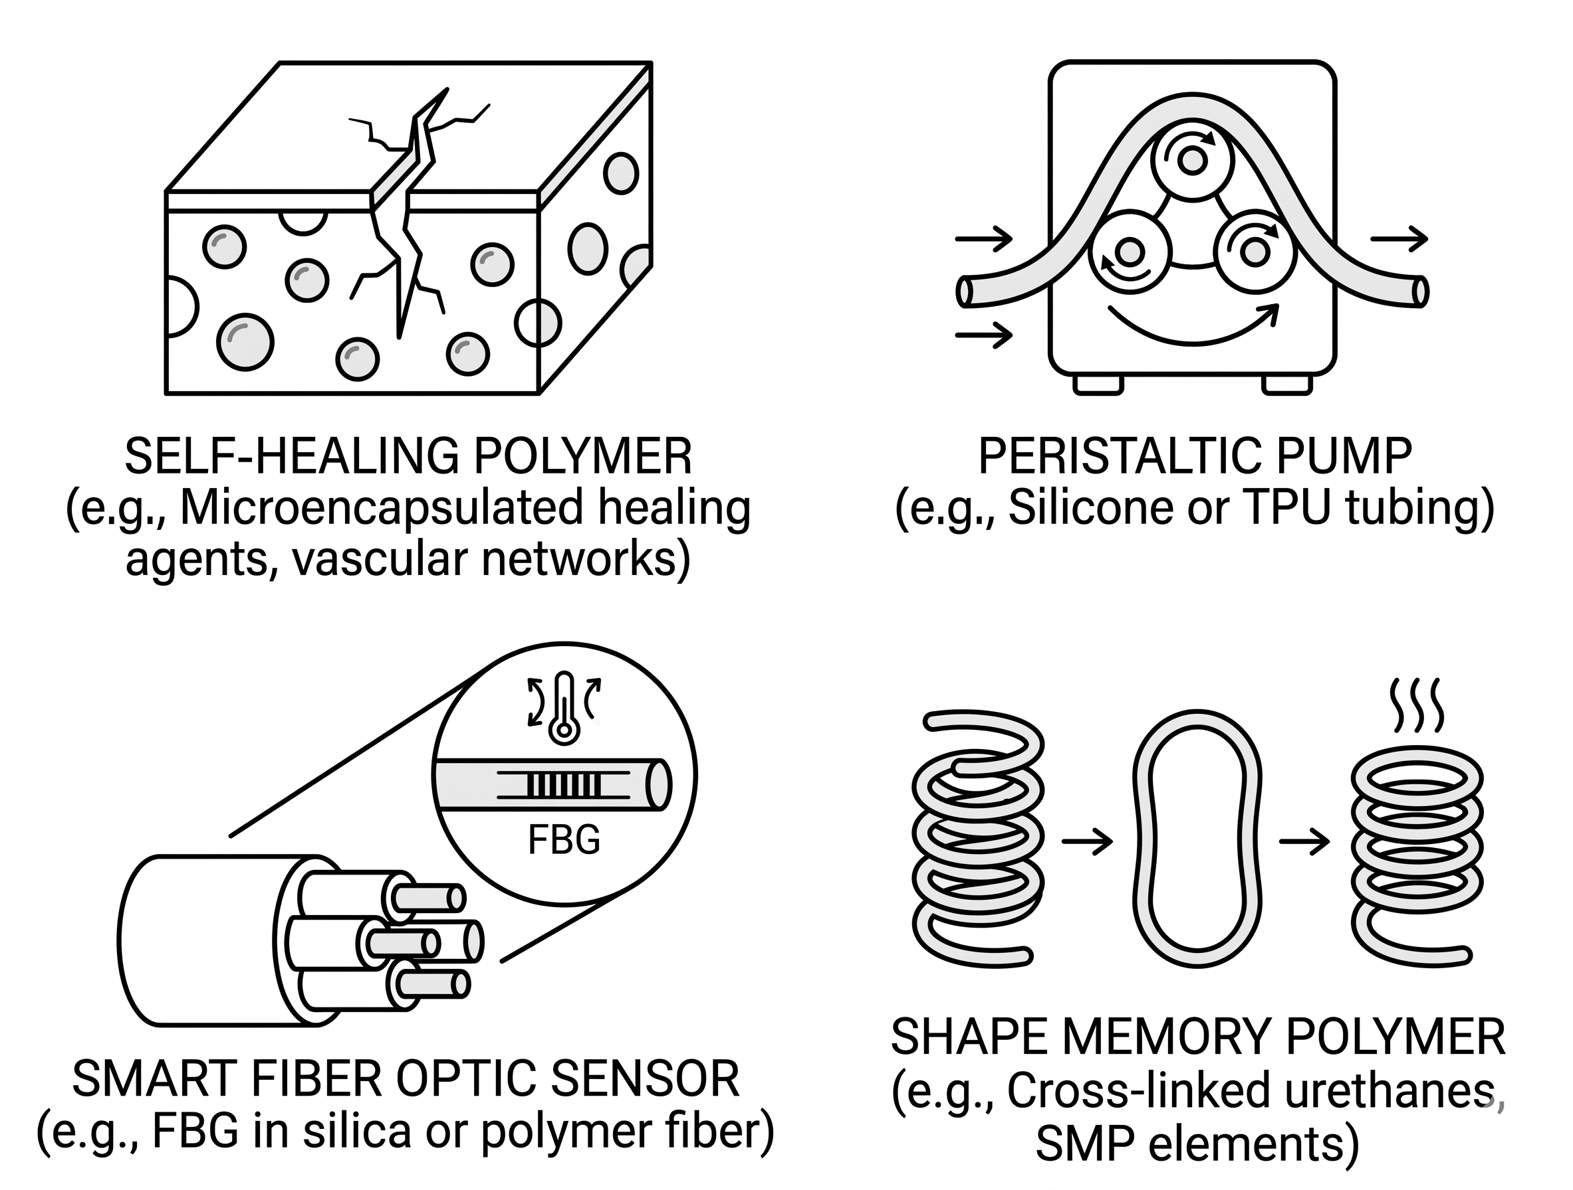
Synthetic Macromolecular Chemistry – Overview
The Mechanism
The Synthesis
The Application

Slide 7
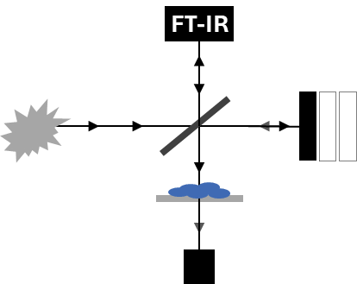
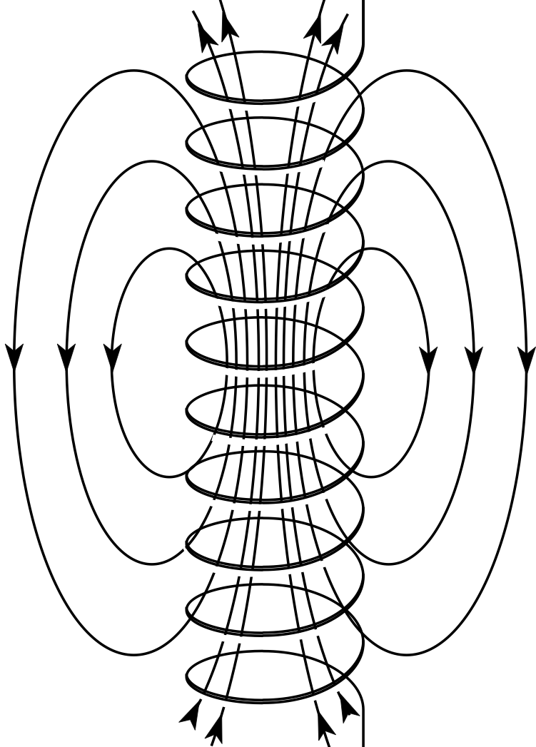

Synthetic Macromolecular Chemistry – Analysis
Established polymer characterization
MALDI
SEC
-
-
-
+
-
Average molecular weight
&
Average Ð
Low molecular weights
&
Linear polymers
NMR
Low molecular weights
&
Average functionalization
Qualitative functionality

Slide 8

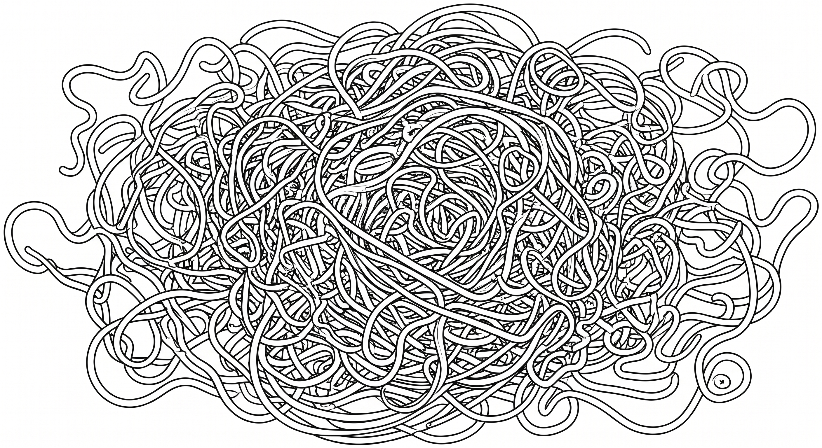
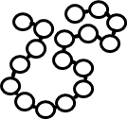
The resolution gap
Precise Synthesis/Sequence Defined Polymers
Atomic Level Polymer Imaging (?)

Slide 9
Common synthetic polymers: towards the atomic level
Step 1: Overcoming the polymer composition

Slide 10
Common synthetic polymers: towards the atomic level
Step 1: Overcoming the polymer composition– make it visible
Wilson et al., J. Am. Chem. Soc. 2015 137 (12), 4215-4222

Slide 11
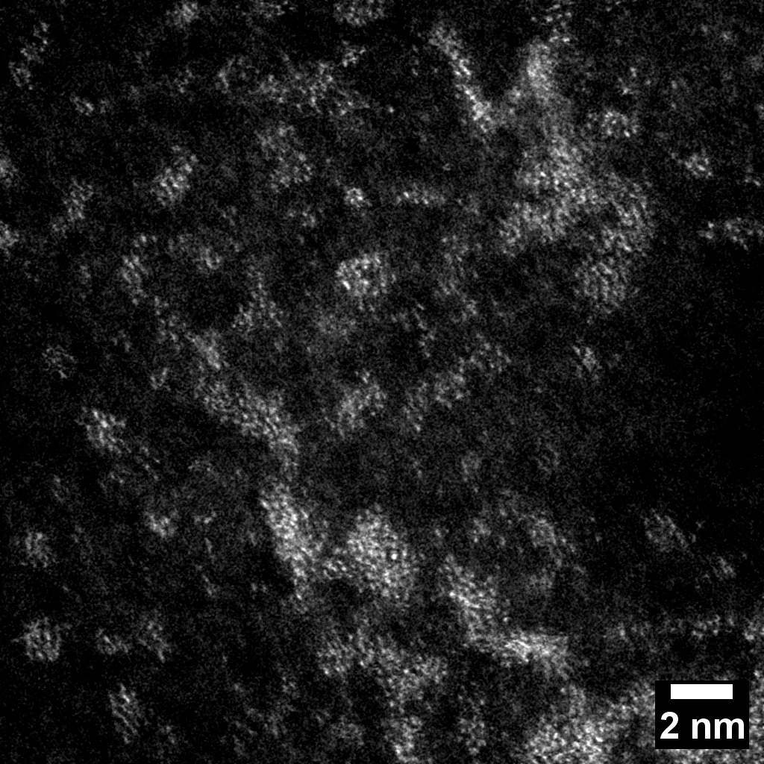
Common synthetic polymers: towards the atomic level
Step 2: ADF-STEM – image it
8 MX magnification – 0.5 mg/mL

Slide 12
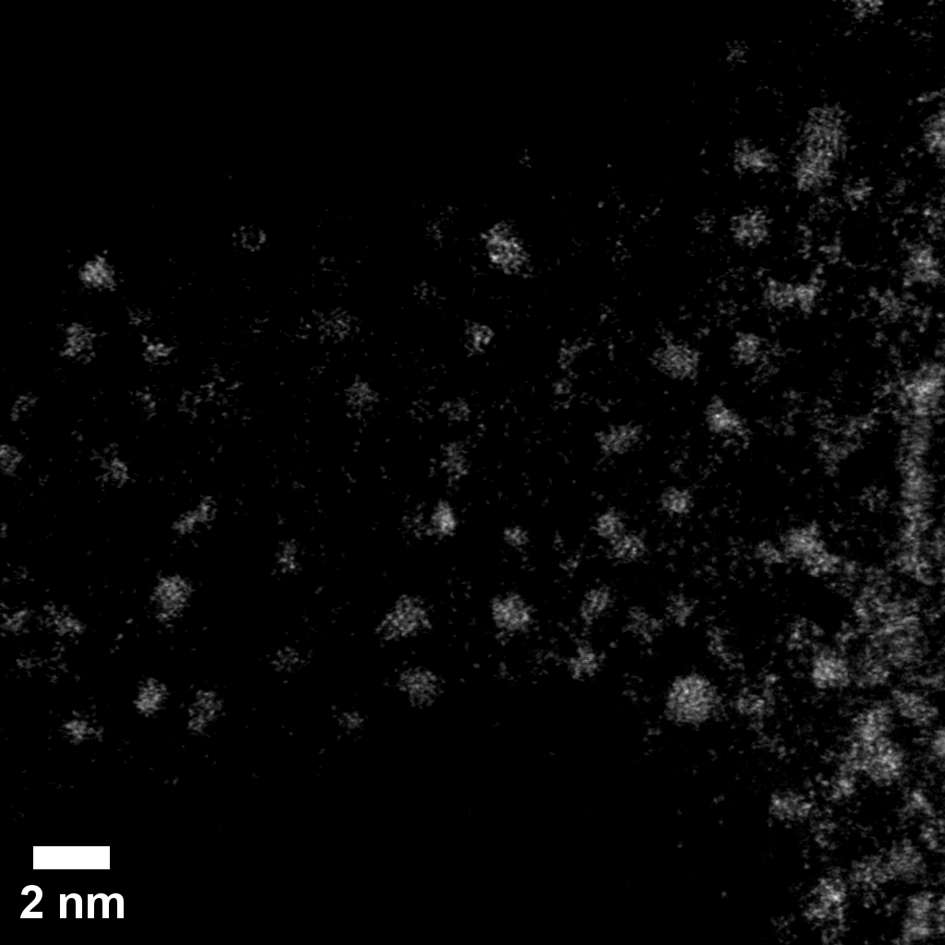
Common synthetic polymers: towards the atomic level
Step 2: ADF-STEM – image it
Step 3: Optimization
8 MX magnification – 0.5 mg/mL
8 MX magnification – 10 μg·mL⁻¹

Slide 13
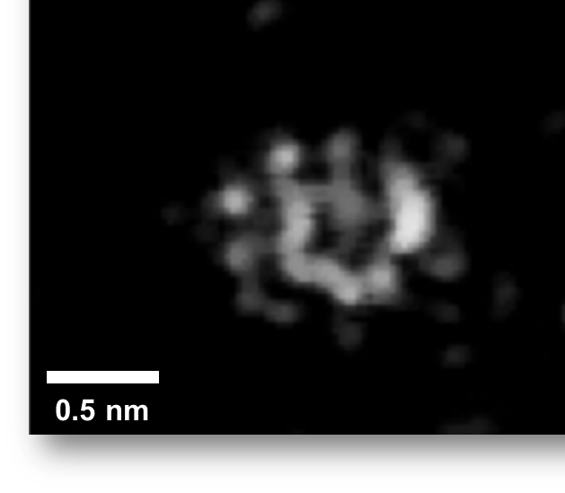
Common synthetic polymers: towards the atomic level
Step 2: ADF-STEM – image it
Step 3: Optimization
Step 4: SPC imaging
8 MX magnification – 0.5 mg/mL
8 MX magnification – 10 μg·mL⁻¹

Slide 14
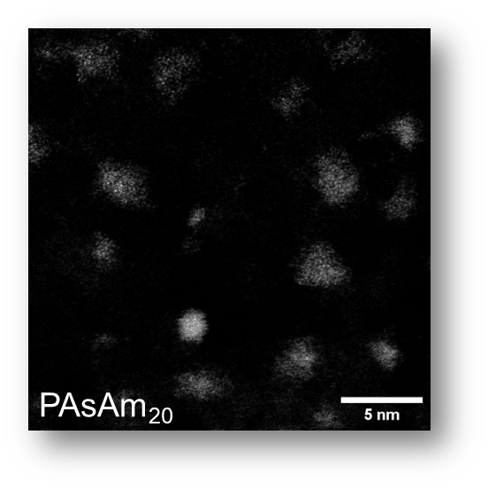
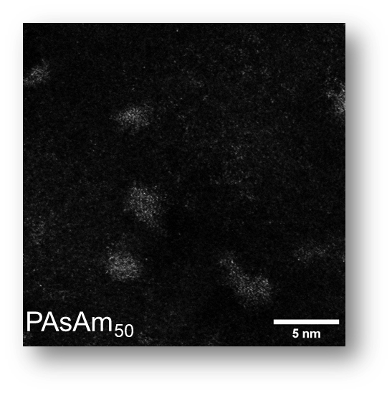
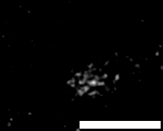
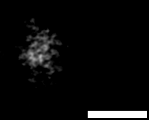
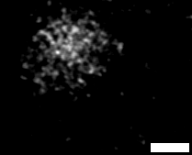
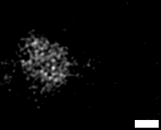
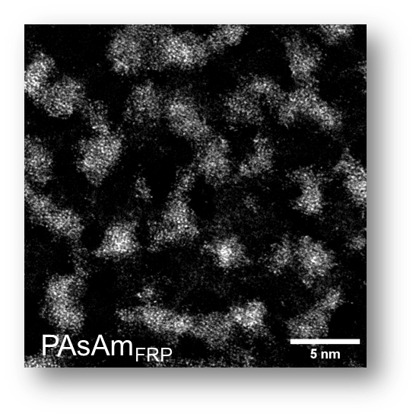
Common synthetic polymers: towards the atomic level
Polymer | M_{n,SEC} | DP_{n,SEC} | M_{w,SEC} | Ð | MW_{,DOSY} | DP_{n,DOSY} | M_{n,STEM} | DP_{n,STEM} | Ð_{STEM}
PAsAm₁₀ | 5,700 | 21 | 6,300 | 1.10 | 2,500 | 9 | 2,300 | 8 | 1.30
PAsAm₂₀ | 7,900 | 29 | 8,700 | 1.10 | 6,900 | 25 | 7,500 | 28 | 1.20
PAsAm₅₀ | 12,100 | 45 | 13,900 | 1.15 | 9,600 | 35 | 11,000 | 40 | 1.10
PAsAm_{FRP} | 218,000 | 804 | 509,000 | 2.30 | 101,700 | 375 | 113,000 | 417 | 1.60
Liarou. E.*, et al., J. Am. Chem. Soc. 2024 146 (50), 34292-34297

Slide 15
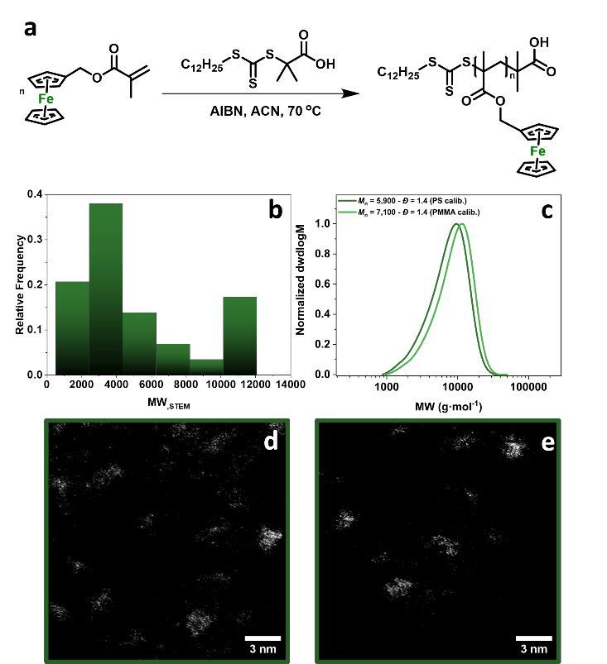
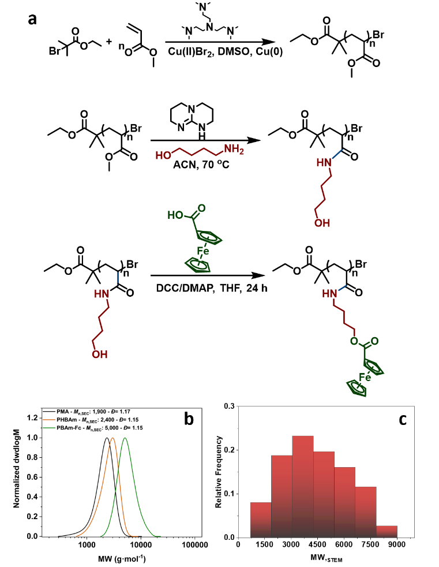
Common synthetic polymers: towards the atomic level
Other elements
Commodity polymers
Liarou. E.*, et al., J. Am. Chem. Soc. 2024 146 (50), 34292-34297

Slide 16
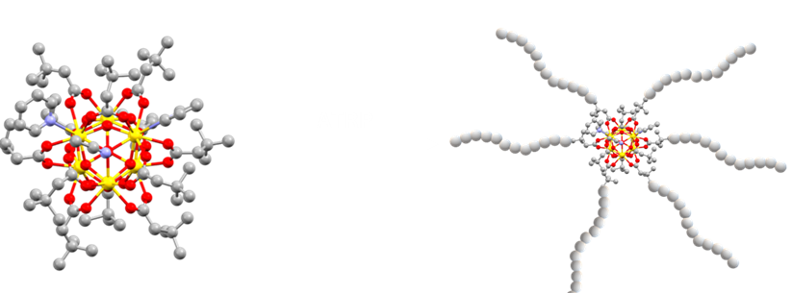
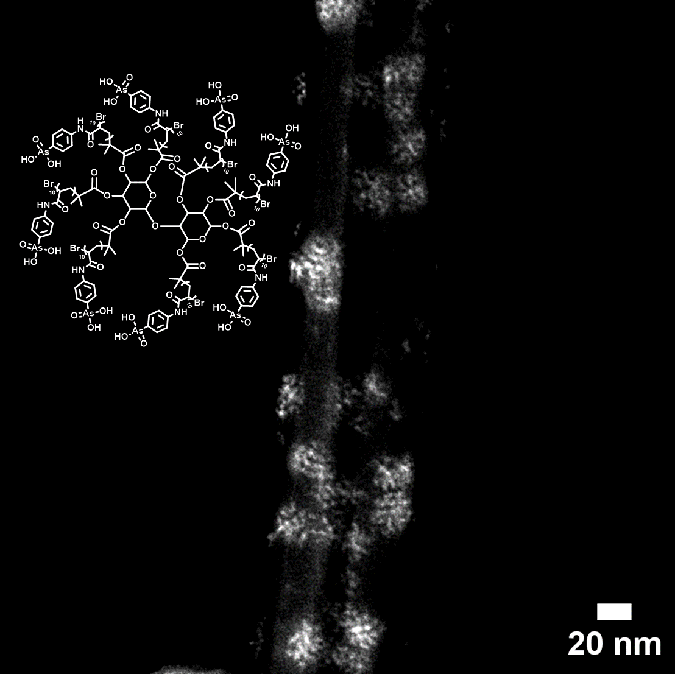
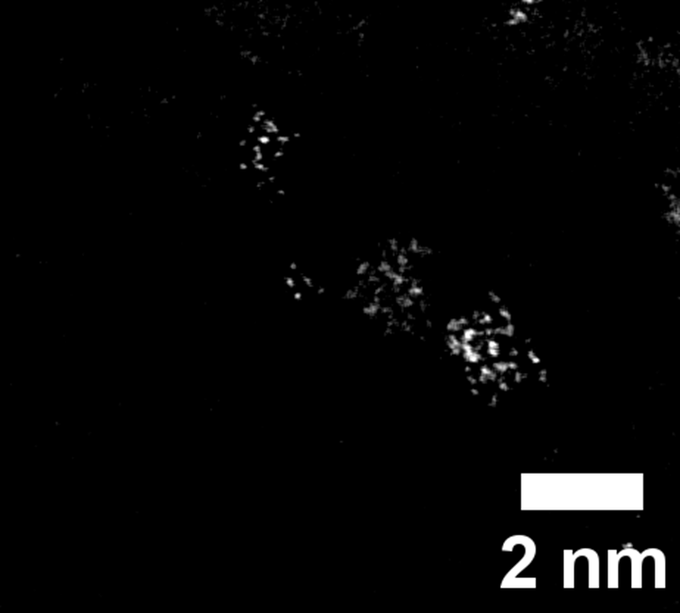
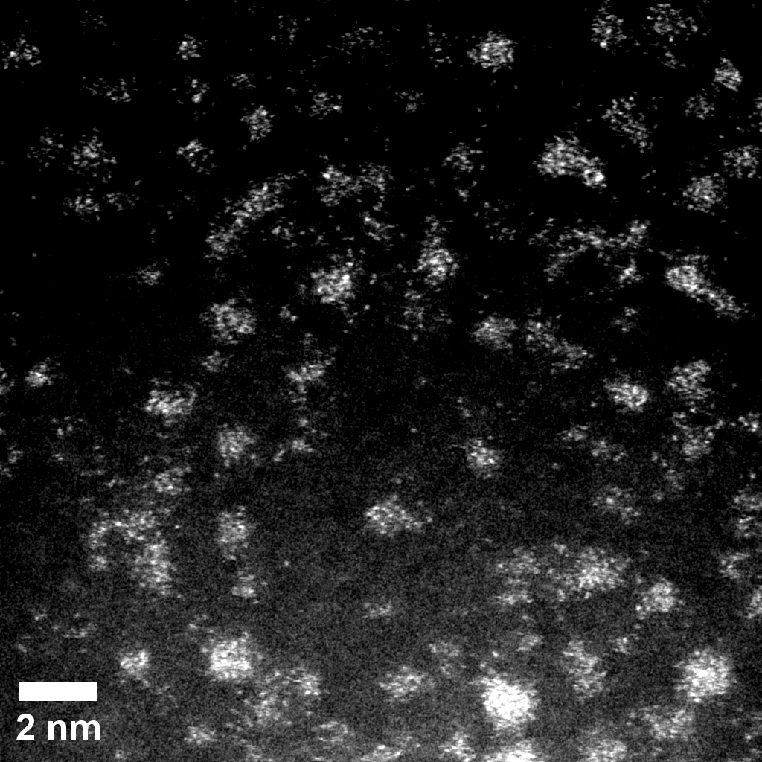
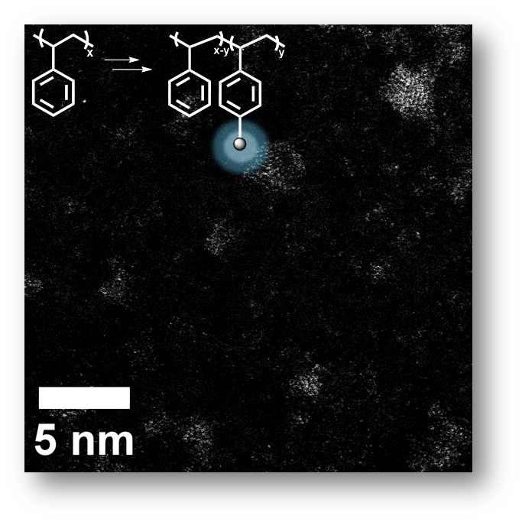
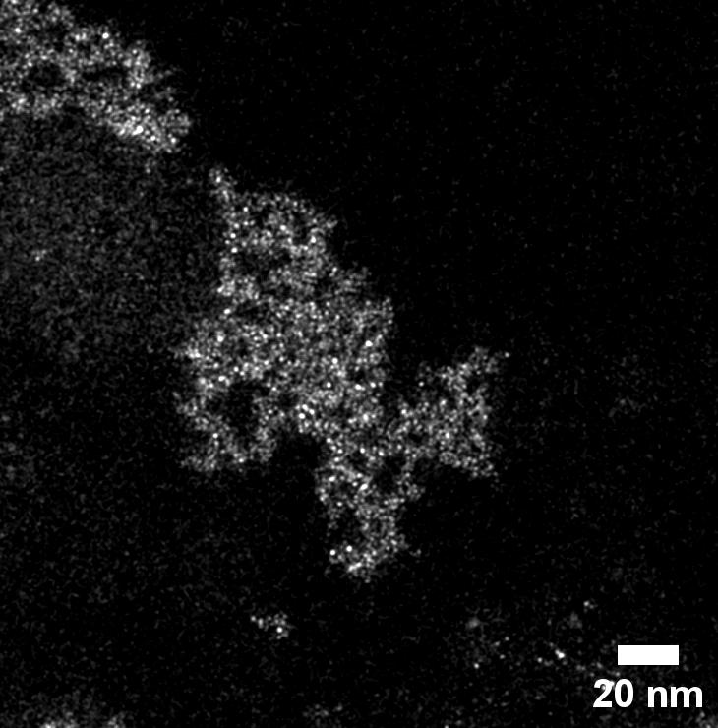
Common synthetic polymers: towards the atomic level
Macromolecular Architectures
M-Oxo Polymers
Organometallic Polymers
Commodity Polymers
UHMW Polymers^{[1]}
*Manuscript in preparation
^{[1]}Ratajczyk, M.; Liarou, E.* et al., Macromol. Chem. Phys. 2026, 227 (3), e00492.

Slide 17
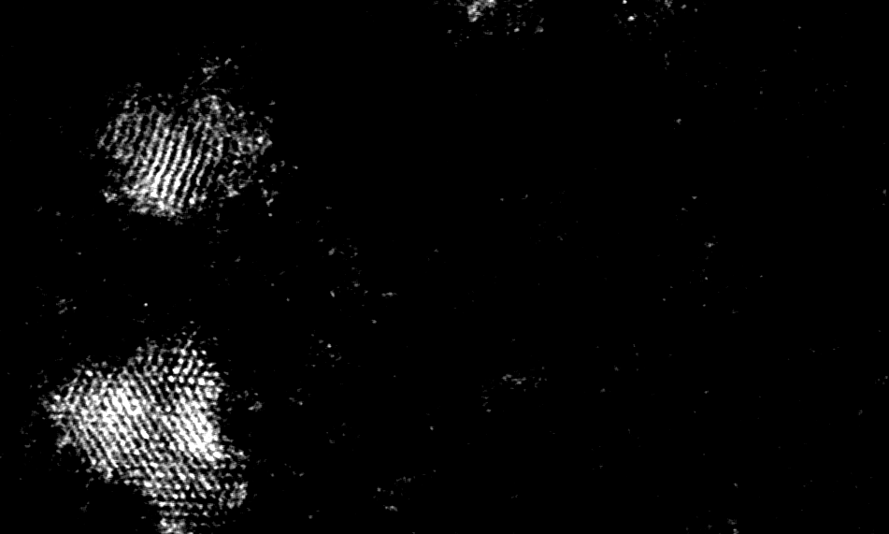
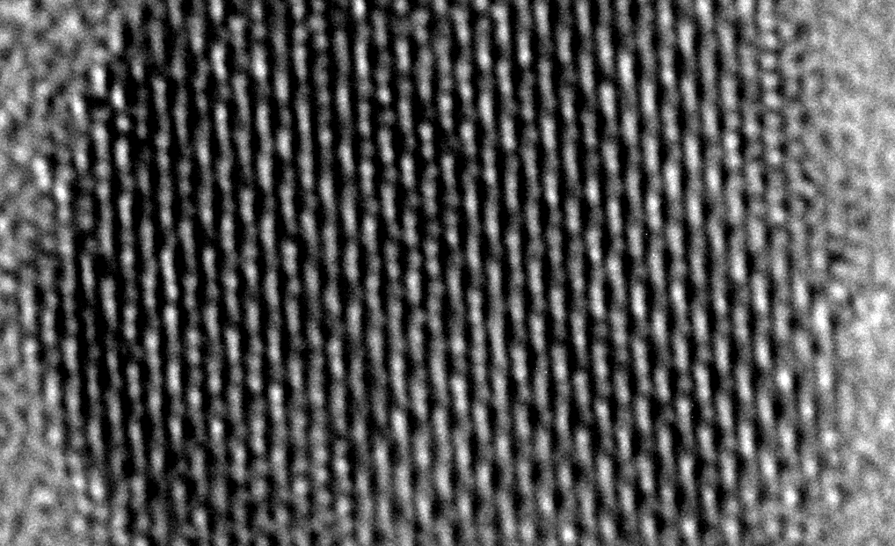
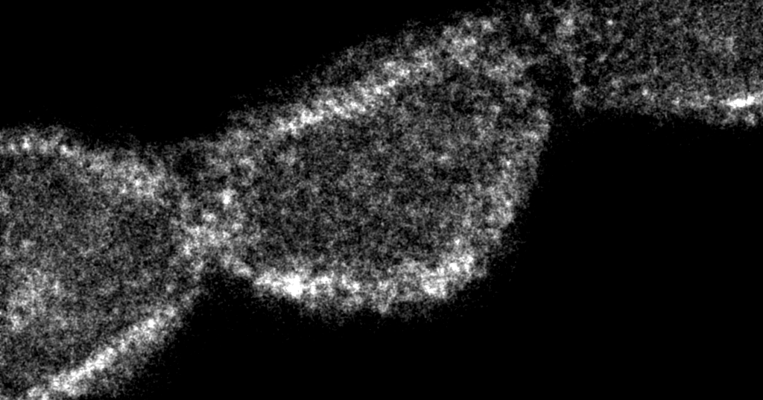
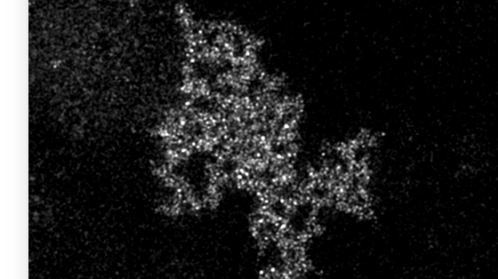
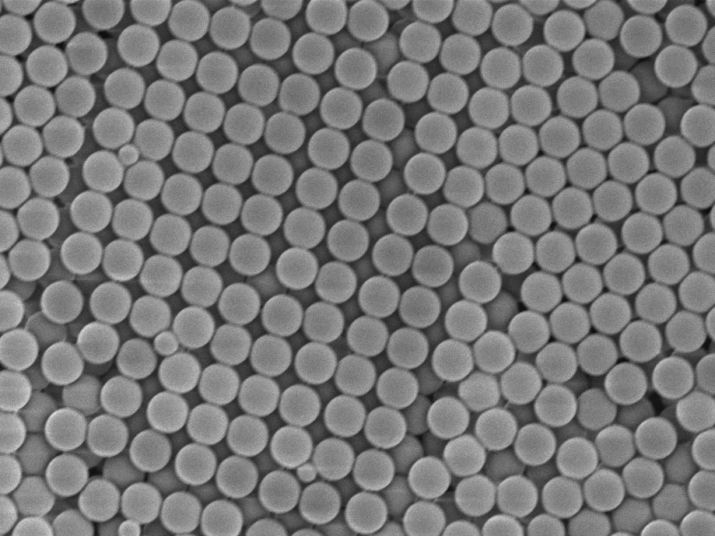
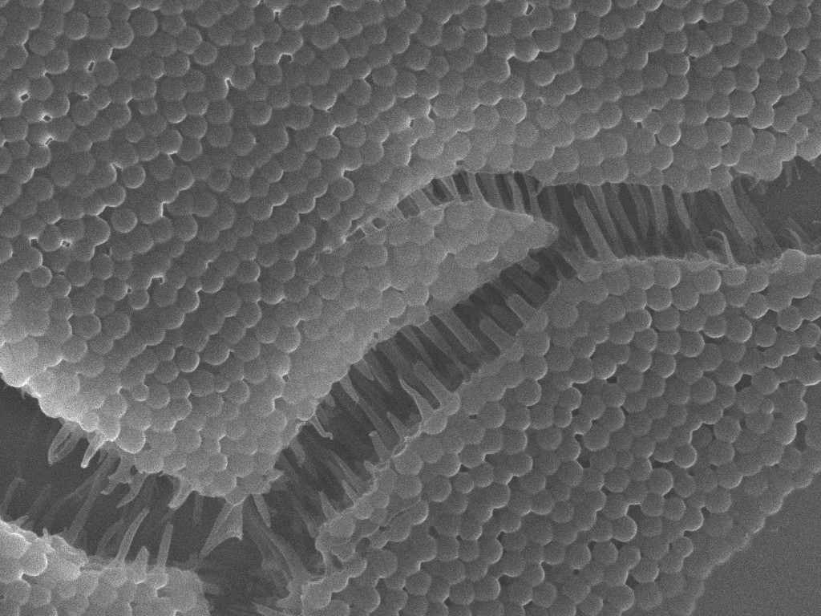
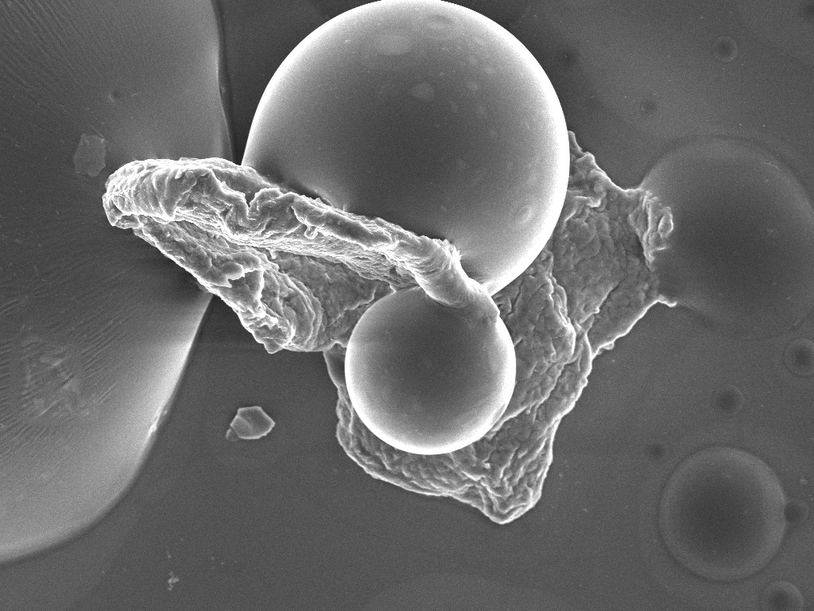
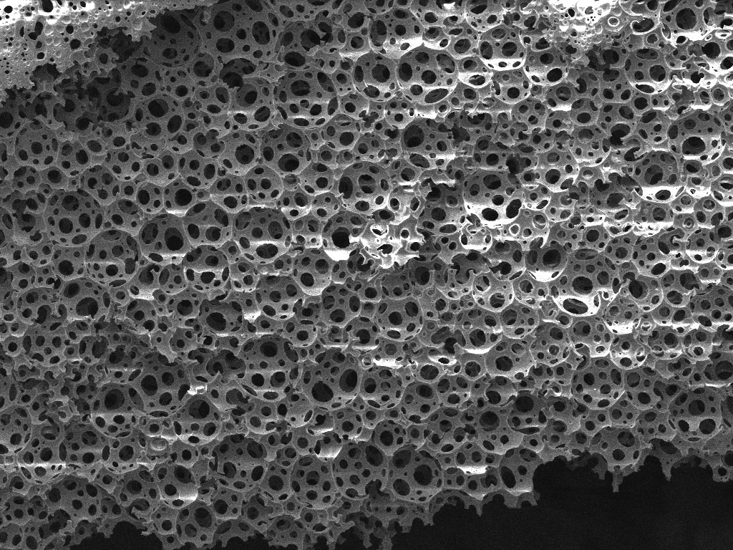
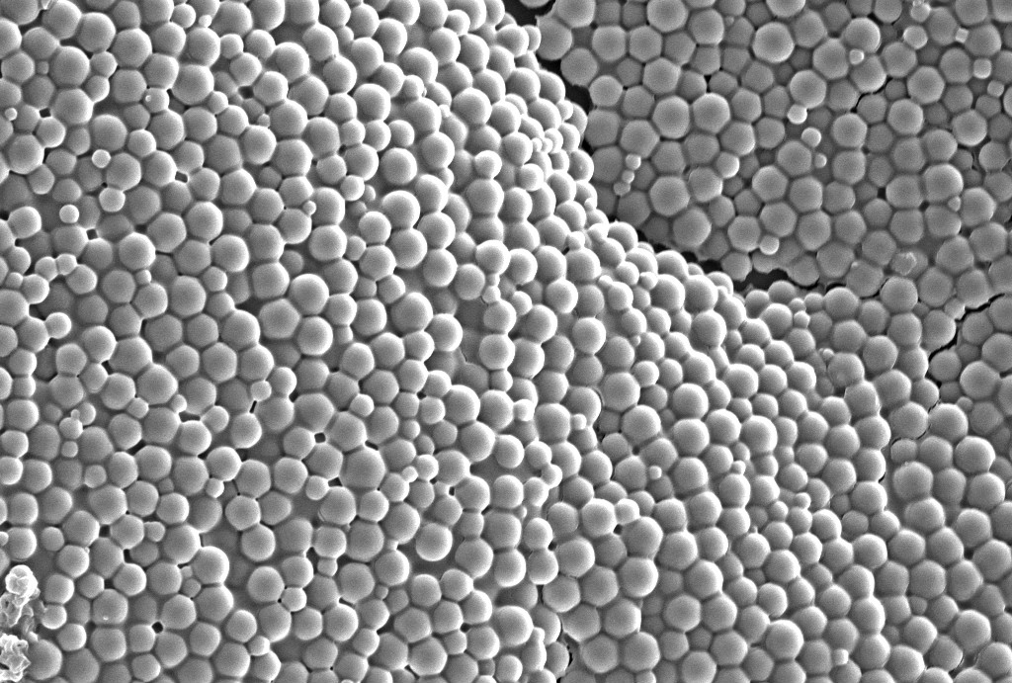
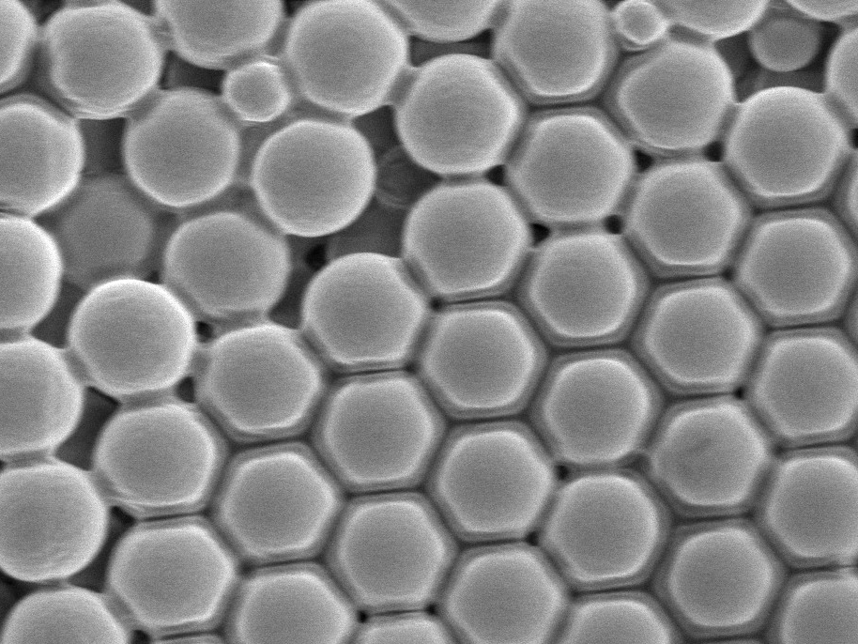
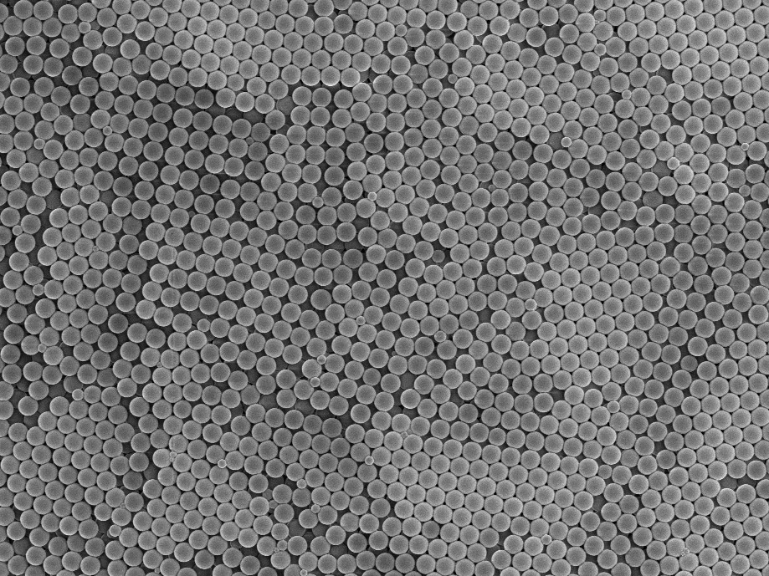
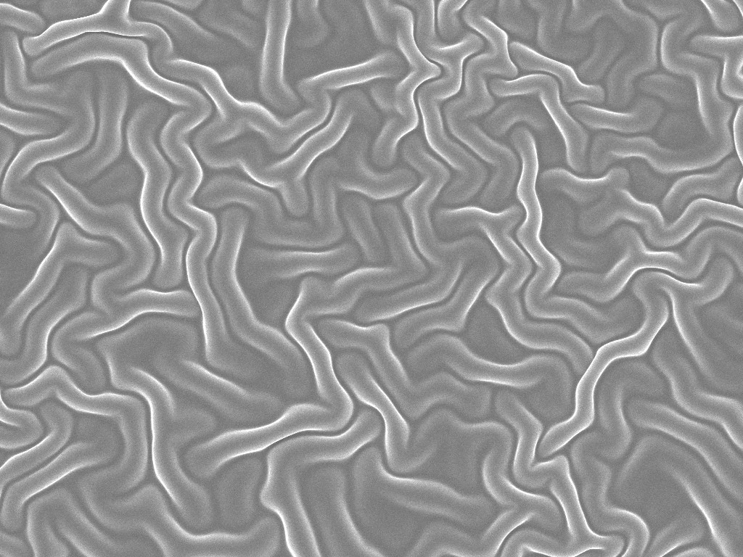
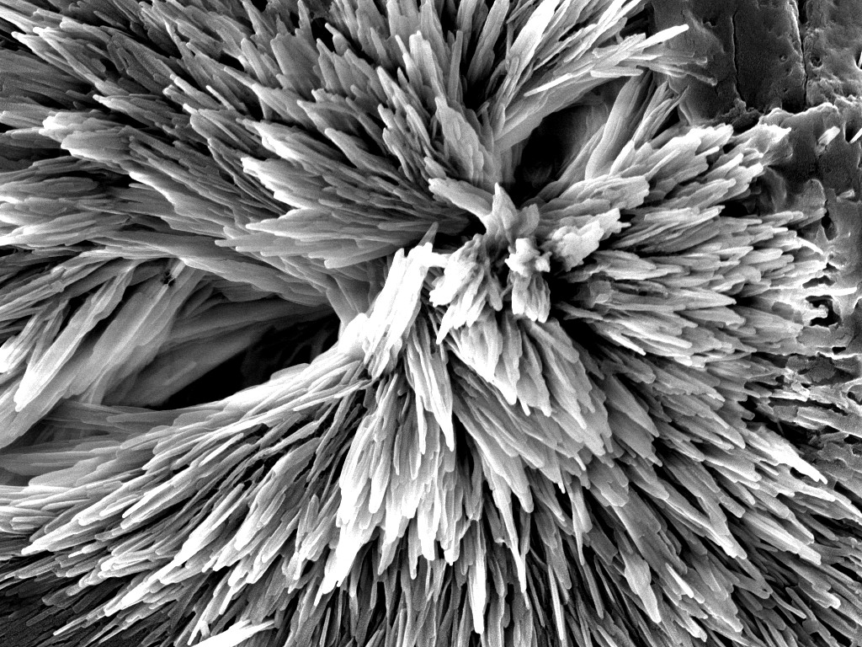
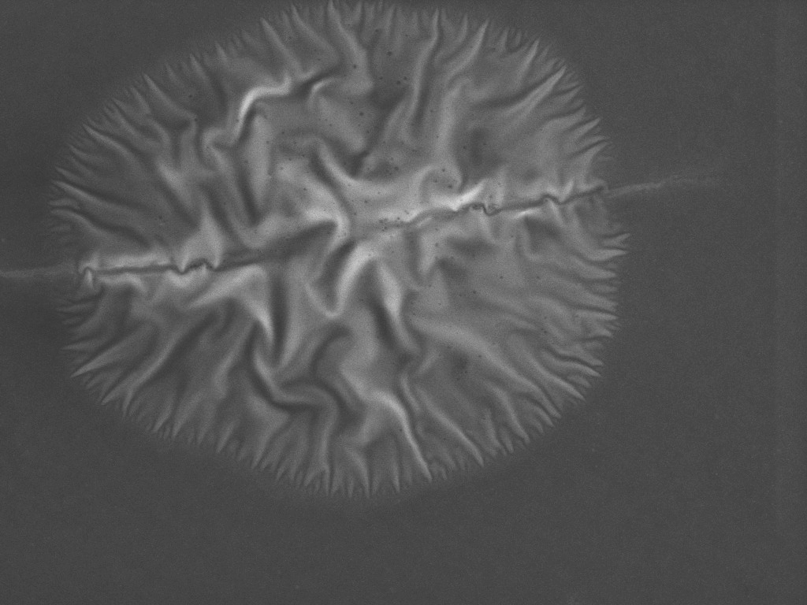
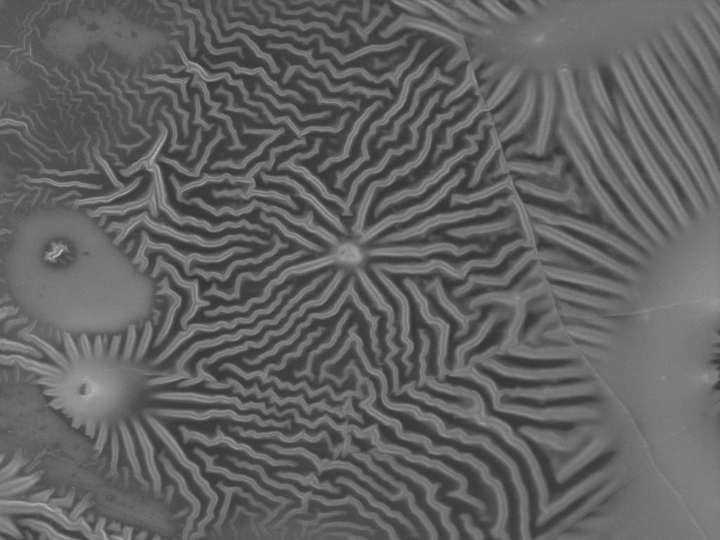
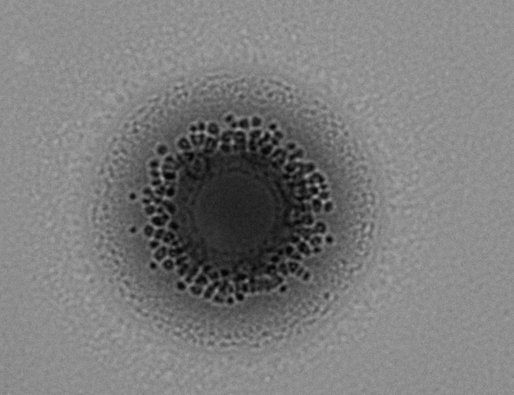
Nat Commun., 11, 1486 (2020) , Chem. Sci., 2020, 11, 5257-5266, J. Am. Chem. Soc., 2022, 144, 15, 6954–6963, J. Am. Chem. Soc. 2024 146 (50), 34292-34297

Slide 18





Acknowledgments
Team & University of Warwick
International Collaborations
Funding
Dr. Arkadios Marathianos (RTP)
Maciej Ratajczyk (MRes)
Prof. Ana Sanchez
Dr. Yisong Han (RTP)
Prof. David Haddleton
Prof. Paul Wilson
Jared Taylor (MChem)
Amirah Mohammed (MChem)
Dr. Alex Magiakos (PDRA)
Dr. Seb Pike
Prof. Athina Anastasaki (ETH-Zurich)
Prof. Christopher Barner-Kowollik (KIT)
Prof. Joe Patterson (UC Irvine)
Prof. Filip Du Prez (Ghent University)
Prof. Kelly Velonia (UCrete)
Prof. Hermis Iatrou (UAthens)
Prof. Paola Manini (UNaples)
Prof. Dmitri Golberg (QUT)

