Slide 1
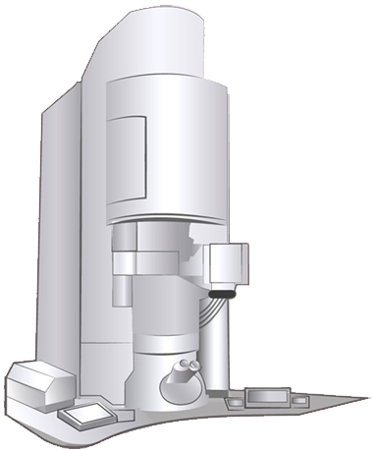

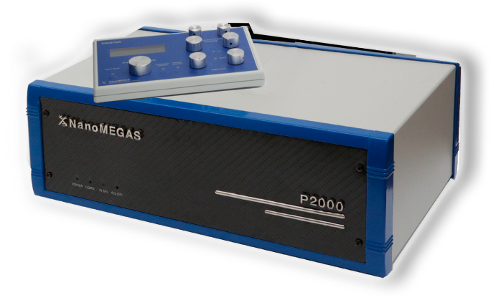
Structure – Property Studies of Nanoscale Materials Using Precession Electron Diffraction in TEM
Thanos Galanis Application Specialist
Brussels, Belgium
nanomegas.com
EM RTP Facility Open Day, Warwick, April 22nd 2026

Slide 2
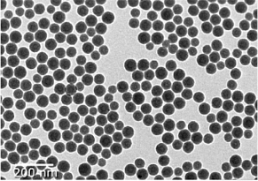
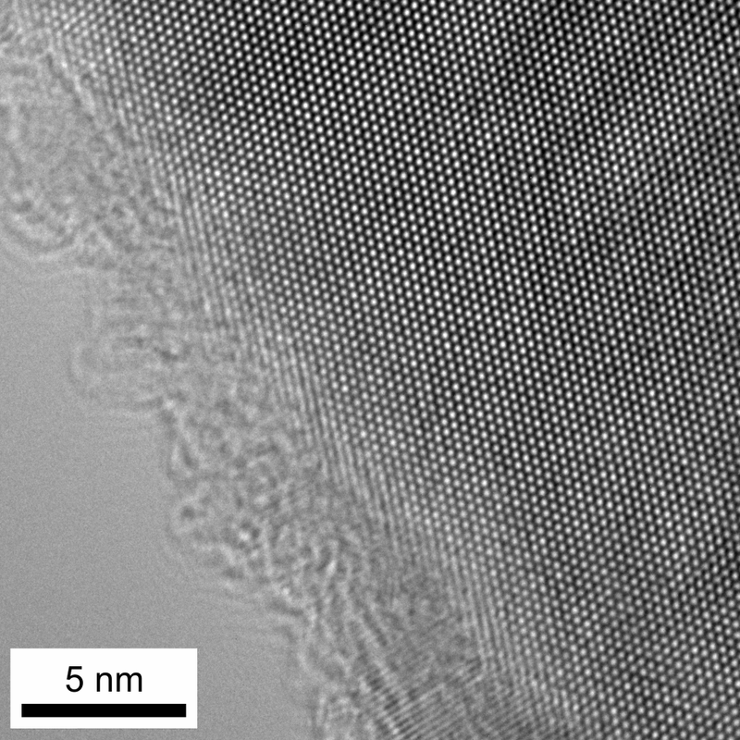
Introduction
Imaging REAL space
High Resolution TEM image
Nanoparticles
Mg Crystal
www.nanomegas.com

Slide 3
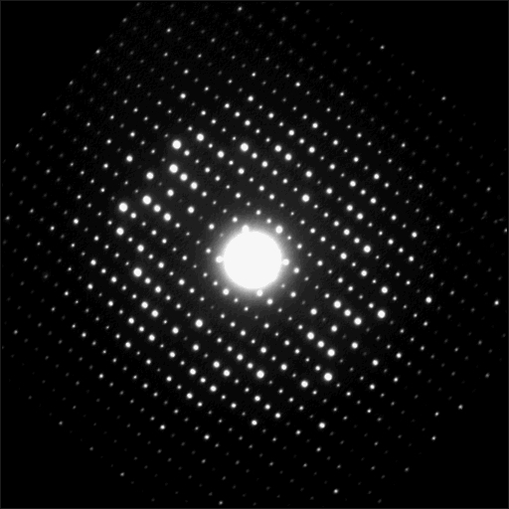
Introduction
Imaging RECIPROCAL Space
Electron Diffraction
Ta O5
Every spot corresponds to crystal planes
&
are indexed by Miller indices: h k l
www.nanomegas.com

Slide 4
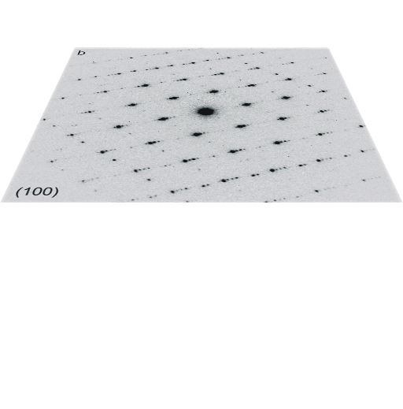
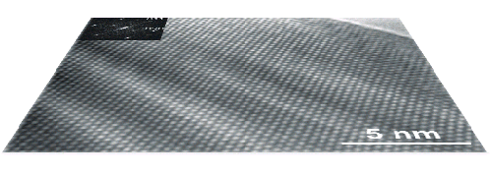
Introduction
REAL and RECIPROCAL Space in TEM
Transmission Electron Microscopy
Image formation in TEM
e⁻
Sample
Objective
Lens
Point resolution
Back Focal
Plane
Electron diffraction
Information limit
Image
Plane
High resolution image
www.nanomegas.com

Slide 5
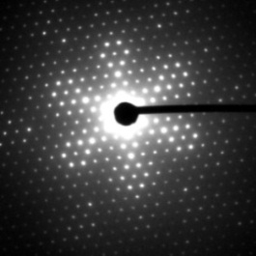
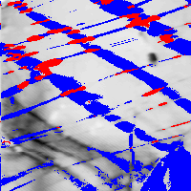
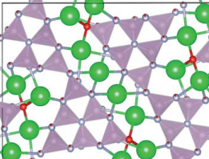
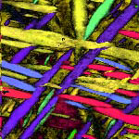
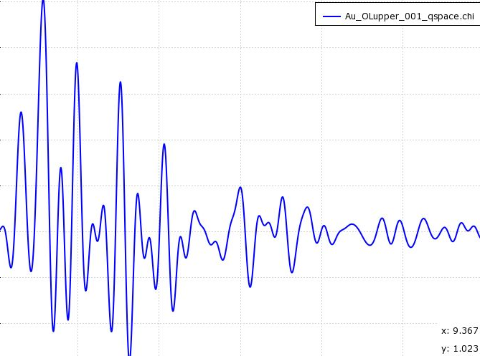
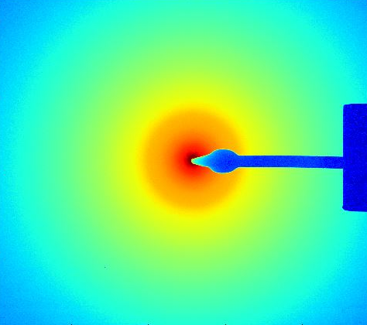
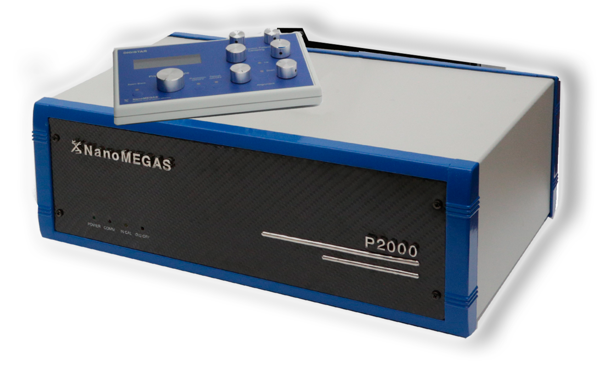
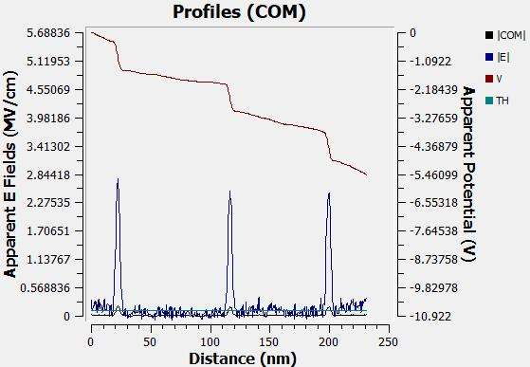
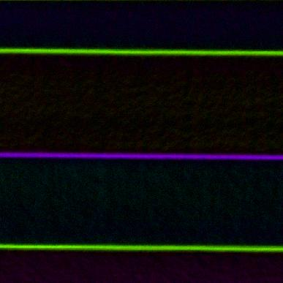

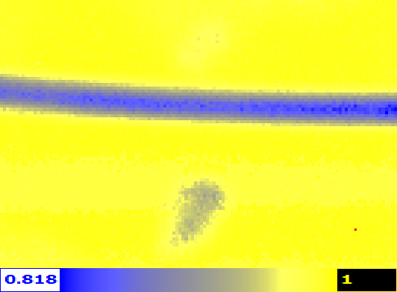
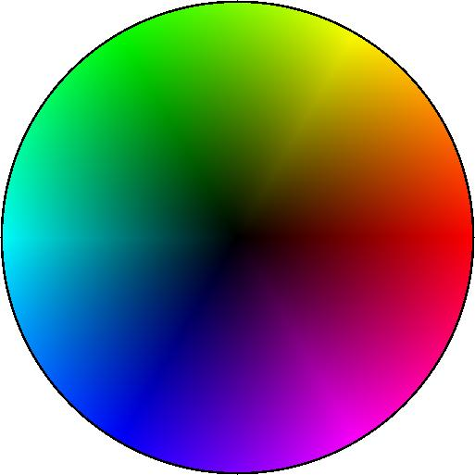
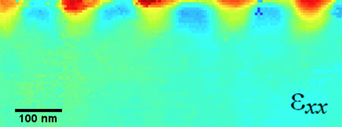

Introduction
Precession Electron Diffraction Solutions
3D diffraction tomography
Orientation & Phase Mapping
Hardware & Software
based applications
GaAs/AlAs (001) interface
e Pair Distribution Function
Si₃N₄
Electric Field Studies
SiO₂
e Pair Distribution Function mapping
Strain Mapping
topspin
www.nanomegas.com

Slide 6



















Introduction
Precession Electron Diffraction
Scan
Increasing Precession angle:
Higher resolution
higher order reflections
Reduce of dynamical effect
Close to kinematical / real reflections
Less sensitivity to specimen thickness / bending
Sample
De-scan
Conventional Diffraction Pattern
Precession…
Precession Diffraction Pattern
Courtesy: C. Own & L. Marks
www.nanomegas.com

Slide 7
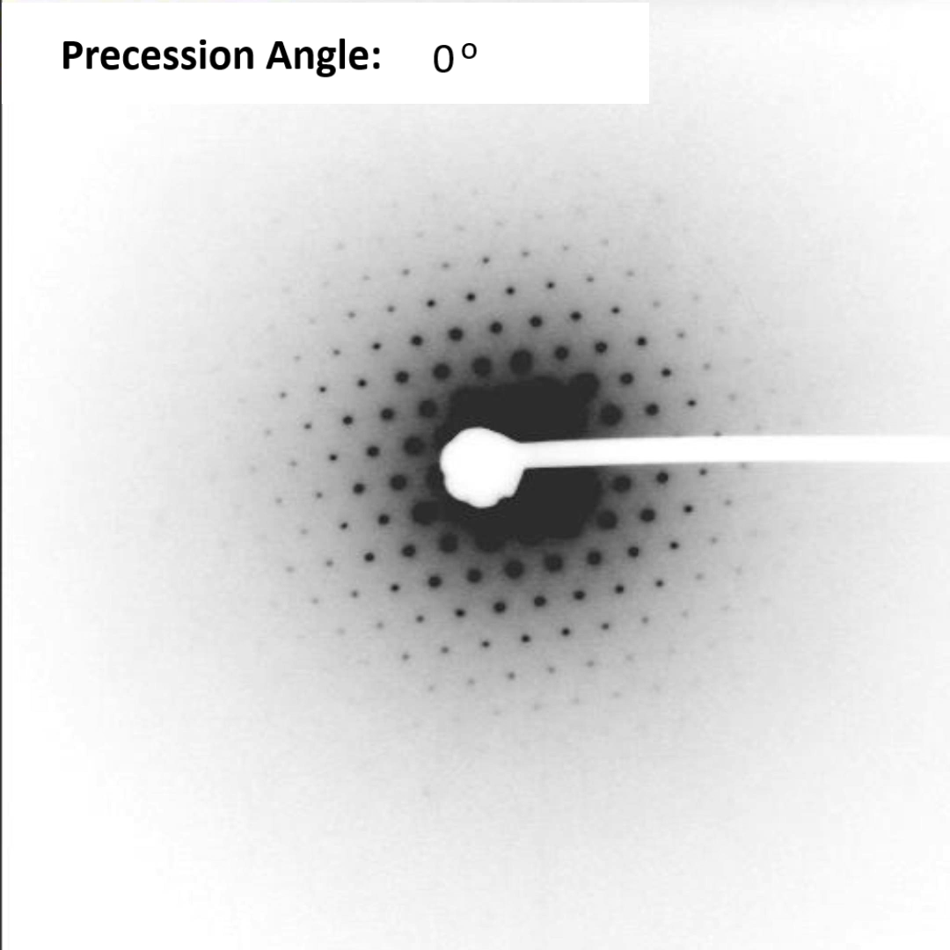
Introduction
Precession Electron Diffraction
Increasing Precession angle:
Higher resolution
higher order reflections
Reduce of dynamical effect
Close to kinematical / real reflections
Less sensitivity to specimen thickness / bending
www.nanomegas.com

Slide 8
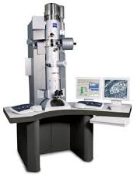
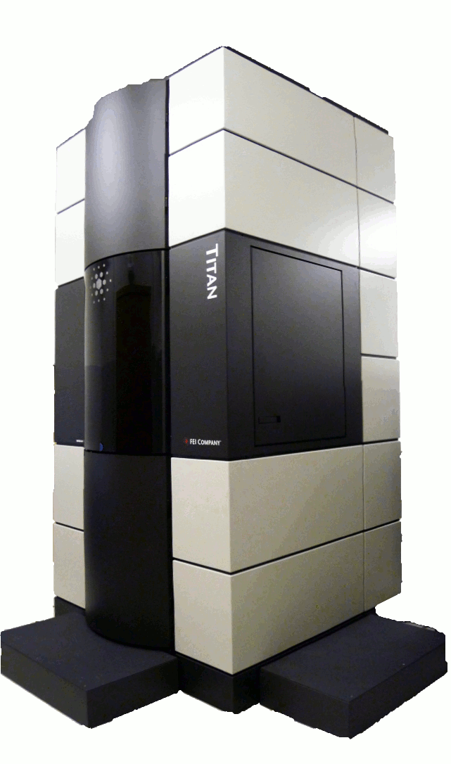

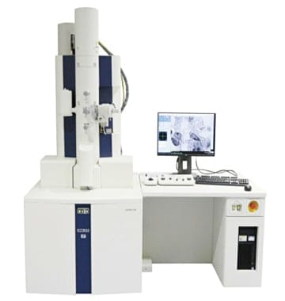

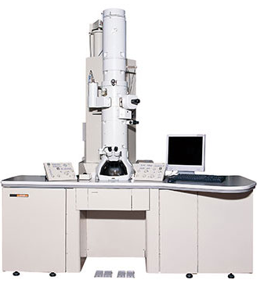

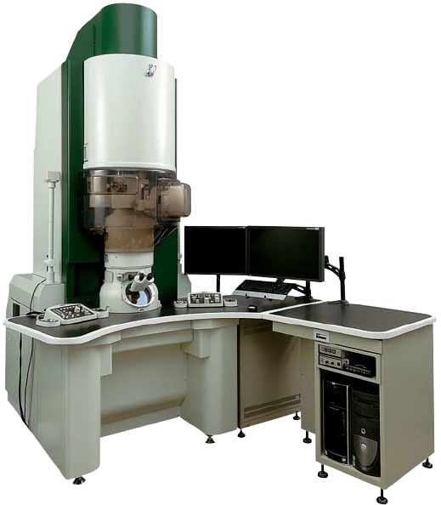
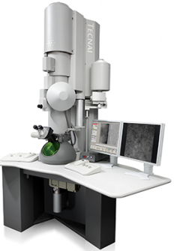

Introduction
PED Applications available for every TEM
FEG |LaB6 sources
100-300kV
www.nanomegas.com

Slide 9
Introduction
Precession Electron Diffraction Solutions
Precession enhanced 4D-STEM
4D-SPED
3D diffraction tomography
Orientation & Phase Mapping
Hardware & Software
based applications
GaAs/AlAs (001) interface
e Pair Distribution Function
Si₃N₄
Electric Field Studies
SiO₂
e Pair Distribution Function mapping
Strain Mapping
topspin
www.nanomegas.com

Slide 10

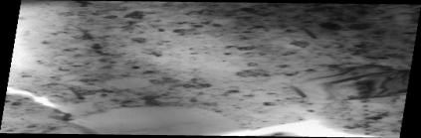
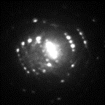
Introduction
4D-SPED: Scanning Precession Electro Diffraction Applications
Pseudo-Parallel
beam
4D-SPED Data Acquisition
Scanning Precession Electron Diffraction
Precession Enhanced 4D-STEM
No precession
Electron Diffraction pattern
www.nanomegas.com

Slide 11
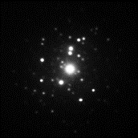
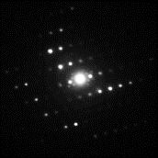
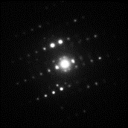
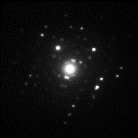
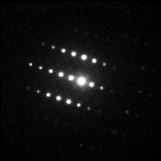
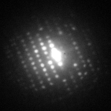
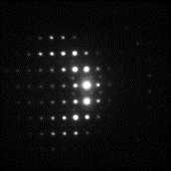
Introduction
4D-SPED: Scanning Precession Electro Diffraction Applications
Pseudo-Parallel
Precessed beam
4D-SPED Data Acquisition
Scanning Precession Electron Diffraction
Scanning
Precession Enhanced 4D-STEM
Precession: 0.6º
Precession Enhanced
Electron Diffraction pattern
www.nanomegas.com

Slide 12
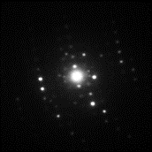
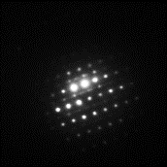
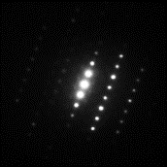
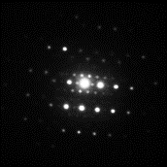
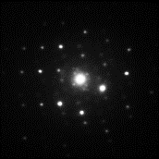
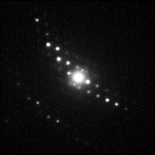
Introduction
4D-SPED: Scanning Precession Electro Diffraction Applications
Pseudo-Parallel
Precessed beam
4D-SPED Data Acquisition
Scanning Precession Electron Diffraction
Scanning
Precession Enhanced 4D-STEM
www.nanomegas.com

Slide 13
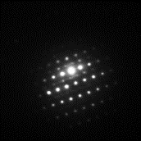
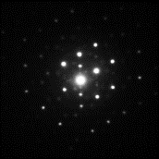
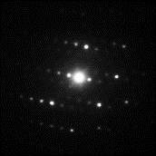
Introduction
4D-SPED: Scanning Precession Electro Diffraction Applications
Pseudo-Parallel
Precessed beam
4D-SPED Data Acquisition
Scanning Precession Electron Diffraction
Scanning
Precession Enhanced 4D-STEM
www.nanomegas.com

Slide 14
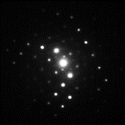
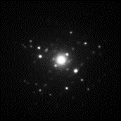
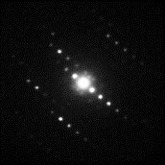
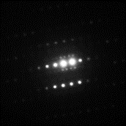
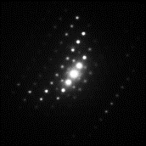
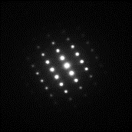
Introduction
4D-SPED: Scanning Precession Electro Diffraction Applications
Pseudo-Parallel
Precessed beam
4D-SPED Data Acquisition
Scanning Precession Electron Diffraction
Scanning
Completed
Precession Enhanced 4D-STEM
www.nanomegas.com

Slide 15
Introduction
Precession Electron Diffraction Solutions
Study of the properties in nm-scale of:
alloys, metals, nanoparticles, semiconductors, minerals, nanowires, ceramics, films, batteries, etc..
Orientation & Phase Mapping
3D diffraction tomography
GaAs/AlAs (001) interface
e Pair Distribution Function
Si₃N₄
Electric Field Studies
SiO₂
e Pair Distribution Function mapping
Strain Mapping
topspin
www.nanomegas.com

Slide 16






Introduction
Orientation & Phase Map
Correlation Coefficient Map
Grain Size Distribution
Texture Analysis
ASTAR: Orientation & Phase Mapping
First turnkey application using 4D-STEM data acquisition since 2007,
few years before the 4D-STEM terminology was introduced
Orientation Map
Virtual Dark Field Image
Grain Boundaries Map
www.nanomegas.com

Slide 17







Introduction
Orientation & Phase Map
ASTAR: Orientation & Phase mapping in nm scale
Spatial Resolution of 1nm
Orientation Map
3D Detailed Projection
Texture Analysis
In Situ Heating / Pd Material
Fe
Fe₁₄Nd₂B
Fe₂B
NdH₂
Interactive Virtual Dark Field
Phase Map
www.nanomegas.com

Slide 18










EXAMPLES
ASTAR: Copper and Copper lines
Nano-twinned copper
Copper lines (cross-sections and longitudinal section) in microelectronic devices
Grain boundaries
Twin boundaries
Index map
Orientation map
Grain size statistics INCLUDING twin boundaries
Orientation map for a 111-nm-thick Cu film imaged in plan view combined to the correlation index map (grayscale).
(TECNAI F20 - Courtesy of Profs. K. Barmak Columbia Univ. NY and A.D. Rollett CMU Pittsburgh PA)
Physical Metallurgy Chap. 10, 2015 (David Laughlin ed.)
Bright-field image
Grain size statistics WITHOUT twin boundaries
Unpublished work
Courtesy of Profs. K. Barmak, Columbia Univ. NY & A.D. Rollett CMU Pittsburgh PA

Slide 19






EXAMPLES
ASTAR: Microelectronic devices
Phase map
Tungsten
Copper
TiN
Si₂N₄ (amorphous)
SiO₂ (amorphous)
Amorphous
Diffraction pattern of an amorphous phase
Orientation and phase maps

Slide 20
Introduction
Precession Electron Diffraction Solutions
3D diffraction tomography
Orientation & Phase Mapping
Study of strain / deformation in nm-scale of:
semiconductors, metals, ceramics, etc..
GaAs/AlAs (001) interface
e Pair Distribution Function
Si₃N₄
Electric Field Studies
SiO₂
e Pair Distribution Function mapping
Strain Mapping
topspin
www.nanomegas.com

Slide 21








Introduction
Orientation & Phase Map
Strain Mapping
TopSPIN: Strain mapping in nm scale and high sensitivity
PED Strain Mapping
topspin
Strain Profile
εxx
εxx
0.010
pMOS device
Strain
0.005
0.000
0
100
200
300
Position (nm)
εyy
εyy
0.015
Strain
0.010
Spatial resolution: 1-5 nm
0.005
Strain Sensitivity: >0.02%
0
100
200
300
Strain Mapping
Single crystal grain area calculated
Position (nm)
www.nanomegas.com

Slide 22










Introduction
Orientation & Phase Map
Strain Mapping
TopSPIN: Strain mapping in nm scale and high sensitivity
TopSPIN strain | Precession 1º
TopSPIN strain | No Precession
topspin
εxx
εxx
εxx
εxx
Si / SiGe
εyy
εyy
Precession ON
Precession OFF
εyy
εyy
Courtesy of Dr. Joaquim Portillo
200KV NonProbe Corrected, ScanStep 1nm, spot8, C2ap20um, 144pixels/frame, 12 bit depth, 20mspf

Slide 23
Introduction
Precession Electron Diffraction Solutions
3D diffraction tomography
Orientation & Phase Mapping
Electric Field studies in nm scale
Different phases Interface, quantum wells, p-n junctions, batteries,
GaAs/AlAs (001) interface
e Pair Distribution Function
Si₃N₄
Electric Field Studies
SiO₂
e Pair Distribution Function mapping
Strain Mapping
topspin
www.nanomegas.com

Slide 24


Electric Field
Precession Electron Diffraction Solutions – Electric field Studies
Data acquitition using NanoMEGAS scan engine and precession generator
Distortion-corrected diffraction patterns
Compatible with 8- to 16-bit data, pixel sizes ranging from 128×128 to 1024 ×1024 or more
Automated user-friendly workflow.
Precession is essential for samples >50nm of thickness
Data processing
Reference selection from any position of the acquired area
Automated beam offset correction from scanning
Adjust rotation of scanning and TEM azimuthal rotation
Full set of offset maps (proportional to EF)
Integrated Profiles of COMx, COMy, COMmag
Calculation and diagrams of Αpparent EF and Αpparent potential.
Reference color map with display option.
www.nanomegas.com

Slide 25


Electric Field
Electric field Studies – STOCa dopped semiconductor
Heterostructures: Visualization of the charge distribution in LAO // AlO_{x} // Sr_{0.97}Ca_{0.03}TiO₃
7nm
20nm
Universitat Rovira i Virgili, Tarragona
Collaborations: Sergi Plana Ruiz, sergi.plana@urv.cat
Jaume Gazquez, jgazquez@icmab.es
R. Guzman, rguzman@icmab.es
NanoMEGAS: Joaquim Portillo,
Thanos Galanis
SrTiO₃
Sr_{0.99}Ca_{0.03}TiO₃
LaAlO₃
AlO amorphous
Au
Potential difference is expected to be detected at the 1% mol of Ca-dopped STO phase: Sr_{1-x}Ca_{x}TiO₃.

Slide 26
Electric Field
Electric field Studies – STOCa dopped semiconductor
Heterostructures: Visualization of the charge distribution in LAO // AlO_{x} // Sr_{0.97}Ca_{0.03}TiO₃
7nm
20nm
Universitat Rovira i Virgili, Tarragona
JEOL 2100
Scan and Precession Generator: DigiSTAR P2010
Acquistion platform: TopSPIN acq
Camera: Gatan OneView
Step size: 1nm
Exp time 10ms
Convergence semi angle: ~3mrad
Precession angle: 0.8º
Precession frequency: 1000Hz
SrTiO₃
Sr_{0.99}Ca_{0.03}TiO₃
LaAlO₃
AlO amorphous
Au
Potential difference is expected to be detected at the 1% mol of Ca-dopped STO phase: Sr_{1-x}Ca_{x}TiO₃.

Slide 27



Electric Field
Electric field Studies – STOCa dopped semiconductor
Heterostructures: Visualization of the charge distribution in LAO // AlO_{x} // Sr_{0.97}Ca_{0.03}TiO₃
CoM map
Why Precession?
Limited contrast inside the transmitted beam, due to dynamical effect reduction:
Uniform intensity into the transmitted beam.
Improved COM calculations.
More reliable and reproducible results.
10 nm
No PED
PED

Slide 28











Electric Field
Electric field Studies – STOCa dopped semiconductor
STOCa: 3% Ca dopped STO
eEF | No Precession Rotation correction
eEF | Precession 0.8º Rotation correction
VBF
7nm
20nm
COMx
Sr_{0.99}Ca_{0.03}TiO₃
SrTiO₃
LaAlO₃
AlO amorphous
Au
Representative DP without Precession
COMy
Representative DP with Precession
EF

Slide 29
Introduction
Precession Electron Diffraction Solutions
3D diffraction tomography
Orientation & Phase Mapping
Semi-Crystalline and Amorphous Materials analysis
spot OR scanning
Semiconductors, Polymers, Batteries, Solar Cells, Sensors Catalysts, Glasses, Thin Films, etc
GaAs/AlAs (001) interface
e Pair Distribution Function
Si₃N₄
Electric Field Studies
SiO₂
e Pair Distribution Function mapping
Strain Mapping
topspin
www.nanomegas.com

Slide 30



PDF
Diffraction Patterns: Crystalline vs Nanocrystalline/Amorphous
🔵 Crystalline Materials:
Sharp Bragg peaks (intense, well-defined)
Easy to solve structure with conventional crystallography
🔴 Nanocrystalline & Amorphous Materials:
Broad, diffuse diffraction rings
Standard crystallography fails → need alternative methods Examples: Glasses, liquids, polymers, oxides…
🔷 Alternative Method to analyze Nanocrystalline & Amorphous Materials > PDF :
Applicable to both crystalline and amorphous materials
Extracts local atomic structure and short-range order information from diffuse scattering
Complements traditional crystallography, especially when Bragg peaks are weak or absent
www.nanomegas.com

Slide 31

Introduction
Orientation & Phase Map
Strain Mapping
Electric Field
e-PDF
PDF: Pair Distribution Function– Characterization of Amorphous materials
Pair Distribution Function G(r) is probability of finding an atom in a distance r
X
R (Å -1)
2 Å
1
2
3
4
5
6
r (Å)
A total pair-distribution function (PDF) is obtained by repeating this process systematically by placing each atom in the origin.
www.nanomegas.com

Slide 32







PDF
PDF
Workflow: From Diffraction Patterns to PDF
Interatomic
distances
2D Diffraction Pattern
Raw experimental data
1D Intensity Profile
Azimuthal integration
Reduced Structure Function F(Q)
Normalization & transformation
Pair Distribution Function G(r)
Atomic distances revealed
$$I(Q)$$
$$Q=\frac{4π\sin{θ}}{λ}$$
$$Reduced Structure Funcation F(Q) = Q [ S(Q) – 1 ]$$
Revealing interatomic distances across crystalline, nanocrystalline, and amorphous materials
I(Q) → S(Q) → F(Q) → G(r)
$$S\left(Q\right)=1+\frac{I\left(Q\right)−{\left\langle f^{2}\left(Q\right)\right\rangle }_{\text{composition}}}{{\left\langle f\left(Q\right)\right\rangle }_{\text{composition}}^{2}}$$
Q: $\text{Scattering} \text{vector} \text{magnitude} \text{or} \text{momentum} \text{transfer}\text{, }$f(Q): Atomic scattering factor (form factor), ⟨ f²(Q) ⟩_composition: Mean square scattering factor ⟨ f²(Q) ⟩ = Σ cᵢ fᵢ²(Q) ,⟨ f(Q) ⟩_composition: Average scattering factor over the sample composition ⟨ f(Q) ⟩ = Σ cᵢ fᵢ(Q)
www.nanomegas.com

Slide 33

PDF
ePDF Mapping: Analysis of amorphous Semiconductor material |2- QOI Map
Crystalline Part
Layer 2
Layer 1
Layer 2 : first-neighbor Si–N 1.68 Å, consistent with silicon nitride (SiₓNᵧ)
Layer 1 : first peak at 1.60 Å — matches Si–O; no carbon; likely SiO𝑥
ePDF QOI map: Variation of the peak position
PHASE IDENTIFICATION
www.nanomegas.com

Slide 34
Introduction
Precession Electron Diffraction Solutions
3D diffraction tomography
Orientation & Phase Mapping
GaAs/AlAs (001) interface
Electron Crystallography
Precession enhanced 3DED; MicroED
Determination of crystal structures of minerals, zeolites, MOFs, pharmaceuticals, proteins, etc
e Pair Distribution Function
Si₃N₄
Electric Field Studies
SiO₂
e Pair Distribution Function mapping
Strain Mapping
topspin
www.nanomegas.com

Slide 35


Introduction
Orientation & Phase Map
Strain Mapping
Electric Field
e-PDF
PED tomography
Why to Use Electron Crystallography?
X-Ray Crystallography Methods - Limits
Small crystals
<0.5 micron in size, progressively broader
X-Ray reflections peaks
Overlapping Powder X-Ray peaks
poorly crystallized materials
www.nanomegas.com

Slide 36






Introduction
Orientation & Phase Map
Strain Mapping
Electric Field
e-PDF
PED tomography
Why to Use Electron Crystallography?
Powder pattens: sum of individual nanocrystals
Cell parameter and symmetry determination from nm single crystals
www.nanomegas.com

Slide 37













Introduction
Orientation & Phase Map
Strain Mapping
Electric Field
e-PDF
PED tomography
Precession Electron Diffraction Tomography (PEDt) – Solve crystal structures
Crystal Image
Precession Electron Diffraction
Precession Electron Diffraction
Precession Electron Diffraction
Precession Electron Diffraction
Precession Electron Diffraction
Select crystal & area for
data acquisition
Track Crystal under the Beam
Tilt 1 degree
Tilt 1 degree
Tilt 1 degree
Tilt every 1 degree
Track Crystal under the Beam
Record PED pattern by TEM detector
Record PED pattern by TEM detector
Record PED pattern by TEM detector
Record PED pattern by TEM detector
Acquire PED pattern every 1º
Tilt range for cell parameters determination: -30º to +30º
Tilt range for structure determination: -60º to +60º
Completeness of reciprocal space
Collect series of PED patterns every 1º
www.nanomegas.com

Slide 38







Introduction
Orientation & Phase Map
Strain Mapping
Electric Field
e-PDF
PED tomography
Precession Electron Diffraction Tomography (PEDt) – Solve crystal structures
Reciprocal Space Reconstruction
Cell parameters determination
PED patterns every 1º
Final Structural Model
Solving Crystal Structure
ED intensities extraction
www.nanomegas.com

Slide 39





Introduction
Orientation & Phase Map
Strain Mapping
Electric Field
e-PDF
PED tomography
Precession Electron Diffraction Tomography (PEDt) – Solve crystal structures
Light-Emitting Diodes
batteries
catalysts
minerals
HAPY_Mg₂Al(OH)₂AlSiO₆
Microporous minerals
PEDt tomography
MFU4L_MOF
Pharmaceuticals & Proteins
pigments
Paracetamol
ITQ43_Zeolite
www.nanomegas.com
Pigment Yellow

Slide 40

NanoMEGAS.COM
Applications details
Literature on PED techniques
Past & Forthcoming Webinars
Brussels, Belgium
nanomegas.com
www.nanomegas.com

Slide 41

Thank you!
Photo from NanoMEGAS annual meeting, Crete, June 2024

