Slide 1
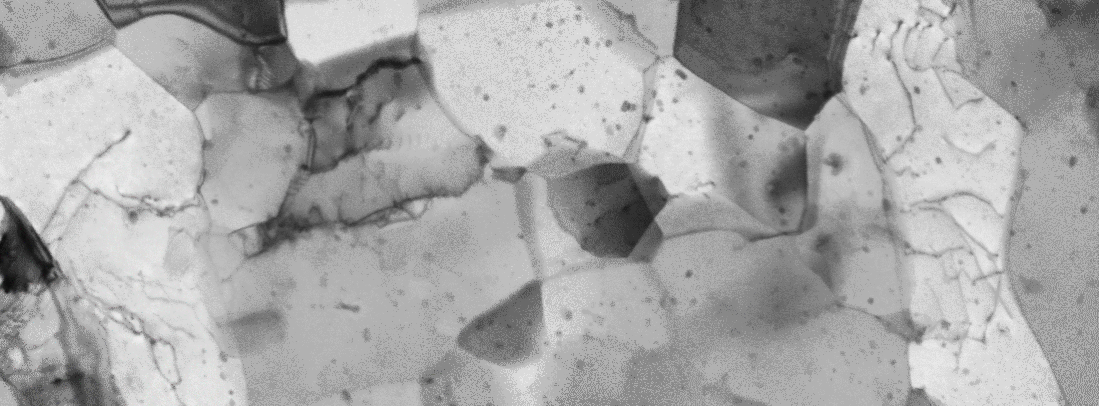
Is STEM in SEM a Viable Alternative to TEM?
Dr. Pat Trimby
Carl Zeiss UK

Slide 2
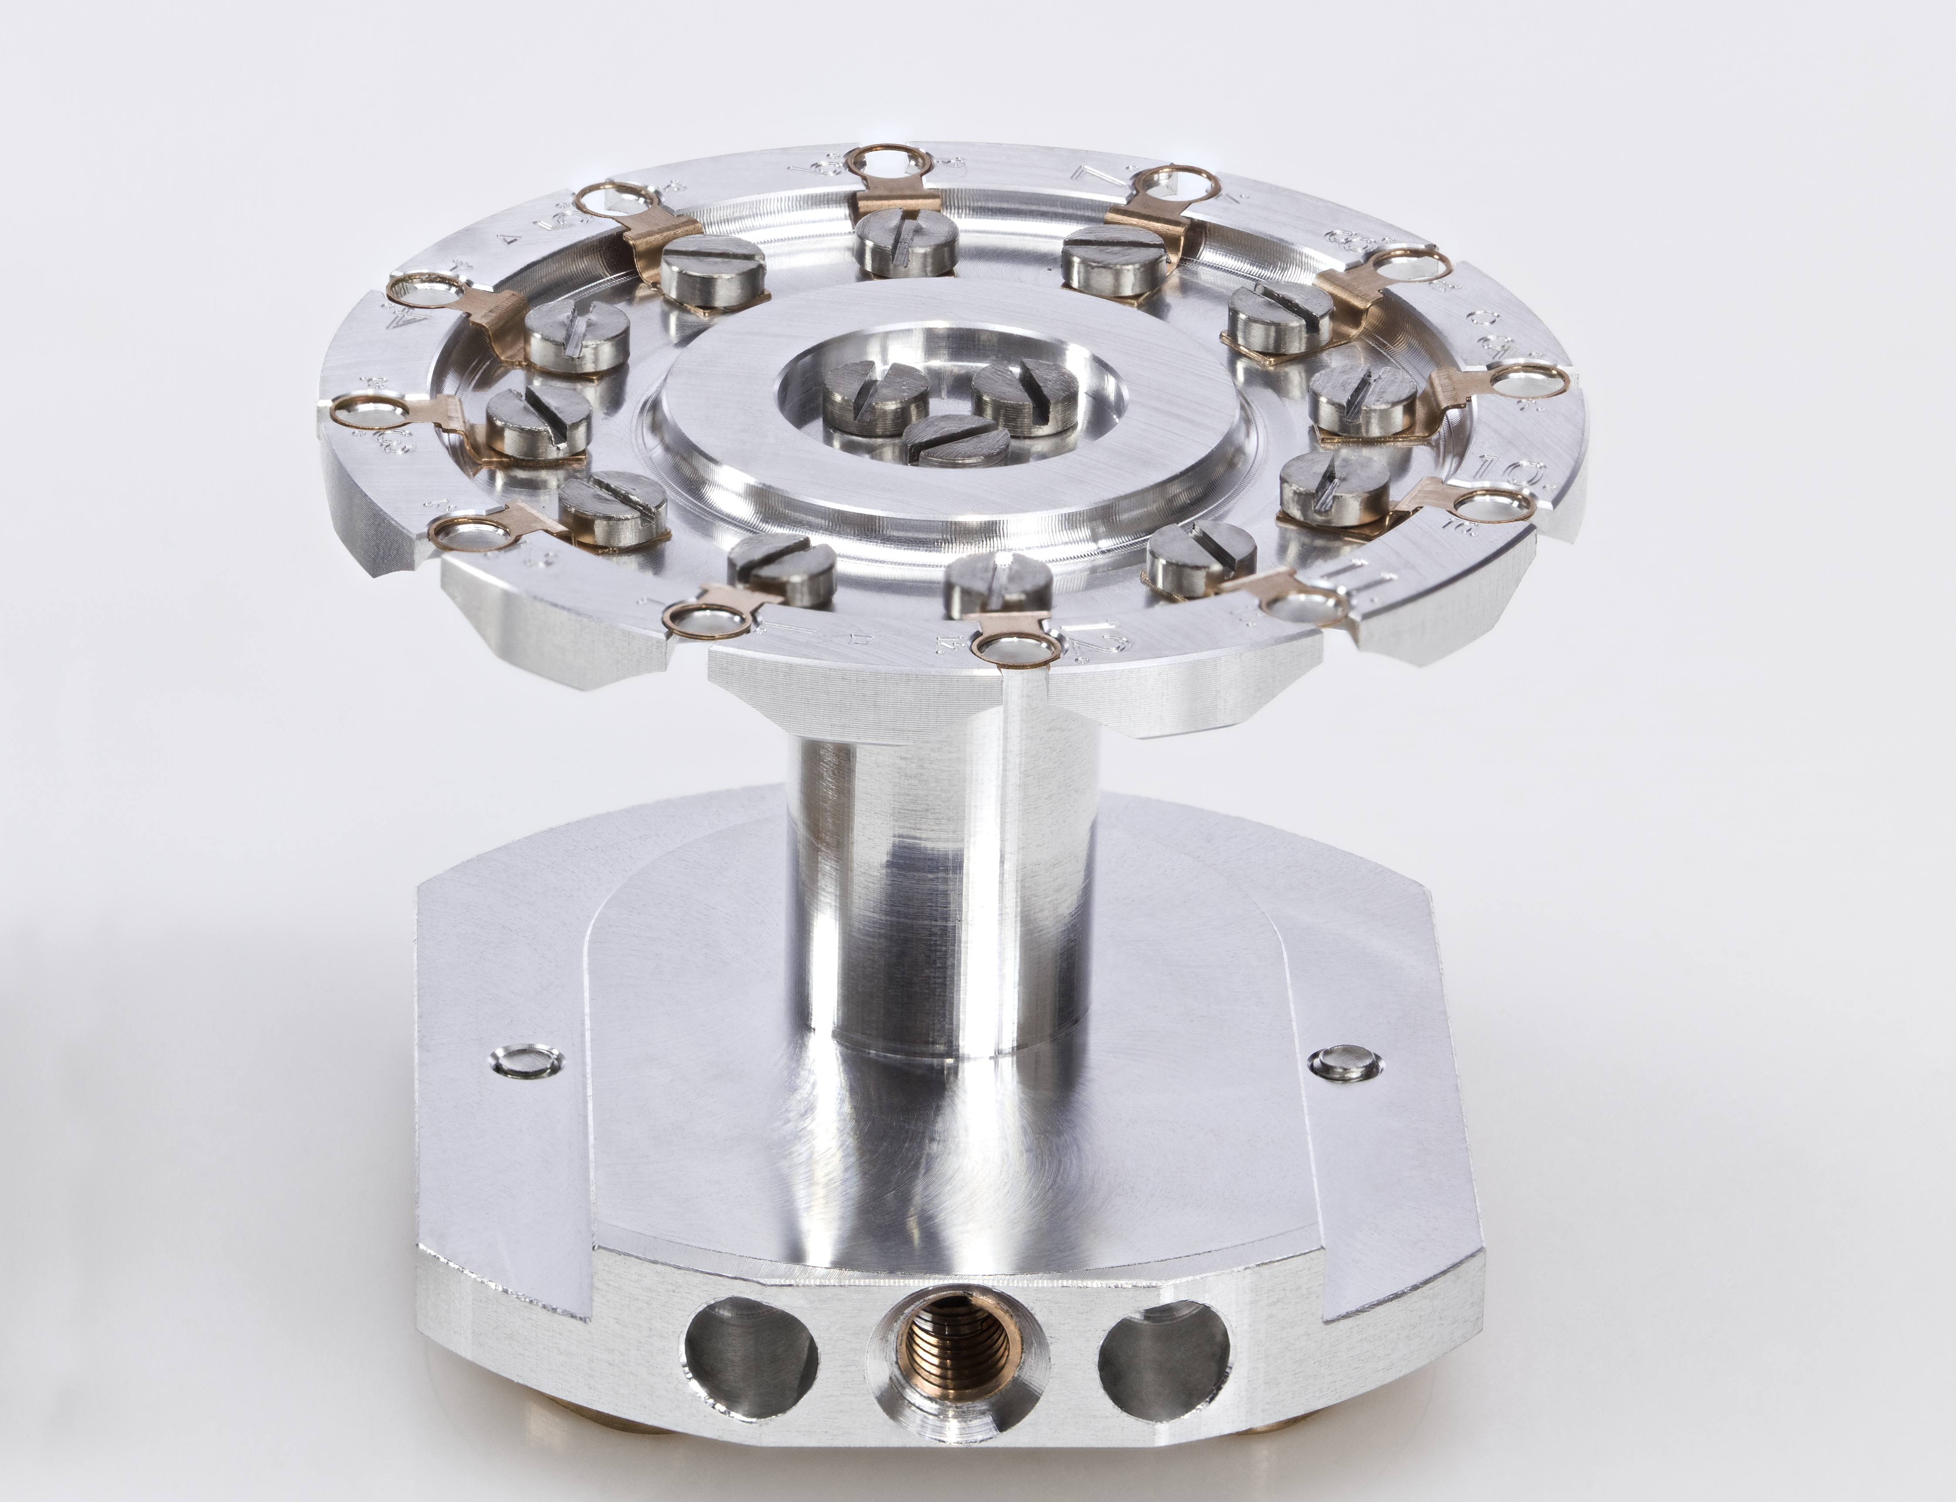
STEM in SEM: an overview
Scanning Transmission Electron Microscopy (STEM) in a Scanning Electron Microscope (SEM) works as follows:
Requires electron transparent (TEM) samples (e.g. 50 – 200 nm thickness):
  Electropolished / broad ion beam thinned 3 mm TEM foils
  FIB-prepared TEM lamellae
  Nanoparticles on a TEM support grid
  Ultramicrotomed sections on a TEM support grid
Mount up to 12 samples in a dedicated STEM holder
Use a side-mounted insertable STEM detector
Position the TEM samples above the detector
Image using the electron beam (usually at the maximum 30 kV beam energy / small aperture or low beam current)
Imaging resolution down to < 5 Å
12-sample STEM holder
Chamberscope image with STEM detector inserted

Slide 3
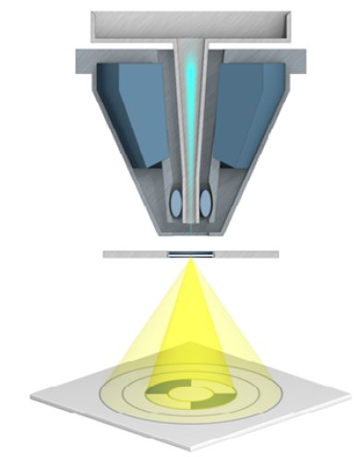
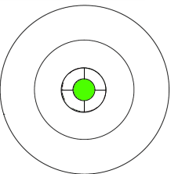
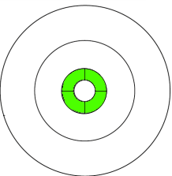
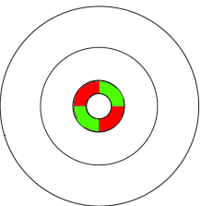
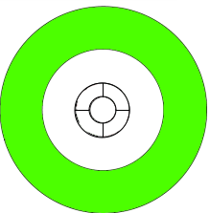
STEM in SEM Imaging Versatility
Nanocrystalline, deformed Al 6060 alloy
Brightfield
Darkfield
Oriented darkfield
High angle annular darkfield
30 kV images collected simultaneously from an electropolished TEM foil using the ZEISS GeminiSEM 360

Slide 4
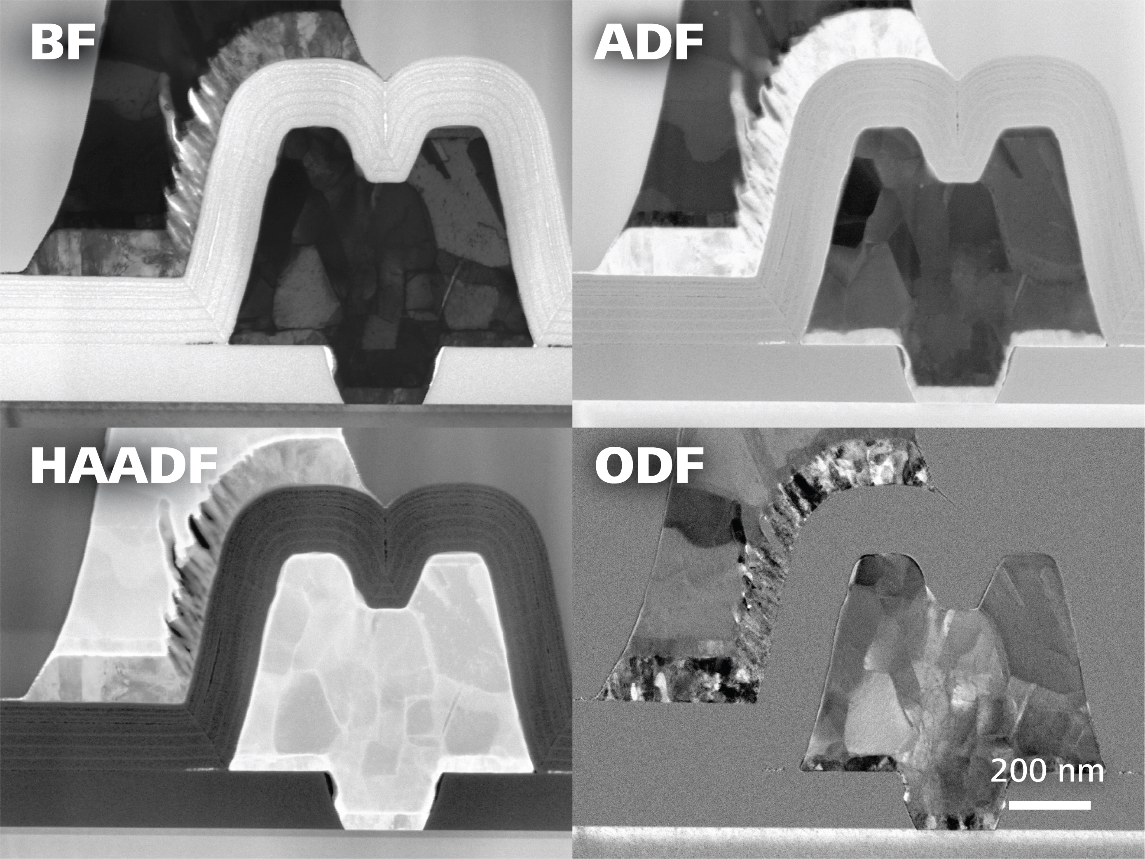
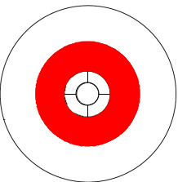
STEM in SEM Imaging Versatility
GaN high electron mobility transistor (HEMT)
30 kV images collected simultaneously using “Quad mode” from a backside-thinned FIB lamella

Slide 5
Al 6060 Alloy
High Pressure Torsion – deformed Al 6060
Sample courtesy of Kaan Tugcu, University of Sydney

Slide 6
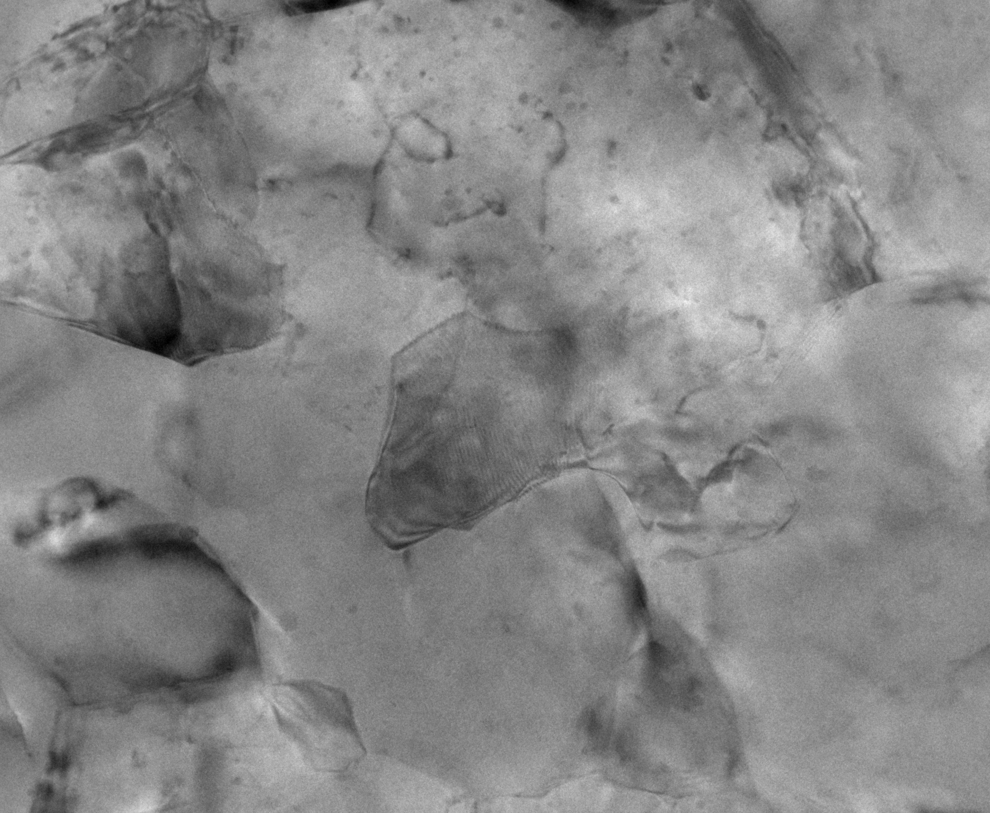
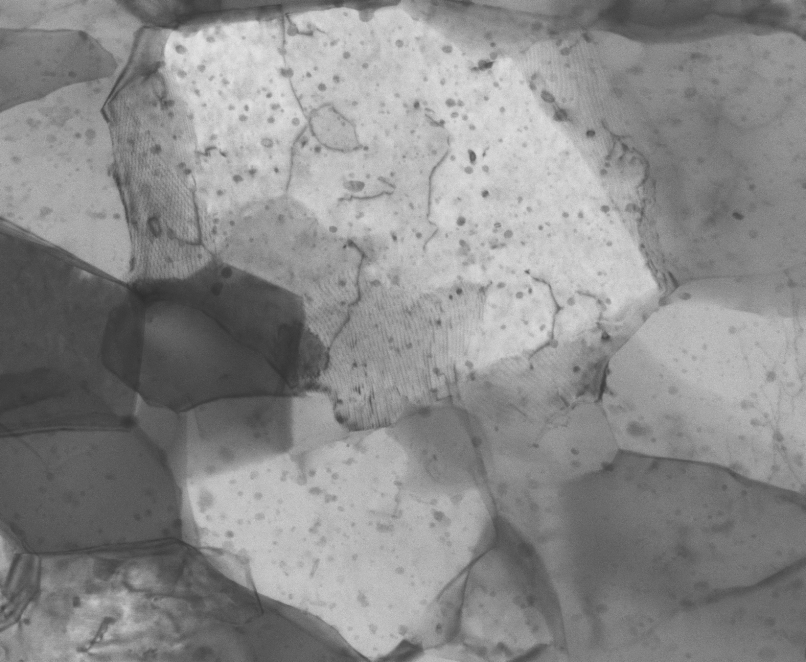
Nanocrystalline Al alloy
Images show the same area in SEM and TEM!
200 nm
200 nm
TEM
SEM
Zeiss Sigma 560
  Thanks to Natalie Allcock (University of Leicester) for the TEM imaging

Slide 7
Erythroblast Cells
Microtomed sections on TEM support grid
Sample courtesy of Dr. Errin Johnson, Oxford University / University of Sydney

Slide 8
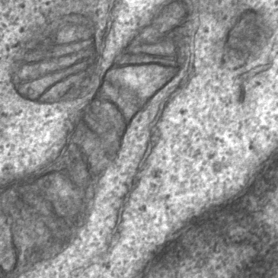
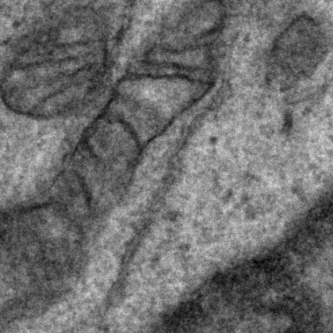
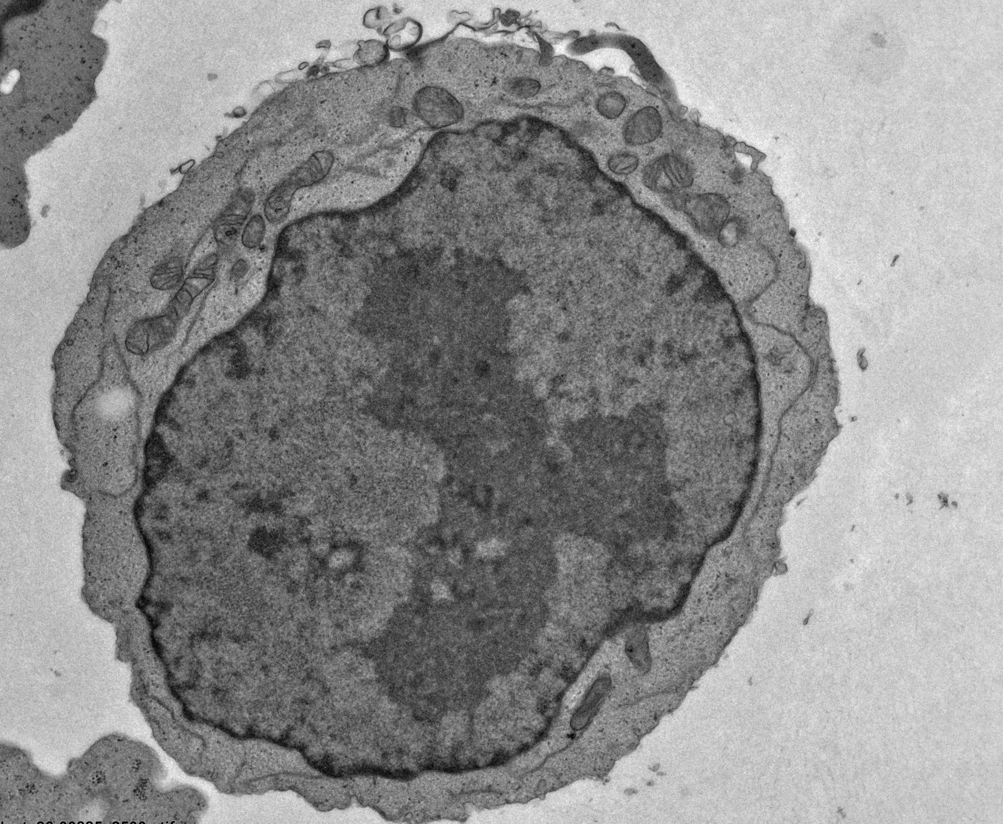
Erythroblast Cell
Identical cell section imaged in SEM and TEM
SEM
Zeiss Sigma 560
2 μm
TEM
2 μm
  Thanks to Natalie Allcock (University of Leicester) for the TEM imaging

Slide 9
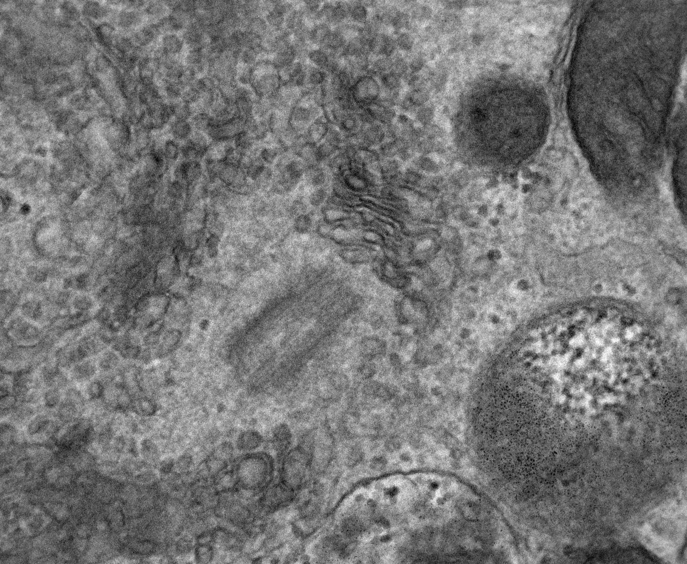
Erythroblast Cell
Identical area imaged in SEM and TEM
200 nm
SEM
Zeiss Sigma 560
200 nm
TEM
  Thanks to Natalie Allcock (University of Leicester) for the TEM imaging

Slide 10
BaFe₁₂O₁₉ Nanoparticles
Sample courtesy of Dr. Romanus, TU Ilmenau, Germany

Slide 11
BaFe₁₂O₁₉ Nanoparticles
Pushing the resolution of STEM in SEM
Sub-nm resolution using 22 kV STEM imaging in a ZEISS GeminiSEM
STEM in HAADF mode
Image clearly shows 1.1 nm (002) lattice spacing
Contrast is due to mass-thickness variations associated with Fe and Ba sites in the lattice
1.1 nm
10 nm

Slide 12
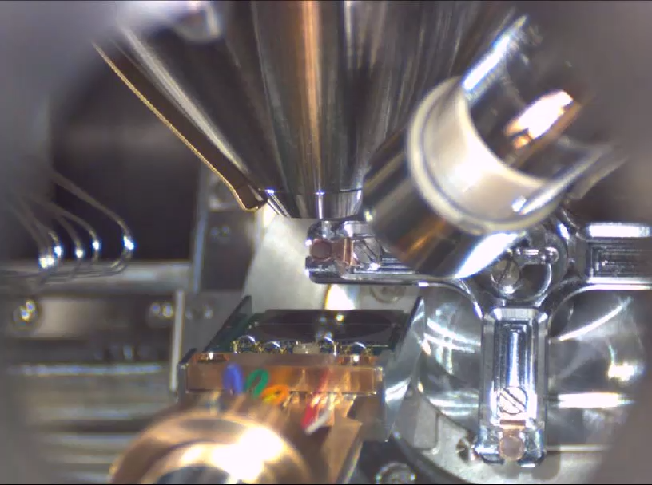
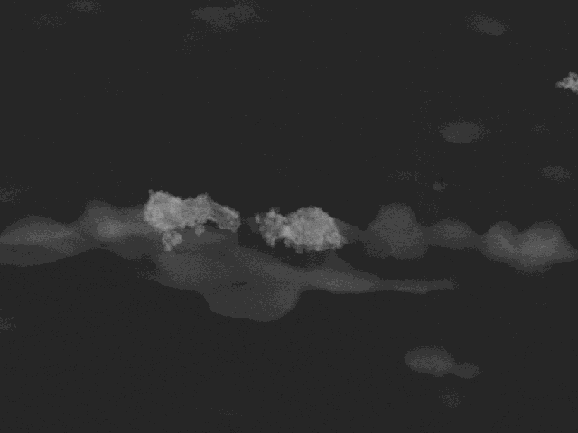
STEM Tomography
3D nanoscale visualisation
700 nm
Me-ZSM-5 zeolite catalyst – Annular Darkfield Tilt Series

Slide 13
Summary
Adding a STEM detector to a FEG-SEM provides significant TEM-like imaging capability
Using a multi-segment ZEISS STEM detector offers versatility in imaging signals, including DF, BF, ODF and (HA)ADF – all collected simultaneously
STEM imaging resolution routinely better than 1 nm (specified down to 4 Å with the ZEISS GeminiSEM 560) – in some cases this enables imaging of lattice planes
Example STEM images collected in the SEM from both materials and biological samples compare very favourably with routine TEM imaging
12-sample STEM holders deliver high throughput in a single session
STEM in SEM capability can be extended to include STEM Tomography for 3D visualisation
Is STEM in SEM a viable alternative to TEM? YES!
Join us for a STEM in SEM demonstration on the ZEISS GeminiSEM 500 after lunch!

Slide 15
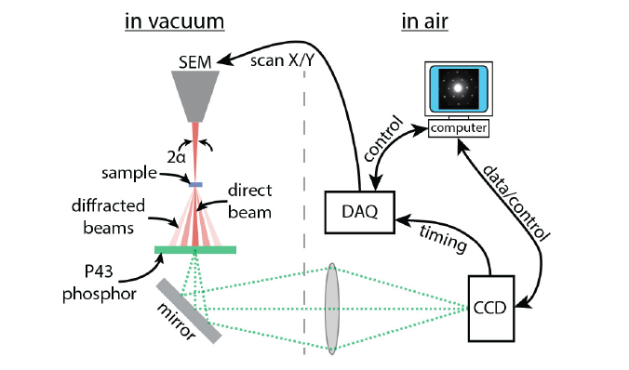
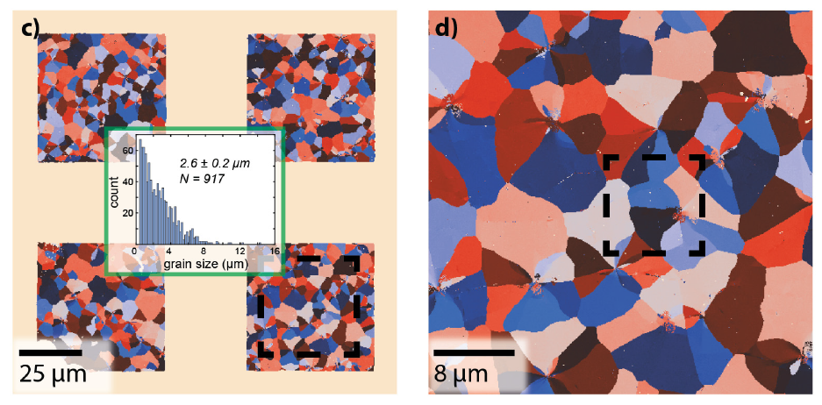
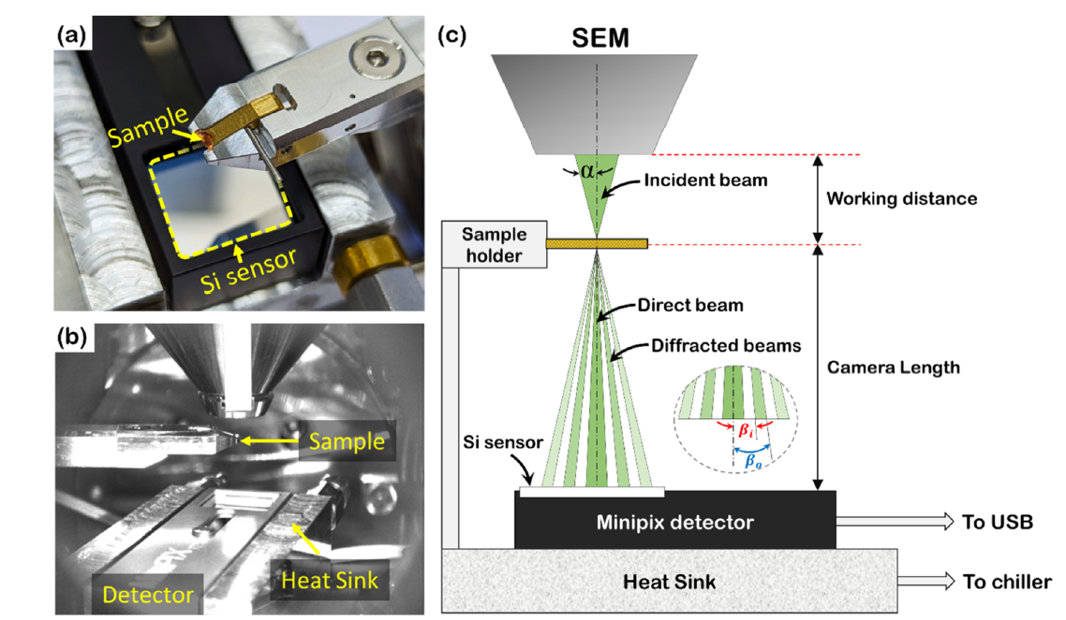
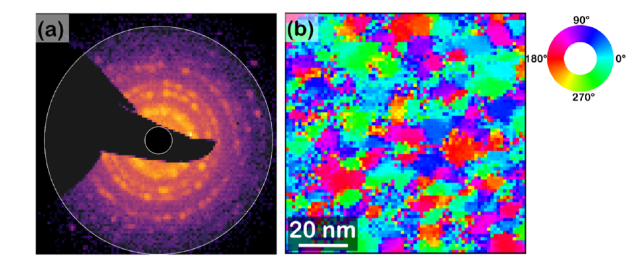
Addendum: 4D STEM in SEM
Caplins et al., (2020), Orientation mapping of graphene using 4D STEM-in-SEM. Ultramicroscopy 219, 113137
(ZEISS GeminiSEM 300)
Orientation maps of Graphene collected using SEM-based 4D STEM
Bansal et al. (2025): Data-efficient 4D-STEM in SEM. Ultramicroscopy 276,114203
(ZEISS Merlin FEG SEM)
Average diffraction pattern and in-plane orientation map from nanocrystalline Pt-Cu (10-15 nm grain size)

