Slide 1
Institute of Digital Healthcare
Overview
RSE Meeting (11/11/21)

Slide 2
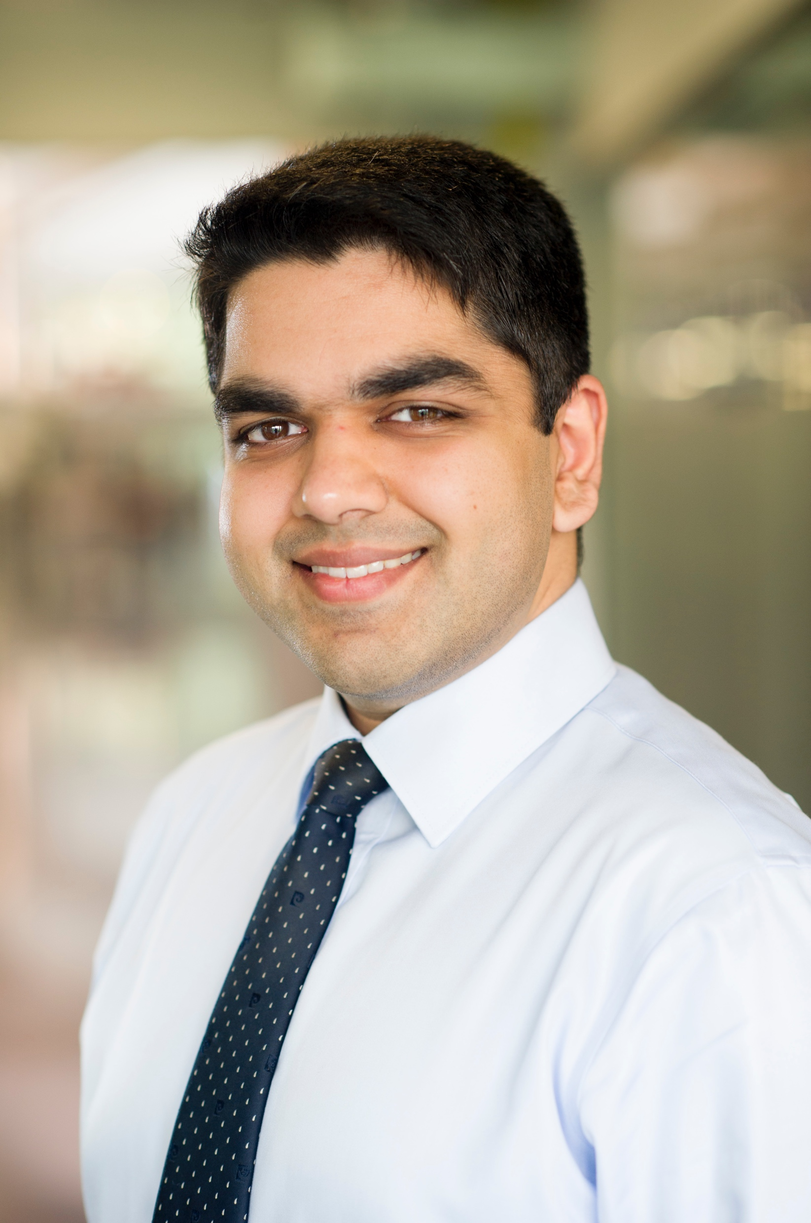
About Me
Background in Software and Biomedical Engineering (medical imaging, biomechanics, cellular engineering)
Worked in industry/NHS
Clinical Decision Support
Online Consultation
Joined WMG/University of Warwick in 2014
Research Software Engineer with focus on Healthcare Interoperability
Lead Software Engineer at the Institute of Digital Healthcare
RSE Team, currently 5 members

Slide 3
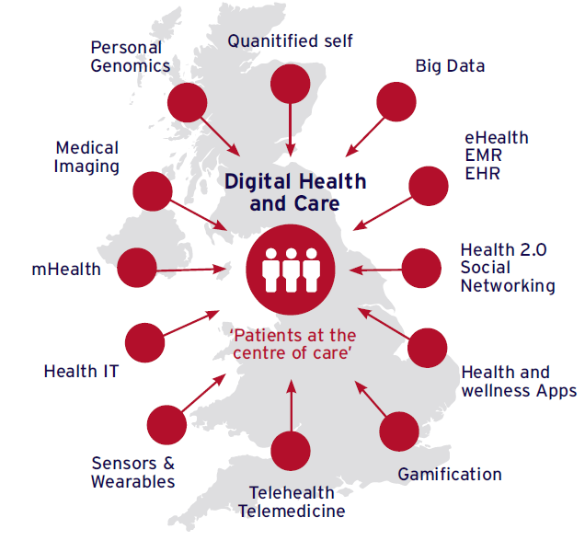





Setting: Smart Healthcare
“The impact technology can have in healthcare is profound and transformative.”
“Novel technologies and materials will continue to improve our ability to predict, diagnose and treat disease.”
“…data and technology has the power to improve health, transforming the quality and reducing the cost of health and care services.”
“Successful health care delivery requires effective medical devices as tools for prevention, diagnosis, treatment and rehabilitation. .”
IDH was set up in 2010 as a joint enterprise between WMG and WMS

Slide 4







IDH Facts and Figures
20 Members
(1 Full Prof, 3 Associate Profs, 1 Prof of Practice, 1 SRF, 4 RFs, 4 Software Engineers, 2 STFs, 1 Business Development Manager, 1 Project Manager, 1 Administrator, 1 Research Officer) 4 Honorary Profs
Students (2014-2021)
Current PhD Students: 15
Completed PhD Students (2014-2020): 14
External PhD Students (2014-2020): 7 (completed)
MSc Students (2016-2021): 105
BSc Students (2019-2021): 23
Publications (2014-2020)
Journal Peer-reviewed papers (including extended abstracts): 104
Conference papers (including extended abstracts): 138
Industry Involvement
80 CAs/NDAs with SMEs and larger industry on health IT, Pharma, biotech
Research Income (2014-2020):
£12,265,875.72
3 Filled Patents
5 EU Innovation Radar Recognitions
IDH
Facts and Figures

Slide 5



IDH Research Areas
Informatics and Health Data Science
Healthcare Technologies & Engineering
Applied Behavioural Science
Data Integration | Data Harmonisation
Data Modelling
Informatics & Analytics
Radiomics
Systems
Devices, Sensors, Microfabrication
Visualisation | Modelling | Simulation
Patient-centred care
Telecare | Telemedicine
Impact of technology Studies
User-Centred Evaluation/Human Factors
Co-Production
Self-Management
Adherence Strategies
IDH
Research Areas
Research Themes

Slide 6
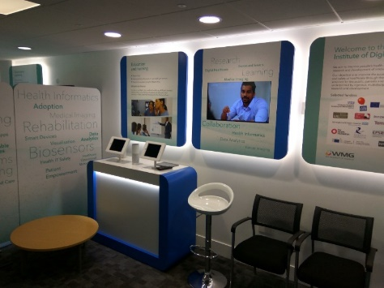
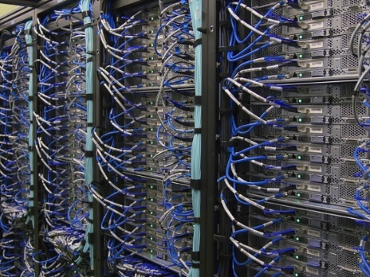
Capabilities: Infrastructure
IDH Showcase facility for public and industry collaboration
IDH Motion Capture Laboratory: 10 Qualisys 3D motion capture video cameras, 14m walkway for gait analysis
Healthcare Technologies Laboratory: Indirect calorimetry and rehab treadmill, Oculus and HTC VR headsets, Shimmer inertial measurement and physiology sensors, Actigraph activity monitors
Health Informatics Computational Facility – GPU, servers & data centre compatible with NHS requirements
IDH
Capabilities
Infrastructure

Slide 7

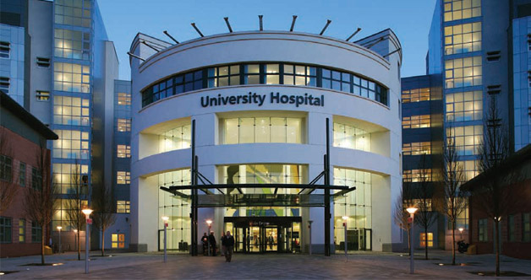
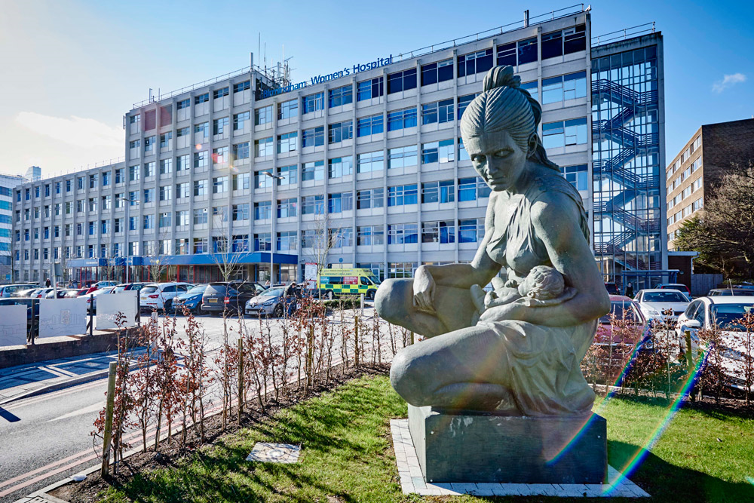
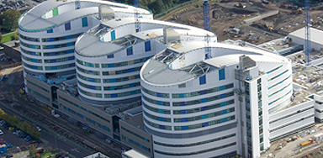
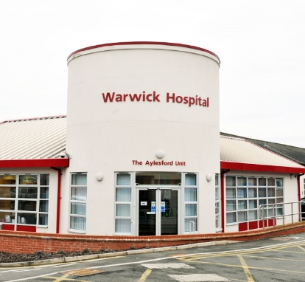
Network: Strategic NHS Partners
University Hospitals Coventry & Warwickshire NHS Trust
Birmingham Women’s and Children’s NHS Foundation Trust
South Warwickshire NHS Foundation Trust
University Hospitals Birmingham NHS Foundation Trust
Arden & GEM CSU - NHS Commissioning Support Unit (CSU)
IDH
Capabilities
Partners

Slide 8
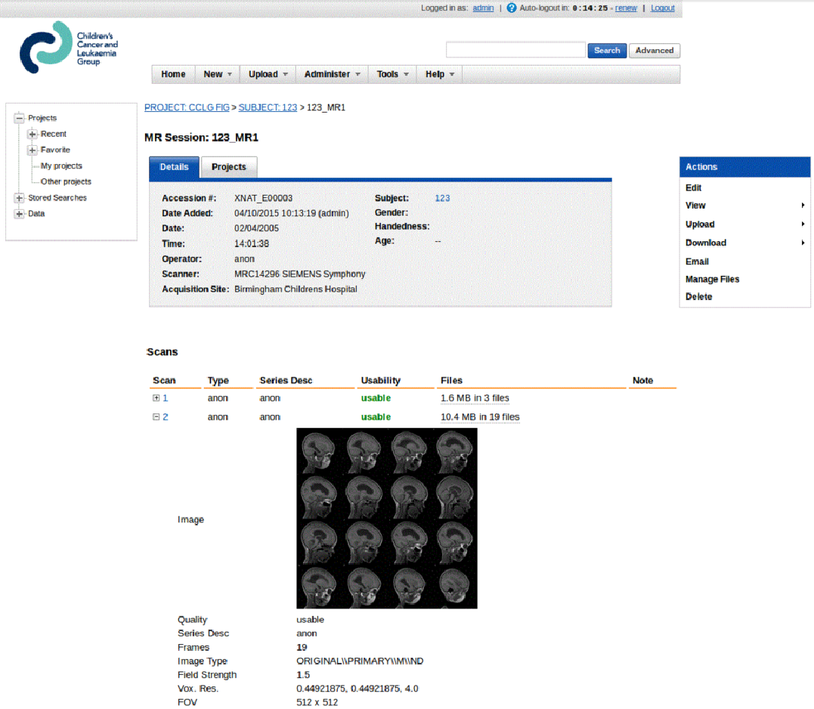
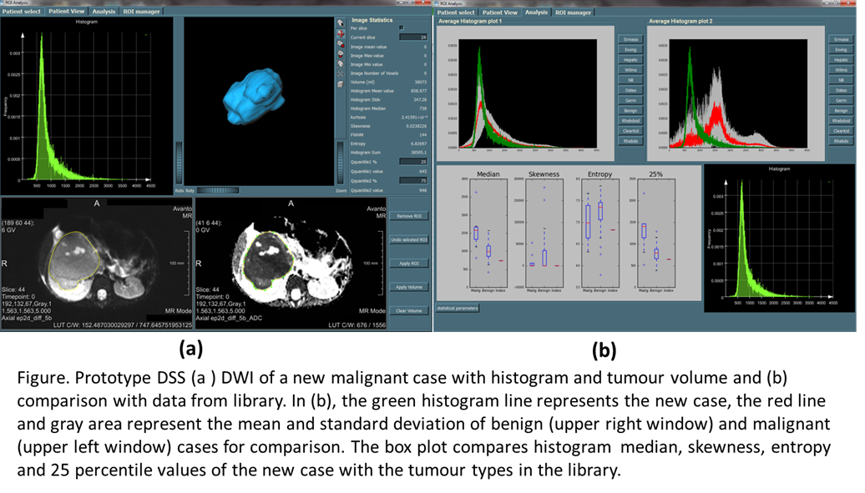











A Framework for Clinical Image-based Data Integration, Harmonisation and Interoperability
Ambition/Impact
To provide a software framework, e-repository and clinical decision making approach for functional imaging data.
Challenge
To augment CCLG’s efforts on efforts on multi-centre imaging trials and produce CDSS.- Link to BEACON trial.
IDH Innovation
Quality control, standardisation in data collection, interoperability, extensibility of imaging software systems.
HDR UK Priority
Applied Analytics
Staff
Theodoros N. Arvanitis (Lead), Andrew Peet (co-Lead), Jay Bhalodiya, Omar Khan, Ashley Peake, Sarah Lim Choi Keung.
Funding & Partners
IDH
Research Projects

Slide 9

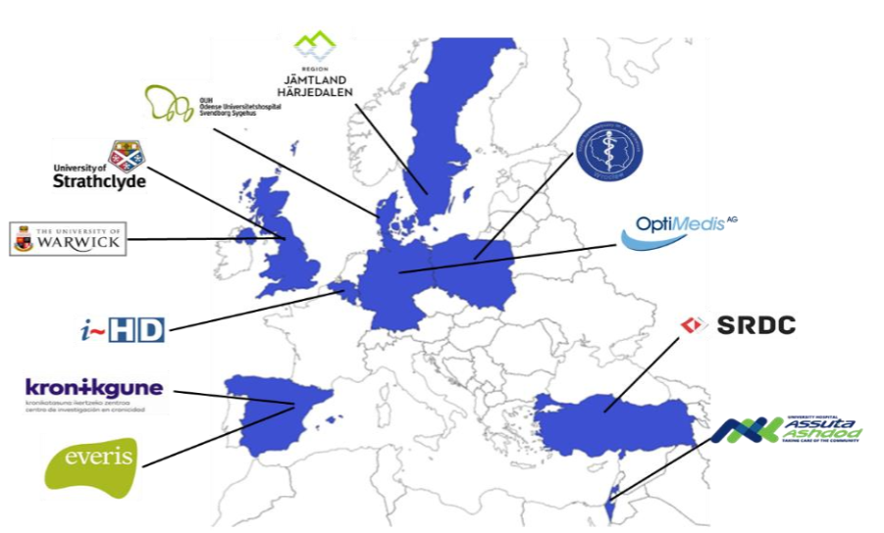











ADLIFE
Ambition/Impact
Early detection of care needs and personalised self-management of patients with advanced chronic diseases
Challenge
To create digital tools for clinical decision supported integrated care systems for heterogeneous multiple pilots
IDH Innovation
Development of clinical decision support tools for advanced chronic diseases.
IDH Innovation
Interoperability of multi-modal heterogeneous data in a mature deployable solution
Staff
Theodoros N. Arvanitis, George Despotou, Sarah Lim Choi Keung, Omar Khan.
Funding & Partners
IDH
Research Projects

Slide 10






Tommy’s Net
Ambition/Impact
National miscarriage research centre, offering accurate big data to clinical researchers.
Challenge
Poor interoperability of clinical sites and storage compliant to information governance.
IDH Innovation
Health IT clinical systems integration, and multi-site data collection and live analysis.
Staff
Theodoros N. Arvanitis, Omar Khan, Sarah Lim Choi Keung
Funding & Partners
IDH
Research Projects

Slide 11

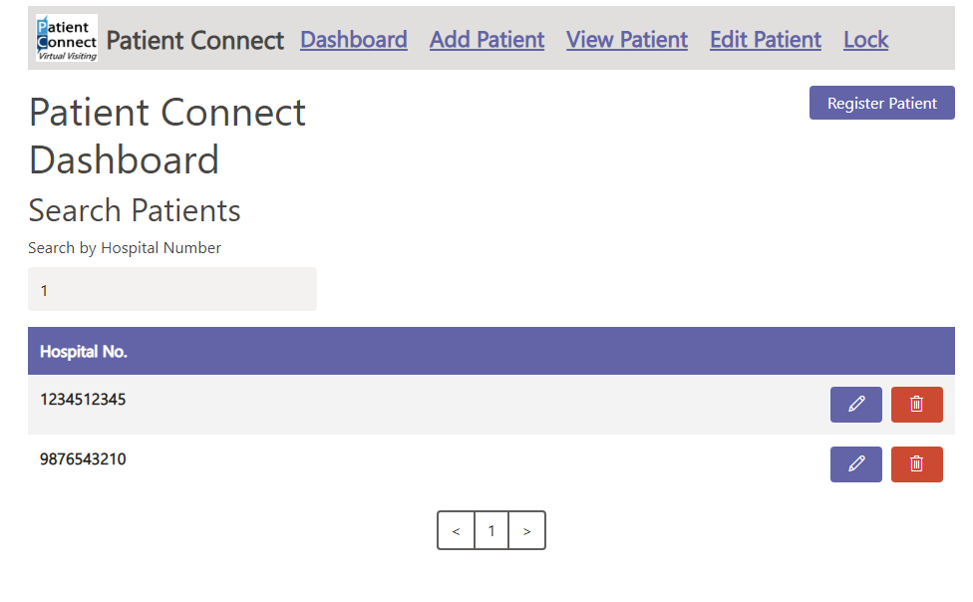
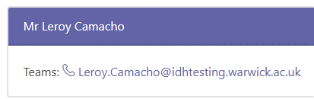

PatientConnect (pro bono)
Ambition/Impact
Support facilitated calls for patients in isolation, who are otherwise unable to contact relatives during the pandemic
Challenge
To create patient facing digital tools to support hospital staff facilitated calls whilst maintaining patient privacy
IDH Innovation
Development of an accessible mobile application which supports facilitated video calling.
IDH Innovation
Development of a HL7 FHIR conformant application which stores data in an IG and GDPR compliant database
Staff
Theodoros N. Arvanitis, Joseph Hardwicke, Ashley Peake, Omar Khan
Funding & Partners
IDH
Research Projects

Slide 12


The Future
Knowledge sharing across RSE teams
More collaboration/upskilling
Training for RSEs
Centrally funded RSEs
Ability to work across projects
Costed in to grants as resource
More flexibility and continuity
Support for Software Development
Closer collaboration and support from IT
Infrastructure to support development and deployment of solution
Approved VC/Issue tracking solutions provided by the University
IDH
Forward View

Slide 13

Thank you
Contact:
Omar Khan,
Lead Software Engineer
M.O.Khan@warwick.ac.uk

