Slide 1
Paul Brown
Systems Biology and Infectious Diseases Epidemiology (SBIDER)
&
Bioinformatics Research Technology Platform

Slide 2
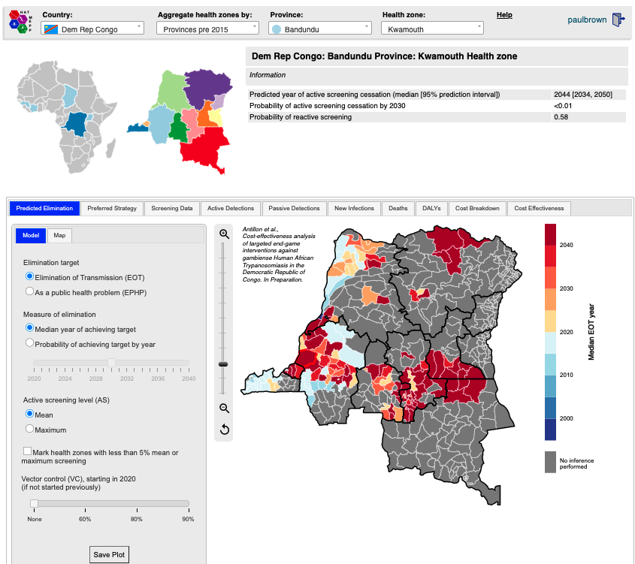

Slide 3
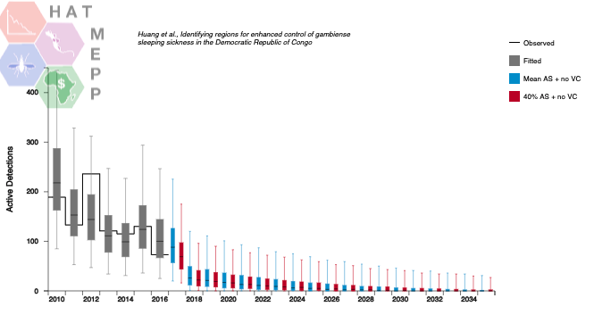
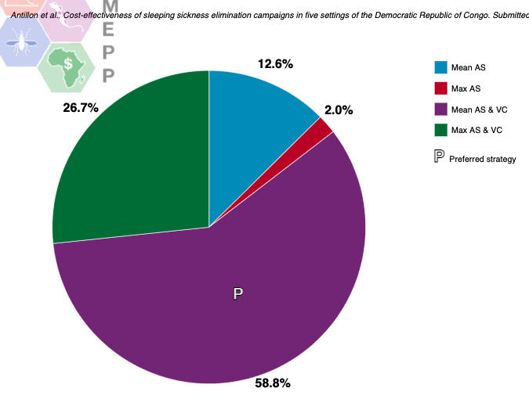
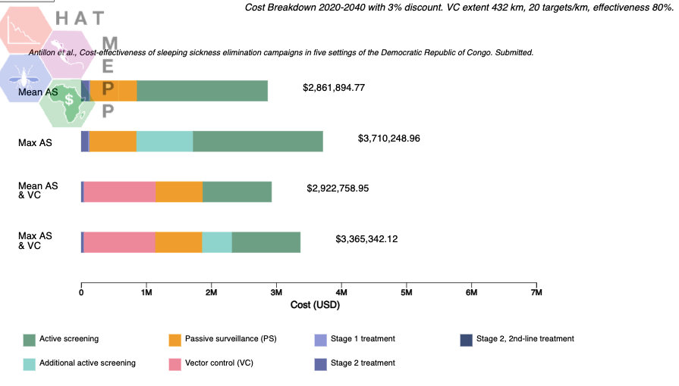

Slide 4
Bioinformatics RTP
Mission Statement
We carry out data analyses, provide advice on designing workflows of experiments and computational analyses, set up web-based applications and databases, facilitate biomedical use of high-performance computing and provide training in a range of Bioinformatics skills.
https://warwick.ac.uk/research/rtp/bioinformatics

Slide 5
Bioinformatics RTP
Funded by a number of departments, including WMS, Life Sciences, Computer Science, Chemistry, Mathematics and Statistics. Free at point of access
Run weekly clinics Tuesday morning in Gibbet Hill Café, or via Zoom
We can provide training in programming languages, such as R, MATLAB, C++, Javascript/HTML/CSS and provide access to HPC clusters

Slide 6
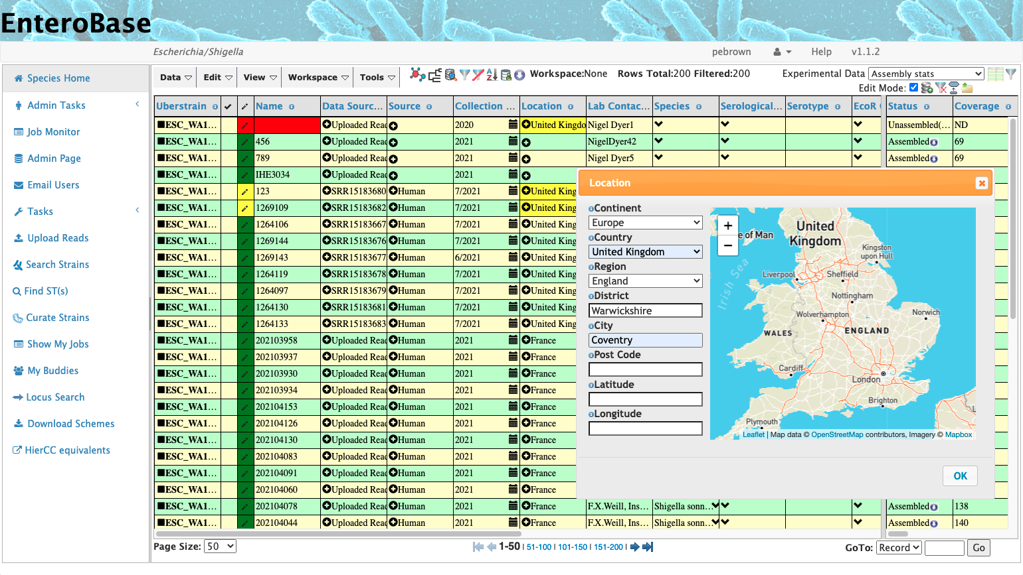
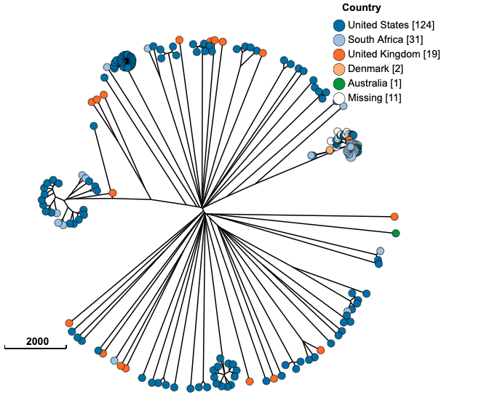
Over 0.5 M genomes
4200 users globally
Used by public health surveillance labs around the world to track food-borne pathogens

