Slide 1
Scientific Computing RTP RSE activity
warwick.ac.uk/scrtp/rse
Prof. David Quigley
Director, Scientific Computing RTP

Slide 2
What is SCRTP?
Scientific Computing Research Technology Platform
Formed in August 2014 from the facilities component of the Centre for Scientific Computing (CSC)
One of 12 RTPs in the university. Shared equipment and expertise at greater than departmental scale
Shared Equipment
SCRTP hosts and operates Warwick’s two tier 3 High Performance Computing (Orac and Avon)
HPC Midlands+ Sulis tier 2 facility
Multi Petabyte “group storage” system for large, live datasets
Pool of “taskfarm” servers for non-HPC workloads
Managed Linux for Scientific Computing
Around 200 desktops/workstations (mostly Physics and Chemistry departments)
Approximately 100 servers hosted for specific projects/groups/modules

Slide 3
Funding
Notionally a university-wide facility
82% of ”shares” held by just 3 departments (Physics, Chemistry, Engineering)
Available to everyone, but job priority set in proportion to shares
Some significant freeloading departments

Slide 4
Research Software Engineering
Followed Shipman review (2016) of Scientific Computing at Warwick
“The Panel believes that the University would benefit from its own in-house expertise in [RSE]. It therefore recommends that consideration be given to the underwriting of such a post, on the understanding that this would be costed into grant applications in the future. Such a post would [be] best located in the SC RTP.”
No budget accompanied this recommendation!
Kickstarted an RSE group in 2017 with funding from an EU grant in Maths and Warwick commitment to provide 0.5 FTE to HPC Midlands+
Now two-and-a-bit people, close to 100% funded on external grants

Slide 5
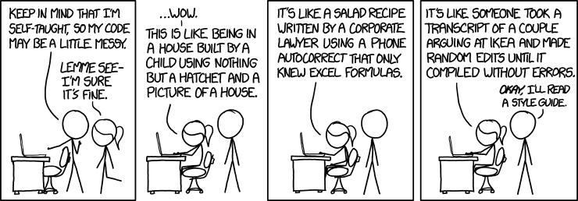
RSE objectives
Stable career path for researchers who develop software that research depends upon (people as research infrastructure)
Instill an institutional culture of competence around research computing and research software (training)
Pool of experienced developers available for secondment to projects
https://xkcd.com/1513/

Slide 6
RSE challenges
National muddying of the water between RSE and DevOps type roles
How many RSEs nationally are developing software?
People Tetris
No capacity to take on short term projects
Obliged to follow the money
Very much HPC focused staff and activity (but no apologies for that)
Long-term grant funding of 1 FTE entirely focused on HPC
Leaves little time for more entry-level training activity
Research vs professional services roles
Complicated REF and financial implications (not Warwick specific)
Software output is REFable, but many universities nervous of entering it….

