Slide 1

Towards a training workshop web platform for Omeka S
Lightening talk at the Warwick RSEs - Autumn Meeting (Hybrid)
By Dr Godwin Yeboah, Senior Research Software Engineer
Research Computing, Research Technology Platforms, University of Warwick
31st October 2023
Notes:
[next]

Slide 2
Outline
Research question and objective
Brief introduction to Omeka S
Options for using Omeka S in training workshops
Outcome and feedback on initial experimentation using an option based on Warwick Linux Hosting provision
Q&A, if any
Notes:
..
[Next]

Slide 3
Research question and objective (I): Ongoing…
Research question (work-in-progress)
How can a training workshop web platform be setup for Omeka S to facilitate upskilling of researchers in the University of Warwick?
Research objective (work-in-progress)
Examine available options. Docker Desktop (PCs in Labs/Participant’s laptop), Omeka.net (trial-limited/paid services), Github Codespaces (free-limited/paid services), participant’s laptop install, Warwick Linux Hosting Service, etc.
Decide pathway(s). Docker Desktop on PCs in a Lab, Warwick Linux Hosting Service, Github Codespaces.
Implement pathway. Setup Omeka-S platform using Warwick Linux Hosting Service, etc
Seek feedback. Find ways to get feedback (e.g., RSE meetings, own team members etc).
Use implementation for organising future Omeka S training workshop. Possibly next term.
(Being a bit daring: There seem to be currently no training workshop web platform for Omeka S)
Notes:
There seem to be currently no training workshop web platform for Omeka S.
…
[Next]

Slide 4
Research question and objective (II): Ongoing…
Add/import items to the site. For example, using workshop data in .csv format.
Make a collection of items. Thus, based on imported data or manually created items.
Create an Exhibit separate from other workshop participants. Thus, participant creating own interactive website showing digital collections and based on workshop materials.
Research objective (work-in-progress): Training workshop scenario
Set Up an Omeka S account using Warwick ITS account details. This is done via LDAP.
Setup Up an Omeka S site unique only to the user account. Thus, unique to each participant.
Possibility to uninstall Omeka S, back up workshop data, delete entire workshop data, re-set instance for another workshop or continue use in another training workshop
Have at least 500MB disk space to work during the workshop. This can be increased.
Notes:
There seem to be currently no training workshop web platform for Omeka S.
…
[Next]

Slide 5
Brief introduction to Omeka S (I): What is Omeka S?
Omeka Technology Ecosystem
Omeka S
Omeka Classic
Omeka S & Classic
Omeka.net
- Next generation technology
- Multiple independent websites installations from one instance
- API-First Design philosophy
- Uses multiple vocabularies
- Advanced Access Control and User Roles
- Modular architecture
- Web Content Management System (CMS)
- Designed for digital collections & online exhibitions, particularly in the context of cultural heritage institutions like museums, libraries, archives, Arts Faculties
- Previous generation technology
- Single website per instance
- Dublin core vocabulary
- Simpler Access Control
- Plugin architecture
- Hosted Omeka Classic
- limited free trial account
- paid service
Notes:
..
[Next]

Slide 6
Brief introduction to Omeka S (II): What is Omeka S?
Core developers:
Roy Rosenzweig Center for History and New Media (CHNM) at
George Mason University (GMU) (2008-2016)
Corporation for Digital Scholarship - digitalscholar.org (2016-Present) (Wikipedia)
Type:
Web Content Management System (e.g., WordPress, Drupal, etc.)
A web publication system for universities, museums, galleries, libraries, and archives
Omeka S
(omeka.org/s)
License:
GPL-3.0-or-later
Free and open-source content management system for online digital collections.
GitHub Repository
https://github.com/omeka/omeka-s
Based on Opensource Technology Software stack:
Written in PHP!
PHP was originally an abbreviation of Personal Home Page, but it now stands for Hypertext Preprocessor.
Developers leveraged on LAMP stack (Linux, Apache, MySQL, PHP)
Other:
Dublin Core (ISO Standard - ISO 15836) for describing digital or physical resources
Possibility to extend core functionalities
Strong support community (Omeka S forum)
Possibility to setup a website without any programming
Notes:
..
[Next]

Slide 7
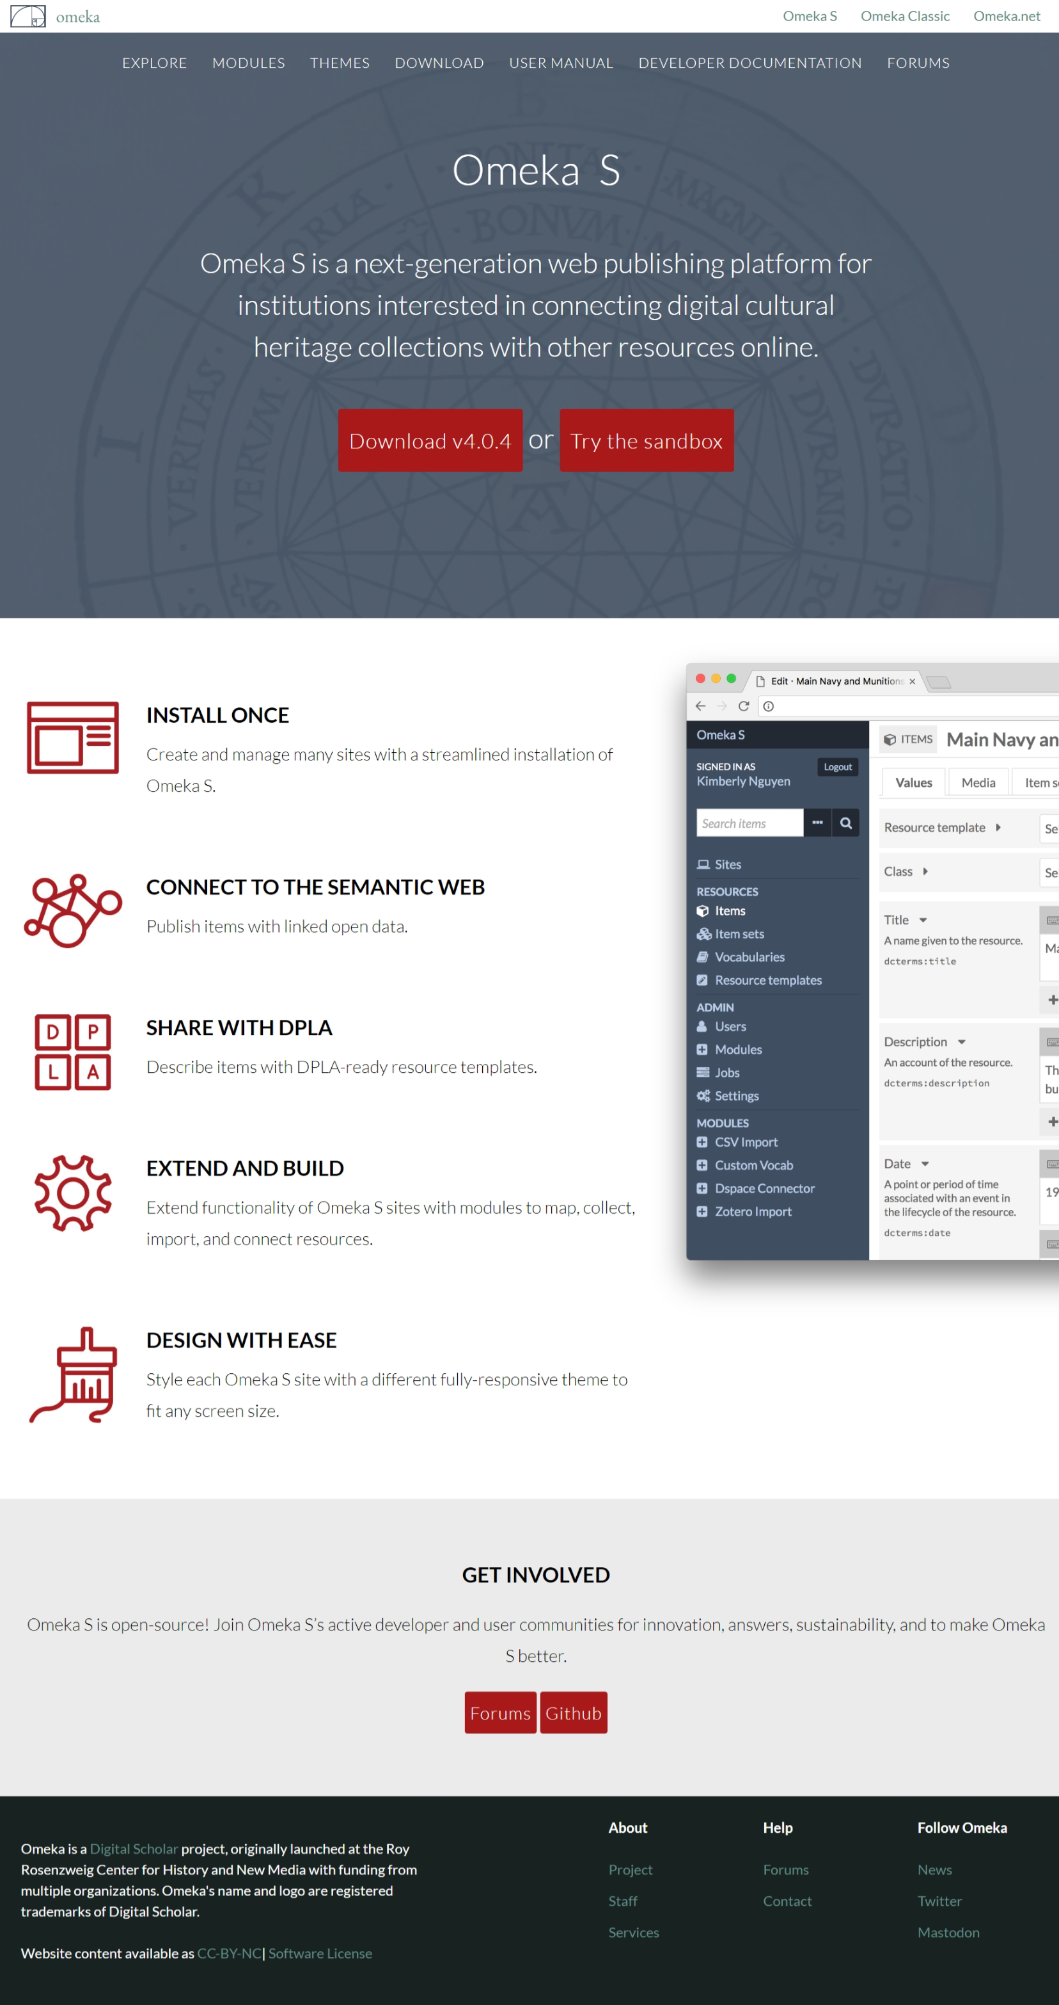
Brief introduction to Omeka S (III): What is Omeka S?
Notes:
…
[Next]

Slide 8
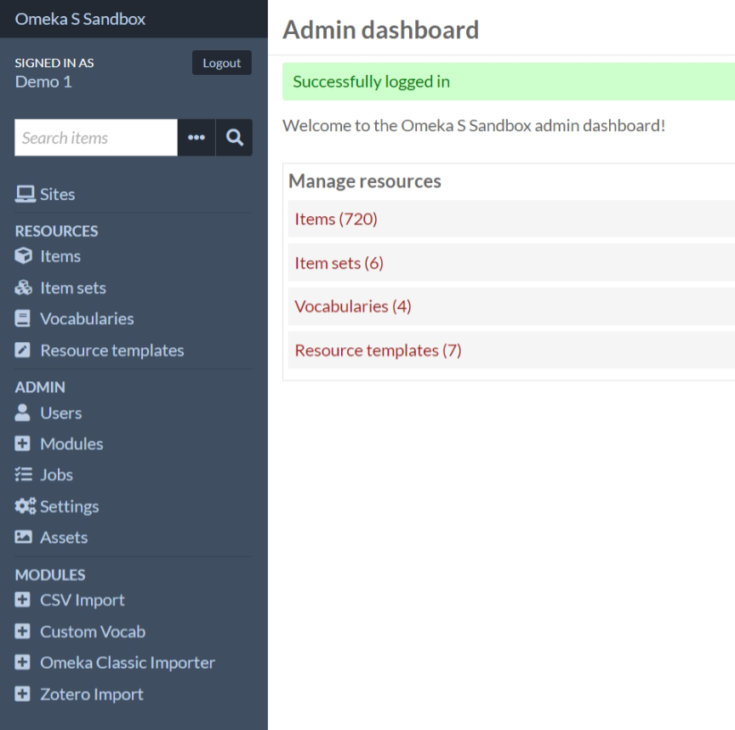
Omeka S sandbox - https://omeka.org/s/download/#sandbox
Brief introduction to Omeka S (I): What is Omeka S?
Brief introduction to Omeka S (IV): What is Omeka S?
Notes:
…
[Next]

Slide 9
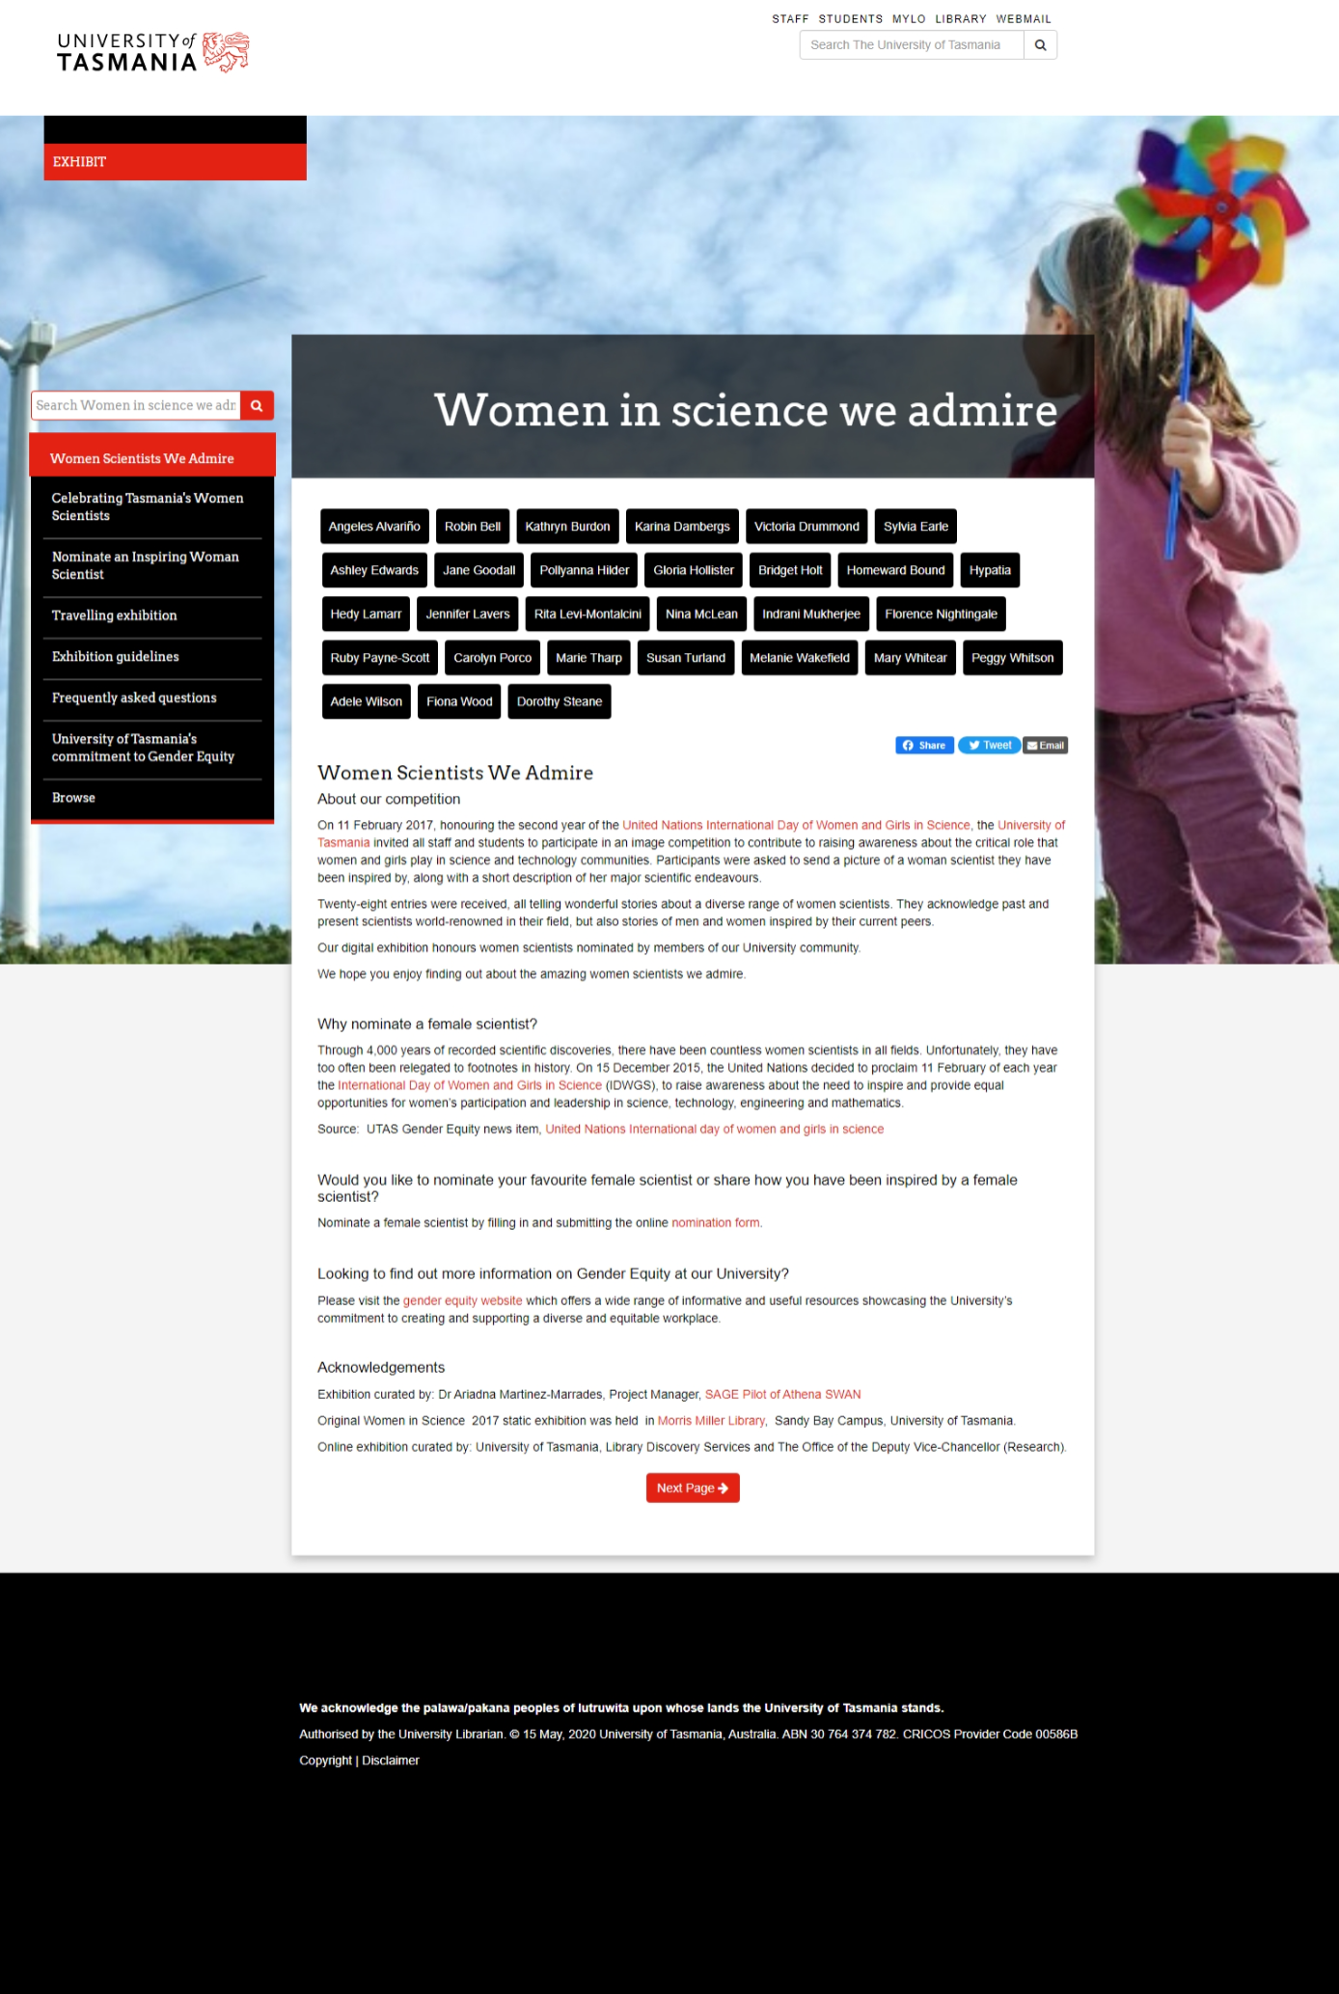
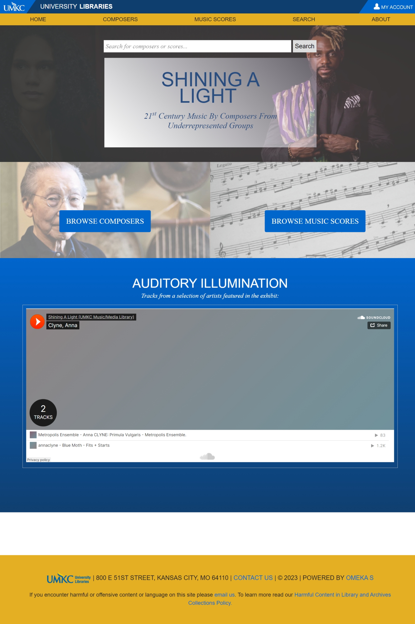
Brief introduction to Omeka S (I): Examples of Omeka S sites
https://exhibit.utas.edu.au/s/women-science-we-admire/page/women-scientists-we-admire
https://exhibits.library.umkc.edu/s/shining-a-light/page/home
Notes:
..
[Next]

Slide 10

https://reve.warwick.ac.uk
Brief introduction to Omeka S (II): Example of Omeka S sites
I recently developed this interactive exhibit/website for Academics from the University of Warwick and University of Verona
Notes:
..
[Next]

Slide 11
Options for using Omeka S in training workshops
Docker
Omeka.net
Based on Omeka Classic (earlier generation of technologies)
Any ideas? …
Full control of resources (seems appropriate for Warwick workshops)
Github Codespaces
Free-limited/paid services
Docker Desktop on PCs in Labs
(No support by IDG but Docker Inc approves usage when requested)
Participant’s laptop (high burden)
Warwick Linux Hosting Service
External resources
Limited free service
Terms and conditions may not permit use for workshop
Partial control of resources
Suitable for LDAP implementation for Warwick staff/students
…
Participant’s laptop install
High burden on participant
Unlimited paid services
Participant may not have personal laptop
Server request (Available for Warwick Staff and researchers)
Notes:
..
[Next]

Slide 12
Initial Experiment (I): Option based on Warwick Linux Hosting provision
Requested
Linux server
(Warwick Linux Hosting)
Programming
(PHP, HTML, CSS, SQL, Shell script)
/var/www/html/
|── users/
│ |── login.php
│ |── logout.php
│ |── profile.php
│ |── setup_config.php
│ |── profile.php
│ |── setup_config.php
|── index.php/
|──Readme.txt
|──runFirstTimeSetup.sh
AlmaLinux Apache Web Server
No. of CPUs: 1
Memory (GB): 2
Additional Storage (GB): 10
MariaDB (MySQL)
Warwick LDAP Server
Notes:
..
[Next]

Slide 13
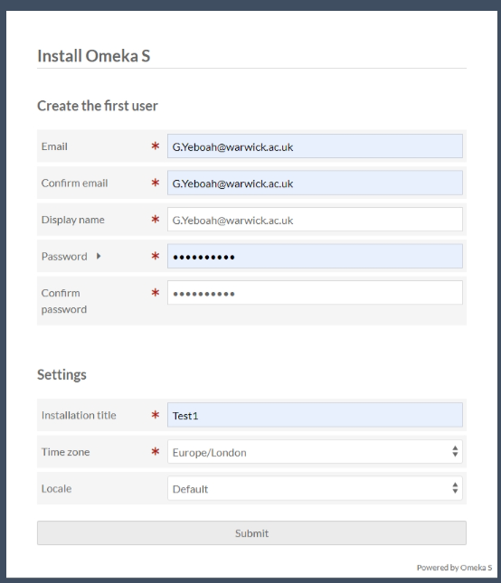
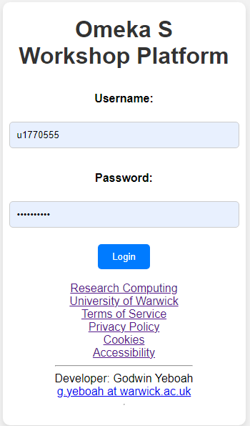
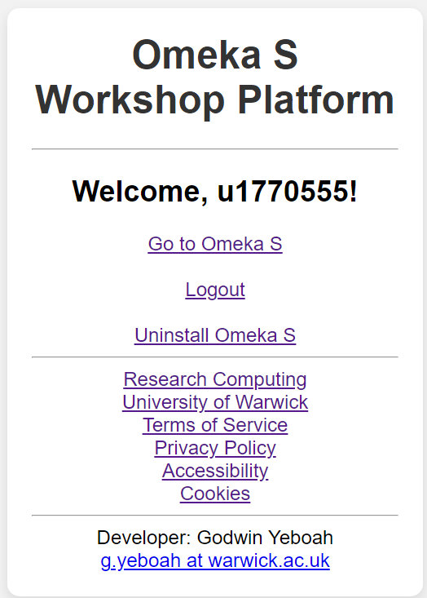
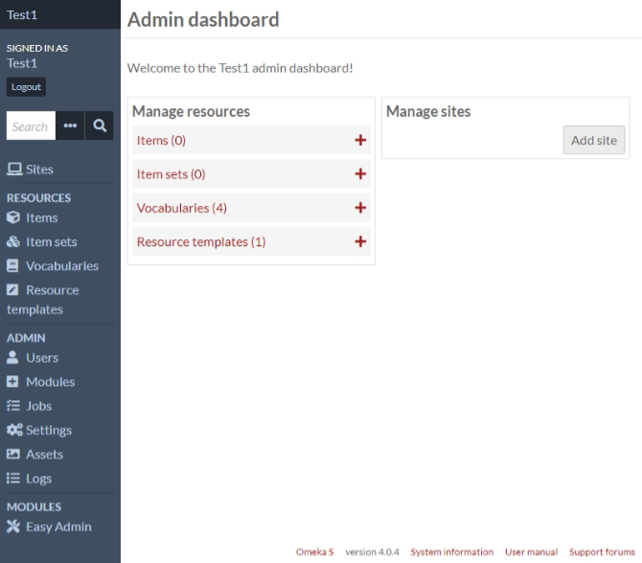
Initial Experiment (II): Option based on Warwick Linux Hosting provision
[You can try by logging in with your warwick ITS account here - https://gold-pony.lnx.warwick.ac.uk]
Notes:
..
[Next]

Slide 14
Feedback strands
Strand A
  Please provide any feedback based on this short presentation
Strand B (if you can)
  Testing
    LDAP-based login implementation
    Omeka S installation & uninstallation
  If you want to provide feedback, please use Warwick ITS account to login and try to install Omeka S (testing LDAP implementation and Omeka S installation)
    Go to following test server: https://gold-pony.lnx.warwick.ac.uk
    Use your Warwick ITS account (LDAP is used so your account will not be stored)
    Confirm if you can setup Omeka S successfully
Notes:
..
[Next]

Slide 15
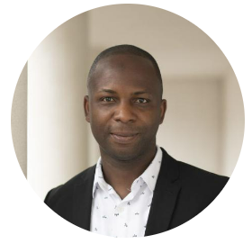
Thank you
Q & A / End
Dr Godwin Yeboah
Research Computing team member, Research Technology Platforms (RTPs), University of Warwick, UK.
Email: g.yeboah@warwick.ac.uk
Twitter: @GodwinYeboah
OrcID: 0000-0003-4618-3175
ResearchGate: https://www.researchgate.net/profile/Godwin-Yeboah
Notes:
[Next – you can wait for Q&A or do the walkthrough]

