Slide 1





MEDICAL SCHOOL
CAMDU Computing
Tim Foster
Computing and Image Analysis Research Fellow
tim.foster@warwick.ac.uk
warwickcamdu
@warwickcamdu
Notes:
Hello, my name is Laura. I am part of the CAMDU team at the Medical School at the University of Warwick. If I was accepted onto the Elixir UK data stewardship fellowship programme I would aim to provide training and develop resources to give microscopists the practical skills to manage and share their data within the FAIR framework.

Slide 2
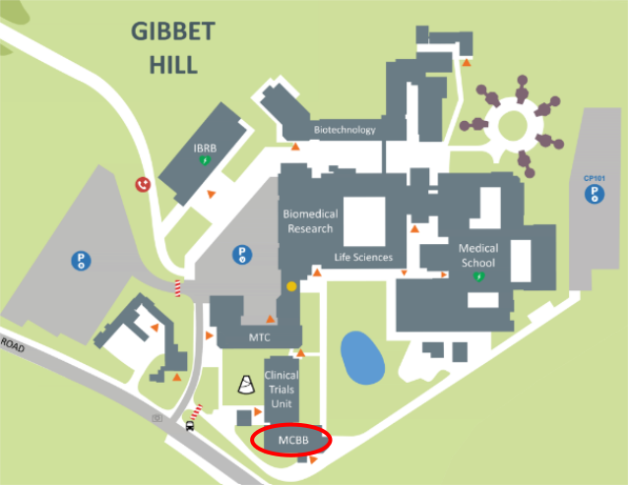
Computing and Advanced Microscopy Development Unit
tim.foster@warwick.ac.uk
warwickcamdu
@warwickcamdu
Notes:
The Computing and Advanced Microscopy Development Unit is a team of technical experts in microscopy and image analysis. We manage 17 microscopes and support 150 users with data management, acquisition and processing tasks. Our user base study the biomedical sciences including cell biology, microbiology and translational medicine and often collaborate with experts in physics and mathematics, requiring large data sets to be shared.

Slide 3
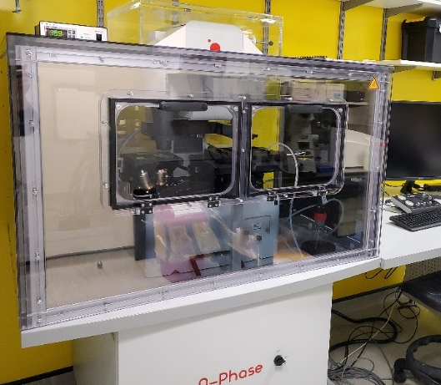
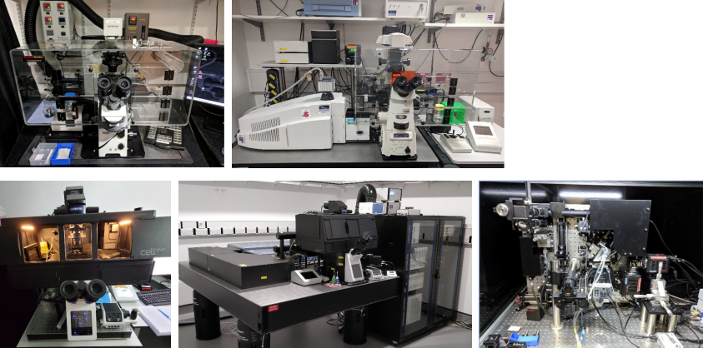

Computing and Advanced Microscopy Development Unit
17
Spinning disk confocals
Laser scanning confocal
Total internal reflection fluorescence
Multiphoton
Lattice Light Sheet
Quantitative Phase Imaging
tim.foster@warwick.ac.uk
warwickcamdu
@warwickcamdu
Notes:
The Computing and Advanced Microscopy Development Unit is a team of technical experts in microscopy and image analysis. We manage 17 microscopes and support 150 users with data management, acquisition and processing tasks. Our user base study the biomedical sciences including cell biology, microbiology and translational medicine and often collaborate with experts in physics and mathematics, requiring large data sets to be shared.

Slide 4
Large Datasets
100s MB
Image from N. Ferrandiz, L. Downie, G. P. Starling, S. J. Royle, bioRxiv 2021.04.23.441091; doi.org/10.1101/2021.04.23.441091
tim.foster@warwick.ac.uk
warwickcamdu
@warwickcamdu
Notes:
One challenge of making microscopy data FAIR is the size of the data files. A single 2D image file will usually be a few 100 megabytes, however depending on the imaging modality and number of time steps acquired a single image file can be

Slide 5
Large Datasets
100s GB
Image from N. Ferrandiz, L. Downie, G. P. Starling, S. J. Royle, bioRxiv 2021.04.23.441091; doi.org/10.1101/2021.04.23.441091
tim.foster@warwick.ac.uk
warwickcamdu
@warwickcamdu
Notes:
hundreds of gigabytes in size and a whole dataset

Slide 6

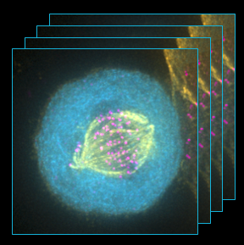
Large Datasets
Dataset
10s TB
tim.foster@warwick.ac.uk
warwickcamdu
@warwickcamdu
Notes:
can be several terabytes.

Slide 7
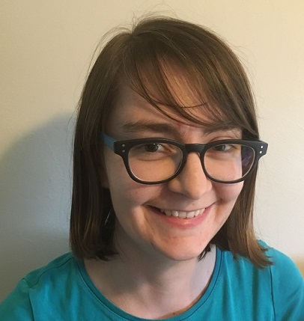

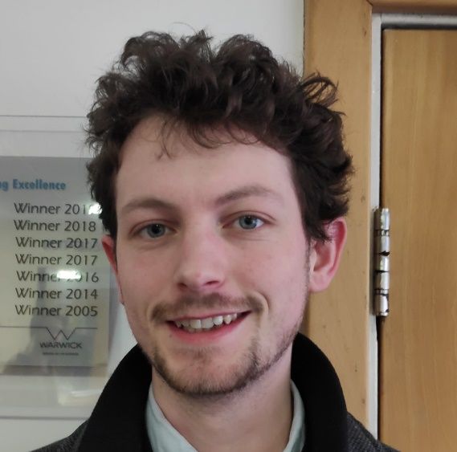

CAMDU Computing
Manage 5 image analysis workstations
Image analysis teaching, workshops, drop-ins, script writing
OMERO – Secure repository for microscope images
Other servers – Booking system, electronic lab notebook
tim.foster@warwick.ac.uk
warwickcamdu
@warwickcamdu
Notes:
The Computing and Advanced Microscopy Development Unit is a team of technical experts in microscopy and image analysis. We manage 17 microscopes and support 150 users with data management, acquisition and processing tasks. Our user base study the biomedical sciences including cell biology, microbiology and translational medicine and often collaborate with experts in physics and mathematics, requiring large data sets to be shared.

Slide 8
Questions?
tim.foster@warwick.ac.uk
warwickcamdu
@warwickcamdu
Notes:
The Computing and Advanced Microscopy Development Unit is a team of technical experts in microscopy and image analysis. We manage 17 microscopes and support 150 users with data management, acquisition and processing tasks. Our user base study the biomedical sciences including cell biology, microbiology and translational medicine and often collaborate with experts in physics and mathematics, requiring large data sets to be shared.

