Slide 1
Research Software in Psychology
RSE meeting

Slide 2
Introduction
Laboratory Research Technician
Part of the role is RSE related
New position from October 2023 – figuring out department needs
Background: PhD in Psychology, focused on Experimental Psychology / Psycholinguistics / Behavioural Economics

Slide 3
Overview
Research in Psychology
RSE in Psychology
What I do
Potential needs for central support

Slide 4
Research in Psychology
“The scientific approach to studying social, mental, and behavioural phenomena” (Hall, 2013)

Slide 5
Research in Psychology
“The scientific approach to studying social, mental, and behavioural phenomena” (Hall, 2013)
Psychology
Behavioural Science
Neuroscience

Slide 6
Research in Psychology
“The scientific approach to studying social, mental, and behavioural phenomena” (Hall, 2013)
Psychology
Behavioural Science
Neuroscience

Slide 7
Research in Psychology
“The scientific approach to studying social, mental, and behavioural phenomena” (Hall, 2013)
Psychology
Behavioural Science
Neuroscience

Slide 8
Research in Psychology
“The scientific approach to studying social, mental, and behavioural phenomena” (Hall, 2013)
Psychology
Behavioural Science
Neuroscience

Slide 9
Research in Psychology
Qualitative
Quantitative
Interview
Content analysis
Corpus analysis Surveying
Experimental Psychology
Computational Psychology

Slide 10
Research in Psychology
Qualitative
Quantitative
Interview
Content analysis
Corpus analysis Surveying
Experimental Psychology
Computational Psychology

Slide 11
Experimental Psychology

Slide 12

Experimental Psychology

Slide 13
Experimental Psychology

Slide 14
Experimental Psychology
Experimental condition
Participant (s)
Measure
Infer & predict behaviour

Slide 15
Experimental Psychology
Experimental condition
Participant (s)
Measure
Infer & predict behaviour

Slide 16
Experimental Tasks
Interactive
Computer- based
Usually light
Very varied and very high level of customisation
Timing tends to be very important

Slide 17
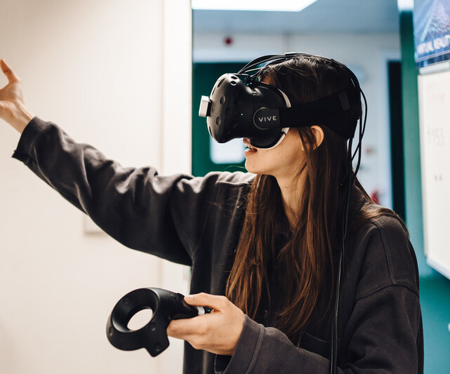
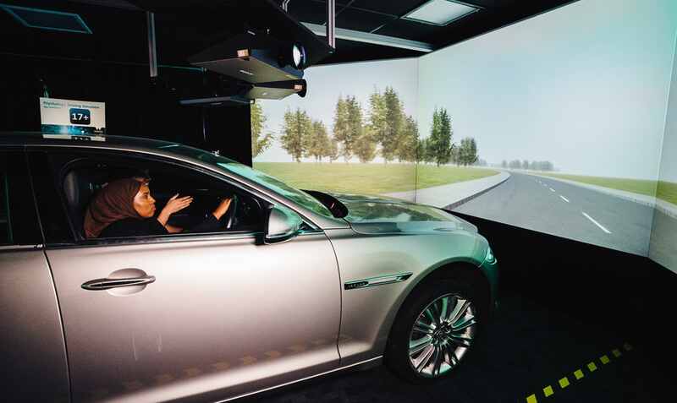
Experimental Tasks
Interactive
Computer- based
Usually light
Very varied and very high level of customisation
Timing tends to be very important

Slide 18
Research Software in Experimental Psychology
What tools are used to build this tasks?
Base Language | Tool
Python | PsychoPy , OpenSesame, oTree
MATLAB | Psychtoolbox
E-Basic | E-Prime
JavaScript | JSPsych, Qualtrics, lab.js, OSweb
C# | Unity3D, Godot

Slide 19
What I do
Lab support
Support choosing programming environment
Offer training in programming
Troubleshooting coding issues
Write custom code for specific functions
Identify research tools

Slide 20
What I would like to do
Better support in Computational Psychology
Better support in data analysis
Learn and extend good coding practices
Connect the members of the department with available resources

Slide 21
Potential wider RSE needs
Hosting & managing a server
HPC (more for computational psychology and data analysis)
Further training
Navigating IDG permissions and keeping up to date with software

Slide 22
Thank you!

