Slide 1

Research Culture:
Wider context and areas for discussion
Research Culture Committee
14 December, 2020

Slide 2

External context: Sector reports and publications
House of Commons Science and Technology ‘Research Integrity Report’
‘What Researchers Think About the Culture They Work In’ - Wellcome Trust
‘Changing Expectations’ programme - The Royal Society
Contractual terms of major funders

Slide 3
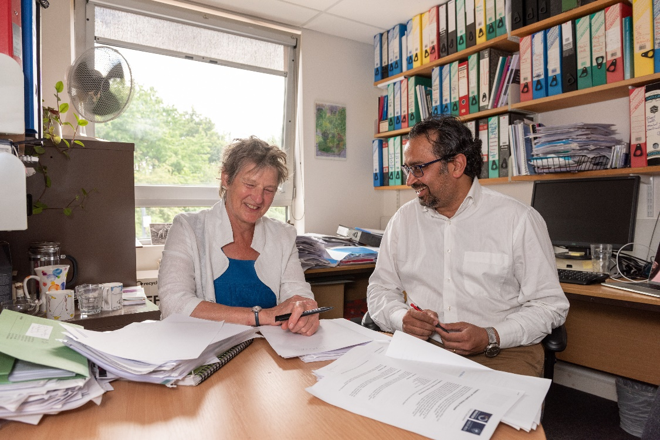
Internal context: Sharing best practice
REF2021
PGR Students
Early career researchers
Equality Diversity & Inclusion

Slide 4
Research culture: Timeline
2012 - ‘Concordat to support Research Integrity’
2018 - House of Commons Science & Technology ‘Research Integrity Report’
2019 - Revised ‘Concordat to support Research Integrity’
2019 - Report by the REF Equality and Diversity Advisory Panel (EDAP)
2019 - Funders T&Cs on bullying and harassment
2018-2020 - Wellcome Trust / Royal Society discussions on Research Culture
2020 - Establishment of a national research integrity committee (UKRI)
2020 - UK R&D roadmap - New R&D People and Culture Strategy

Slide 5

Concordat to Support Research Integrity 2012
UK’s national policy statement on research integrity – five commitments
Compliance is a prerequisite for receiving funding from UK research councils and higher education funding councils

Slide 6
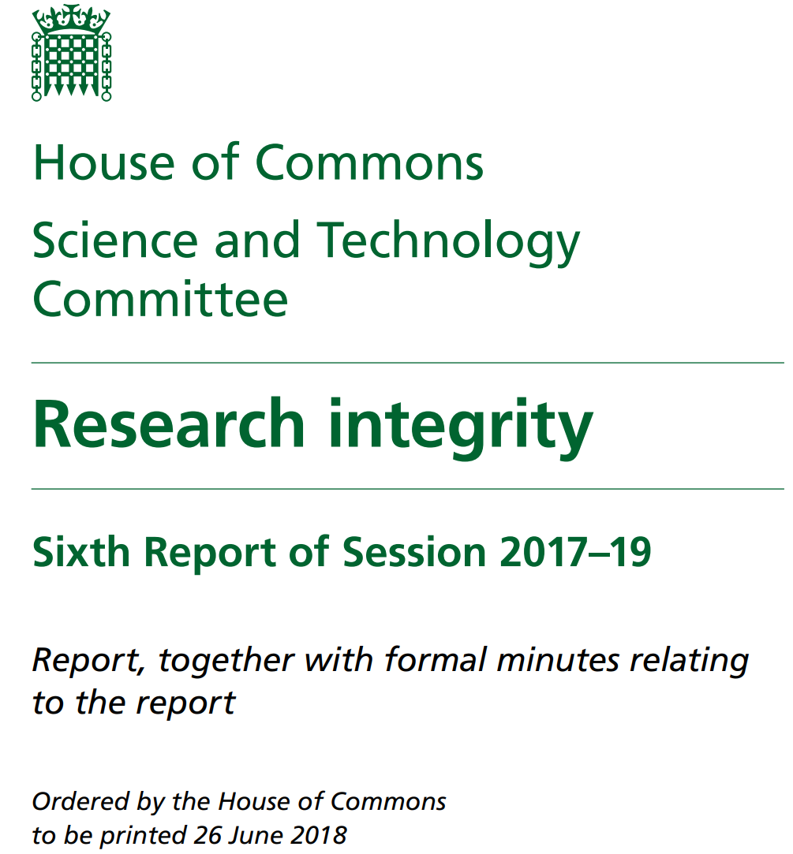
House of Commons Select Committee Report 2018
Concluded there was a continuing upward trend in misconduct and errors in publishing and a 'reproducibility crisis’ in some disciplines
Key recommendations of the inquiry:
  Strengthen the current Concordat so compliance can more easily be assessed
  Increased transparency on research misconduct required
  External members to be included on research misconduct investigation panels for serious cases
  A new committee to be responsible for championing research integrity in the sector to be established by UKRI

Slide 7
Concordat to Support Research Integrity 2019
Funders to only award funding to organisations that demonstrate compliance and incorporate into funding conditions
Employers of researchers must have mechanisms to periodically review research practice and culture
Employers must participate in an annual monitoring exercise demonstrating compliance
Employers must ‘promote training and development opportunities to research staff and students, and encourage their uptake’
Employers must have transparent, timely, robust and fair processes to manage research misconduct
Additional responsibilities on researchers to contribute to embedding a culture of research integrity
Definition of research misconduct expanded with more examples, e.g. plagiarism
Notes:
One of the key recommendations from the House of Commons Science and Technology Committee report was around strengthening the 2012 Concordat. The revised Concordat published in October 2019 sets out five high-level commitments that institutions are expected to demonstrate compliance with. The commitments are similar to those outlined in the 2012 Concordat, however there are a number of significant changes in the detail around the commitments. In addition, the language throughout the Concordat has been tightened, with the aim that compliance can be more easily assessed.
Commitment 1 now includes far greater emphasis on funders in terms of setting expectations of researchers through policy development and associating Concordat compliance with funding conditions.
(The 2019 Concordat states that research funders will publish clear statements of their expectations of researchers and employers of researchers regarding professionalism and integrity, take research integrity into account in the development of policies and processes and, crucially, encourage adoption of the Concordat by associating it with their funding conditions by only awarding funding to institutions that can demonstrate compliance. Funders are also required to take appropriate action when research misconduct is reported to them, which, in the most serious cases could include funding sanctions or mandatory improvements.)
Commitment 3 ‘Embedding a culture of research integrity’ sets out the signatories commitment to ‘supporting a research environment that is underpinned by a culture of integrity and based on good governance, best practice, and support for the development of researchers’. It requires employers of researchers to have in place mechanisms to periodically review research practice and culture.
(It goes on to describe the minimum key features of a research environment that helps to develop good research practice and embed a culture of research integrity. These include features such as clear policies, practices and procedures to support researchers, training on research ethics and research integrity and support for the development of researchers’ skills throughout their careers, robust management systems to ensure that policies relating to research, research integrity and researcher behaviour are implemented, mechanisms for providing support to researchers in need of assistance and clear processes for any staff member to raise concerns about research integrity.)
The revised Concordat states that employers of researchers will be required to participate in an annual monitoring exercise to demonstrate that the institution has met the commitments of the Concordat, however further information is yet to be received regarding what form this will take.
There had been an expectation within the sector that research integrity training would be made mandatory, however the 2019 Concordat stops short of this, requiring that employers of researchers ‘promote training and development opportunities to research staff and students, and encourage their uptake’. Despite the revised Concordat not requiring that research integrity training be made mandatory, the University has established a Research Integrity Training Committee with the remit of reviewing requirements around the completion of research integrity training, with the aim of working towards mandatory research integrity training for all staff and PhD students in order to strengthen the our research integrity environment.
Responsibilities of employers of researchers have been expanded to ensuring that procedures are in place to ensure that research is carried out in accordance with best practice, that there are systems in place to promote research integrity and that there are transparent, timely, robust and fair processes in place to investigate alleged research misconduct. In addition to these requirements, policies must ensure that there is no stigma attached to those researchers needing assistance from their employer and that research misconduct investigations are independent and well documented.
The revised Concordat also places additional responsibilities on researchers to contribute to embedding a culture of research integrity, stating that researchers will take responsibility for keeping their knowledge up to date on the frameworks, standards and obligations that apply to their work; collaborate to maintain a research environment that encourages research integrity and design, conduct and report research in ways that embed integrity and ethical practice throughout.
The 2019 Concordat also expands the definition of research misconduct, providing many examples, including a revised definition of plagiarism which now includes the use of other researchers’ ideas, including intellectual property, written or otherwise rather than just the use of materials without acknowledgment or permission.

Slide 8



Funders Terms and Conditions: Bullying and Harassment
Expectations of funders from organisations
  Foster a safe and supportive environment
  Policies and procedures in place
  Report actual and potential cases
  Check allegations with previous employers
Sanctions against individuals/organisation

Slide 9
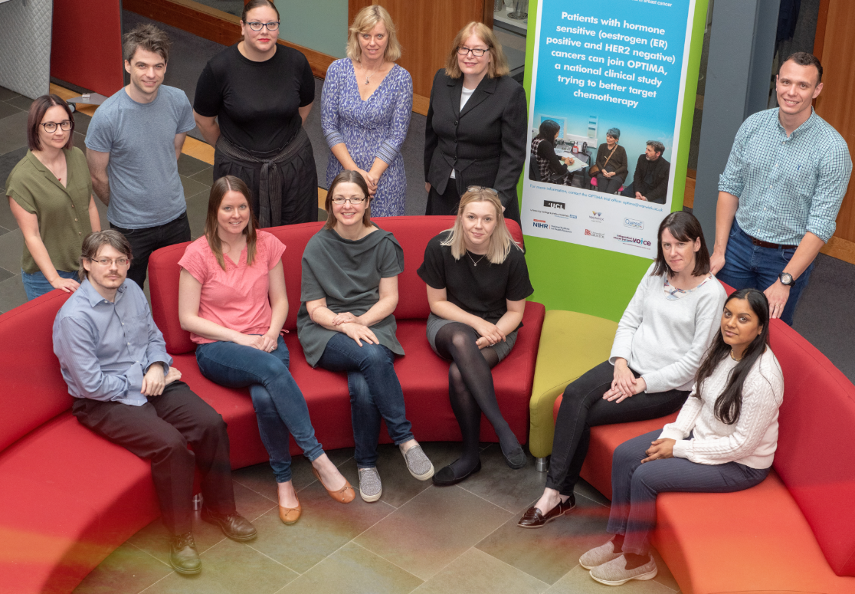
‘What Researchers Think About the Culture They Work In’
Wellcome Trust survey
Many negative responses
Impact of top-down strategies highlighted
Future options:
  Changes to funding and incentives
  Support for ECRS
  Misconduct
  Promotion of good practice

Slide 10
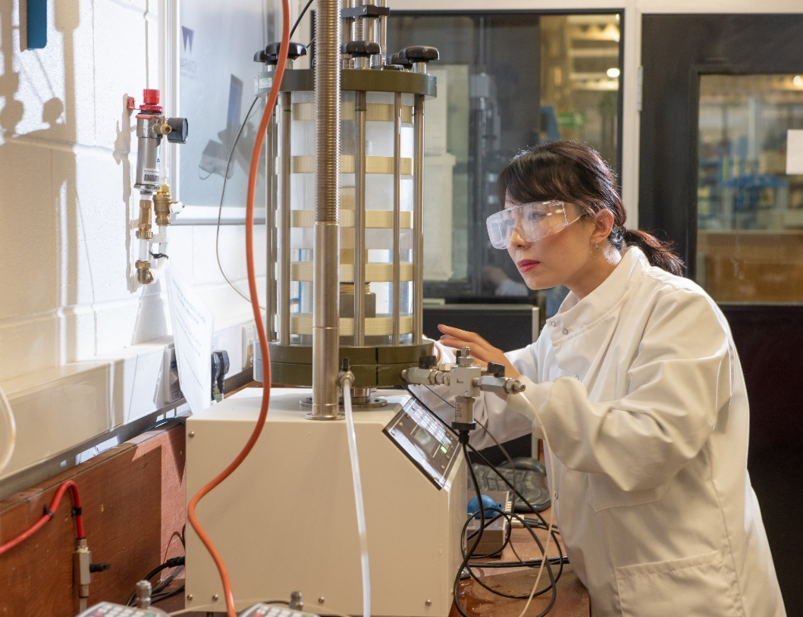
‘Changing Expectations’ Programme
Royal Society
Assessment of research and researchers
Researcher career development
Open science

Slide 11
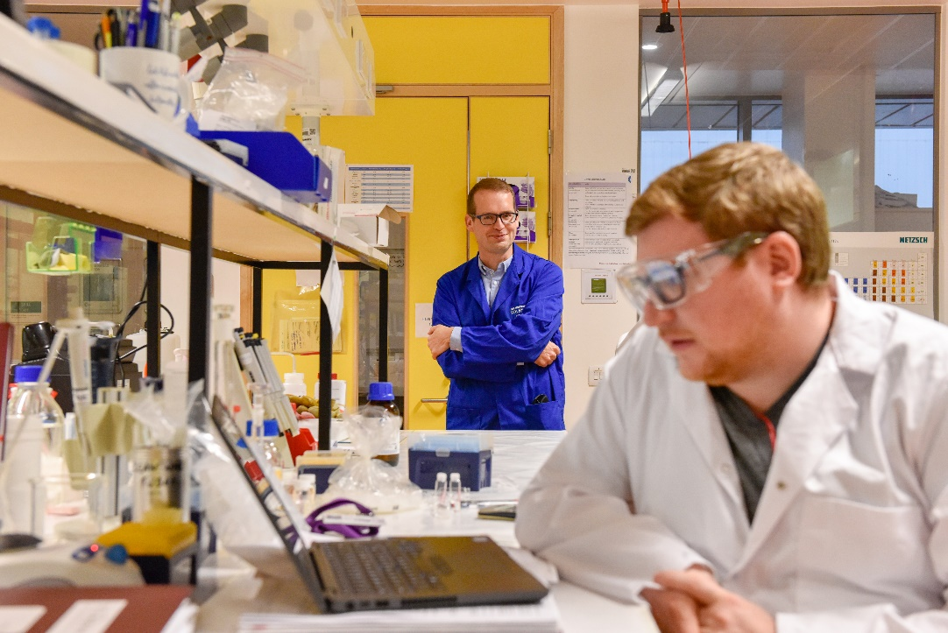
‘Changing Expectations’ Programme (2)
Recognition and Esteem
Setting Culture
A Culture of Mobility
Fostering Scientific Leadership
Consistent wide-reaching messaging
Develop and embed positive values and behaviours

Slide 12
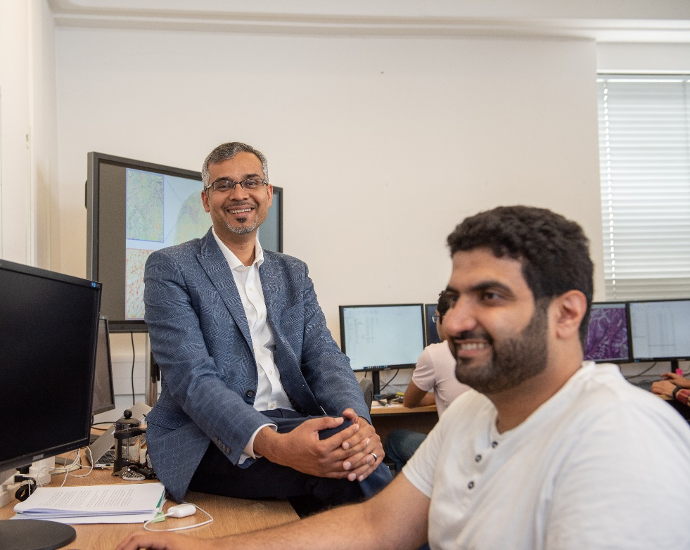
UK Research & Innovation
Policy review and update
First national research integrity committee
Launch of ‘Forum for Tackling Bullying and Harassment in Research’
Development of ‘Good research resource hub’
Dame Ottoline Leyser – long-term interest in research culture

Slide 13
External reports: Summary of key points
Encourage and celebrate diversity
Support a collaborative environment
Provide and promote the uptake of training and development to all levels of researcher
Develop research managers and leaders
Deal effectively with research misconduct and the reporting of misconduct
Reward and recognise good research culture
Share, promote and embed good practice
Research culture to be developed both ‘top-down’ and ‘bottom-up’ - University policies AND departmental / research groups, individual behaviours and practices

Slide 14
Sharing best practice – REF2021
Transformed from a top-down review process to a collaborative approach
Advice, guidance and challenge offered to all areas of submission
An ongoing dialogue, with regular touch points and support provided
New innovations in systems and processes to support changes
How to embed the lessons learned into the wider research planning processes at the University

Slide 15
Sharing best practice - PGRs
CDT in EPRSC Diamond Science and Technology: Statement of commitment to EDI and signposting to resources https://warwick.ac.uk/fac/sci/dst/equality
Training delivered through the ‘Postgraduate Certificate in Transferable Skills in Science (PGCTSS)’ course - focuses on the skills required to be a successful researcher, including ‘Teamworking in a Research Environment’ and ‘Research Ethics and Practice’ https://warwick.ac.uk/fac/sci/transferable-skills/pgctss
Postdoctoral Society of Chemistry (PSoC) awarded a grant from the Royal Society of Chemistry's ‘Inclusion and Diversity Fund’ to run a series of seminars in relation to 'Breaking Barriers' to highlight and celebrate diversity in the workplace

Slide 16
Sharing best practice – ECRs (Arts)
Integration of postdoctoral research fellows on fixed-term contracts - invitations to seminars, workshops, staff training, and represented at departmental committee meetings
Fostering a sense of community between postdocs within departments and across the Faculty – ‘get to know each other’ events, fellowship sharing of experiences
Sessions organised by departments and R&IS re external funding landscape e.g. planned funding-focused event for early career female scholars
All staff encouraged to apply for research funding and departmental internal peer review systems for research funding applications, providing feedback and mentoring for early career researchers

Slide 17
Sharing best practice – ECRs (Medicine)
Opportunities for networking at all levels (3C - coffee, cake and catch-up)
Discussion forum for ECRs to facilitate sharing of ideas, experience and knowledge across disciplines, encouraging researchers to stay at WMS
Support and internal peer review for fellowship applications
Allocation of a mentor, to identify training needs and to develop an individualised Career Development Plan
Progress monitored via a bespoke departmental advisory committee. Established for all WMS ECRs, providing a sounding board for them, covering research focus/funding, teaching, career development and planning

Slide 18
Sharing best practice – Mentoring (Social Sciences)
Departmental mentor schemes to establish support systems aiming to boost morale and enhance a positive research environment
Internal peer review systems to support academics applying for research grants
Dedicated senior management resource with responsibility for overseeing Postdoctoral experience
Nominated points of contact to raise any issues / concerns

Slide 19
Sharing best practice – ED&I (Science)
Support for ECRs regarding clear progression routes - Professor Dave Haddleton is champion of de-mystification of promotions procedures, to encourage more female submissions
Careful choice of wording in recruitment adverts to encourage diversity in applications. Mixed gender and ethnicity interview panels
Bespoke individual support to staff in special circumstances who need extra help
Open culture where everyone feels welcome and valued, i.e. a multi-faith prayer room and celebration of multi-faith important feasts
‘Black in Physics’ week - topical days covering different aspects of Physics, with professional and social events, as well as community-building activities on Twitter and featuring a daily article written by a Black physicist

Slide 20
Areas for discussion
How can the Research Culture Committee…
Raise issues from Faculties / Departments and disseminate Committee ideas?
Gather and share examples of best practice?
Create a Research Culture network?

