Slide 1

NSS 2018 staff briefing
11th January 2018
Please help yourself to a drink and we’ll get going at 2.35pm

Slide 2
NSS contacts
Operational Contacts
Dan Derricott, Assistant Registrar, TQ Operational Lead / First Point of Contact
d.derricott@warwick.ac.uk Cara Pearson, Assistant Registrar, TQ
Nichola Howell-Manning, Student Communications Officer
Jenny Hall, Marketing Officer
Strategic Leads
Prof. Chris Hughes, PVC Education
Prof. Gwen van der Velden, Academic Director (WIHEA) { Both available for help, guidance,
Prof. Andy Clark, Academic Director (Undergraduate) { dissemination of best practice.

Slide 3

Key points for staff new to NSS:
Mandatory survey for all publicly funded HE Providers
Regulated by HEFCE: target list (eligible students) -> promotion -> use of results
Third party “Ipsos MORI” undertake survey “fieldwork”
Eligible students (target list) agreed with HEFCE – contact details provided
Results used internally for QA & enhancement (Uni/dept/course)
Results used externally: nUnistats, Rankings, TEF, OfS monitoring (Uni/JACS subject)
Notes:
To set the scene… a few key points that influence the way that we run the survey…

Slide 4
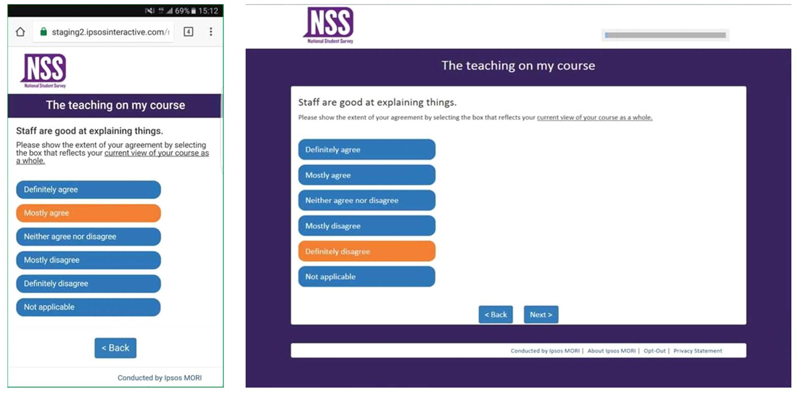

Slide 5
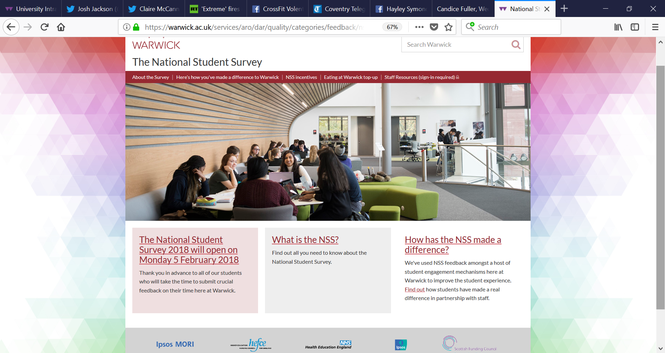

Slide 6
HEFCE “Review of info for students” & NSS work:
No new changes to the survey since last year
…review continues with respect to:
comparable survey for short courses, PGT
aggregation methodology where datasets below publication thresholds (in conj. with ONS)
Degree Apprenticeships
Notes:
Data futures project – more regular data returns

Slide 7
Key points for 2018:
SU not promoting boycott of the NSS this year
Policy motion “Focus on Fees, end the NSS Boycott”
338 for, 271 against, 105 abstained
‘opt out’ requests direct to Ipsos MORI from 8th Jan
Publication threshold:
external: 10 students and 50% response rate
internal: 10 students (regardless of response rate)

Slide 8
SURVEY TIMETABLE
Spr term wk | w/c | Contact
4 | 31-Jan | Display promotional materials. Email from Warwick
5 | 05-Feb | LAUNCH Ipsos 1st email Wed 8th
6 | 12-Feb | Ipsos 2nd email Mon 12th ; 3rd email Fri 16th
7 | 19-Feb | Ipsos SMS Weds 22nd ; some phonecalls from Thur 23 Feb
8 | 26-Feb | telephone phase (all non-responders)
9 | 05-Mar
10 | 12-Mar
11 | 19-Mar | UoW Easter holidays
12 | 26-Mar
13 | 02-Apr
14 | 09-Apr
15 | 16-Apr
Summer 1 | 23-Apr | (Summer term begins)
2 | Survey ENDS Mon 30TH APR
 | Ipsos MORI follow – up: conducted via telephone and email

Slide 9
Student Communications and NSS Marketing
Taken from Dialogue pillar of Student Communications Strategy:
At Warwick, we like our students to have a say in how things are done. It’s (their/your) university, after all. We’re creating a vibrant community and want our students to feel like they’re part of one big family. This can only happen by working together with our students and always having an honest and open dialogue.
Notes:
Pillar is a communication of the Education Strategy which informs the content and themes we use when communicating with current students

Slide 10
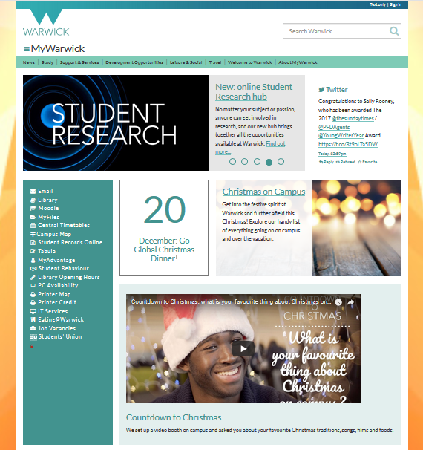
Communication to all students
Email to all qualifying students from Chris Hughes and Stuart Croft week before NSS opens
Promote across MyWarwick consistently
Include in fortnightly student communication emails to UG students
Include on University social media networks
Include on digital screens across campus
Promotion on Oculus Screens
Lamp post banners across campus and along bus route
Notes:
Also add onto Insite and inbox insite when it launches

Slide 11
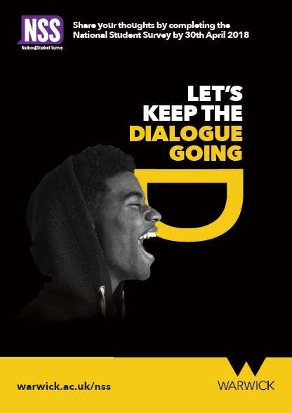
Department marketing resources
Developing a new visual identity for Dialogue pillar
Providing printed materials for all departments including posters and leaflets
PowerPoint templates to include at end of lectures
Downloaded from NSS staff portal, including placing your orders for materials
Major focus on complimenting staff talks with striking visual reminders around campus: digital screens, pull-up banners

Slide 12
Notes:
All students directed to these web pages – details of £5 Eating at Warwick top up and department donations
Form on this page to order quantity of materials

Slide 13
Inappropriate Influence
“Any activity which may encourage students to reflect anything other than their true opinion of their experiences during their course in their NSS responses.”
Explicitly NOT permitted:
Measures to safeguard:
Instructing how to complete the NSS, eg. explaining the meanings of questions or the response scale
Defining “neither agree nor disagree” as a negative response
Comparing the NSS scale to other scales (eg. Assignment marking schemes)
Linking the NSS to league tables, job prospects or perceived value of students’ degrees
Arranging compulsory sessions to complete the NSS
Develop early familiarity with Qs & format (eg. analysis of past results, signpost Qs in advance)
Refer to Uni NSS webpages for descriptions/info or extract from template texts on staff portal
Briefing for any student reps on staff portal here
Briefing content for any general staff with UG student contact on staff portal here
Ensure opportunities to complete the survey are clearly anonymous and not overseen by staff
Ensure promotion/incentives maintain anonymity and don’t ask/required proof of completion

Slide 14
Departmental Survey Promotion - Incentives
Incentives
Prize Draws
At department’s discretion (for heatlhy resp. rates)
Max total spend of £3 £5 per student on target list
Must consult students to vote/decide on incentive (student/staff-facing webpage here)
Either Prize draws or Gifting to Warwick Charities
Best practice: stagger sum/no of incentive(s) to key milestones in resp. rates (eg. 50%, 60%, 80%)
Must be drawn from all eligible students (ie. winner may not have participated)
Info on student/staff-facing webpage
Charity Donations
Must be Warwick Charity
info on student/staff-facing webpage
Central support: Weekly response rate reports (weds) & regular charity totals (for feedback to students)

Slide 15
What should departments do?
Before survey:
During survey:
Staff to familiarise themselves with NSS pages, especially:
How student engagement & surveys have made a difference
Student and staff FAQs (the tricky ones to answer…)
General staff NSS guidance document
Staff resources available via staff portal
Consult students on incentive scheme (where incentives necessary) and submit details (via staff portal) by Fri 26th Jan
Review survey timetable and have dept promo/comms plans and options ready
Download student contact list ready for use (staff portal)
Display promo visuals from Mon 5th Feb (some physical materials can be installed from w/c 31st Jan)
Review weekly Weds response rate reports (email and staff portal) and disseminate news to staff/students
(If gifting to charity…) review updates of totals raised (staff portal) as you might want to include this in updates to students
Encourage completion sooner rather than later, especially prior to the Easter break
Contact d.derricott@warwick.ac.uk with any questions or concerns.

Slide 16
What have we done in response to staff NSS queries/requests?
Feedback from last year:
Feedback & requests from/since October briefings:
Provide charity fundraising totals to assist with news stories
Update all NSS pages – especially examples of where feedback is being used.
Prepare FAQs with “tricky topics” in advance of the survey
Requested student rep briefing (supplied by Ipsos this year)
Response rate reports will be provided by Dept, course and subject where possible this year.
Need to improve visibility of survey in campus common space – targeting more high traffic areas/plasma screens and better lamppost coverage this year.
Clarified in £5 incentive pages and invite to students that claimants are confidential to all but a few central staff
Improved info on what happens to small cohort (or below threshold data) in FAQ 10 here
Provided screenviews of what the survey looks like
We will be assisting with briefing all staff who interact with students about the survey this year and will share this with key NSS contacts in advance of circulation/publication and post it on the staff portal.
Slide with information on “neither agree nor disagree” provided following the October briefing and available in staff portal here.

Slide 17

THE END…
Questions, comments and feedback are welcome
Dan Derricott
d.derricott@warwick.ac.uk
Sub title here if needed

