Slide 1

What to expect at the Global Opportunities Showcase
These slides will guide you through step by step to help you know what to expect

Slide 2
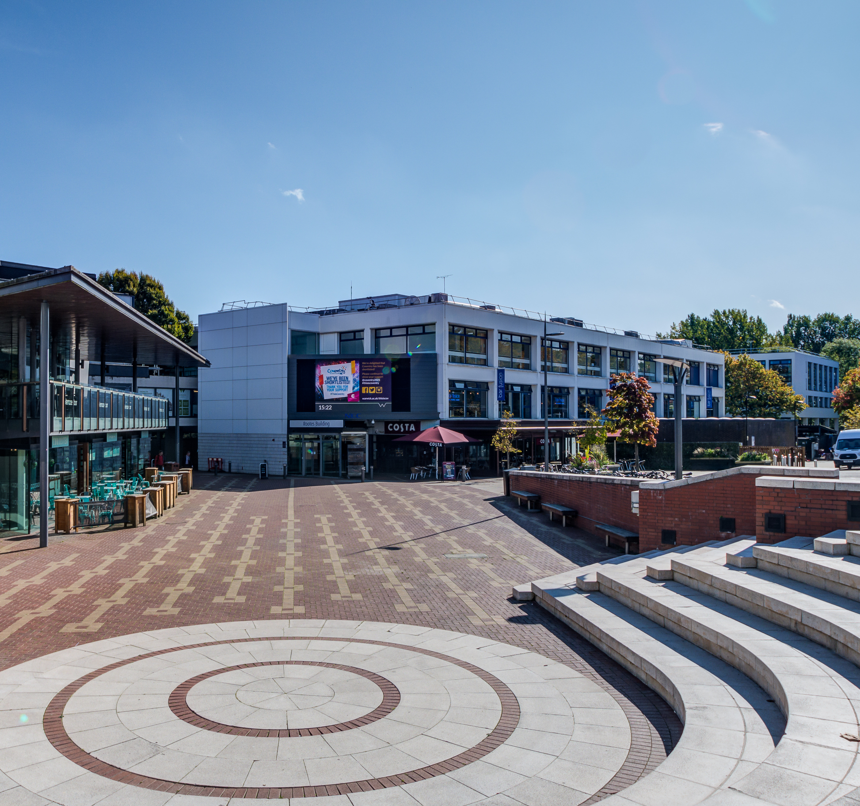
The Global Opportunities Showcase is taking place in the Rootes Building on the Piazza

Slide 3
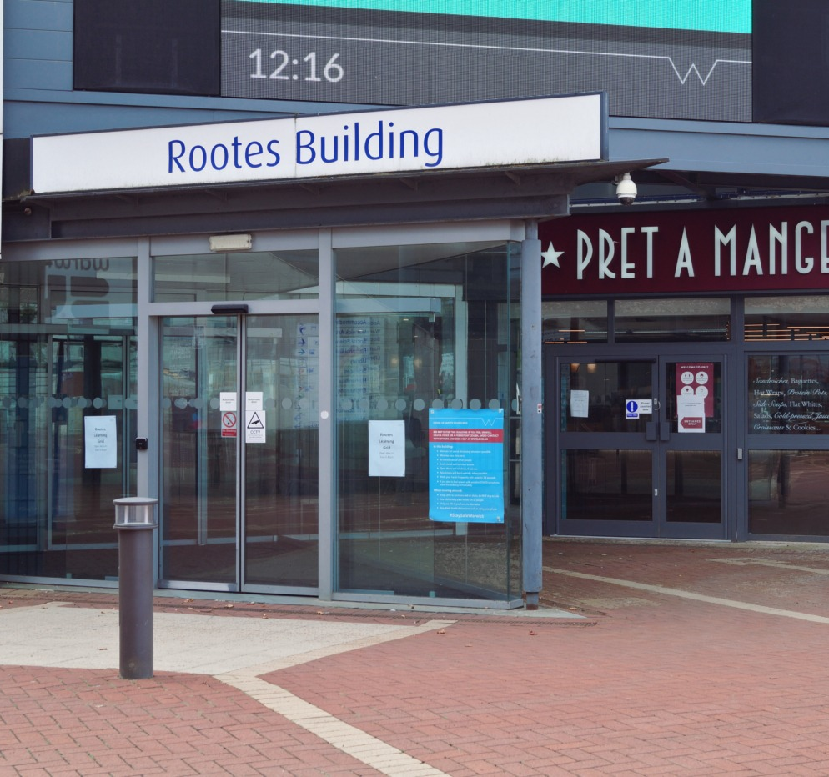
A team of Student Opportunity staff will be available to support you on the day with any questions
Community Safety are also present at University events where there is high attendance

Slide 4
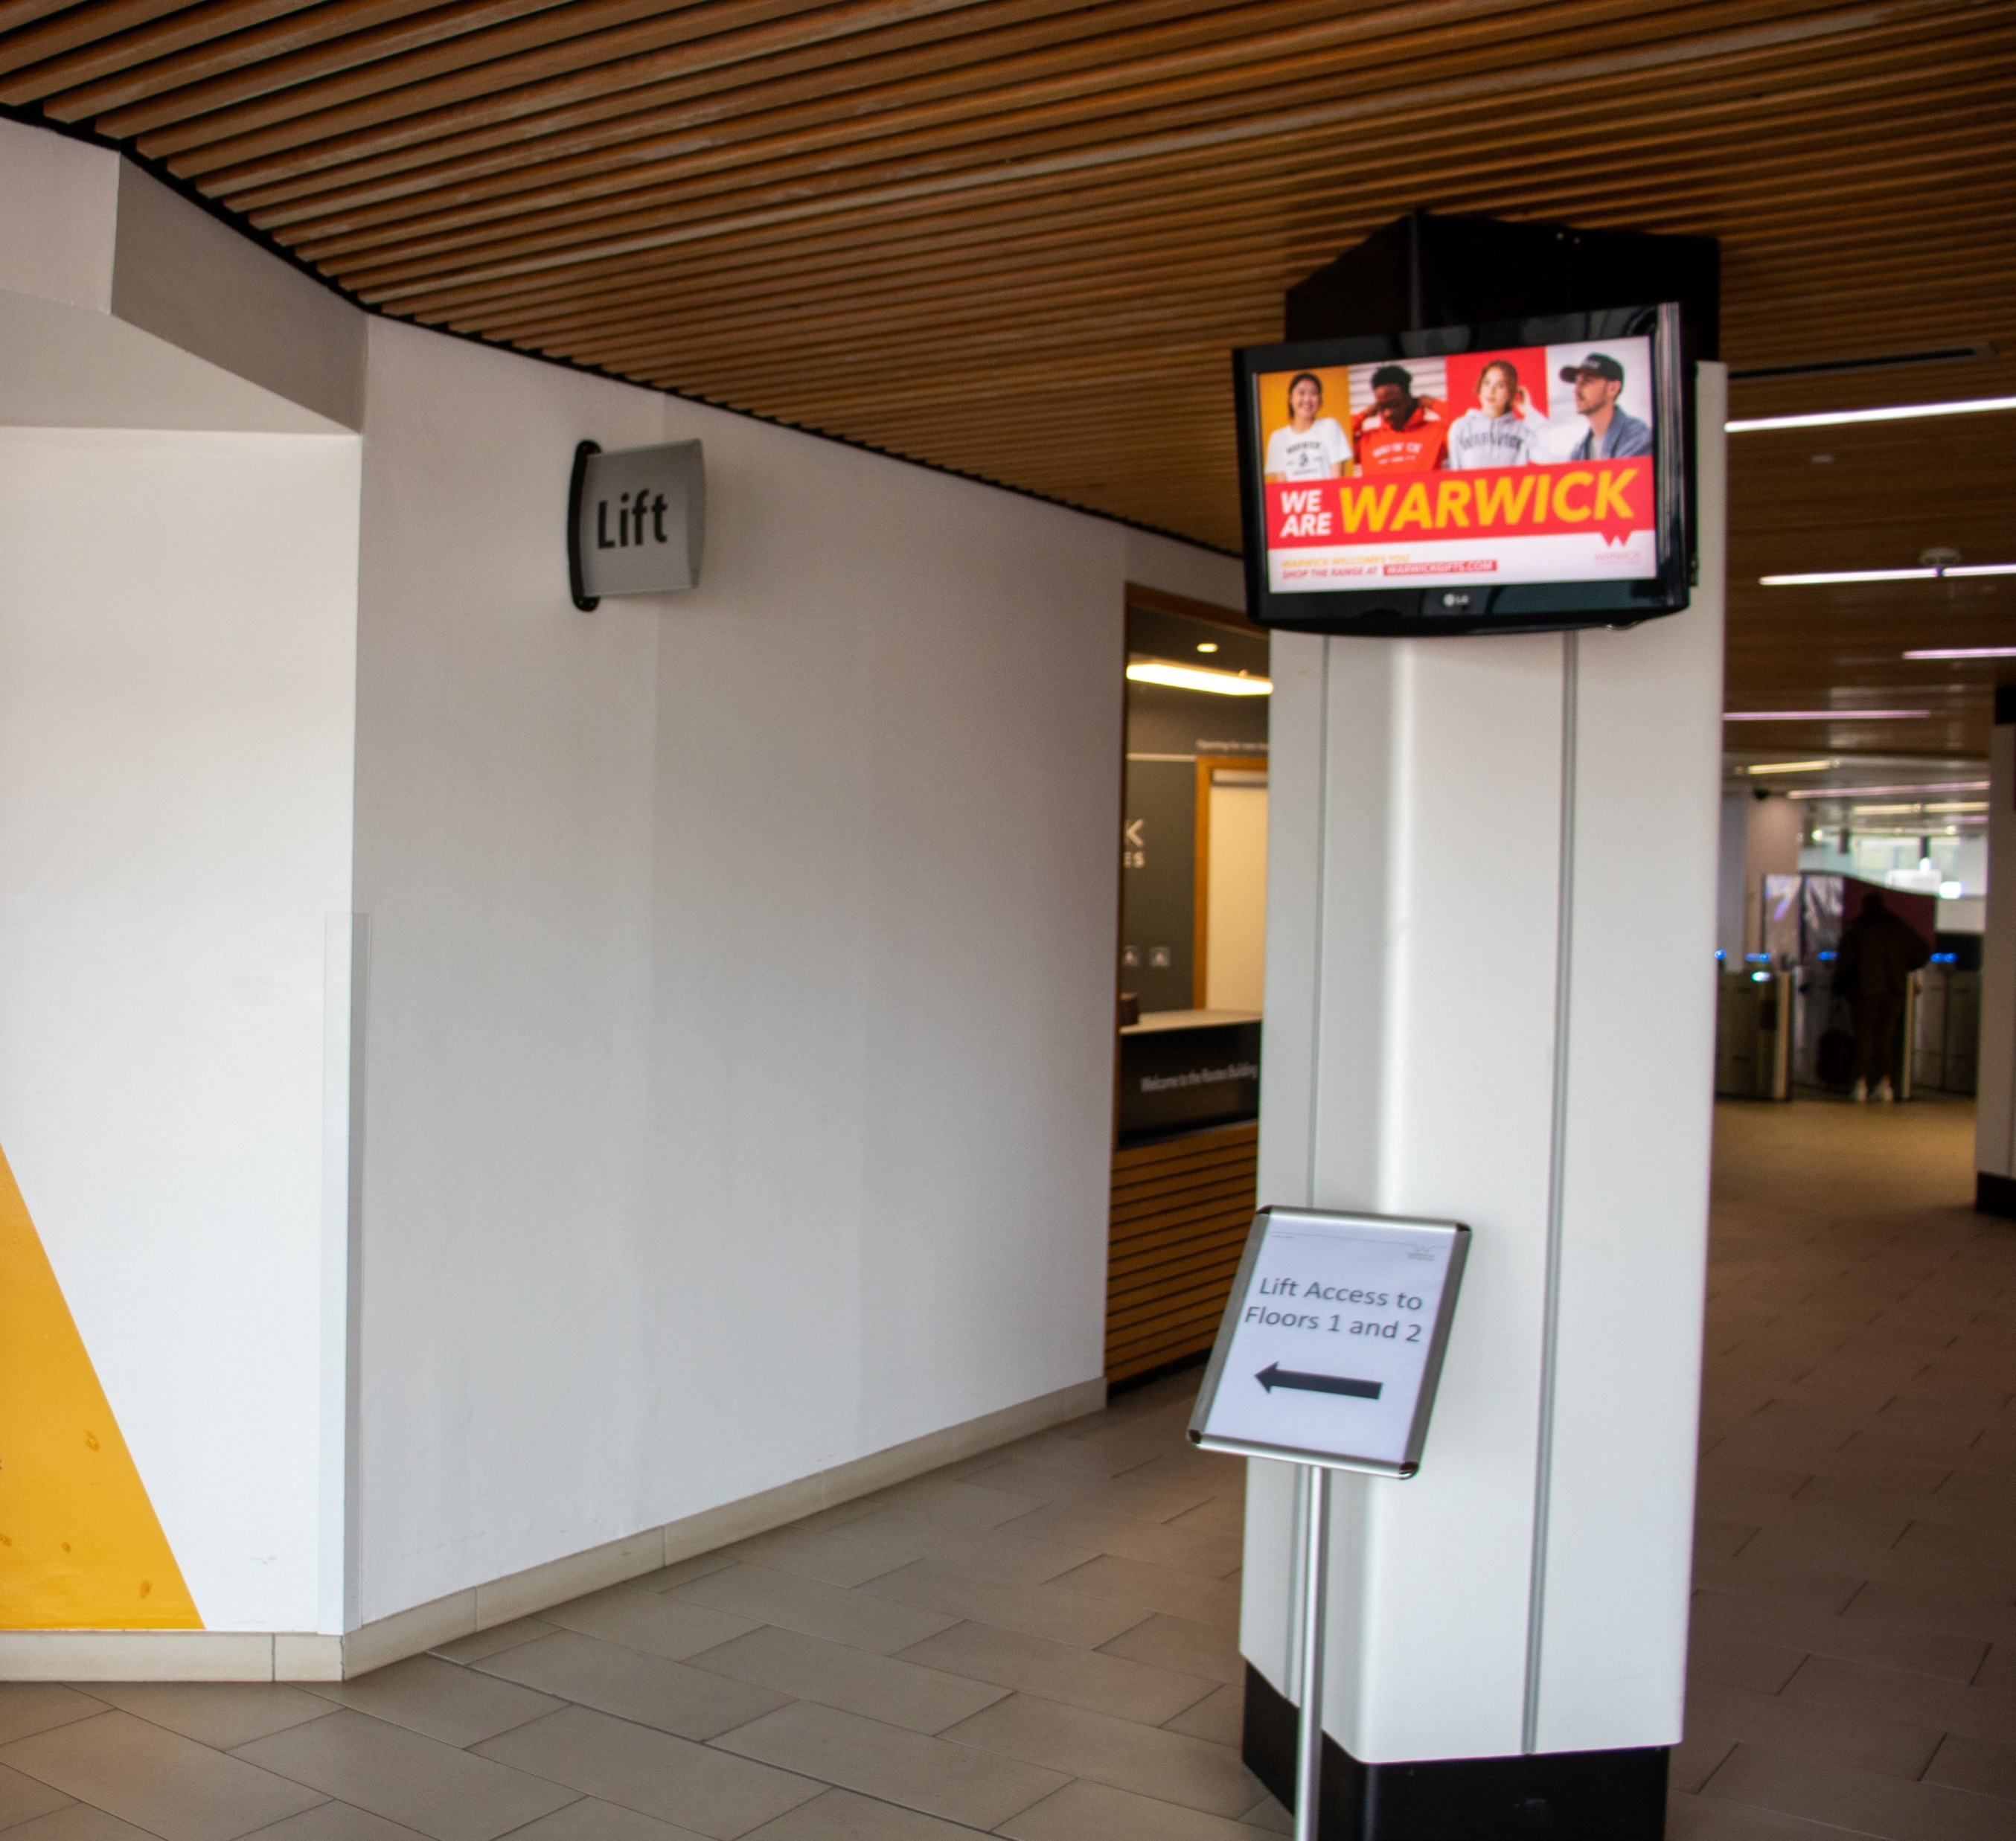
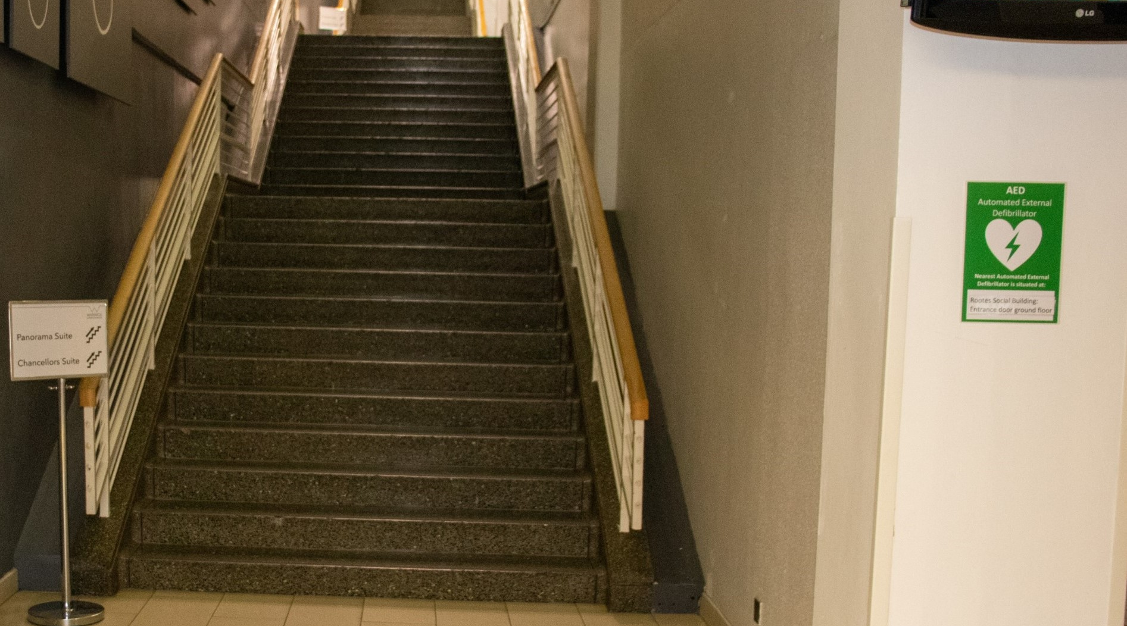
Once in Rootes, you will either need to take the lift, or the stairs to the 1st floor
The lift is by the entrance to the building, on the left-hand side

Slide 5
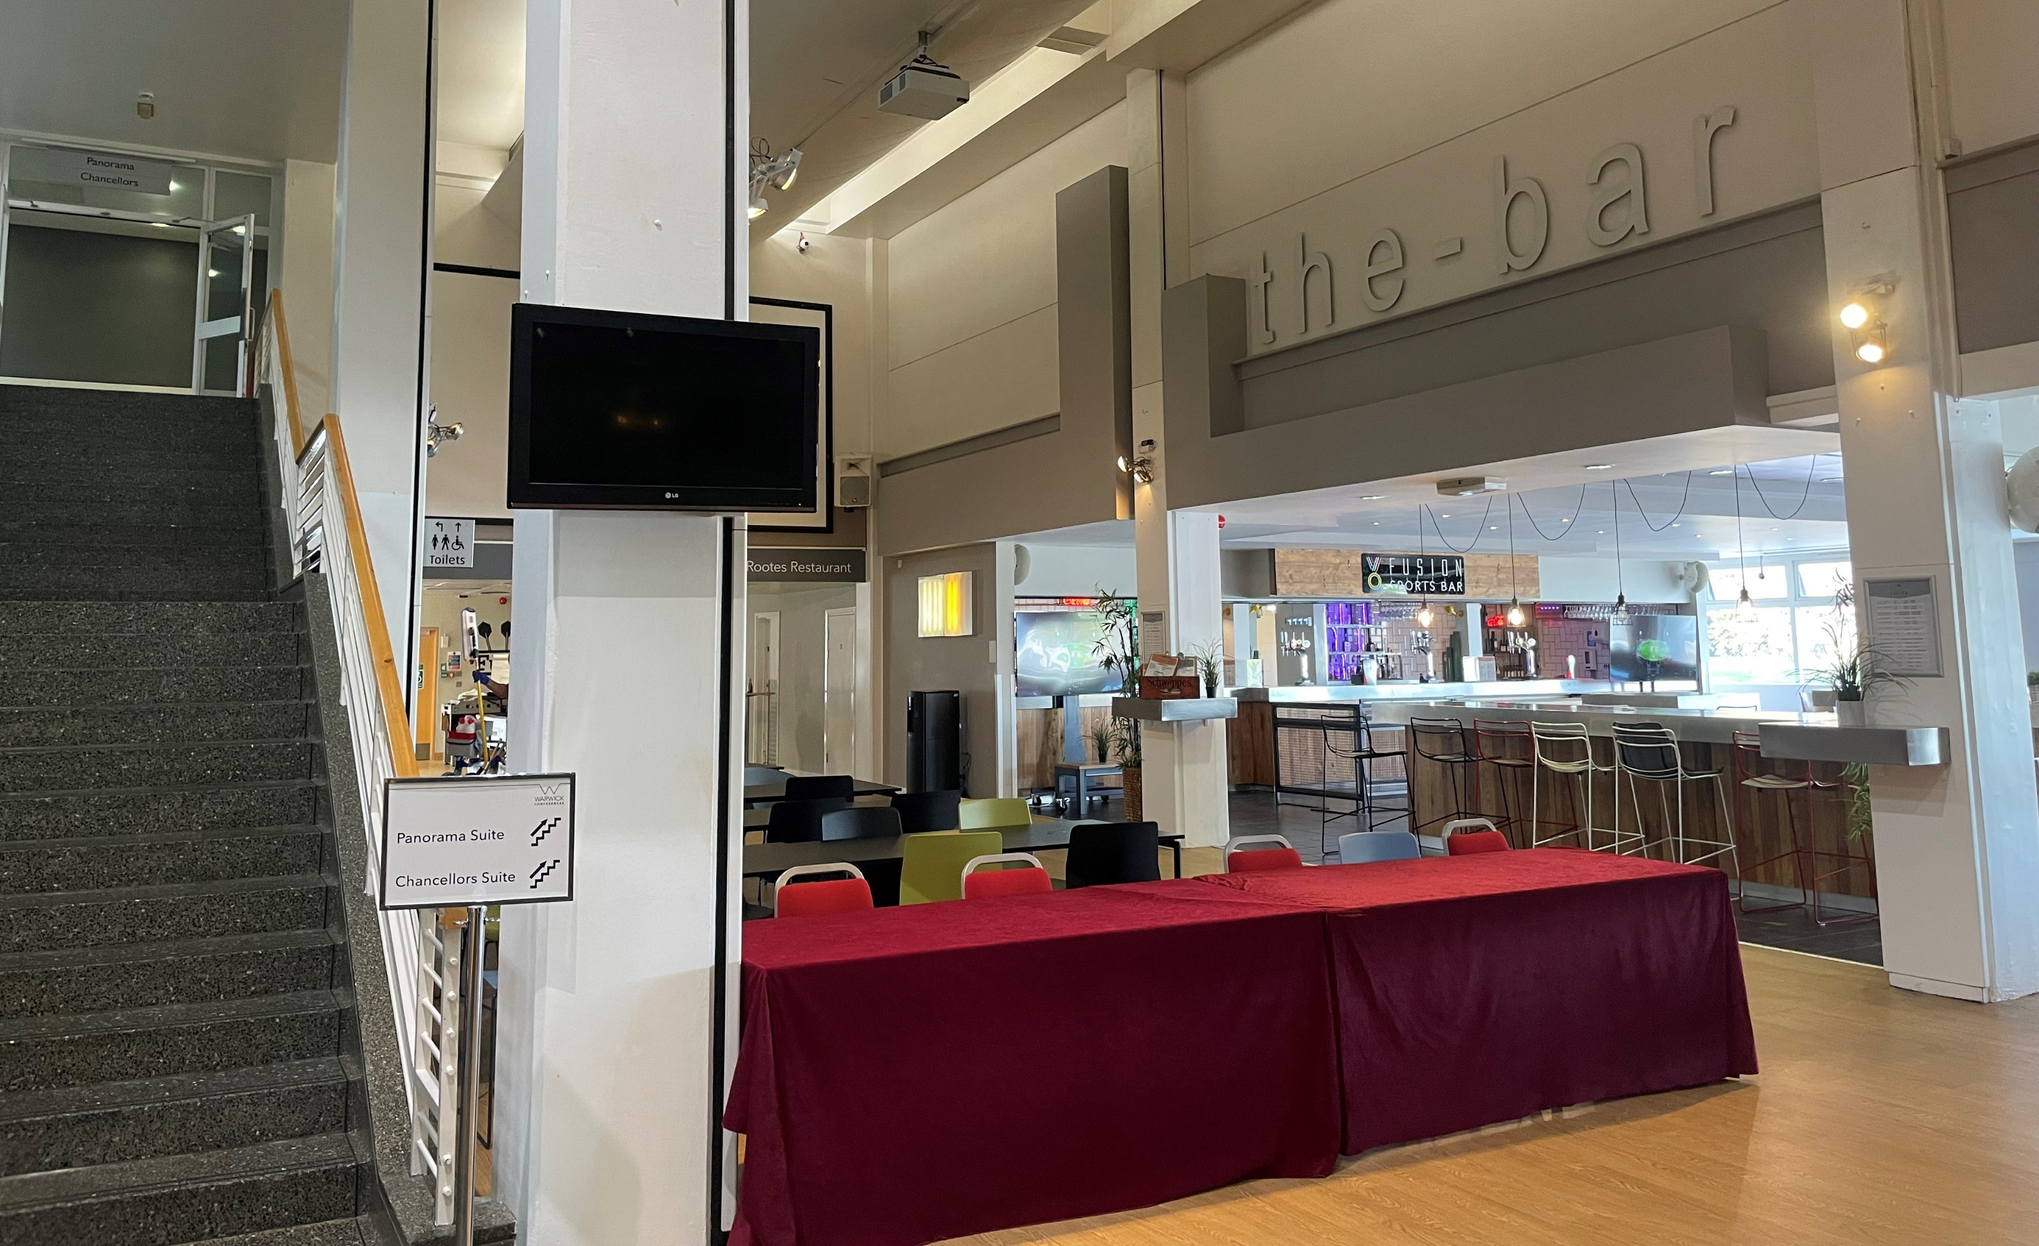
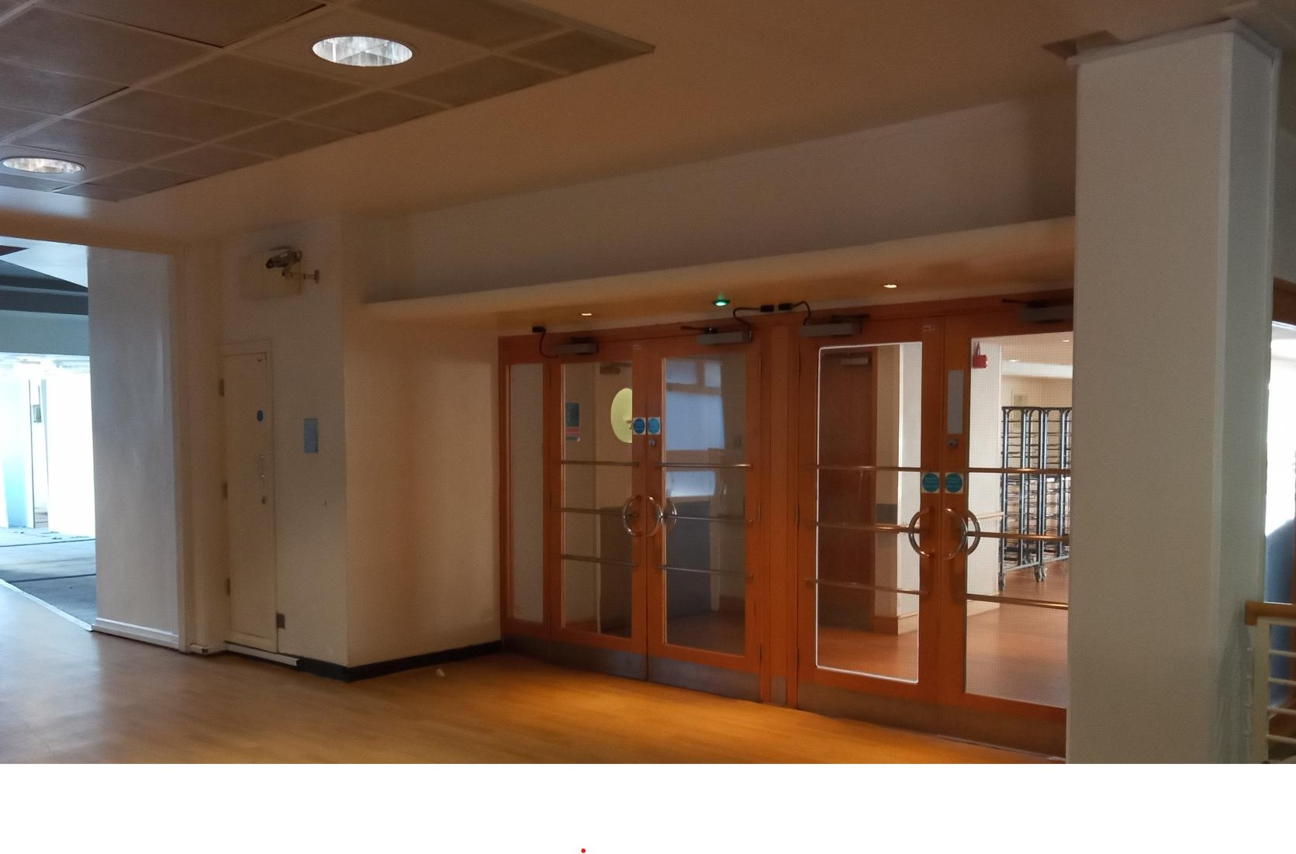
On the 1st floor, our team will direct you to Rootes Restaurant. You will enter through the doors at the opposite end to bar fusion.
Have your University ID card ready to swipe into the Showcase when you get to our registration desk

Slide 6
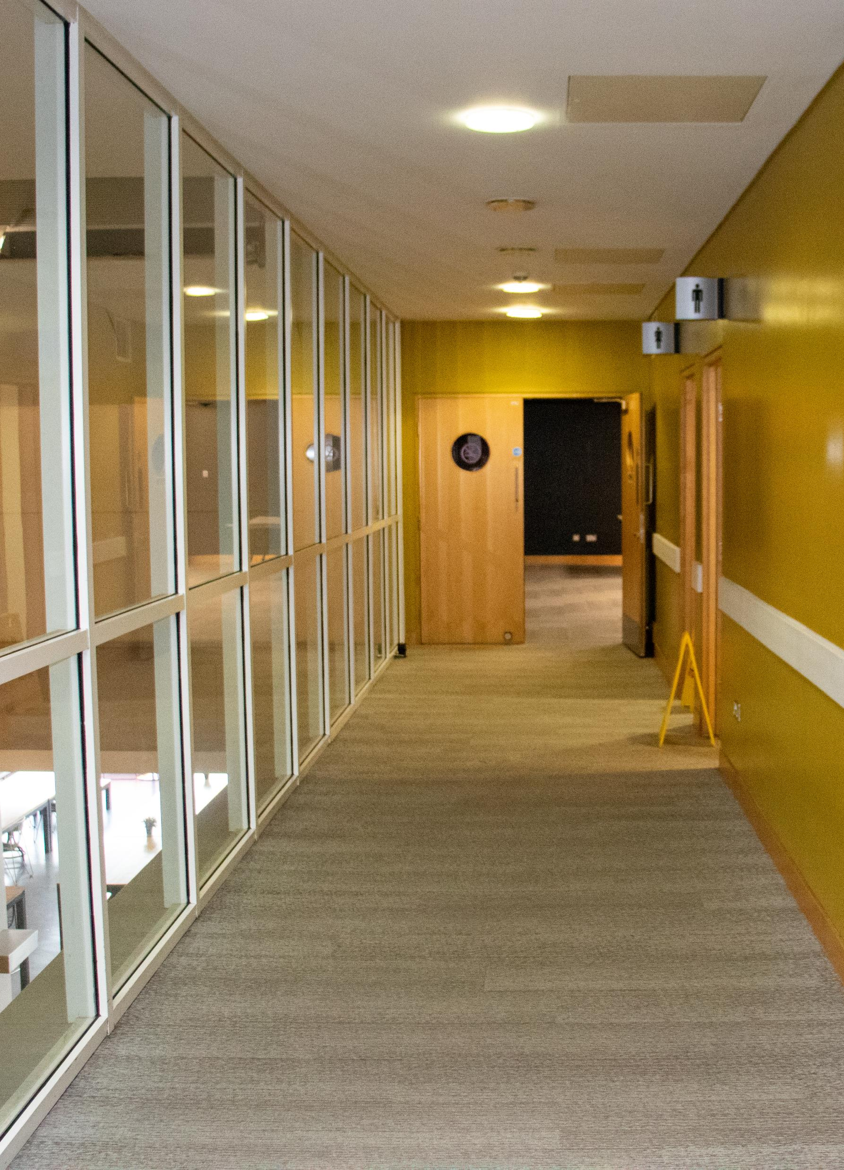
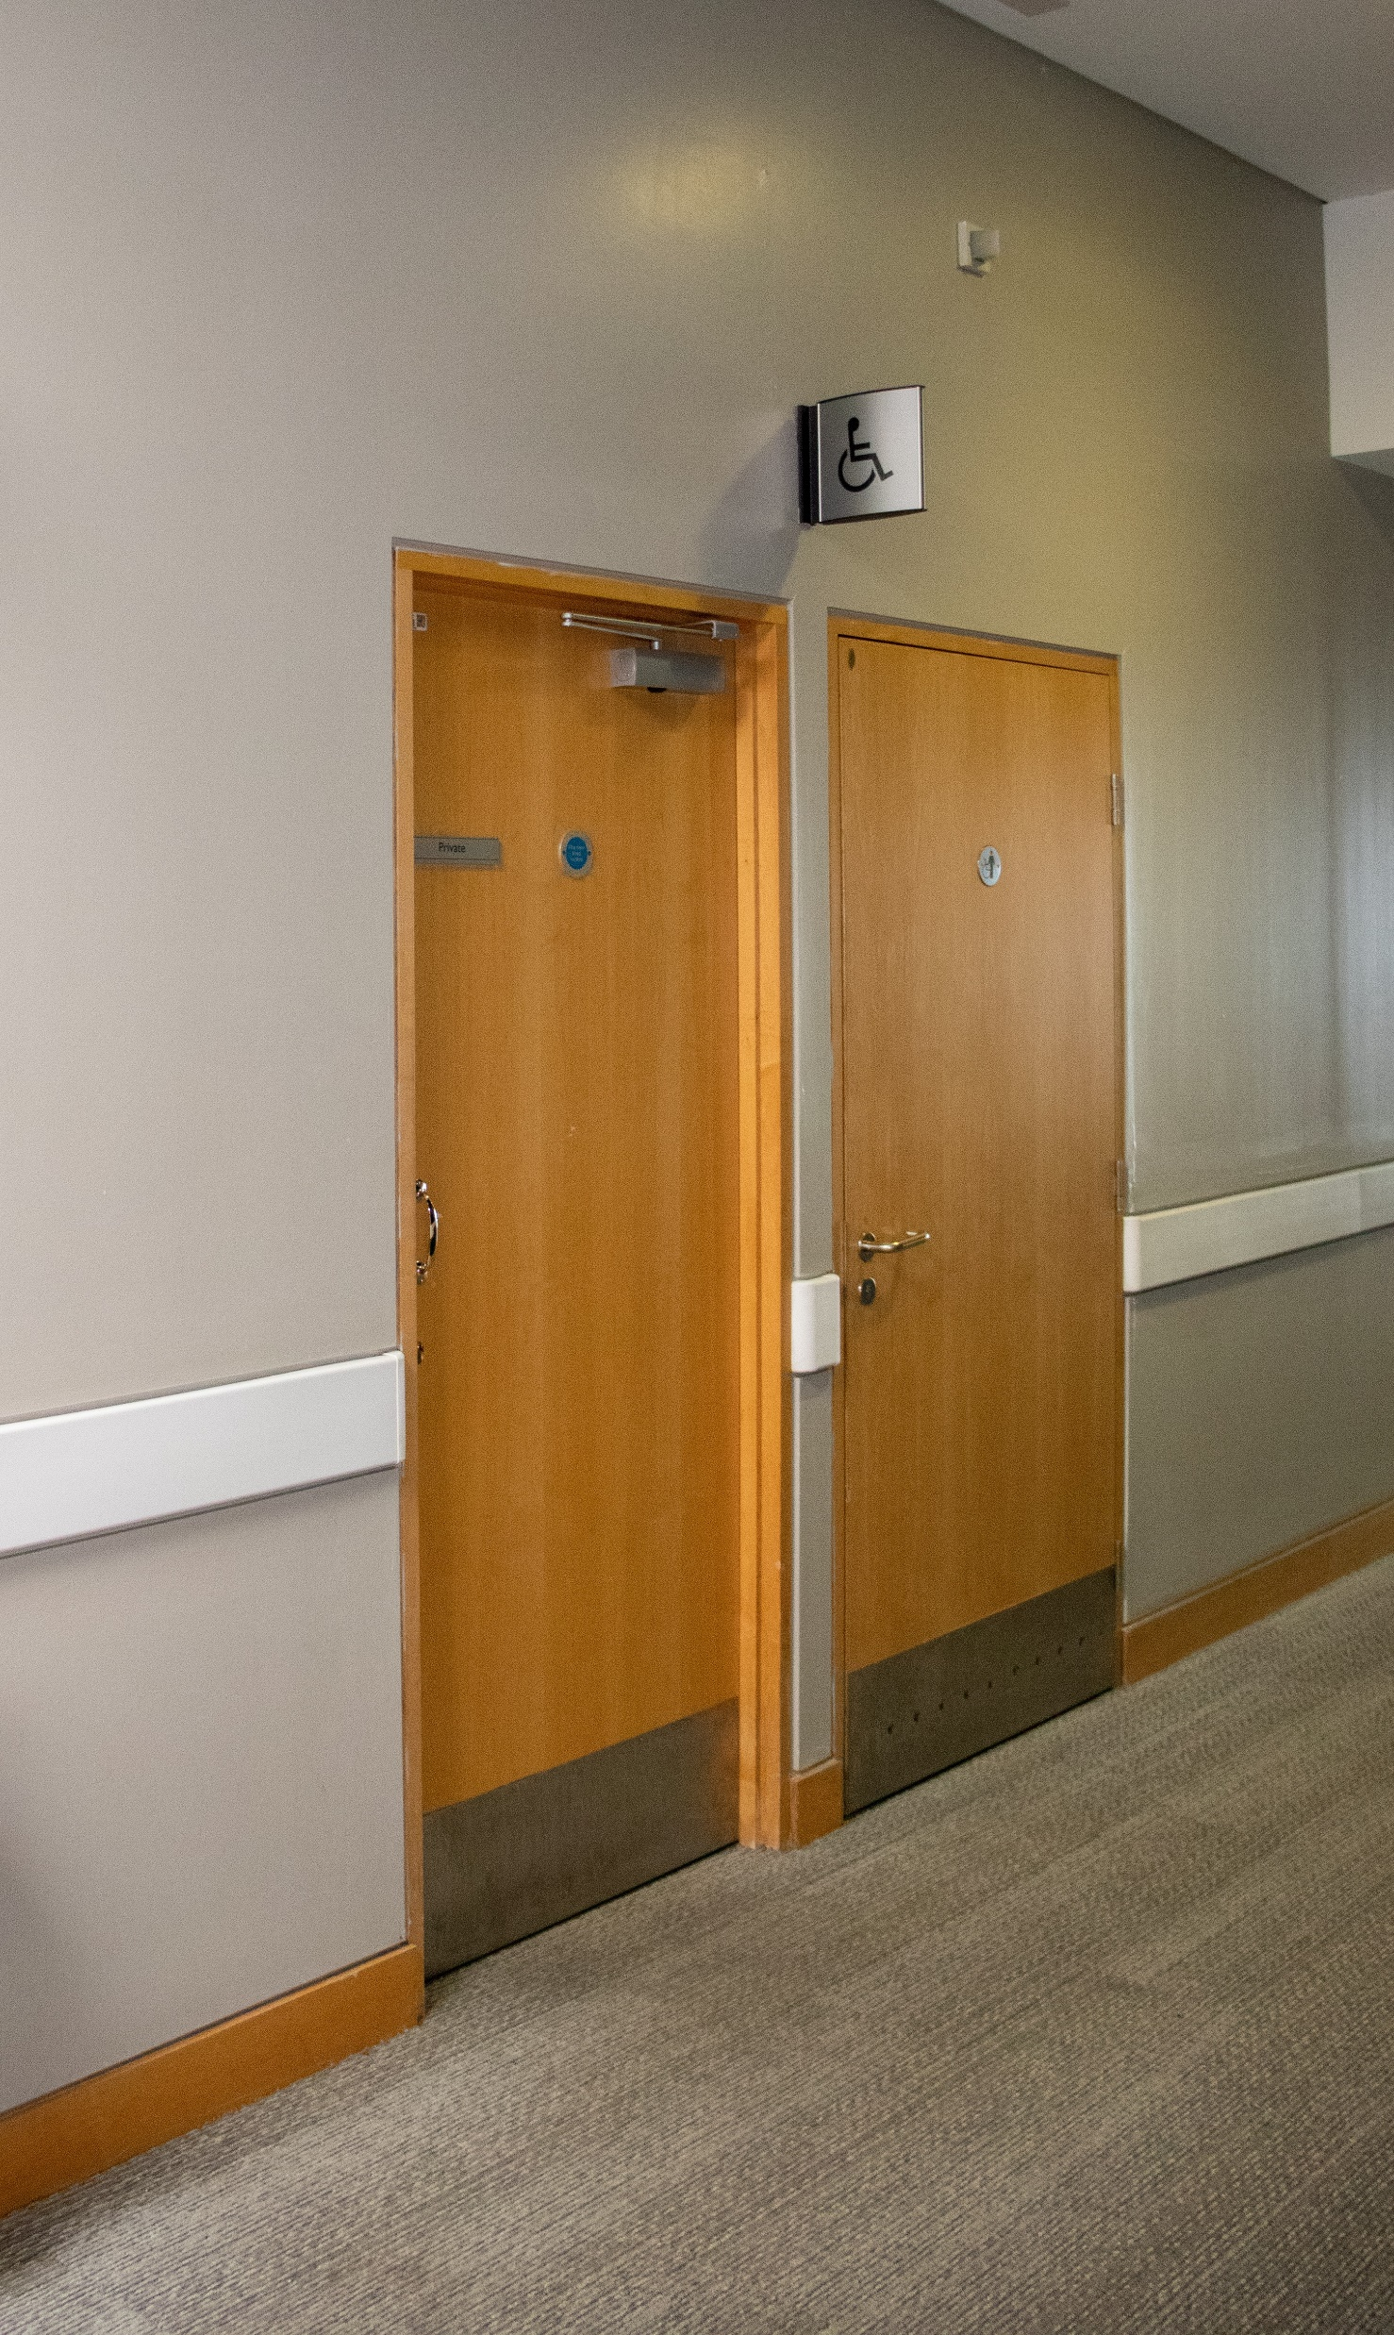
Toilets are available on both the 1st and 2nd floors
There are also facilities on the ground floor next to Pret A Manger

Slide 7
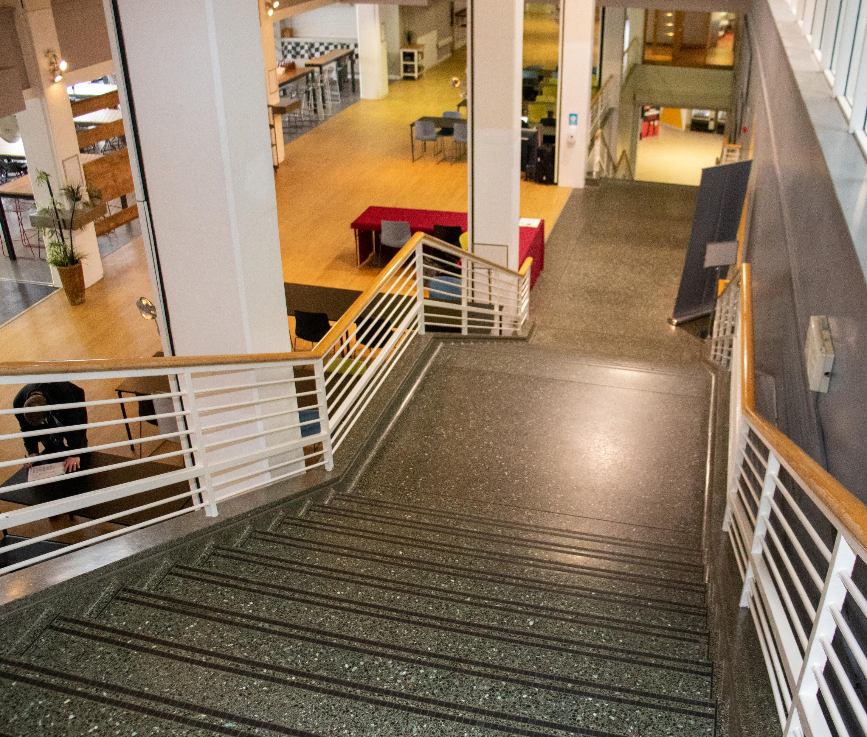
When you are ready to leave, you can exit down the stairs or in the lift
There is no need to check-out

Slide 8
Quiet Time
It may be that you have a disability or condition that can make events overwhelming or difficult to attend.
We will have a designated ‘Quiet Time’ for students who prefer a calmer environment to visit the Global Opportunities Showcase exhibition.
The Quiet Time will open at 12.30, which is 30 minutes prior to the advertised start time of 1pm.
If you have additional needs or require support on the day, please email careers@warwick.ac.uk and we would be happy to help you further.

