Slide 1
Careers outside the law profession for lawyers
Claire Leslie – Senior Careers Consultant

Slide 2
Session Aims
Understand the transferable skills you have learnt as part of your law degree
Appreciate the variety of opportunities available
Start to understand what might make you happy
Learn how to find out more about employers and sector areas
Explore how to research company culture in different sectors – the prospects, risks, potential and future directions
Know how to find out more through on line resources, networks and specialist databases

Slide 3
So what skills and knowledge do law graduates have?
Analytical skills, a facility forensically to break a problem down into manageable sections and deal with it.
Excellent verbal and written communication skills
Strong intellect
Logic
Good time management skills
An understanding of Property Law, Employment Law, Constitutional and Administrative law, Contract Law and dispute resolution
Negotiation skills?

Slide 4
What other skills might you have acquired?
Events management?
Customer service?
Financial budgeting?
Commercial awareness?
Marketing?
IT?
Fundraising?
Empathy?

Slide 5















Slide 6
What sorts of jobs are these employers offering?
Accountants – Actuarial work, consultancy, deals, forensics, tax
Investment Banking
Civil Service – Policy work, communications, Human Resources, European work
Charity work – fund-raising, marketing, management
Consultancy – analysis, investigation, advice
Retail general management
Teaching general management development programme

Slide 7



Slide 8
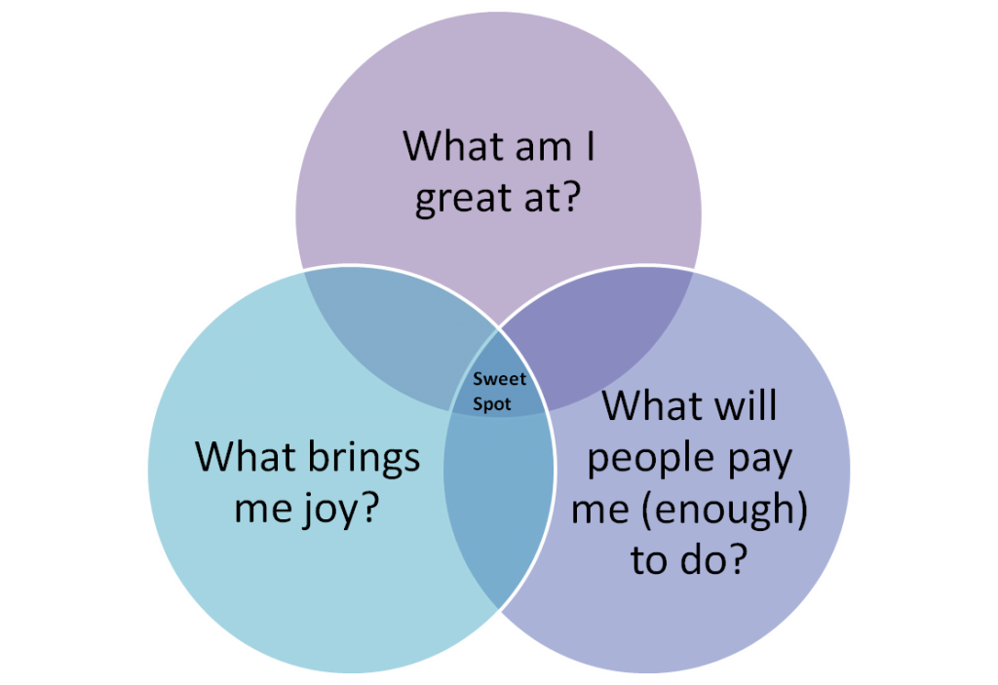
Think about this…

Slide 9
What to Research
What sort of work do you want to do?
Helping others?
Earning lots!
Intellectually demanding?
Working as part of a team?
Directly using some of the things you’ve learnt on the degree?
Varied?
Don’t really know yet?

Slide 10

How to find out about yourself
Book a guidance appointment
Use resources to explore things about yourself:
Careers blog suggestions
Talk to employers

Slide 11
Getting ready to make applications
Map how your skills and experience match what the employer is looking for
Look at how to go about making the application
When are the closing dates?
Plan a strategy of when you are going to make each application
Keep a record of your applications
Have a look at some assessment tests

Slide 12
Skills sought | Where did you practise / learn those skills
Communication
Interpersonal skills
Tenacity / Resilience
Accuracy and attention to detail
Commercial Awareness
Flexibility
Teamwork
Integrity
Marketing ability
Specific knowledge areas
And…….

Slide 13
Drilling Down
Look at the news – understand the environment
Look at sectors – commercial awareness
Look at organisations – differentiate them
Look at jobs – match yourself to the role

Slide 14
Why Read the News?
Employers want to know that you understand the environment; local, national, international. For example..
Does the refugee crisis have any impact on the possibility of Brexit?
What will be the effect of the re-election of Erdogan?
Are free schools “a good thing”?
Why did the funding of Kid’s company continue notwithstanding the expression of concerns?

Slide 15
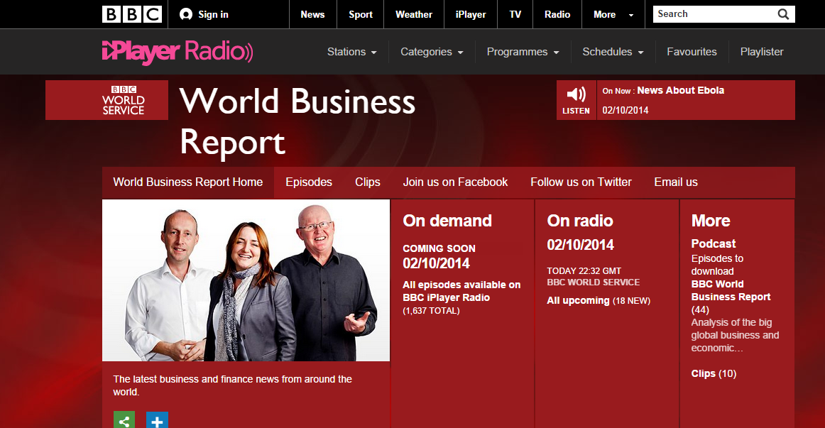
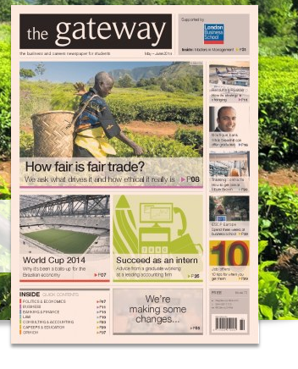
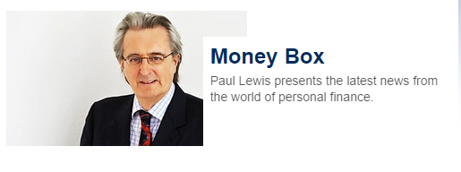
What’s the News
Television: news, business
Radio
  BBC World Service
    World Business Report
  Radio 4
    World at One
    PM
Money Box Live
Gateway Newspaper for students – is also online https://twitter.com/GatewayOnline
http://thegatewayonline.com/

Slide 16
Why Research Job Sectors
Employers value commercial awareness
  How businesses operate
  What are trends in the industry
  Size of the sector £ and people
  What is it like to work in the sector
  What opportunities/job roles operate in the sector?

Slide 17
Job Sector Information
Prospects
Careers and Skills Sector Pages
Sector publications/websites
Gateway Newspaper
Warwick Career Blog

Slide 18

What do I need to know about employers?
Organisational Structure
Values and vision
SWOT analysis
Clients
Training
Day to day work (hours, offices, etc.)
Culture

Slide 19

Inside information
Company Website
Marketline Advantage
http://webcat.warwick.ac.uk/search~S1/v?business
    MarketLine (SWOT)
    Company profile and history
    Current deals
Careers Library/Website
    - Employer visit reports (key job sector pages)
Annual Report & Accounts
Notes:
To demonstrate MarketLine Advantage – Student Careers and Skills, Researching Jobs, MarketLine Advantage – and sign in
NB: The (apparently) most relevant company is not always first on the list from a search. The link may not be obvious (EG Jaguar Land Rover as a subsidiary of Tata).

Slide 20
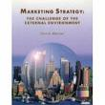
External Environment – Key Resources
Warwick Library Business Databases: http://webcat.warwick.ac.uk/search~S1/v?business
      Fame
      Factiva
BBC Online, The Economist
Government Sites
Department for Business Innovation and Skills: http://www.bis.gov.uk/
Notes:
EG Factiva is under ‘Business Market Research Databases’

Slide 21
Industry Insight – Key Resources
Professional Bodies/Journals
Warwick Library Business Databases (as in previous slide):
      Mintel
      Global Market Information Database
BizEd - http://www.bized.co.uk/ Broadcasting
Corporate Watch - www.corporatewatch.org.uk

Slide 22
Even More Resources:
  Professional Bodies websites (see our sector pages)
Employers’ websites
  Useful to get an insight into a role in an organisation, its culture and commitment to staff
  Support you in articulating your skills and getting in
  But will only tell you what they want you to know, so use other resources too!
Podcasts / video casts

Slide 23
Social media...
LinkedIn – www.linkedin.com
Twitter – Twitjobsearch.com
Blogs eg Wiki Job
Identifying key industry figures eg IPA
Webinars
  Sharing Sector Knowledge Eg Law Society – Junior Lawyers

Slide 24
So How Do I Use All This Information?
In applications and interviews, use examples to back up statements you make about the organisation.
Show the company that you have considered up to date information about their values, mission, operations, challenges AND HOW YOU FIT IN.

Slide 25
Application information
Interview Questions
  http://www2.warwick.ac.uk/services/scs/applications/interview/
Business Case Studies
  http://www2.warwick.ac.uk/services/scs/findingajob/jobsectors/mc
  http://www2.warwick.ac.uk/services/scs/applications/interview/films/
  Burning Question: www.lawcareers.net/Information/BurningQuestion/

Slide 26
Any Questions?

