Slide 1

Careers support for you at the University of Warwick
Rish Baruah
Senior Careers Consultant
careers@warwick.ac.uk

Slide 2

In this presentation
How can Careers support you through (and beyond) your time at University of Warwick?
Upcoming events and opportunities
Get in touch, stay in touch
Useful links

Slide 3

Careers support for you
University will hopefully be a great experience for you, and although you are here to learn, it also offers a chance for you to try lots of different things.
Here are some examples of typical student activities:
Societies, sports and activities
Student rep or ambassador work
Volunteering (including overseas opportunities)
Part-time work
Internships
All of these things are (hopefully) fun, and all of them can make you more employable!

Slide 4
Career Planning
Self-Awareness | Exploration | Decision-making | Action - Apply
Knowing yourself Your interests, values, skills, strengths, weaknesses and motivations | Research your ideas and options Trying out through gaining experience Talking to people in the role/sector | Make choices : Work experience & other opportunities Roles/sectors Next steps | Put together a CV and get feedback Know how to write cover letters Practice and prepare for interviews
“To be employed is to be at risk …
to be employable is to be secure”
Prof Peter Hawkins: The Art of Building Windmills (1999)

Slide 5
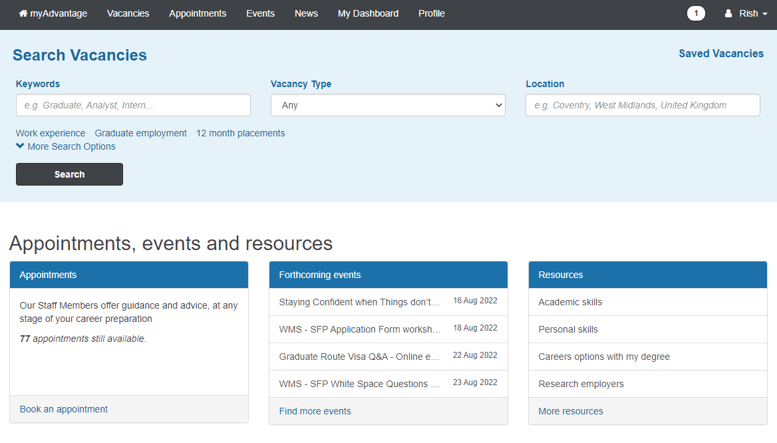
My Advantage: Careers Portal
View vacancies
Book 1-1 appointments
Book events:
Careers Fairs
Webinars
Skills workshops
Employer presentations
Sector events
Visit MyAdvantage

Slide 6
More Careers support and information
You don’t need to have specific career ideas before booking a careers guidance appointment, but you may wish to explore:
Warwick Careers website
Self-Awareness Moodle
Prospects Planner
Some light careers research to help you get started:
Where do I start?
What Can I Do With My Degree?
Popular industries and job sectors
Different types of jobs
Internships and work experience
Notes:
Warwick Careers website
Self-awareness Moodle – especially useful if you are not sure what makes you tick just yet – could help you to plan activities to make the most of your time at university
Prospects Planner (and job match quiz) – also based around self-awareness but gives ideas of the types of graduate jobs that might suit you in the future
Where do I start: Warwick Careers resource – where do you think you are in terms of preparedness for your future?
What Can I Do With My Degree? Do all law students become solicitors or barristers? What do history graduates actually do after graduation?
Popular industries and job sectors – Prospects’ guide to graduate job destinations
Different types of jobs: Target Jobs descriptions of a variety of graduate job roles
Warwick Careers guide to internships and work experience – experience is really important in the graduate job market, so it is never too early to start thinking about it (especially if you are thinking about spring weeks in the banking and finance sectors)

Slide 7
1:1 careers support
If you would like a 1:1 chat with a member of the Careers team, then there are two main options:
Careers guidance or mock interview
Meet with a Senior Careers Consultant or Careers Project Officer face-to-face or via MS Teams for an in depth discussion to help with your career planning and career choices, or to have a mock interview.
Applications feedback & opportunity advice
Our Job Search team can provide you with help and feedback on applications, CVs, covering letters and personal statements, searching for jobs, interviews and work experience.
There is a Senior Careers Consultant or Careers Project Officer linked to every subject area in the university – visit MyAdvantage to find out who to see and book an appointment.

Slide 8
Careers Fairs
We have a range of events through the year to help you gather information about future career paths and what support you can receive on the way.
Careers fairs and sector events provide you with opportunities to engage with employers face to face and learn about graduate, work experience or internship opportunities.
Employer presentations give you the opportunity to hear from contacts within specific organisations about their industry and skills sessions help you to develop skills for the recruitment process.
Find out more including booking details, how to make the most of Careers Fairs and Employer Events, and the latest on forthcoming events by visiting our Careers Events page.

Slide 9



Making the most of your time at Warwick
Work experience
Virtual internships
Part-time jobs (via Unitemps)
Societies
Sports Clubs
Volunteering
Enterprise
Sprint
Widening Participation
The Warwick Award

Slide 10


Find us – contact us
Student Opportunity Hub: Ground floor, Senate House
Careers appointments and queries take place in The Student Opportunity Hub
Find out more and contact us via the Warwick Careers website
Or email us careers@warwick.ac.uk
You can also find us on the following channnels:
Twitter: @so_warwick
YouTube: Careers and Skills
Facebook: WarwickStudentOpportunity
Warwick Careers Blog

