Slide 1

Things I wish I’d known about Academia .…
Dr Liz Blagrove
Department of Psychology
(Before I got the job!)

Slide 2

"Remember that confusion isn't a sign of failure. Seek it out! It is a crucial clue that we need to think and read a bit more about something."
With thanks to Professor Nick Chater

Slide 3
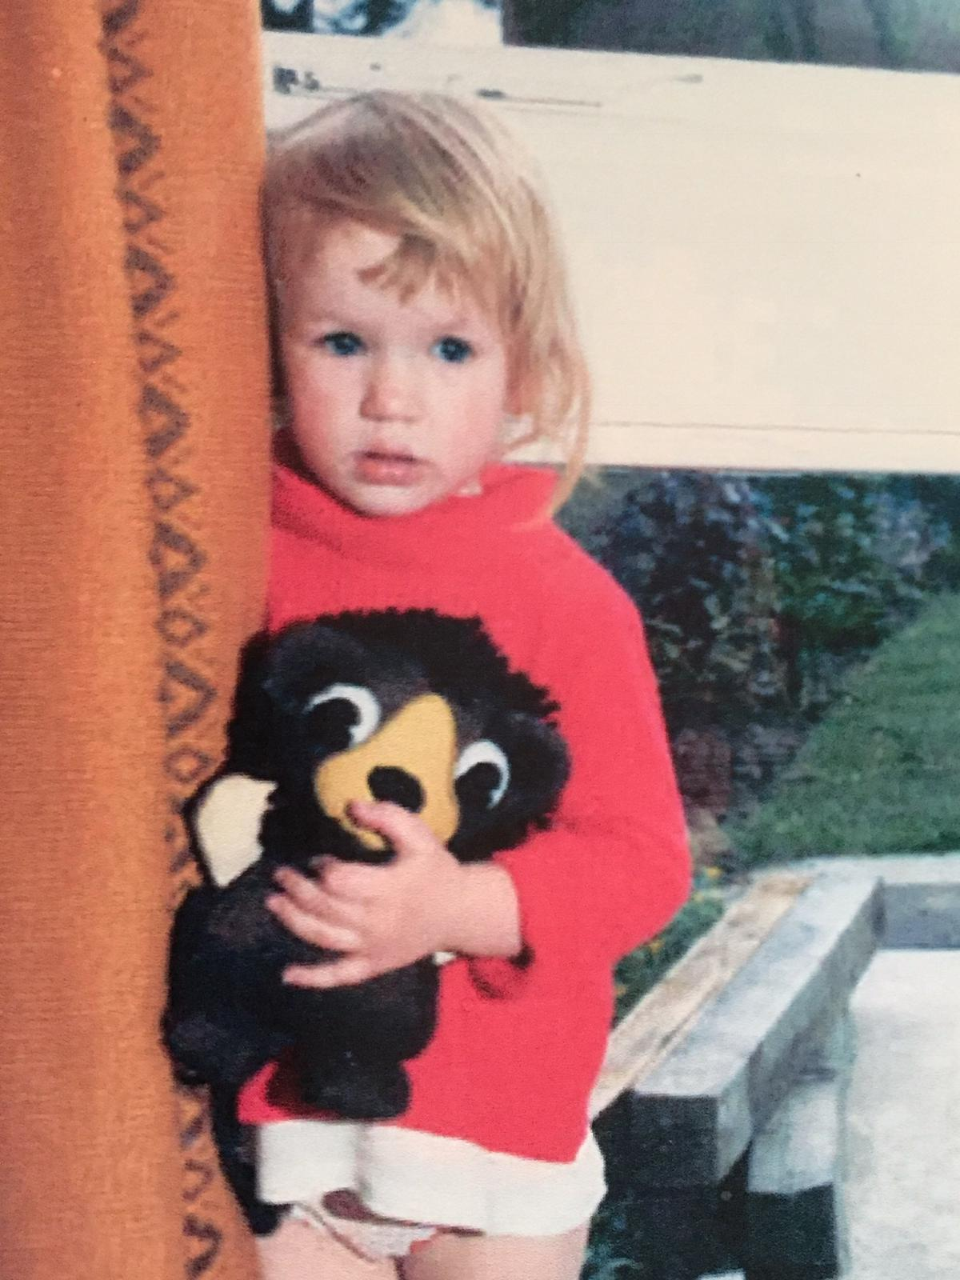
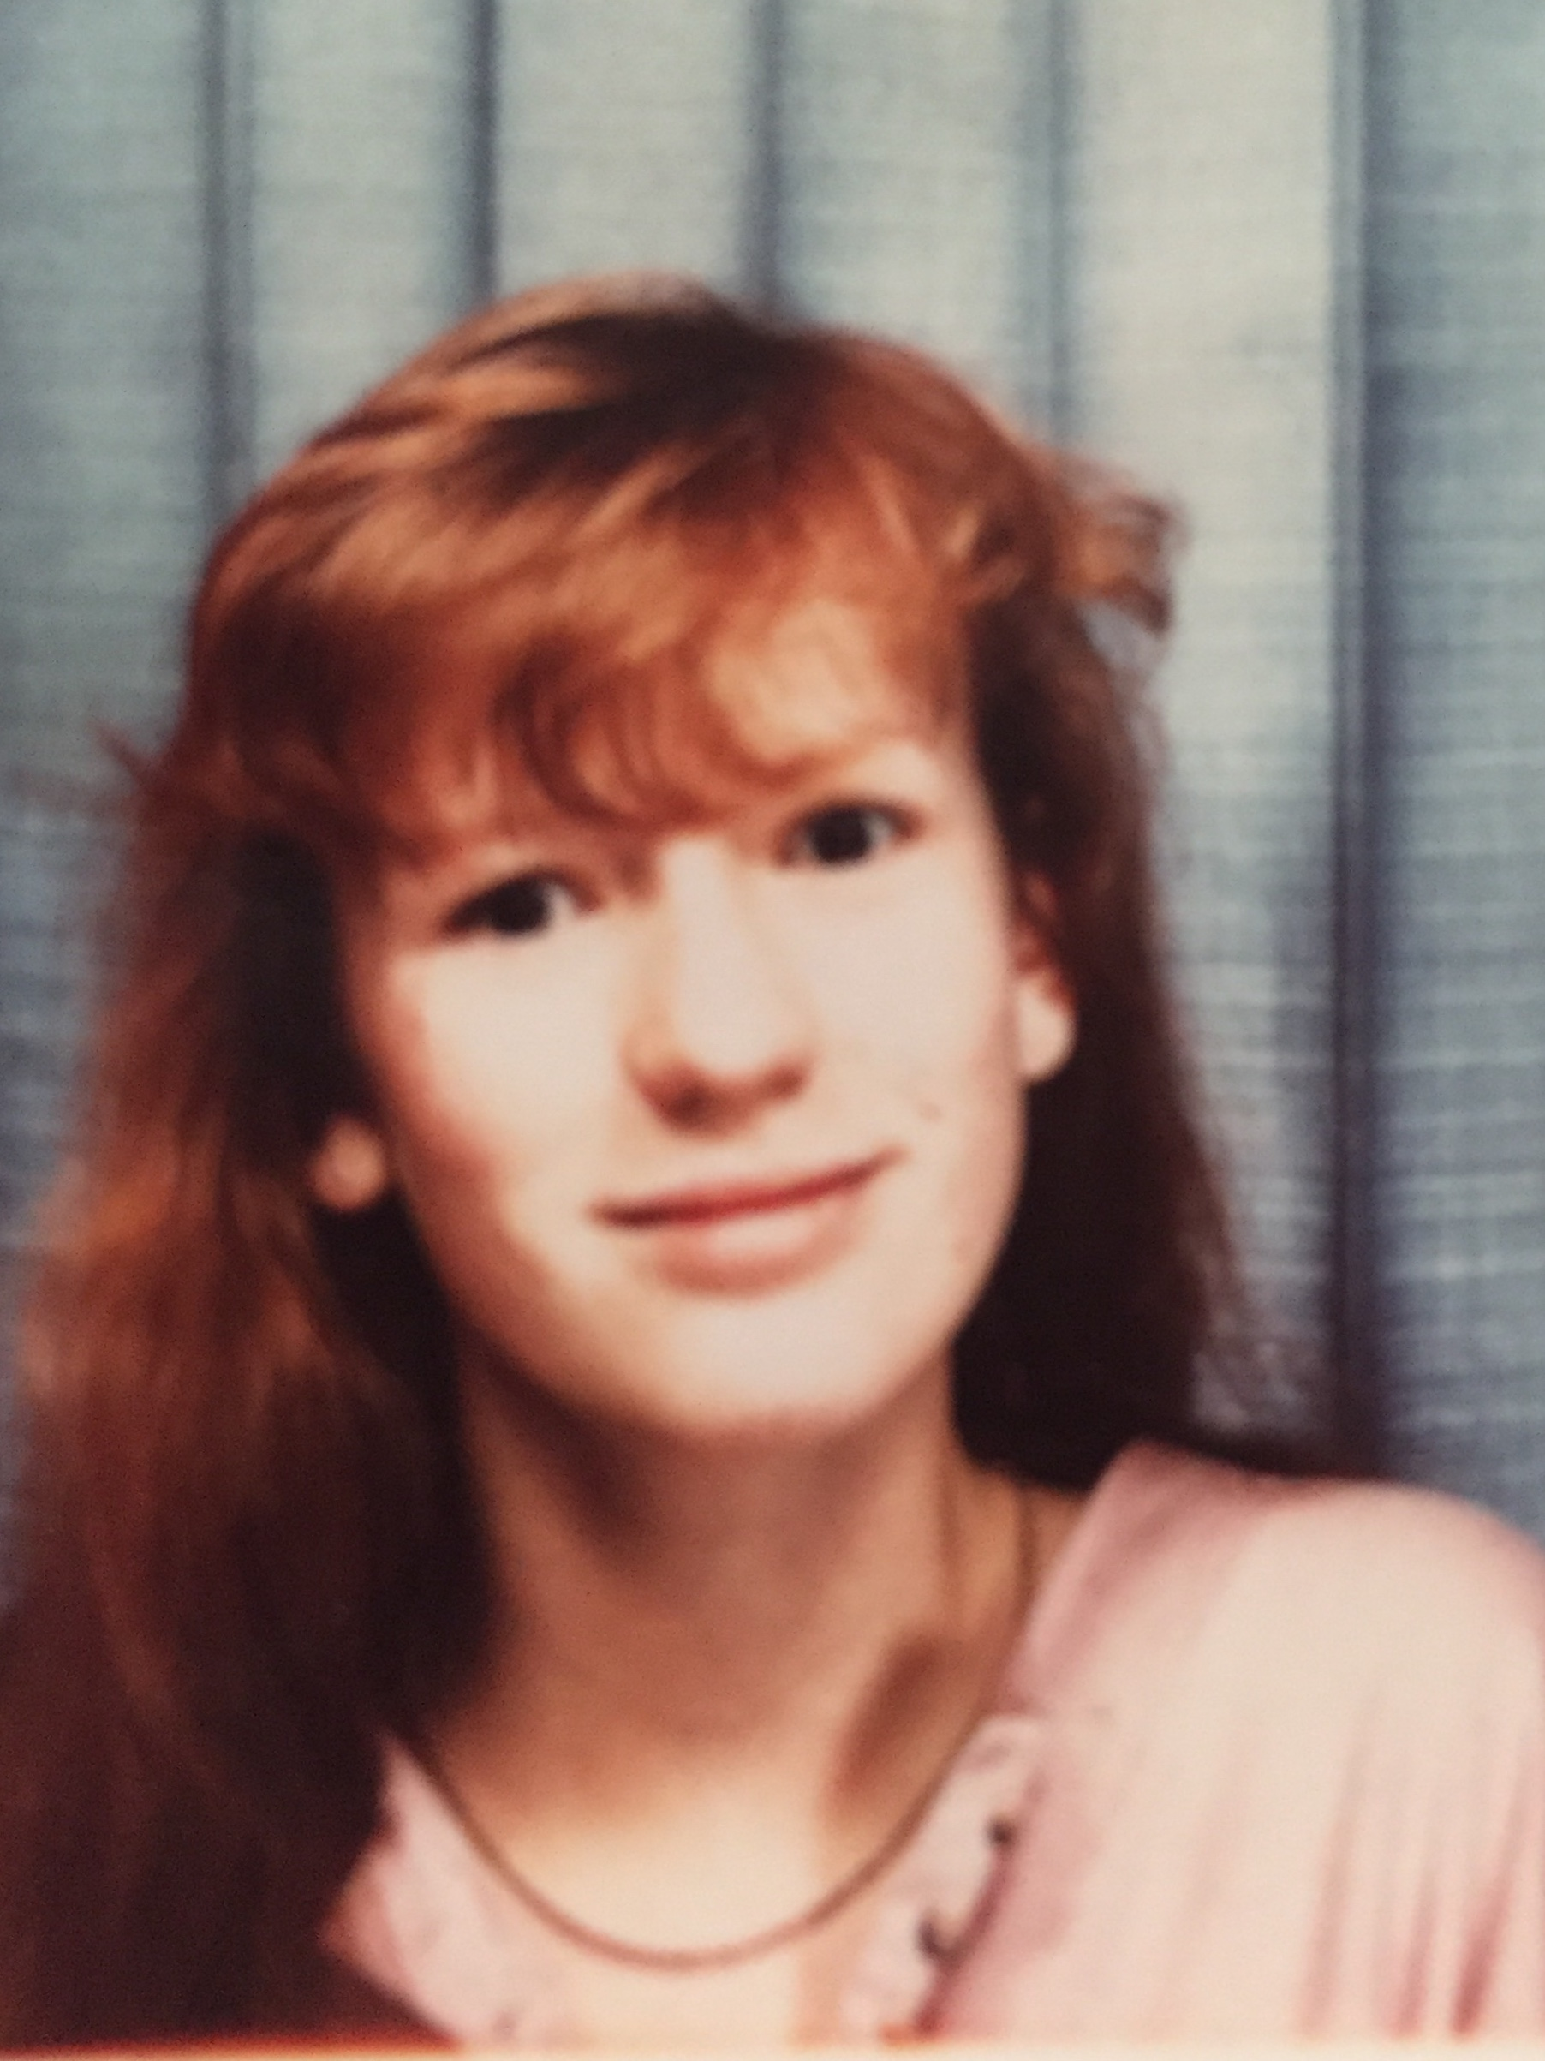
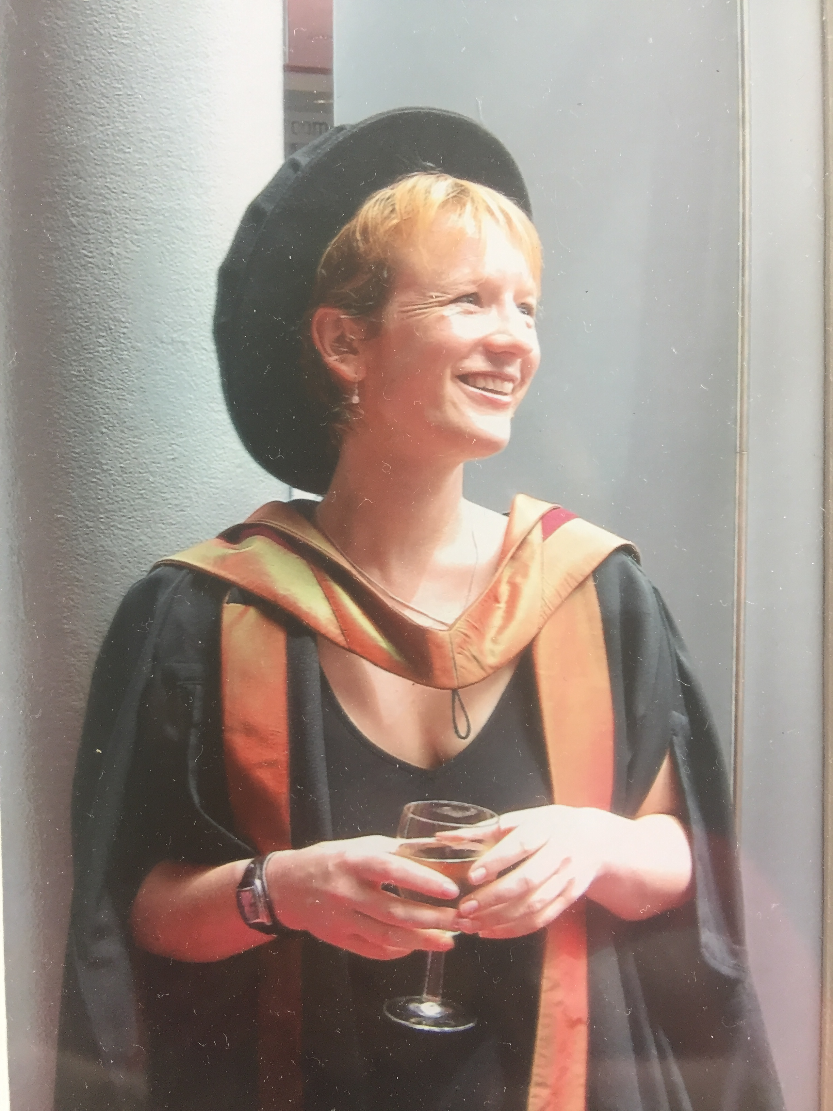
A long time ago… In a Galaxy, far far away…

Slide 4
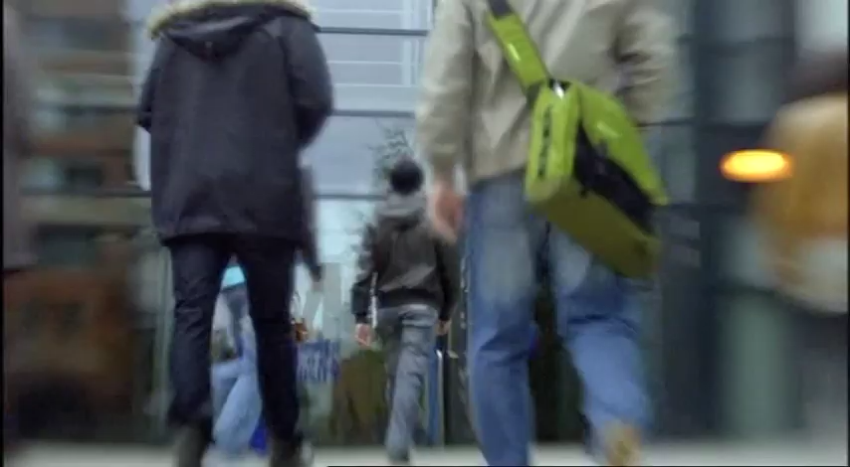
And suddenly, you find yourself…
NB Apologies for the F-Bomb

Slide 5
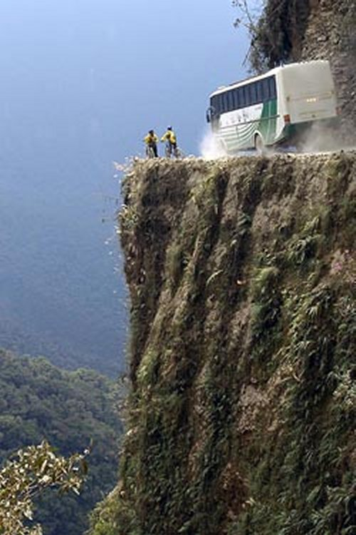
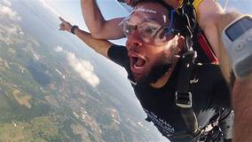

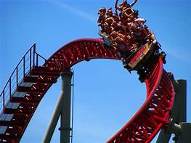
A Summary of My ‘Journey’ into Academia…

Slide 6

My Role…

Slide 7

The Best Bits…
Sharing my knowledge & passion
Seeing students develop
Continuing my professional development
Making impact where I *feel* it counts
Sense of vocation
Opportunities for creativity & autonomy
Having a strong ‘professional voice’
Being the pedagogical expert in the room…

Slide 8
The Worst Bits…
Parity of status and esteem
Becoming a ‘factotum’
Fighting for research & CPD time
Challenging students’ misconceptions of HE
Challenging colleagues’ misconceptions of teaching-focused roles
Admin…and ‘picking up the pieces’
WORKLOAD!

Slide 9
What does that mean in Practical Terms..?

Slide 10
It’s about more than your research…REALLY!

Slide 11
Be AUTHENTIC
Inscriptions at Temple of Apollo, Delphi
Γνῶθι σαυτόν (gnóthi sautón)
Μηδέν άγαν (medén ágan)

Slide 12

Follow your PASSION
No one-size-fits-all…
Play to your strengths…
It’s your journey!

Slide 13

Build a THICK SKIN
Not everyone plays nicely [sigh]
Criticism can cut deeply- even CC!
Rejection is not always a reflection on you
‘Fit’ reigns supreme…

Slide 14

Try NEW Stuff
You are not a ‘one-trick pony’
Novelty can be a powerful motivator…
Failure is not a barrier to learning….
Challenge is core to professional development!

Slide 15

Be CONFIDENT!
Intellectual & Professional Confidence are…
NOT arrogance
NOT an antidote to IMPOSTER SYNDROME
Things that develop over time
Things that improve with practice
NOT measures of previous success
NOT the same as hard work
Essential for Academia!

Slide 16

So… What’s the THM?
“…You can’t really control your future, so you should enjoy what you are doing while pointing yourself in the direction you think you want to go. “
With thanks to Dr Laura Adams

Slide 17
Any Questions..?
Dr Liz Blagrove
Department of Psychology
(e.l.blagrove@warwick.ac.uk)

