Slide 1
Academic Career Workshop
Science, Engineering and Medicine
Dr Meera Unnikrishnan
Associate Professor
Warwick Medical School

Slide 2
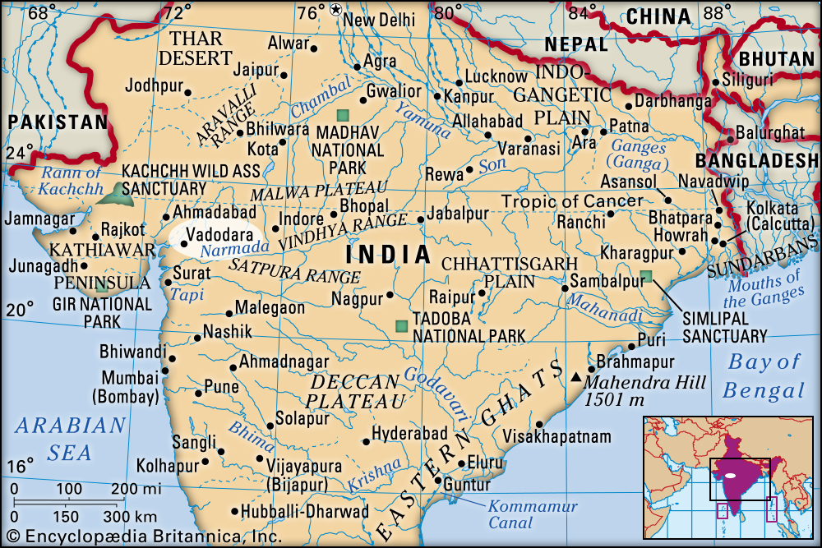
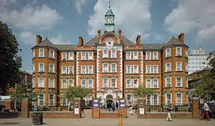
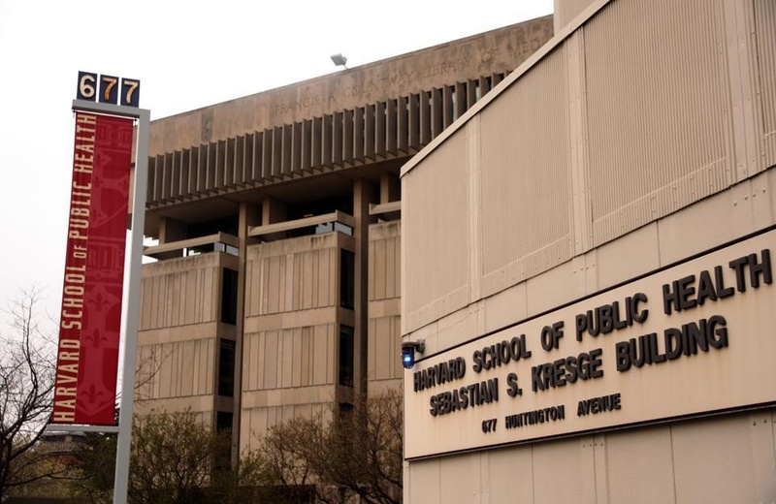
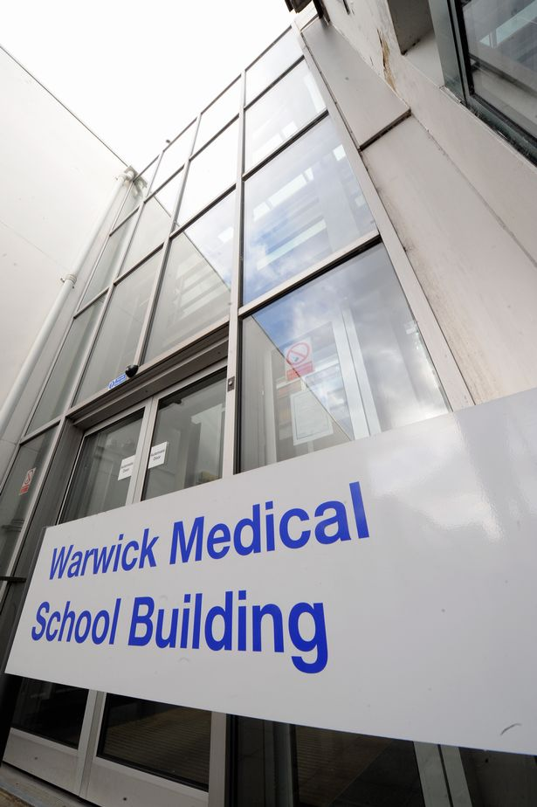
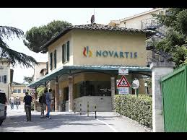
A non-conventional career path
MSc Biotech, Baroda, India
PhD in Microbiology, Imperial College London
Postdoctoral Fellow
Harvard University
(2 labs)
Boston
8 years
Assistant
Professor
UK
Senior Scientist, Novartis Vaccines
Siena,
Italy

Slide 3
Finding a postdoctoral position
Write to PI’s expressing interest, even if they have not advertised
Go to a major conference in the area and arrange to meet with key scientists that you might want to work with
If you see an advert, contact the PI and discuss the project
Find out from others about the PI/ laboratory
Find out if the PI is open to you applying for Fellowships
If considering a future industry career try to find a lab which has links to industry
Ask your PhD supervisor for advise!!

Slide 4
Things you could do to enhance your CV:
Write a small grant / apply for postdoctoral fellowship
Research papers: Consider Pre-print servers
Talks in conferences
Make sure you get feedback on your CV and cover letters
from researchers in the field.
Get on Twitter/ Linkedin

