Slide 1

Wellbeing & Student Support
Services and resources available to you
12th February 2025
Janet Winter

Slide 2
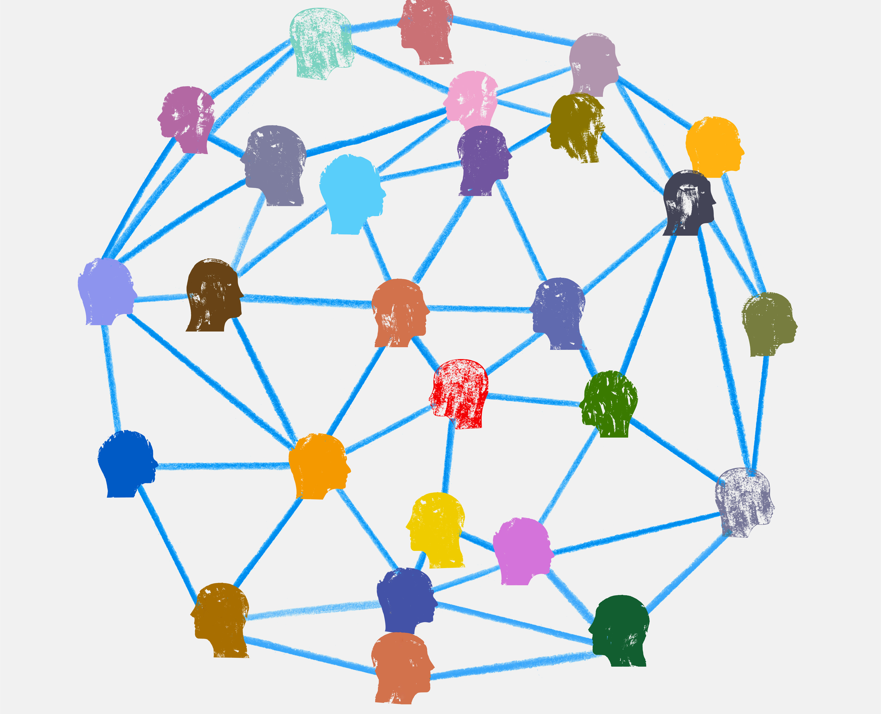
Who we are

Slide 3
Wellbeing & Student Support
Our Teams
What support is available?
Wellbeing Support Team
Wellbeing Advisers
Mental Health Nurses
Sexual & Domestic Abuse Advisers
Counselling & Psychotherapy Services
Psychological Therapists
Disability Services
Disability Advisers
Mental Health Mentors
Specialist Study Support Tutors

Slide 4

WHAT WE DO

Slide 5
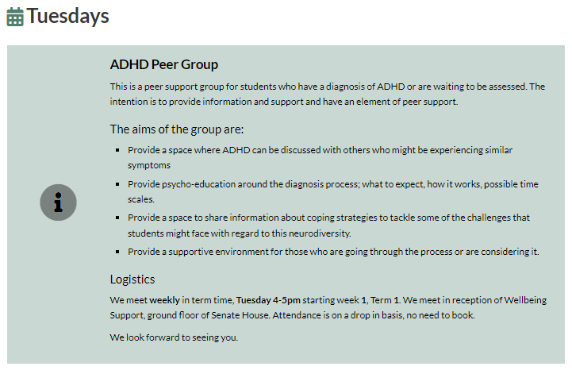
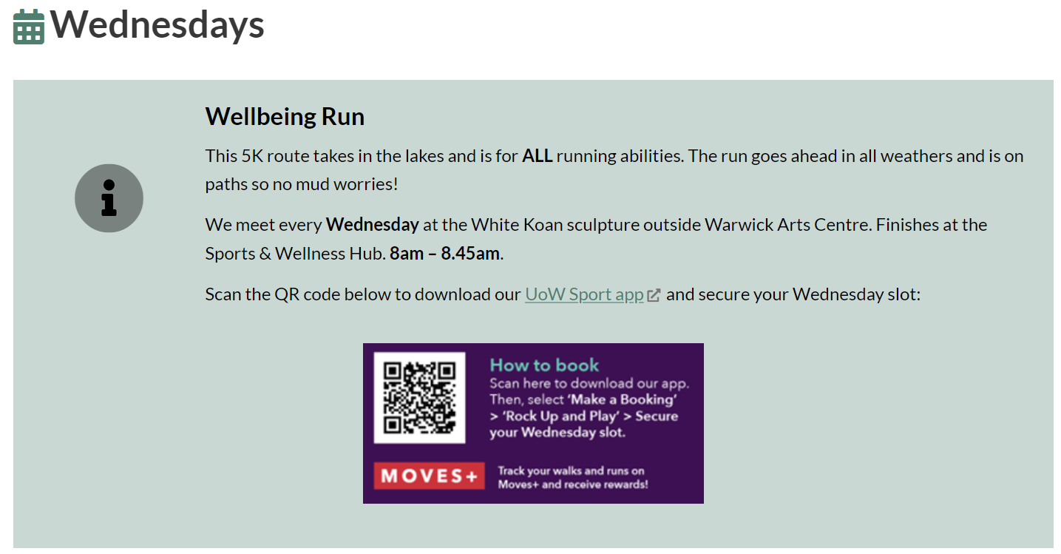
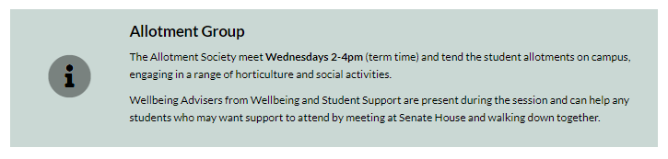
What’s On
Keep an eye on our website for more

Slide 6
Wellbeing Support Team
Wellbeing Advisers, Mental Health Nurses, Sexual & Domestic Abuse Advisers
The WST provides practical advice & emotional support through:
Brief Consultations
1:1 Appointments
Group & Interest Sessions
Outreach in Departments
Responding to concerns

Slide 7
Brief consultations
Brief consultation
Advice & support
1:1 Session booked
CAPS referral
Disability Services referral
Referral to other support
Self help resources
Mon-Fri, 10am-3pm, face to face or online
Often the first point of contact with Wellbeing.
A confidential conversation with a wellbeing professional.
An initial conversation to talk through what it is you are looking for support with, and to explore your support options.
Next steps depend on individual needs and circumstances.

Slide 8

Wider support at Warwick
Personal Tutor System
Student Immigration & Compliance
The Health Centre
Report + Support
SU Advice Centre
Community Safety
Student Funding
Residential Community Team
Doctoral College
Local Police/
PCSO
Chaplaincy

Slide 9



Counselling & Psychotherapy Services
CAPS
Help for a range of personal, psychological and emotional issues from a team of qualified, professional Counsellors and Psychologists.
The aim of therapy is to support you to thrive and help you understand how you can make some positive changes.
Ways to engage include:
Face to face therapy
Video therapy
Email therapy (self-referral available)
Group therapy
Counselling and Psychotherapy Services
Notes:
Brief interventions.
Wait times.

Slide 10

Therapy Groups
Available through CAPS
Therapy Groups available in 2024-2025:
Compassion-Focused Therapy (CFT) for Perfectionism Groups
8 week programme
Groups starting in Terms 1 & 3
Interpersonal Relations Groups
10 week programme
Groups starting in Terms 1 & 2
Self and Trauma
8 week programme
Groups starting in Terms 1 & 3
Counselling and Psychotherapy Services
Notes:
Brief interventions.
Wait times.

Slide 11

Disability Services
Support available from application to graduation
Guidance, support and advice to disabled students
Transition programme offered to autistic students
Supporting with accommodation requirements
Putting in place reasonable adjustments, including exam arrangements, informed by supporting evidence
Advice about the Disabled Student Allowances and other available funding
Specialist study skills support, specialist (AS and MH) mentoring and other enabling support
Initial screenings for Dyslexia, Dyspraxia, ADHD, ADD and Autism
Advice on assistive technology and productivity tools
To access support, submit a query directly to Disability Support on the
Wellbeing Portal

Slide 12
What is a ‘disability’?
Equality Act
Neurodevelopmental, Social, Communication differences, Autism Spectrum, Asperger’s
Blind or a serious visual condition uncorrected by glasses
D/deaf, other hearing issues or conditions
A long-standing physical illness or health condition (such as ME/chronic fatigue, epilepsy, diabetes, digestive conditions, or HIV)
A mental health condition, such as depression, anxiety, OCD, or schizophrenia
Neurodiverse, specific learning differences (such as dyslexia, dyspraxia, or ADHD)
A physical or mobility issue, use of mobility aids or difficulty using arms
A disability or medical condition that is not listed above, such as speech difficulties/stammer
You’re disabled under the Equality Act 2010 if you have a physical or mental impairment that has a ‘substantial’ and ‘long-term’ negative effect on your ability to do normal daily activities.

Slide 13



Confidentiality
Confidentiality

Slide 14

HOW TO get in touch

Slide 15

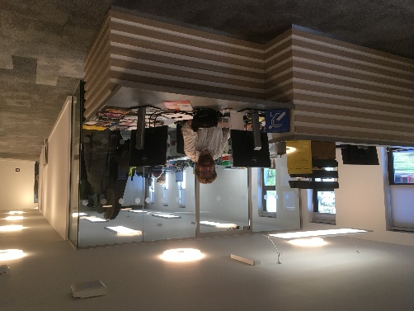
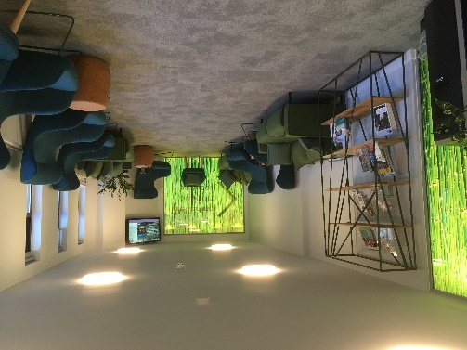

Getting in touch
Brief consultations available every working day from 10am-3pm to identify the correct support for you.
 024 7657 5570
wellbeing.warwick.ac.uk
Senate House (ground floor)

Slide 16
Using the Wellbeing Portal
How to join the queue for a brief consultation
wellbeing.warwick.ac.uk
Log in using Warwick ID
Make an enquiry
Access a brief consultation
Select online (Teams) or face-to-face (Senate House)
Read the info and click ‘Access the queue’
Wait times vary. Often 20-30 min, can be longer.
Receive guidance about the most appropriate form of support & next steps.
Notes:
Mention can go straight to disability query.
Mention wait times may be 1 hour.

Slide 17

When to see us

Slide 18
Common signs of wellbeing declining
Becoming more irritable, easily angered or upset.
Changes in appetite.
Changes in sleep patterns.
Low energy or chronic fatigue.
Low mood, feeling of numbness or apathy
Increased alcohol or drug use.
Loss of interest or pleasure in fun activities.
Overwhelming sense of impending danger, panic, or doom.
Changes in concentration, motivation, or confidence.
Increased risk-taking and aggression.
Notes:
To start with, let’s have a look at what we mean by wellbeing.
Wellbeing is about feeling good and functioning well in lots of different areas of life – physical health, emotional or psychological wellbeing, social interactions, intellectual stimulation, financial stability, occupational wellbeing, environmental health and spirituality. Functioning well is more than just doing well academically.
Everybody experiences ups and downs in their day to day life, this is normal and it is not possible to maintain optimum wellbeing in all areas at once, it’s about getting a balance.
All aspects of wellbeing are interconnected and impact on each other.
What looks like ‘good’ versions of each of these areas of wellbeing is different for each person - you need to know what is good for you.
It’s likely that options that fit with your strengths, passions and values are most likely to create positive wellbeing. This means you have to be honest with yourself about what is important to you.

Slide 19
Top wellbeing tips
There are things you can do to improve your own wellbeing, but remember support is available!
What support is available?
Time to relax
Regular sleep
Reflect
Physical activity
Express
Connect
Set goals
Food & hydration
Seek support when needed
Notes:
To start with, let’s have a look at what we mean by wellbeing.
Wellbeing is about feeling good and functioning well in lots of different areas of life – physical health, emotional or psychological wellbeing, social interactions, intellectual stimulation, financial stability, occupational wellbeing, environmental health and spirituality. Functioning well is more than just doing well academically.
Everybody experiences ups and downs in their day to day life, this is normal and it is not possible to maintain optimum wellbeing in all areas at once, it’s about getting a balance.
All aspects of wellbeing are interconnected and impact on each other.
What looks like ‘good’ versions of each of these areas of wellbeing is different for each person - you need to know what is good for you.
It’s likely that options that fit with your strengths, passions and values are most likely to create positive wellbeing. This means you have to be honest with yourself about what is important to you.

Slide 20

Get in touch early
You’re not alone

Slide 21

Additional resources

Slide 22
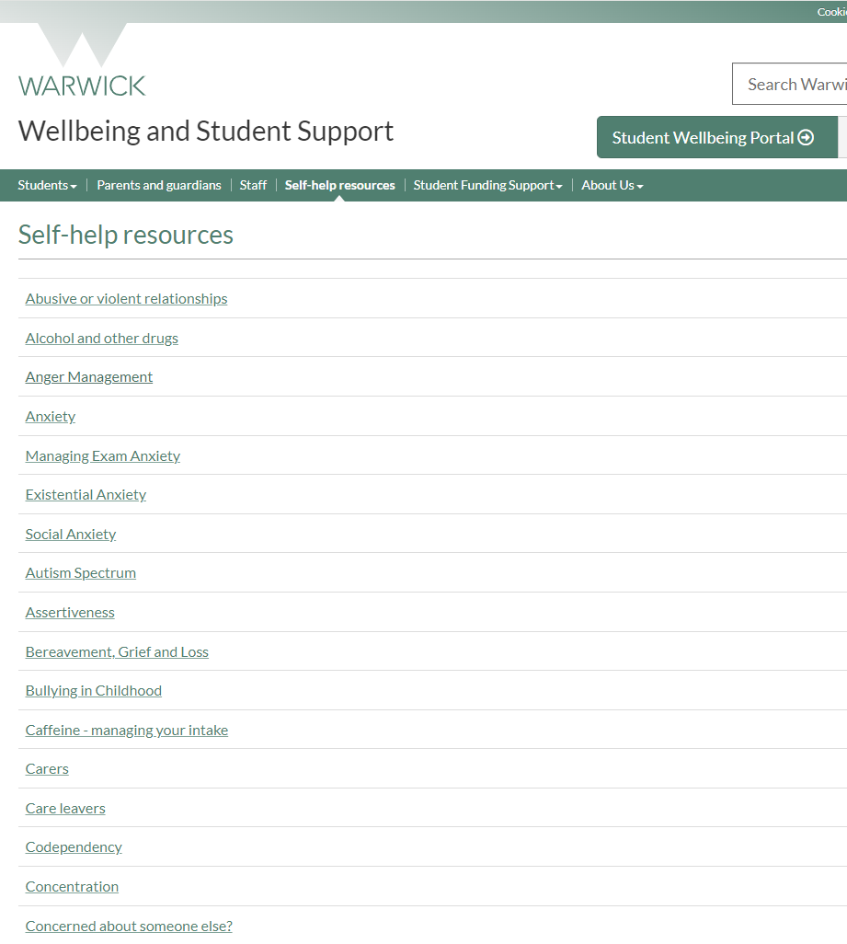
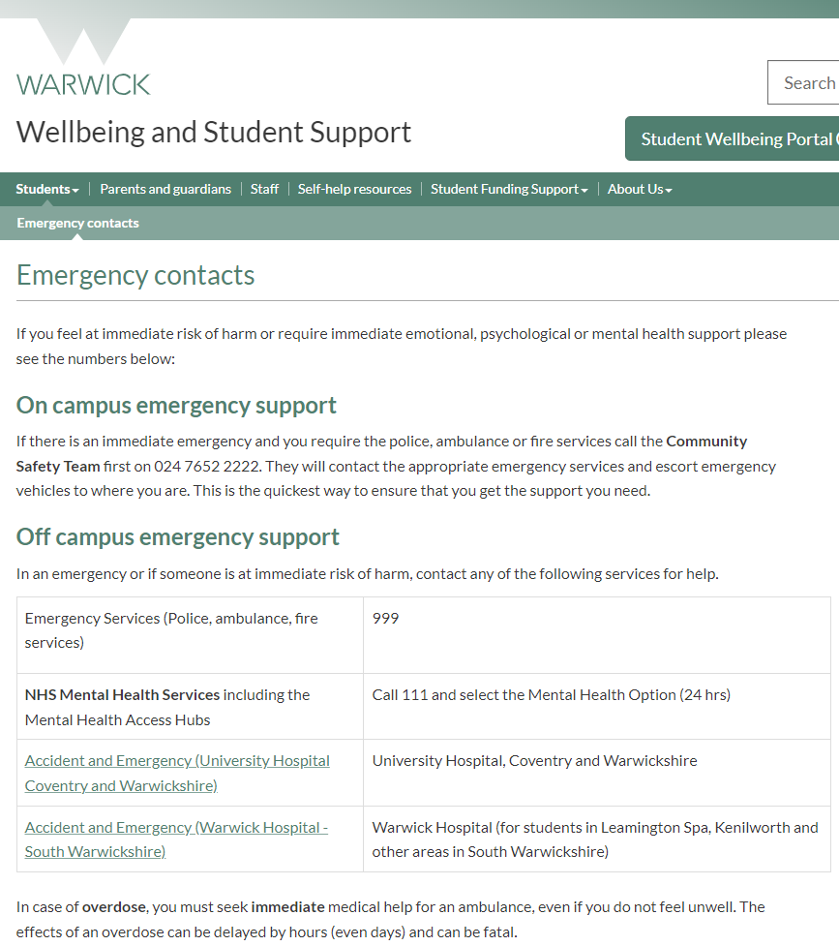
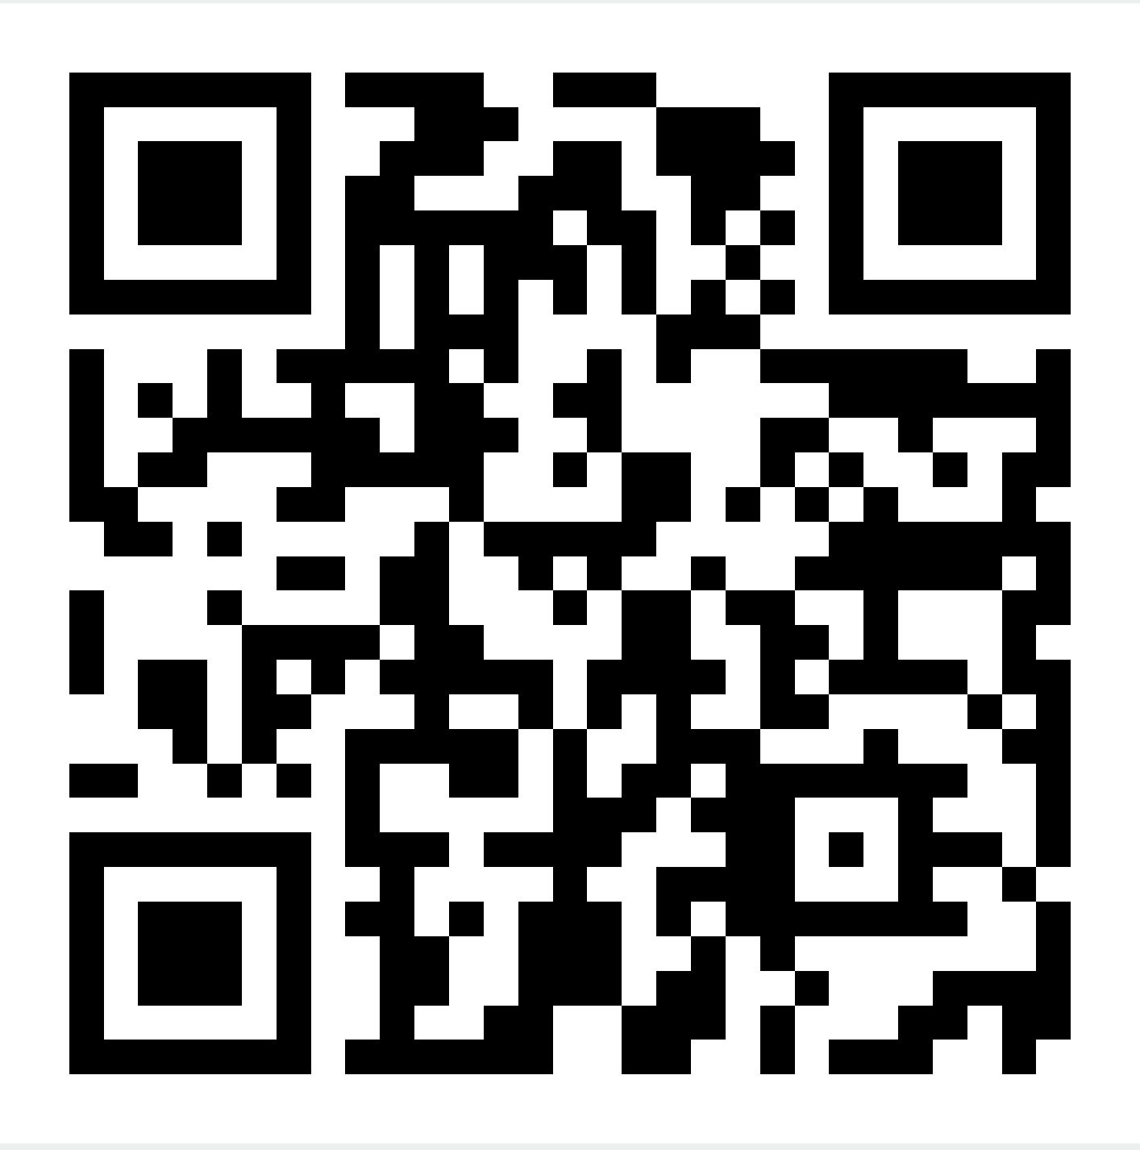
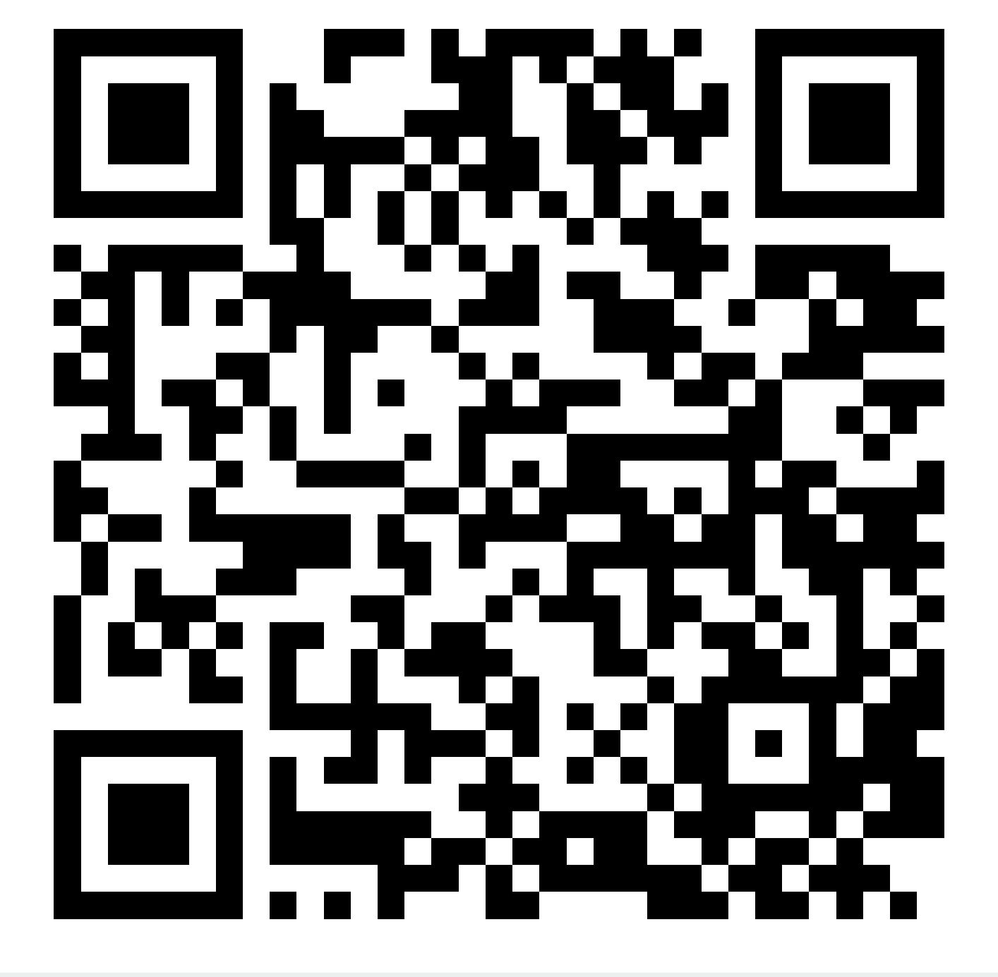
Explore our website
https://warwick.ac.uk/services/wss/
Self-help resources https://warwick.ac.uk/services/wss/topics/
Emergency contacts https://warwick.ac.uk/services/wss/students/emergency_contacts

Slide 23

Togetherall
A free digital platform all about mental health and wellbeing.
Available 24/7 for students at Warwick
Sign up using your Warwick email address.
Notes:
Students at the warwick can access Togetherall, an online platform all about mental health and wellbeing. Togetherall is available 24/7 and has three main parts to the support it offers. There is a supportive online community where you can share your experiences and get and offer support to other members. There is a range of short online courses available covering a wide range of subjects and a library of self help materials.

Slide 24

Q&A

Slide 25
Thank you
Notes:
Chance for Q&As if appropriate

