Slide 1

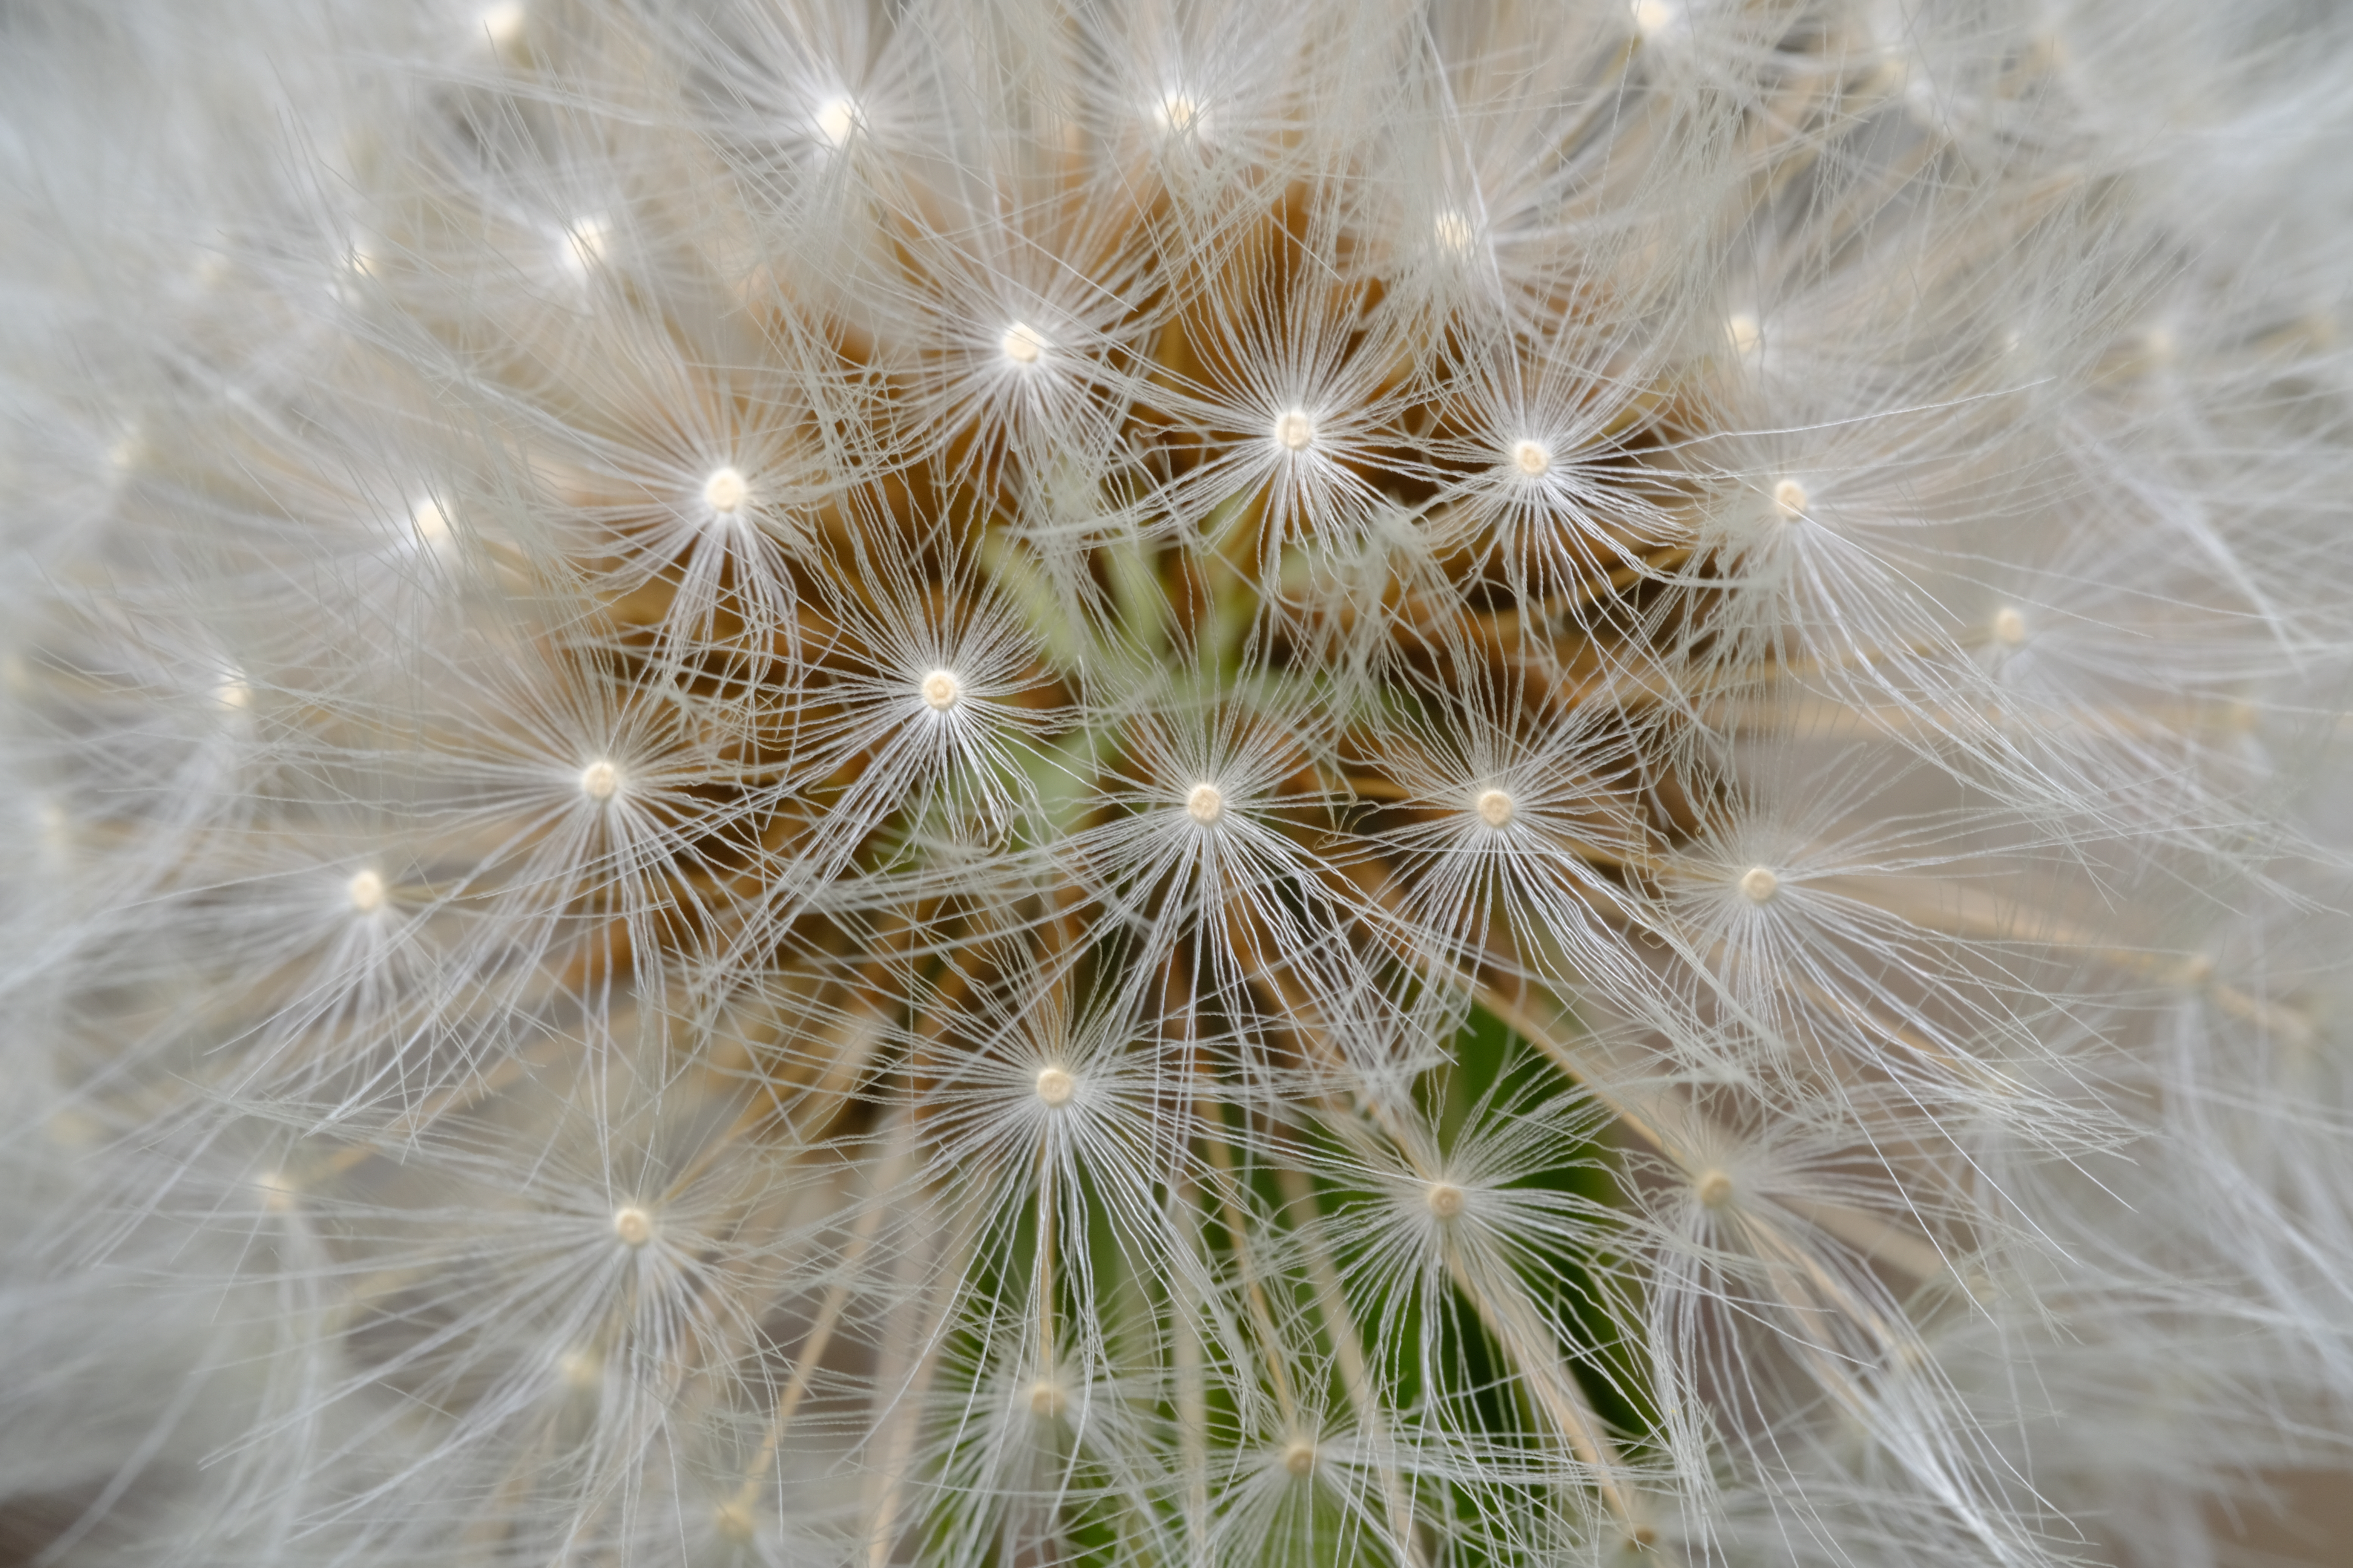

To help you get the best out of your time at Warwick and the best out of yourself.

Slide 2
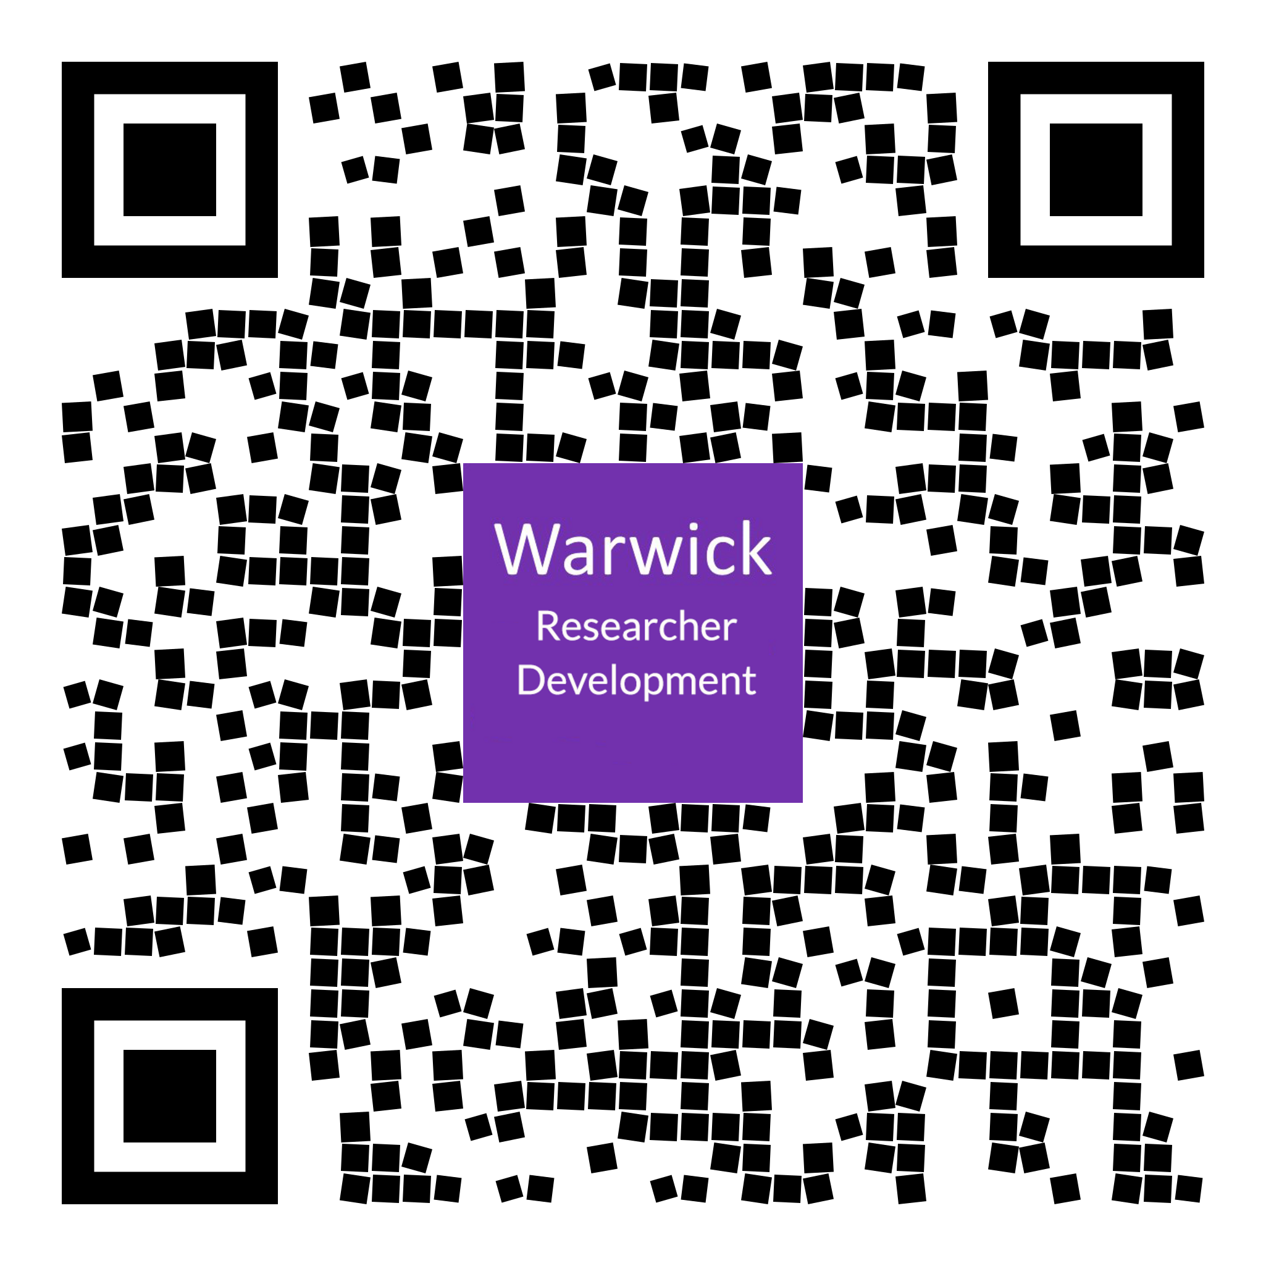
Why Researcher Development?
The prime gain from doing a PhD is little to do with the subject.
It is the life skills; surviving countless struggles, persisting through difficult times, becoming a resourceful problem solver and independent thinker; and knowing when to ask for help.
Invaluable for any future role!

Slide 3
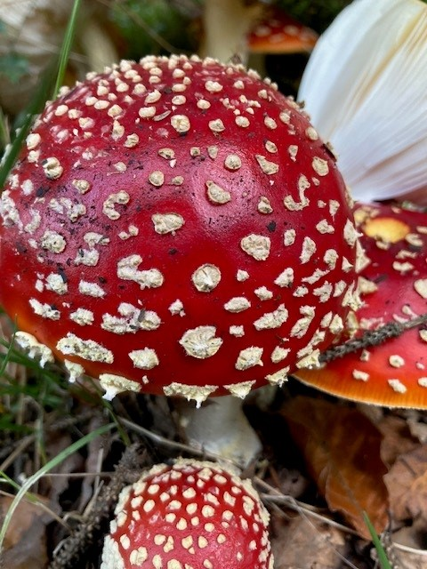
What we believe
Designed by researchers for researchers
Researcher Development is here to help you thrive as a researcher and a person
You are in charge of your own learning
You shape your own development
Build on existing strengths
Gain skills for your research and beyond
Learn in the ways that suit you

Slide 4
Six Pillars of Development
Accelerator series
Careers and Next Steps
PhD in second language
Research Practises and Methodologies
Your PhD journey
Writing Support
PhD Essentials

Slide 5
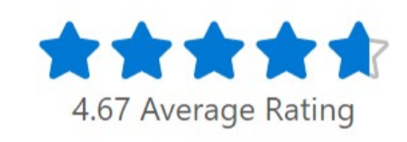
97% of attendees would recommend the workshop
200+ workshops offered per year
Rating the workshop a good use of their time 4.67
Community of 2500+ Researchers
RDO in numbers

Slide 6
Global research community
Flexible around research, work and caring commitments
Connect with researchers worldwide
Interactive small-group learning
Not webinars. Not lectures. Conversations and development.
Why are we online?

Slide 7
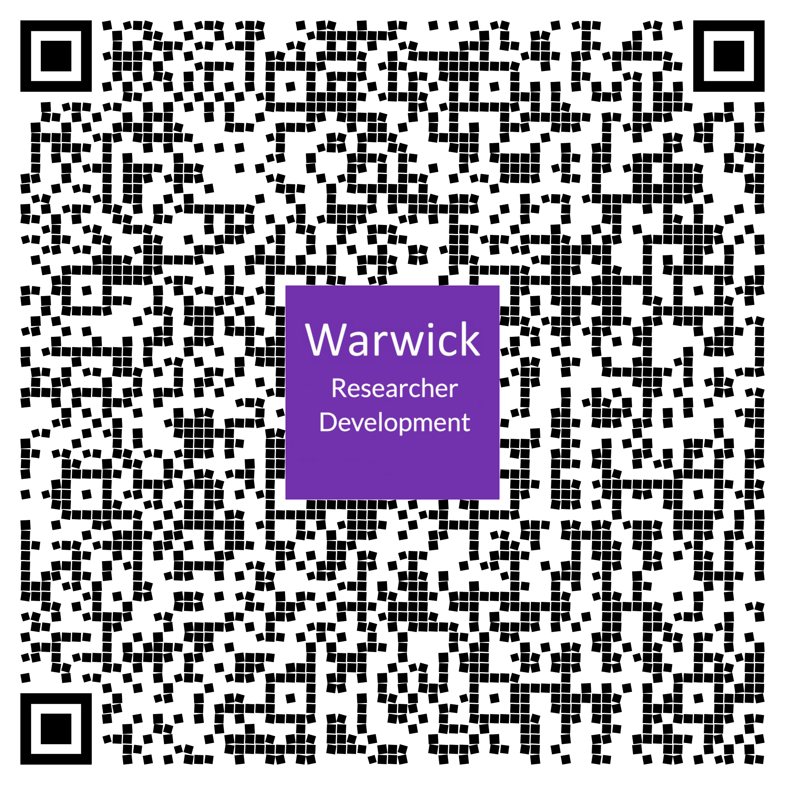
2,500+ researchers connected
Weekly Wednesday update from RDO Teams Channel
Resource sharing
Research Culture channel
Parent Juggle community
Part-time researcher community
97% would recommend RDO workshops
Join the Community

Slide 8
Interactive
Coaching-focused
Discussion-based
Practical
Task achieved
Many members of the Researcher Development team are Warwick PhD alumni, bringing first-hand insight into the opportunities and challenges of doctoral research.
Come ready to think, contribute and learn from others.
What to Expect in an RDO Session

Slide 9
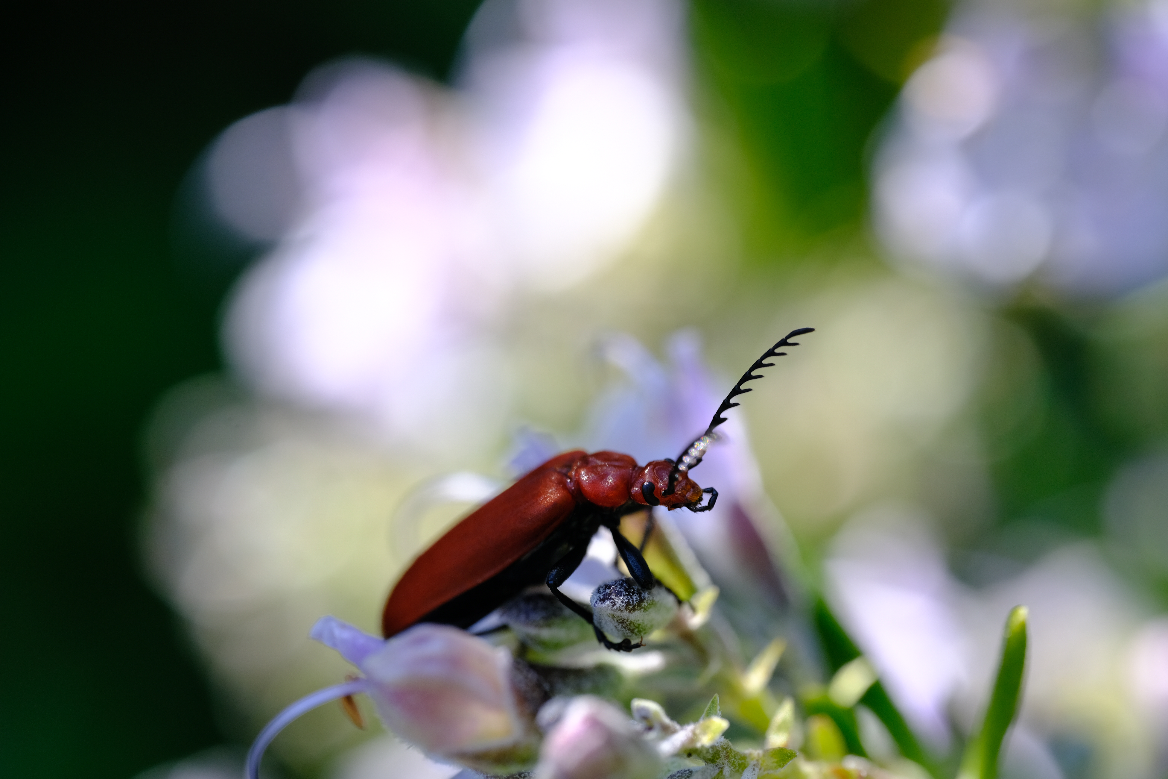
Meet the team
Researcher Development Website
RDO Teams
SkillsForge
RDContact@Warwick.ac.uk
Researcher Development RDO | LinkedIn
@warwickrdo.bsky.social
Meet the team
Find us

