Slide 1

Coached
A Story

Slide 2
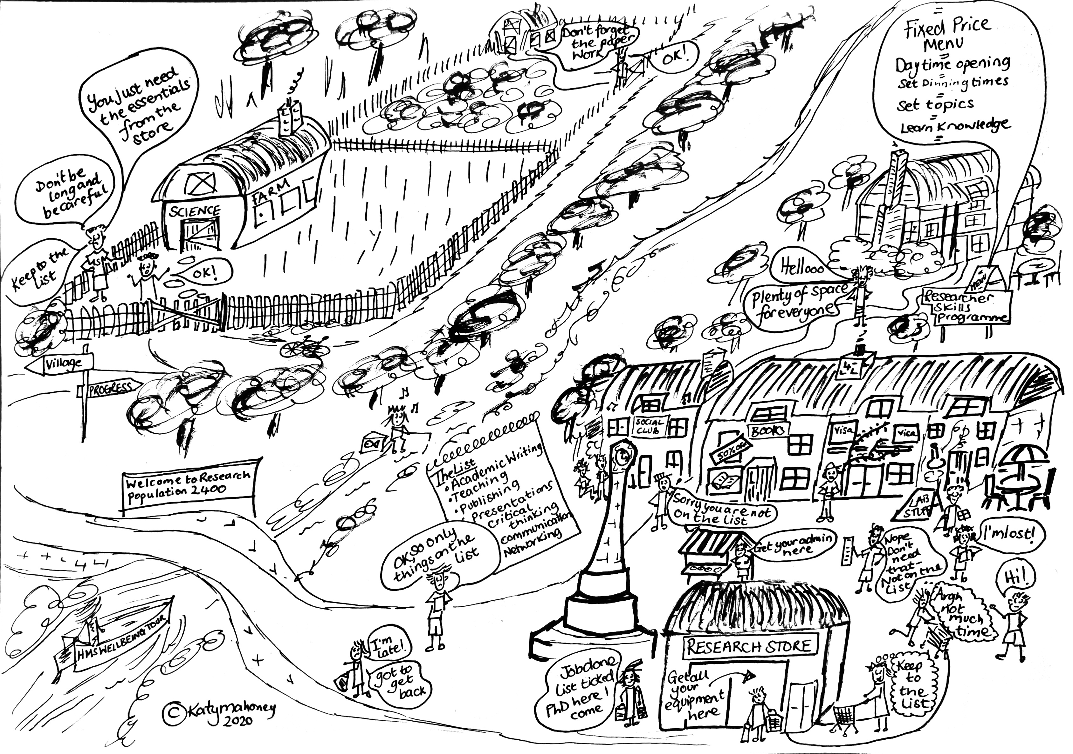
Once upon a time there was a village. Everyone in the village was very busy trying to attract researchers to come and sample their goods.
Fixed Price
Daytime Opening
Set Dining Times
Set Courses
Learn Knowledge

Slide 3
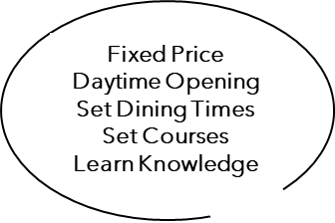
The Researcher Development Restaurant opened with great excitement but it stood empty with only the occasional customer.

Slide 4
When the researchers came to the village they had specific things to do and were worried about deviating from the list their supervisors had given them.

Slide 6
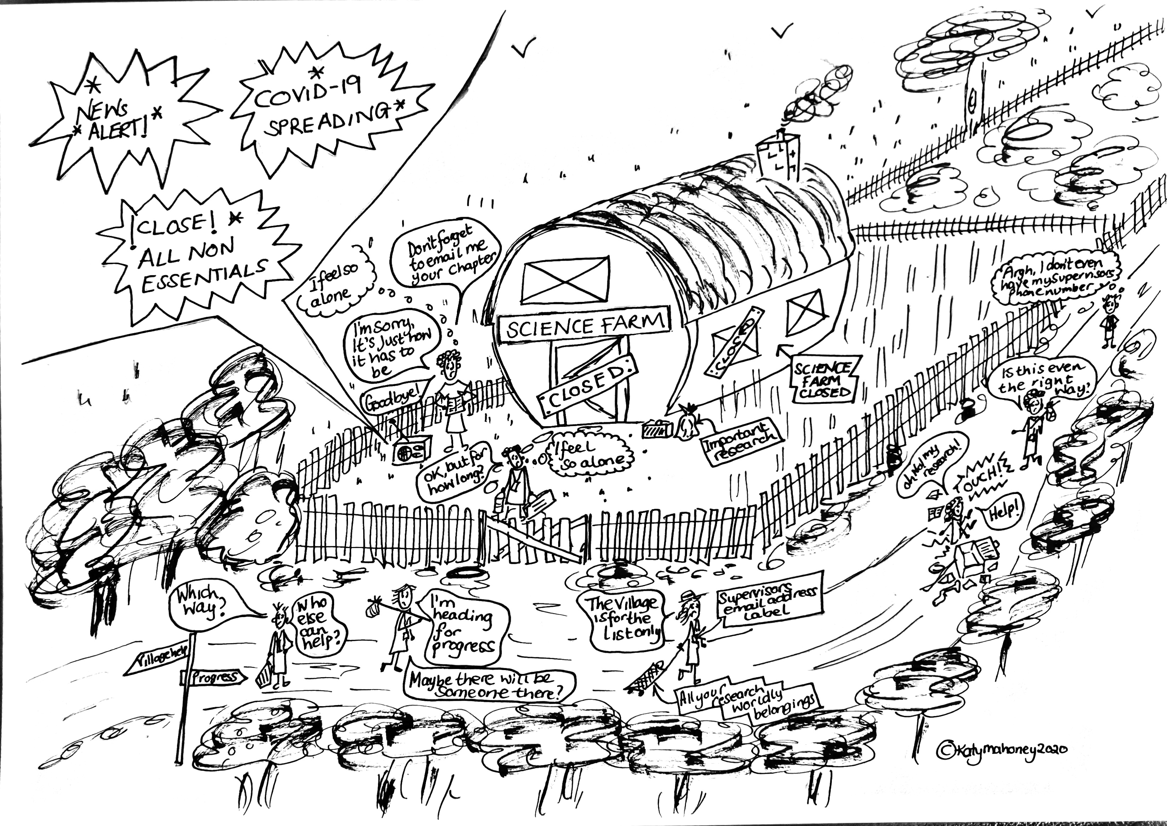
One day a great pandemic came to the village and all the researchers were set free to find their own way in the world.

Slide 7
Everyone felt alone

Slide 8
Everyone felt anxious Everyone was worried

Slide 9
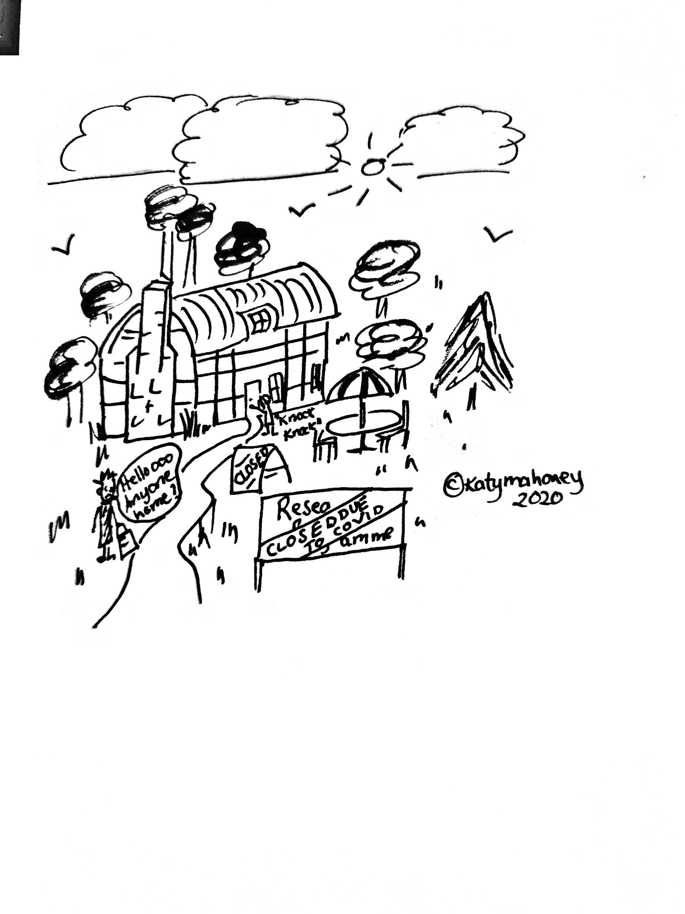
Some researchers ventured in to the village but everything was closed

Slide 10
Others made their own way towards progress

Slide 11
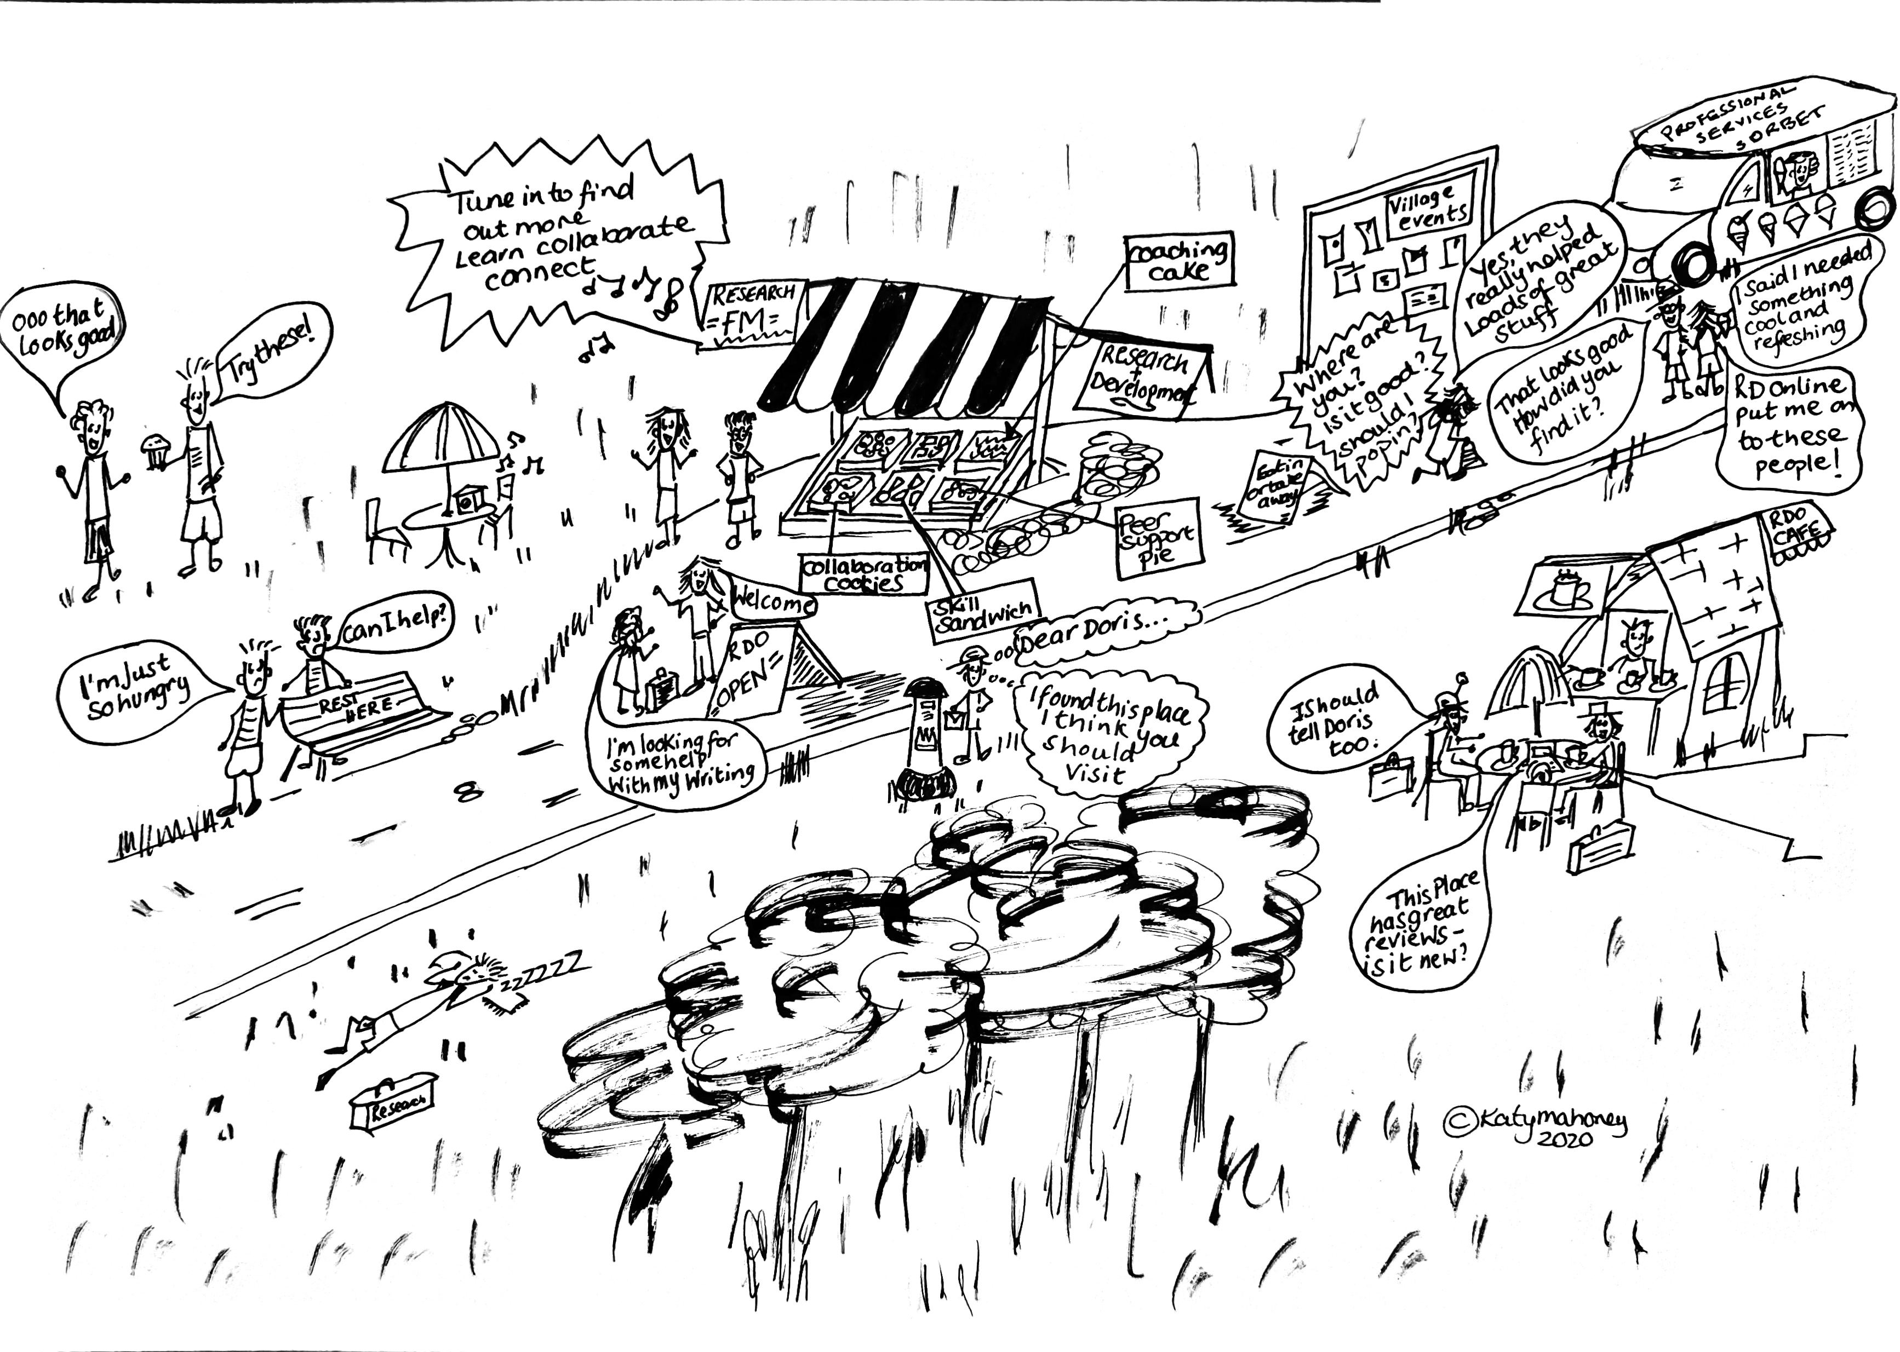
As the researchers continued on their journey they came upon a roadside shop.

Slide 12
The researchers soon realised all the people at the roadside shack had lots to offer. The people there didn’t offer a set menu or fixed dining hours. They could eat in, take away or just meet up with others and share stories.
I have found some helpful tips, and it's nice to catch up with other researchers also trying to work from home during a pandemic
I felt safe to voice my experiences, opinions and concerns in the session, and was satisfied with the responses and help I was given.

Slide 13
The researchers soon started to tell others about the roadside shack

Slide 14
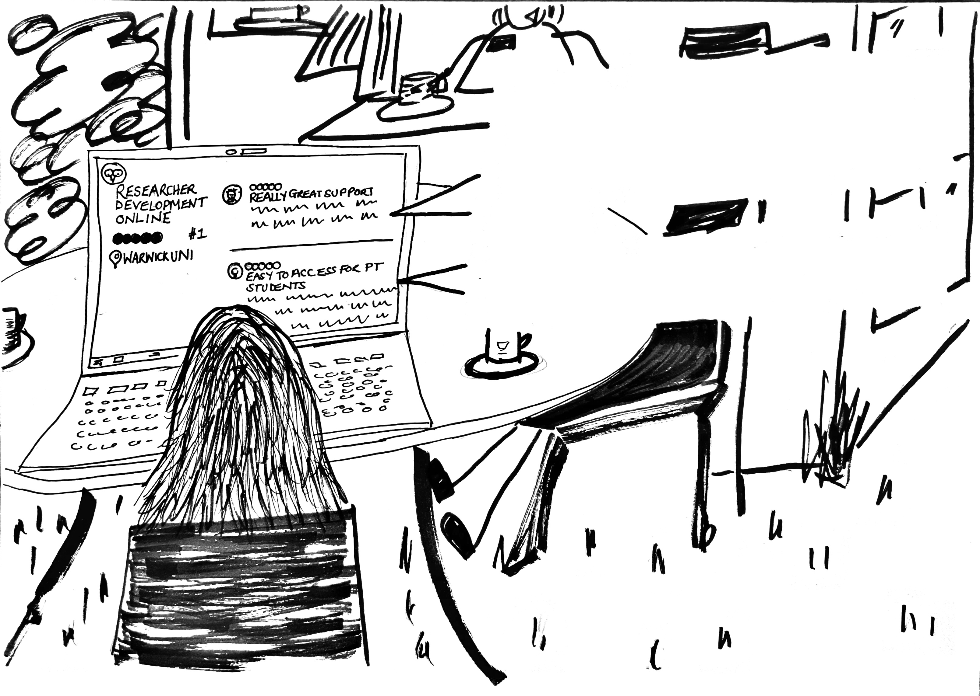
I very much appreciated the small group setting: there were just two of us, which meant that the session leader was able to personalise the coaching specifically for our needs. The session leader was happy to adjust to the different levels of progress we were at, acknowledged our strengths and helped us with the areas we wanted to improve on.
I really enjoy interactive sessions, time for exercises and interactions, because they give us time to reflect and share our experiences. Interactive sessions are engaging and provide opportunities for PhD students to communicate and ask questions.

Slide 15
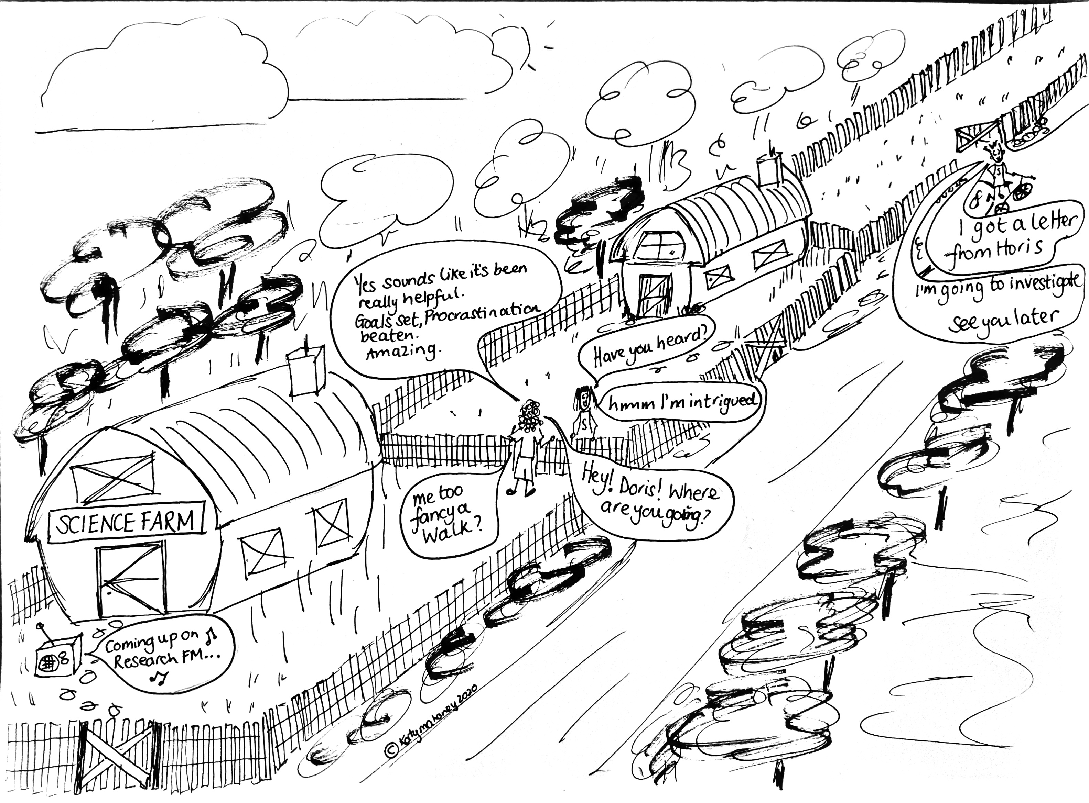
After a while news filtered back to the supervisors of the farms the researchers had left behind.

Slide 16
Some supervisors decided to investigate this roadside shack for themselves.

Slide 17
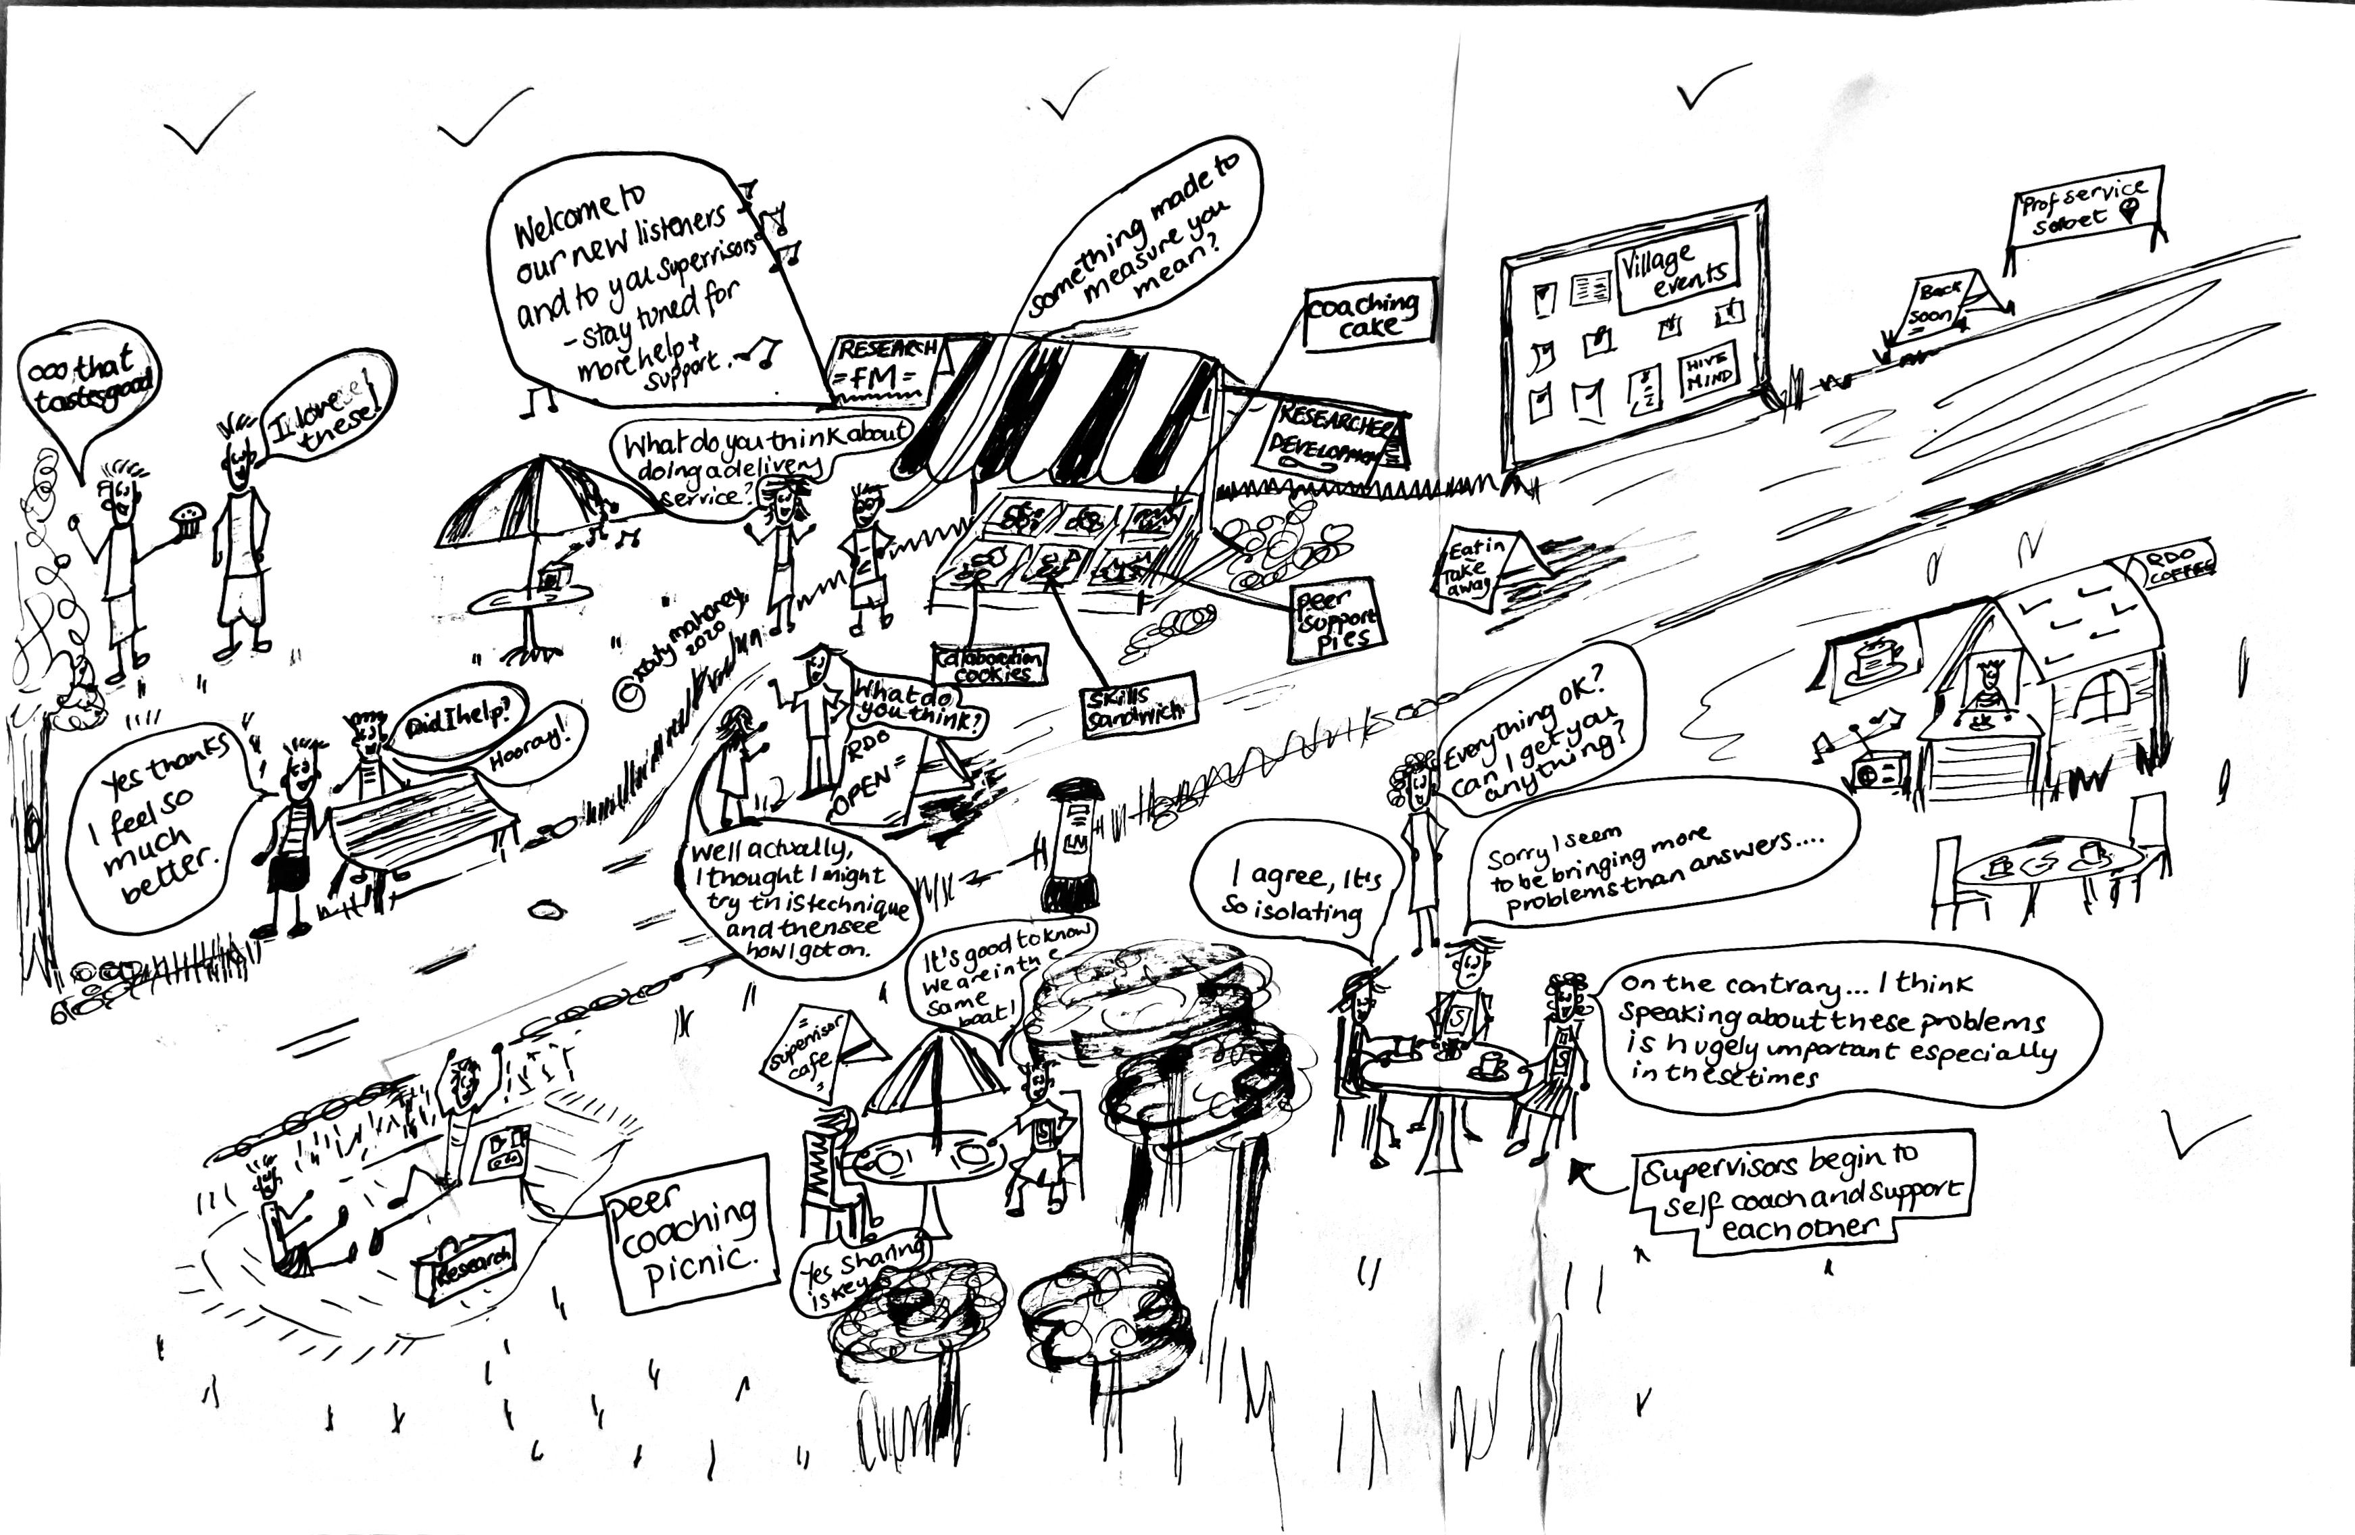

Slide 18
The supervisors met with others and shared their experiences too. Soon the supervisors begin to feel more relaxed, part of a community and embrace a self coaching mindset.

Slide 19
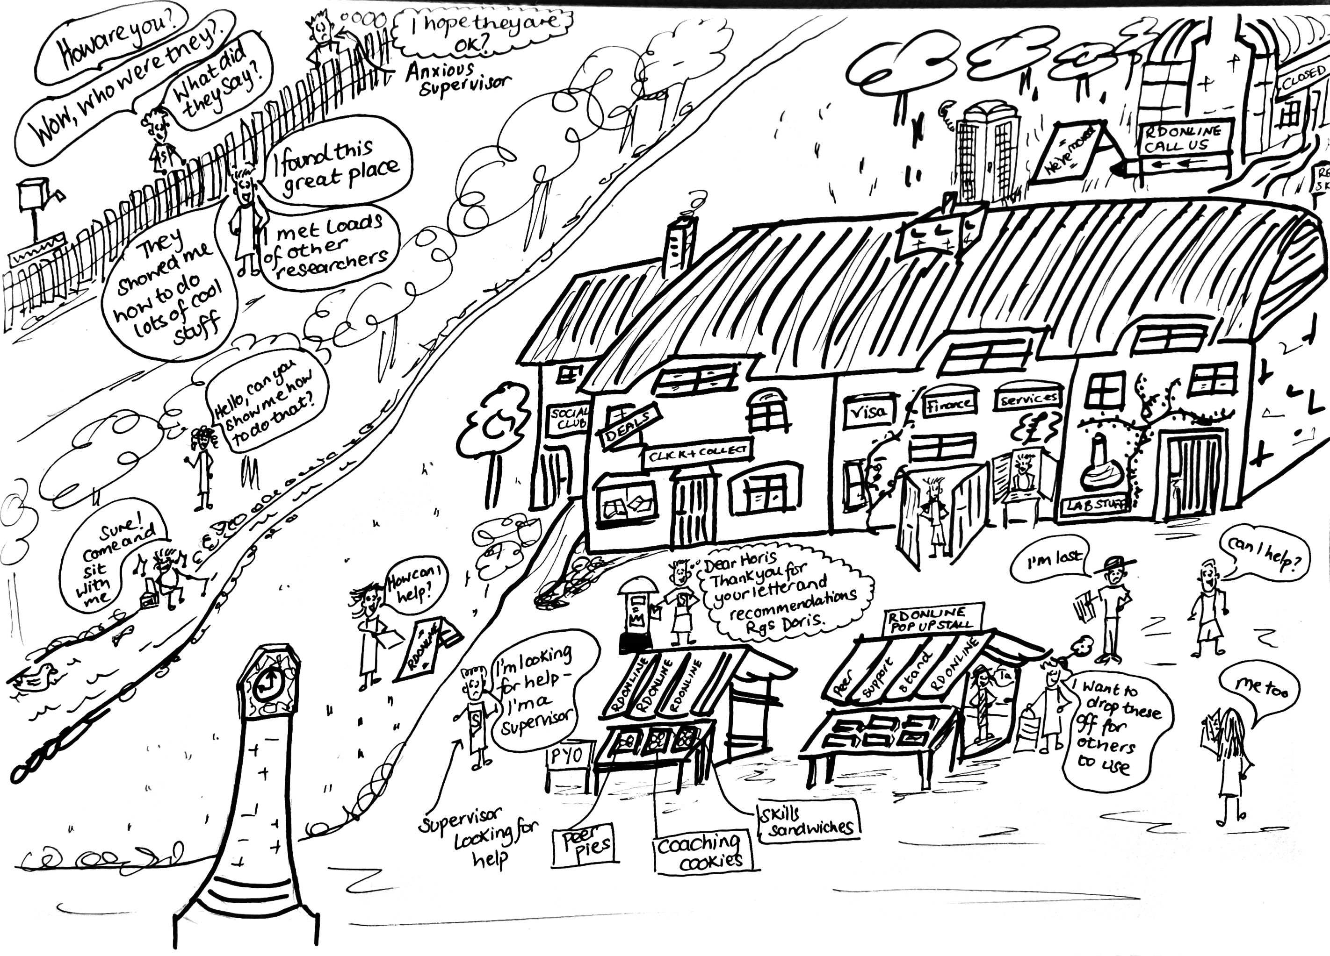
As the pandemic continues the village slowly reopens, but things have changed.

Slide 20
The researchers and supervisors begin to come together in the village to share experiences, but also to share knowledge and skills.

Slide 21
The Researcher Development Restaurant stays closed for the foreseeable but a new phonebox is installed for researchers to contact the community and seek support, advice and guidance.

Slide 22
To be continued…

