Slide 1

Lab access: Do it, Prove it, Value it
Dr Katherine Deane
University of East Anglia
k.deane@uea.ac.uk
Katherine@accessingbrilliance.org

Slide 2
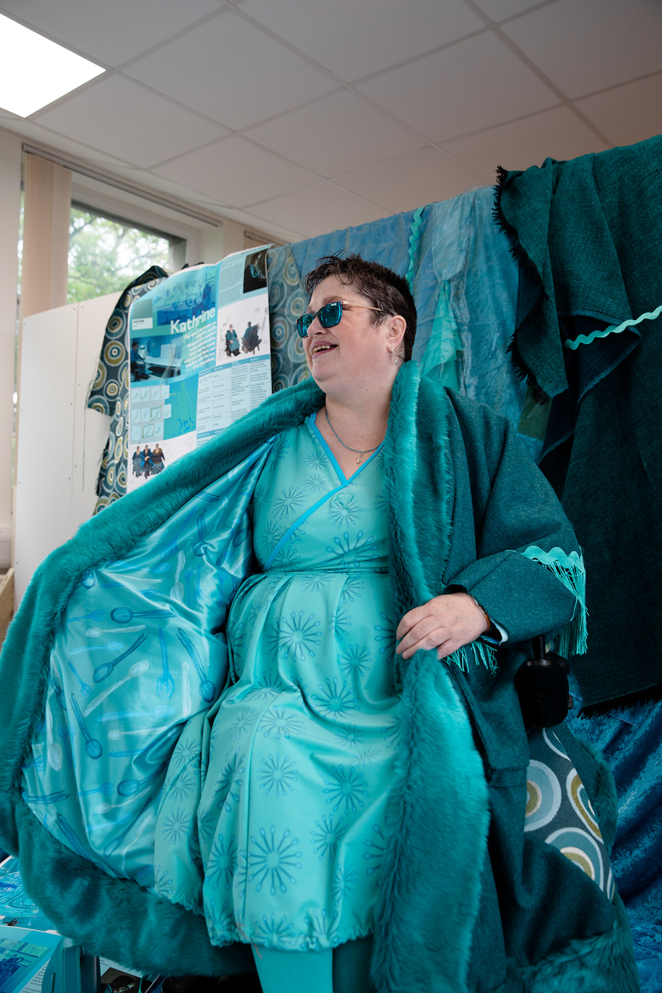
Who am I?
Notes:
I am Dr Katherine Deane, Associate Professor in Healthcare research at the University of East Anglia, Norwich. In this role I research the management of long term conditions and disabilities – the everyday management skills such as taking your pills right, doing the exercises, sticking to the diets, managing the depression, anxiety, and fatigue better. I have published over 80 peer-reviewed journal articles. My work informs clinical guidelines in the NHS and World Health Organisation.
I work with Dan Burrill, Teaching Fellow in the School of Health Sciences assisting me with writing up and disseminating the program of inclusive research. He was previously technician in charge of the Physics and Electronics lab in the New Science building at UEA. He was responsible for the safe, efficient, and effective operation of the lab, which supports the teaching of modules in physics, computing, and engineering, from foundation year to Masters. He provides support for final year projects, postgraduate students, and staff when required. Having previously worked as a technician covering areas as diverse as pharmacy, IT support, and school science teaching (KS2 to KS5 in physics, chemistry, and biology), I gave a technical perspective to the development of the survey and guidelines, as well as subject area expertise. Dan will be joining me in the workshop tomorrow.

Slide 3
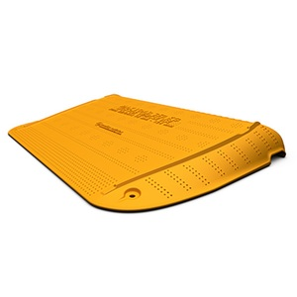
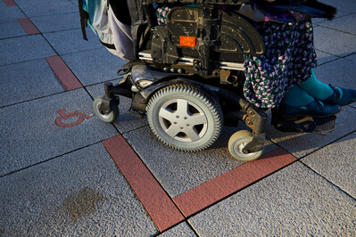
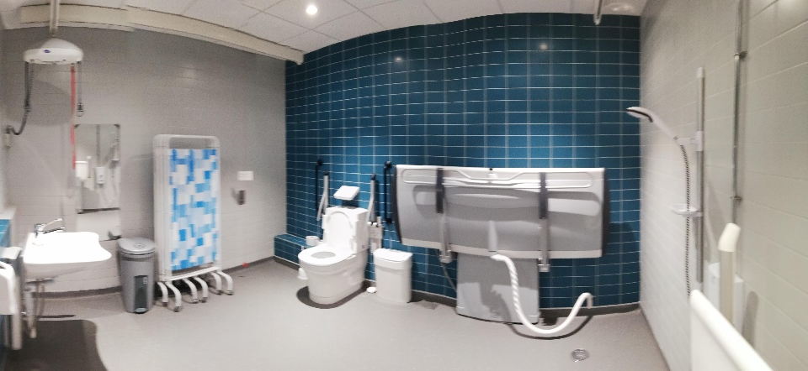

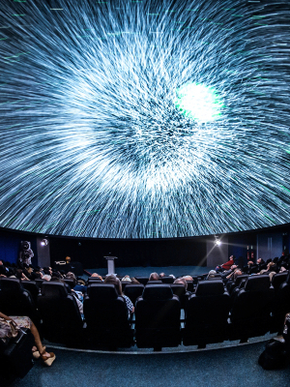
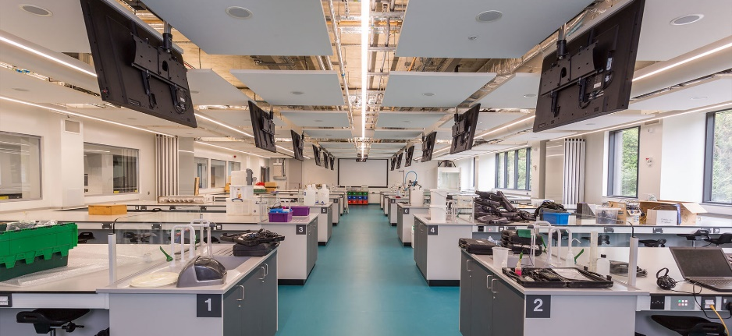
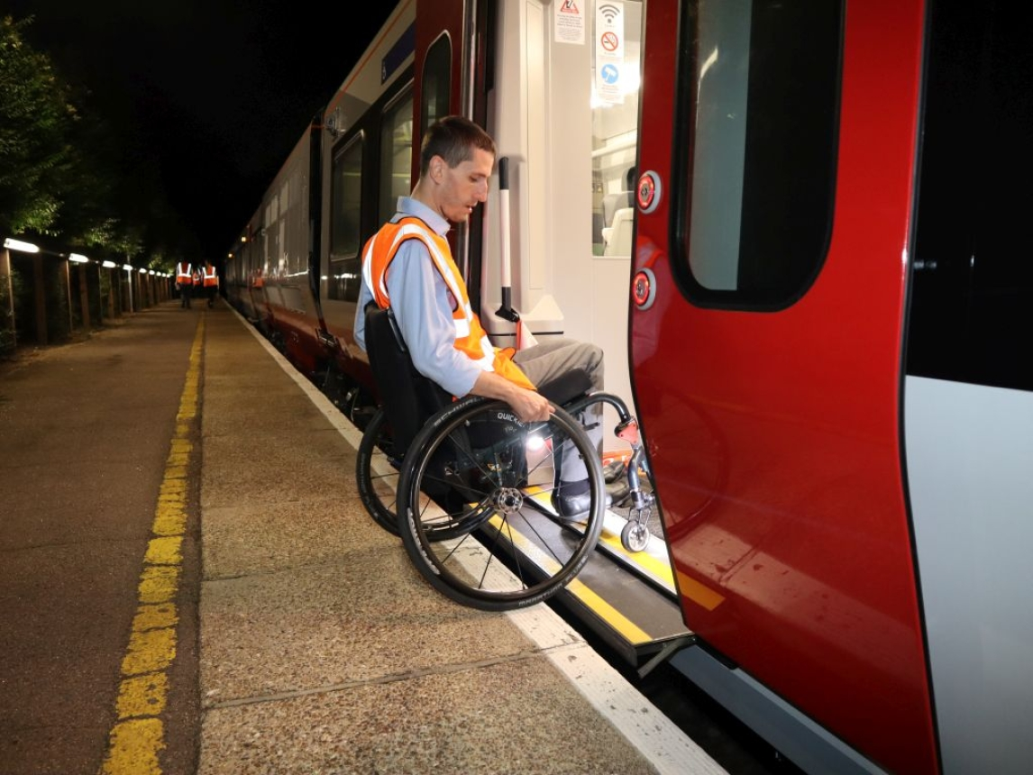
What do I impact?
Notes:
But I also have the role of Access ambassador to the university – a title I took on for myself and they haven’t dared take off me. In this role I have worked with our Access All Areas team to improve the accessibility of our campus – which is now one of the most accessible campuses in the country. This is brilliant and awful in the same sentence – brilliant that we have transformed our concrete jungle (with Grade I and II listed buildings on it) – and awful that such a basic access standard is world leading – if I were grading it I would give it a C minus. But the structural accessibility has led to colleagues having the confidence to address teaching access, web access, communication access, and refine our student support to be more responsive to the needs of our disabled students.
Those pictures on the left show my New Science building which is highly accessible and includes a changing place accessible toilet. This is where Dan’s lab is based. And we have a standing invitation to all of you to come and visit us and see our labs and campus and get a warts and all tour of how we have made UEA accessible.
But I want to emphasise its not all big new builds – one of the most impactful projects we have done is shown in the middle picture – where you can see the base of my wheelchair and an orange line that indicates the step free routes across our campus. Yes it has limitations – it doesn’t tell you where you are going to end up – we really need an interactive map app that can cope with height differences to work on our campus – but it is very visible – it tells everyone that we are willing to “mark up” our campus to ensure access for everyone – that the disabled community is import. And the advice has not stayed within the campus. I have provided access advice to the Houses of Parliament, research funders, conference organisers, castles (that is Norwich Castle), theatres, museums, science centres (that’s Winchester Planetarium which I “opened” after its refurbishment), train companies, television companies, water and power companies, and roadworks equipment manufacturers. I co-designed an accessible roadworks ramp with a team of disabled people with a variety of disabilities – up there in the right-hand corner.

Slide 4

What is disability?
Significant impact on daily activities
Long lasting (>12 months)
Variable conditions too
Mobility
Sensory
Mental wellbeing
Cognition / Neurodiversity
© Freepik

Slide 5

Ultimate Intersectional Bias
Two types of people:
  Those with a disability
  Those who will have one
Disability is inherently intersectional
© Freepik
Notes:
Two types of people:
Those with a disability
Those who will have one
Visible/ invisible
Physical / Mental / Deaf / Neurodiverse
Disability is inherently intersectional
Everyone has to rise up together – so EDI innovations have to take other biases and opporessive structures into account – and address them too
No-one left behind

Slide 6

Under-represented and under valued in the workforce
24% of working age people are disabled
6% of UK academics declare a disability (~3% in STEM)
% reduces with seniority
Less likely to be hired or promoted
More likely to be bullied or discriminated against
Fewer gain or lead grants. Grants tend to be smaller and less prestigious
© GOWI

Slide 7
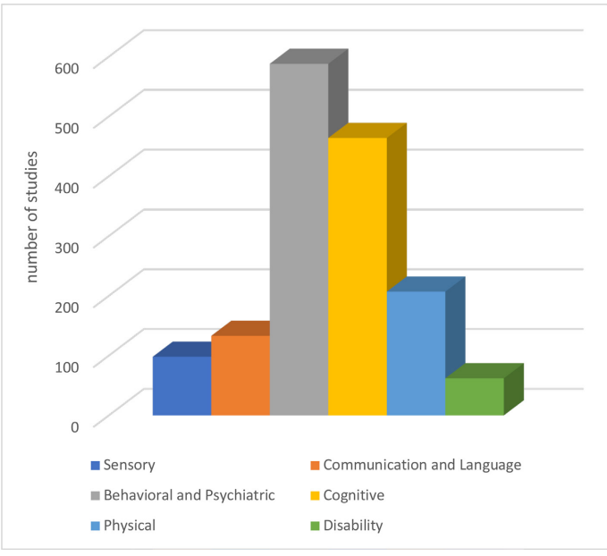
Disability as an exclusion criteria
Cammani 2023 (https://pubmed.ncbi.nlm.nih.gov/37918873/)
Scoping review
2710 clinical trials
60% potentially excluded disability
96% criteria “relative”

Slide 8



Deeds not words
31st anniversary DDA
Disability often lowest priority from Equality Act
Concerns about complexity and costs
Anticipatory duty
Hold people accountable to their mission statements
  UKRI: Research by everyone, for everyone
Notes:
We need deeds not words (to borrow from the suffragettes)
We are impatient – we’ve been waiting for a decent response to legal requirements in place since 1995
Hold people accountable to their mission statements
UKRI: Research by everyone, for everyone
Perfect is the enemy of done
Take action
Best guess (informed by evidence & those impacted)
With feedback loops
Don’t need RCT for a ramp

Slide 9

Social model of disability - inclusion and activism
Social model of disability shifts responsibility for change from the disabled person to their society
Training should focus on everyone’s responsibility to take action
  Informed by disabled people
  BUT not solely enacted by them
Activism / advocacy necessary to overturn societal norms
© Freepik
Notes:
For those of you who are not aware there are various models of disability out there – the two major ones are the medical model and the social model. The medical model states that my inability to walk far is my personal problem and I should take responsibility to solve it by under taking more rehabilitation, taking more drugs, etc.
The social model states that my use of a wheelchair isn’t the problem – in fact my wheelchair is a tool for freedom – the problem lies in the lack of ramps and lifts to access buildings appropriately.
Please note this is not a criticism of medicine (which can be essential and very useful) – just the medical model of thinking about who has the greatest responsibility to change.
All of my research and activism is informed by the social model of disability. I firmly place responsibility for change on the shoulders of institutions and their staff. The actions and training needed to improve accessibility should be informed by disabled people, but it should not be up to disabled people alone to implement them. I emphasise that everyone has a responsibility to take action to improve disability access – irrespective of their position in an organisation. My work is as a change make – a trouble-maker even – it is necessary to overturn societal norms to get better access

Slide 10
Why are diverse teams valuable?
Diversity of team’s expertise = creative problem solving
Data quality and impact
Ethics - Declaration of Helsinki amended 2024 (https://bit.ly/4hz535w)
Everyone has aspects of diversity
Everyone has differing needs
Compassionomics (https://www.compassionomics.com/)
  Taking action on empathy
  Helper’s high – less burnout

Slide 11

“My lab broke me –
I hope others are better”
© Eucalyp
Notes:
Unfortunately this quote “My lab broke me – I hope others are better” pretty much summarised the results

Slide 12

Getting the basics wrong
Ergonomics
  46% ergonomic adjustable seating
  >90% benches & equipment not height adjustable
Toilets
  68% labs in building with accessible toilet
Safety
  80% did not have a PEEP
Poor access = poor safety, unlawful practices, poor recruitment, poor retention
Suite of access guidelines
© IconMarketPK
Notes:
I’m not going to cover the details of the survey results – there is a link to a talk I’ve recorded at the end of this that goes through them in more detail. But what I want to emphasise is that this isn’t treating disabled people poorly – this is treating everyone poorly – it just has more direct and absolute impact on disabled people
We are getting the basics wrong
Ergonomics
46% ergonomic adjustable seating
>90% benches & equipment not height adjustable (Height adjustable benches (9%), fume hoods (6%), or Category II microbiological safety hoods (4%))
Toilets
68% labs in building with accessible toilet
26% accessible toilets had good visual access
12% had a Changing Place accessible toilet

Slide 13
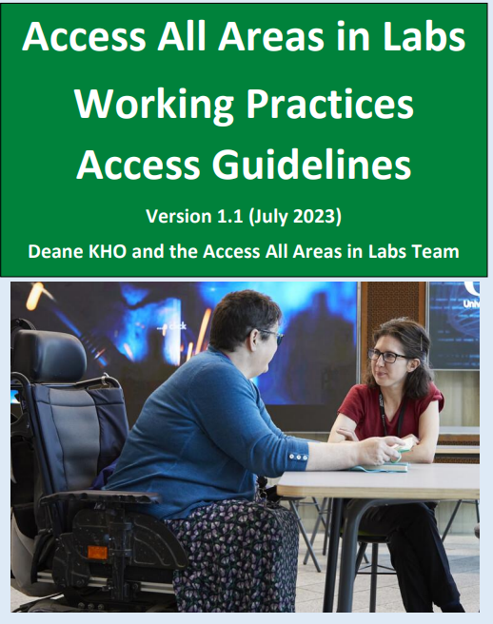
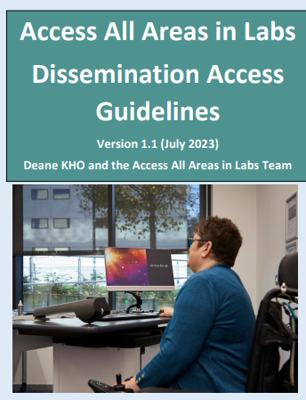
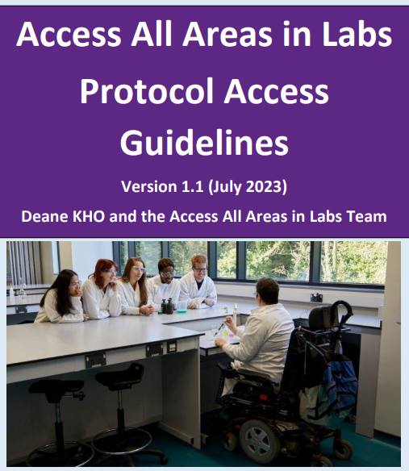
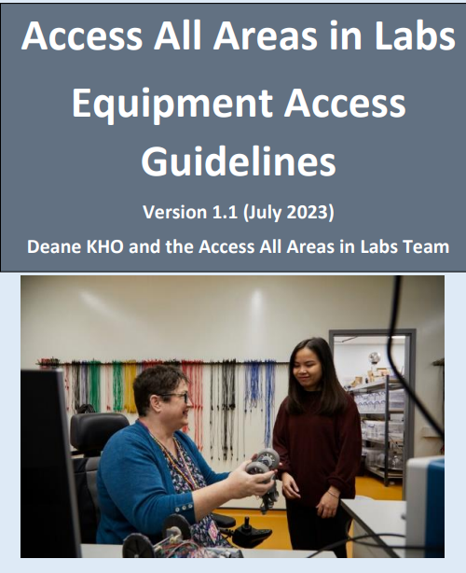
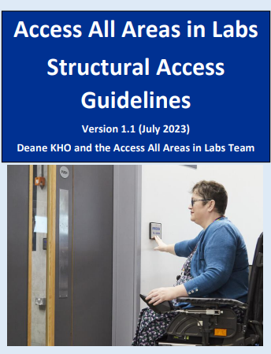
Access Guidelines: https://bit.ly/4od2J84
Notes:
And here is my suite of access guidelines covering the ecosystem of work in labs – but they are relevant to the majority of university settings

Slide 14
Nice – but do they work?
New Science
  New build
  Labs for biology, chemistry, physics, electronics
  6 years use
Productivity East
  Refurbishment
  Engineering workshops
  5 years use
Design is safe, durable, effective
Works well for everyone
Amendments generally of the “Yes, but more” kind

Slide 15
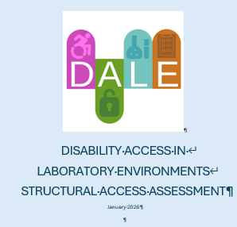
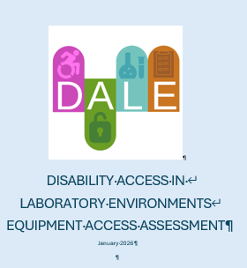
Access Assessments
Derived from guidelines plus expert advice
Tested across 4 institutions and multiple lab types
Working on sharable electronic version
Pragmatic assessment of disability access
Provide info that can be shared on web pages
Allow creation of list of future improvements

Slide 16
Assessment as an intervention
Raised awareness and increased priority
Challenged and changed thinking about disability access
Highlighted deficits in current practice
  PEEPs for temporary impairments due to injury (need to ask)
Highlighted need for access consideration in
  Maintenance
  Equipment purchases (discussions with manufacturers)
  Refurbishments and new builds
Created a “long list” of access barriers
  Quick wins and long-term considerations

Slide 17
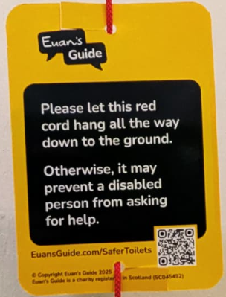
Easy wins
PEEPs and GEEPs
Access info pack for staff and visitors
Collate disability related info – central resource
Euan’s guide red cord cards https://www.euansguide.com/safertoilets
Everyday maintenance e.g. paint colour choices
New equipment choices
Notes:
Immediate targets for structural access
New builds and refurbishments to guideline standards
New equipment and its placement to guideline standards
Evac chairs or alternatives
Microphones, PA systems, and portable hearing loops
Euan’s guide red cord cards
Colour contrast in accessible toilets (pot of paint)

Slide 18
Systemic Design Impact
Negative – e.g. signage
Positive – e.g. sound baffles
Lack of sign naming building
Students get lost, head to wrong building
Compounded by:
  Building being at bottom of hill
  Buildings having similar names
  Lack of navigation app
Reduce noise transmission
Create a quiet environment
Aid ease of conversations
Particularly impactful for neurodiverse students
Space used preferentially for studying

Slide 19
Accessibility is a fragile system
Limited training – commonly staff pay out of pocket
Advocates unsupported – risk burn out, worry about acting outside scope of expertise
Information fed into university but doesn’t feed back to staff in labs
  PEEPs, requests for reasonable accommodations, accident and near miss reports
  Limited sharing of knowledge – reinventing wheels
Challenge of assessing the less tangible aspects of disability access – attitudes, behaviours etc

Slide 20
Accessible environment driving culture change
“It does actually embolden people. It feels like it is literal, inclusive practise in action. And I think we are increasingly seeing students who are happier to talk about their additional needs. And as a cohort I think they are very supportive of each other in terms of people that might not look like them”

Slide 21

WHY?
To remove the barriers to accessing life, so people can express their brilliance
© Freepik
Notes:
Why do this? – well this is the mission statement of my research team – to remove the barriers to accessing life, so people can express their brilliance. Please note it isn’t limited to removing barriers for disabled people – I find huge wash-over benefits for treating diversity as the valuable asset it is – e.g. a ramp helps me as a wheelchair user, but it also helps people pushing buggies, delivery people with trollies etc. Flexible working patterns are essential for me to manage an energy limiting disability, but over the course of a career everyone has periods when they need to have greater flex in their working times and roles – new babies, broken legs, caring for a relative – all have impact – and if your workplace is set up to accommodate this human variation then you can allow people to perform far far better.
Also it is well evidenced that a more diverse workforce = greater profits, greater responsiveness to change, greater relevance to populations you serve. Particular importance in healthcare research – we know that more diverse research teams means greater diversity of research populations, better questions, more relevancy of findings, greater impact.

Slide 22

COM-B Model
Changing behaviour requires change of one or more
  Capability
  Opportunity
  Motivation
Put system into new configuration
Minimise risk of reverting
  Push back
© Pause08
Notes:
Changing behaviour requires change of one or more of the university’s capabilities, opportunities, and motivations to drive anti-ableist actions being implemented systemically by universities
Put system into new configuration
Minimise risk of reverting
There will be push back – Robert Sutton’s books are great for identifying and coping with bullying – and Minister for Science and Innovation’s input on the UKRI funded EDI “debate” – this is perceived as going “too far” and creating “too much paperwork” – this sort of work is having impact – its annoying the Tories, so we must be doing something right

Slide 23
Lund University – Core Values Work
Suppression technique | Counter strategy | Affirmation technique
Making invisible | Demand attention | Acknowledge
Ridiculing | Question | Respect
Withholding information | Be honest | Inform
Double binding | Break the pattern | Enforce double reward
Blaming & shaming | Intellectualise | Affirm reasonable norms
Notes:
Lund university has done a lot of research and implementation around what they call core values work – how to identify how a damaging culture is supported, how people become complicit with it – and how you as an individual can take actions to counter it, and how the institution can change its structures and systems to ensure that they support this changed behaviour – its is affirmed

Slide 24
Change is possible and necessary
31 years of unlawful practice
Many changes do not cost
Retrospective infrastructure changes cost at least 10-fold more
Discussions with equipment manufacturers
Funders are asking for access / inclusion in grant applications
  May ask for access assessments, minimum standards in future
Access increases diversity of teams, and quality of research
Staff recruitment and retention
Safety

Slide 25
Access Actions
Guidelines
  Structures
  Equipment
  Protocols
  Dissemination (websites, conferences)
  Working practices (HR)
Assessments
  Structures
  Equipment
Information sharing of already collected data
Training
  Detailed access solution finding
  Cultural competency
  Bystander interventions
  Reciprocal mentoring
Research
  Metrics (validated outcomes and diversity measures)
  Interventions
  Standards – minimum, bronze, silver, gold

Slide 26
System shift
Explicit statements of need for diversity for quality research
Funder / Learned Society requirements for
  Access assessments
  Common diversity metrics – staff and researched populations
Provision of
  Quality training
  Access to advice
  Flexible and rapid funds for access improvements – structures, staff, research
Challenge societal structures that impact work
  Access to Work, PIP, Motability etc

Slide 27
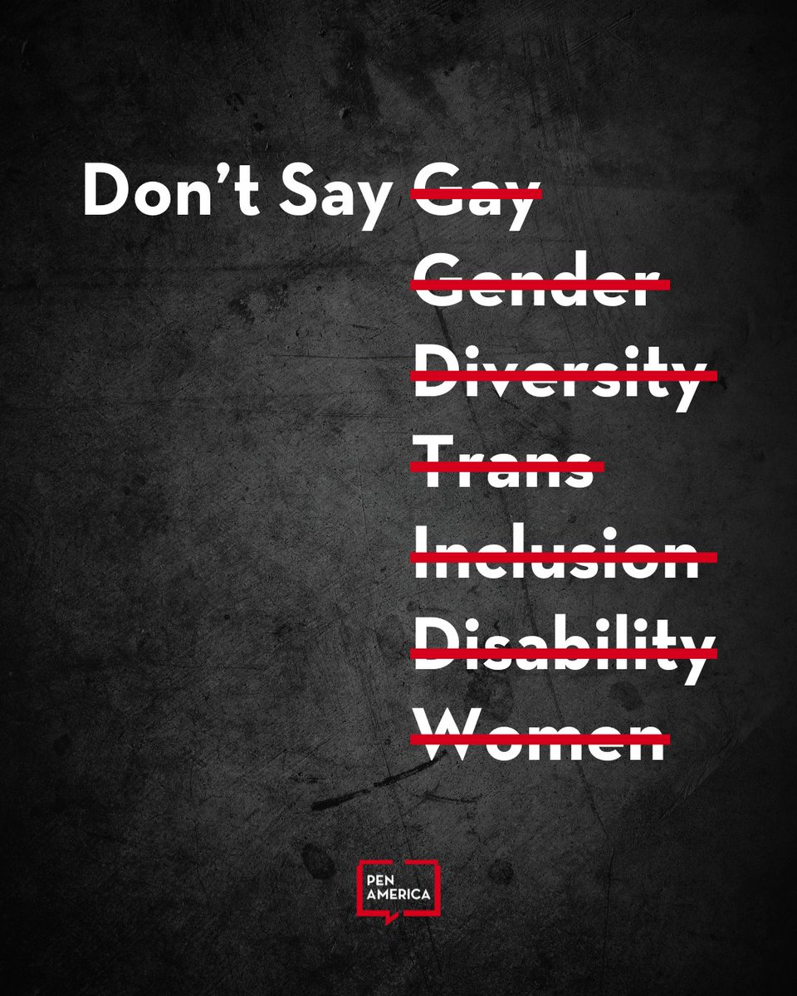
Inclusion is inherently political
Censorship of “EDI” phrases in USA.
  Papers
  Grant calls
  Web sites
EDI considerations have never been more precious or precarious
Be aware of risk of push back
Be clear on your principles and reasoning
If you don’t make changes, you are complicit
© @PEN America

Slide 28
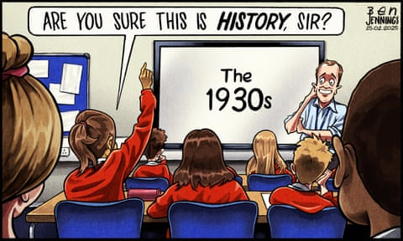
© Ben Jennings The Guardian

Slide 29

Thanks
May Gauntlett
Dan Burrill
Anisah Tufal
DALE steering group
Research participants

Slide 30
Links
DALE website (access assessment coming soon): https://www.uea.ac.uk/groups-and-centres/projects/access-all-areas-in-labs/DALE/DALE
Access All Areas website (access guidelines): https://www.uea.ac.uk/groups-and-centres/projects/access-all-areas-in-labs
Katherine Deane: k.deane@uea.ac.uk
Katherine@accessingbrilliance.org

Slide 31
References
World Medical Association announces adoption of the 2024 Revision of the Declaration of Helsinki - Health Research Authority. https://bit.ly/4hz535w
Inclusive research design to become an NIHR condition of funding https://www.nihr.ac.uk/inclusive-research-design-become-nihr-condition-funding
‘Being disabled’ as an exclusion criterion for clinical trials: a scoping review. Camanni, G. et al. BMJ Glob Health. 8, e013473 (2023). https://gh.bmj.com/content/bmjgh/8/11/e013473.full.pdf
Deane K, Burrill B. Step up and be an ally – accessible labs benefit everyone. Biochem (Lond) 2024; bio_2024_138. https://doi.org/10.1042/bio_2024_138

Slide 32
References
Deane KHO and the Access All Areas in Labs Team. 2023. Access All Areas in Labs: Access Guidelines. Version 1. March 2023. University of East Anglia, Norwich. https://www.uea.ac.uk/web/groups-and-centres/projects/access-all-areas-in-labs
Deane K, Delbecque L, Gorbenko O, et al. Co-creation of patient engagement quality guidance for medicines development: an international multistakeholder initiative. 2019 BMJ Innovations. 13. https://innovations.bmj.com/content/5/1/43 (Table 3)
Schroeder K, Bertelsen N, Scott J, Deane K, et al. Building from Patient Experiences to Deliver Patient-Focused Healthcare Systems in Collaboration with Patients: A Call to Action. 2022. Therapeutic Innovation & Regualtory Science. https://doi.org/10.1007/s43441-022-00432-x
Brage T, Lövkrona I, Eldh C, et al. (2016). Core values work in academia: – with experiences from Lund University. Lund University https://eige.europa.eu/sites/default/files/core_values_work_brage_lovkrona.pdf
World Medical Association announces adoption of the 2024 Revision of the Declaration of Helsinki - Health Research Authority. https://bit.ly/4hz535w

Slide 33
More best practice and guidelines
DeCormier Plosky, W. et al. Accessibility by Design in Clinical Research Toolkit. Version 1.3; https://mrctcenter.org/diversity-in-clinical-research/tools/abd_toolkit/ Multi-Regional Clinical Trials Center of Brigham and Women’s Hospital and Harvard (MRCT Center) 2024).
iHEAR Peers for Equity; https://www.sangath.in/projects/ihear-peers-for-equity (Sangath, accessed 12 September 2024)
DAISY DIVERSITY AND INCLUSION SURVEY (DAISY) QUESTION GUIDANCE - WORKING DRAFT (V2) https://edisgroup.org/wp-content/uploads/2022/05/DAISY-guidance-current-upated-May-2022-V2.pdf

Slide 34
Useful books
Susan Jeffers. “Feel the fear and do it anyway.” https://susanjeffers.com/books/
Robert Sutton. “The No Asshole Rule” and “The Asshole Survival Guide” https://en.wikipedia.org/wiki/The_No_Asshole_Rule
Simon Sinek. “Start with Why” and “Find your Why”. https://simonsinek.com/books/start-with-why/
Brene Brown. “Dare to Lead” https://brenebrown.com/hubs/dare-to-lead/
Stephen Trzeciak & Anthony Mazzarelli. “Compassionomics”. https://www.compassionomics.com/
Susan Michie et al. “The Behaviour Change Wheel.” http://www.behaviourchangewheel.com/
Adam Rutherford. “How to Argue With a Racist: History, Science, Race and Reality.” https://www.amazon.co.uk/How-Argue-Racist-History-Science/dp/1474611249

Slide 35
Other talks
Lab access sucks – so here are guidelines to start solving this. Vitae 2023. https://www.youtube.com/watch?v=j9H9tdPjpQw&t=10s
Starting Change Making. Cultural Forum Norwich. 2022. https://youtu.be/XZ72o4fbuh8
Values, disability, saying no, and how fabulous it is to fail during the research process. 2021 https://emmaelvidge.wordpress.com/2021/10/26/episode_2_katherine_deane/
Benefits of being a Disabled Scientist. UK Association for Science and Discovery Centres. 2020 https://www.youtube.com/watch?v=vjMHySCxY2k&feature=youtu.be

