Slide 1


Reasonable Adjustments in Laboratory Settings

Slide 2
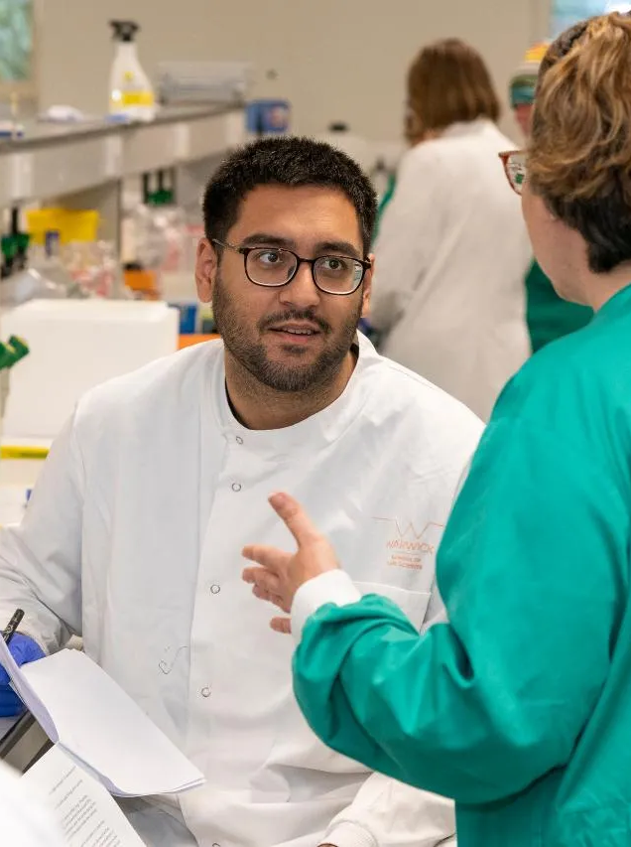
RAiLS Aims
Generate resources for students and staff with regards to Reasonable Adjustments (RAdjs) in Laboratory Settings at Warwick
Support the creation of internal processes to optimise decision making and data storage
Create a network of UK STEM laboratory teaching practitioners to share best practice
Promote inclusion in Laboratory Settings and diverse participation in HE

Slide 3
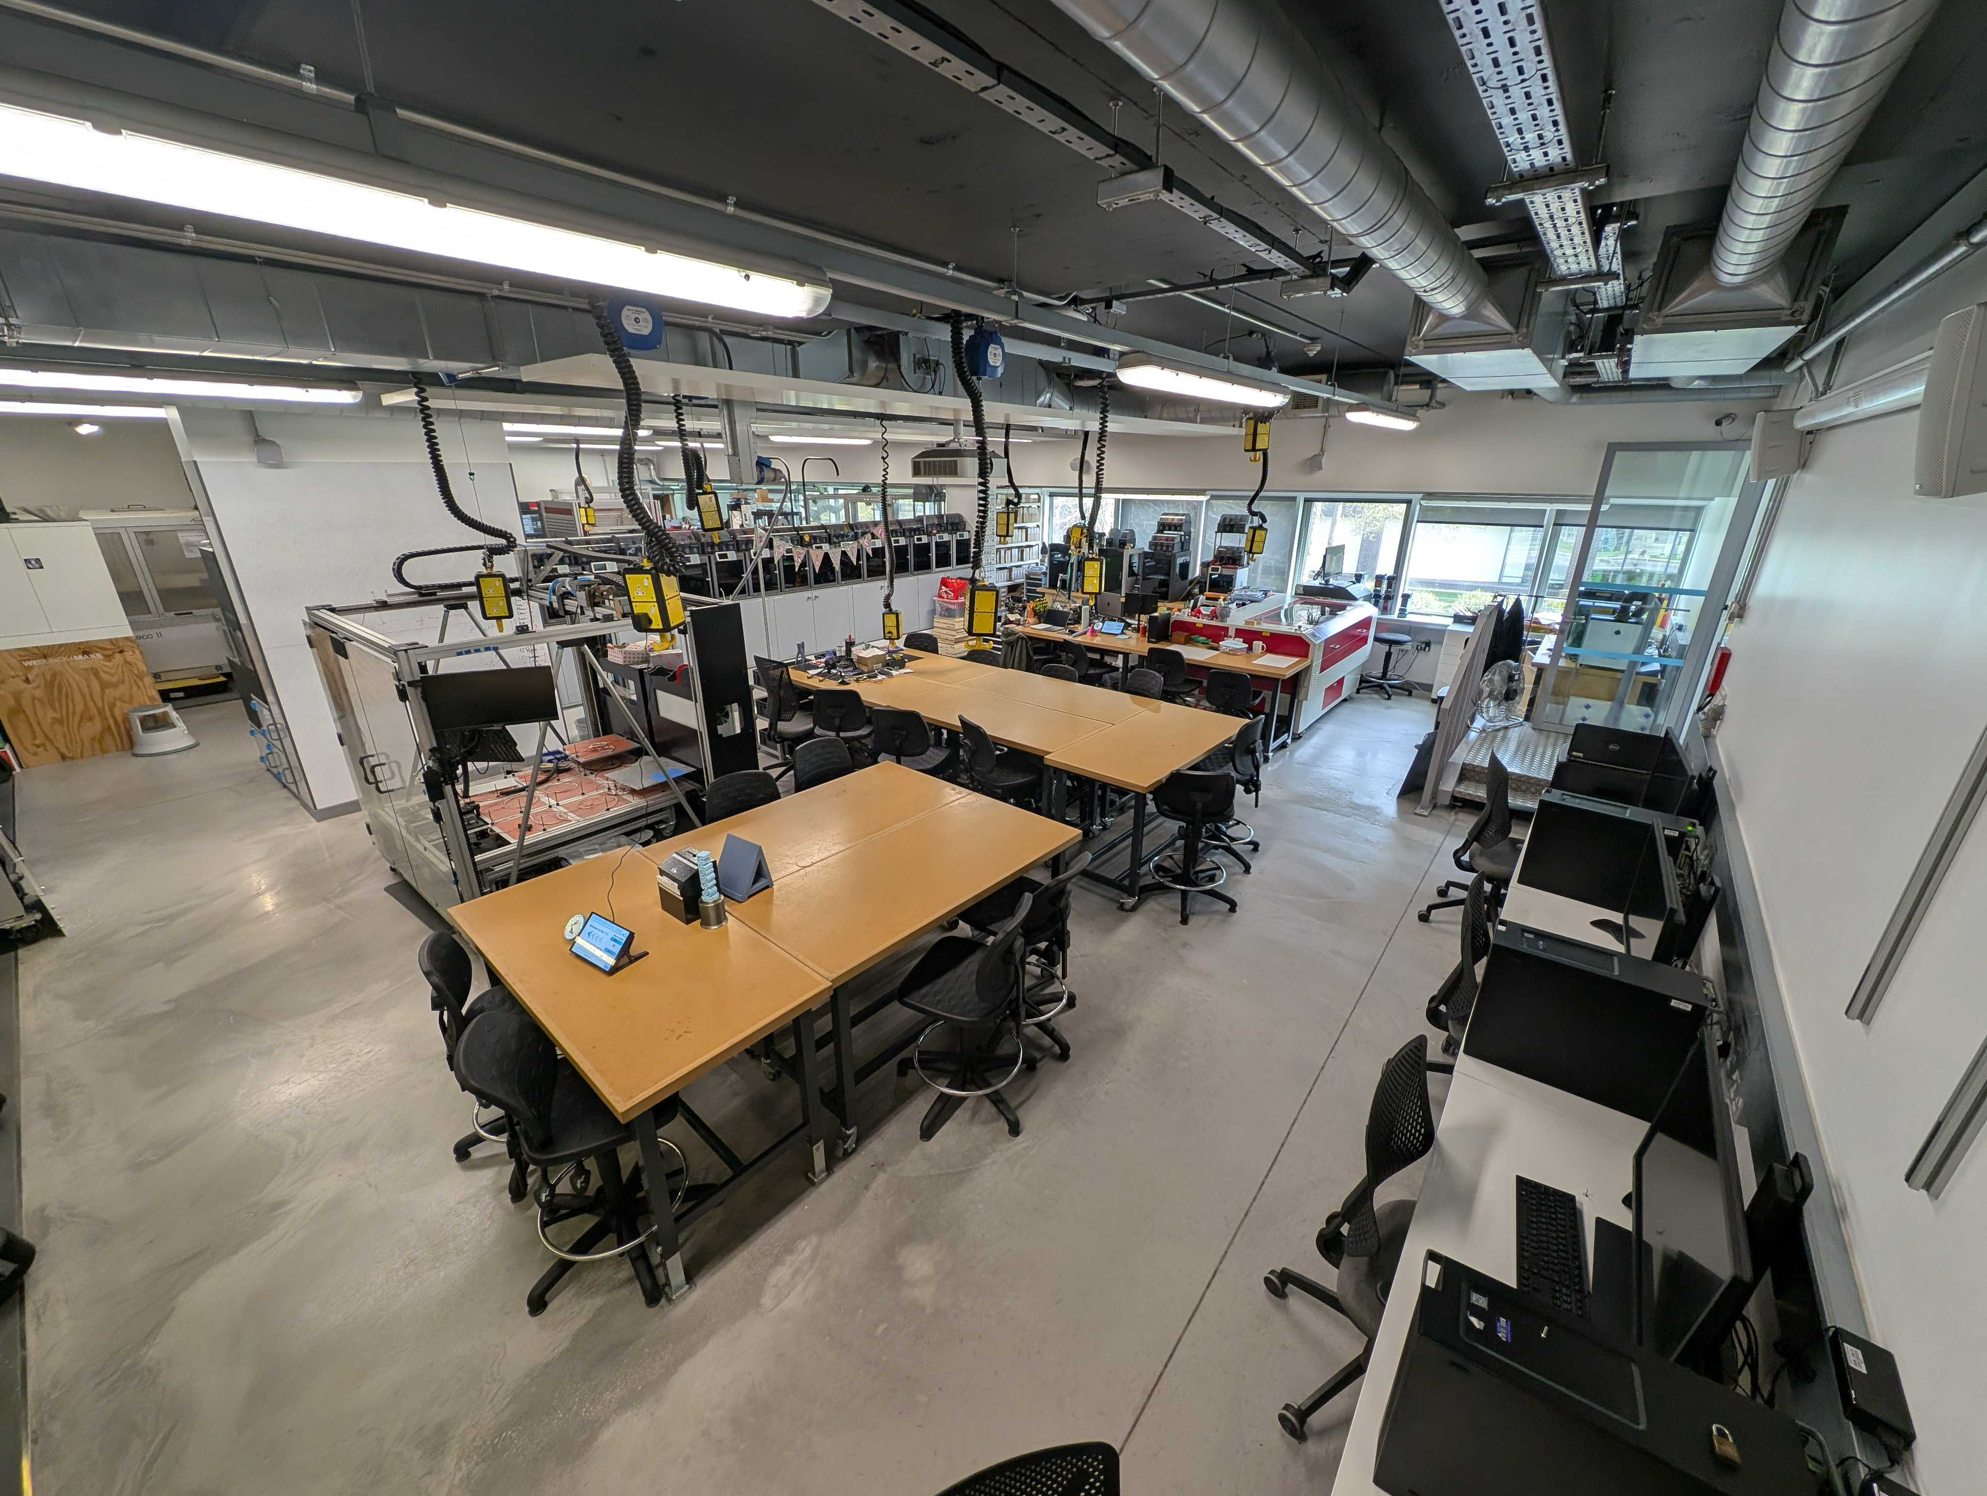
Key Definitions
What do we mean by lab?
A non-traditional teaching space where students perform active learning
  Includes:
    Computer rooms/labs
    Wet labs
  Doesn’t include
    Lecture/Seminar rooms (i.e. chairs, tables and whiteboard).
STUDENT NEEDS SHOULD BE ADJUSTED FOR IN ALL LEARNING ENVIRONMENTS

Slide 4
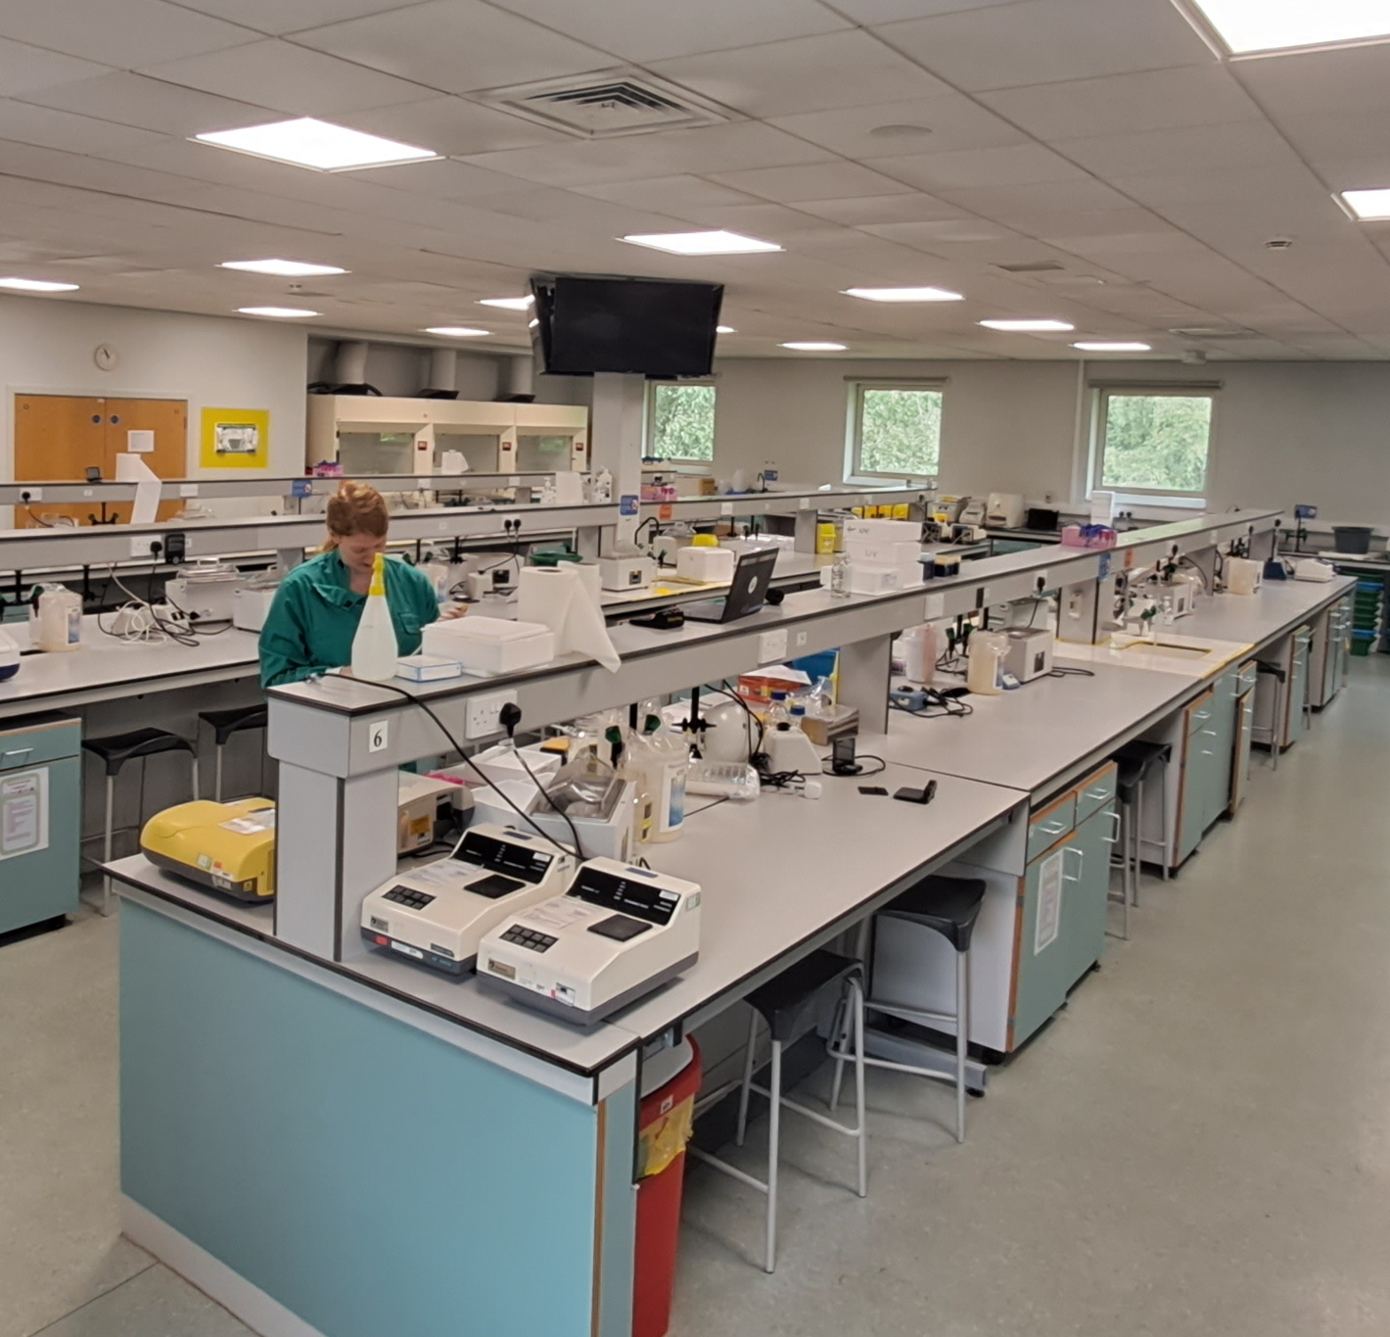
Key Definitions
What are Reasonable Adjustments (RAs, RAdjs)?
Anticipatory reasonable changes to ensure disabled applicants and students do not experience substantial disadvantage in comparison with non-disabled people.
Unique to disability.
Duty contains three requirements:
  Make RAdjs to any provision, criterion or practice which places disabled students at a substantial disadvantage
  Make RAdjs to physical features (comes with a cost!)
  Provision of auxiliary aids (including services)

Slide 5

Complying with the law
Student-facing staff training on their duties under the Equality Act and to recognise symptoms of mental health crises and trained to know what to do next to obtain support for the student and remove additional stressors such as deadlines.
Pre-emptive consultation of students and timely adjustment provision.

Slide 6
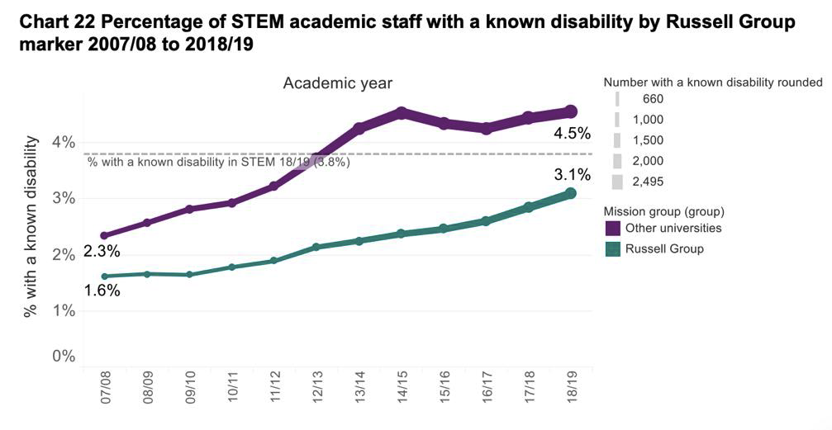
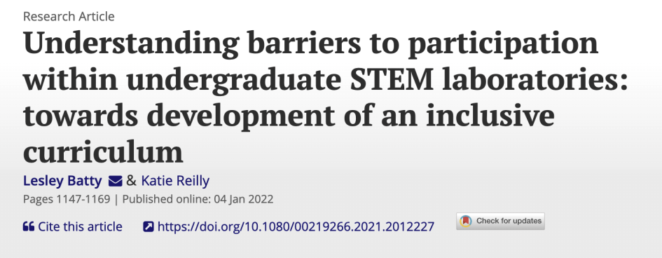
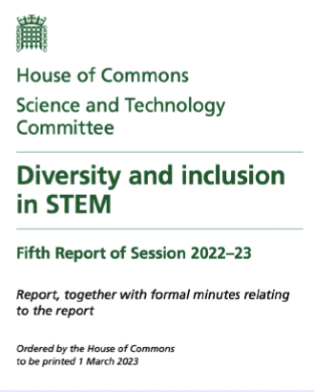
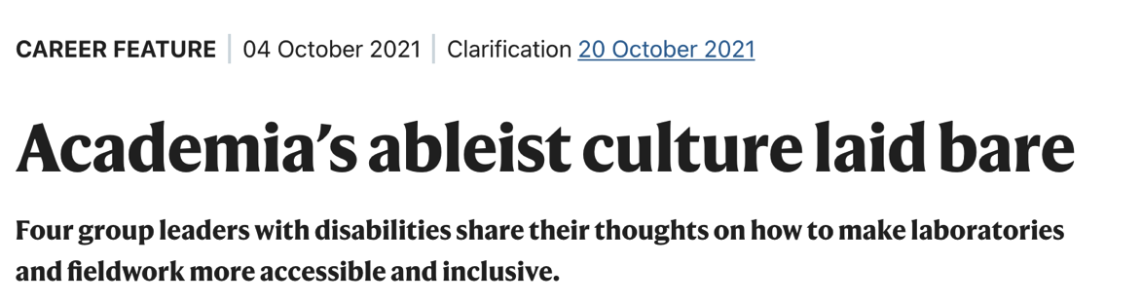
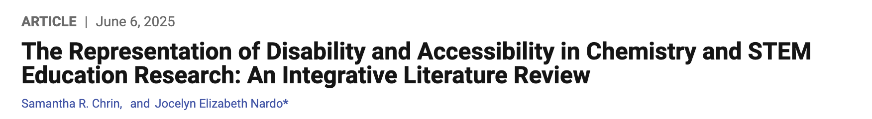
Why focusing on Warwick STEM?
UK HE student numbers with declared disabilities has increased from ~10% to about 30% [HESA data].
UK HE STEM Academic staff with disabilities has also increased but it is not comparable to UK national disability rates or student disclosures, and % is even lower in Russell group institutions. Royal Society Report
Both representation data and literature support academia’s ableist nature.
Recent sector reports indicate the need for advancement on STEM inclusion. House of Commons 2023 Diversity and inclusion in STEM report.
Other universities
Russel Group

Slide 7
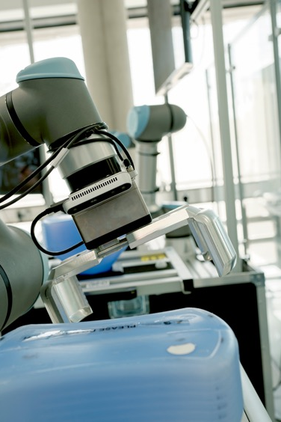
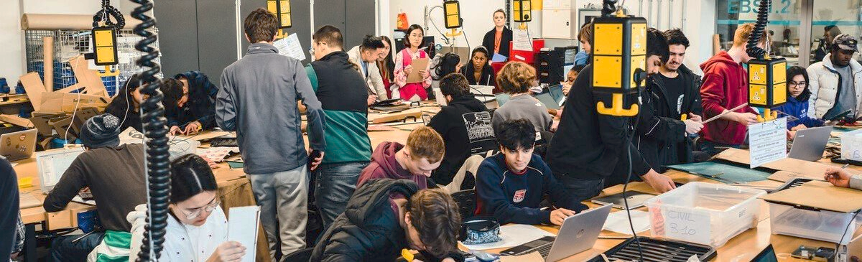
Challenges
Practical environments are department-specific (and so should be the adjustments)
  They require TRAINED departmental staff involved in decision making WITH APPROPRIATE WORKLOAD ALLOCATION
    Decision making involves adjustments and alternative assessments
There are H&S implications (not all adjustments are reasonable)
  Some conditions (e.g. uncontrolled movements) are incompatible with keeping the students safe.
  Trained staff need to be confident on when it is NOT REASONABLE to adjust.

Slide 8
Identified gaps
Lack of University wide standardised approach to RAdjs in lab settings
Lack of training and coordinated support of decision-making departmental staff
Disclosure gap (departments aware of student needs not in disability records)
Lack of Equality Impact Assessment on lab spaces to promote future inclusion (including responsibility of costs)

Slide 9
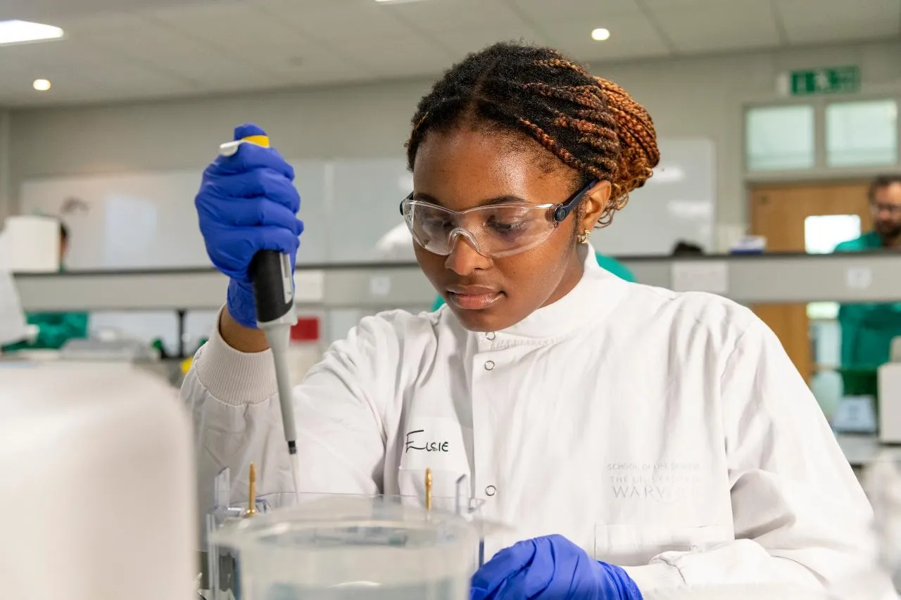
Best practice at Warwick
Directors of Teaching labs overseeing all labs in a department.
Proactive anticipatory consultation with students.
Staff and student guidance on how to approach RAdjs in labs. Soon on the webpage.
Department specific best practice:
  Digitalised labs (screens, microphones, caption software). Video resources of labs and techniques.
  Adjustable benches
  Quiet lab spaces
  Locker allocation (medication, epipens)
  Allocation of a safe space for students with severe anxiety

Slide 10
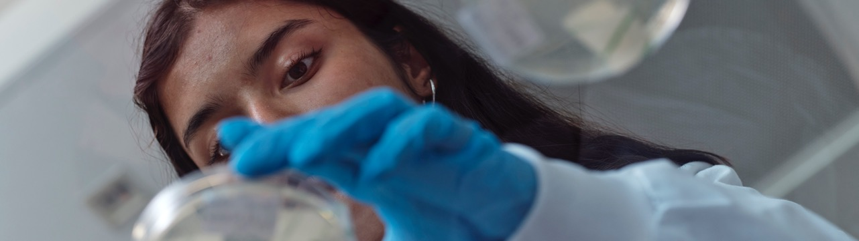
Progress at Warwick
Revision of the guidance documents by all STEM departments.
Making connections with schools to raise awareness of our project and facilitate inclusion in STEM.
Project progress with students in staff spaces (PGR and PGT) and staff adjustments.
First UK conference on RAdjs in labs organised by Warwick.

Slide 11

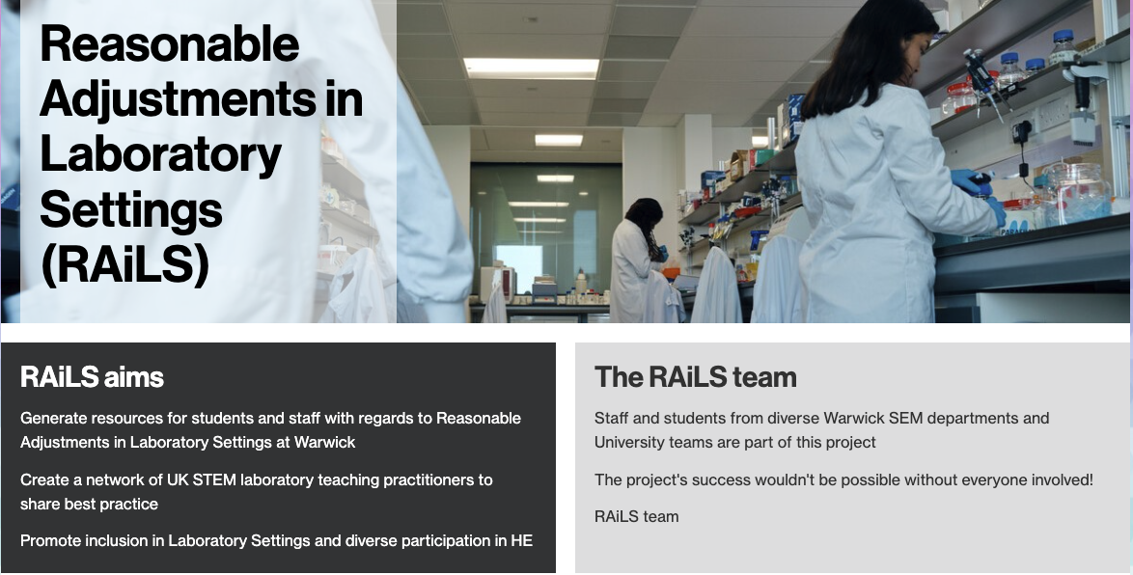
Want to discuss about RAdjs in non-traditional spaces?
Email: RAILS@warwick.ac.uk
Visit the webpage:
https://warwick.ac.uk/services/dean-of-students-office/inclusiveeducation/training-resources/res-adj-labs/
https://padlet.com/s_martucci/rails-break-out-room-feedback-b9kn18v2ja1hkpzt?frame_id=page%3AChm0eHWmZwS2q5-j15L8g
Lightening talks questions collection padlet:
Notes:
Padlet 1: https://padlet.com/s_martucci/rails-talk-questions-padlet-n6bkxm5lsxhx385?frame_id=page%3A_6QbtmYRIAVGMDvHum7X5
Talks questions
Padlet 2: https://padlet.com/s_martucci/rails-break-out-room-feedback-b9kn18v2ja1hkpzt?frame_id=page%3AChm0eHWmZwS2q5-j15L8g
Break out room

Slide 12
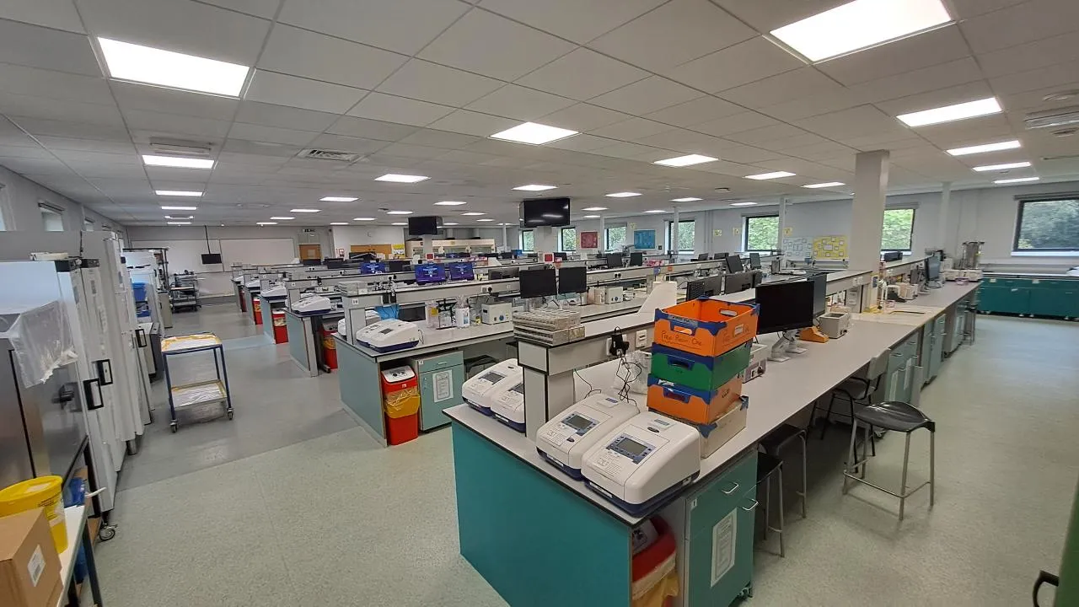
Thank You

Slide 13
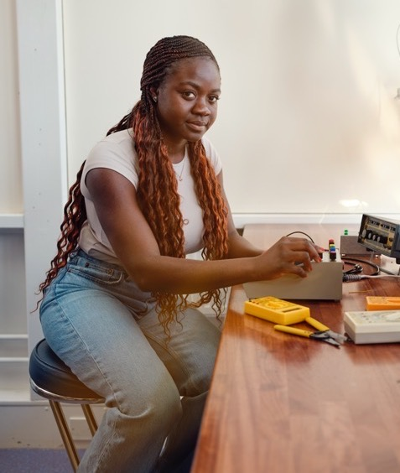
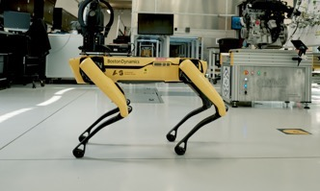

Notes:
Random slide with pics we might want to use!

Slide 14

Competence standards… competencies and modes of assessment
An academic, medical or other standard applied for the purposes of determining whether or not a person has a particular level of competence or ability (Equality Act, 2010; Sch 13, para 4(3)). E.g. those in certain medical, nursing or other specific professions.
Legally different to other concepts such as ‘competency/cies’, ‘competent’.
Often confused with those or with learning objectives (subject to academic judgement).
Objectively justifiable – proportionate means to legitimate aim (if not, they may be discriminatory).
Need to be clearly communicated in admission and progression criteria.
These are not modes of assessment (e.g. oral presentations)

Slide 15










Iconography
Iconography Colour Usage
Our icons can use any of our brand colours and always appear within a square shape.
When placing icons on pastel or white backgrounds, the square should be black, and the icon itself should match the background colour.
If the background is purple or black, the square should be white, and the icon should match the background colour (purple or black).
These rules help our icons to stand out.

