Slide 1
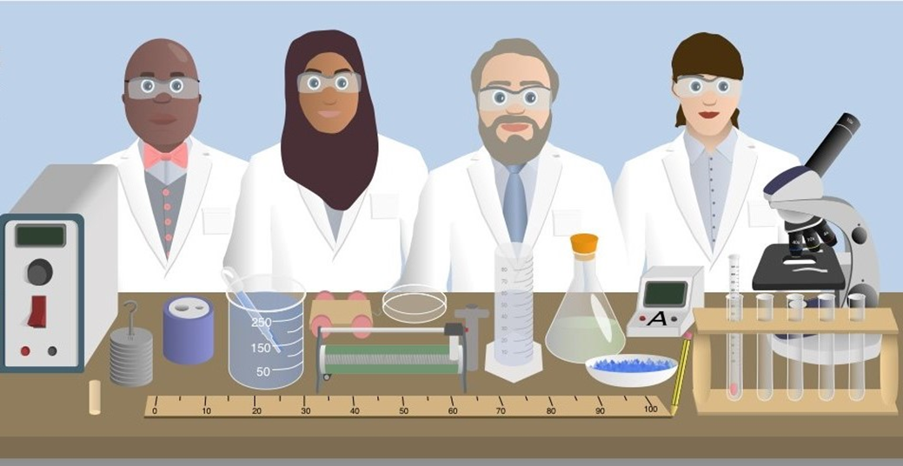

Liberating Learning using the MaRILU® System to Accommodate Adjustments in the Laboratory Learning Environment
Sobia Kauser
University of Bradford, UK
®

Slide 2
Background & Context
Implementation of SENDA and Part 4 of the Disability Discrimination Act (2002) and Equality Act (2010) required Universities to remove discriminatory practices.
The Legislation had enormous implications in terms of its requirements for reasonable adjustments to the curriculum, pedagogy and assessment.
As a result, Learner Support Profiles or there equivalent were introduced across the Higher Education sector.
The number of students’ with disabilities in HE has steadily increased over the past five years and accounts for around 18% of students (HESA, 2025).

Slide 3
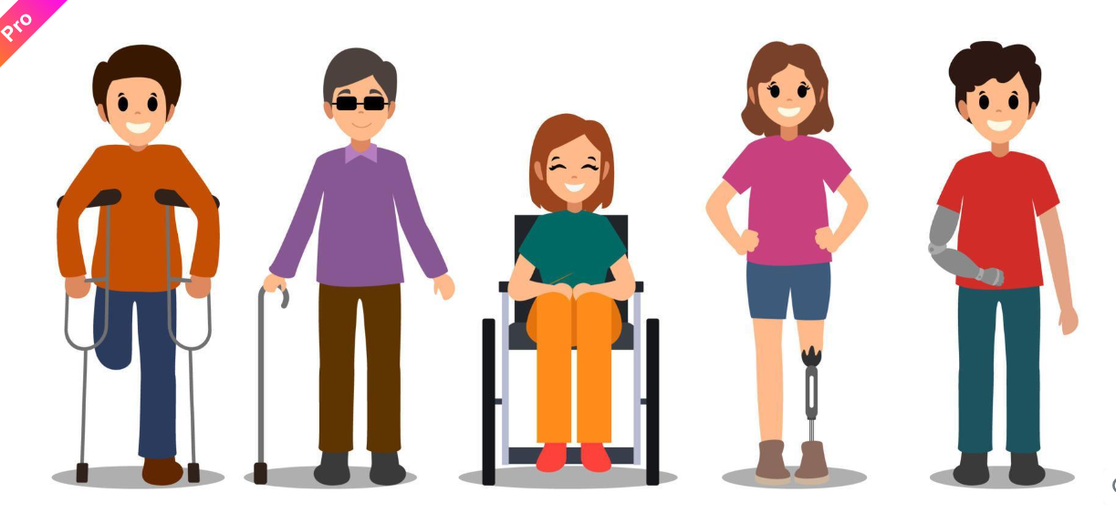
Background & Context
Significant proportion of disabled students in HE, including Bradford University have complex needs.
Students with certain disabilities struggle with laboratory work (Boval and Kennedy, 2018).
Absence nationally of a comprehensive strategy for implementing reasonable adjustments

Slide 4

What is the Problem?
Inclusive Practices Focus Mainly on:
Laboratory Practicals?
Teaching &
Learning
Inclusive Practices
Assessment Strategy

Slide 5
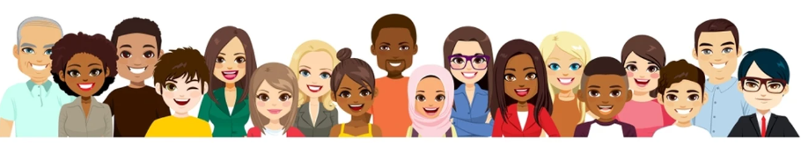
Diverse Student Co-hort at UoB
Students are predominately from ethnic minorities (84%)
Socioeconomically disadvantaged backgrounds with a diverse intersectionality of protected characteristics including disabilities (17%).
Notes:
The students I teach are predominately from ethnic minorities (84%)
From socioeconomically disadvantaged backgrounds with a diverse intersectionality of protected characteristics including disabilities (17%)

Slide 6
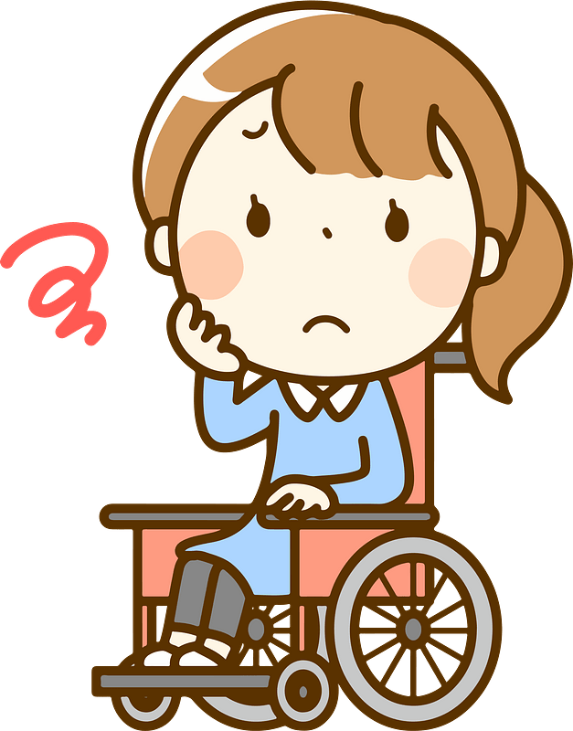
Student Voice
They Said……
Student Feedback
Laboratory Experience is not inclusive
Needs were not being met
Did not feel a sense of belonging

Slide 7


Student Voice
I Took Action………..
I Heard.……….
Managing Risks Assessment for Disabled/Temporarily Impaired Laboratory Users
(MaRILU®)

Slide 8


What is the MaRILU® Process
Student-centred approach to accommodate laboratory adjustments.
Empowers students to complete questionnaire
- Long term impairments/conditions
- Temporary impairments
Captures nature of impairment, how they are affected and the barriers faced in the laboratories
Risk assessment is co-created with students
- Support measures are discussed, agreed & implemented

Slide 9
MaRILU® data flow diagram
MaRILU®
Form is Completed
Appointment with Student
Notification Sent to H&S Advisors
Reasonable Adjustments Identified
Risk Assessment Made
Lab Adjustments Implemented

Slide 10
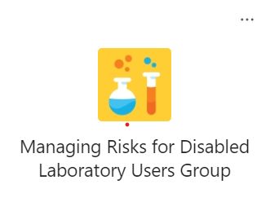
Where Does the Completed Questionnaire & RA go?
Only those conducting MaRILU® RA have access
Teams User
Group

Slide 11
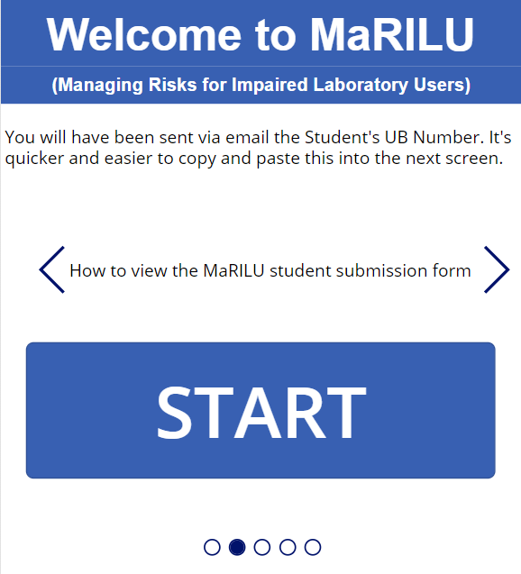
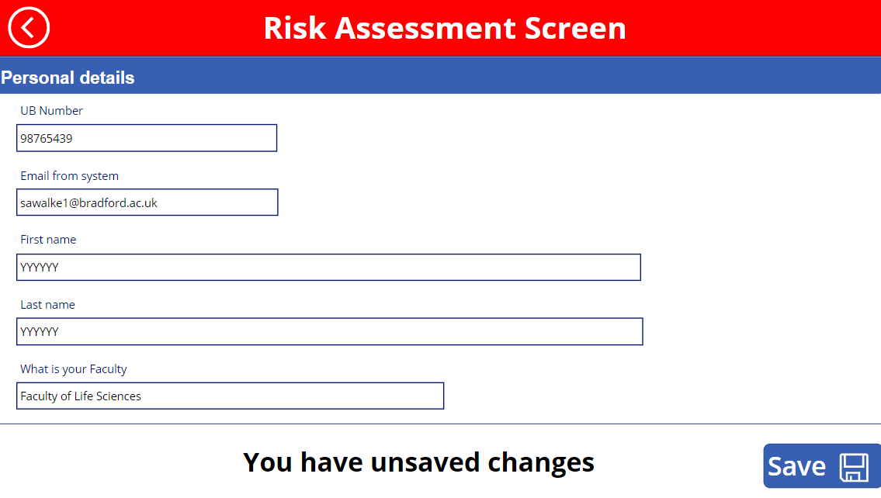
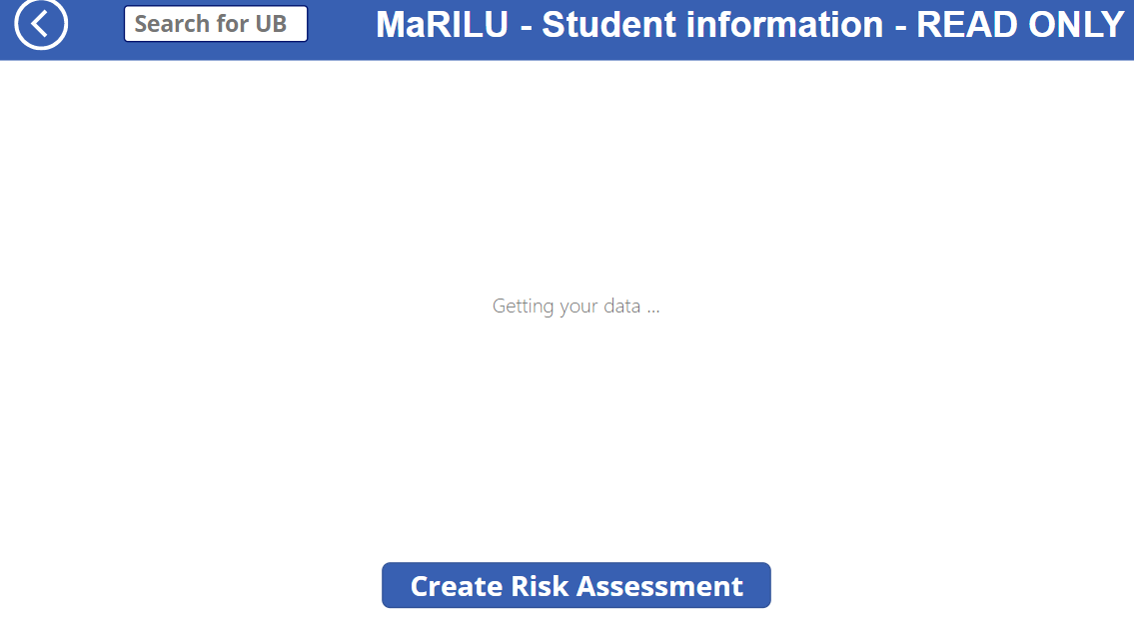
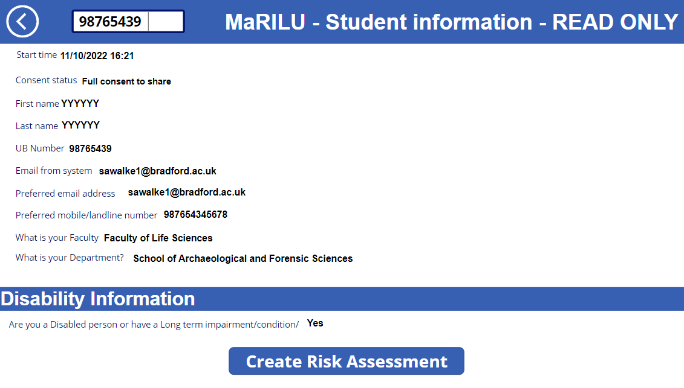
Who Receives the Adjustment Recommendations?
Faculty
H&S Advisor
School/Dept
H&S Advisors
LSP
Champions
Lead
Technicians
PATs

Slide 12
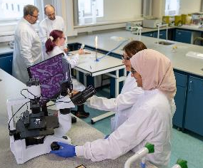
The Value of the Implementation of the MaRILU® System
Since its inception March 2022, 72 students have benefitted from MaRILU® assessments.
Type of impairment
Long-term health condition/impairment
Temporary impairment
Both

Slide 13
Enhancing Disabled Students Learning & Experience
Prior to MaRILU®’s implementation Disabled Students needs were not being met
MaRILU® supports Disabled students’ needs
13%
87%
Yes
Agree
No
Strongly Agree

Slide 14

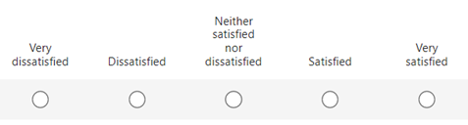
Enhancing Disabled Students Learning & Experience
Participants were very satisfied with the MaRILU® process?
“This process has benefitted me a lot, I am able to participate in practicals a lot more easily it has given me the confidence to speak about my adjustment needs”. (MaRILU® user, 2023)
“ It has helped me a lot and I feel less anxious in the labs”. (MaRILU® user, 2025)

Slide 15
Promoting Disabled Students Sense of Belonging
Promoting Sense of Belonging
“This is the first time during my university learning journey that I have felt valued and provisions are being put in place to meet my needs”. (MaRILU® user, 2025)
“It has definitely helped me feel more welcomed and supported in my lab work. I absolutely love lab sessions despite the difficulties I face, and I hope that with this in place that those difficulties will be reduced”. (MaRILU® user, 2024)

Slide 16
Conclusions
MaRILU® is a tool institutions can use to harness the knowledge and lived experience of disabled students to ensure inclusivity and accessibility in laboratories.
MaRILU®’s applications is not limited to biosciences/chemistry courses.
MaRILU® improves disabled students' safety and empowers them to work in an improved ‘social model’ of disability (Bunbury, 2018).
The MaRILU® process helps to improve our anticipatory duty under the Equality Act.

Slide 17
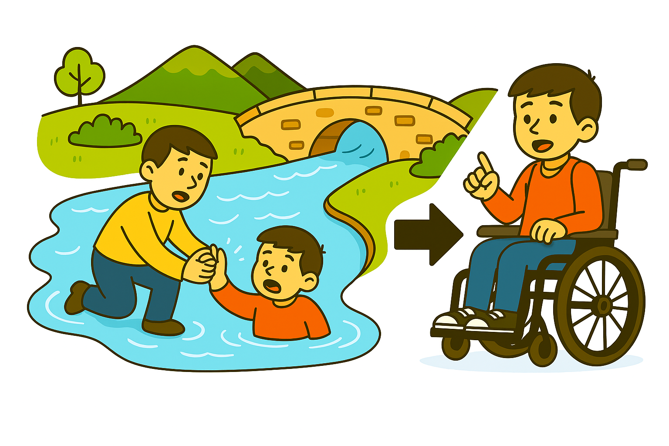
Conclusions
“ There comes a point where we need to stop just pulling people out of the river. We need to go upstream and find out why they’re falling in”. Archbishop Desmond Tutu

Slide 18

Awards
HE Bioscience Teacher of the Year (2025)
Recipient of Times Higher Education Award for MaRILU® (2024) in the EDI category
Bradford Teaching Excellence Award (2024)
Vice Chancellor’s Outstanding Achievers Award for outstanding contribution to Learning and Teaching (2024)
Vice Chancellor’s Outstanding Achievers Award Winner (2023) in the EDI category
Vice Chancellor’s Outstanding Achievers individual commendation award for my commitment to inclusive learning and teaching (2023)

Slide 19

MaRILU®: Registered Trademark

Slide 20
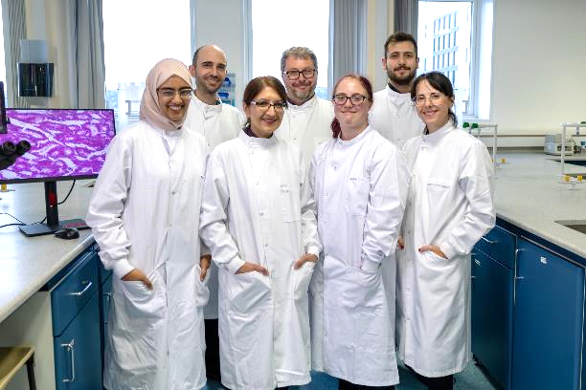


Slide 21
References
Disability Discrimination Act (1995). https://www.legislation.gov.uk/ukpga/1995/50/contents
Equality Act (2010). https://www.legislation.gov.uk/ukpga/2010/15/contents
HESA. (2025). What are the characteristics of HE Students? HESA. https://www.hesa.ac.uk/news/20-03-2025/sb271-higher-education-student-statistics/numbers
Boval, J., & Kennedy, S. (2018). Laboratory Safety for All: Accommodating Students with Disabilities in Chemistry Teaching Laboratories. In E. Sweet, W. Strobel Gower, & C. E. Heltzel (Eds.), Accessibility in the Laboratory (pp. 99–115). American Chemical Society. https://doi.org/10.1021/bk-2018-1272.ch008
Oliver, M. (2013). The social model of disability: Thirty years on. Disability & Society, 28(7), 1024–1026. https://doi.org/10.1080/09687599.2013.818773

