Slide 1
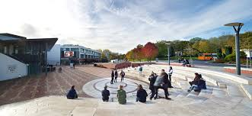
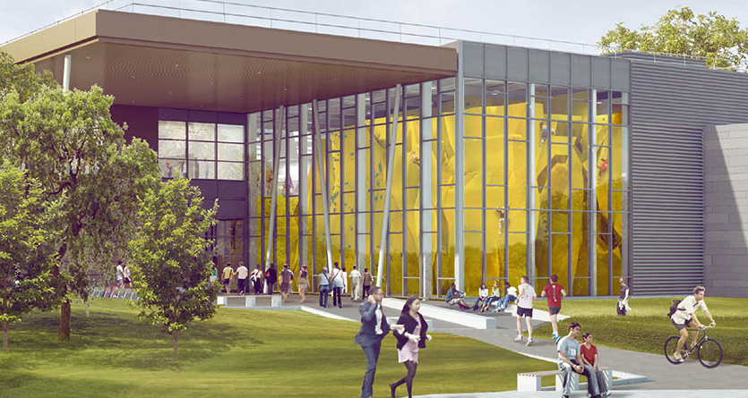

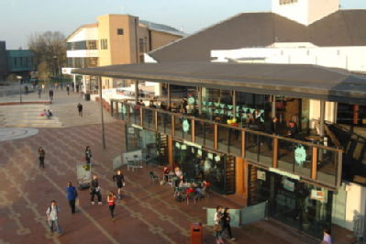
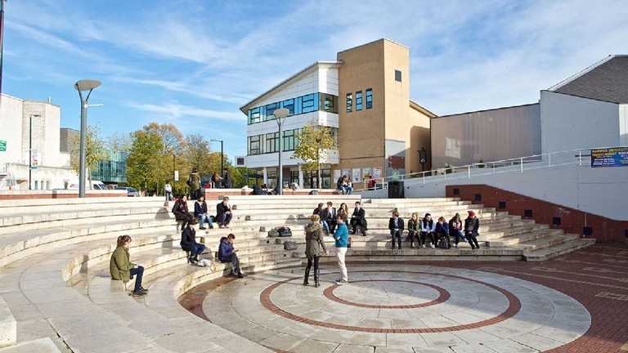
Welcome!
Title of session (e.g. exploring community values)

Slide 2
This building was easy to find

Slide 3
I am confident about
cooking for myself

Slide 4
I have always been passionate
about my degree subject

Slide 5
I am more excited about joining clubs and societies

Slide 6
I am uncertain about what is expected of me at Warwick

Slide 7
Warwick’s guiding principles
We treat everyone with respect
We do not tolerate discrimination
We do not tolerate sexual misconduct, violence or abuse
We keep our campus and community safe
“We” means all of us, students and staff alike

