Slide 1
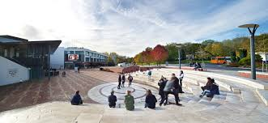

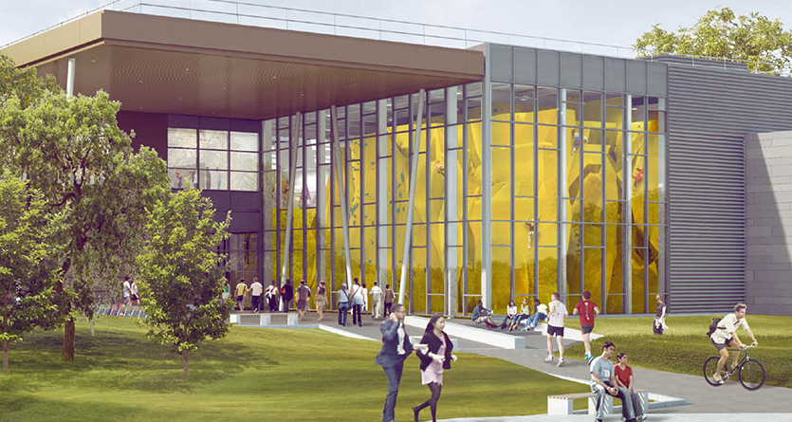
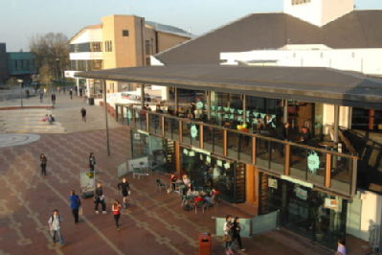
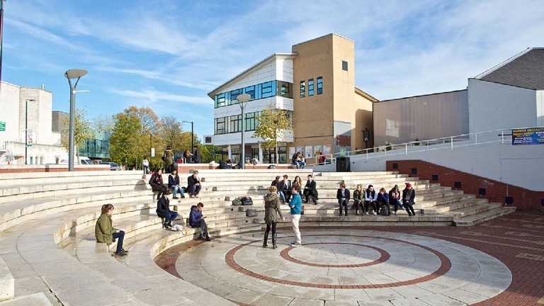
Welcome!
Exploring our values workshop

Slide 2
Choose the five words that matter to you
the most right now
Notes:
note them down where possible.

Slide 3
Get into a group of 4

Slide 4
Discuss and agree on the five words which matter to you most as a group

Slide 5

A reminder of the Warwick Values
We treat everyone with respect.
We do not tolerate discrimination.
We do not tolerate sexual misconduct, violence or abuse.
We keep our campus and community safe.
“We” means all of us, students and staff alike.

Slide 6
Scenario
Scenario
Scenario
Scenario
Question
Question
Question
Question
Question
Question
Question

Slide 7
Finally…
Share one bit of feedback about today…
new, surprising, challenging, or reassuring
Notes:
note them down where possible.

