Slide 1
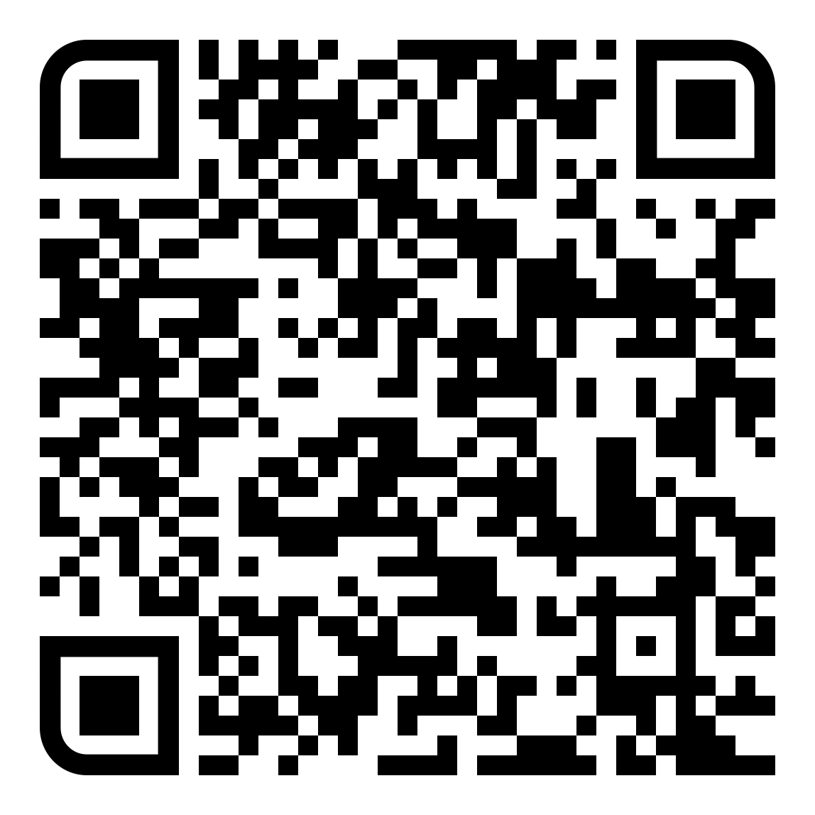
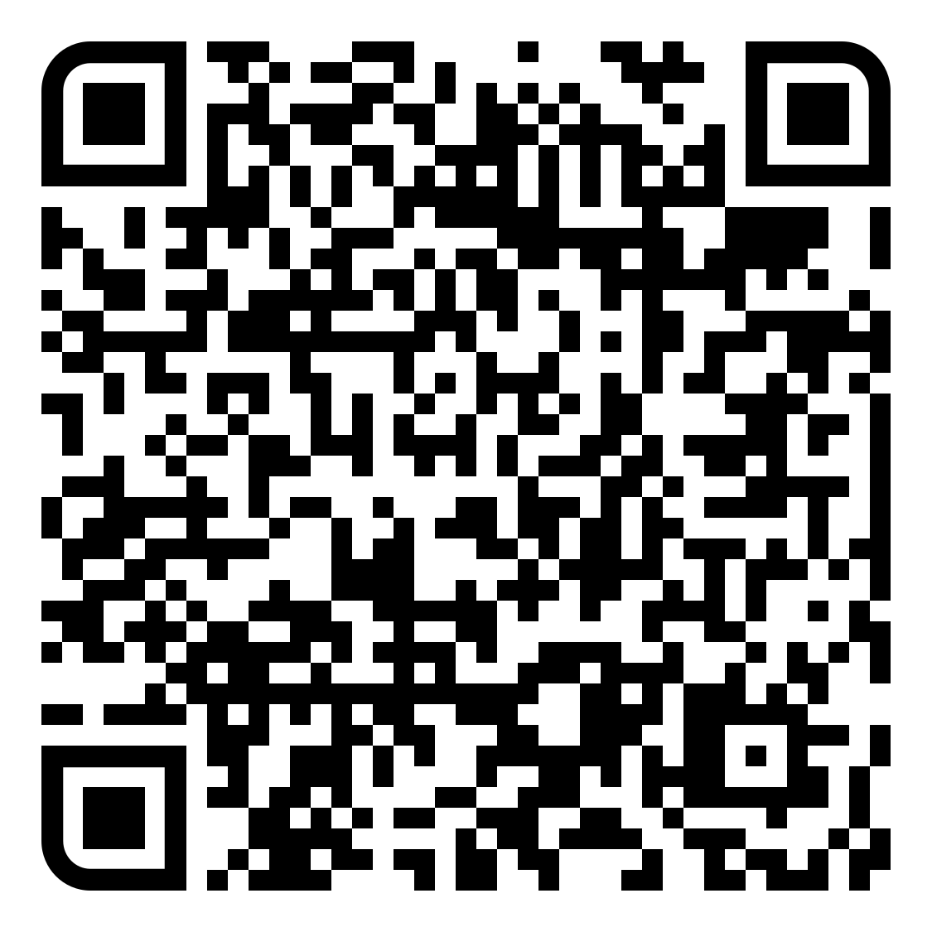


Personal Tutor Meeting: Conversation Starters
First year undergraduate: Term 1
The following guidance has been created by students and is intended as inspiration for a productive meeting at this point in your tutee’s university journey. Students at Warwick come from a range of backgrounds and will have different interests and needs so your conversation should always be tailored to the individual tutee.
Suggested conversation starters:
Tell me about yourself… Why did you choose Warwick?
Is there anything about being a university student that you are worried about?
Tell me about any student societies, sports clubs or liberation groups that you have looked into?
How are you settling into University life and your accommodation (if relevant)?
Have you been able to access any support that you need? / Do you know how to access support services at the university?
Are you living in on-campus accommodation?
Do you have any hobbies or interests that you enjoy doing?
Relevant topics to discuss:
Tips for building rapport
Get to know your tutee’s background and interests
Highlight sports clubs, societies, liberation groups and ways to make friends/connect with other students
Introduce your role and remit as a personal tutor (set boundaries while establishing yourself as a first point of contact)
Flag how students can raise concerns/ provide feedback e.g. Personal Tutors, DSEPs, SSLCs
Encourage students to look at the University cost-of-living information
Signpost wellbeing services particularly self-help resources designed to prepare students for a positive experience including topics such as meeting new people, settling in and managing change
Explain mitigating circumstances procedures and self-certification and the importance of seeking support
As a personal tutor you should have been informed if a student has disclosed a disability. It is important that you ask about this during the meeting to see how they are finding things and whether reasonable adjustments are in place. Direct students to Disability Services if they have not yet been assessed to ensure the right department support is in place. Explain how we’re here to help and that there is extra support, all given without cost to the student or judgement/stigma.
Useful services/opportunities to signpost:
It is good practice to email students after a meeting to remind them of some of the information discussed and share key links e.g. mitigating circumstances, how to contact you as their tutor, how to contact Wellbeing Support. Further training and guidance for personal tutors is available on the Dean of Students website.

Slide 2
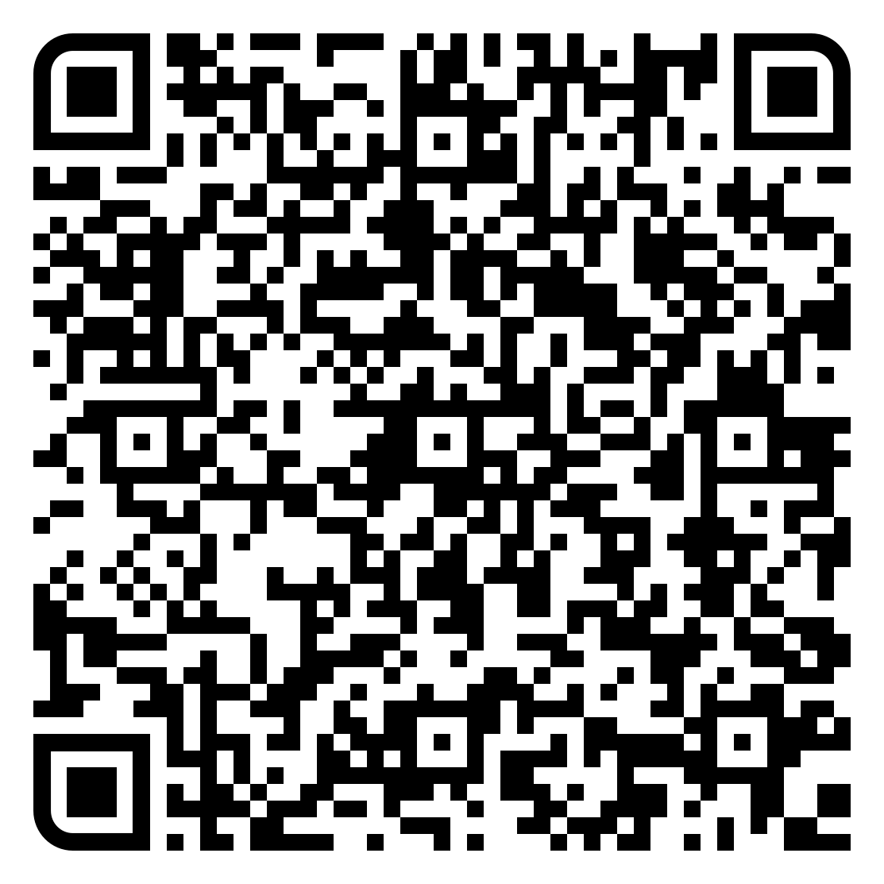
Personal Tutor Meeting: Conversation Starters
First year undergraduate: Term 2
The following guidance has been created by students and is intended as inspiration for a productive meeting at this point in your tutee’s university journey. Students at Warwick come from a range of backgrounds and will have different interests and needs so your conversation should always be tailored to the individual tutee.
Suggested conversation starters:
Share one new experience from last term and what discoveries you made - what’s next for T2?
Is there any specific assignment feedback you would like to go through together?
How has your attendance been during first term? Use this opportunity to look at their attendance record together. Depending on what this looks like there may be an opportunity to discuss any barriers and signpost to further support
How have you been managing university workload? What strategies have you adopted?
Have you been able to access any support that you need? / Do you know how to access support services at the university
Relevant topics to discuss:
Personal Tutoring and Neurodiversity
Discuss academic progress so far
Help the student develop confidence with revision skills and practices
Discuss any early thoughts on work experience and careers. Encourage students to think about applications for summer vacation roles/internships/placements
Remind students of self-certification and mitigating circumstances and how to submit and the importance of seeking support
Signpost wellbeing services self-help resources designed to prepare students for a positive experience including topics such as imposterism, loneliness and working well in groups
Signpost to opportunities through the Warwick Skills Award, Sports and Societies
Signpost to Warwick Accommodation and the SU accommodation guidance pages
Encourage students to look at the University cost-of-living information
Useful services/opportunities to signpost:
It is good practice to email students after a meeting to remind them of some of the information discussed and share key links e.g. mitigating circumstances, how to contact you as their tutor, how to contact Wellbeing Support. Further training and guidance for personal tutors is available on the Dean of Students website.

Slide 3
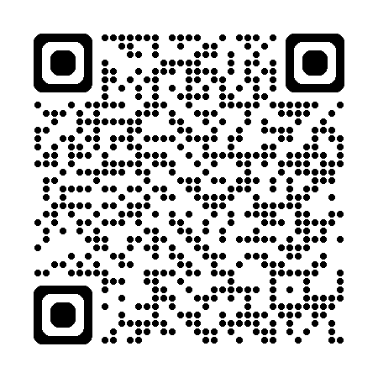
Personal Tutor Meeting: Conversation Starters
First year undergraduate: Term 3
Term 3 is, for most students, focused on assessment as well as making plans for the summer and engaging in end of year sports and society activity. The following guidance has been created by students and is intended as inspiration for a productive meeting at this point in your tutee’s university journey. Students at Warwick come from a range of backgrounds and will have different interests and needs so your conversation should always be tailored to the individual tutee.
Suggested conversation starters:
Is there any specific feedback you would like to discuss from returned assessments?
How have you been organising your workload and revision?
Have you thought about next year’s modules?
Looking back over the last year, what have been your highlights? What has been the hardest part and how have you managed this?
Do you have any different types of assessments this term? How are you feeling about that / those?
Do you have any concerns about progressing to Year Two?
Do you know how to access support services at the university?
Relevant topics to discuss:
Volunteering Opportunity
Check if your tutee requires any special examination arrangements or reasonable adjustments
Remind students of self-certification and mitigating circumstances and how to submit and the importance of seeking support
Discuss plans for the summer and any applications for summer vacation work
Discuss opportunities for intercalated work and study abroad
Discuss the student’s management of academic work and social activity
Signpost wellbeing services including workshops on managing exam stress, procrastination and revision.
Useful services/opportunities:
It is good practice to email students after a meeting to remind them of some of the information discussed and share key links e.g. mitigating circumstances, how to contact you as their tutor, how to contact Wellbeing Support. Further training and guidance for personal tutors is available on the Dean of Students website.

Slide 4
Personal Tutor Meeting: Conversation Starters
Intermediate Year: Term 1
The following guidance has been created by students and is intended as inspiration for a productive meeting at this point in your tutee’s university journey. Students at Warwick come from a range of backgrounds and will have different interests and needs so your conversation should always be tailored to the individual tutee.
Suggested conversation starters:
How was your summer?
Looking back on your first year, what were your highlights? What was the hardest part and how did you manage this?
How are you feeling about the year ahead?
How did you find your assessments last year?
Have you had any thoughts about potential careers or work experience that you would like to find out more about?
Do you know how to access support services at the university?
Relevant topics to discuss:
Tips for building rapport
Discuss how the student is feeling about the start of the second year
Identify any academic or study skill areas for development that the student has identified in Year 1
Students should be encouraged to use their second year to build on the skills and experiences that will set them up for their final year and next steps beyond that - encourage them to get involved in things that interest them such as research or co-creation projects, volunteering and part-time jobs
Encourage early application for summer vacation roles/internships/placements
Remind students of self-certification and mitigating circumstances and how to submit and the importance of seeking support
Encourage students to look at the University cost-of-living information
Signpost wellbeing services self-help resources
As a personal tutor you should have been informed if a student has disclosed a disability. It is important that you ask about this during the meeting to see how they are finding things and whether reasonable adjustments are in place. Direct students to Disability Services if they have not yet been assessed to ensure the right support is put in place
Useful services/opportunities
It is good practice to email students after a meeting to remind them of some of the information discussed and share key links e.g. mitigating circumstances, how to contact you as their tutor, how to contact Wellbeing Support. Further training and guidance for personal tutors is available on the Dean of Students website.

Slide 5
Personal Tutor Meeting: Conversation Starters
Intermediate Year: Term 2
The following guidance has been created by students and is intended as inspiration for a productive meeting at this point in your tutee’s university journey. Students at Warwick come from a range of backgrounds and will have different interests and needs so your conversation should always be tailored to the individual tutee.
Suggested conversation starters:
Have you received any assessment feedback for this year? How does this compare to the first year of your studies?
Are you managing to balance your university workload with social life / other commitments?
How has your attendance been during first term? Use this opportunity to look at their attendance record together. Depending on what this looks like there may be an opportunity to discuss any barriers and signpost to further support
When do you need to choose next year’s modules? Have you thought about them?
Tell me about any career plans that you have. Meeting with a Careers Advisor is for all students, whether you know what you want to do or not
Relevant topics to discuss:
Personal Tutoring and Neurodiversity
Discuss how the student feels they are getting on
Discuss opportunities for intercalated work and study abroad
Remind students of self-certification and mitigating circumstances and how to submit and the importance of seeking support from the personal tutor and Wellbeing Services
Encourage students to look at the University cost-of-living information
Check in on any reasonable adjustments and ask how students with a disability are getting on. Signpost to Disability Services where there are any concerns. Explain how we’re here to help and that there is extra support, all given without cost to the student or judgement/stigma.
Signpost to their Academic Skills Librarian and study support in preparation for exams and assignments
Useful services/opportunities
It is good practice to email students after a meeting to remind them of some of the information discussed and share key links e.g. mitigating circumstances, how to contact you as their tutor, how to contact Wellbeing Support. Further training and guidance for personal tutors is available on the Dean of Students website.

Slide 6
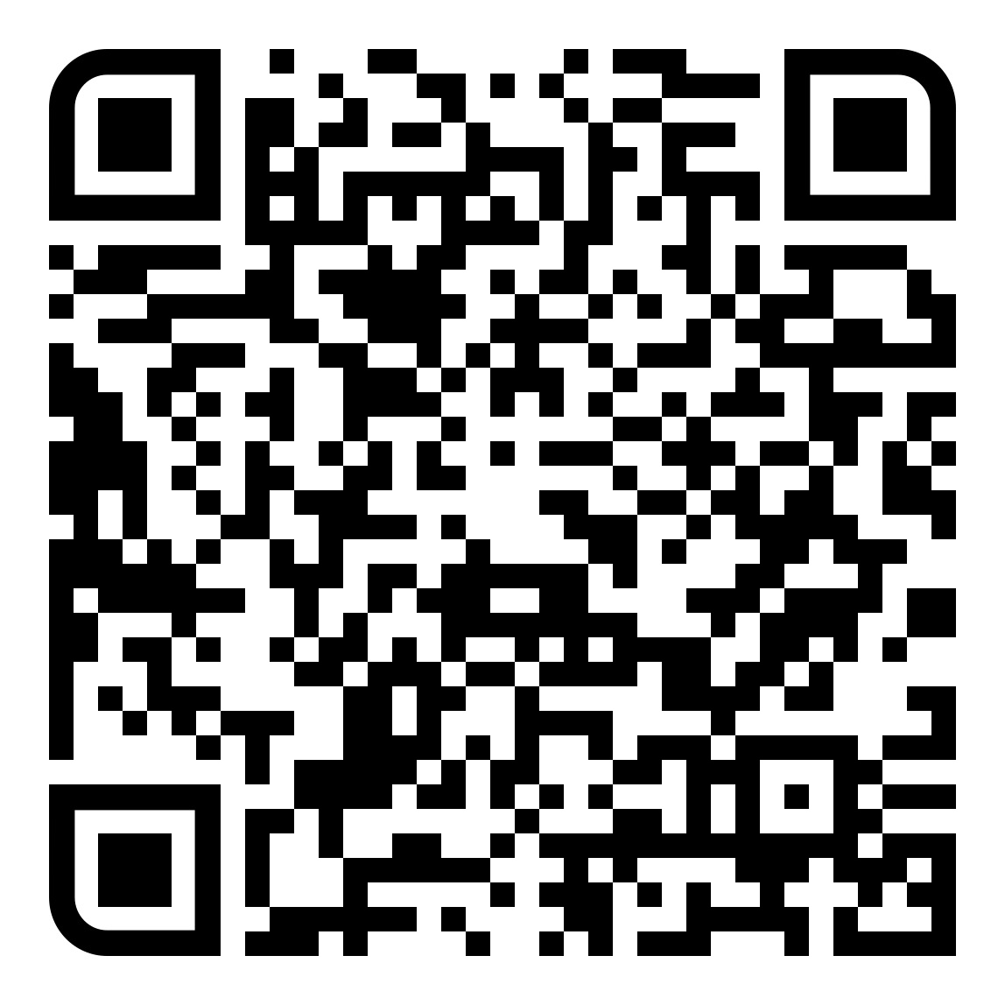
Personal Tutor Meeting: Conversation Starters
Intermediate Year: Term 3
The following guidance has been created by students and is intended as inspiration for a productive meeting at this point in your tutee’s university journey. Students at Warwick come from a range of backgrounds and will have different interests and needs so your conversation should always be tailored to the individual tutee.
Suggested conversation starters:
How are you feeling about your exams and assignments?
Do you have any worries or concerns you’d like to talk about?
What are your favourite parts of your degree? Are there ways that you could explore these further through final year work, module options and/or discussion with Careers about work experience options?
Looking back over the last year, what have been your highlights? What has been the hardest part and how have you managed this?
Relevant topics to discuss:
Exam Support Information
Discuss how the student is managing academic and social life, and signpost wellbeing services if necessary
Signpost information on Examination Boards and Degree Conventions
Remind students of self-certification and mitigating circumstances and how to submit and the importance of seeking support from the department/Wellbeing services if they encounter challenges
Encourage students to look at the University cost-of-living information
Signpost to their Academic Skills Librarian and study support in preparation for exams and assignments
Useful services/opportunities:
It is good practice to email students after a meeting to remind them of some of the information discussed and share key links e.g. mitigating circumstances, how to contact you as their tutor, how to contact Wellbeing Support. Further training and guidance for personal tutors is available on the Dean of Students website.

Slide 7
Personal Tutor Meeting: Conversation Starters
Final Year: Term 1
The following guidance has been created by students and is intended as inspiration for a productive meeting at this point in your tutee’s university journey. Students at Warwick come from a range of backgrounds and will have different interests and needs so your conversation should always be tailored to the individual tutee. You may have students returning from study abroad or placement years and this is an opportunity to encourage them to reflect and to ensure that they are settling back into department life.
Suggested conversation starters:
Looking back on your second year, what were your highlights? What was the hardest part and how did you manage this?
What did you do over the summer and how are you feeling about the year ahead?
How do you feel about your intermediate-year assessment results?
How has your dissertation/final year project been progressing? Remind students of Academic Support Librarians.
Do you have any post-graduation plans? Flag Careers and resources such as CV Support
Relevant topics to discuss:
Tips for building rapport
Discuss whether your tutee is on track for their desired degree result and talk through opportunities to develop areas that may require further work
Encourage your tutee to share experiences that they have had at University so far, work experience/part-time work, volunteering, sports, societies
Signpost Careers support and further study opportunities
Remind students of self-certification and mitigating circumstances - how to submit and the importance of seeking support
Encourage students to look at the University cost-of-living information
As a personal tutor you should have been informed if a student has disclosed a disability. It is important that you ask about this during the meeting to see how they are finding things and whether reasonable adjustments are in place. Direct students to Disability Services if they have not yet been assessed. Explain how we’re here to help and that there is extra support, all given without cost to the student or judgement/stigma.
Useful services/opportunities:
It is good practice to email students after a meeting to remind them of some of the information discussed and share key links e.g. mitigating circumstances, how to contact you as their tutor, how to contact Wellbeing Support.
Further guidance for personal tutors is available on the Dean of Students website.

Slide 8
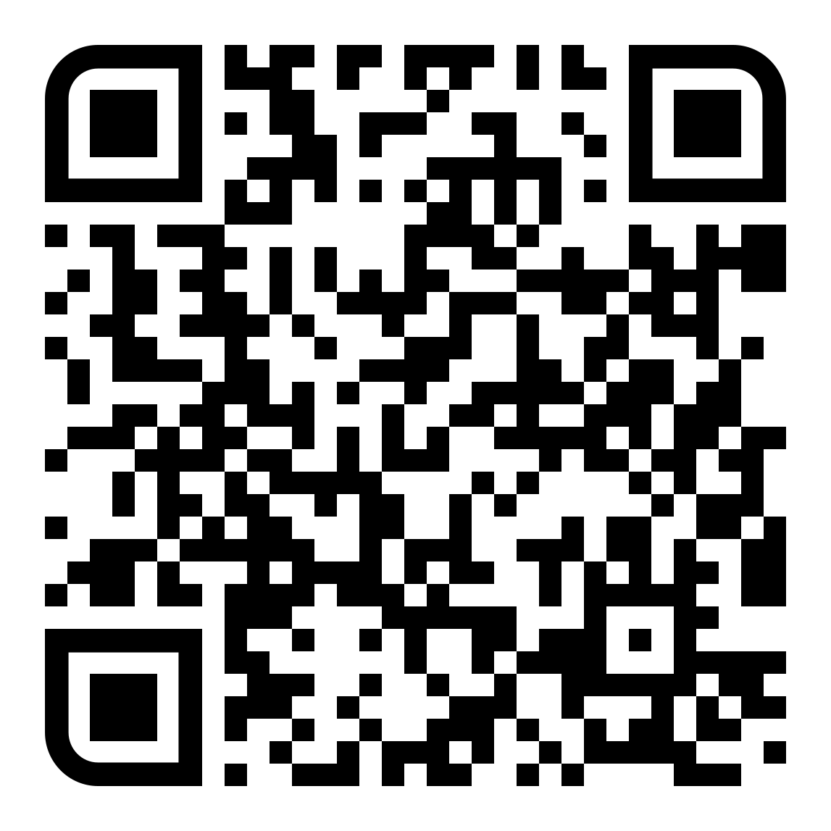
Personal Tutor Meeting: Conversation Starters
Final Year: Term 2
The following guidance has been created by students and is intended as inspiration for a productive meeting at this point in your tutee’s university journey. Students at Warwick come from a range of backgrounds and will have different interests and needs so your conversation should always be tailored to the individual tutee.
Suggested conversation starters:
Is there any specific feedback you would like to discuss from returned assessments?
How has your final year project been progressing (where relevant)?
How are you ensuring that you have a good work and social balance?
What plans do you have after graduating? Have you considered post-graduate study?
Relevant topics to discuss:
Careers Support Guidance
Remind students of self-certification and mitigating circumstances - how to submit and the importance of seeking support
Encourage students to look at the University cost-of-living information
Discuss future pathways and encourage applications for graduate roles, if appropriate
Find out how they are getting on with their dissertation or final year project, if relevant
Encourage planning for life after Warwick and engagement with Careers and Skills to understand options
Highlight the NSS and ways for students to feedback about their time at university
As a personal tutor you should have been informed if a student has disclosed a disability. It is important that you ask about this during the meeting to see how they are finding things and whether reasonable adjustments are in place. Check if any special examination arrangements are required, prior to Term 2 deadline – and signpost to Disability Services, if needed.
Useful services/opportunities
It is good practice to email students after a meeting to remind them of some of the information discussed and share key links e.g. mitigating circumstances, how to contact you as their tutor, how to contact Wellbeing Support.
Further guidance for personal tutors is available on the Dean of Students website.

Slide 9
Personal Tutor Meeting: Conversation Starters
Final Year: Term 3
The following guidance has been created by students and is intended as inspiration for a productive meeting at this point in your tutee’s university journey. Students at Warwick come from a range of backgrounds and will have different interests and needs so your conversation should always be tailored to the individual tutee.
Suggested conversation starters:
How are you feeling about your exams and assignments?
Looking back at your time at university, what have been your highlights? What has been the hardest part and how have you managed this?
Do you know how graduation works?
Relevant topics to discuss:
Exam Support Information
Discuss how the student is balancing their academic and social life.
Remind students of self-certification and mitigating circumstances - how to submit and the importance of seeking support
Discuss your tutees university experience – celebrate learning and success and encourage them to reflect on how they have grown as a person and the skills they have learnt during their time at Warwick
Encourage your tutees to sign up to the Alumni Community to benefit from mentors, career support and networking opportunities after graduation
Talk through the graduation process
Check in with students with special arrangements that they are comfortable with what they need to do during their exams and assessments
Useful services/opportunities:
It is good practice to email students after a meeting to remind them of some of the information discussed and share key links e.g. mitigating circumstances, how to contact you as their tutor, how to contact Wellbeing Support.
Further guidance for personal tutors is available on the Dean of Students website.

Slide 10
Personal Tutor Meeting: Conversation Starters
Postgraduate Students: Term 1
The following guidance has been created by students and is intended as inspiration for a productive meeting at this point in your tutee’s university journey. Students at Warwick come from a range of backgrounds and will have different interests and needs so your conversation should always be tailored to the individual tutee.
Suggested conversation starters:
Tell me about yourself… What has your academic journey been like before Warwick?
Is there anything about being a postgraduate student that you are worried about?
How are you settling into University life? Tell me about your first lectures
What are your first impressions of Warwick/The UK?
Tell me where you would go for support and assistance?
Tell me about any student societies, sports clubs or liberation groups that you have looked into?
Have you visited the Library or PG Hub?
Relevant topics to discuss:
Tips for building rapport
Get to know your tutee’s background and interests
Introduce your role at Warwick and remit as a personal tutor (set some boundaries while establishing yourself as a first point of contact)
Signpost wellbeing services particularly self-help resources designed to prepare students for a positive experience including topics such as meeting new people, settling in and managing change
Explain mitigating circumstances procedures and self-certification and the importance of seeking support
Encourage students to look at the University cost-of-living information
As a personal tutor you should have been informed if a student has disclosed a disability. It is important that you ask about this during the meeting to see how they are finding things and whether reasonable adjustments are in place. Direct students to Disability Services if they have not yet been assessed. Explain how we’re here to help and that there is extra support, all given without cost to the student or judgement/stigma.
Useful services/opportunities:
It is good practice to email students after a meeting to remind them of some of the information discussed and share key links e.g. mitigating circumstances, how to contact you as their tutor, how to contact Wellbeing Support.
Further guidance for personal tutors is available on the Dean of Students website.

Slide 11
Personal Tutor Meeting: Conversation Starters
Postgraduate Students: Term 2
The following guidance has been created by students and is intended as inspiration for a productive meeting at this point in your tutee’s university journey. Students at Warwick come from a range of backgrounds and will have different interests and needs so your conversation should always be tailored to the individual tutee.
Suggested conversation starters:
Share one new experience from last term and what discoveries you made - what’s next for T2?
Is there any specific assignment feedback you would like to go through together?
How have you found building a social circle and meeting other students?
Do you have a particular destination or career in mind or are you hoping that this degree will help shape your ideas?
Are you thinking about further study beyond your Masters? If so, do you know when the application deadlines are and how to prepare for them?
Relevant topics to discuss:
Careers Support Guidance
Signpost to their Academic Skills Librarian and study support in preparation for exams and assignments
Remind students of self-certification and mitigating circumstances and how to submit and the importance of seeking support
Encourage students to look at the University cost-of-living information
Encourage planning for life after Warwick and engagement with Careers and Skills to understand options
Useful services/opportunities:
It is good practice to email students after a meeting to remind them of some of the information discussed and share key links e.g. mitigating circumstances, how to contact you as their tutor, how to contact Wellbeing Support.
Further guidance for personal tutors is available on the Dean of Students website.

Slide 12
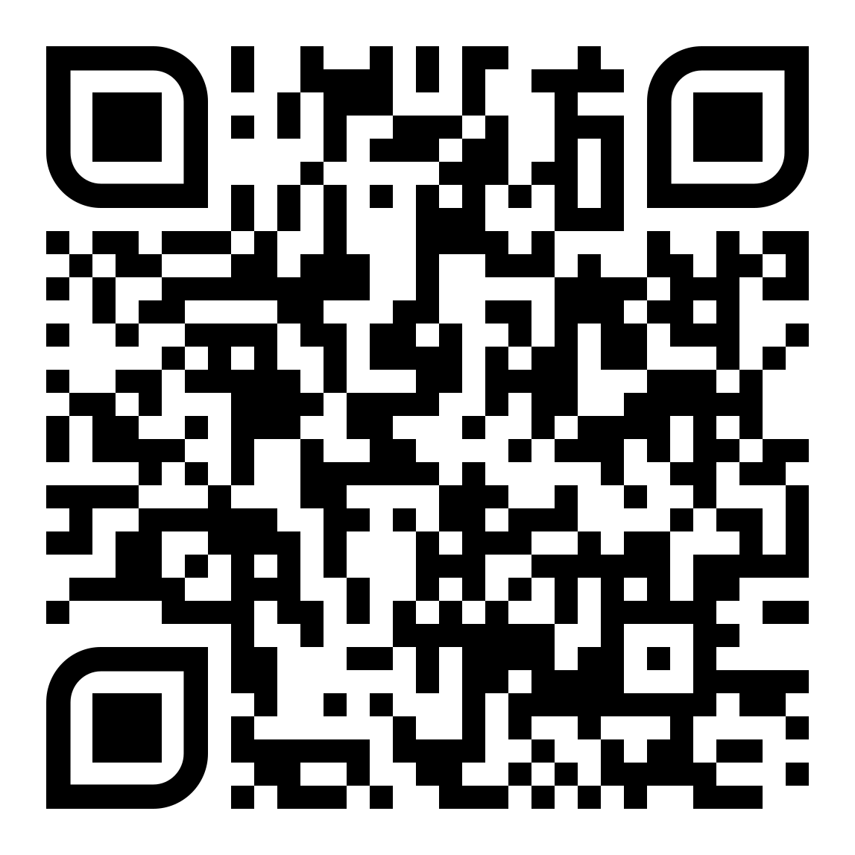
Personal Tutor Meeting: Conversation Starters
Postgraduate Students: Term 3
The following guidance has been created by students and is intended as inspiration for a productive meeting at this point in your tutee’s/supervisor groups’ university journey. Students at Warwick come from a range of backgrounds and will have different interests and needs so your conversation should always be tailored to the individual tutee.
Suggested conversation starters:
Looking back over the last year, what have been your highlights? What has been the hardest part and how have you managed this?
Do you know how graduation works?
What plans do you have after completing your course?
How has your project/dissertation been progressing (where relevant)?
Relevant topics to discuss:
PG Resources and Support
Discuss how the student is balancing their academic and social life.
Remind students of self-certification and mitigating circumstances - how to submit and the importance of seeking support
Students may be working with a supervisor on a project or dissertation, discuss how that is progressing.
Discuss your tutees university experience – celebrate learning and success and encourage them to reflect on how they have grown as a person and the skills they have learnt during their time at Warwick
Check in with students with special arrangements that they are comfortable with what they need to do during their exams and assessments
Encourage your tutees to sign up to the Alumni Community to benefit from mentors, career support and networking opportunities after graduation
Talk through the graduation process
Useful services/opportunities:
It is good practice to email students after a meeting to remind them of some of the information discussed and share key links e.g. mitigating circumstances, how to contact you as their tutor, how to contact Wellbeing Support.
Further guidance for personal tutors is available on the Dean of Students website.

