Slide 1

Identity Development Guidance
Research Centres

Slide 2

Introduction
Research Centres
The majority of Research Centres should use a University of Warwick lockup as their identity. This is the standard approach and helps maintain a clear, consistent connection to the University's brand.
In some circumstances, a Research Centre may be eligible to develop its own independent identity. This is considered an exception and requires approval through a business case process.
This guidance outlines the two possible routes:
Standard Route: Use of a University of Warwick lockup as the Centre's identity.
Exception Route: Apply for approval to develop an independent identity through a business case process.
The diagram on the following page will help you identify which route applies to your Research Centre.

Slide 3
Research
Centre
Identity
Decision
Process
Research Centre is owned by University of Warwick
Research Centre is not fully owned by University of Warwick
Centre is provided with a University of Warwick lockup
Complete business case for independent branding
Centre requests own logo/branding
Business case not approved
Business case approved
Brand Team will advise next steps and guidance after sharing with UEB for final approval based on Brand's recommendation.

Slide 4


Lockup Approach
Research Centres
As a standard approach, Research Centres should utilise the central brand for their identity using a University of Warwick lock up.
A unified branding approach ensures consistency and strengthens overall brand equity, enabling more effective promotion when aligned with the central University brand.
As most centres are Warwick-owned, adopting the core brand (or appropriate departmental lock-ups) provides a clear, cohesive framework.

Slide 5

Best Practice Example
Lock Up
Research Centre Name: Centre for Global Health Law
Focus: An interdisciplinary hub within the Warwick Law School, dedicated to advancing research expertise at the intersection of health, law, technology and crises.
Lockup:
Design:
Centre lockup used alongside University of Warwick Crest following split usage approach.
University of Warwick colour and typography utilised.

Slide 6
Identity Guidance for Approved Business Cases

Slide 7
Identity Guidance
Research Centres
The next slides outline best practice guidance for Research Centres with an approved Business Case to develop an independent identity. It is intended to support the creation of identities that are:
Appropriate and inclusive
Visually coherent and accessible
Ethically sound and culturally aware
Distinct, while maintaining a clear connection to the wider institution
The aim is to support innovation in branding while maintaining consistency, credibility, and alignment with broader institutional standards.
If you need further guidance at any stage, the brand team is available to provide advice and support.
Approval and support
Please submit final drafts of your Research Centre identity
to the Brand Team. We will review and provide any feedback if needed.
Once approved by our team, you can start using your identity.
If you need further support, please contact brand@warwick.ac.uk

Slide 8
Identity Creation
Naming Guidance
Do:
Choose a name that is clear, descriptive, and aligned with the research focus.
Wherever possible, the name should provide an immediate sense of the research center's purpose, area, or methodology.
Ensure the name is simple to pronounce and easy to spell.
This supports clear communication across clinical, academic, and public settings, and reduces the risk of misunderstanding.
Undertake appropriate checks for existing usage and trademarks.
Confirm that the proposed name is not already in use or legally protected to avoid confusion, duplication, or potential legal issues.
Consider international and cross-cultural interpretation, including religious, political, or social sensitivities.
Reflect on how the name may translate across different languages and cultural contexts, particularly for studies with global reach.
Avoid acronyms that are obscure, overly complex, or difficult to interpret.
Acronyms should only be used where they are intuitive and add clarity.
Avoid implying commercial sponsorship or endorsement without explicit approval.
Do not include company names, product references, or language that could suggest a commercial relationship (unless formally agreed and authorized).
Avoid using “Warwick” in a way that implies full ownership or standalone entities.
Research Centre names should reflect appropriate affiliation without suggesting institutional ownership if not owned by Warwick.

Slide 9
Identity Creation
Logo Guidance
Please work with an approved supplier from our creative framework to ensure the logo is professional and fit for purpose. The briefing should ensure the agency considers the following:
Do:
Design with purpose and audience in mind.
The logo should clearly reflect the Research Centres mission, subject area, and intended audience.
Ensure clarity and legibility at all sizes with simple design.
Logos must remain readable and recognisable across a range of applications, including small digital formats.
Adhere to accessibility standards.
Consider colour contrast, readability, and inclusivity to ensure the logo is accessible.
Include the full Research Centre name where appropriate.
This supports clarity and ensures the logo is easily understood without additional context.
Use a distinct but appropriate colour palette.
Colours should differentiate the trial from Warwick's institutional brand colours.
Select clear, professional typography.
Use fonts that are legible, accessible, and avoid Warwick’s institutional typography.
Be mindful of cultural and social sensitivities.
Visual elements should be respectful and appropriate across diverse audiences and contexts.
Do not:
Use restricted or unofficial medical symbols without approval.
Symbols such as red crosses or stylised DNA imagery may carry specific meanings or restrictions.
Use decorative, script, or novelty fonts.
These can reduce legibility and appear inconsistent with a professional research context.
Use University of Warwick institutional brand assets (typography, colour palette etc.)

Slide 10
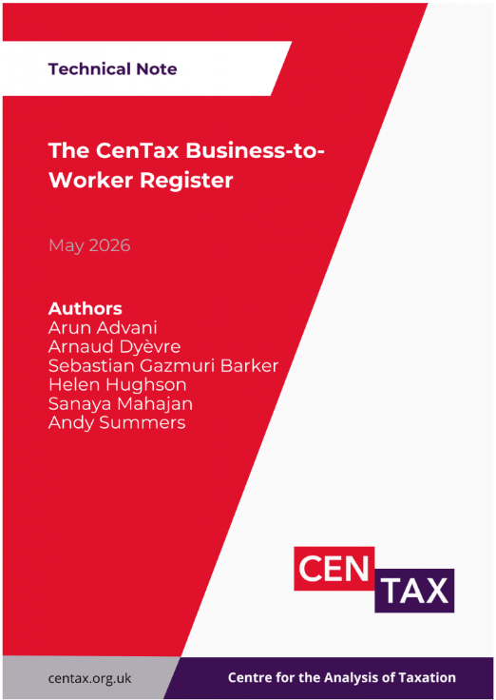

Best Practice Example
Independent Identity
CenTax
✓ Uses its own typography
✓ Uses its own colour palette
✓ Does not use University of Warwick design elements
✓ Clear and legible

Slide 11
Summary
The below summaries the two different approached for Research Centres
University of Warwick Lock Up
Approved Independent Identity
Owned by University of Warwick
No business case required
Default approach
University of Warwick brand colours
University of Warwick typography
For further guidance, please refer to slides 4 - 5
Not fully owned by University of Warwick
Business Case required
Exceptional route
Independent Logo
Independent colour palette
Independent typography
For further guidance, please refer to slides 7 - 10

Slide 12
Thank you

