Slide 1

Academic Probation
A Guide to the Process of Academic Probation at
The University of Warwick
Professor Christine Ennew, Provost
Karen Terry Weymouth, HR Strategy Director
Dr Letizia Gramaglia, Head of Academic Development
Spring Term 2022/23
Notes:
CHRIS TO OPEN & WELCOME

Slide 2

Probation Process
Probation Review Group
Responsibilities of Head of Department
Probationer’s responsibilities
Probation Annual Review
Criteria
APP TE
Completion of Probation
Non completion of Probation
Appeals Process
Notes:
CHRIS AS PART OF INTRO

Slide 3
Introduction
The purpose of probation is to allow newly appointed academic staff a period of time to reach a position where they are able to demonstrate a proven ability in teaching, research and academic service/management.
Notes:
CHRIS

Slide 4

Those involved….
Probation Review Group
Heads of Department
Probationer
Mentor
Academic Processes team, HR
Academic Development Centre
Notes:
KAREN

Slide 5
Length of Probation
The usual length of academic probation is five years
Differs to many other UK institutions because there is automatic promotion to Associate Professor following complete of probation
Probation will be extended automatically when a probationer is on parental or long-term sick leave
Heads of Departments may recommend staff for early completion of probation in terms of performance where they deem it appropriate
In no case may the total period of probation (excluding regulated absence under University policies on parental leave, sickness, etc) be more that five years, with a sixth and final year’s notice
Notes:
KAREN

Slide 6
Probation Review Group
A sub-group of the Academic Staff Committee
Representatives from each Faculty
Holds meetings in Autumn, Spring & Summer terms to discuss probationers progress
Currently c.220 Assistant Professors subject to Academic Probation
The meeting in which a probationer is reviewed is normally determined by their start date:
Start date | Meeting
1 November – 28 February | Autumn
1 March – 31 May | Spring
1 June – 31 October | Summer
Notes:
KAREN

Slide 7
Probation Review Group responsibilities
Monitoring probationers and deciding whether to confirm appointment at the end of probation;
Considering annual reports from the Head of Department on the progress of all probationers (using submitted proforma and current CV in the approved style);
Advising departments and probationers of any concerns and deciding whether probation can continue;
Agreeing remedial action if it considers a probationer is at any point during probation likely to fail to reach the required standard;
Considering cases for completion and early completion of probation;
Considering cases where the Head of Department recommends that a probationer’s appointment should be terminated at the end of the probationary period
Notes:
KAREN

Slide 8
Responsibilities of Head of Department
Discussing and agreeing explicitly with the probationer the targets for the completion of probation and measures that will be used for assessing their progress against these targets (with the University’s progression and promotion framework as context);
Holding an annual meeting to discuss progress and achievements in line with the criteria and targets and talk through any problems encountered by the probationer which are adversely affecting progress and what might be done to improve the situation;
Submitting to the Probation Review Group a report on each probationer in the department ensuring that any issues from the previous report or feedback from earlier PRG meetings are addressed;
Making recommendations to PRG for completion or non completion of probation;
Providing each probationer with a mentor from within the department;
Ensuring that the mentor relationship is maintained throughout the probation period.
Notes:
KAREN

Slide 9
Probationer’s Responsibilities
Developing their academic career in line with the agreed criteria for probation and targets set by the department (with the University’s progression and promotion framework as context);
Keeping in regular contact with their mentor;
Keeping their mentor and Head of Department informed of research, teaching and administrative activities;
Working in a collegial way;
Maintaining a portfolio of evidence to support progress;
Identifying promptly any difficulties in meeting the agreed targets;
Providing a current CV using the guidance notes.
Notes:
KAREN

Slide 10
Probation Criteria
The broad criteria against which colleagues’ contribution will be assessed are:
Research
Teaching
Impact, Outreach, engagement
Leadership, Collegiality and Management
Regulation 4 of University Statutes governs probation but detail is provided in the Probation Policy.
Notes:
CHRIS

Slide 11
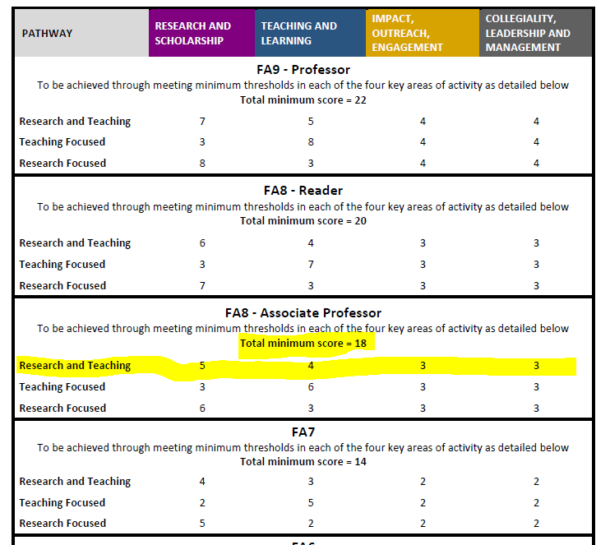
This is an integrated framework for all career pathways. Your are on the R&T pathway and to complete probation we expect you to reach the standard required for an Associate Professor.
This standard requires a certain minimum level of performance across each of 4 areas of activity, but also allows for individuals to be recognised for differential contributions.
Notes:
CHRIS

Slide 12
How this works
Each score in the framework is translated into a stated expectation around level of performance (band 5 in research means “national eminence and authority for the quality and impact of their research and scholarship”).
You demonstrate that you have met this standard/criterion using a range of evidence (and we give examples of the kind of evidence you might use).
The nature/value of the evidence may be discipline specific and your HoD/mentor will be able to advise.
You may use other forms of evidence if they are appropriate – our list is not exclusive!
Notes:
CHRIS

Slide 13
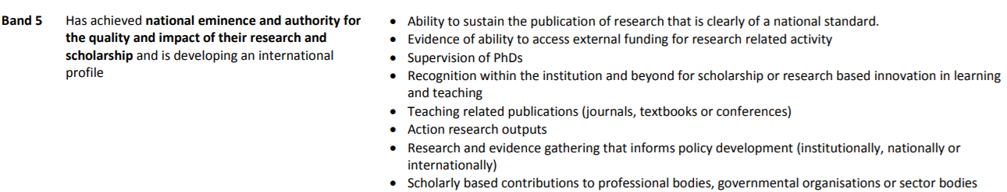
Research: Minimum requirement and indicative evidence
Notes:
CHRIS

Slide 14
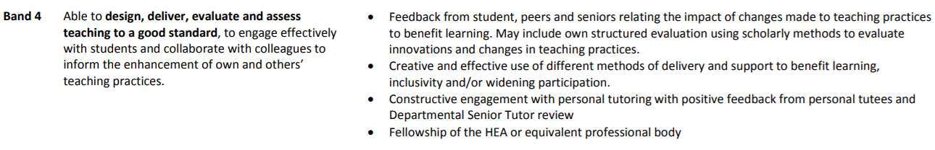
Teaching: Minimum requirement and indicative evidence
APPTE!
Notes:
CHRIS

Slide 15
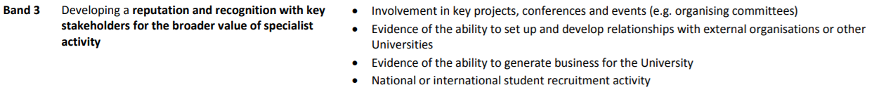
Impact, Outreach, Engagement: Minimum requirement and indicative evidence
Notes:
CHRIS

Slide 16
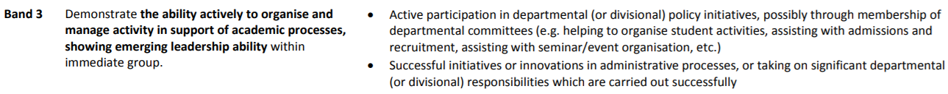
Leadership, Collegiality and Management: Minimum requirement and indicative evidence
Notes:
CHRIS

Slide 17
External Work
Many staff receive external requests to review journal articles, grants, to externally examine, to provide advice etc;
These are likely to be more common as you progress through your career;
They are important (because we rely heavily on peer review, peer guidance and peer evaluation);
They can be time consuming;
Seek advice – about norms in your discipline/department; ask your HoD, mentor;
Notes:
CHRIS
To set some expectation about managing external requests for work…

Slide 18
Academic and Professional Pathway for Teaching Excellence (APPTE)
Probationary staff are required to successfully complete the APPTE
Heads of Department and Probation Review Group receive a progress report from the Academic Development Centre detailing their progress towards APPTE
Notes:
LETI

Slide 19
Academic and Professional Pathway for Teaching Excellence (APPTE)
Accredited to award Fellowship of the Higher Education Academy (FHEA)
12 month blended learning programme
3 x day f-2-f workshops plus Moodle materials (c. 2-4 hours pw)
Monthly Teams hang-outs with Programme leaders (optional)
Small group activities
Formative assessment (drafts of summative pieces)
Developmental teaching observations: APP TE tutors; departmental mentor; reciprocal peer observation or dialogue
Notes:
LETI

Slide 20
Foundations of APPTE
practice
scholarship
dialogue
reflection
Authentic formative and summative assessment supports development of practice
Introduces theory as framework for understanding teaching & learning and fosters engagement with pedagogic research to provide evidence-base for practice
Small group activities create opportunities for collaboration, dialogue, sharing of practice and peer support
Programme focuses upon individual as a reflective practitioner: responsive to disciplinary context
Notes:
LETI

Slide 21
APPTE
Teaching excellence: excellence in practice and policy.
Research & Education at Warwick: supervision, personal tutoring.
Teaching as enquiry: reflective & scholarly practice.
Design & assessment: module design, principles of assessment.
Feedback for learning: effective marking and feedback.
Teaching in context: engagement; autonomy; collaboration; inclusivity.
Theories of learning
Notes:
LETI

Slide 22
APPTE – Partial Exemptions
Hold Fellowship (FHEA) or Senior Fellowship (SFHEA)
Send us copy of your Fellowship Certificate
Complete Part 1 of APP TE (first 3 months)
Previously completed similar programme at other HE and/or significant experience of teaching in HE
Complete application form to evidence intended learning outcomes
Complete Part 1 of APP TE (first 3 months)
Gain HEA Fellowship by completing APP TE assessment or APP EXP pathway to Fellowship (narrative or dialogue)
Notes:
LETI

Slide 23
Beyond APPTE
Probationary staff should undertake further teaching observations (two per year – one mentor and one peer) and continue to engage in reflective practice by keeping an online portfolio after the completion of APPTE (i.e. years 2-5 of probation)
Notes:
LETI

Slide 24

Communication
Important to build a picture for the Probation Review Group (PRG) of your progress (evidence your trajectory)
Probationers will receive letters from PRG, with Heads of Department copied in, providing updates and feedback on their progress
Four-way process of communication:
Probation Review Group
Heads of Department
Probationer
Mentor
Notes:
KAREN

Slide 25

Completion of Probation
At the end of the probation period the department can either:
Recommend completion of probation
Put forward an adverse recommendation
A case for early completion can be put forward if a probationer is deemed to have met the criteria in advance of their probation end date
If PRG agree with the department’s decision to complete probation, the Probationer will be promoted to Associate Professor
Notes:
KAREN

Slide 26
Adverse Recommendation
If the department recommend that a probationer should not complete probation, they will need to provide a full and detailed explanation why completion cannot be confirmed
PRG can also decide that a probationer should not complete probation, even if the department’s recommendation is to complete
PRG can also choose to override the department’s recommendation regarding non-completion
If an adverse recommendation is received, we will write to the probationer and they will be given the opportunity to either attend the meeting in person to present their case or submit a statement. We will also contact up to 3 referees of the probationer’s choice.
There is an appeals process
The full process for an adverse recommendation is detailed in regulation 4 of the University's regulations.
Notes:
KAREN

Slide 27
Summary
Communication is vital
Meeting the four criteria and individual targets is key
Probation cannot be confirmed until you have attended the residential and APPTE is complete
PRG is the decision-making body
Notes:
KAREN

Slide 28
Useful contacts
Any questions regarding Academic Probation should be emailed to the Academic Processes team within HR at academicprocesses@warwick.ac.uk
Any questions regarding APPTE should be emailed to APPTE@warwick.ac.uk
Notes:
KAREN

Slide 29

Any questions?
Notes:
CHRIS

