Slide 1

Translation and Validation of the Warwick Edinburgh Mental Wellbeing Scale (WEMWBS) in Urdu and Bengali Frances Taggart - Medical School, University of Warwick Shabnam Sardar, Michael Taylor, Sarah Stewart-Brown Funded by Heywood, Middleton and Rochdale PCT Five Ways to Wellbeing Conference 9 December 2013, Rochdale Town Hall

Slide 2
The WEMWBS Mental Wellbeing Scale
Assesses both hedonic and eudaimonic wellbeing
Hedonic – Positive emotions, happiness, joy, interest and contentment
Eudaimonic: Psychological functioning associated with personal growth, autonomy, self-acceptance, mastery, positive relationships with others, and a sense of purpose in life
14 statements all positively worded with 5 response categories scored 1-5

Slide 3
The Warwick-Edinburgh Mental Well-being Scale
(WEMWBS)
STATEMENTS | None of the time | Rarely | Some of the time | Often | All of the time
I’ve been feeling optimistic about the future | 1 | 2 | 3 | 4 | 5
I’ve been feeling useful | 1 | 2 | 3 | 4 | 5
I’ve been feeling relaxed | 1 | 2 | 3 | 4 | 5
I’ve been feeling interested in other people | 1 | 2 | 3 | 4 | 5
I’ve had energy to spare | 1 | 2 | 3 | 4 | 5
I’ve been dealing with problems well | 1 | 2 | 3 | 4 | 5
I’ve been thinking clearly | 1 | 2 | 3 | 4 | 5
I’ve been feeling good about myself | 1 | 2 | 3 | 4 | 5
I’ve been feeling close to other people | 1 | 2 | 3 | 4 | 5
I’ve been feeling confident | 1 | 2 | 3 | 4 | 5
I’ve been able to make up my own mind about things | 1 | 2 | 3 | 4 | 5
I’ve been feeling loved | 1 | 2 | 3 | 4 | 5
I’ve been interested in new things | 1 | 2 | 3 | 4 | 5
I’ve been feeling cheerful | 1 | 2 | 3 | 4 | 5

Slide 4
WEMWBS Validation and Use so far
Validated in a student sample in Warwick and Edinburgh and a random sample of general population in Scotland. Also recently in secondary schoolchildren, a population sample in Northern Ireland and among people with Chinese and Pakistani family background living in Birmingham.
Used in
Surveys – eg Health survey for England
Interventions: eg Parenting programme
Longitudinal and panel studies - NCDS 1958 Birth cohort: 2008 sweep

Slide 5
Strengths of the WEMWBS
Positive wording – Study participants and patients have said they prefer the WEMWBS to negatively worded questionnaires and believe that the statements are relevant to wellbeing
Normal distribution in general population
Sensitive to change – useful for evaluating interventions

Slide 6
Background to Study
Need to develop translated versions - multicultural communities and requests from abroad
We aimed to deliver a robust, validated tool that will be available to measure the wellbeing of the Bengali and Urdu speaking population of Rochdale and elsewhere.

Slide 7
Methods
Translation of the WEMWBS in Bengali and Urdu
Validation of translated versions
Qualitative – Focus groups among Urdu and Bengali speakers
Quantitative – Psychometric analysis of sample of questionnaires completed by Urdu and Bengali speakers

Slide 8
Translation Challenges
Not simple! Language usage is complex and translation of meaning is not always straightforward.
There are many languages spoken in Bangladesh and Pakistan - Urdu or Bengali may not be the only or first language spoken.
Bengali and Urdu language speakers ability to read and write the text is variable and forms of the language vary from formal academic to popular.

Slide 9
Translation Process
First translation by two translators - language as simple and clear as possible – consensus by discussion between them
Back translation by at least two people who have not seen the original in English
Review of back translations by expert committee
Feedback to translators
Further back translation and further evaluation by committee

Slide 10
Validation Methods - Rochdale
Convenience sampling among people congregating in community centres for other reasons.
Mainly single sex focus groups, in community centres in Rochdale and Oldham for both qualitative and quantitative parts of study
Quantitative data
At the beginning of the focus group session participants completed a booklet containing the translated WEMWBS and questions for basic demographic information along with consent forms.

Slide 11
Qualitative study in Rochdale Oldham
Focus groups and led by facilitators who followed a topic guide
Conducted in Urdu and Bengali but facilitators recorded comments in English. Sound recording also made
Comments for each question entered into a grid by facilitators and additional general comments about the questionnaire and the measurement of wellbeing recorded in English.

Slide 12
Results – Bangla qualitative
6 focus groups in community centres –groups such as women's welfare mainly in Wardleworth area Rochdale
In total 78 Bangla speaking participants 41 men and 37 women – 57 from Rochdale and 21 from Oldham

Slide 13
Bangla Comments - Acceptability
“Overall everyone was happy with the core questions and appreciated the efforts to have them translated so that the South Asian Community is not ignored.”
“Mind and body working in harmony/ together. The brain is working well.”
“All Okay! Found it easy to understand overall. Useful to complete.”
“Participants understood what mental well-being was and how WEMWBS could be used as a tool”

Slide 14
Bangla Comments - Literacy
“We had to speak with and explain the purpose and methodology on an individual basis. However the overall consensus was positive and most participants were happy with the formal process and translations.”
“Happy with the tone for her but it isn't reflective of people's /individuals literacy skills”
“Language used is not appropriate for the layman. Context is not user friendly. Simplify”
“Bangla form appeared difficult for most participants to understand and complete”
“4th question in Bangla is not clear”
“The Bangla facilitator had some difficulty with the Bangladeshi participants in terms of their ability to complete the WEMWBS.”
Questionnaire included demographic questions. Did some of these comments relate to the whole questionnaire?

Slide 15
Comments on WEMWBS Questions in Bangla
No problems in any of the 6 focus groups for most questions
Q4 Two groups some doubt about translation but other 4 groups OK
Q5 3 groups unsure about meaning of energy is it strength? 1 group questioned translation of “to spare”
Q6 One group said there is an Urdu word here – Other 5 said it’s OK
Q9 One group unsure about “feeling close”. Other 5 no problem
Q12 One group concerned about context for “loved”, one other concerned about word used. Other 4 groups OK
Q13 One group some people preferred simpler language but in other 5 groups no problems

Slide 16
Results – Bangla Quantitative
In Rochdale & Oldham of 78 participants (41 men and 37 women) 64 completed the questionnaire, 8 left one or more questions out and 6 could not read/write Bangla.

Slide 17
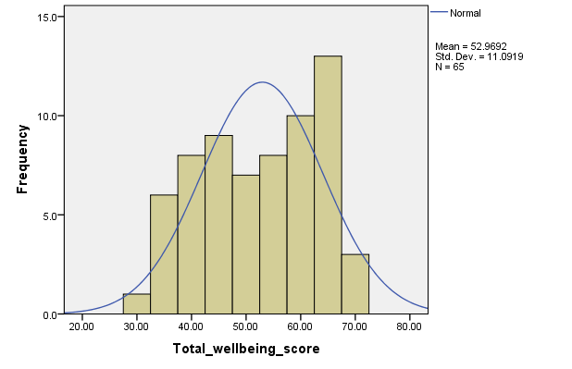
Bangla version - Distribution of WEMWBS total Scores for Rochdale

Slide 18
Bangla version of WEMWBS in Rochdale and Oldham - analysis
64 participants mean age 47 from 18 to 86 yrs
Mean WEMWBS total sore 52.96 (50.22 – 55.71)
Median WEMWBS total score 54
Cronbach’s alpha = 0.925

Slide 19
Bangla Version Item Total Correlations
 | Scale Mean if Item Deleted | Corrected Item-Total Correlation | Cronbach's Alpha if Item Deleted
I've been feeling optimistic about the future | 49.14 | .515 | .924
I've been feeling useful | 49.09 | .645 | .920
I've been feeling relaxed | 49.11 | .533 | .924
I've been feeling interested in other people | 49.58 | .669 | .920
I've had energy to spare | 49.26 | .617 | .921
I've been dealing with problems well | 49.29 | .698 | .919
I've been thinking clearly | 49.14 | .715 | .918
I've been feeling good about myself | 48.98 | .664 | .920
I've been feeling close to other people | 49.45 | .720 | .918
I've been feeling confident | 49.02 | .716 | .918
I've been able to make up my own mind about things | 49.18 | .740 | .917
I've been feeling loved | 49.25 | .648 | .920
I've been interested in new things | 49.17 | .651 | .920
I've been feeling cheerful | 48.94 | .687 | .919

Slide 20
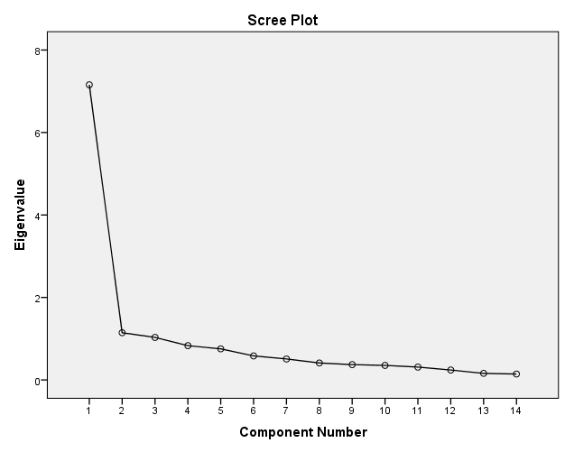
Bangla version of WEMWBS Principal component analysis

Slide 21
Principal Component Analysis
Component Matrixª
 | Component
 | 1 | 2 | 3
I've been feeling optimistic about the future | .577 | -.261 | .187
I've been feeling useful | .702 | -.067 | .433
I've been feeling relaxed | .595 | .493 | .001
I've been feeling interested in other people | .722 | -.185 | -.497
I've had energy to spare | .676 | .189 | -.337
I've been dealing with problems well | .751 | -.187 | -.064
I've been thinking clearly | .763 | .187 | -.246
I've been feeling good about myself | .718 | .427 | .218
I've been feeling close to other people | .770 | -.205 | -.189
I've been feeling confident | .766 | .323 | .076
I've been able to make up my own mind about things | .789 | -.292 | -.069
I've been feeling loved | .706 | -.050 | .520
I've been interested in new things | .701 | -.494 | .114
I've been feeling cheerful | .737 | .168 | -.069
a. 3 components extracted.

Slide 22
Summary - Bangla version
Quantitative
Responses are similar to the English version in the UK population.
Findings consistent with one underlying construct i.e. It is measuring one thing.
Qualitative
All were positive about the questionnaire and agreed that the questions are measuring mental wellbeing
Interpretation of some questions was difficult for some people while other questions were interpreted easily and consistently
Literacy was an Issue– Some individuals who spoke Bengali were not able to read or write it

Slide 23
Results – Urdu qualitative
9 focus groups in community centres
In total 113 Urdu speaking participants from Rochdale

Slide 24
Urdu Qualitative – Acceptability
"If your mind has a positive approach your body will be positive“
"It has made us more aware of wellbeing”
“On an individual basis the participants explained that mental wellbeing means good mental health and this is a good way to gauge that. "very good questions"
“Participants positive and happy. All felt it was easy and straightforward task. One participant said at first she thought it would be hard but once explained the process was simple. One participant had never completed a form before so she felt this was good experience for her and felt positive. One lady said that some Urdu words were hard to read but she understood them. One participant said she can't read Urdu but speaks it well so when statements were read out to her she answered and understood.”
"Keeping healthy physically and mentally". "Must have a sense of relaxation" "Mentally comfortable in oneself"

Slide 25
Urdu Qualitative – Literacy
“Most participants agreed with why the WEMWBS relates to mental wellbeing. Facilitators had to spend a lot of time on a 1 to1 basis with some of the participants because some were illiterate in English and Urdu. Overall happy.”
“Ok translation overall agreed by all participants. It may be worth re-examining the words chosen in Urdu as some are complex and confusing.”
"It is to ascertain people's wellbeing". Some participants understood the purpose but felt it may not achieve the objective of understanding of someone's actual mental wellbeing. A couple of participants felt that even in Urdu this format may not capture people's feelings due to inability to read or write Urdu.”

Slide 26
Urdu Qualitative – Some Negative Comments
“Overall there was a clear distinction of opinions within the group.”
"No meaning to this questionnaire.“
“There were some words in Urdu that did not reflect the English translation - those need to be amended. Other methods should be considered for individuals that cannot read or write English and Urdu.”
“What was the purpose of the "I have spare energy" in Urdu makes no sense.”

Slide 27
Comments on WEMWBS Questions in Urdu
For most questions no problems in any of the 9 focus groups
Q2 One person "does not make sense to me” All other groups fine
Q3 One person said there should be a female form
Q4 One person upset and angry about “feeling interested in other people”
Q5 7 out of 9 focus groups problem about “Energy”. “The literal translation is correct but the context is confusing.”
Q9 2 groups concerned about lack of context and meaning of “close to other people”
Q12 Three groups concerned about lack of context – other 6 fine

Slide 28
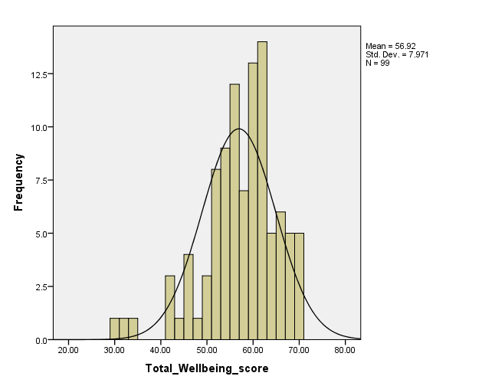
Urdu version - Distribution of WEMWBS total Scores

Slide 29
Urdu version of WEMWBS
113 participants mean age 50.16 (16 to 85yrs)
Mean WEMWBS total score 56.92 (55.33-58.5)
Cronbach’s alpha = 0.847
English population sample mean was 51.61(51.40-51.81) Health Survey for England 2011

Slide 30
Urdu version of WEMWBS Item Total Correlations
 | Scale Mean if Item Deleted | Corrected Item-Total Correlation | Cronbach's Alpha if Item Deleted
I've been feeling optimistic about the future | 52.82 | .388 | .844
I've been feeling useful | 52.88 | .490 | .837
I've been feeling relaxed | 53.02 | .470 | .839
I've been feeling interested in other people | 53.24 | .473 | .839
I've had energy to spare | 53.61 | .500 | .837
I've been dealing with problems well | 53.07 | .593 | .830
I've been thinking clearly | 52.86 | .561 | .833
I've been feeling good about myself | 52.53 | .503 | .837
I've been feeling close to other people | 52.71 | .449 | .840
I've been feeling confident | 52.62 | .568 | .833
I've been able to make up my own mind about things | 52.69 | .493 | .837
I've been feeling loved | 52.51 | .418 | .841
I've been interested in new things | 52.70 | .484 | .837
I've been feeling cheerful | 52.72 | .503 | .836

Slide 31
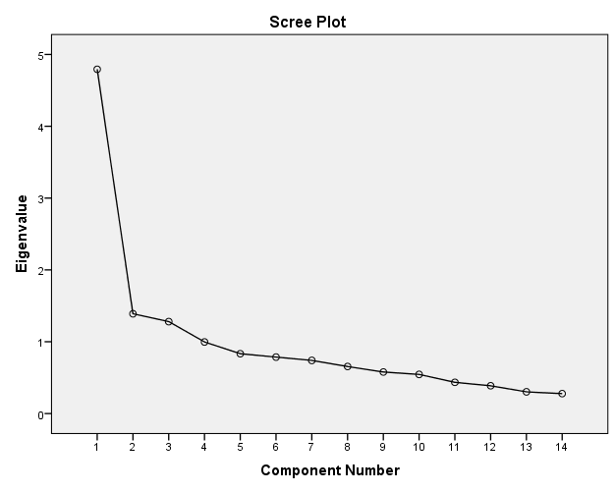
Urdu version of WEMWBS Principal component analysis

Slide 32
Urdu version of WEMWBS Principal Component analysis
Component Matrixª
 | Component
 | 1 | 2 | 3
I've been feeling optimistic about the future | .477 | .216 | -.391
I've been feeling useful | .581 | -.023 | -.496
I've been feeling relaxed | .553 | .289 | -.127
I've been feeling interested in other people | .550 | .515 | .189
I've had energy to spare | .600 | -.184 | .328
I've been dealing with problems well | .686 | -.198 | -.046
I've been thinking clearly | .657 | -.196 | -.126
I've been feeling good about myself | .608 | -.501 | -.043
I've been feeling close to other people | .529 | .320 | -.145
I've been feeling confident | .651 | .131 | -.322
I've been able to make up my own mind about things | .597 | -.233 | -.079
I've been feeling loved | .519 | -.543 | .336
I've been interested in new things | .564 | .353 | .541
I've been feeling cheerful | .585 | .194 | .408
a. 3 components extracted.

Slide 33
Summary - Urdu version
Quantitative
Responses are similar to the UK population
Findings consistent with one underlying construct – it is measuring one thing
Focus group findings
All groups were positive about the WEMWBS and were happy that it was being translated
Despite repeated cycles of translation and back translation difficulty with one question remained
Literacy was an issue – Some individuals who spoke Urdu were not able to read or write it

Slide 34
General Comments both Urdu and Bangla – Engagement
“The older generation - that would have arrived in the 1970's (or earlier) as migrant workers, perhaps illiterate in English and Bangla. These individuals found the translated WEMWBS most relevant and appropriate, even if read out to them on some occasions”
“We also found the older females tended to initially lack confidence and had less literacy skills; however once the session started and they realised the importance and significance of the study their confidence was boosted - and in fact were probably the most engaging participants.”

Slide 35
Conclusions
Methods used to translate and validate scale were effective
Translated versions were acceptable and psychometric tests confirmed validity
Both Urdu and Bangla translations of the WEMWBS are fit for purpose

Slide 36
Future plans
Urdu and Bengali versions developed in Rochdale will be published in a peer reviewed journal
Urdu and Bangla versions of the WEMWBS can be used in Rochdale and elsewhere to evaluate interventions e.g. walking programs to increase exercise and improve wellbeing
Can be RCTs or observational studies.

Slide 37
Thank you

