Slide 1
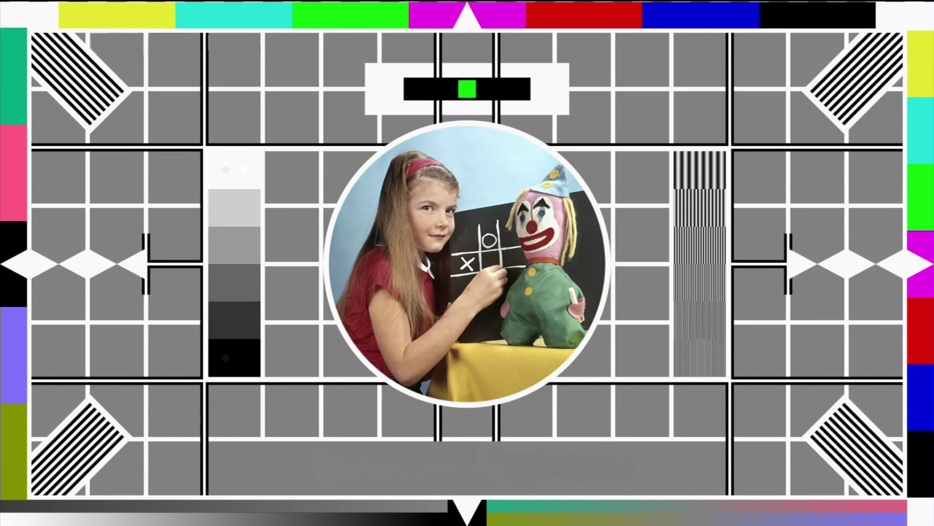
Holding slide
Take a moment to relax. We will begin shortly.

Slide 2

Creating accessible audio and video
Learning Design Consultancy Unit
Kerry Pinny – Senior Academic Technologist, Academic Technology
Cameras are optional. Raise your hand or type questions in the chat.

Slide 3
Overview
What is accessibility?
Thinking more broadly about accessibility
Regulatory requirements
Summary of requirements
Definitions
How to…

Slide 4
What is accessibility?

Slide 5
Accessibility and Universal Design for Learning
“[A]ccessibility is essential but insufficient on its own to be Universal Design for Learning. Accessibility is really captured in the first principle of UDL which is multiple representations of information and from an instructional perspective there's a whole mantra that if you can't reach them you can't teach them”
Skip Stahl. UDL on Campus

Slide 6
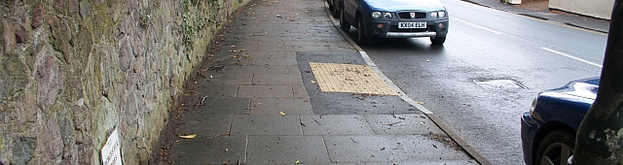
Removing barriers benefits everyone.
https://commons.wikimedia.org/wiki/File:Milestone_on_the_Worcester_Road_-_geograph.org.uk_-_1778056.jpg
Bob Embleton / Milestone on the Worcester Road

Slide 7
Our obligations
Equality Act 2010 – make reasonable adjustments
Avoid substantial disadvantage where a provision, criterion or practice puts disabled students at a substantial disadvantage.
Equality and Human Rights Commission
The Public Sector Bodies (Websites and Mobile Applications) (No. 2) Accessibility Regulations 2018.
“[Y]ou must make your website or mobile app more accessible by making it ‘perceivable, operable, understandable and robust’. You need to include and update an accessibility statement on your website.”

Slide 8
The Public Sector Bodies (Websites and Mobile Applications) Accessibility Regulations 2018 (1)
Accessible when required
Accessible by design
Reactive
Reasonable adjustments
Proactive
Accessible at publication

Slide 9
The Public Sector Bodies (Websites and Mobile Applications) Accessibility Regulations 2018 (2)
Must meet the international WCAG 2.1 AA accessibility standard
Must publish an accessibility statement for websites and apps
Designed for local government websites, for example.
As a public sector body, we are subject to it.
It is a ‘blunt’ instrument.
Does not consider the HE context or disciplinary differences.
Disproportionate burden only accepted under specific circumstances.
Government Digital Service will monitor compliance via a sample annually.
Equality and Human Rights Commission will enforce the requirement and use their legal powers against non-compliant institutions.

Slide 10
The Public Sector Bodies (Websites and Mobile Applications) Accessibility Regulations 2018 (3)
Perceivable
make sure users can recognise and use your service with the senses that are available to them.
Operable
make sure users can find and use your content, regardless of how they choose to access it
Understandable
make sure people can understand your content and how the service works.
Robust
make sure your content can be interpreted reliably by a wide variety of user agents

Slide 11
The Public Sector Bodies (Websites and Mobile Applications) Accessibility Regulations 2018 (4)
Things you might not need to fix:
pre-recorded audio and video published before 23 Sept 2020
live audio and video (information captured from a real-world event and transmitted to the receiver with no more than a broadcast delay)

Slide 12
Thinking more broadly about accessibility

Slide 13
Teaching for Learning Online
https://warwick.ac.uk/teachingforlearningonline
Section 8: Inclusive online teaching and learning
How do we ensure that the teaching materials and learning experiences that we are designing and supporting are inclusive and accessible for all students? This section explores how diversifying how, what and who we teach, working openly and collaboratively, and sharing responsibility to create safe online spaces enables all students to succeed. We also introduce Universal Design for Learning, a framework to improve and optimise teaching and learning for all based on research from the field of cognitive neuroscience.

Slide 14
Disability is not always visible
Many disabilities are unseen.
Accessibility is often focused on technical accessibility such as screen readers.
Therefore, guidance is often directed toward mobility, hearing and visual impairments.
We should consider specific learning differences (SpLDs) and neurodivergence in our design.

Slide 15
Disability is individual
Avoid assuming all disabilities impact people in the same way.
Don’t be afraid to discuss it!
Talk to your students. Find out what they need and what can help them.

Slide 16
Writing inclusively
Write in short, clear sentences and paragraphs.
Avoid using unnecessarily complex words and phrases.
Avoid colloquialisms, slang and metaphors.
Expand acronyms on first use.
Consider providing a glossary for terms readers may not know.
Stories aren’t universal.
Interests and pop culture aren’t universal either. Don’t assume everyone will ‘get it’.
Useful tool: http://www.hemingwayapp.com/

Slide 17
Structuring inclusively
Describe the structure e.g. of the Moodle space or lecture.
Make expectations clear.
Indicate what is required and optional.
Indicate when something needs to be done e.g. before lecture, after etc.
Indicate timeframes- how long ‘approximately’ should you be spending on activities.
Ensure resources are available prior to ‘live’ sessions.
Give students prior warning about activities or questions that will be asked.

Slide 18
Recording Inclusively

Slide 19


Recording inclusively (1)
Ask yourself:
Would a viewer gain the same information, if they couldn’t see or hear my content?

Slide 20
Recording inclusively (2)
Be descriptive!
Speak clearly and slowly.
Give people time to process information.
Ensure your audio is high quality.
Background sounds (like music) should be at least 20 decibels lower than foreground speech.
Avoid flashing content or ensure you warn viewers.
Avoid content at the bottom of the screen.
If you can, be visible on screen and consider where you are placed.

Slide 21
Recording inclusively (3)
We also need to think about our content and supporting visuals.
Ensure fonts, visuals and graphics have sufficient contrast against the background.
Where use graphs or tables etc. are used as part of the presentation, ensure you are describing it for viewers.
Where links to additional content are used, provide them elsewhere or read them out (in a shortened format) for people to follow.

Slide 22
Accessible Live Events

Slide 23
Live events basics
Many features are in the control of the participant.
Live captions. Speak clearly.
Pin a meeting participants video.
Add interpreters or note takers to a call.
Use do not disturb to reduce distractions.
Use the Dark, light or high contrast theme.
Be clear about etiquette, expectations and the structure of the session.
Provide content ahead of the session e.g. slides and activities.
Where links are shared in the chat, be clear whether that needs to viewed now or later.
Are the activities you are using accessible? Padlet and Miro are not fully accessible. Vevox has good accessibility.
What alternatives or mitigations can you put in place to ensure everyone can participate fully?
Encourage participants to turn cameras on when speaking.
Record the session.
Learn more about Teams accessibility: Accessibility overview of Microsoft Teams.

Slide 24
Regulatory Requirements

Slide 25
1.2.1 Audio or video only (Prerecorded) (Level A)
Content that contains audio only (e.g. a podcast) or video only (e.g. photo slideshow).
Prerecorded Audio-only
An alternative for time-based media is provided that presents equivalent information for prerecorded audio-only content.
Prerecorded Video-only
Either an alternative for time-based media or an audio track is provided that presents equivalent information for prerecorded video-only content.

Slide 26
1.2.2 Captions (Prerecorded) (Level A)
An alternative for time-based media or audio description of the prerecorded video content is provided for synchronized media, except when the media is a media alternative for text and is clearly labeled as such

Slide 27
1.2.5 Audio Description (Prerecorded) (Level AA)
Audio description is provided for all prerecorded video content in synchronized media.

Slide 28
Summary of requirements

Slide 29
Video and Audio Accessibility for Teaching
Must have | Transcript
Best endeavours to have | Captions (subtitles)
For more information relating to teaching, see Video and Audio Accessibility for teaching.

Slide 30
Definitions

Slide 31
“alternative for time-based media” aka transcripts
document including correctly sequenced text descriptions of time-based visual and auditory information and providing a means for achieving the outcomes of any time-based interaction
NOTE
A screenplay used to create the synchronized media content would meet this definition only if it was corrected to accurately represent the final synchronized media after editing.
Alternative for time-based media full definition

Slide 32
Captions (1)
synchronized visual and/or text alternative for both speech and non-speech audio information needed to understand the media content
NOTE
Captions are similar to dialogue-only subtitles except captions convey not only the content of spoken dialogue, but also equivalents for non-dialogue audio information needed to understand the program content, including sound effects, music, laughter, speaker identification and location.

Slide 33
Captions (2)
Closed Captions are equivalents that can be turned on and off with some players.
Open Captions are any captions that cannot be turned off. For example, if the captions are visual equivalent images of text embedded in video.
In some countries, captions are called subtitles.
Captions full definition

Slide 34
Captions (3)
There is a failure of success criteria 1.2.2
"If the "caption" does not include all of the dialogue (either verbatim or in essence) as well as all important sounds then the 'Captions' are not real captions."
"automatically-generated captions do not meet user needs or accessibility requirements, unless they are confirmed to be fully accurate. Usually they need significant editing.“
Jisc Video captioning and accessibility regulations

Slide 35
“audio description”
narration added to the soundtrack to describe important visual details that cannot be understood from the main soundtrack alone
NOTE
Audio description of video provides information about actions, characters, scene changes, on-screen text, and other visual content
Audio description full definition

Slide 36
How to…

Slide 37
Automated transcription tools
Echo360
In-room lecture capture
Universal Capture (screen recording)
Direct upload
Integrated with Moodle
Transcripts can be displayed as captions
Amazon Speech Recognition
Microsoft Stream
Teams recordings
Screen recording (15 mins)
Direct upload
Link/embed
Transcripts are displayed as captions
Microsoft Azure Speech-to-Text
eStream does not have automated captions/transcripts. However, captions can be uploaded.
Guide: Uploading a closed caption file to eStream.

Slide 38

Echo360
All videos, regardless of recording mechanism, uploaded, to Echo360 will have a transcript automatically generated.
Transcripts can be edited in Echo360.
Guide: Echo360 Automated Transcripts and Closed Captions
Guide: Echo360 workflow

Slide 39
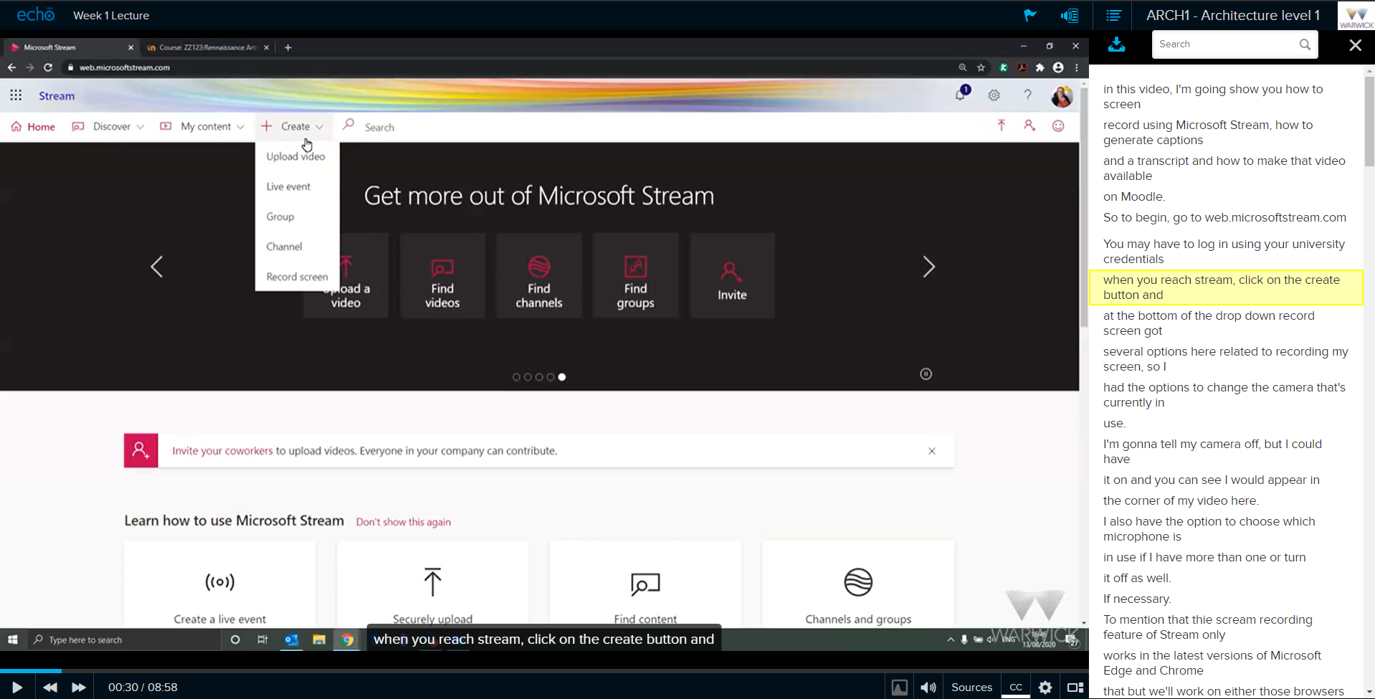
Echo360 Student View
The transcript panel once enabled, will move as the video plays and highlight the text as it’s spoken.
Captions, where available can be turned on at the bottom of the player.

Slide 40
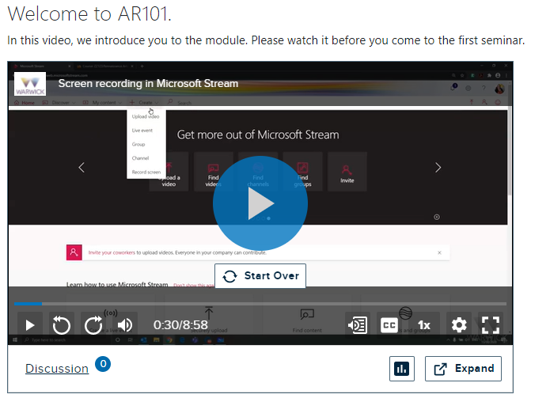
Echo360 Embedded View
In the embedded view, for example on a Moodle space, the player offers captions or the transcript.
Clicking on the transcript button will take the viewer to a view that shows the transcript next to the video.

Slide 41
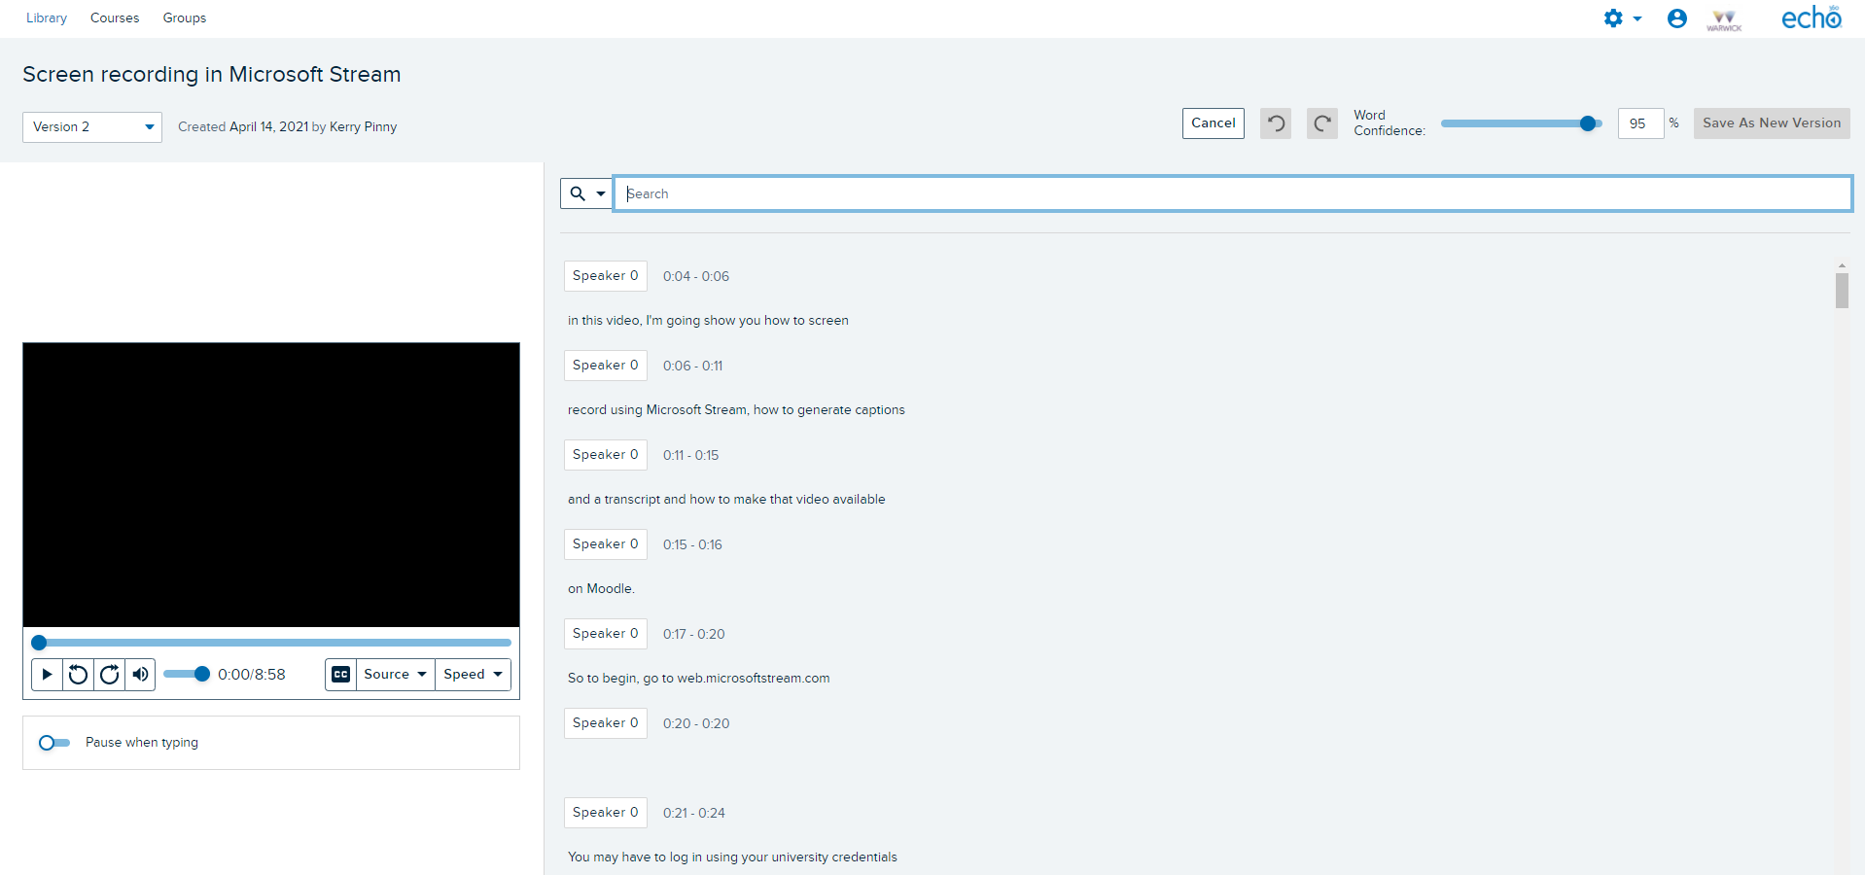
Echo360 Editing the transcript
Edited transcripts are saved as new versions.
Word confidence is displayed to show how confident the software was with its interpretation.

Slide 42
Microsoft Stream
Microsoft Stream captions can be requested. A transcript is also generated.
Guide: Generate automatic captions and a transcript for your Microsoft Stream videos
Guide: Use Microsoft Stream to create, stream and caption video
Guide: Microsoft Stream Workflow

Slide 43
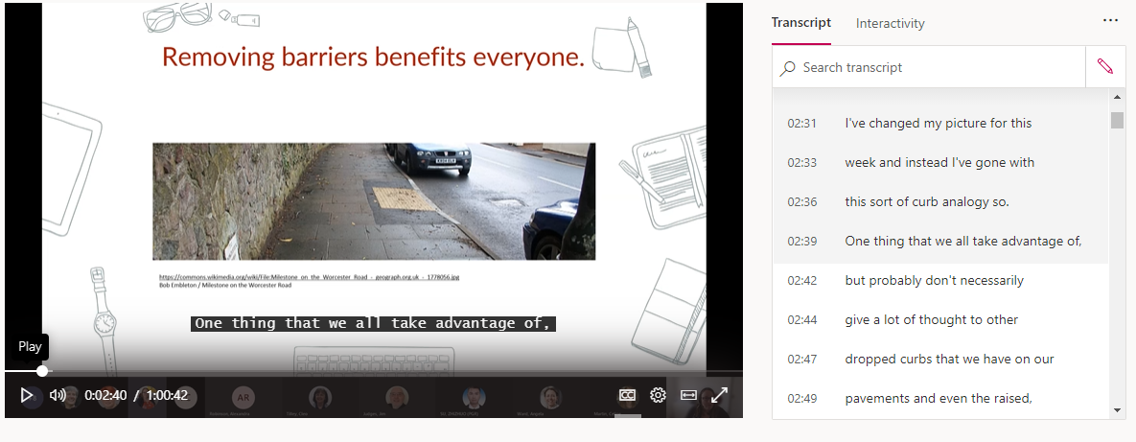
Microsoft Stream Student View
The transcript panel is displayed next to the video and moves with the speech. The captions are enabled from the bottom of the player.

Slide 44
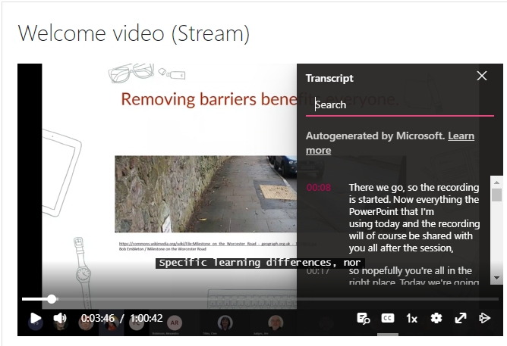
Microsoft Stream Embedded View
In the embedded view, for example on a Moodle space, the player offers captions or the transcript at the bottom of the player.

Slide 45
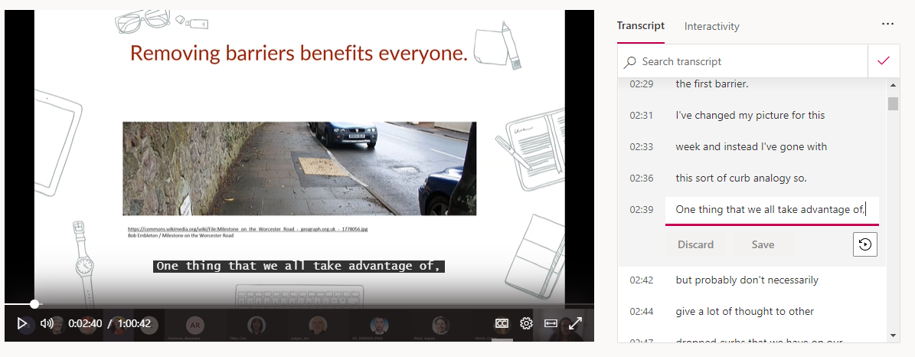
Microsoft Stream Editing the Transcript
The transcript can be edited in the transcript panel by clicking on the Edit Transcript pencil icon. Each sentenced can be edited and saved.
The transcript will auto scroll with the speech but that can be disabled under the … More actions menu.

Slide 46
Help and Support

Slide 47
Digital Accessibility Network
The Digital Accessibility Network (DAN) has been set up to create a supportive space to focus on accessibility given the increased use of digital platforms and the regulatory changes.
DAN is open to all Warwick staff with an interest in accessibility and those responsible for digital platforms and content. The team is a space for the network to share practice, resources and ideas, to seek advice and discuss the opportunities and challenges.
Click here to join the DAN Team

Slide 48
Upcoming LDCU Workshops
Tuesday 27th April 12-13:00 Creating accessible Moodle spaces
Full details and booking on https://warwick.ac.uk/ldcuevents

Slide 49
Links to resources and guidance (1)
Accessibility Statement for Warwick Website
Accessibility Statement for Moodle VLE
University of Warwick General Guidance
Microsoft Office: Make your content accessible to everyone
Create accessible PDFs with PowerPDF
A guide to writing accessible emails
Create accessible web pages using Sitebuilder
Creating accessible Moodle spaces: all guides
Accessible video and audio (general)
Video and Audio Accessibility for Teaching
Accessibility support for Microsoft Teams
H5P content type accessibility
Windows 10 Accessibility Features
An inclusive, accessible Microsoft 365
Apple support accessibility channel
Creating accessible mathematical content 09/03/2021
Creating accessible online teaching materials and activities 10/03/2021

Slide 50
Links to resources and guidance (2)
Creating accessible online teaching materials and activities 10/03/2021
Creating accessible PDFs 18/03/2021
Unseen disability and teaching: the student experience 30/03/2021
Accessibility Learning Webinar Series: Present More Inclusively with PowerPoint
Creating accessible PowerPoint presentations
Podcast Accessibility

Slide 51
Resources shared during sessions
Equality, Diversity and Inclusion list of Warwick acronyms
Office for National Statistics guidance on bullet points
Writing for dyslexic readers
The A11Y project
6 surprising bad practices that hurt dyslexic users
Image descriptions on Twitter – a quick guide

