Slide 1
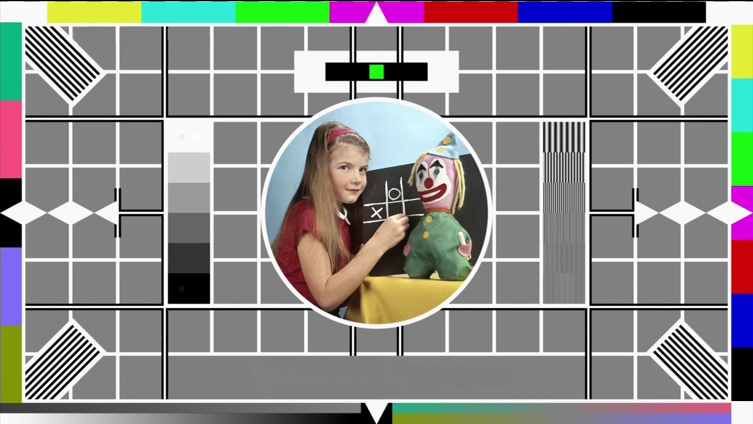
Holding slide
Take a moment to relax. We will begin shortly.

Slide 2

Creating accessible Moodle spaces
Learning Design Consultancy Unit
Kerry Pinny – Senior Academic Technologist, Academic Technology
Cameras are optional. Raise your hand or type questions in the chat.

Slide 3
Overview
What is accessibility?
Thinking more broadly about accessibility
Moodle accessibility tools
Structuring inclusively
Course formats
Fonts, colours, heading styles, hyperlinks, audio and video and H5P
Mathematical content

Slide 4
What is accessibility?

Slide 5
Accessibility and Universal Design for Learning
“[A]ccessibility is essential but insufficient on its own to be Universal Design for Learning. Accessibility is really captured in the first principle of UDL which is multiple representations of information and from an instructional perspective there's a whole mantra that if you can't reach them you can't teach them”
Skip Stahl. UDL on Campus

Slide 6
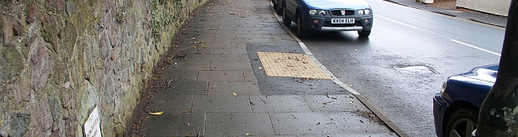
Removing barriers benefits everyone.
https://commons.wikimedia.org/wiki/File:Milestone_on_the_Worcester_Road_-_geograph.org.uk_-_1778056.jpg
Bob Embleton / Milestone on the Worcester Road

Slide 7
Our obligations
Equality Act 2010 – make reasonable adjustments
Avoid substantial disadvantage where a provision, criterion or practice puts disabled students at a substantial disadvantage.
Equality and Human Rights Commission
The Public Sector Bodies (Websites and Mobile Applications) (No. 2) Accessibility Regulations 2018.
“[Y]ou must make your website or mobile app more accessible by making it ‘perceivable, operable, understandable and robust’. You need to include and update an accessibility statement on your website.”

Slide 8
The Public Sector Bodies (Websites and Mobile Applications) Accessibility Regulations 2018 (1)
Accessible when required
Accessible by design
Reactive
Reasonable adjustments
Proactive
Accessible at publication

Slide 9
The Public Sector Bodies (Websites and Mobile Applications) Accessibility Regulations 2018 (2)
Must meet the international WCAG 2.1 AA accessibility standard
Must publish an accessibility statement for websites and apps
Designed for local government websites, for example.
As a public sector body, we are subject to it.
It is a ‘blunt’ instrument.
Does not consider the HE context or disciplinary differences.
Disproportionate burden only accepted under specific circumstances.
Government Digital Service will monitor compliance via a sample annually.
Equality and Human Rights Commission will enforce the requirement and use their legal powers against non-compliant institutions.

Slide 10
The Public Sector Bodies (Websites and Mobile Applications) Accessibility Regulations 2018 (3)
Perceivable
make sure users can recognise and use your service with the senses that are available to them.
Operable
make sure users can find and use your content, regardless of how they choose to access it
Understandable
make sure people can understand your content and how the service works.
Robust
make sure your content can be interpreted reliably by a wide variety of user agents

Slide 11
Thinking more broadly about accessibility

Slide 12
Teaching for Learning Online
https://warwick.ac.uk/teachingforlearningonline
Section 8: Inclusive online teaching and learning
How do we ensure that the teaching materials and learning experiences that we are designing and supporting are inclusive and accessible for all students? This section explores how diversifying how, what and who we teach, working openly and collaboratively, and sharing responsibility to create safe online spaces enables all students to succeed. We also introduce Universal Design for Learning, a framework to improve and optimise teaching and learning for all based on research from the field of cognitive neuroscience.

Slide 13
Disability is not always visible
Many disabilities are unseen.
Accessibility is often focused on technical accessibility such as screen readers.
Therefore, guidance is often directed toward mobility, hearing and visual impairments.
We should consider specific learning differences (SpLDs) and neurodivergence in our design.

Slide 14
Disability is individual
Avoid assuming all disabilities impact people in the same way.
Don’t be afraid to discuss it!
Talk to your students. Find out what they need and what can help them.

Slide 15
Accessible Moodle Spaces

Slide 16
What is within your control?
What you can control
The way you use Moodle and the content you create.
What you can influence
The platform. By raising issues, suggestions and your requirements.
Everything else.
Making technical changes to the platform.

Slide 17
Moodle WCAG compliance
July 2021 Moodle will be upgraded to 3.10.
3.10 is WCAG 2.1 A and AA compliant.
Like all platforms, it is only as accessible as the content you place on it.

Slide 18


Moodle accessibility tools
Moodle Accessibility Checker checks for common accessibility errors in text which could prevent all users from accessing information or functionality equally.
Screenreader Helper provides additional information about the currently selected text (e.g. is it bold), as well as a listing any images or links in the text. The image below show's the Screenreader helper identifying the style, links and images present in the text.

Slide 19
Structuring inclusively
Be consistent.
Describe the structure of the Moodle space e.g. weekly, by topic etc.
Indicate what is required and optional.
Indicate when something needs to be done e.g. before lecture, after etc.
Indicate timeframes- how long ‘approximately’ should you be spending on activities.
Ensure resources are available prior to ‘live’ sessions.

Slide 20
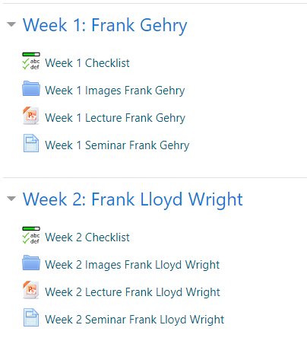
Naming conventions
Names should be short and meaningful.
Be consistent.
Files downloaded from Moodle need descriptive file names i.e., Word, PowerPoint etc.

Slide 21
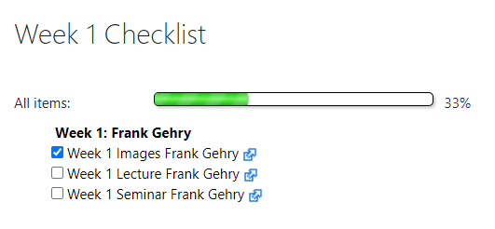
Checklists
Moodle Checklists help students keep track of their work.
Checklists are another way for you to see which students are engaging in your activities.
Guide: Moodle Checklist

Slide 22
Releasing materials with restrict access
If you are concerned about releasing content too early, use Restrict access to release materials at a time of your choosing.
Be clear about when you will release your materials and be consistent.
Guide: Restrict access to sections and activities

Slide 23
Course formats
Topics format (best)
Weekly
Collapsible
Grid
Guide: Accessible course formats

Slide 24
Writing inclusively
Write in short, clear sentences and paragraphs.
Avoid using unnecessarily complex words and phrases.
Avoid colloquialisms, slang and metaphors.
Expand acronyms on first use.
Consider providing a glossary for terms readers may not know.
Stories aren’t universal.
Interests and pop culture aren’t universal either. Don’t assume everyone will ‘get it’.
Useful tool: http://www.hemingwayapp.com/

Slide 25
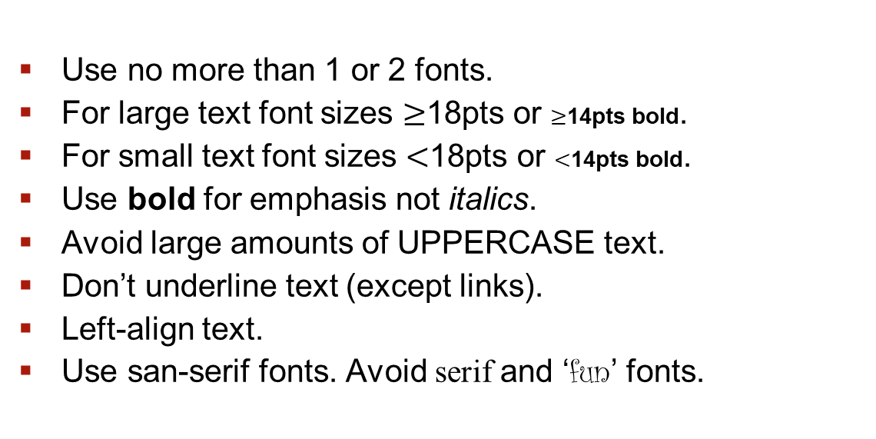
Fonts
Use no more than 1 or 2 fonts.
For large text font sizes $≥$18pts or $≥$14pts bold.
For small text font sizes $<$18pts or $<$14pts bold.
Use bold for emphasis not italics.
Avoid large amounts of UPPERCASE text.
Don’t underline text (except links).
Left-align text.
Use san-serif fonts. Avoid serif and ‘fun’ fonts.

Slide 26
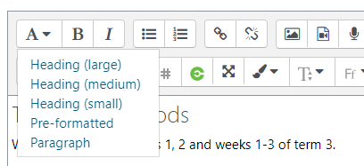
Heading styles
Use Heading styles in the text editor to structure your content.
This will add the heading hierarchy in html to the content e.g. H1, H2, H3.
Guide: Edit content boxes using the editing toolbar

Slide 27
Use of colour and contrast
Ensure sufficient contrast between the background and text.
Contrast ratio 4:5:1 for small text. 3:1 for large text.
Avoid using colour as the only means of understanding.
3:1 contrast ratio needed for any graphics/icons too.
Useful tool: WebAIM colour contrast checker

Slide 28
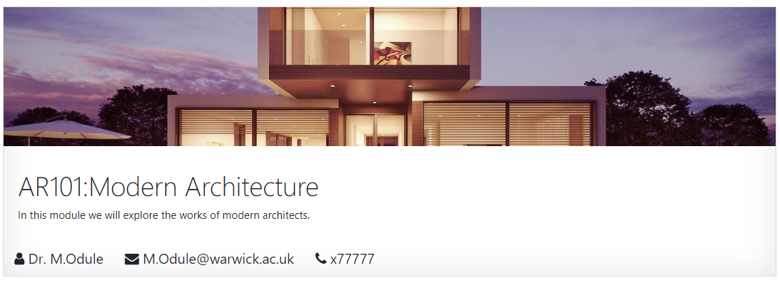
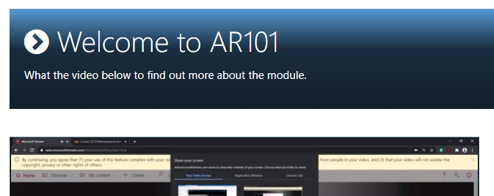
Styling your space with Templates4U
Ready to use templates and style elements.
Designed to be accessible.
Can be added to any ‘text’ area.

Slide 29
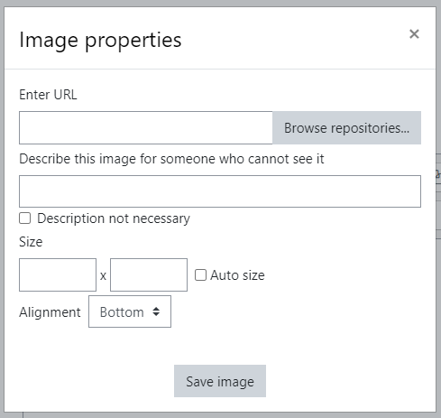
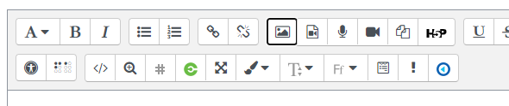
Images
Enter alt-text for images, graphs or any other important visuals. Be descriptive and specific.
Where an image is purely decorative, mark it as decorative.
Avoid using images with text ‘embedded’.

Slide 30


Hyperlink Text
Unique.
Meaningful when read out of context i.e. does the link make sense if the surrounding text is missing?
Shorten URLs, e.g. via bit.ly, if navigating during the presentation.
Avoid: For more information about meaningful hyperlink text, click here.
Meaningful: For more information, see meaningful hyperlink text.
Guide: Using meaningful link text

Slide 31
Video and Audio
Include a transcript or captions for all video and audio content at minimum.
If you use a third-party video, e.g. from YouTube, check it has captions available. If not, avoid using it. Also, include a direct link to the video on the slide.
Use Microsoft Stream or Echo360 to host your video.
Guide: Use Microsoft Stream to create, stream and caption video
Guide: Echo360 Automated Transcripts and Closed Captions

Slide 32
Moodle Quizzes
Consider whether a content type is suitable even if it’s accessible. Drag and drop would be difficult for those with visual or physical impairments.
Images, videos and text in the questions need to be accessible.
Students can be given more time or attempts using overrides.
Always think of an alternative.
Guide: Question types

Slide 33
H5P
H5P has accessible content types listed on their website.
Popular types: Course Presentation, Interactive Video.
Consider whether a content type is suitable even if it’s accessible. Drag and drop would be difficult for those with visual or physical impairments.
Authors still need to be vigilant that their content is accessible by being vigilant for issues such as colour contrast etc.
Always think of an alternative.
Guide: Recommendations and overviews of content types.

Slide 34
Mathematical Content
Creating accessible mathematical content by Dr Martyn Parker
MathJax and TeX filters (LaTeX)

Slide 35
Help and Support

Slide 36
Digital Accessibility Network
The Digital Accessibility Network (DAN) has been set up to create a supportive space to focus on accessibility given the increased use of digital platforms and the regulatory changes.
DAN is open to all Warwick staff with an interest in accessibility and those responsible for digital platforms and content. The team is a space for the network to share practice, resources and ideas, to seek advice and discuss the opportunities and challenges.
Click here to join the DAN Team

Slide 37
Upcoming LDCU Workshops
Open discussion Thursday 29th April
TEALfest 10-14th May
Full details and booking on https://warwick.ac.uk/ldcuevents

Slide 38
Links to resources and guidance (1)
Accessibility Statement for Warwick Website
Accessibility Statement for Moodle VLE
University of Warwick General Guidance
Microsoft Office: Make your content accessible to everyone
Create accessible PDFs with PowerPDF
A guide to writing accessible emails
Create accessible web pages using Sitebuilder
Creating accessible Moodle spaces: all guides
Accessible video and audio (general)
Video and Audio Accessibility for Teaching
Accessibility support for Microsoft Teams
H5P content type accessibility
Windows 10 Accessibility Features
An inclusive, accessible Microsoft 365
Apple support accessibility channel
Creating accessible mathematical content 09/03/2021
Creating accessible online teaching materials and activities 10/03/2021

Slide 39
Links to resources and guidance (2)
Creating accessible online teaching materials and activities 10/03/2021
Creating accessible PDFs 18/03/2021
Unseen disability and teaching: the student experience 30/03/2021
Accessibility Learning Webinar Series: Present More Inclusively with PowerPoint
Creating accessible PowerPoint presentations
Podcast Accessibility
Creating accessible audio and video

Slide 40
Resources shared during sessions
Equality, Diversity and Inclusion list of Warwick acronyms
Office for National Statistics guidance on bullet points
Writing for dyslexic readers
The A11Y project
6 surprising bad practices that hurt dyslexic users
Image descriptions on Twitter – a quick guide

