Slide 1
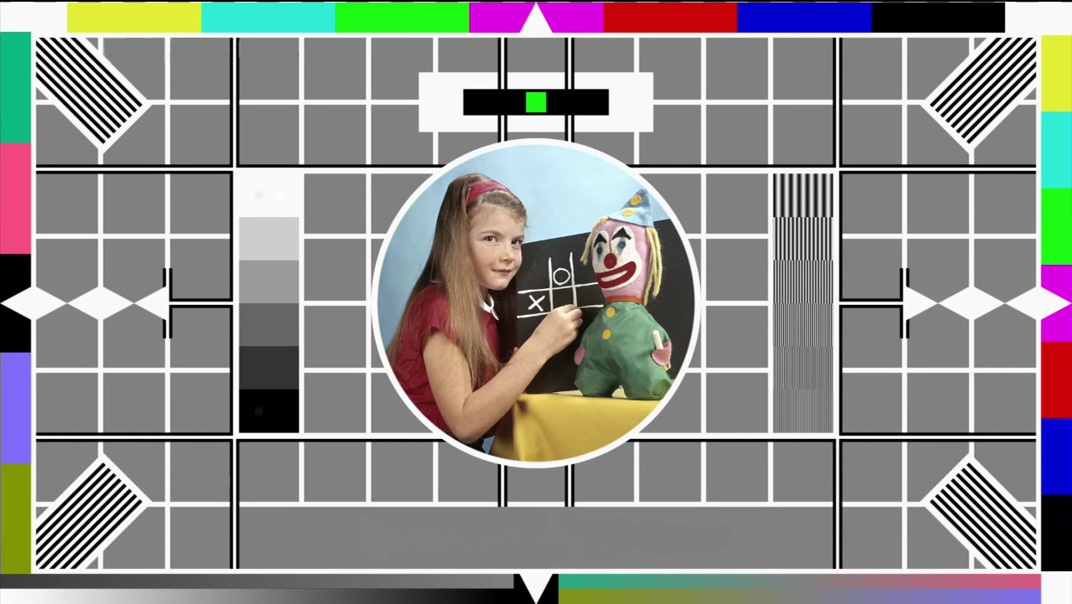
Holding slide
Take a moment to relax. We will begin shortly.

Slide 2

Creating accessible PowerPoints
Learning Design Consultancy Unit
Kerry Pinny – Senior Academic Technologist, Academic Technology
Cameras are optional. Raise your hand or type questions in the chat.

Slide 3
Overview
What is accessibility?
Where’s inaccessibility?
Thinking about presenting
Feature availability.
The Accessibility Checker.
Fonts, colour, contrast, images, visuals, links, audio and video

Slide 4
What is accessibility?

Slide 5
Accessibility and Universal Design for Learning
“[A]ccessibility is essential but insufficient on its own to be Universal Design for Learning. Accessibility is really captured in the first principle of UDL which is multiple representations of information and from an instructional perspective there's a whole mantra that if you can't reach them you can't teach them”
Skip Stahl. UDL on Campus

Slide 6
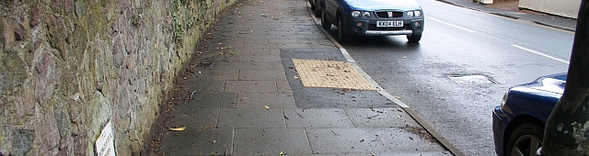
Removing barriers benefits everyone.
https://commons.wikimedia.org/wiki/File:Milestone_on_the_Worcester_Road_-_geograph.org.uk_-_1778056.jpg
Bob Embleton / Milestone on the Worcester Road

Slide 7
Our obligations
Equality Act 2010 – make reasonable adjustments
Avoid substantial disadvantage where a provision, criterion or practice puts disabled students at a substantial disadvantage.
Equality and Human Rights Commission
The Public Sector Bodies (Websites and Mobile Applications) (No. 2) Accessibility Regulations 2018.
“[Y]ou must make your website or mobile app more accessible by making it ‘perceivable, operable, understandable and robust’. You need to include and update an accessibility statement on your website.”

Slide 8
The Public Sector Bodies (Websites and Mobile Applications) Accessibility Regulations 2018
Accessible when required
Accessible by design
Reactive
Reasonable adjustments
Proactive
Accessible at publication

Slide 9
The Public Sector Bodies (Websites and Mobile Applications) Accessibility Regulations 2018 (2)
Must meet the international WCAG 2.1 AA accessibility standard
Must publish an accessibility statement for websites and apps
Designed for local government websites, for example.
As a public sector body, we are subject to it.
It is a ‘blunt’ instrument.
Does not consider the HE context or disciplinary differences.
Disproportionate burden only accepted under specific circumstances.
Government Digital Service will monitor compliance via a sample annually.
Equality and Human Rights Commission will enforce the requirement and use their legal powers against non-compliant institutions.

Slide 10
The Public Sector Bodies (Websites and Mobile Applications) Accessibility Regulations 2018 (3)
Perceivable
make sure users can recognise and use your service with the senses that are available to them.
Operable
make sure users can find and use your content, regardless of how they choose to access it
Understandable
make sure people can understand your content and how the service works.
Robust
make sure your content can be interpreted reliably by a wide variety of user agents

Slide 11
Thinking more broadly about accessibility

Slide 12
Teaching for Learning Online
https://warwick.ac.uk/teachingforlearningonline
Section 8: Inclusive online teaching and learning
How do we ensure that the teaching materials and learning experiences that we are designing and supporting are inclusive and accessible for all students? This section explores how diversifying how, what and who we teach, working openly and collaboratively, and sharing responsibility to create safe online spaces enables all students to succeed. We also introduce Universal Design for Learning, a framework to improve and optimise teaching and learning for all based on research from the field of cognitive neuroscience.

Slide 13
Disability is not always visible
Many disabilities are unseen.
Accessibility is often focused on technical accessibility such as screen readers.
Therefore, guidance is often directed toward mobility, hearing and visual impairments.
We should consider specific learning differences (SpLDs) and neurodivergence in our design.

Slide 14
Disability is individual
Avoid assuming all disabilities impact people in the same way.
Don’t be afraid to discuss it!
Talk to your students. Find out what they need and what can help them.

Slide 15
Writing inclusively
Write in short, clear sentences and paragraphs.
Avoid using unnecessarily complex words and phrases.
Avoid colloquialisms, slang and metaphors.
Expand acronyms on first use.
Consider providing a glossary for terms readers may not know.
Stories aren’t universal.
Interests and pop culture aren’t universal either. Don’t assume everyone will ‘get it’.
Useful tool: http://www.hemingwayapp.com/

Slide 16
Structuring inclusively
Describe the structure e.g. of the Moodle space or lecture.
Make expectations clear.
Indicate what is required and optional.
Indicate when something needs to be done e.g. before lecture, after etc.
Indicate timeframes- how long ‘approximately’ should you be spending on activities.
Ensure resources are available prior to ‘live’ sessions.
Give students prior warning about activities or questions that will be asked.

Slide 17
Presenting inclusively
Provide your slides to the audience in advance.
Present as though the audience can’t see the slides.
Say everything (important) on the slides.
Turn on live captions.
Think about your activities.
Give people time to read your content.
Avoid transitions and animations.
Keep slide content to a minimum. Add detail in the speaker notes or additional documents.
Avoid content at the bottom of the screen.

Slide 18

‘Where’s inaccessibility’ exercise
WHERE’S
INACCESSIBILITY
This Photo by Unknown Author is licensed under CC BY-SA

Slide 19
Accessible PowerPoints

Slide 20
Feature Availability
Feature | Windows | Mac | Online | iOS | Android
Accessibility Checker | Yes | Yes | Yes
Alt text | Yes | Yes | Yes | Yes | Yes
Automatic alt text for pictures | Yes
Reading order pane
Slide title commands | Yes
Designer | Yes
Presenter Coach |  |  | Yes
In-band closed captions playback | Yes | Yes | Yes | Yes | Yes
Out-of-band closed captions insertion and playback | Yes
Live captions and subtitles | Yes | Yes | Yes
Presenter view keyboard shortcut – screen reader reads notes | Yes

Slide 21
PowerPoint Accessibility Checker
Checks for a lot of common issues
Presence of alt-text
Table header and header rows
Images and objects are inline with text
Checks for document permission restrictions
Can’t check for everything!

Slide 22
Slide Titles
Slide titles aid navigation and identification of slides.
The accessibility checker will check that each slide has a title and flag to you where they are missing.
Slide titles can be ‘hidden’ off slide.
Guide: Title a slide

Slide 23
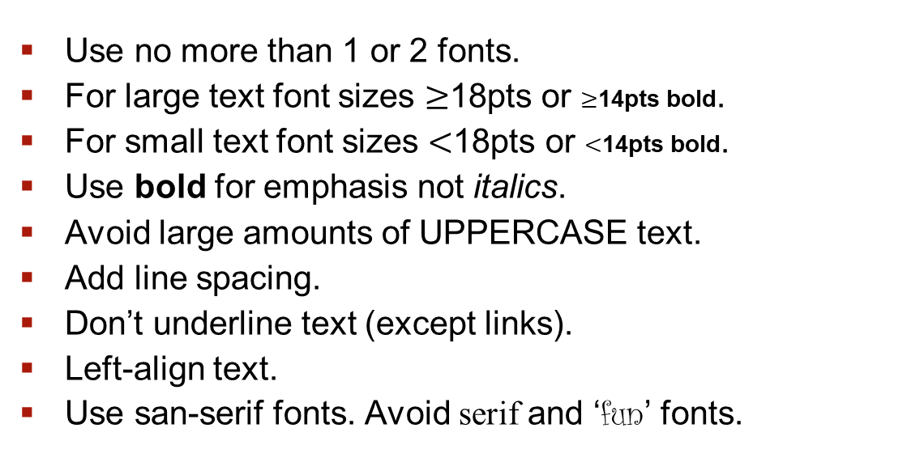
Fonts
Use no more than 1 or 2 fonts.
For large text font sizes $≥$18pts or $≥$14pts bold.
For small text font sizes $<$18pts or $<$14pts bold.
Use bold for emphasis not italics.
Avoid large amounts of UPPERCASE text.
Add line spacing.
Don’t underline text (except links).
Left-align text.
Use san-serif fonts. Avoid serif and ‘fun’ fonts.

Slide 24
Use of colour and contrast
Ensure sufficient contrast between the background and text.
Contrast ratio 4:5:1 for small text. 3:1 for large text.
Avoid using colour as the only means of understanding.
Useful tool: WebAIM colour contrast checker

Slide 25
Use of colour and contrast (2)
Add markers to a graph to differentiate lines in the key.
3:1 contrast ratio needed for any graphics/icons too.
The contrast checker can pick up on text contrast issues in text boxes, shapes, tables and smart art. Including highlight and links.

Slide 26
Use of colour and contrast (3)
The Accessibility Checker does not detect:
Transparency,
Non-solid fills,
Graphics,
Text in charts,
Text across multiple objects.

Slide 27
Images and visuals (1)
Enter alt-text for images, graphs or any other important visuals. Be descriptive and specific.
Where an image is purely decorative, mark it as decorative.
Avoid using images with text ‘embedded’.
Avoid looping GIFs.

Slide 28
Images and visuals (2)
For complex visuals, such as graphs and charts, where the content needs to be described to be understood:
Describe the pertinent information i.e. graph shows visits to website grew in first quarter but fell in second.
Provide a description in the surrounding text.
Provide a longer description as an appendix/footnote to the document.
Guide: Alt-text long descriptions

Slide 29


Hyperlink Text
Unique.
Meaningful when read out of context i.e. does the link make sense if the surrounding text is missing?
Shorten URLs, e.g. via bit.ly, if navigating during the presentation.
Avoid: For more information about meaningful hyperlink text, click here.
Meaningful: For more information, see meaningful hyperlink text.
Guide: Add a hyperlink to a slide

Slide 30
Video and Audio
Include captions for all video and audio content at minimum.
If you use a third-party video, e.g. from YouTube, check it has captions available. If not, avoid using it. Also, include a direct link to the video on the slide.
Audio description may also be necessary depending on the content.
Guide: Add closed captions or subtitles to media in PowerPoint.

Slide 31
Reading Order
The reading order of a slide, determines the order in which content on your slides is read by a screen reader.
The Accessibility Checker will check the reading order and alert you when it detects a problem.
Guide: Make slides easier to read by using the Reading Order pane

Slide 32
Presenter Coach
Available in PowerPoint 365 Online only.
“Presenter Coach evaluates your pacing, pitch, your use of filler words, informal speech, euphemisms, and culturally sensitive terms, and it detects when you're being overly wordy or are simply reading the text on a slide.
After each rehearsal, you get a report that includes statistics and suggestions for improvements.”

Slide 33
Help and Support

Slide 34
Digital Accessibility Network
The Digital Accessibility Network (DAN) has been set up to create a supportive space to focus on accessibility given the increased use of digital platforms and the regulatory changes.
DAN is open to all Warwick staff with an interest in accessibility and those responsible for digital platforms and content. The team is a space for the network to share practice, resources and ideas, to seek advice and discuss the opportunities and challenges.
Click here to join the DAN Team

Slide 35
Upcoming LDCU Workshops
Tuesday 30th March 14-15:30 Unseen disability and teaching: the student experience
Wednesday 31st March 12-13:00 Creating accessible PowerPoint presentations
Thursday 15th April 12-13:00 Creating accessible audio and video
Tuesday 27th April 12-13:00 Creating accessible Moodle spaces
Full details and booking on https://warwick.ac.uk/ldcuevents

Slide 36
Links to resources and guidance (1)
Accessibility Statement for Warwick Website
Accessibility Statement for Moodle VLE
University of Warwick General Guidance
Microsoft Office: Make your content accessible to everyone
Create accessible PDFs with PowerPDF
A guide to writing accessible emails
Create accessible web pages using Sitebuilder
Creating accessible Moodle spaces: all guides
Accessible video and audio (general)
Video and Audio Accessibility for Teaching
Accessibility support for Microsoft Teams
H5P content type accessibility
Windows 10 Accessibility Features
An inclusive, accessible Microsoft 365
Apple support accessibility channel
Creating accessible mathematical content 09/03/2021
Creating accessible online teaching materials and activities 10/03/2021

Slide 37
Links to resources and guidance (2)
Creating accessible online teaching materials and activities 10/03/2021
Creating accessible PDFs 18/03/2021
Unseen disability and teaching: the student experience 30/03/2021
Accessibility Learning Webinar Series: Present More Inclusively with PowerPoint

Slide 38
Resources shared during sessions
Equality, Diversity and Inclusion list of Warwick acronyms
Office for National Statistics guidance on bullet points
Writing for dyslexic readers
The A11Y project
6 surprising bad practices that hurt dyslexic users
Image descriptions on Twitter – a quick guide

