Slide 1

Creating accessible online teaching materials and activities
09/03/2021
Kerry Pinny – Senior Academic Technologist, Academic Technology
Cameras are optional. Raise your hand or type questions in the chat.

Slide 2
Overview
Our regulatory obligations
Written content and presentations
Multimedia
Interactive media
Creating accessible ‘live events’

Slide 3
What is accessibility?

Slide 4
Teaching for Learning Online
https://warwick.ac.uk/teachingforlearningonline
Section 8: Inclusive online teaching and learning
How do we ensure that the teaching materials and learning experiences that we are designing and supporting are inclusive and accessible for all students? This section explores how diversifying how, what and who we teach, working openly and collaboratively, and sharing responsibility to create safe online spaces enables all students to succeed. We also introduce Universal Design for Learning, a framework to improve and optimise teaching and learning for all based on research from the field of cognitive neuroscience.

Slide 5
Accessibility and Universal Design for Learning
“[A]ccessibility is essential but insufficient on its own to be Universal Design for Learning. Accessibility is really captured in the first principle of UDL which is multiple representations of information and from an instructional perspective there's a whole mantra that if you can't reach them you can't teach them”
Skip Stahl. UDL on Campus

Slide 6
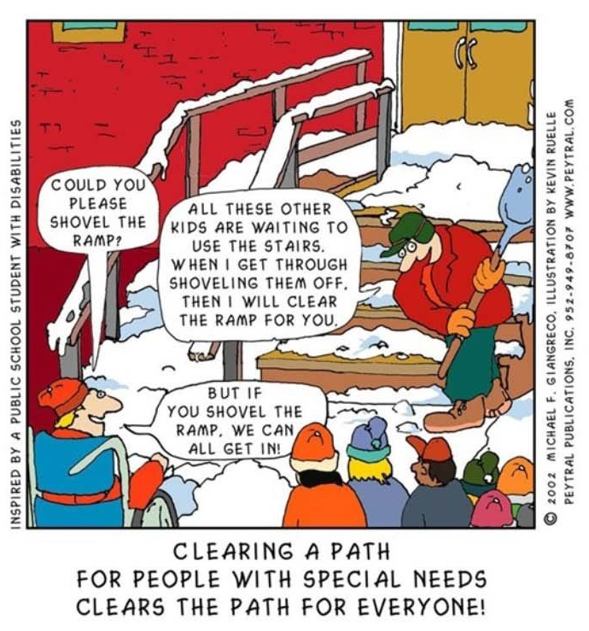
Removing barriers benefits everyone.

Slide 7
Disability is not always visible
Accessibility is often focused on technical accessibility such as screen readers.
Therefore, guidance is often directed toward mobility, hearing and visual impairments.
We should consider specific learning differences (SpLDs) and neurodivergence in our design.

Slide 8
Disability is individual
Avoid assuming all disabilities impact people in the same way.
Don’t be afraid to discuss it!
Talk to your students. Find out what they need and what can help them.

Slide 9
Our obligations
Equality Act 2010 – make reasonable adjustments
Avoid substantial disadvantage where a provision, criterion or practice puts disabled students at a substantial disadvantage.
Equality and Human Rights Commission
The Public Sector Bodies (Websites and Mobile Applications) (No. 2) Accessibility Regulations 2018.
“[Y]ou must make your website or mobile app more accessible by making it ‘perceivable, operable, understandable and robust’. You need to include and update an accessibility statement on your website.”

Slide 10
The Public Sector Bodies (Websites and Mobile Applications) Accessibility Regulations 2018
Accessible when required
Accessible by design
Reactive
Reasonable adjustments
Proactive
Accessible at publication

Slide 11
The Public Sector Bodies (Websites and Mobile Applications) Accessibility Regulations 2018 (2)
Must meet the international WCAG 2.1 AA accessibility standard
Must publish an accessibility statement for websites and apps
Designed for local government websites for example
As a public sector body, we are subject to it
It is a ‘blunt’ instrument
Does not consider the HE context
Does not consider disciplinary differences
Disproportionate burden only accepted under specific circumstances
Government Digital Service will monitor compliance via a sample annually
Equality and Human Rights Commission will enforce the requirement and use their legal powers against non-compliant institutions.

Slide 12
The Public Sector Bodies (Websites and Mobile Applications) Accessibility Regulations 2018 (3)
Perceivable
make sure users can recognise and use your service with the senses that are available to them.
Operable
make sure users can find and use your content, regardless of how they choose to access it
Understandable
make sure people can understand your content and how the service works.
Robust
make sure your content can be interpreted reliably by a wide variety of user agents

Slide 13
Writing for accessibility
Write in short, clear sentences and paragraphs.
Avoid using unnecessarily complex words and phrases.
Avoid colloquialisms, slang and metaphors.
Expand acronyms on first use.
Consider providing a glossary for terms readers may not know.
Useful tool: http://www.hemingwayapp.com/

Slide 14
Structure for accessibility
Describe the structure e.g. of the Moodle space or lecture.
Make expectations clear.
Indicate what is required and optional.
Indicate when something needs to be done e.g. before lecture, after etc.
Ensure resources are available prior to ‘live’ sessions.
Indicate timeframes- how long ‘approximately’ should you be spending on activities.

Slide 15
Accessible Word Documents

Slide 16
Word basics
Use heading styles.
Use meaningful link text.
Sufficient contrast between foreground and background.
Use one or two san-serif fonts.
Use colour with sufficient contrast and not as the only means of understanding.
Avoid text over images or patterned backgrounds.
Include alt-text for all images and visuals that are not purely decorative.
Use simple table structures.
Use the accessibility checker, but remember, it can’t detect everything!

Slide 17
Learn more about Word accessibility
Creating accessible Word documents recording from 2nd March 2021.
01:48 What is accessibility?
08:47 Where's inaccessibility exercise
15:15 Writing for accessibility
19:36 Heading styles
26:01 Hyperlink text
29:06 Use of colour and contrast
31:11 Fonts
33:30 Images and visuals
37:05 Tables
38:30 Other considerations
39:49 Word Accessibility Checker
42:47 Help and Support
Creating accessible Word documents full PowerPoint.

Slide 18
Accessible PowerPoint

Slide 19
PowerPoint basics
Check the reading order of all slides or use the built-in slide designs.
Add a unique slide title to every slide.
Use meaningful link text.
Sufficient contrast between foreground and background.
Use one or two san-serif fonts at 18pts or larger.
Use colour with sufficient contrast and not as the only means of understanding.
Avoid text over images or patterned backgrounds.
Include alt-text for all images and visuals that are not purely decorative.
Use simple table structures.
Ensure video and audio content has subtitles/closed captions.
Use the accessibility checker, but remember, it can’t detect everything!
Learn more about PowerPoint accessibility: Creating accessible PowerPoints 31/03/2021 12pm.

Slide 20
Accessible PDFs

Slide 21
PDF basics
Do you need a PDF? Consider HTML.
Making PDFs accessible can be a lot of work.
Mathematical and scientific notation cannot currently be made accessible in PDF files.
Check and correct tag and reflow order.
Scanned PDFs (e.g. a page from a book) can be passed through Optical Character Recognition (OCR) to be converted.
For PDF forms, form fields must be tagged.
Use the accessibility checker, but remember, it can’t detect everything!
Learn more about PDF accessibility: Creating accessible PDFs 18/03/2021 12pm.

Slide 22
Accessible Web Pages

Slide 23
Web basics
Ensure content is keyboard navigable.
Use heading styles in a logical order.
Use meaningful link text.
Sufficient contrast between foreground and background.
Use one or two san-serif fonts.
Use colour with sufficient contrast and not as the only means of understanding.
Include alt-text for all images and visuals that are not purely decorative.
Avoid text over images or patterned backgrounds.
Use simple table structures.
Ensure video and audio content has subtitles/closed captions.
Use an accessibility checker like Wave to check for common issues.
Learn more about web accessibility: Sitebuilder content editor accessibility checklist.

Slide 24
Accessible Audio and Video

Slide 25
Audio and video basics
At minimum, provide a transcript (correctly sequenced text description representing the final media). Echo360 and Microsoft Stream provide automated transcription. Automated transcripts are not 100% accurate.
Include closed captions (dialogue and other relevant audio).
Provide audio description (explains what is happening on screen).
Describe all visual content ensuring the viewer is aware of the key information.
When using 3rd party content, avoid content without captions/transcript and ensure you indicate what will be available for students.
When creating a video ask yourself “will this make sense if I can’t see or hear it?”
Learn more about PDF accessibility: Creating accessible audio and video 15/04/2021 12pm.

Slide 26
Accessible interactive media

Slide 27
Interactive media basics
Use an accessible H5P content type.
Principles around use of images, colour, contrast, font, audio and video apply.
Avoid text embedded in images. Add text using the H5P tool.
Ensure you have an alternative planned for those unable to participate.
Articulate 360 Accessibility FAQs
Adobe Captivate Accessibility

Slide 28
Accessible Live Events

Slide 29
Live events basics
Many features are in the control of the participant.
Live captions. Speak clearly.
Pin a meeting participants video.
Add interpreters or note takers to a call.
Use do not disturb to reduce distractions.
Use the Dark, light or high contrast theme.
Be clear about etiquette, expectations and the structure of the session.
Provide content ahead of the session e.g. slides and activities.
Where links are shared in the chat, be clear whether that needs to viewed now or later.
Are the activities you are using accessible? Padlet and Miro are not fully accessible. Vevox has good accessibility.
What alternatives or mitigations can you put in place to ensure everyone can participate fully?
Encourage participants to turn cameras on when speaking.
Record the session.
Learn more about Teams accessibility: Accessibility overview of Microsoft Teams.

Slide 30
Help and Support

Slide 31
Digital Accessibility Network
The Digital Accessibility Network (DAN) has been set up to create a supportive space to focus on accessibility given the increased use of digital platforms and the regulatory changes.
DAN is open to all Warwick staff with an interest in accessibility and those responsible for digital platforms and content. The team is a space for the network to share practice, resources and ideas, to seek advice and discuss the opportunities and challenges.
Click here to join the DAN Team

Slide 32
Upcoming LDCU Workshops
Thursday 18th March 12-13:00 Creating accessible PDFs
Wednesday 31st March 12-13:00 Creating accessible PowerPoint presentations
Thursday 15th April 12-13:00 Creating accessible audio and video
Tuesday 27th April 12-13:00 Creating accessible Moodle spaces
Full details and booking on https://warwick.ac.uk/ldcuevents

Slide 33
Links to resources and guidance
Accessibility Statement for Warwick Website
Accessibility Statement for Moodle VLE
University of Warwick General Guidance
Microsoft Office: Make your content accessible to everyone
Create accessible PDFs with PowerPDF
A guide to writing accessible emails
Create accessible web pages using Sitebuilder
Creating accessible Moodle spaces: all guides
Accessible video and audio (general)
Video and Audio Accessibility for Teaching
Accessibility support for Microsoft Teams
H5P content type accessibility
Windows 10 Accessibility Features
An inclusive, accessible Microsoft 365
Apple support accessibility channel
Creating accessible mathematical content 09/03/2021

Slide 34
Resources shared during the session
Equality, Diversity and Inclusion list of Warwick acronyms
Office for National Statistics guidance on bullet points
Writing for dyslexic readers
The A11Y project
6 surprising bad practices that hurt dyslexic users
Image descriptions on Twitter – a quick guide

