Slide 1



Creating video content
Kerry Pinny, Senior Academic Technologist, Academic Technology
Welcome, we will begin shortly after 10am. Enjoy the music and relax.
The session will be recorded. Use the chat or raise your hand for questions.
Did you know we have a site-wide license for Padlet?
If you’re unfamiliar with Padlet, watch our workshop recording:
https://warwick.ac.uk/ldcuEventResources

Slide 2
Today we’ll explore:
Recording video with Microsoft Teams
Recording video with PowerPoint
Recording video with Microsoft Stream
Recording video with Universal Capture
Other options
Editing a video
Accessibility
Where to host your video

Slide 3

Synchronous vs. Asynchronous
Synchronous
Interaction
Perceived sense of presence
Instant feedback
Stressful
Technical difficulties likely
No interaction, what’s the advantage?
Exclusive
Asynchronous
Flexible
Self-paced
Inclusive
Perceived lack of presence
Risk of apathy/disengagement
"Synchronous or asynchronous?" video on Teaching for learning online.

Slide 4
Top tips
It doesn’t have to be perfect!
Keep it short
Use a headset or webcam mic
Try to find somewhere quiet
Outline/script your video content
Rehearse
Position the camera above you
Try to position yourself so light is in front of you
Have everything you need to hand
Interruptions can liven up a video…

Slide 5
Hierarchy of needs for video creation
Sound recording
(microphone placement, speed, etc)
Content
Video Location
(background, lighting, shot framing)
Video recording (camera quality)
Supporting Visuals
Advanced needs
When developing a video, put your effort relative to the size of the step.
Start at the bottom and work upwards in viability, planning and implementation.
If you get stuck half-way through, have a re-think and scale your output back to a podcast, narrated slideshow, or visually engaging document.
Basic need for time-based
(audio or video)
Basic needs
Inspired by Maslow’s hierarchy of needs: Maslow, A.H. (1943). "A theory of human motivation". Psychological Review. 50 (4): 370–96.

Slide 6

Recording video with Microsoft Teams

Slide 7
Teams Recordings
Hold a meeting on your own or with others
Record the meeting
Share your screen
The video can be downloaded from Teams and is stored in Microsoft Teams for 20 days
Trim the video
Automatically generate captions and a transcript
Download or share the video

Slide 8
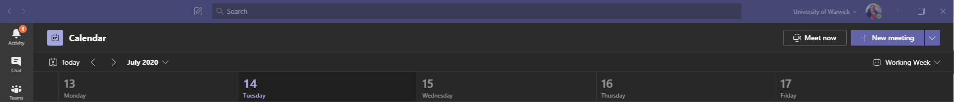

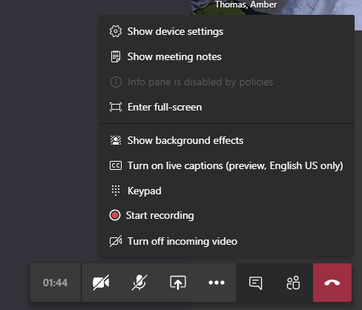

In Teams, go to Calendar
Meet now
Start recording
Need to record with a colleague? Or record an interview?
No problem, invite them along to the meeting.

Slide 9

Recording video with Microsoft Stream

Slide 10
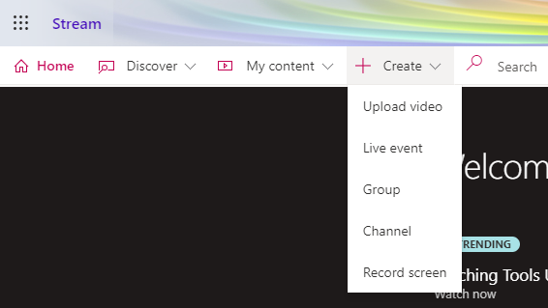
Microsoft Stream – Record your screen
Create a screen recording
Latest Microsoft Edge or Google Chrome on Windows 10 or macOS.
15 minutes max
Camera, microphone and screen.

Slide 11
Microsoft Stream
Microsoft's video hosting platform
Limited video editing options
Share by link, email, embed code and Teams groups/channels
Automated transcript (will need checking!)
Be careful of this setting on upload - Allow everyone in your company to view this video
Get started with Microsoft Stream

Slide 12

Recording video with PowerPoint

Slide 13
Further training
Watch the recording https://warwick.ac.uk/ldcuEventResources
IT Training offer a Microsoft PowerPoint – Recording a Slide Show – Online Webinar

Slide 14
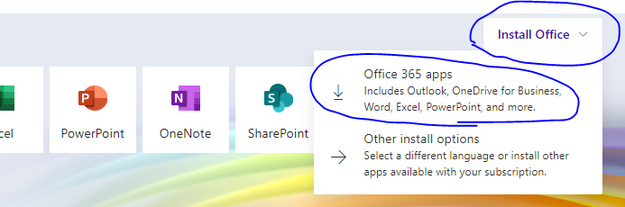
PowerPoint for Mac
PowerPoint 2016 does not export as video
  Use an alternative screen recorder software (e.g. Screenshot) to record the PowerPoint in presentation mode
Screen recording not supported on Mac
Office365 PowerPoint 16.19 or higher does allow export as .mp4/.mov
Upgrade to Office365 apps via https://office.com
Webcam in the corner not supported currently

Slide 15
PowerPoint 2016
Use content you already have
Built-in to PowerPoint
Record audio narration
Record your screen and embed it into your PowerPoint video
Export as video
Creating video with PowerPoint recording and slides

Slide 16
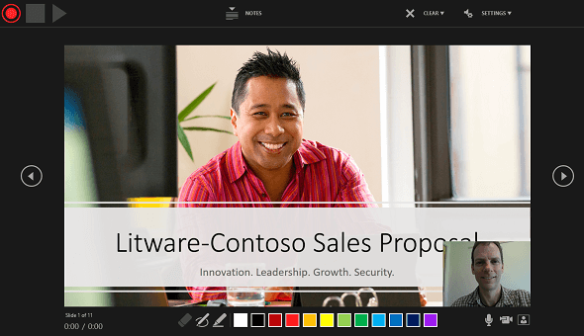
PowerPoint 365
New version coming this year (no ETA)
Webcam in the corner!
Publish directly to MS Stream

Slide 17

Recording video with Universal Capture

Slide 18
Universal Capture
Echo360 product available on the software centre (update via VPN) or direct download for unmanaged machines
Need to make sure you have an account and 'sections' set up to share recordings with students
  Email lecturecapture@warwick.ac.uk to get set up
Record 2 video streams and audio
Publish to your 'sections' to access via Moodle
Edit in Echo360
Automated transcription (more guidance to come)

Slide 19
Universal Capture
How to install Universal Capture
Using Universal Capture
Edit in Echo360
Universal Capture system requirements

Slide 20
Other options
Record using your mobile device
  Use the OneDrive mobile app to move the file between devices
  Echo360 mobile app
Windows Camera (Windows 10)
Quicktime Player screen recording (Mac)
H5P Interactive Video (Moodle)
  Content type built into Moodle
  “Add an activity or resource” select H5P Interactive Content
  Matches source quality
  A caption/subtitle file can be uploaded (.vtt)

Slide 21
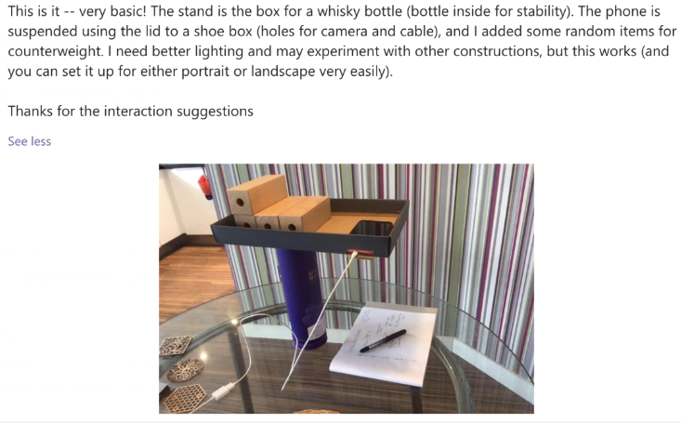
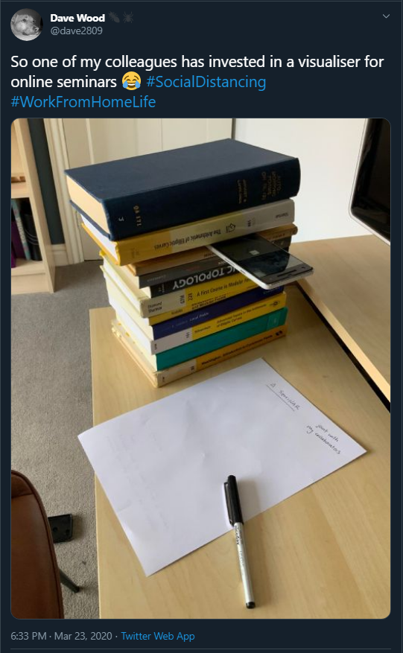
Document cameras

Slide 22
Editing Tools
Video Editor for Windows 10 (free)
iMovie for iOS (free)
Adobe Premier Pro (monthly cost)
Microsoft Stream – trim video
Echo360 – editor
eStream - editor

Slide 23
Accessibility
The Public Sector Bodies (Websites and Mobile Applications) (No. 2) Accessibility Regulations 2018 require us to ensure that our platforms and content meet the international WCAG 2.1 AA accessibility standard.
At minimum, a transcript is required for all pre-recorded content (that is not in itself an alternative for text)
Subtitles/captions are also recommended.
Echo360 and Microsoft Stream have automated transcription features.

Slide 24

Where to host your video?
eStream
Integrated with Moodle
6GB size limit
Share externally
No automated transcription (currently)
Echo360
Integrated with Moodle
Automated transcription
Share externally
Microsoft Stream
Automated transcription
Can’t be shared externally
You can use these now but it's worth waiting for transcription in Echo360.
Wait for this.
Sharing in Stream relies on sharing to people, channels or groups. Groups and channels are Office 365 groups.
We do not have any Office 365 groups for modules. When the Moodle – Teams integration is ready, you will be able to create a Team for a module which in turn will create an Office 365 group. So you will be able to share your Stream content with a module of students and embed it in Moodle.
You can start producing your video content now, save it somewhere safe and host it later.

Slide 25
Adding video to Moodle
Sharing eStream content in Moodle
Add audio or video files to Moodle using an embed code
Share your Echo360 recordings on Moodle
Share Stream recordings on Moodle

Slide 26

Help and further resources
warwick.ac.uk/covid19-teachonline
warwick.ac.uk/academictechnology
warwick.ac.uk/academictechnologyguides
academictech@warwick.ac.uk
warwick.ac.uk/av
warwick.ac.uk/itstraining
Academic Development Centre
Find out more about teaching online pedagogies and tools on:
Teaching for Learning Online

