Slide 1
Inclusive Practice and Accessibility:
Experiences and examples of practice
Learning Design Consultancy Unit 04/02/2021
Jessica Humphreys – Senior Teaching Fellow, Academic Development Centre
Kerry Pinny – Senior Academic Technologist, Academic Technology

Slide 2

Session Overview
A brief introduction to inclusive teaching practice​ and accessibility
An update on web accessibility from Sara Lever
Student experiences​
  Eleanor Hassall, Politics, President Warwick Enable
  Michael Cavaliere, Warwick Mathematics Institute
  Sophie Kitching, Global Sustainable Development
Examples of practice
  Developing CAGE - Nivaria Morales Salas, IT Developer, Economics
  Accessible mathematical materials – Dr Martyn Parker, Associate Professor Statistics
Questions and discussion
Cameras are optional. Feel free to raise your hand or type in the chat.

Slide 3
What is inclusive practice?

Slide 4
A definition of inclusive practice
“Inclusive learning and teaching in higher education refers to the ways in which pedagogy, curricula and assessment are designed and delivered to engage students in learning that is meaningful, relevant and accessible to all. It embraces a view of the individual and individual difference as the source of diversity that can enrich the lives and learning of others.”​​
(Hockings, C., Inclusive learning and teaching in higher education: a synthesis of research, 2010)

Slide 5
A definition of Universal Design for Learning
Universal Design for Learning (UDL) is framework for guiding educational practice that provides flexibility in the ways information is provided, in the ways students respond or demonstrate knowledge and skills, and in the ways students are engaged.
(Higher Education Opportunity Act, Sec. 103, Additional Definitions)

Slide 6
Three key UDL principles ​
Provide multiple means of representation​
Provide multiple means of action and expression​
Provide multiple means of engagement

Slide 7
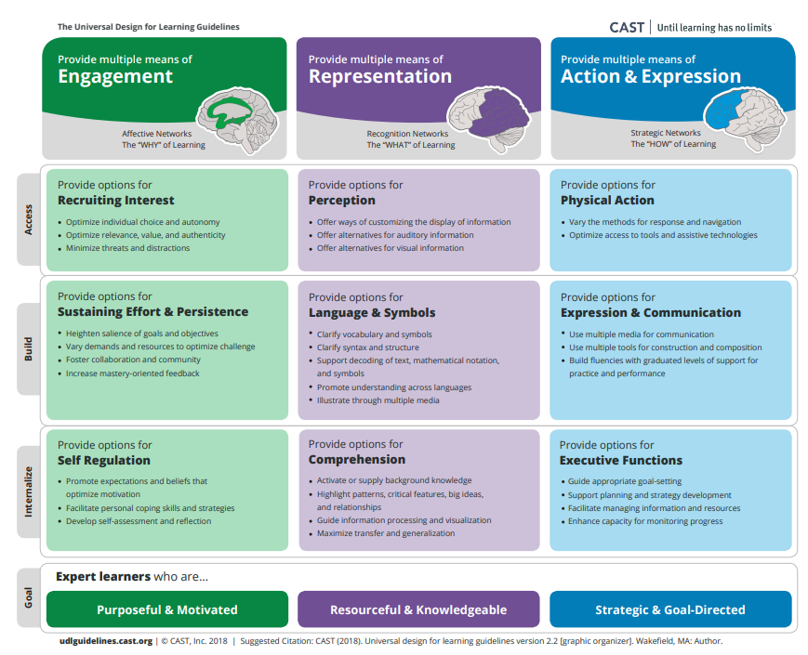
Universal Design for Learning Guidelines

Slide 8
Teaching for Learning Online
https://warwick.ac.uk/teachingforlearningonline
Section 8: Inclusive online teaching and learning
How do we ensure that the teaching materials and learning experiences that we are designing and supporting are inclusive and accessible for all students? This section explores how diversifying how, what and who we teach, working openly and collaboratively, and sharing responsibility to create safe online spaces enables all students to succeed. We also introduce Universal Design for Learning, a framework to improve and optimise teaching and learning for all based on research from the field of cognitive neuroscience.

Slide 9
What is accessibility?

Slide 10
Accessibility and Universal Design for Learning
“[A]ccessibility is essential but insufficient on its own to be Universal Design for Learning. Accessibility is really captured in the first principle of UDL which is multiple representations of information and from an instructional perspective there's a whole mantra that if you can't reach them you can't teach them”
Skip Stahl. UDL on Campus

Slide 11
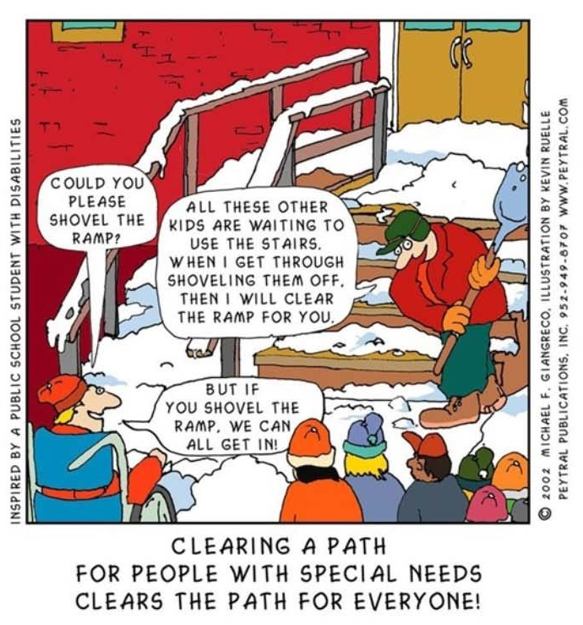
Removing barriers benefits everyone.

Slide 12
Our obligations
Equality Act 2010 – make reasonable adjustments
Avoid substantial disadvantage where a provision, criterion or practice puts disabled students at a substantial disadvantage.
Equality and Human Rights Commission
The Public Sector Bodies (Websites and Mobile Applications) (No. 2) Accessibility Regulations 2018.
“[Y]ou must make your website or mobile app more accessible by making it ‘perceivable, operable, understandable and robust’. You need to include and update an accessibility statement on your website.”

Slide 13
The Public Sector Bodies (Websites and Mobile Applications) Accessibility Regulations 2018
Accessible when required
Accessible by design
Reactive
Reasonable adjustments
Proactive
Accessible at publication

Slide 14
The Public Sector Bodies (Websites and Mobile Applications) Accessibility Regulations 2018 (2)
Must meet the international WCAG 2.1 AA accessibility standard
Must publish an accessibility statement for websites and apps
Designed for local government websites for example
As a public sector body, we are subject to it
It is a ‘blunt’ instrument
Does not consider the HE context
Does not consider disciplinary differences
Disproportionate burden only accepted under specific circumstances
GDS will monitor compliance via a sample annually
Equality and Human Rights Commission will enforce the requirement and use their legal powers against non-compliant institutions.

Slide 15

Content and platform
In your control
Content
Choices
Platform

Slide 16
The Public Sector Bodies (Websites and Mobile Applications) Accessibility Regulations 2018 (3)
Perceivable
make sure users can recognise and use your service with the senses that are available to them.
Operable
make sure users can find and use your content, regardless of how they choose to access it
Understandable
make sure people can understand your content and how the service works.
Robust
make sure your content can be interpreted reliably by a wide variety of user agents

Slide 17
Principle 1: Perceivable
provide text alternatives (‘alt text’) for non-text content
provide transcripts for audio and video
provide captions for video
make sure content is structured logically and can be navigated and read by a screen reader
don’t use colour as the only way to explain or distinguish something
use text colours that show up clearly against the background colour
https://www.w3.org/TR/WCAG21/#perceivable

Slide 18
Principle 2: Operable
make sure everything works for keyboard-only users
let people play, pause and stop any moving content
not use blinking or flashing content - or let the user disable animations
make sure users can move through content in a way that makes sense
use descriptive links so users know where a link will take them, or what downloadable linked content is
use meaningful headings and labels, making sure that any accessible labels match or closely resemble the label you’re using in the interface
https://www.w3.org/TR/WCAG21/#operable

Slide 19
Principle 3: Understandable
use plain English
keep sentences short
don’t use words and phrases that people won’t recognise - or provide an explanation if you can’t avoid it
explain all abbreviations and acronyms, unless they are well known and in common use
make it clear what language the content is written in, and indicate if this changes
https://www.w3.org/TR/WCAG21/#understandable

Slide 20
Help and Support

Slide 21
Digital Accessibility Network
The Digital Accessibility Network (DAN) has been set up to create a supportive space to focus on accessibility given the increased use of digital platforms and the regulatory changes.
DAN is open to all Warwick staff with an interest in accessibility and those responsible for digital platforms and content. The team is a space for the network to share practice, resources and ideas, to seek advice and discuss the opportunities and challenges.
Click here to join the DAN Team

Slide 22
Links to resources and guidance
Accessibility Statement for Warwick Website
Accessibility Statement for Moodle VLE
University of Warwick General Guidance
Microsoft Office: Make your content accessible to everyone
Create accessible PDFs with PowerPDF
A guide to writing accessible emails
Create accessible web pages using Sitebuilder
Creating accessible Moodle spaces: all guides
Accessible video and audio (general)
Video and Audio Accessibility for Teaching
Accessibility support for Microsoft Teams
H5P content type accessibility
Windows 10 Accessibility Features
An inclusive, accessible Microsoft 365
Apple support accessibility channel

Slide 23
Upcoming LDCU Workshops
Tuesday 2nd March 12-13:00 Creating accessible Word documents
Thursday 18th March 12-13:00 Creating accessible PDFs
Wednesday 31st March 12-13:00 Creating accessible PowerPoint presentations
Thursday 15th April 12-13:00 Creating accessible audio and video
Tuesday 27th April 12-13:00 Creating accessible Moodle spaces
Full details and booking on https://warwick.ac.uk/ldcuevents

Slide 24
Student experiences
  Eleanor Hassall, Politics, President Warwick Enable
  Michael Cavaliere, Warwick Mathematics Institute
  Sophie Kitching, Global Sustainable Development

Slide 25
Examples of practice
  Developing CAGE - Nivaria Morales Salas, IT Developer, Economics
  Accessible mathematical materials – Dr Martyn Parker, Associate Professor Statistics

