Slide 1


Padlet: activities for teaching and learning
Sara Hattersley (Academic Development Centre) and Kerry Pinny (Academic Technology)
Welcome, we will begin shortly after 11am. Relax and enjoy the music.
The session will be recorded. Use the chat or raise your hand for questions.

Slide 2
Session objectives
Understand what Padlet is
Explore some of the activities Padlet can support
Create your first padlet
Consider how you will use Padlet in your own practice

Slide 3
Share your practice https://warwick.padlet.org/academictech/padletactivities

Slide 4
What is Padlet?
An online collaborative board space
A choice of different board types for different activities
Share files, videos, images, audio, screen recordings and drawings etc.
Share your padlets with colleagues and students

Slide 5
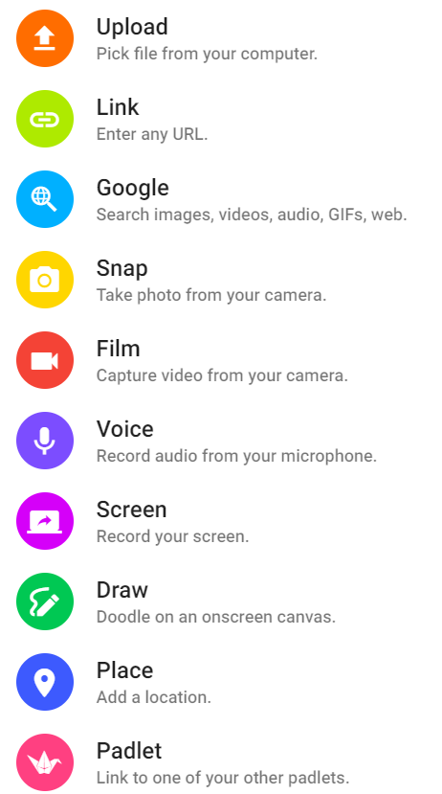
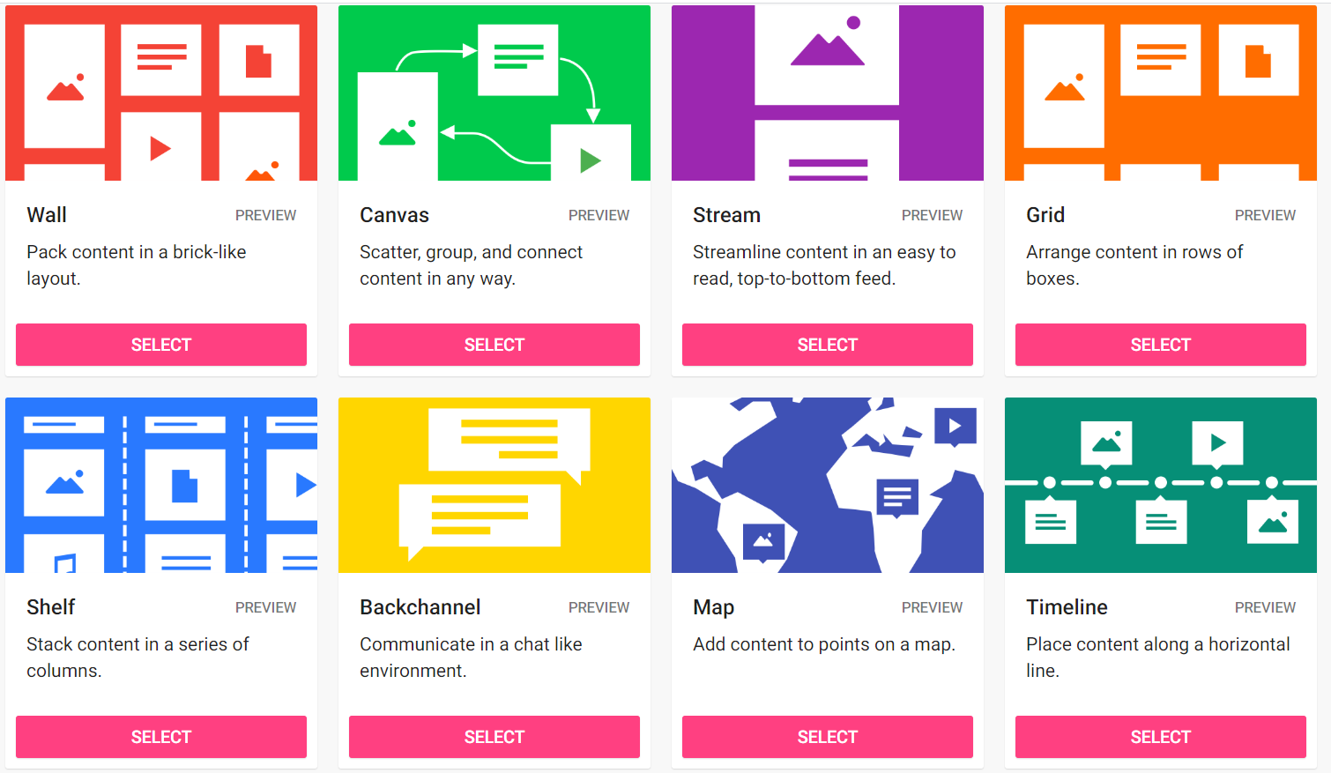
Many ways to interact; versatile templates

Slide 6
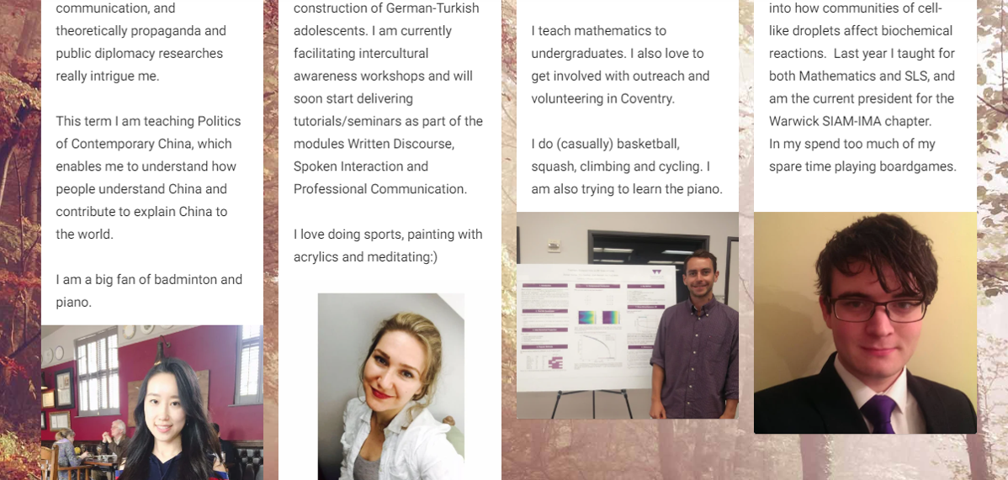
Welcome wall
'Presence' is important to achieve in blended and online approaches.
Creating a 'welcome wall' in a VLE such as Moodle can help to build community amongst students who are learning at distance.
Students and teachers can return to this page to remind themselves who is in the group – photos help peers to recognise each other in different spaces too (e.g. on a Teams calls).

Slide 7
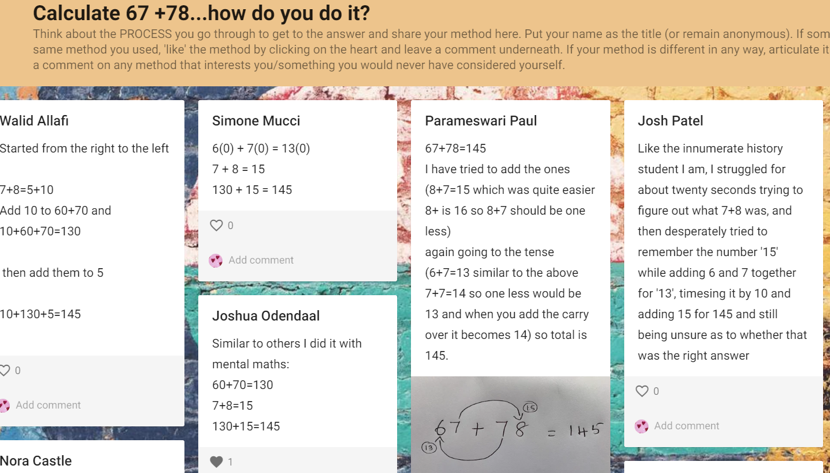
Articulating thinking
Social constructivist approaches - One of the key strengths of shared learning experiences is when students articulate their thinking/justify their ideas, and others can hear those utterances and compare them to their own understanding.
Padlet walls can facilitate this and leave a record of that thinking for the group to refer to at any point (note this includes something hand-drawn).

Slide 8
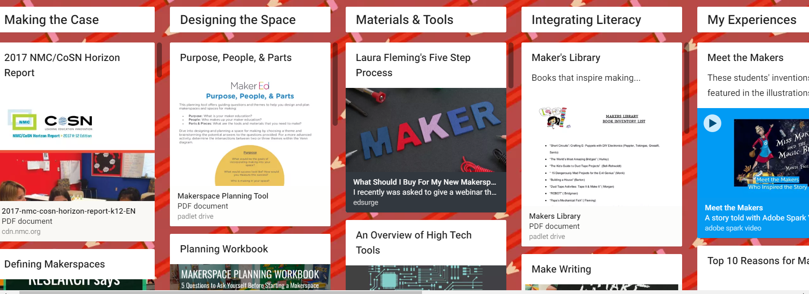
Project planning and crowdsourcing
The freestyle format of Padlet makes it a useful space for crowdsourcing activities – students can search for materials and post relevant links and multimedia quickly.
In addition, a column format can support planning of any kind – essay writing, collaborative projects, research, experiment protocol, study diary etc...
https://padlet.com/mandifiglioli/jdoreomjln66

Slide 9
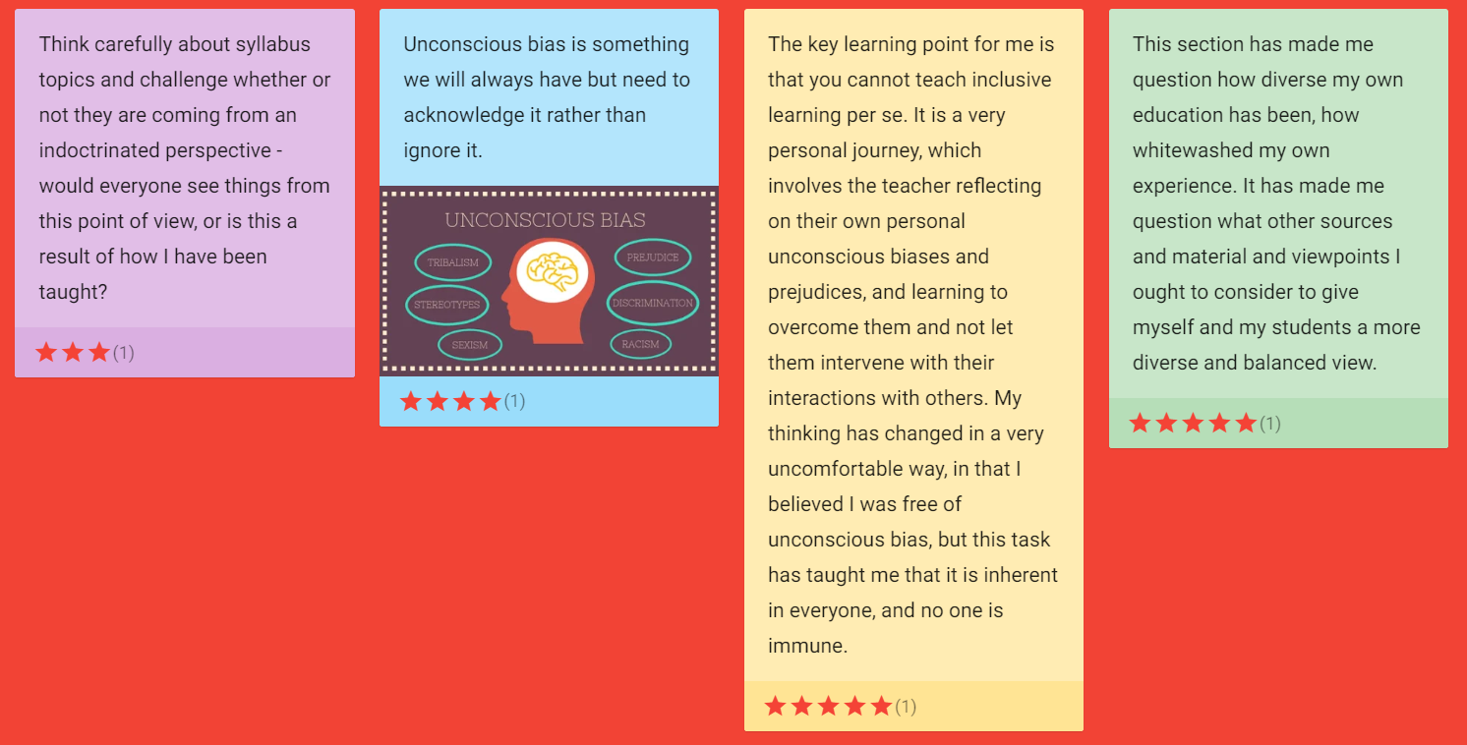
Student evaluation
Padlet can provide a quick space for student evaluation and feedback on a teaching session or activity.
Anonymous responses can be pasted using virtual post-it notes and students can add a rating as well as qualitative comments. Here students were asked 'What was the key learning point for you, in this session?'

Slide 10
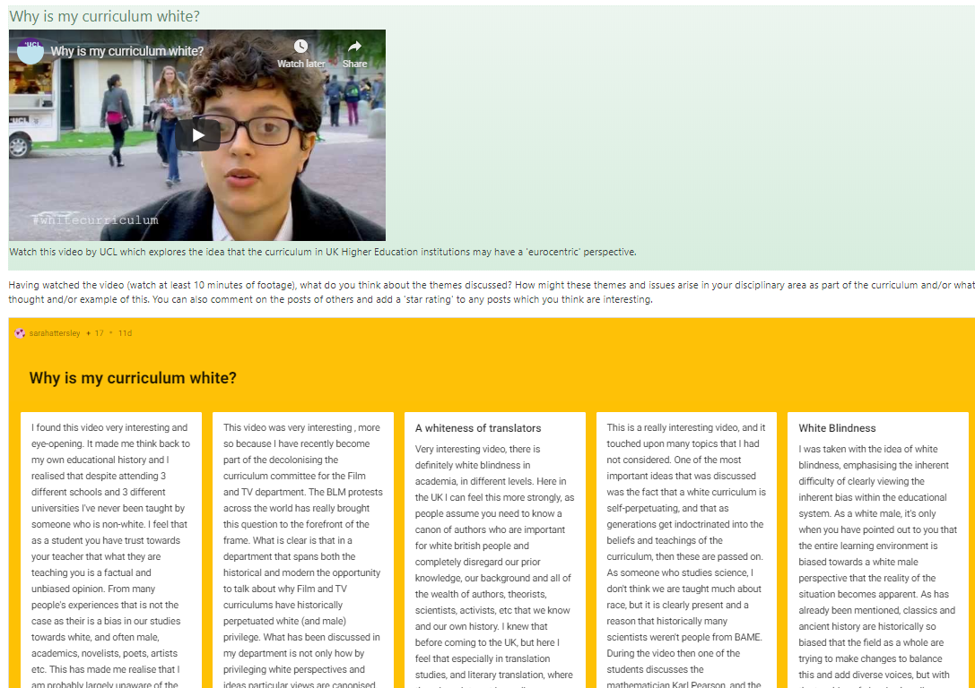
Task-based learning for groups
Padlet can be a useful tool to gather responses from students in relation to a key learning point, perhaps stimulated by a shared resource.
Here students watch a short video and then complete a task in relation to that video. This can be useful formative assessment of key concepts for teachers as well as a shared resource for students.
Multiple Padlets can be set up to establish small group tasks.

Slide 11
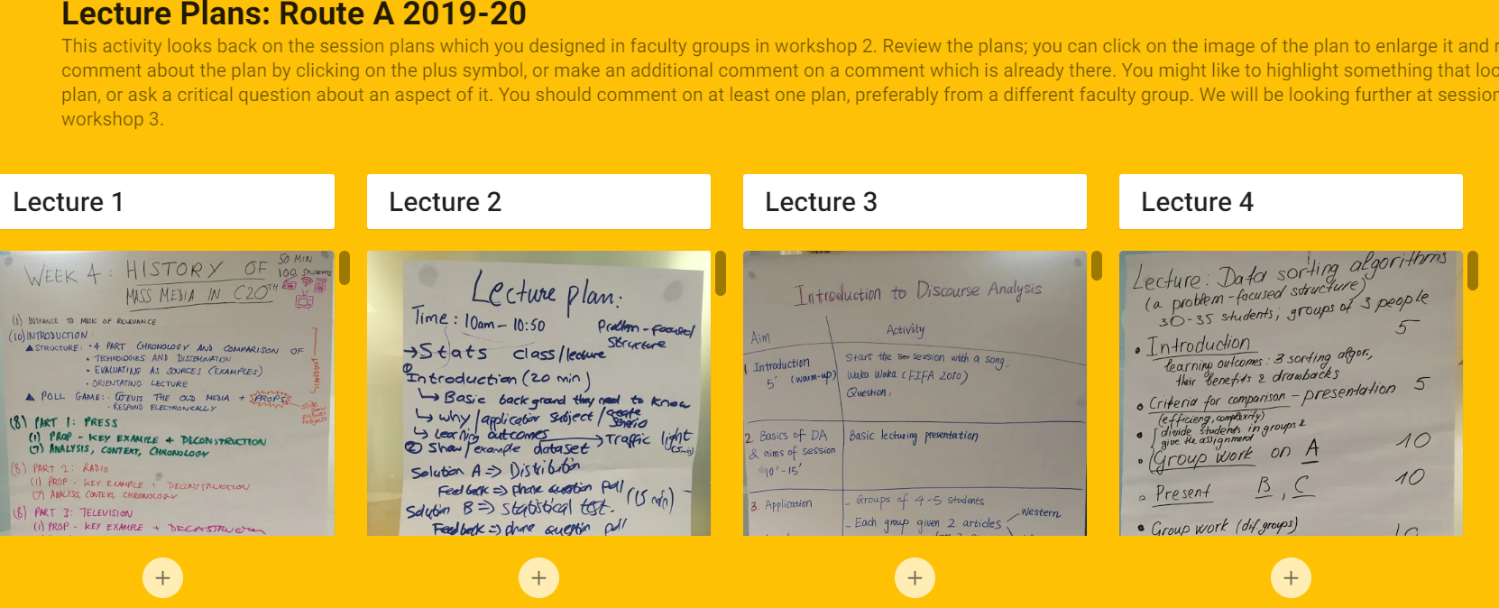
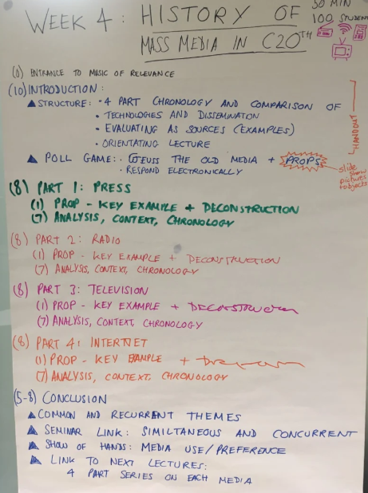
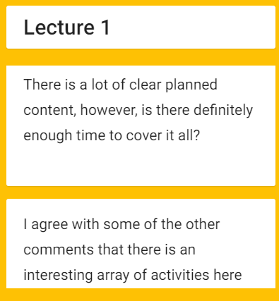
Peer assessment
Both 'in class' work or online tasks can be captured and pasted to a Padlet wall. Students can then peer assess each other's work using the comments facility beneath the resource.
Here, students co-created a lesson plan (in a face-to-face session), photographed their plan and uploaded to Padlet. Students later peer assessed each other's plans.

Slide 12
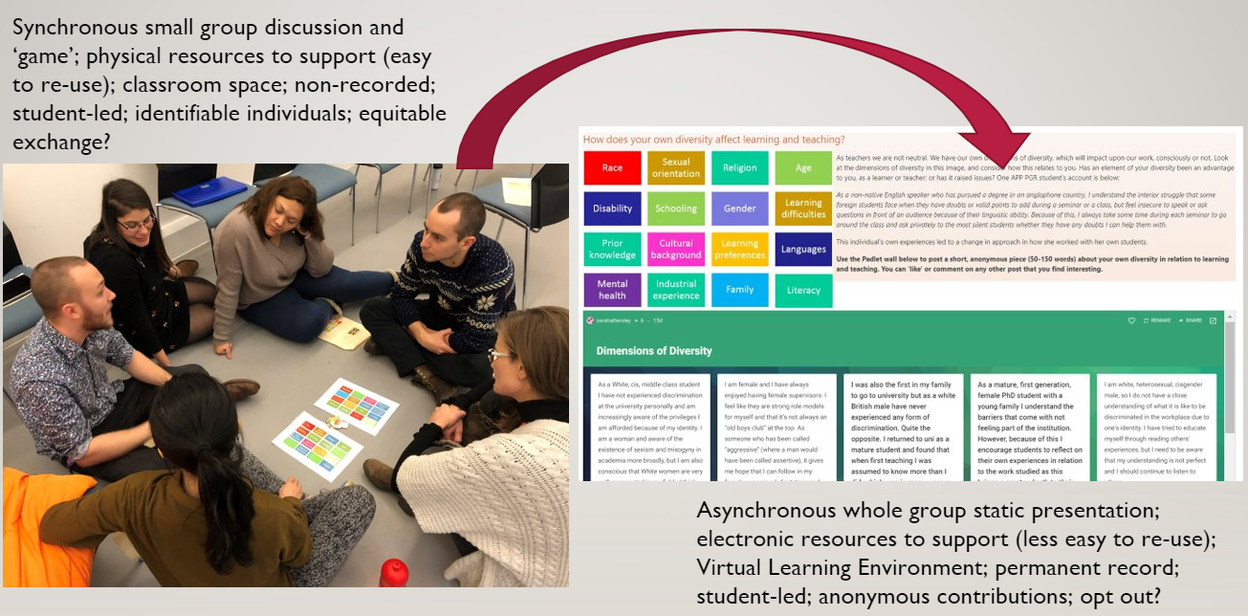
Using Padlet to help 'pivot' to online learning

Slide 13
Using Padlet as an ‘anonymous forum’
Anonymous space for discussion
Updates almost instantaneously
Moderate posts (if needed)
Use Stream activity type
No attribution
Try it out https://warwick.padlet.org/academictech/anonforum

Slide 14
Share your practice https://warwick.padlet.org/academictech/padletactivities

Slide 15
Create your first padlet

Slide 16
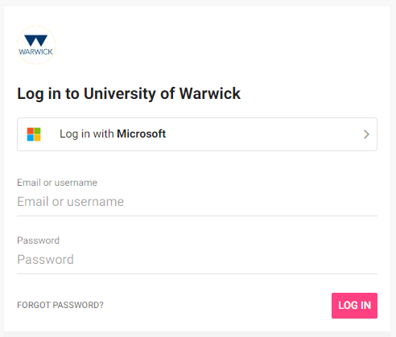

Log in and set up an account
Go to warwick.padlet.org
Click on Log in with Microsoft
Enter your email address in the following format:
Username@live.warwick.ac.uk
Complete two-step authentication
Set up a Padlet account

Slide 17


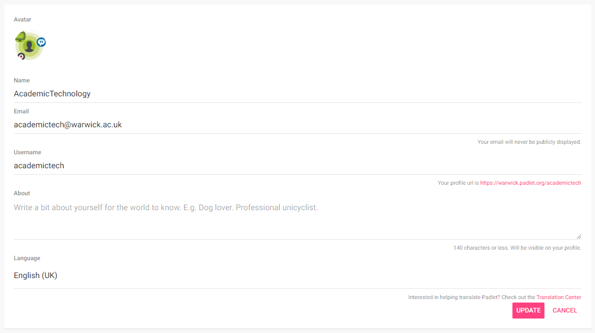
Update your profile
Click on your avatar in the top right corner
Click on Profile
Click on EDIT PROFILE
Update your details
Avatar
Username
Bio
Language
Click Update to save
Account guides

Slide 18
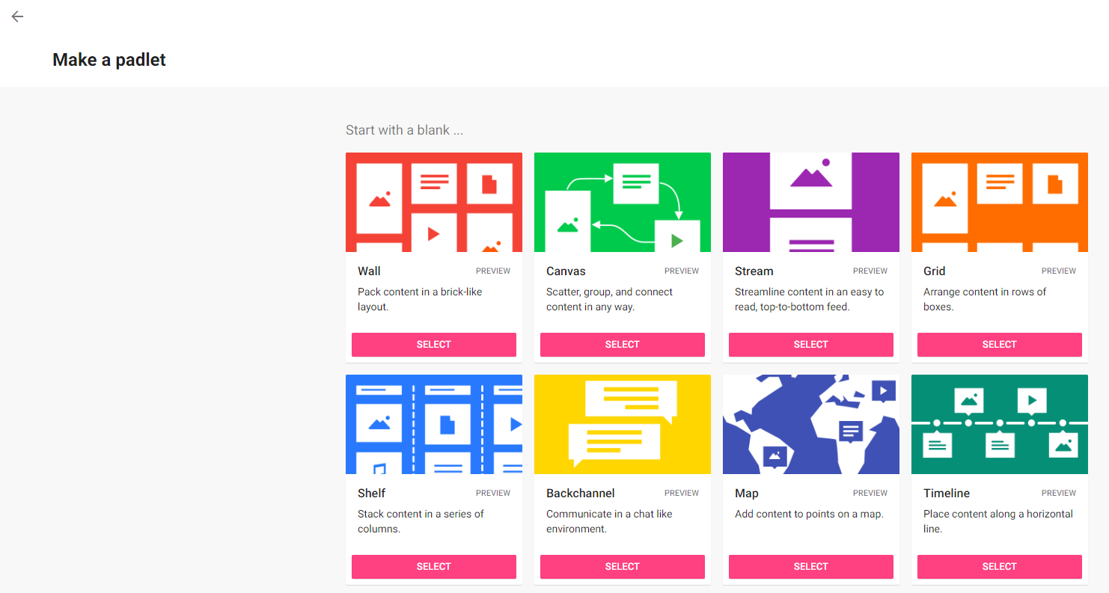
Create a Padlet
Click on + MAKE A PADLET
Pick a padlet type:
Wall
Canvas
Stream
Grid
Shelf
Backchannel
Map
Timeline
Click SELECT
How to make a Padlet

Slide 19
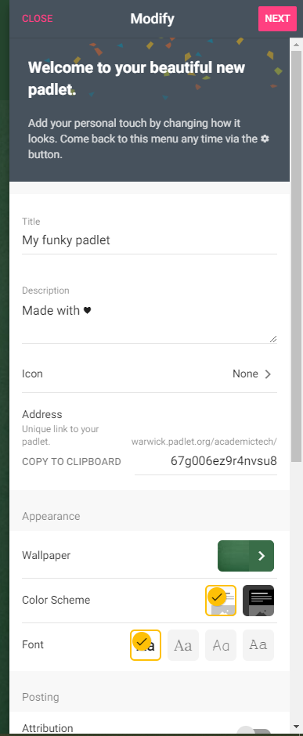
Create a Padlet
Change the Title
Add a Description
Change the Address
Change the Wallpaper, Color Scheme and Font
Change the Posting options
Enable Reactions i.e. likes, votes, stars and grades
Enable moderation with Require Approval

Slide 20
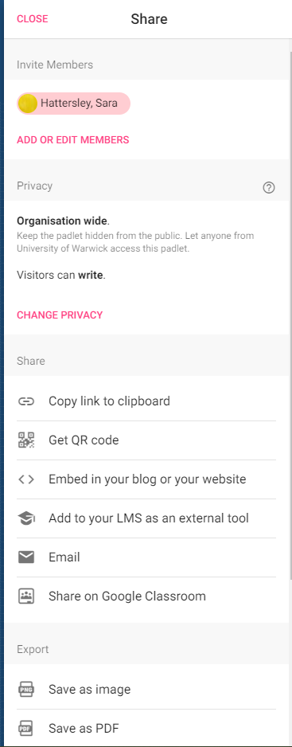
Share a Padlet
Invite Members e.g. collaborator to edit
Change Privacy
Copy link to clipboard
Get a QR code
Get an embed code
Export as image, PDF, CSV, Excel or print
Privacy Settings

Slide 21
Let’s look at what you’ve shared https://warwick.padlet.org/academictech/padletactivities

Slide 22

Help and further resources
warwick.ac.uk/academictechnology
warwick.ac.uk/academictechnologyguides
academictech@warwick.ac.uk
Find out more about teaching online pedagogies and tools on:
Teaching for Learning Online

