Slide 1
Module Audit Project
Kritz Yeoh (Intern)
Amber Thomas, Academic Technology

Slide 2
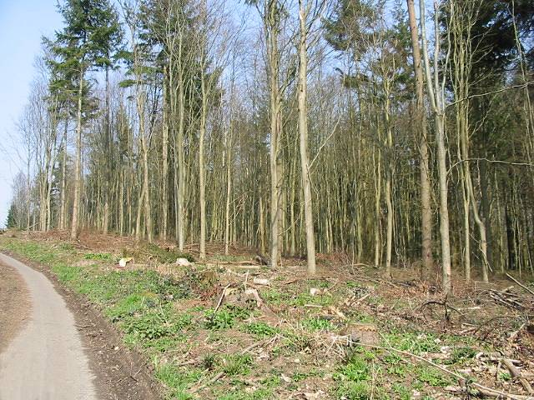
Background

Slide 3
Background
We knew that provision of module-level information and teaching content varied across departments
We knew that this could be frustrating for students
Many universities are starting to look at a more consistent approach to module homepages, we wondered if this is something we should do too
The Warwick University Administrative Internship Programme was the ideal opportunity to find a skilled student to investigate and we were lucky enough to hire Kritz Yeoh to undertake a module audit

Slide 4
Project Manager
Kritz Yeoh
BSc Mathematics, Operational Research, Statistics and Economics (MORSE)
Module Audit intern of Warwick Undergraduate Internship Programme (WUIP)

Slide 5
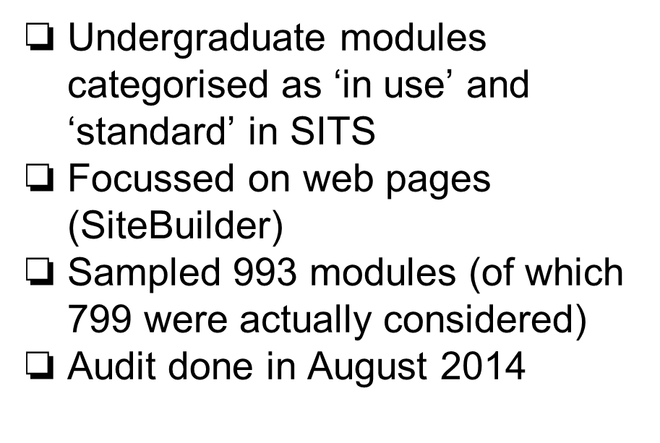
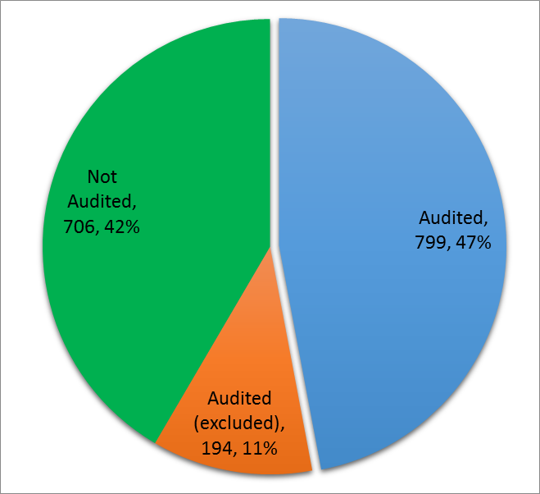
Scope

Slide 6
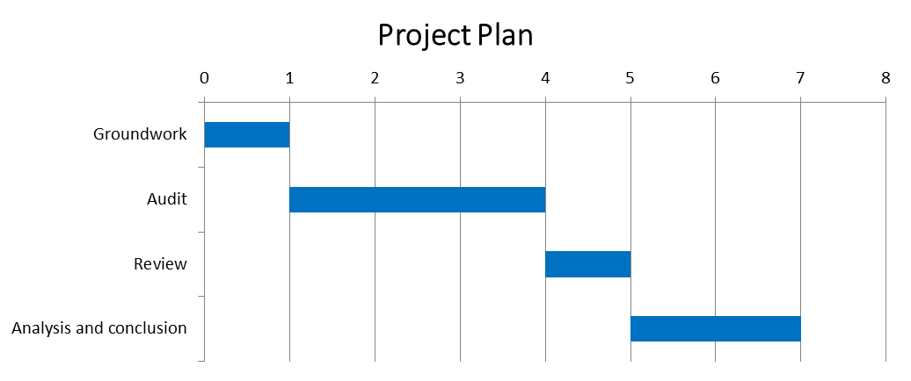

Methodology

Slide 7
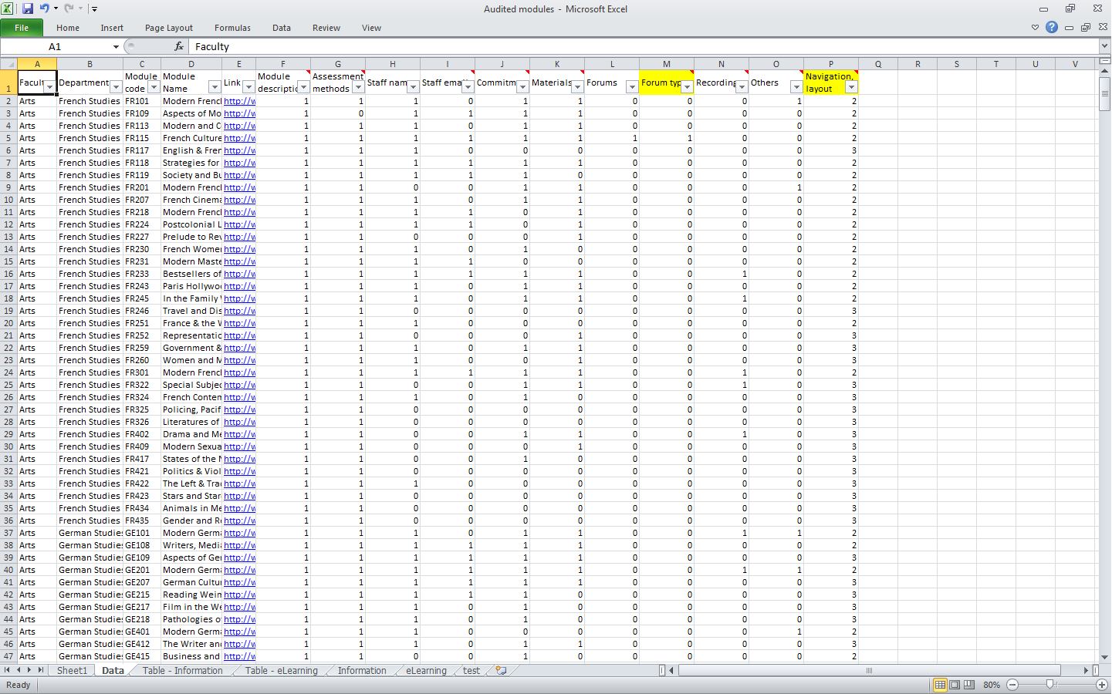
Classifications
Module description
Assessment methods
Staff name, email
Commitment
Materials
Additional materials - forums, recordings, others
Navigation, layout

Slide 8
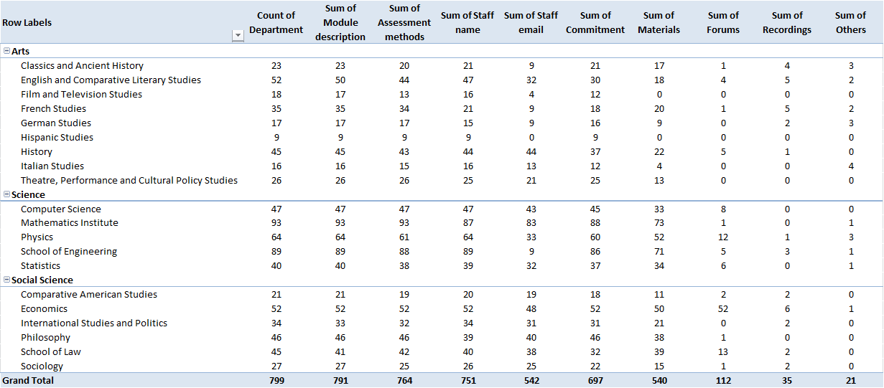
Highlights - Course Information

Slide 9
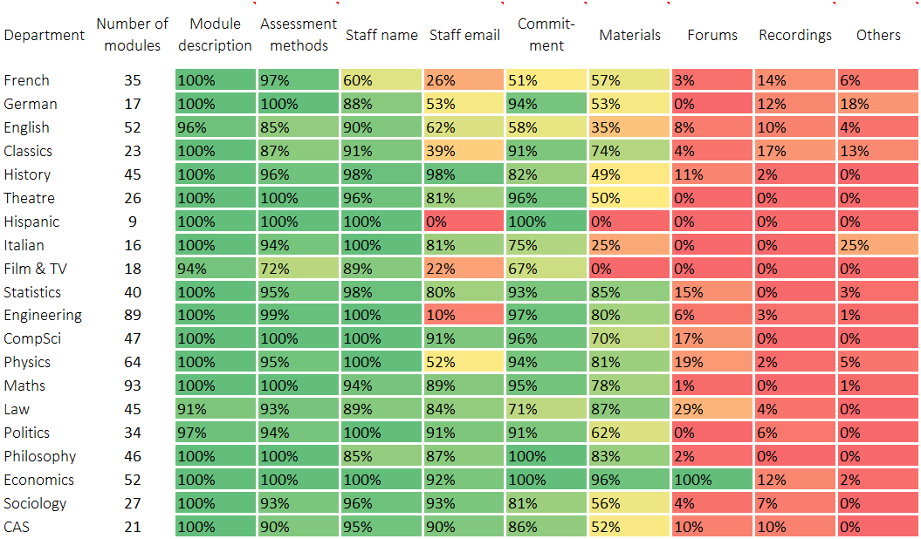

Slide 10
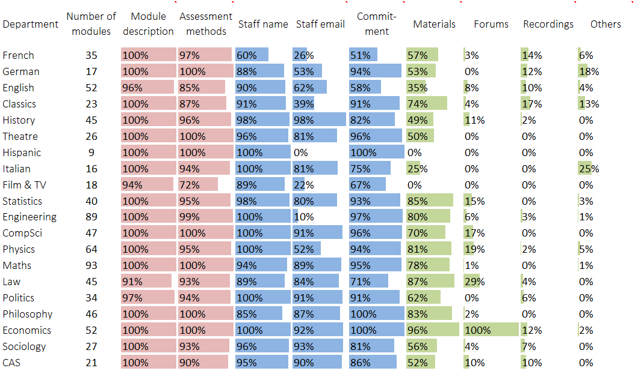

Slide 11
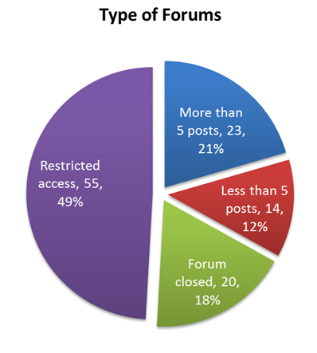
Highlights - Additional Materials
14.0% of modules had forums
(112 out of 799)
4.4% of modules had recordings
(35 out of 799)
2.6% of modules had quizzes, exercises or others
(21 out of 799)

Slide 12
Highlights - navigation/layout
Departments with highest scores:
Statistics - 3.90
Classics - 3.52
Politics - 3.50
10 out of 20 departments scored 3.00 or lower.

Slide 13
Emerging Conclusions
Inconsistent
Not much interaction online
Feels dated
Require departmental initiative
Needs support and coordination

Slide 14

Implications and Next Steps

Slide 15
Implications and Next Steps
The report’s findings highlight the need to act. We think the next steps are:
Set a recommended module specification
Consider making the module specification a minimal requirement
Apply the audit framework to a sample of Moodle modules for comparison
Investigate smarter ways of feeding administrative data into module spaces

Slide 16
Credits
Photo Credits
“wood for the trees” Nick Smith, CC BY SA
http://commons.wikimedia.org/wiki/File:Can't_see_the_wood_for_the_trees_-_geograph.org.uk_-_386949.jpg
ukgardenphotos, CC BY ND
https://www.flickr.com/photos/ukgardenphotos/5618316267/in/photostream/
People Credits
Warwick University Internship Programme
Interviewees

