Slide 1

Life Sciences e-learning practical skills (IATL funded – Digichamps project)
Dr Leanne Williams
John Harvey
Leanne.williams@warwick.ac.uk

Slide 2
Barriers to teaching a practical subject
Increase in student numbers
Less resources.
Limited demonstrators with the appropriate experience and skills.
Increased diversity of student experience

Slide 3
Barriers to learning a practical subject
Limited practical experience
Low confidence
Less focus on the underlying
scientific principles

Slide 4
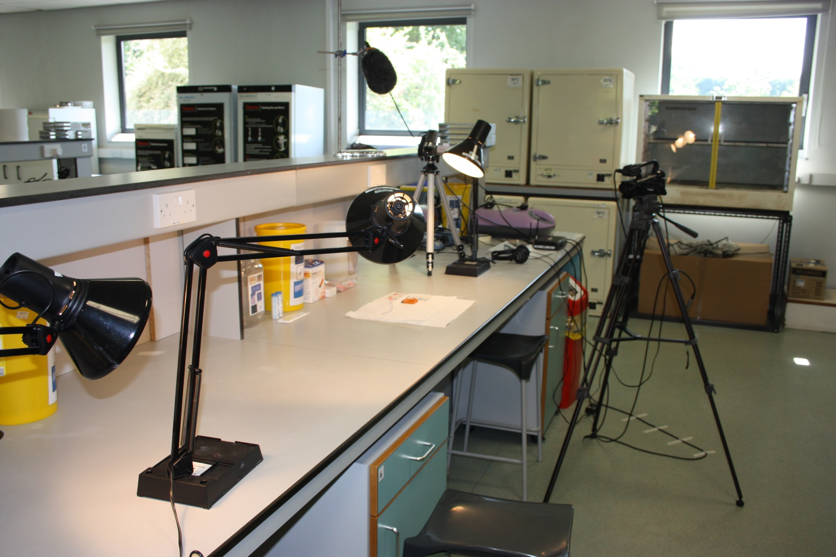
The lab set-up

Slide 5
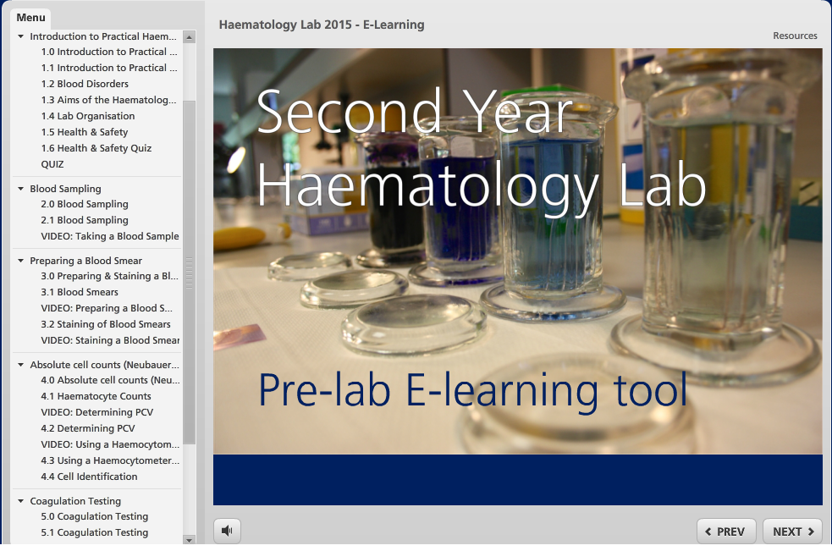

Slide 6
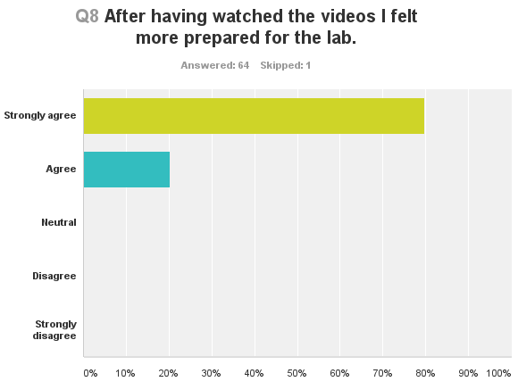
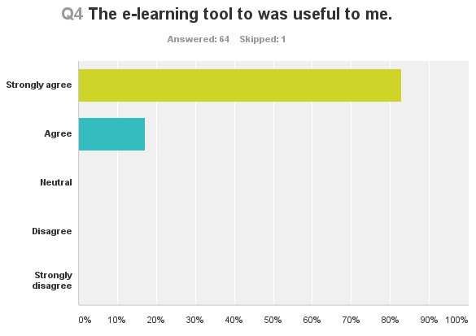
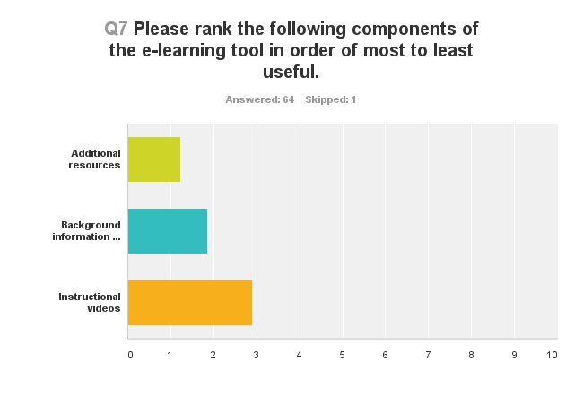
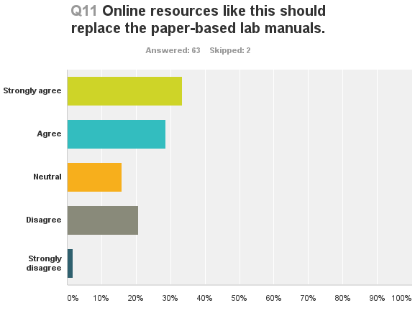
Student opinion

Slide 7
Student opinion
“I thought the e-learning tool was useful and suited my style of learning - being able to see the lab protocol being carried out gave me a far better idea of what to do (and more confidence in doing it) than I would have had if I was simply reading instructions from a lab manual.”
“I think it should be used as an additional resource, not as a replacement. It was very, very useful and I enjoyed using it. However, when I'm in the lab, I am unable to use it so the paper manuals are perfect for rejogging your memory of the e-learning tool and helping you even further. The combination of the two is GREAT!”
“It makes me feel more like an independent student, as did I not only do the experiment on my own but also collect the data and analyse it.”

Slide 8
The value of this is three fold
Students as producers – let students guide you in how you teach them (not what you teach).
Increases preparedness, confidence and gives students more time to focus on the underlying principles of the experiment.
For us - more flexibility –
flipped lab
distance learning
different assessment methods e.g. practical exams

Slide 9
Digichamps and e-tutorials
Lab skills video
Offer holder videos
E-tutorial support
Notes:
Started with Me (Kevin) on a plane to Australia watching 40 or so one minute physics videos……….On returning asking Rebecca how we might fund doing something similar –as such we wrote an IATL DigiChamp grant. You’ve already heard from Leanne – won’t have time for – but wanted to a/ bridge the gap and b/ show some exciting areas and support 2nd yr tutorials.
E-tutorials were a separate IATL funded project to Miriam Gifford and Jom Beynon – recruiting Myself and the digichamps, Lorenozo Frigerio

Slide 10
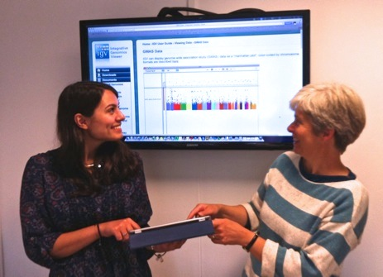
Life Sciences e-tutorials
SLS has an intensive tutorial programme
1h every week for year 1
1h every 2 weeks for years 2 and 3
Year 2 research-led sessions
rotation sessions with 4 different academics
traditional format: read papers + discussion
How can we take a good format and make it amazing?
IATL academic fellowship funding (project led by Miriam Gifford)
engaged a former Life Sciences student
and an academic technologist to
produce ad-hoc e-resources
involve the Y2 students as producers
in their tutorial programme
Semina Ploumakis
Judith Brown
Notes:
Leanne discussed one of the projects within our Digichamps. For the e-tutorial – employed Judith Brown (Edu tech

Slide 11
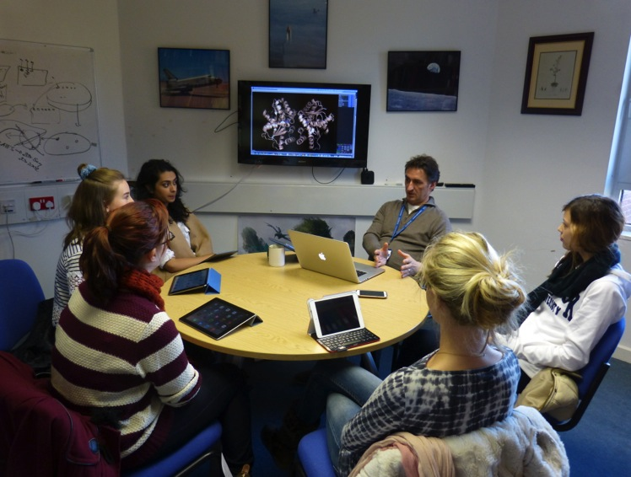
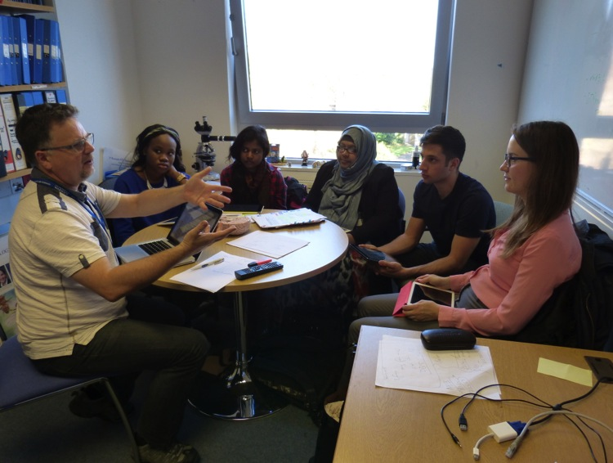
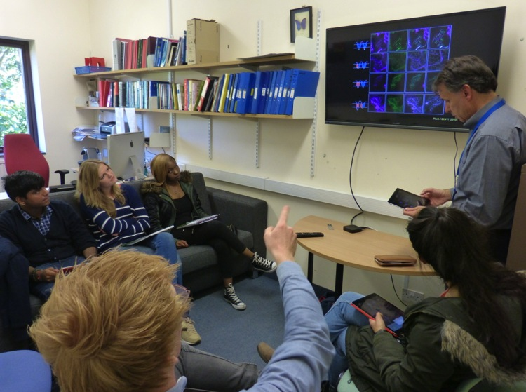
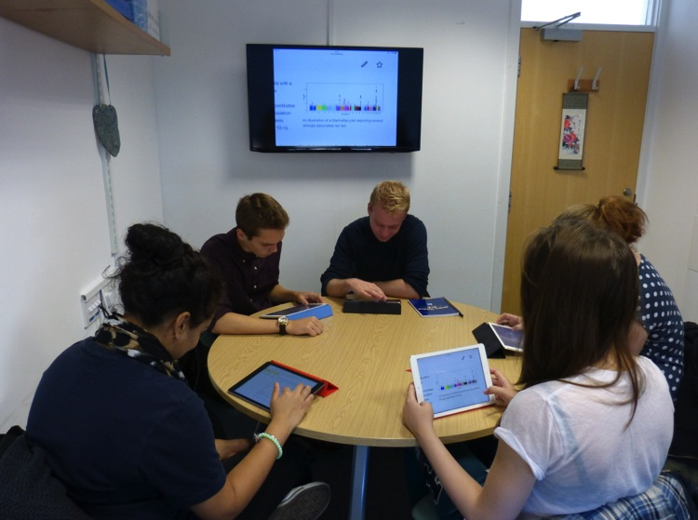
drug discovery
drunken flies
organelle shape
genetics

Slide 12

Nearpod app and the ER
organelle shape
……annotate diagrams and draw structures as well as verbally explain key concepts underlying ER dynamics

Slide 13


GWAS – app use
genetics

Slide 14
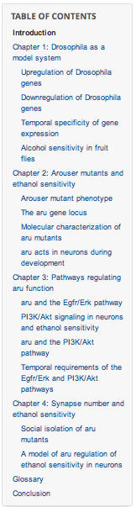

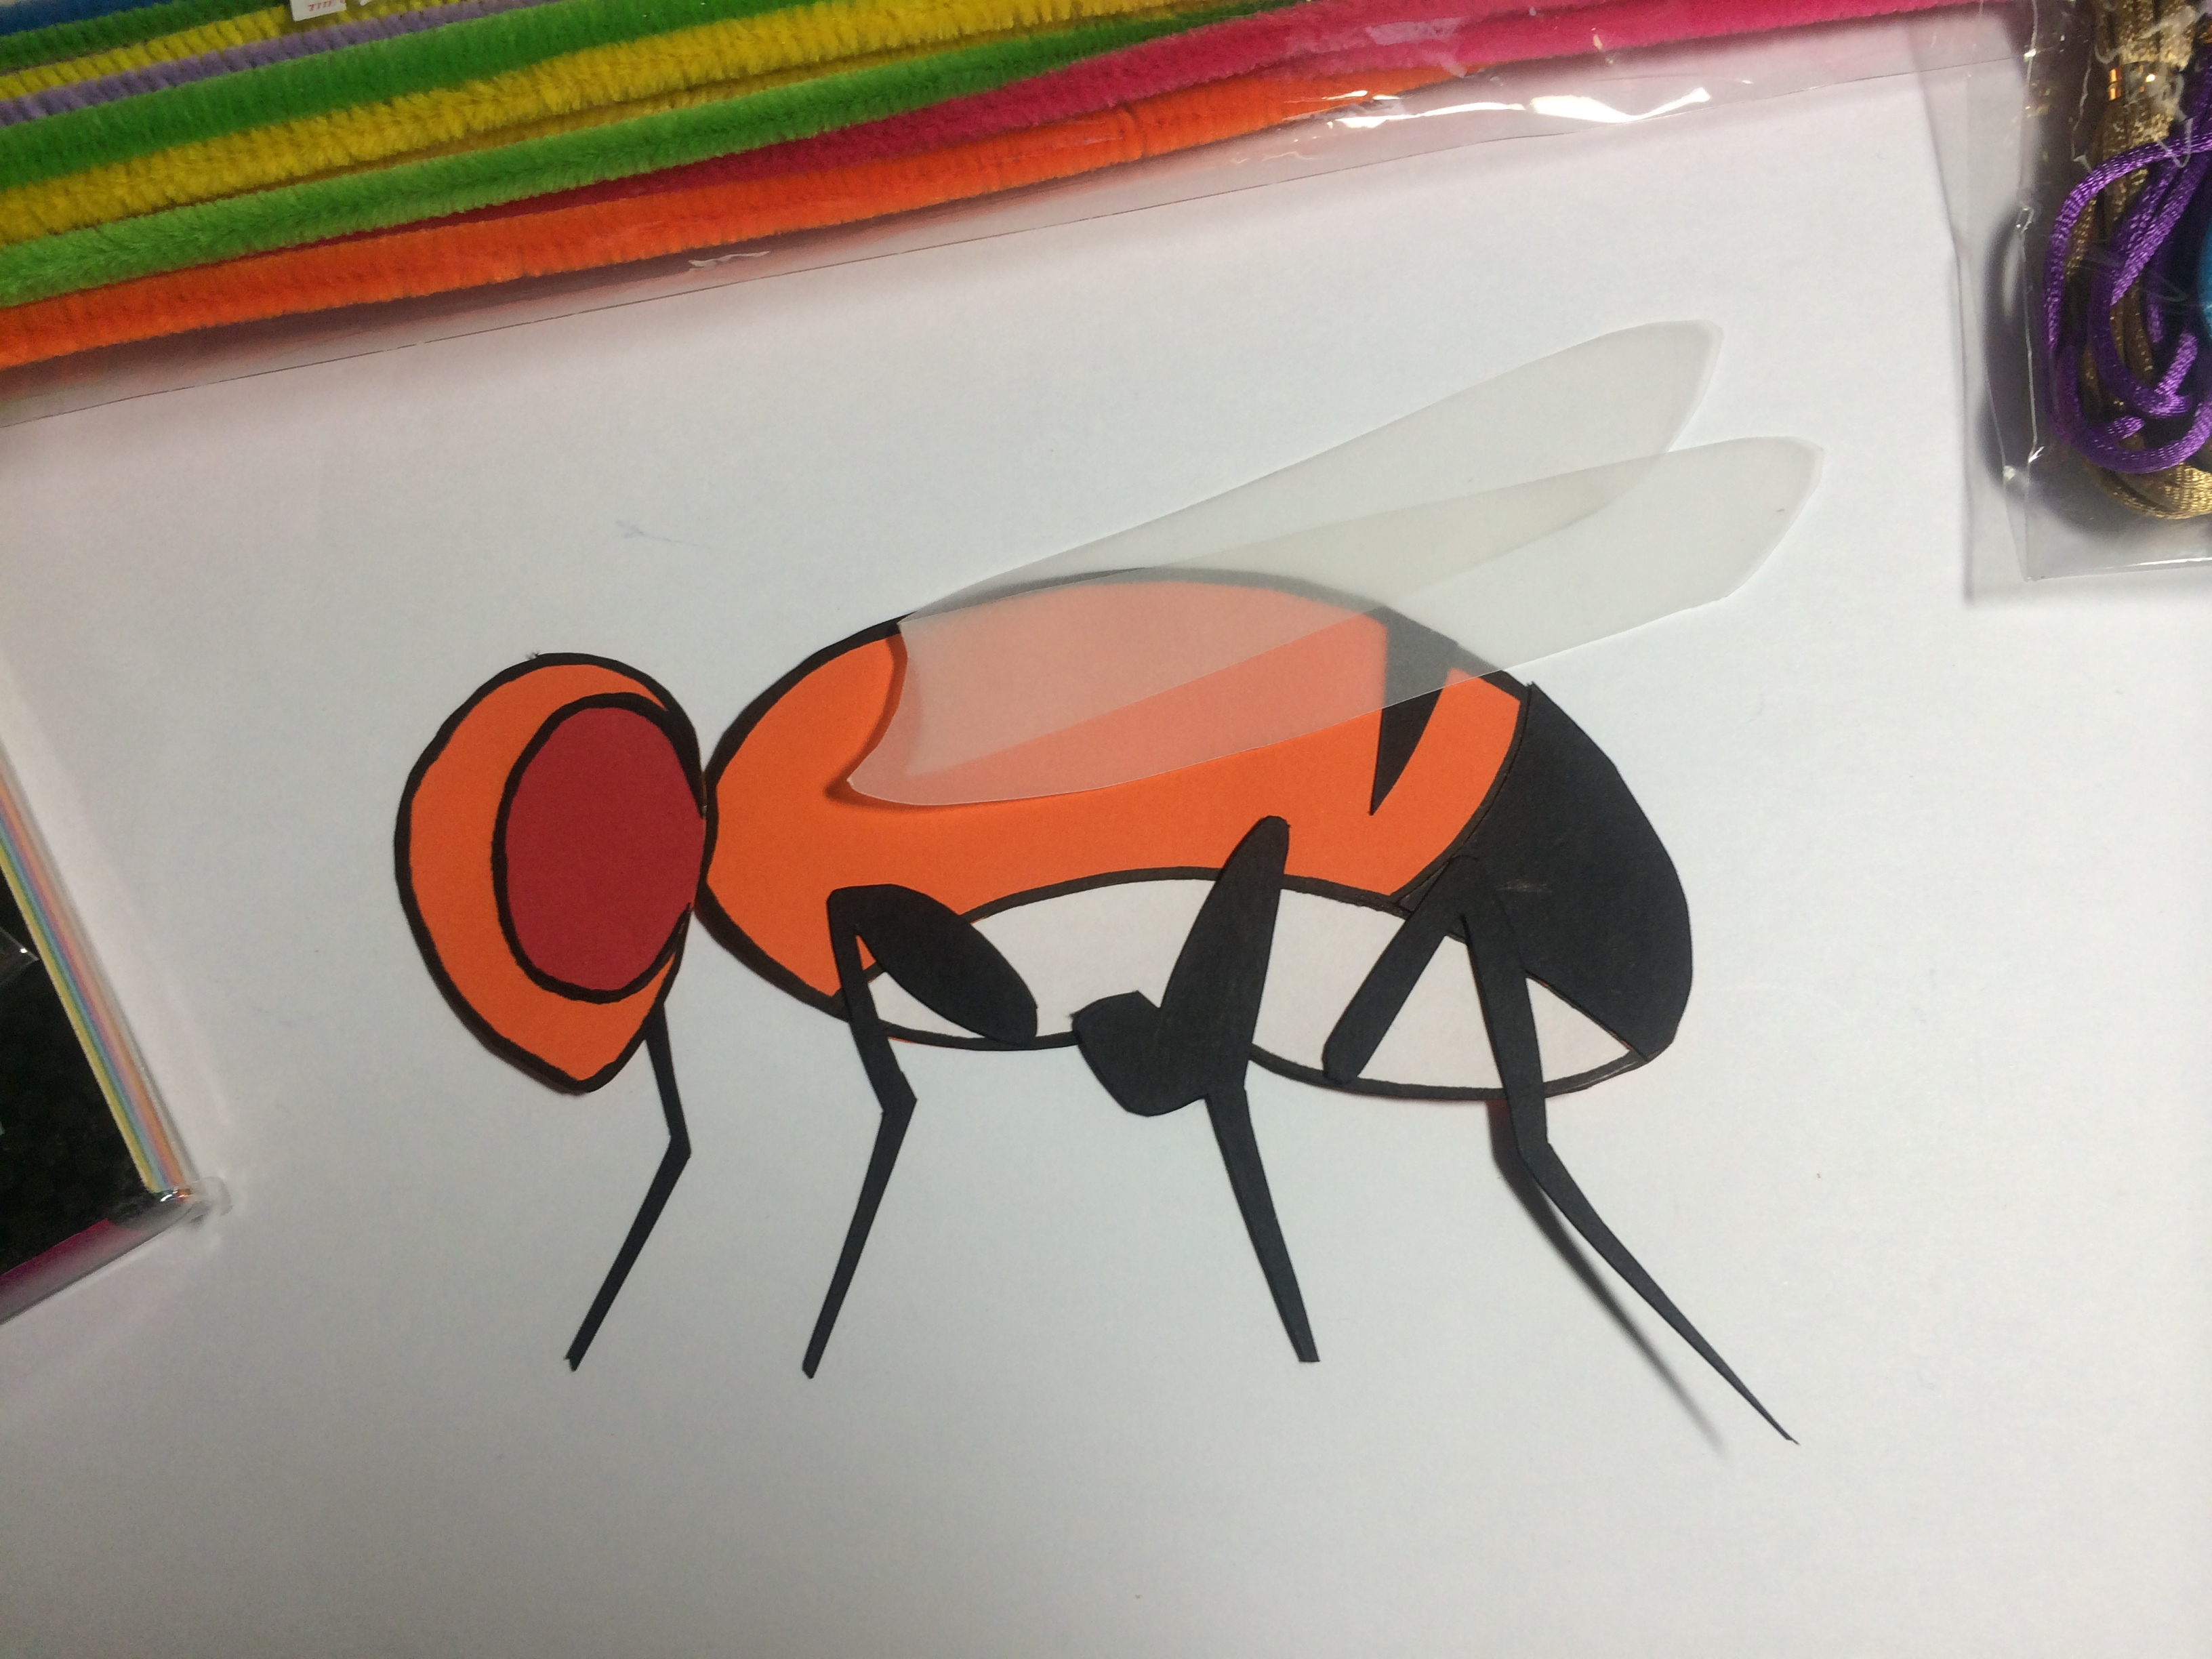
Drunken flies – Production of an e-book
Prefaced with Digichamps video:
http://moodle.warwick.ac.uk/mod/book/view.php?id=78470
Myself and Semina wrote the introduction
Tutorials, each contributed a chapter to the book

Slide 15
Student opinion
“ There was an app called 'NearPod' that we used (which is amazing!) which allowed us to fully engage within the tutorial ……... Throughout this tutorial, there was a lot of interactive sections…….. I 100% believe that this would not have been the same experience without the iPads .”
“…I found the diversity of learning materials very helpful as it gave me the opportunity to engage with the information in different ways which, I found, made learning the information easier.”
“In Kevin Moffat’s tutorial, we were asked to write a section of the eBook.
I found the formation of the eBook very useful. It gave me the opportunity do develop my understanding on a topic by reading information which was produced by my peers and so was in a language I found easier to understand.
Much more co-productive vibe, able to lead tutorial more and control train of thought. Much more exciting and motivating.
”

Slide 16
Outcomes and outlook
Excellent student feedback
sessions are more interactive and engaging
“we go to tutorials A LOT more confident about what we’re about to do”
Staff buy-in
student-led improvement of teaching material
many staff have now installed enabling technology:
TV/Apple TVs
Added value
e-resources extended to other traditional tutorial sessions
iPads used for note taking + revision
What next?
ALL tutorial material to be made interactive with the help of our students; link to other e-developments in SLS
Students suggest apps: involved in their own learning

Slide 17
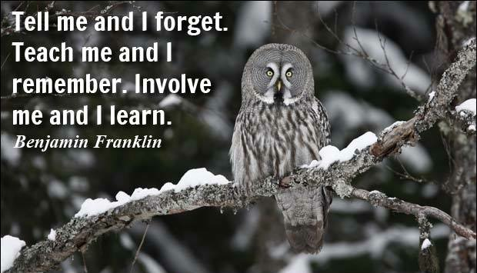
(maybe)
E-tutorials: Thanks to Lorenzo Frigerio, Miriam Gifford, David Roper, Judith Brown, Semina Ploumakis and the twenty students who contributed to the tutorials and their development.
Digichamps: Thanks to Rebecca Freeman, Leanne Williams, John Harvey, Hannah Pape, Marylaka Griffiths and Leonie Lee

