Slide 1
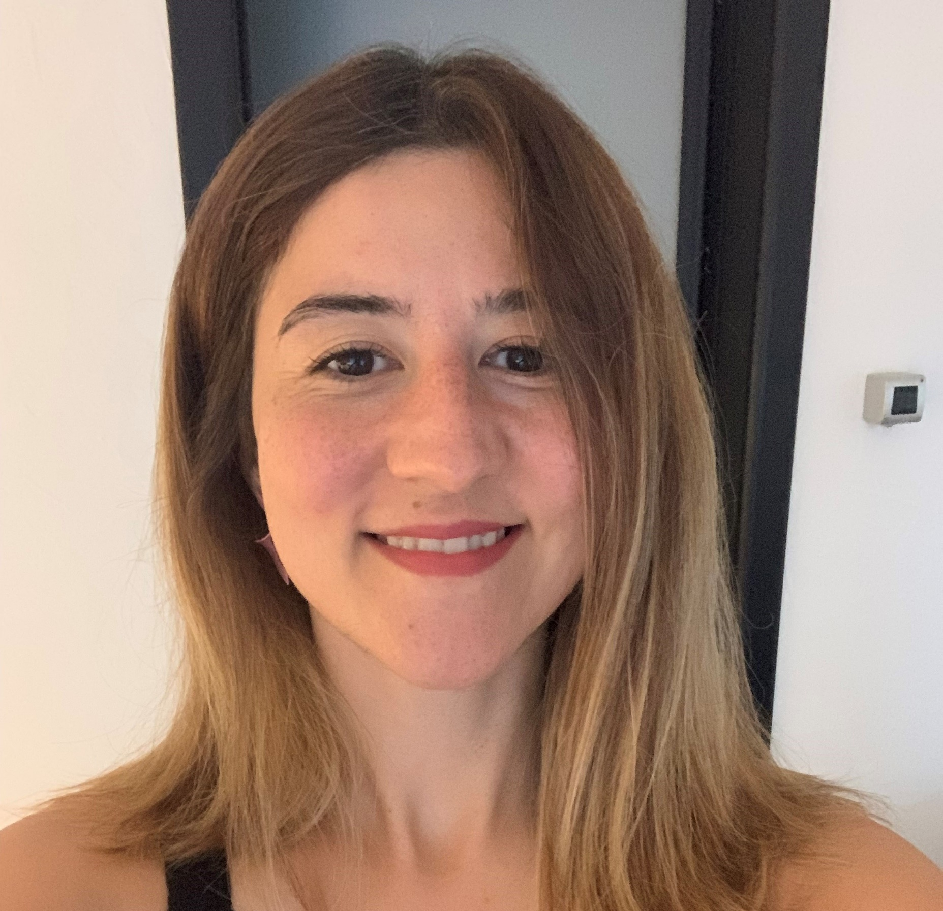
Talent Management Officer, Fulya Goray
Fulya has experience across talent management, leadership development and talent acquisition. She has worked with senior leaders and executive teams on a range of talent and development initiatives, including succession planning, leadership development and talent assessment.
Fulya is an ILM Level 7 qualified coach, Hogan accredited practitioner and CIPD qualified. She also holds a Master’s degree in Comparative Studies in History and Sociology.
Fulya is passionate about helping people see how they can progress in their careers and unlock their potential. She particularly enjoys coaching and using the right diagnostic and assessment tools to help people better understand their strengths, development areas and what they want from their careers.
Insert your photo

