Slide 1
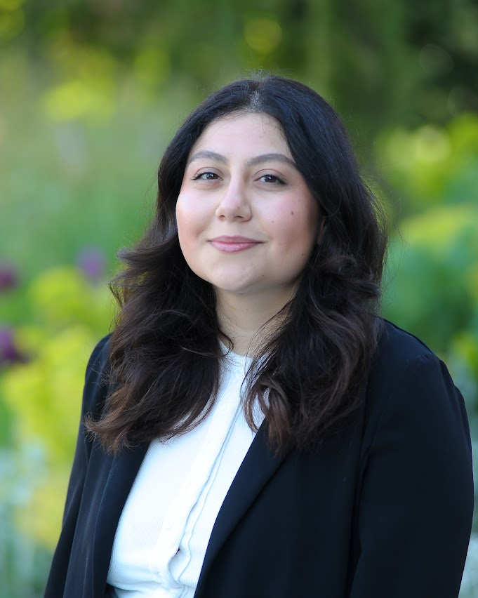
Talent Coordinator
Ruby Koca
Ruby is a Talent Coordinator within the Talent and Development function, supporting the delivery of learning programmes and systems across the organisation. She has experience in data management, learning management systems (LMS), and the design and implementation of digital learning platforms.
Her responsibilities include coordinating programme logistics, maintaining accurate learner data, and managing administrative processes to improve efficiency and learner experience. Ruby also oversees financial tasks such as processing invoices for learning and development activities.
Passionate about digital learning, Ruby is currently undertaking a Master’s in Biomedical Research with Warwick Medical School, where she is exploring technology-driven approaches to learning and applying advanced analytical skills to support evidence-based development solutions.

