Slide 1
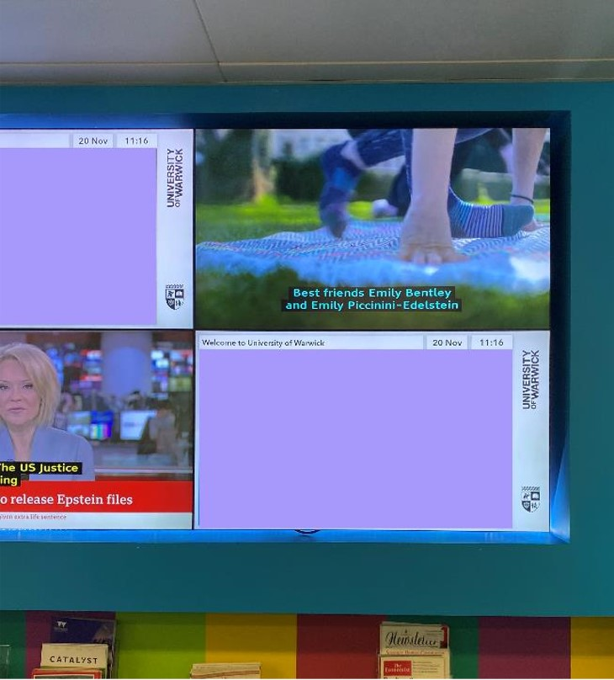
Guidance
Maximise your digital signage
Choose a template from this selection to suit your content.
Don’t add extra UoW logos - branding is already in the screen frame (see example, right).
Keep copy to a minimum.
Always use the Aptos font in black.
Make important text bold and keep less important text in regular weight to show what matters most.
If using a QR code, don’t make it any smaller than shown in these templates.
If using a departmental lockup, always use the .png RGB files (as shown in examples).
Ensure you have consent to use images / videos (check out our Asset Bank for options).
Remember people will be viewing your slide very briefly and from a distance.

Slide 2


Slide 3


Slide 4



Slide 11


Slide 12


Slide 13




Slide 16


Slide 18


Slide 27


Slide 29


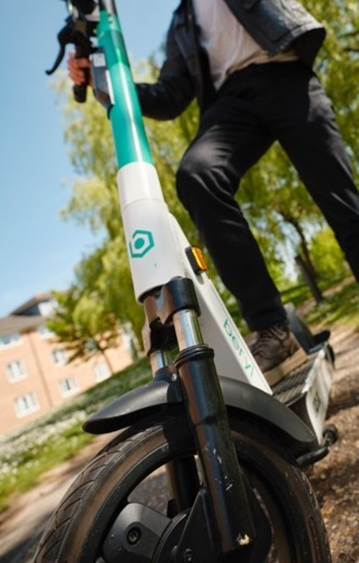

Slide 32


Slide 34


Slide 43
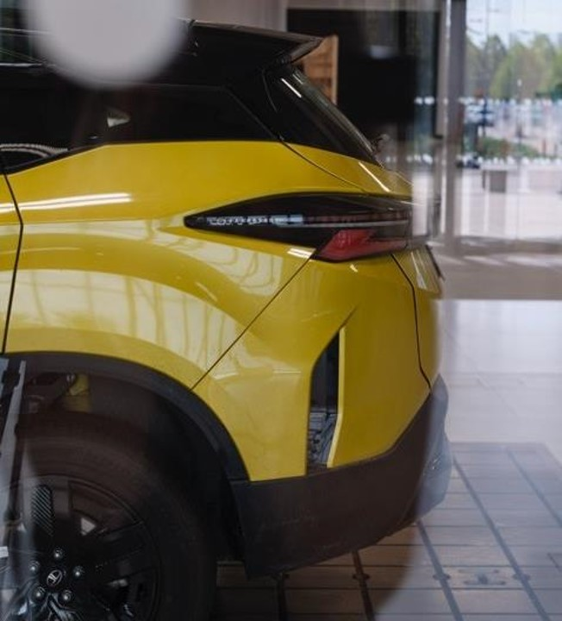

Slide 45




Slide 48


Slide 50


Slide 59


Slide 61

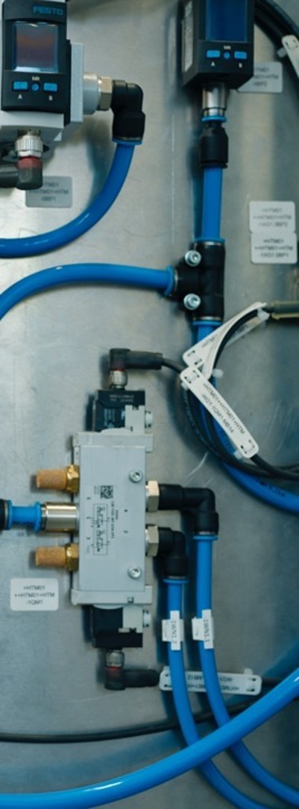


Slide 64


Slide 66


Slide 75


Slide 77




Slide 80
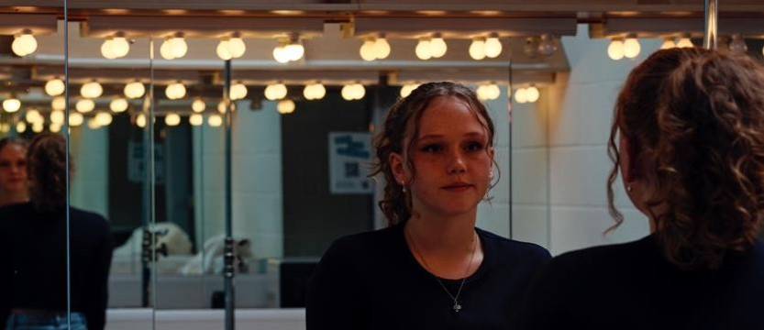

Slide 82


Slide 83


Slide 91


Slide 93




Slide 98


Slide 107


Slide 109


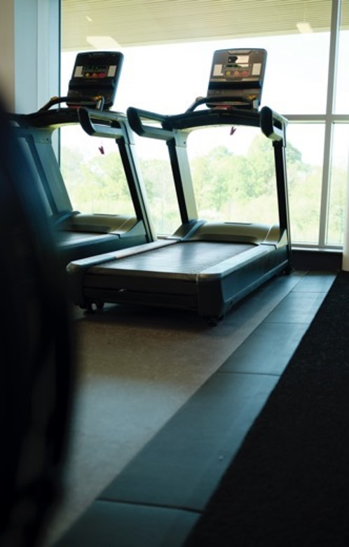

Slide 112


Slide 114


Slide 123


Slide 125




Slide 128


